Slide 1

The origin of translation
and interpretation
Peng Ruihong(彭锐宏）

Slide 2
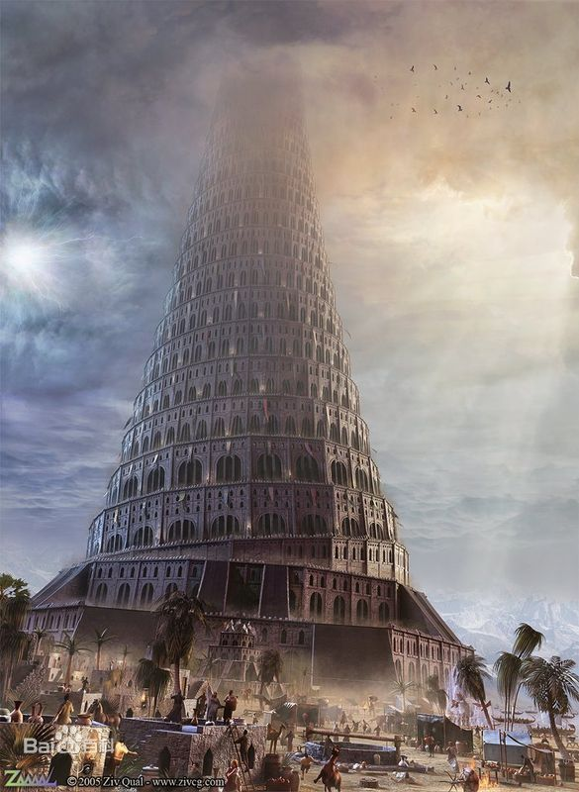
Tower of Babel

Slide 3

Introduction to the Tower of Babel
The Tower of Babel is a tower built by people in the story of Chapter 11 of the Bible · Old Testament · Genesis. According to records, at that time mankind united to build a tower that hoped to lead to heaven; in order to prevent mankind's plan, God let mankind speak different languages, so that mankind could not communicate with each other, the plan failed, and mankind was separated. This event provides an explanation for the emergence of different languages ​​and races in the world.

Slide 4

Part one
The origin of interpretation

Slide 5
Interpretation has a long history, dating back to the early days of human society. With the development of history, this self-enclosing social form obviously hindered the further development of human economic and cultural activities, so various tribal groups have a desire to develop across borders and outside the country.
Language barriers have obviously become the biggest obstacle to this kind of inter-ethnic communication, and interpreting can make people’s desire for economic and cultural exchanges with the outside world a reality. As a result, interpreting came into being.

Slide 6
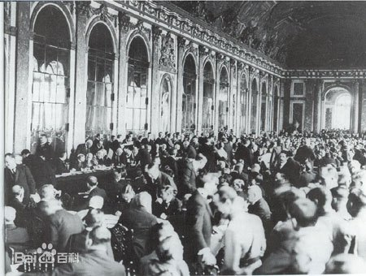
It is the 20th century that interpreting is recognized as a formal professional profession in the world. Before the 1920s, the common language of the Western world was French. After the end of World War I, English became one of the international languages. During diplomatic negotiations, English and French are spoken at the same time, so interpreting is required. In 1919, the organizers of the "Paris Peace Conference" recruited a large number of full-time interpreters to do interpretation for the "Paris Peace Conference".

Slide 7
Part two
The origin of translation

Slide 8
China has an over five thousand-year long history of human civilization and a three thousand-year history of translation.
However, we have little knowledge of when translation activities really began either in China or in the world.

Slide 9
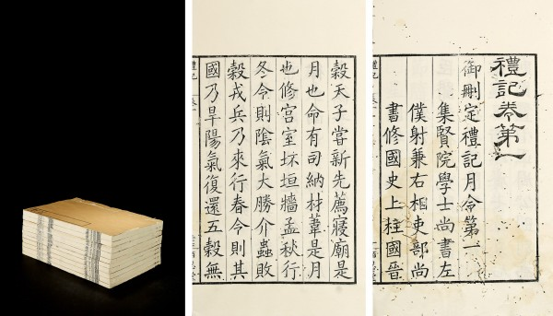
In China, we didn’t have any record of translation until Zhou Dynasty(1066B.C-256B.C)
“五方之民，言语不通。达其志，通其欲，东方曰寄，南方曰乡，西方曰狄，北方曰译。”
《礼记•王制》
（“Translators are called Ji in the east, Xiang in the south, Di in the west, and Yi in the north”)
Later, Buddhist scripture translators added the “翻”in front of “译”, which became the term "translation", which has been used to this day.

Slide 10
Thank you!

