Slide 1
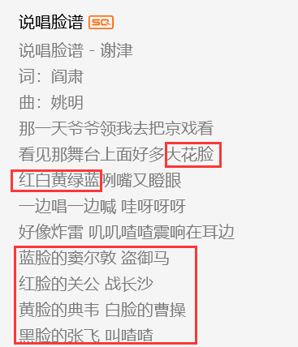
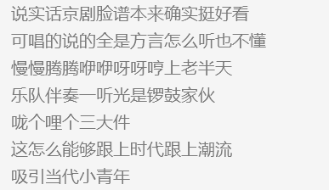

Slide 2
Facial Makeup
Su Xiao

Slide 3
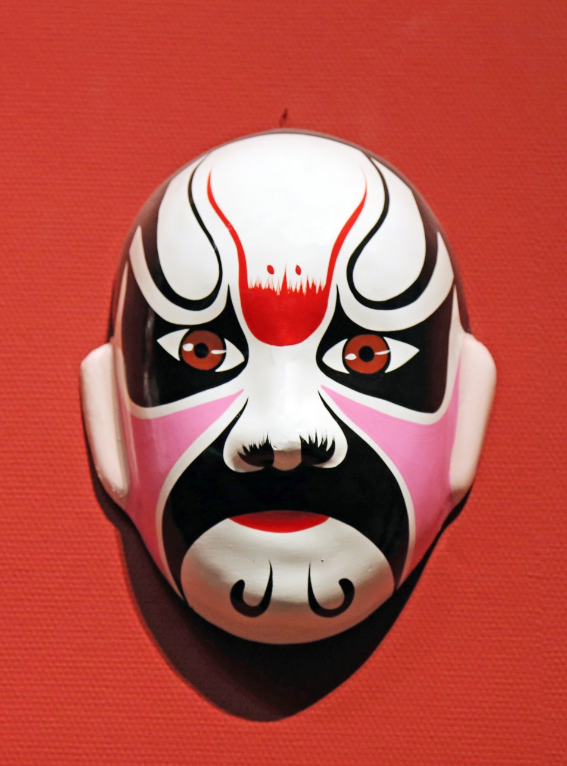
Facial Makeup
“
Facial makeup, a sort of makeup art used in stage performance, is painted on the face of traditional opera singers in China and varies when it come to different types of role.
”

Slide 4
Contents
Main character roles in Beijing opera
Different colors of facial makeup
About translation
About conclusion & reflections

Slide 5
Main character roles
in Beijing opera

Slide 6
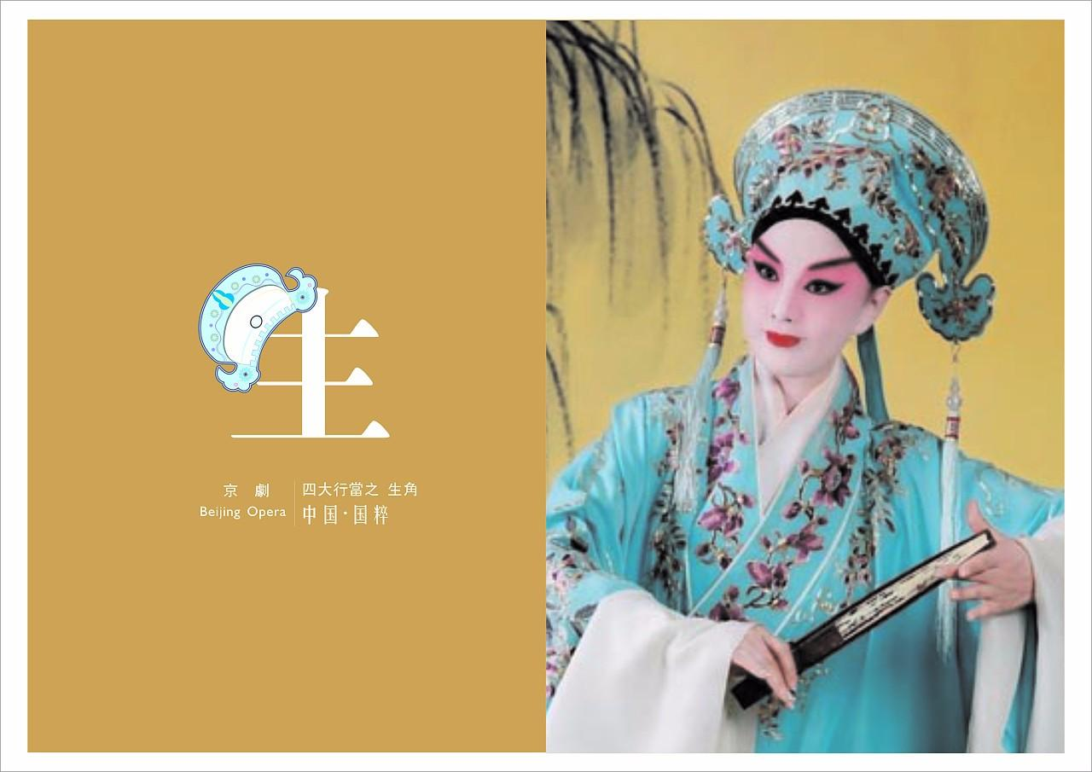
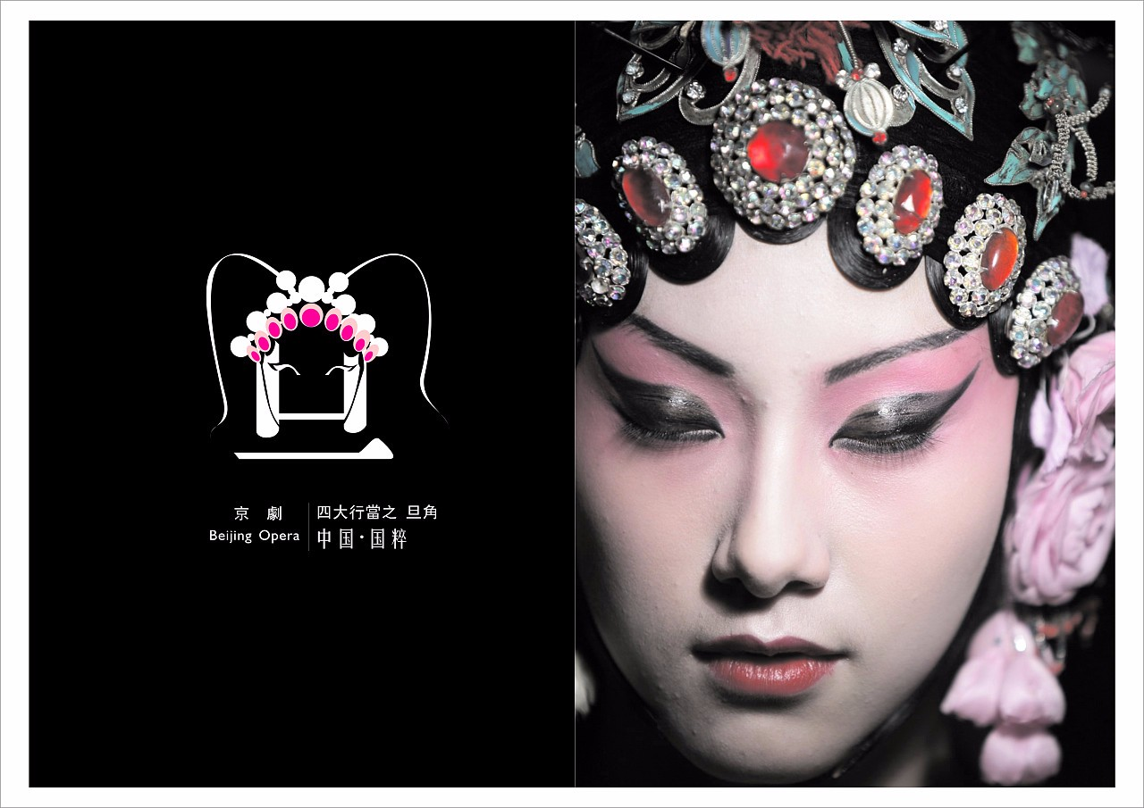
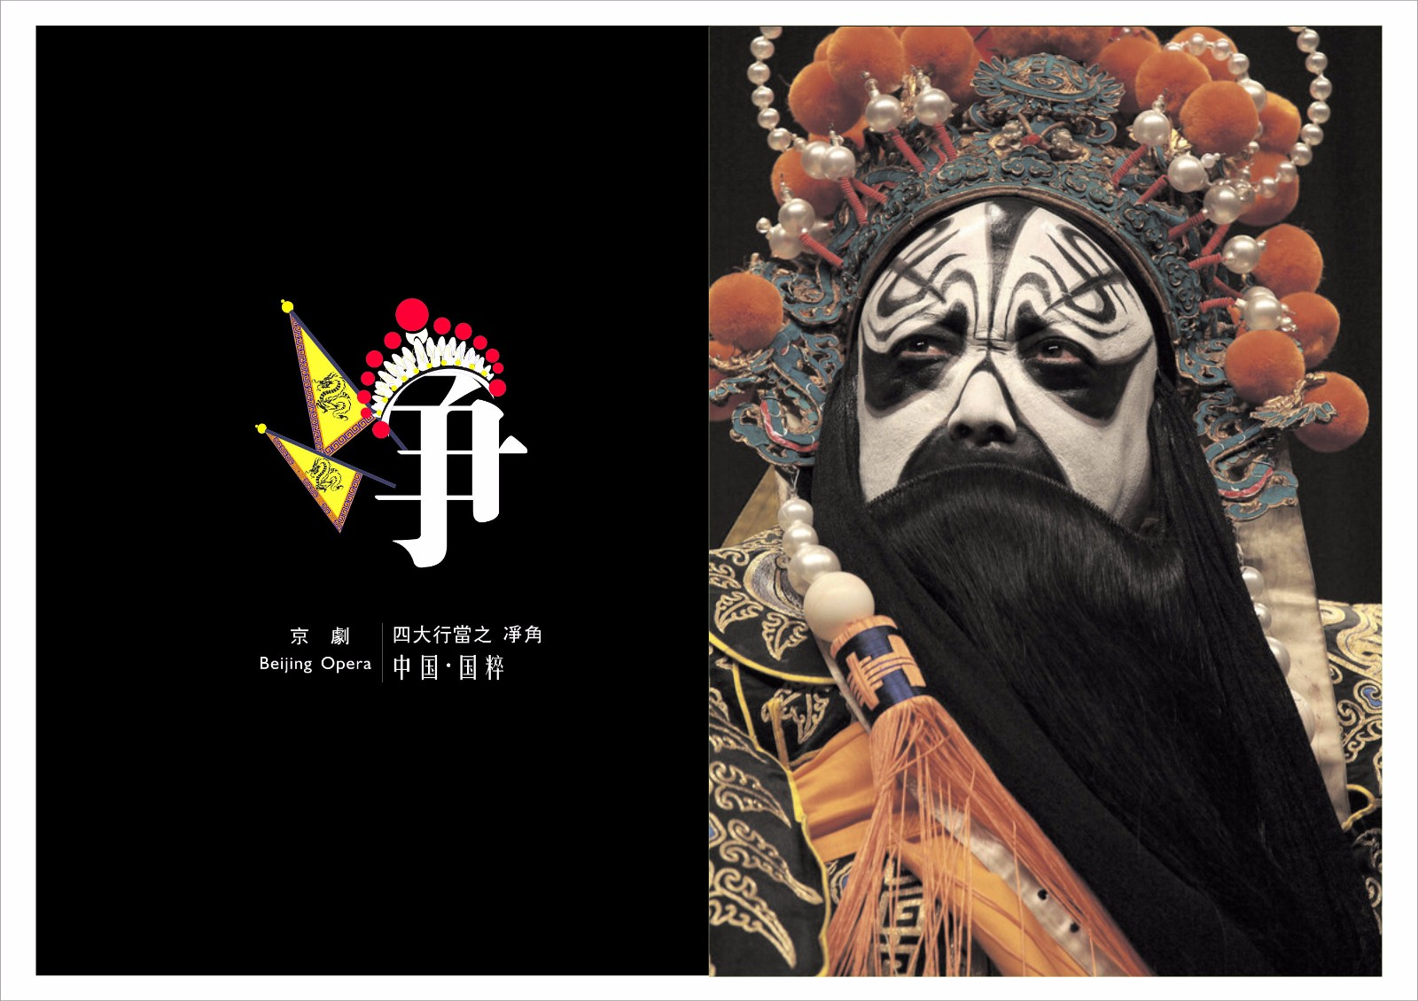
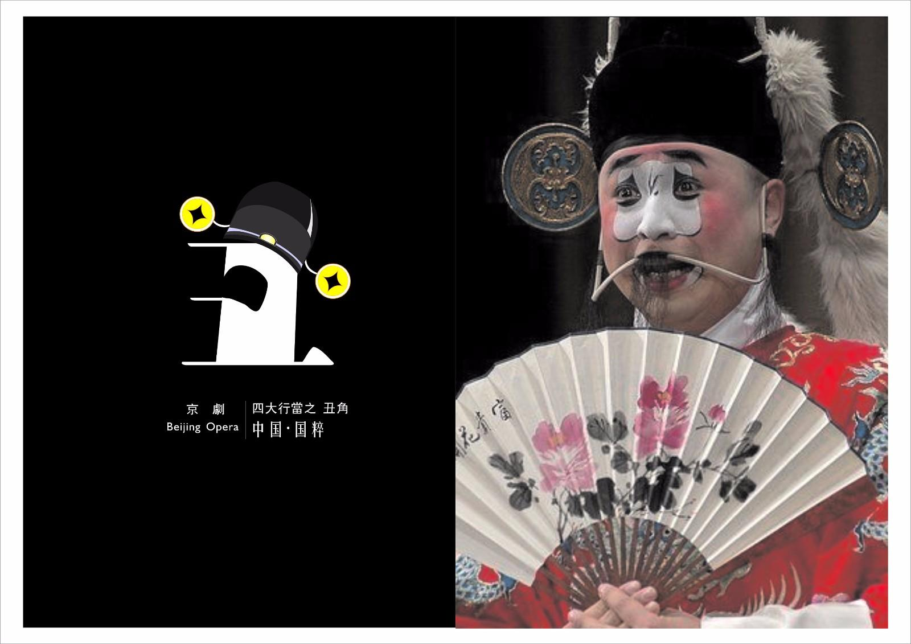
Main character roles
01. Sheng
02. Dan
Male roles
laosheng: middle-aged or old men
xiaosheng: young men
wusheng: men with martial skills
Female roles
qingyi: a woman with a strict moral code
laodan: an elderly woman
03. Jing
04. Chou
Clown, a comic character
can be recognized at first sight for his special make-up
The roles with painted faces
warriors, statesmen or even demons

Slide 7
Plain face : quite simple with a thin layer of powder
“sheng”, “dan”
Painted face : relatively complicated,
applied with heavy color and complicated patterns
“jing”, ”chou”
“俊扮”“素面”“洁面”
“花脸”“小花脸”
Facial make-up, which is applied to Jing roles only, shows the character’s age and personality by using different colors.
They are accustomed to wiping a patch of white powder on the nose.

Slide 8
Different colors of
facial makeup

Slide 9
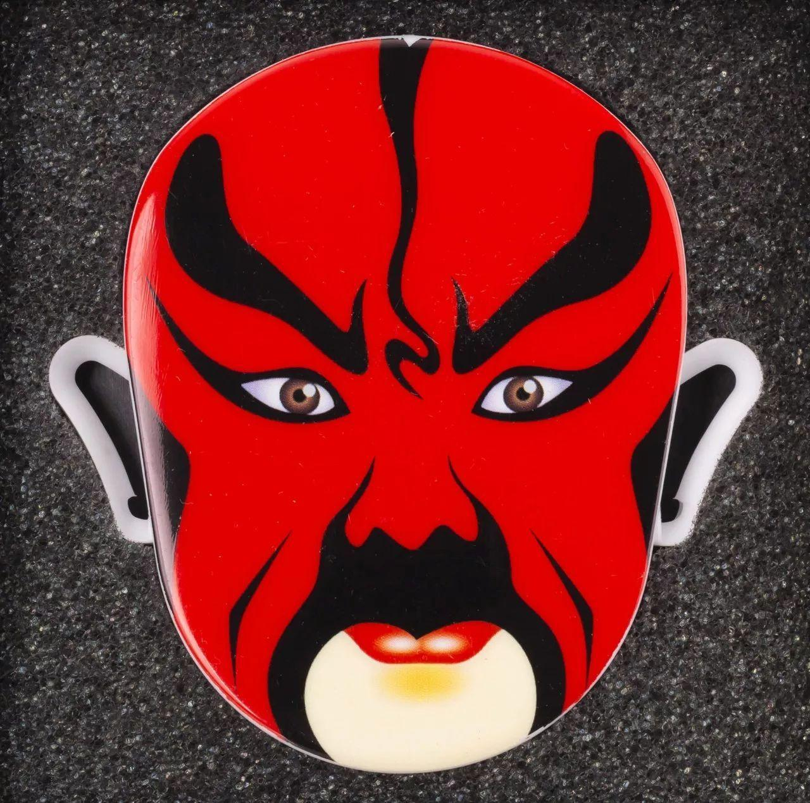
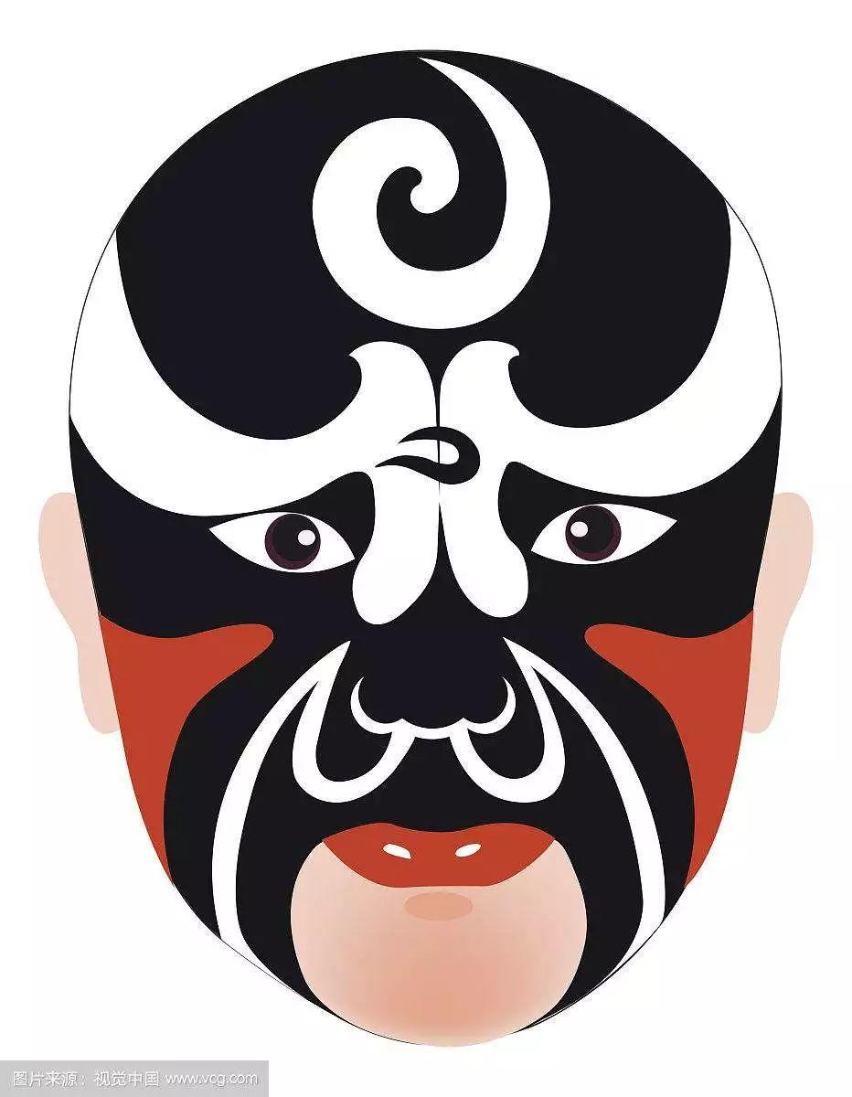
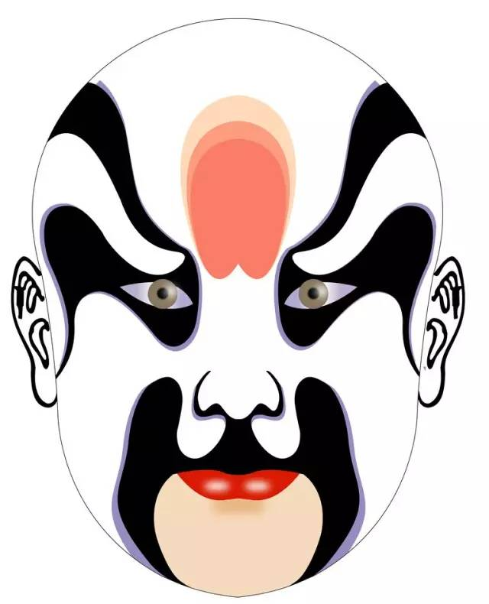
Red
Symbolic meaning：loyalty, upright and integrity
Representatives： Guan Yu， Wu Han(吴汉)
Black
Symbolic meaning：seriousness,courage and wisdom
mighty force and boldness
Representatives：Bao Zheng , an impartial official
Zhang Fei, in drama the Three Kingdoms
Li Kui, in drama Water Margin of the Marsh
White
Symbolic meaning： a derogatory sense, a deceitful and suspicious nature
Representatives： Cao Cao, in drama the Three Kingdoms
Yan Song(严嵩), Qin Hui(秦桧)

Slide 10
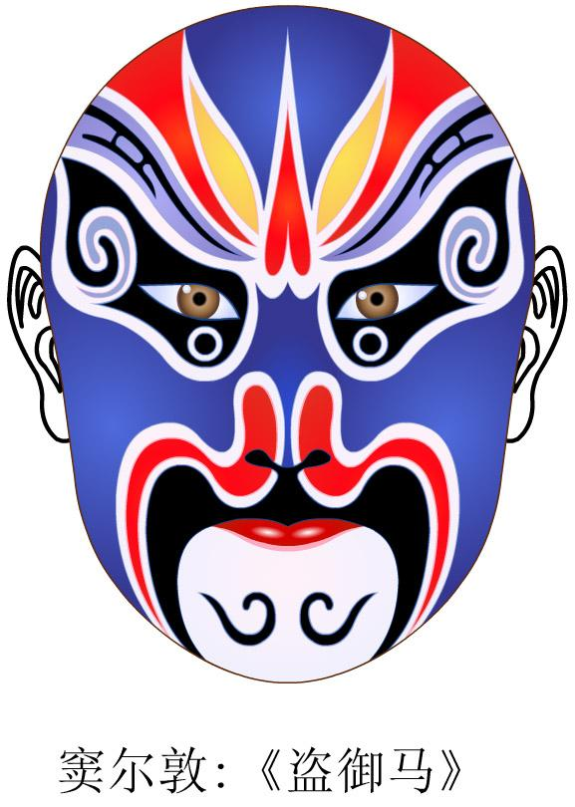
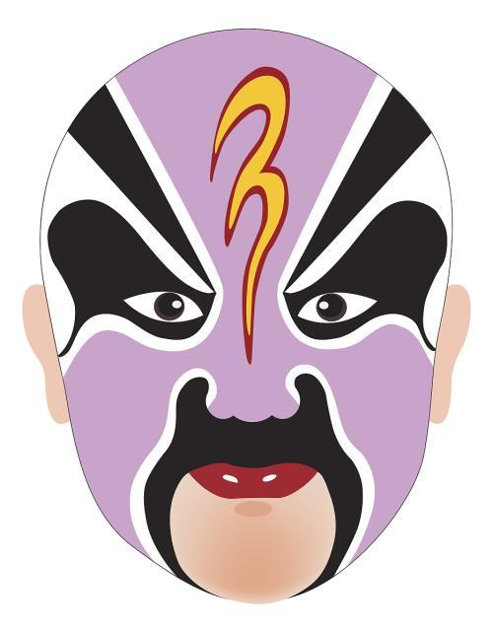
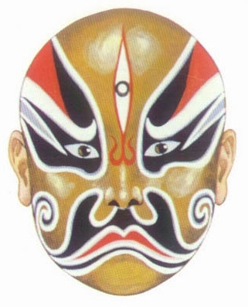
Blue
Symbolic meaning：upright, outspoken, obstinate and even unruly
Representatives： Ma Wu(马武), Dou Erdun(窦尔墩)
Purple
Symbolic meaning：sedate and righteous
Representatives： Xu Yanzhao(徐延昭), Zhuan Zhu(专诸)
Golden
Symbolic meaning： dignity and power fitting roles like supernatural being
Representatives： Tathagata(如来佛)， Erlang Shen(二郎神)

Slide 11
About translation

Slide 12
Translation
01. 京剧脸谱
02. 生旦净丑
male roles
female roles
painted faces
comic roles(clowns)
sheng
dan
jing
chou
facial makeup in Beijing opera
facial design of Peking opera
facial pattern of Beijing opera
Peking opera makeup
Peking opera mask
facial painting (lianpu)
or
老生、小生、武生、青衣、老旦……？
Tsing yi, qingyi, black cloth

Slide 13
About conclusion
& reflections

Slide 14
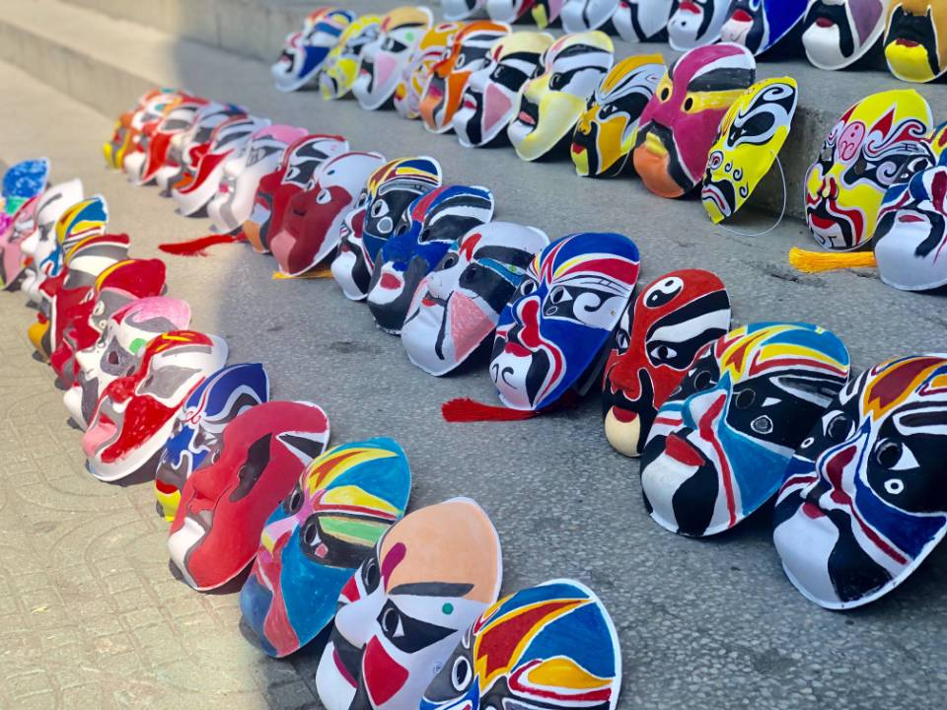
Conclusion
“
”
The features
of facial makeup
1. It is a contradictory unit of beauty and ugliness.
2. It is closely related to the character’s personality.
3. Its pattern is stylized.

Slide 15
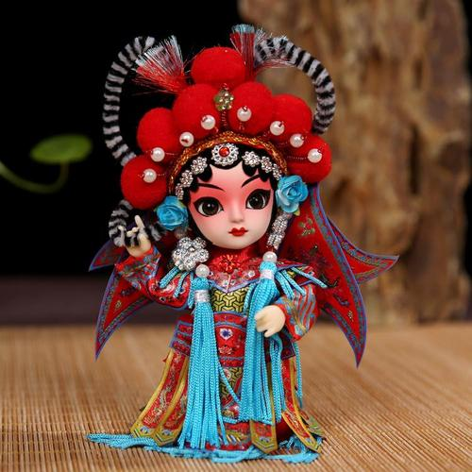
Reflections
“
Chinese Peking opera makeup is favored by many opera enthusiasts and is widely known both at home and abroad, having been regarded as one of the mark of traditional Chinese culture. It is derived from the stage and could be seen on some large buildings, packages of some commercials, various porcelains and people’s clothes in different styles. It is far beyond the scope of stage use, showing its status in people’s heart and strong vitality. Out of curiosity and affection for facial makeup in Chinese opera, a great many foreign friends and Chinese of insight start to explore the mystery of it.
”

Slide 16
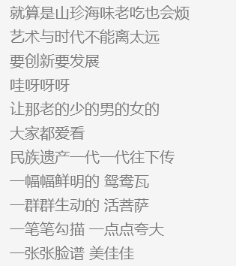
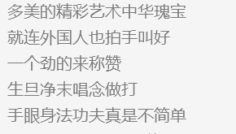

Slide 17
THANK
YOU

