Slide 1
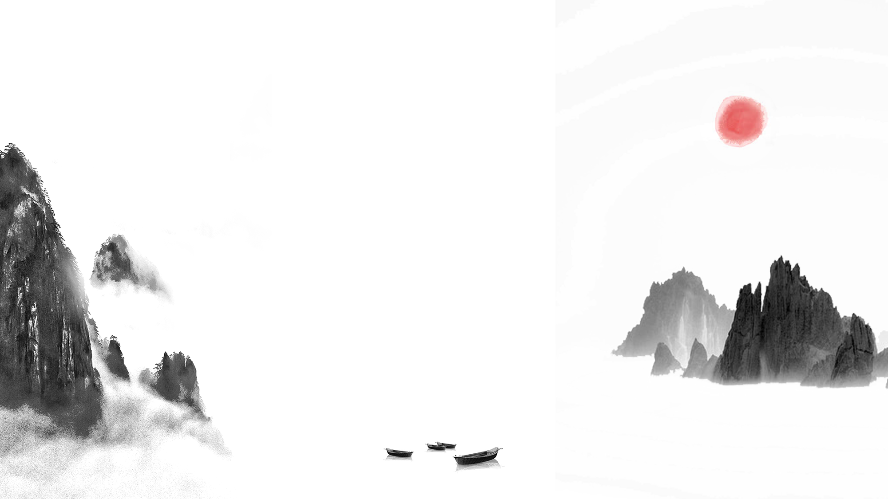

Chinese Characters
Liú Zhuófán 刘卓凡
Notes:
本PPT模板部分元素使用了幻灯片母版制作。如果需要修改，点击-视图-幻灯片母版-修改；完成后关闭编辑母版即可。

Slide 2

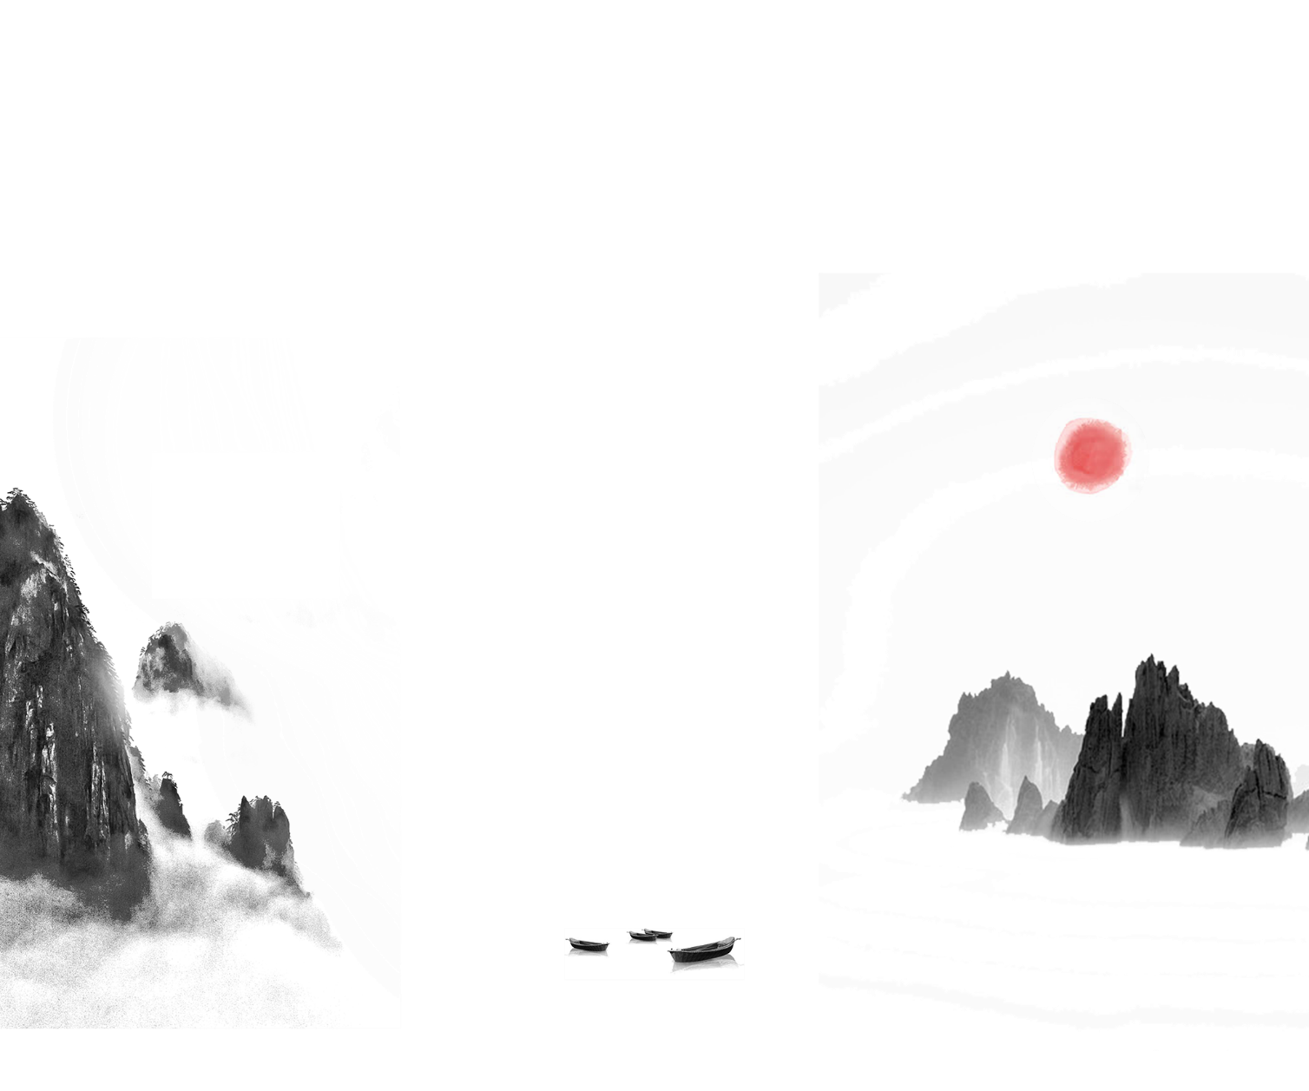


Contents
Origin
Status and function
壹
Evolution
贰
Formation
叁
肆

Slide 3
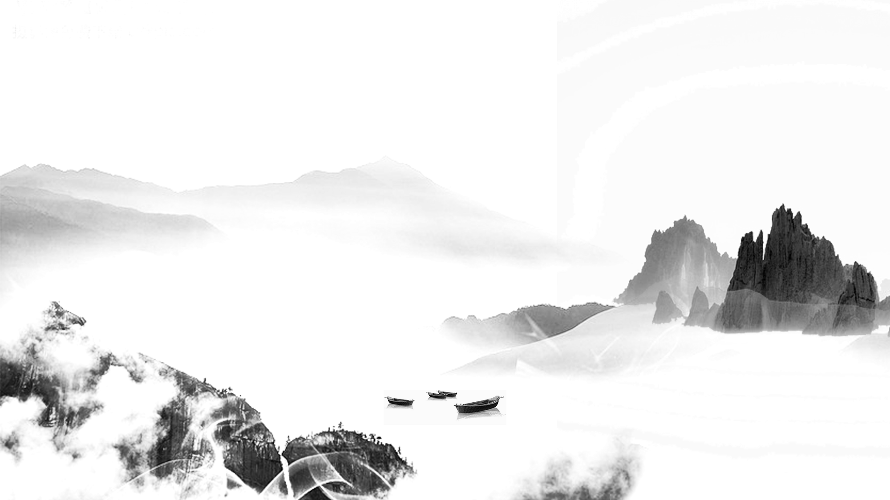

壹
Origin

Slide 4
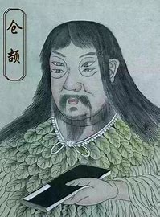
Origin
Chinese characters, also known as Hanzi are one of the earliest forms of written language in the world, dating back approximately five thousand years. According to legend, Chinese characters were invented earlier by Cangjie, a bureaucrat under the legendary emperor, Fu Hsi. The legend tells that Cangjie was hunting on Mount Yangxu when he saw a tortoise whose veins caught his curiosity. Inspired by the possibility of a logical relation of those veins, he studied the animals of the world, the landscape of the earth, and the stars in the sky, and invented a symbolic system called zì—Chinese characters. It was said that on the day the characters were born, Chinese heard the devil mourning, and saw crops falling like rain, as it marked the beginning of civilization, for good and for bad.

Slide 5
贰
Evolution

Slide 6
Oracle bone script
Shang Dynasty (1711–1066 BC)
Bronze script
Shang and Zhou Dynasties
Seal script
Spring and Autumn Period & Qin Dynasty
Clerical script
Han Dynasty (206 BC — 220 AD)
Regular script
Eastern Han Dynasty (25–220)

Slide 7
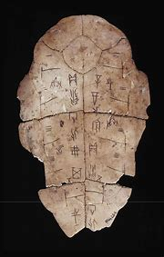
Oracle bone script 甲骨文
Oracle bone script is the inscription on animal bones and tortoise shells. It was first found by the local farmers in Xiaotun Village, Anyang, Henan Province and the bones and shells were sold as a kind of traditional Chinese medicine called “long” (dragon bones).

Slide 8
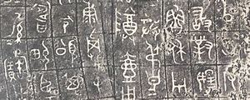
Bronze script 金文
In the “Age of Bronze Ware” of China during the period of Shang and Zhou Dynasties, bronze ware was cast as a container, and most often as the sacrificial vessels to inscribe great events such as sacrifice, battle results, trade of slaves, etc. In the Shang Dynasty, the inscriptions on bronze ware had very few characters, the form of which is extremely close to that of the oracle bone script. However, in the Zhou Dynasty, the characters in bronze inscriptions were simpler, and the size and formation were more fixed. The bronze inscriptions looked like drawings but had made significant progress from pictographic forms to block-shaped linear words we use today.

Slide 9
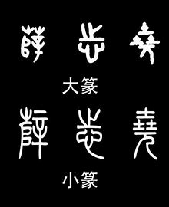
Seal script 篆书
Toward the end of the Zhou Dynasty, a new script called the “seal script” began to be used in Qin State. There are two kinds of seal script: large or great seal script and lesser or small seal script. The large seal script was widely used in many vassal states in the Spring and Autumn Period (770–476 BC). While small seal script was the official style of characters in Qin Dynasty. It was the result of the first extensive simplification and standardization of Chinese characters. The forms of characters were simpler, the writing method was consistent, and the character pattern was more orderly. And the lesser seal script marked the end of the ancient Chinese characters.

Slide 10
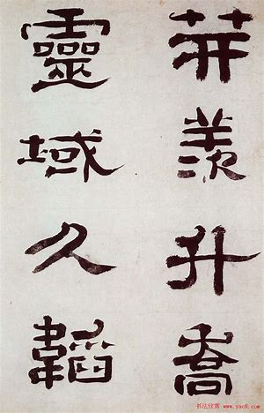
Clerical script 隶书
After the unification of China, another faster and convenient style of writing called “clerical script” appeared during the late of the Qin Dynasty and the Han Dynasty. In order to save time, people changed the rounded lines into straight ones which became the officially approved formal way of writing.
From the clerical change to the present, it has been more than 2,200 years. This the period in the historical development of Chinese characters is still called modern because the structures of Chinese characters have remained the same until today.

Slide 11
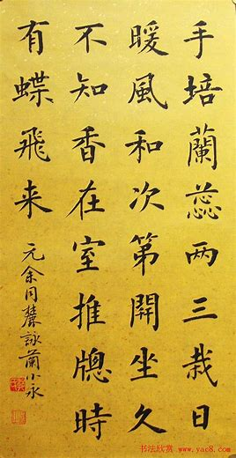
Regular script 楷书
Toward the end of the Han Dynasty, the strokes with the wavy endings and some thick curvy lines seen in the clerical script became smooth and straight. This change is known as “regularization” after which the characters called the regular script appeared at the end of the Eastern Han Dynasty (25–220) and replaced the clerical script to be the major font of daily writing. It has been the standard and formal writing style for more than 1,800 years with the widest and longest usage.

Slide 12
Translation
Oracle bone script 甲骨文
oracle ≈ prediction of auspicious and inauspicious things
Carriers of the characters
Bronze script 金文
Seal script 篆书
Clerical script was frequently used in preparing official records and documents, and it was utilized for both public monuments and private correspondence.
Clerical script 隶书
Functions of the characters
Regular script was the standard for students to admire, imitate and learn.
Regular script 楷书

Slide 13
叁
Formation

Slide 14
Pictograms 象形
Pictograms make up only a small portion of Chinese characters. While characters in this class derive from pictures, they have been standardized, simplified, and stylized to make them easier to write.
Examples include 日 for "sun," 月 for "moon," and 木 for "tree."
Pictophonetic compounds指事
This category represents the largest group of characters in modern Chinese. Characters of this sort are composed of two parts: a pictograph, which suggests the general meaning of the character, and a phonetic part, which is derived from a character pronounced in the same way as the word the new character represents. Examples are 河 “river”, 湖 “lake”, 流 “stream”,etc.

Slide 15
Ideograph 会意
Characters of this sort either add indicators to pictographs to make new meanings, or illustrate abstract concepts directly. For instance, while 刀 is a pictogram for "knife," placing an indicator in the knife makes 刃, an ideogram for "blade."
Logical aggregates形声
Also translated as associative compounds, characters of this sort combine pictograms to symbolize an abstract concept. For instance, 木 is a pictogram of a tree, and putting two 木 together makes 林 ,meaning forest.

Slide 16
Associate transformation转注
Characters in this category originally didn‘t represent the same meaning but have bifurcated（分为两部分） through orthographic（拼字法的） and often semantic（语义的） drift. For instance, 考 ,“to verify” and 老, “old” were once the same character, meaning "elderly person," but detached into two separate words.
Borrowing假借
Also called phonetic loan characters, this category covers cases where an existing character is used to represent an unrelated word with similar pronunciation; sometimes the old meaning is then lost completely, as with characters such as 自, which has lost its original meaning of nose completely and exclusively means “oneself”.

Slide 17
肆
Status and function

Slide 18
Status and function
Chinese characters are undoubtedly China's most beautiful and valuable asset, representing not only a national spirit, but also the roots of the Chinese nation and the soul of China.

Slide 19
Thanks!
Notes:
本PPT模板部分元素使用了幻灯片母版制作。如果需要修改，点击-视图-幻灯片母版-修改；完成后关闭编辑母版即可。

