Slide 1
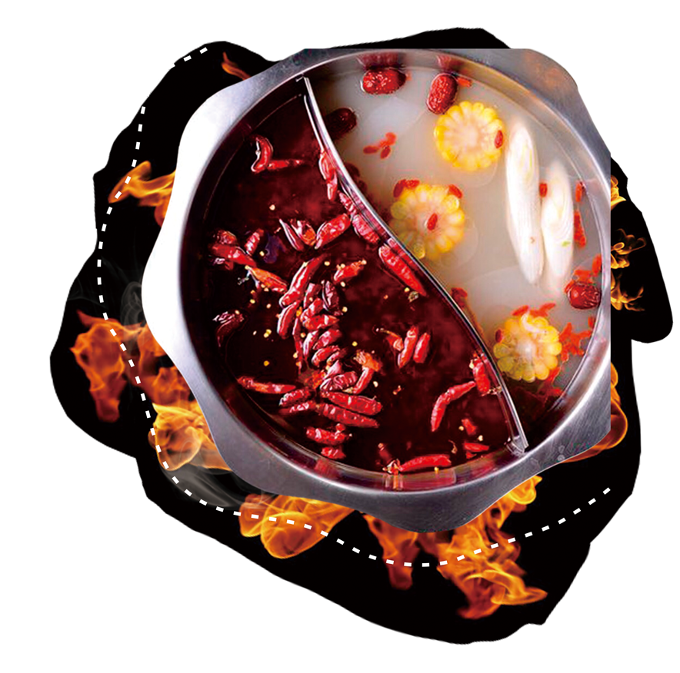
Hot
Pot
【Chinese·Cuisine】】
Cao Chunyang

Slide 2
Region
Coconut Chicken Hot Pot in Hainan
Copper Pot Mutton Hot Pot in Beijing
Tender chicken simmered in coconut water and coconut meat, paired with zesty lime and ginger dip.
Thinly sliced lamb cooked in a copper pot with clear broth, served with sesame sauce and fermented tofu.
Spicy Hot Pot in Chongqing
Chrysanthemum Hotpot in Zhejiang and Jiangsu
Delicate fish slices and shrimp poached in light chicken broth, infused with edible chrysanthemum petals.
Fiery broth with beef tallow, featuring beef tripe, duck blood, and spices, simmered in a gridded pot.

Slide 3
the Mountain Hotpot and the River Hotpot
the Mountain Hotpot——Ingredients
the River Hotpot—— Flavor
Lost merchants were resting on the South Mountain, they tried to make some hot soup to keep them warm. However, a careless cook accidentally threw their bags of chili, pepper, and other spices into the boiling water. they just randomly added several other food into the broth.
The bank of the Yangtze River and the Jialing River used to be the place where butchers slaughtered the oxen. While the internal organs were unwanted, the boat trackers bought these at a very low price and cooked them with chili and pepper.

Slide 4
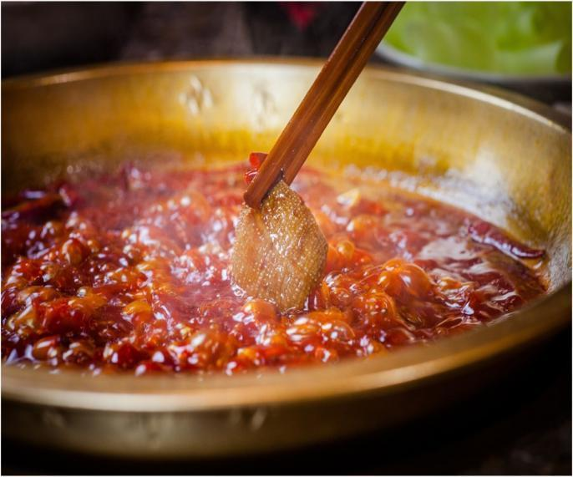
Timing and Techniques
Beef tripe (毛肚): Crisp texture, cooked for 15 seconds.
Duck intestine (鸭肠): Blanched for 15-20 seconds.
Thinly sliced beef/lamb (肉片): Swish in broth for 5-8 seconds.
Leafy vegetables ( lettuce): Simmer for 1-2 minutes.

Slide 5
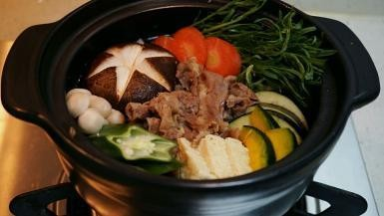
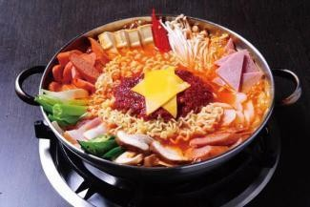

Overseas Hotpot
Hotpot was invented in China but has been spread all over the world such as Japan, Korea and Switzerland in order to fit their local taste, which is very popular among the people.
Japan: Sukiyaki (sweet soy-based broth)
Korea: Budae Jjigae (fusion hotpot with spam and kimchi)
Switzerland: Cheese fondue and chocolate fondue

Slide 6
Thanks for your listening

