Slide 1
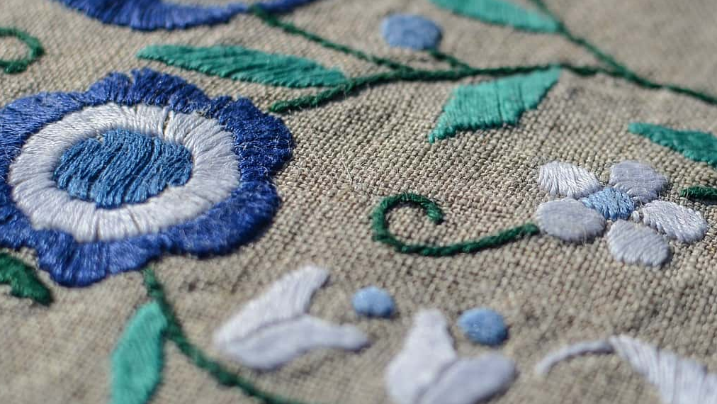
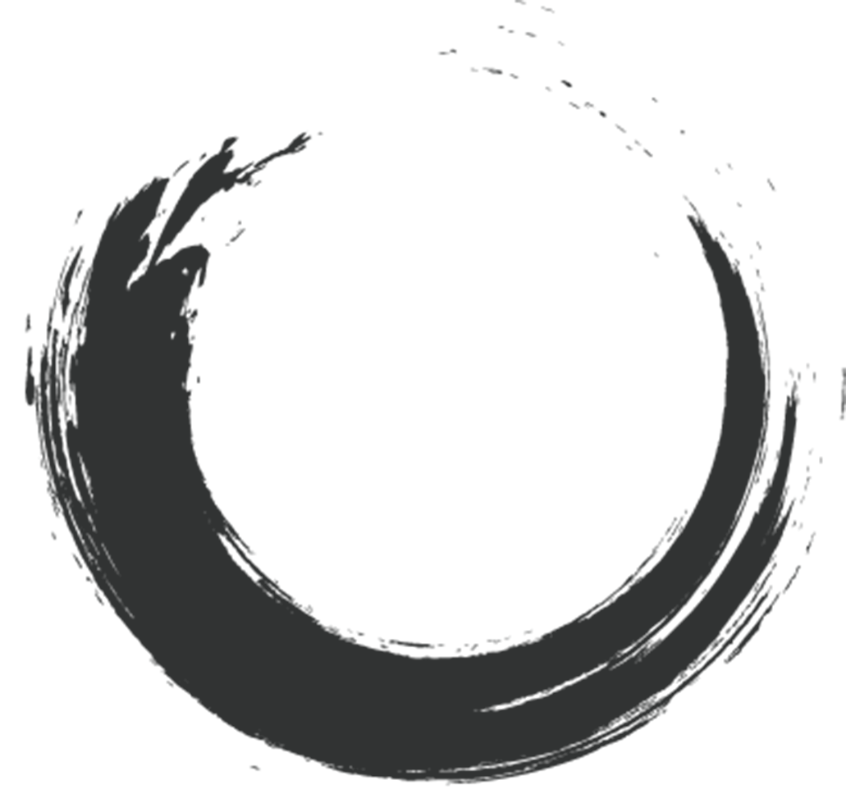
Shu Embroidery
Shi Muyu

Slide 2
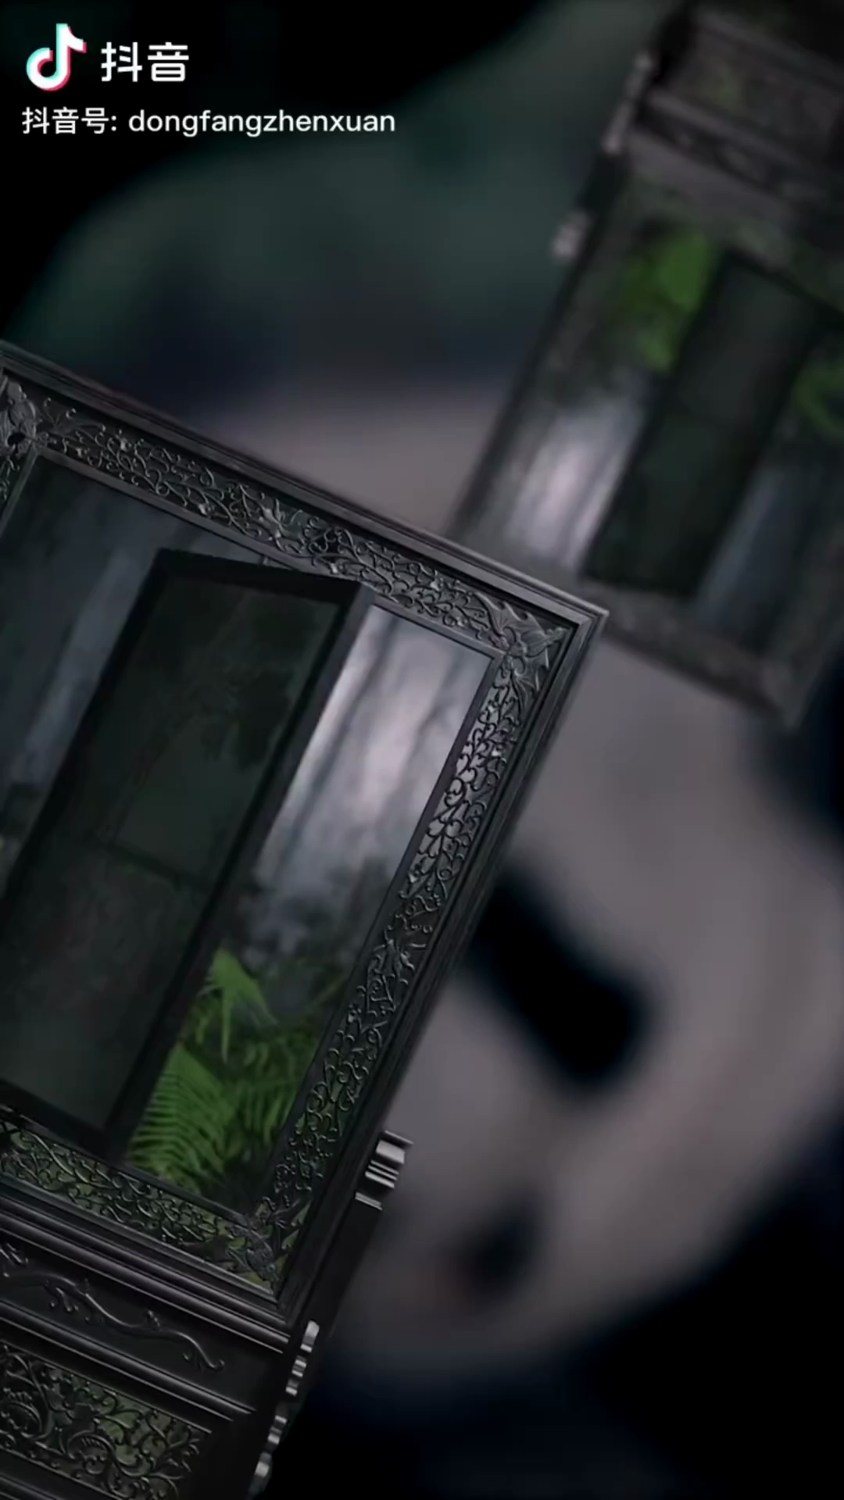

Slide 3

Contents
Introduction
Characteristics
One
Two
Three
Four
Current Situation and Inheritance
History and Development

Slide 4
One
Brief Introduction

Slide 5
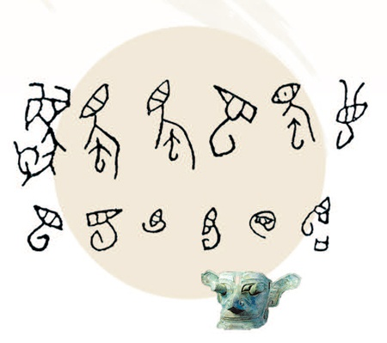
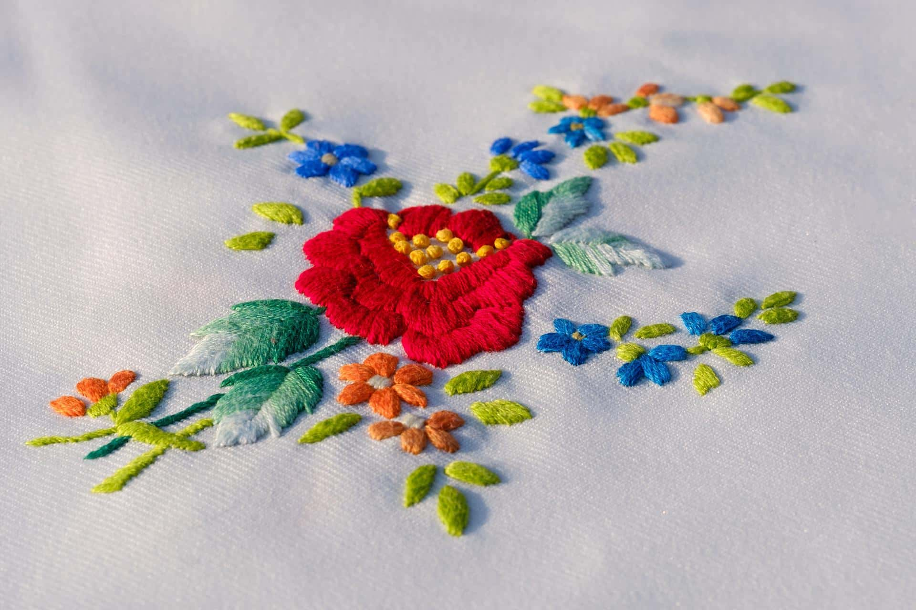
Shu
beautiful and rich land
a silkworm crawling on a wide leaf
the image of silkworm
the birthplace of slikworms and the kingdom of silk
advanced silk weaving technology
raw materials
foundation for its development

Slide 6
Two
History and Development

Slide 7
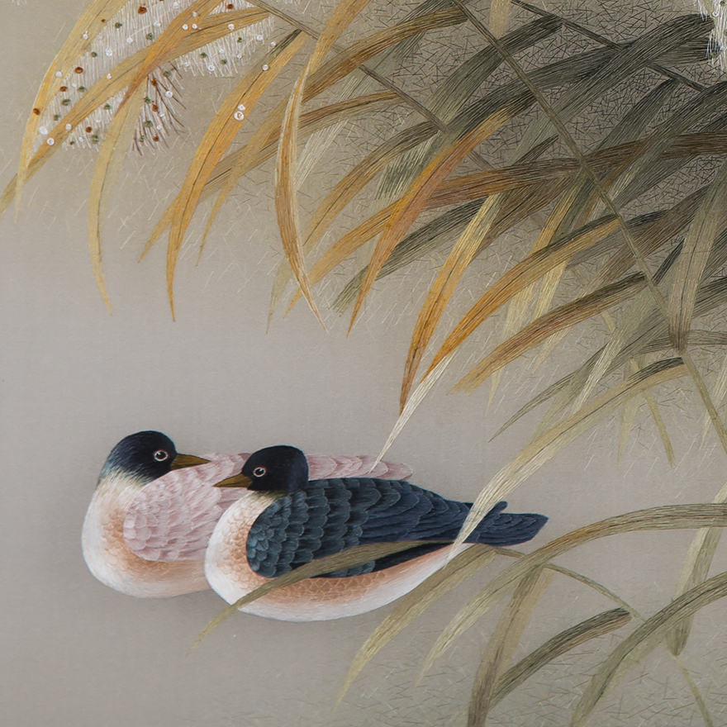
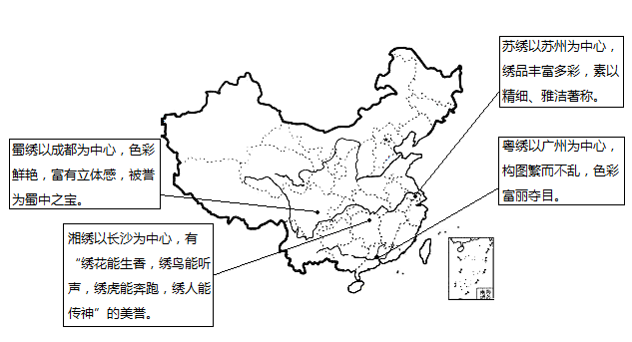
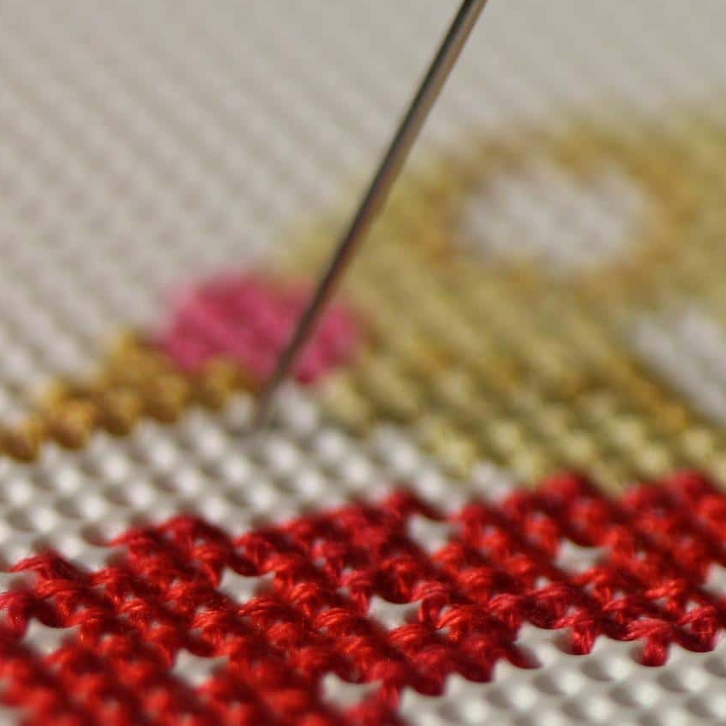
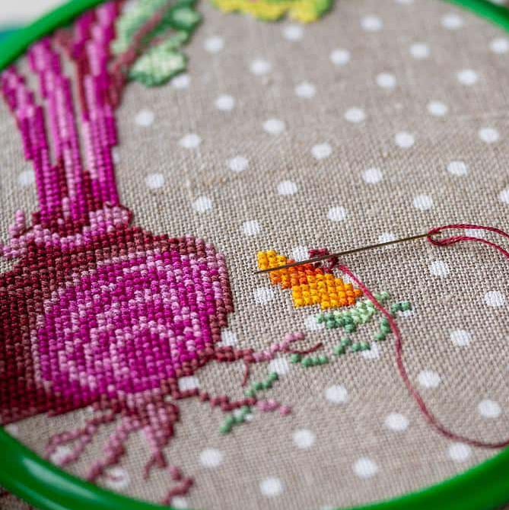
Shu embroidery
Su embroidery
入标题
Xiang embroidery
Yue embroidery

Slide 8
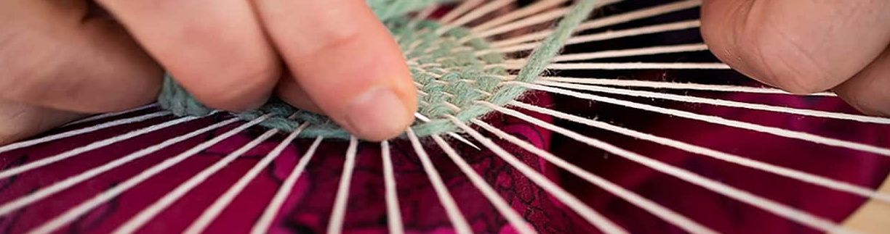
Three Kingdoms Period
Spring and Autumn Warring States Period
Shang Dynasty
Qin Dynasty
Qilu area
(the most developed textile industry)
the center of textile biased towards the ancient shu
a symbol of wealth and status
prepare for war
originate

Slide 9
Sui and Tang Dynasties
Song Dynasty
Ming Dynasty
Qing Dynasty
stimulate the demand
focus on decroation and artistry
develop by leaps and bounds
market-oriented managaemnet
spread overseas
reach its peak
enrich its patterns

Slide 10
Modern Times
New China
Nowadays
on the verge of extinction
construction of technical centers and cultural bases
shine home and abroad
return to glory and prosperity

Slide 11
Three
Characteristics

Slide 12
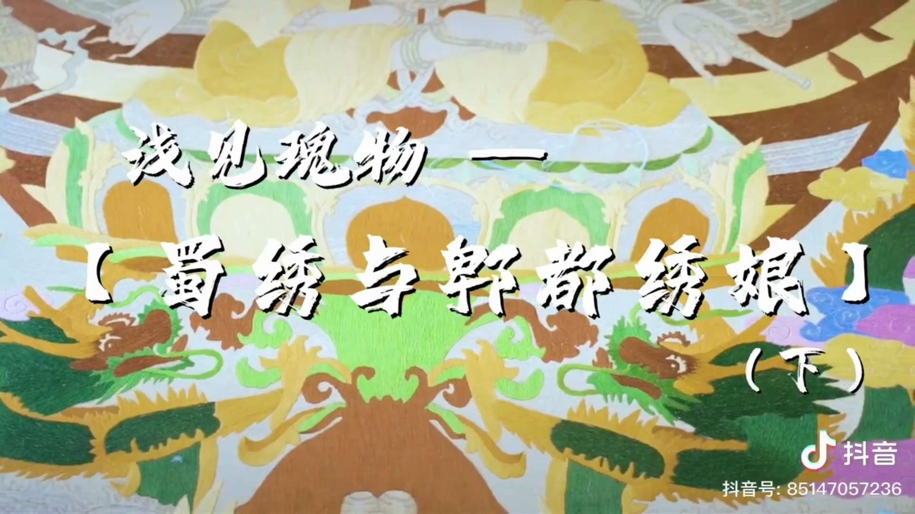

Slide 13
Material Selection
base material: silk soft satin
embroidery thread: silk thread
two strands in one thread,
eight silk threads in one velvet
made of silk, satin, spun silk, yarn and crepe

Slide 14
12 categories of stitches
130 kinds of stitches in Shu embroidery
70 processes of exquisite “Yi Jin Thread”
Embroidery Techniques
halo stitch, needle laying, needle rolling, needle cutting, needle blending, needle covering, etc
single-sided embroidery,
double-sided embroidery,
double-sided triple-variant embroidery

Slide 15
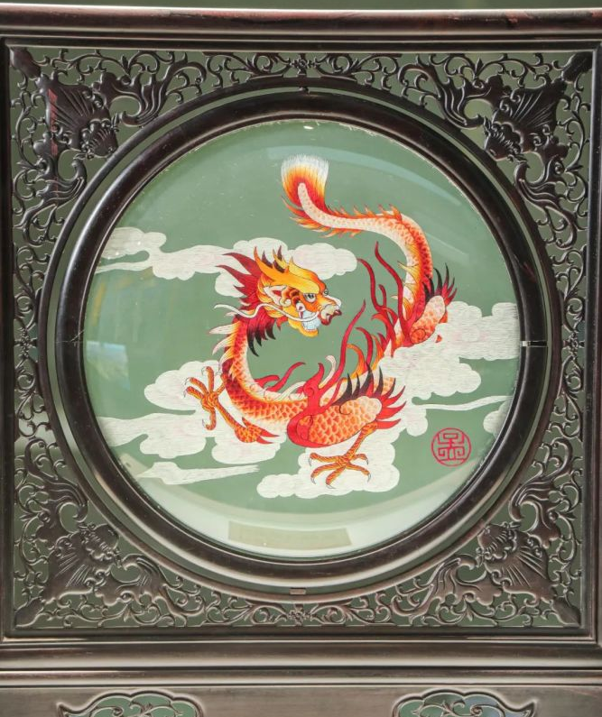
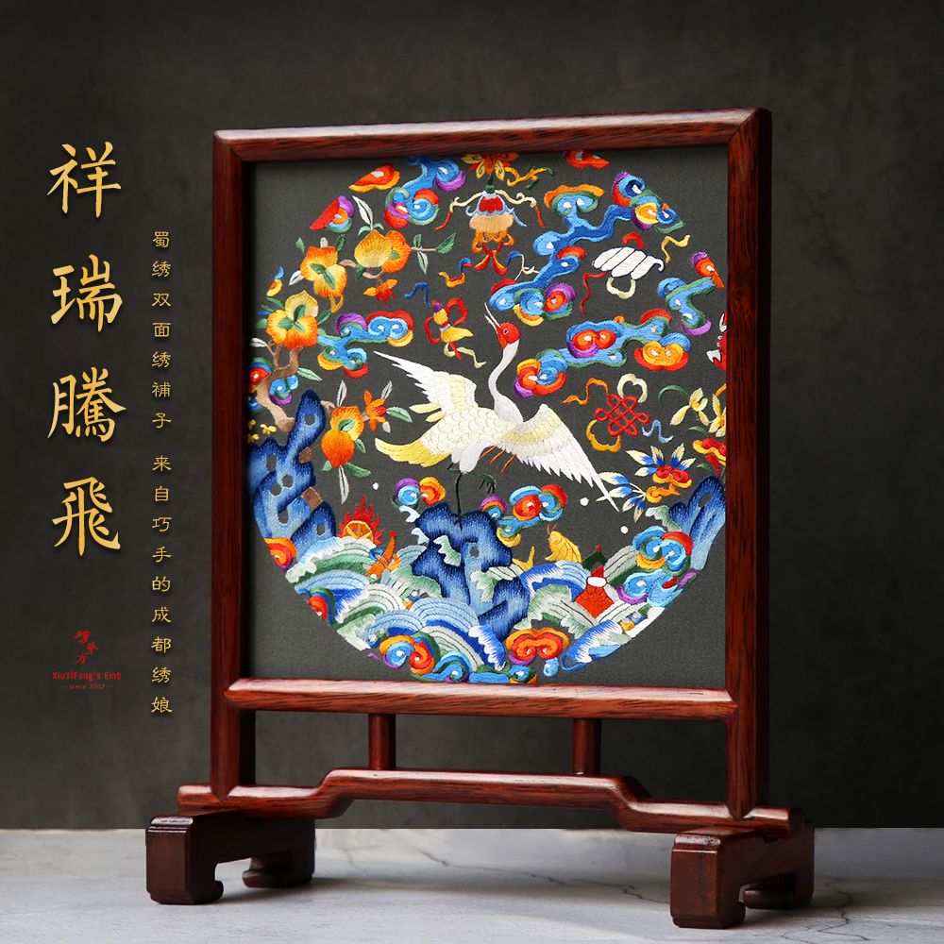
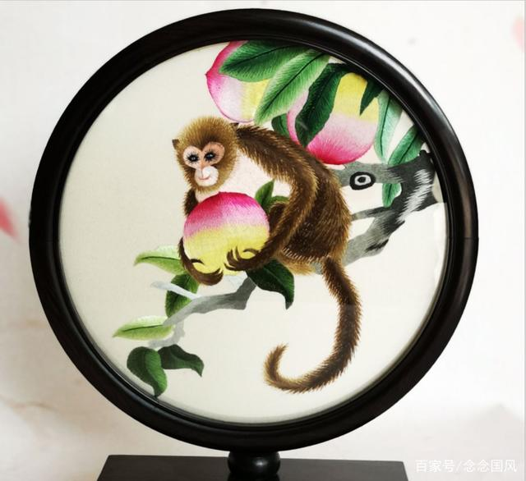
Classic Patterns
dargon and phoenix symbolizing nobility
mandarin ducks symbolizing a happy couple
beautiful and auspicious objects
butterflies symbolizing happy love
carp symbolizing luck and good fortune
rare animals unique to Sichuan

Slide 16
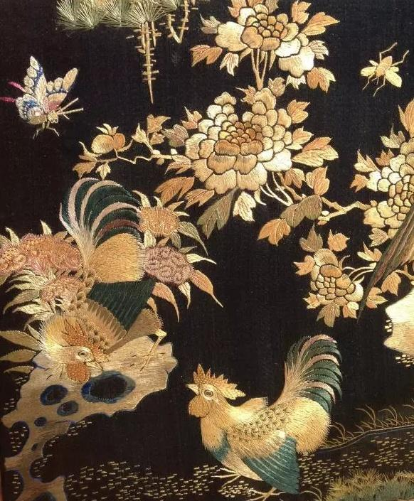
Color Matching
the overlay color
a simple and generous work with consistency and coherence
the single-color
the upper five-color
the lower five-color

Slide 17
Four
Current situation and Inheritance

Slide 18
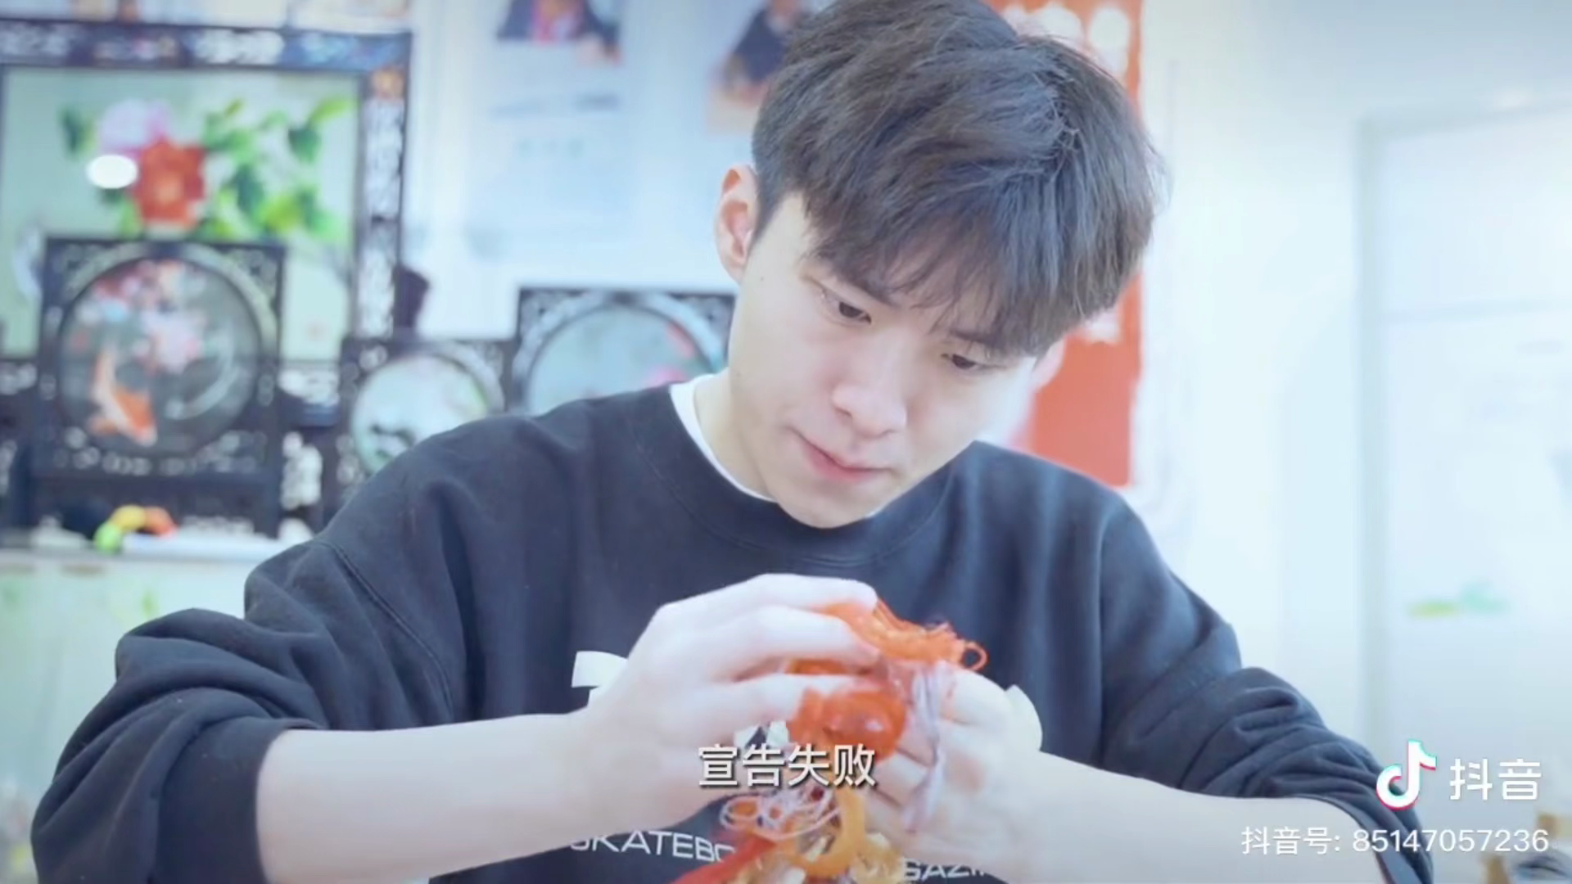

Slide 19
lower consumption and foreign export sales
mainly handcrafts,few practical items
enterprises :
1.small in scale
2.insufficient brand influence
3.backwarrd talent training mechanism
4.the problem of talent gap
Current Situation

Slide 20
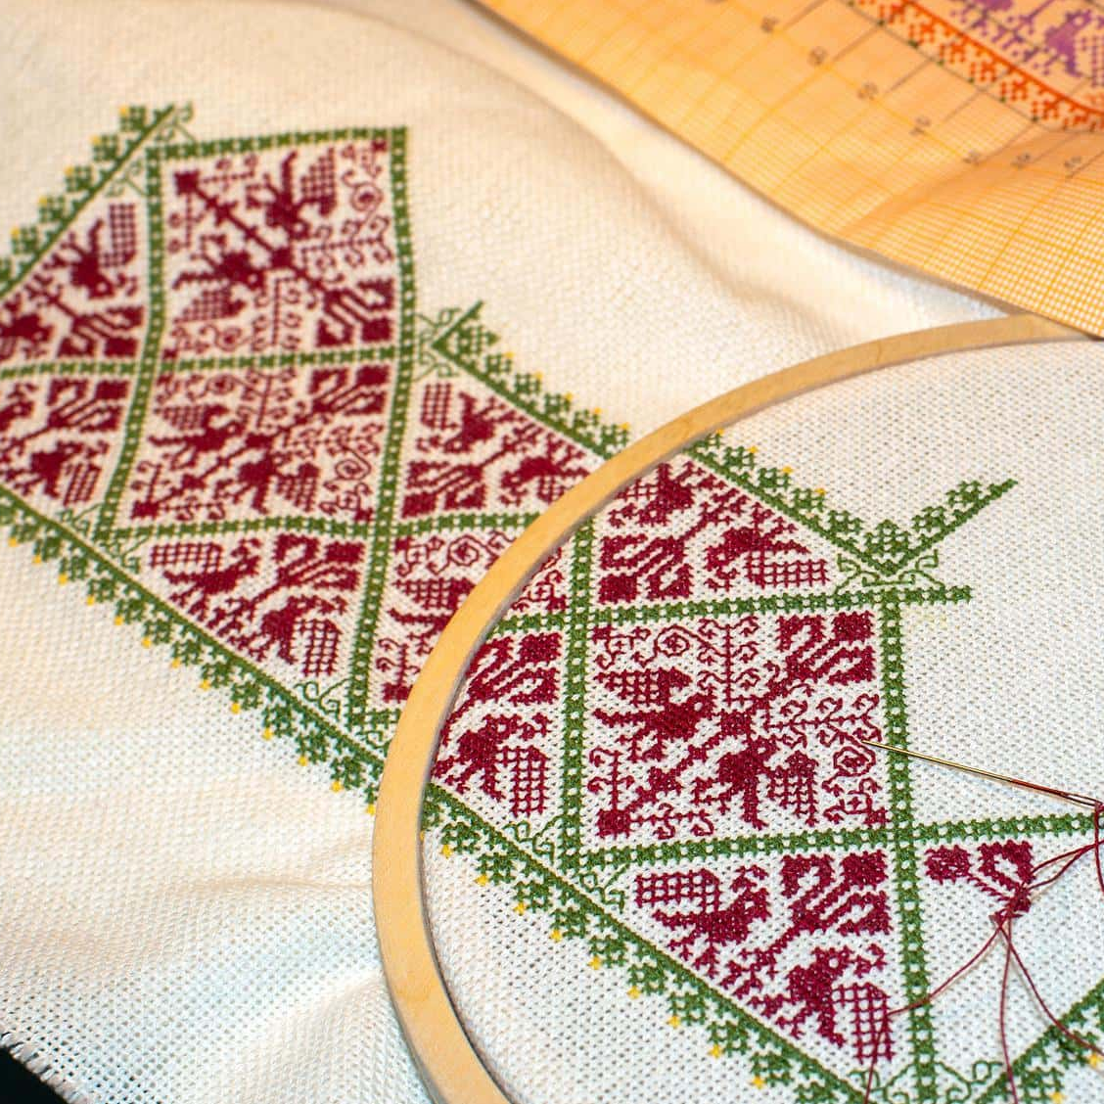
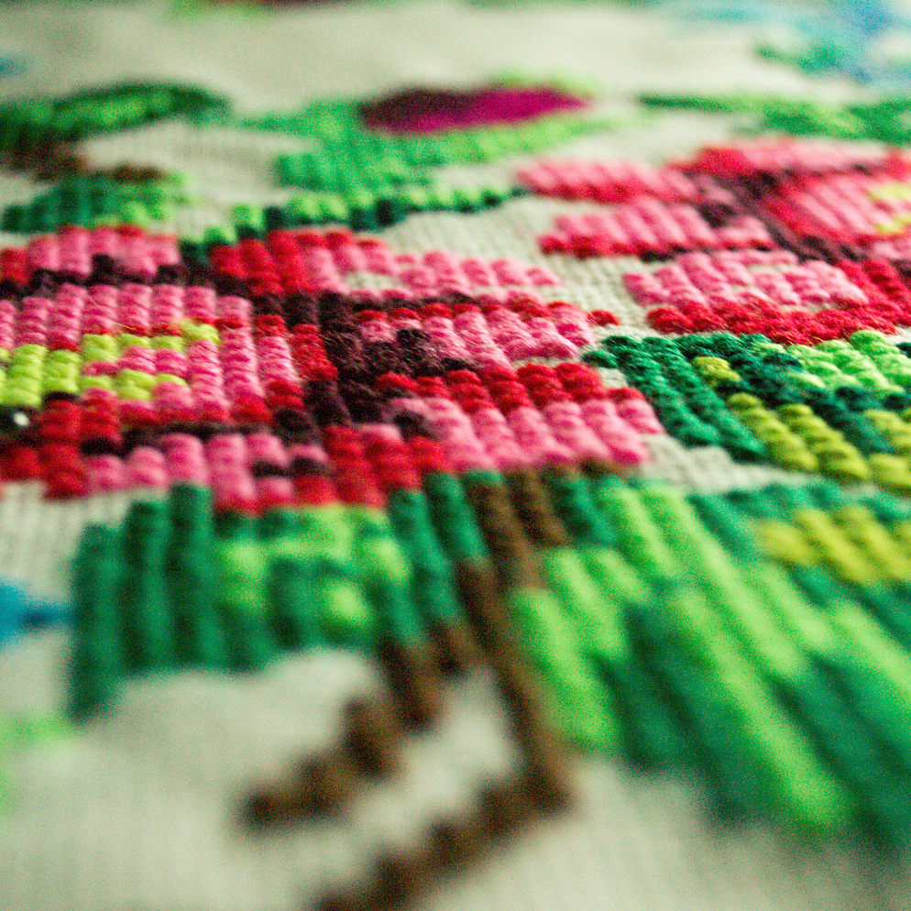
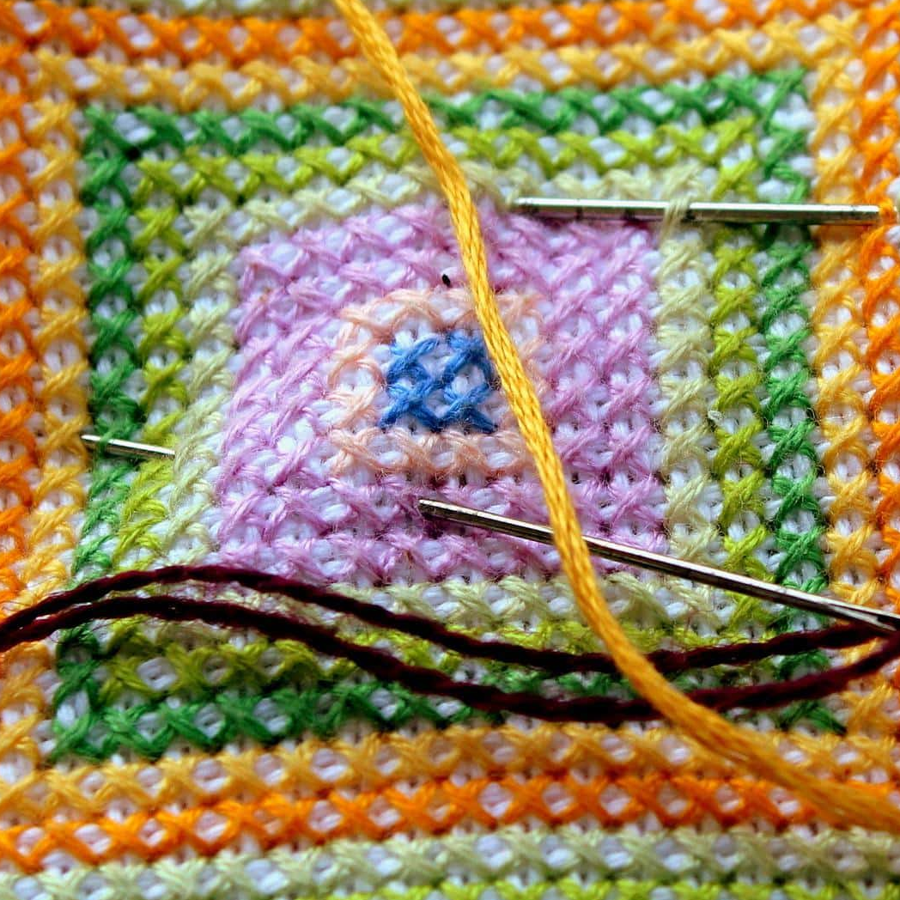
Inheritance
Works
People
integrate Shu culture with imagination and storytelling on the basis of retaining its own characteristics
develop Bashu culture
preserve Shu embroidery works
nurture back-up talents
Government
strengthen the market regulation
encourage the development of Shu enterprises
give more preferential policies

Slide 21
Thanks for your listening..

