Slide 1


Marriage Culture in China
Reporter: Xiang Minghui
Jiang Zhengjun
Major: English Translation

Slide 2
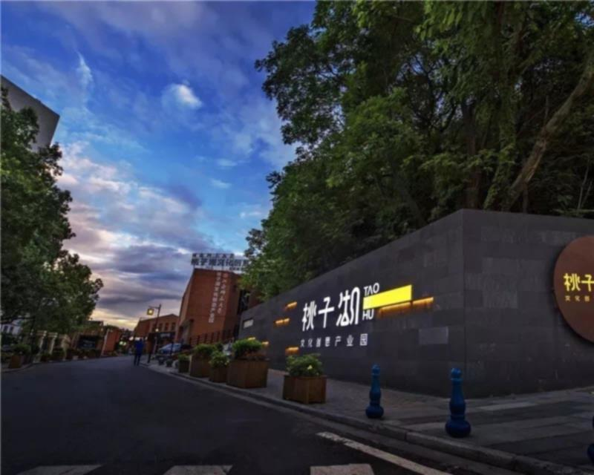


Ancient Marriage Customs and Characteristics
1
2
Changes in terms of Wedding Dresses
Discussion Time

Slide 3

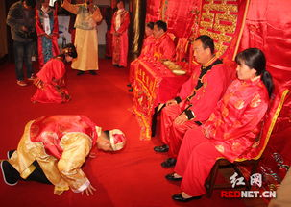
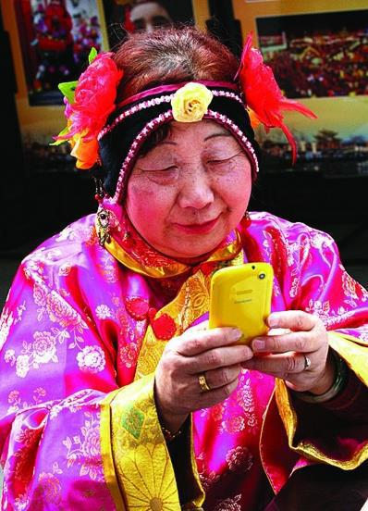

Slide 4
Six Rites of Marriage
纳采 | marriage proposal (with the help of a match maker)
问名 | asking for the bride’s name and birth date to divine
纳吉 | good omen, deciding marriage
纳征 | giving betrothal gifts
请期 | choosing the wedding date
亲迎 | celebration of marriage

Slide 5
Seven conditions under which a husband could unilaterally dissolve his marriage “七去/七出”
不顺父母 | Being unfilial to husband’s parents
无子 | Failing to bear son
淫 | Adultery
妒 | Jealousy
有恶疾 | Contracting serious illness
口多言 | Too much comments leading to family discord
窃盗 | Theft/Larceny

Slide 6
Three conditions under which a wife couldn’t be evicted “三不去”
有所娶无所归 | the wife ‘s families passed way so that she has no one to rely on
与更三年丧 | the wife obeyed all the restrictions for three years to mourn her parents-in-law ( no entertainment or social life, etc.)
前贫贱后富贵 | the wife lived in a poor life with her husband at the beginning and a well-off life later

Slide 7
Consentual Divorce and Forced Divorce
《战国策》(history of 490BC-221BC)“出妇嫁乡曲者，良妇也” ;
《汉书》“无义则离”(history of 206BC-23BC) ; 东汉班昭《女诫·敬慎》“恩义俱废”
Consentual divorce（和离） was brought into the law system in Tang Dynasty.
If the husband, wife or a relative of them commits assault, scolding, killing, wounding or rape against a relative of the other party, the government would force them to divorce.（义绝）

Slide 8
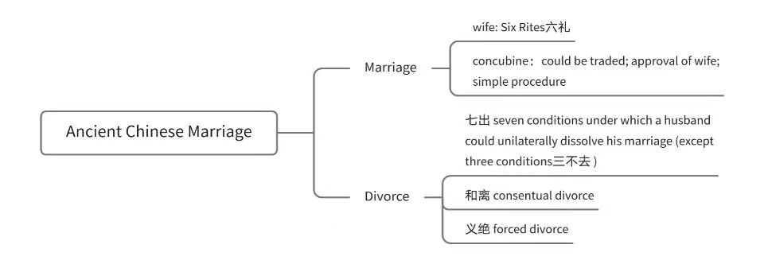

Slide 9
Characteristics of Ancient Chinese Marriage
personal emotions had little to do with marriage
constraints of parents
family interests came first
women were subordinate to men

Slide 10
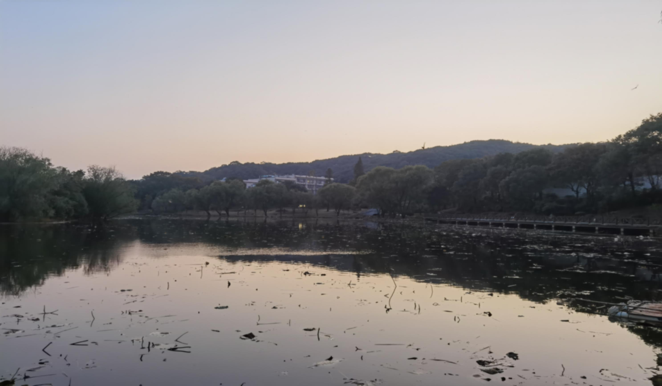
Part 2

Slide 11
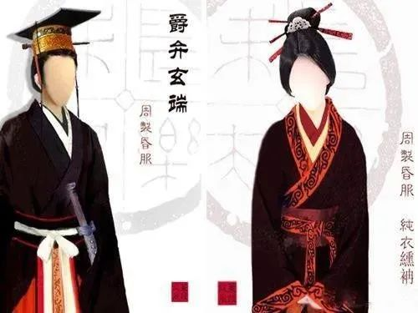
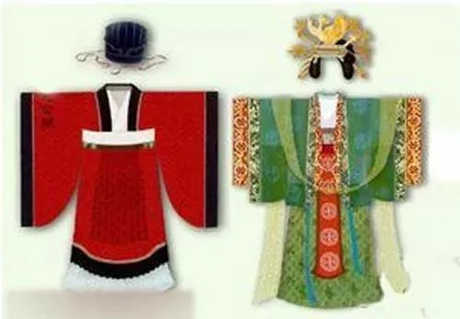
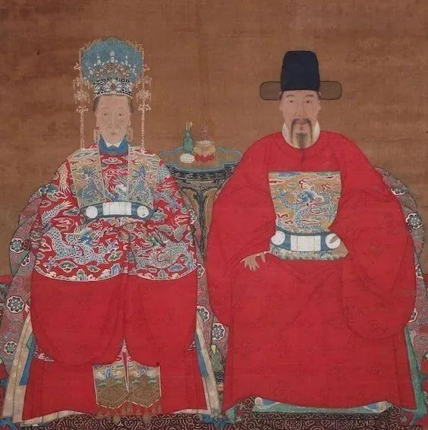
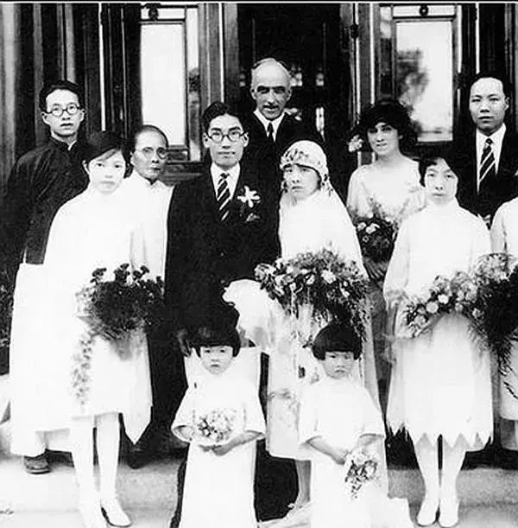
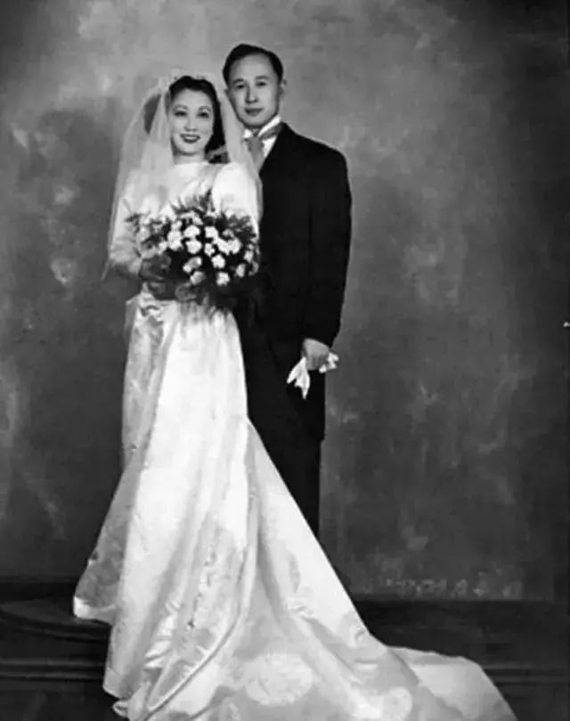
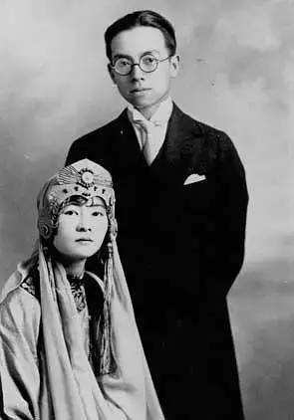
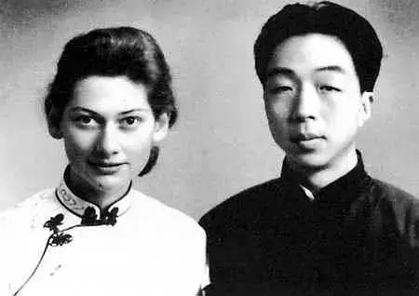
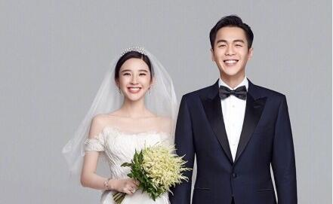
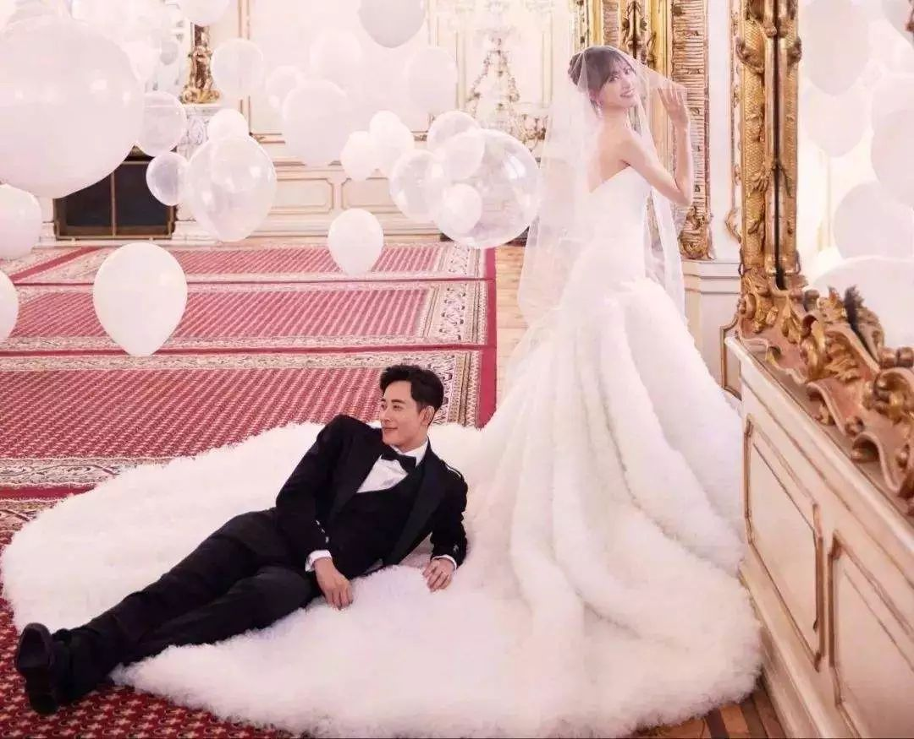
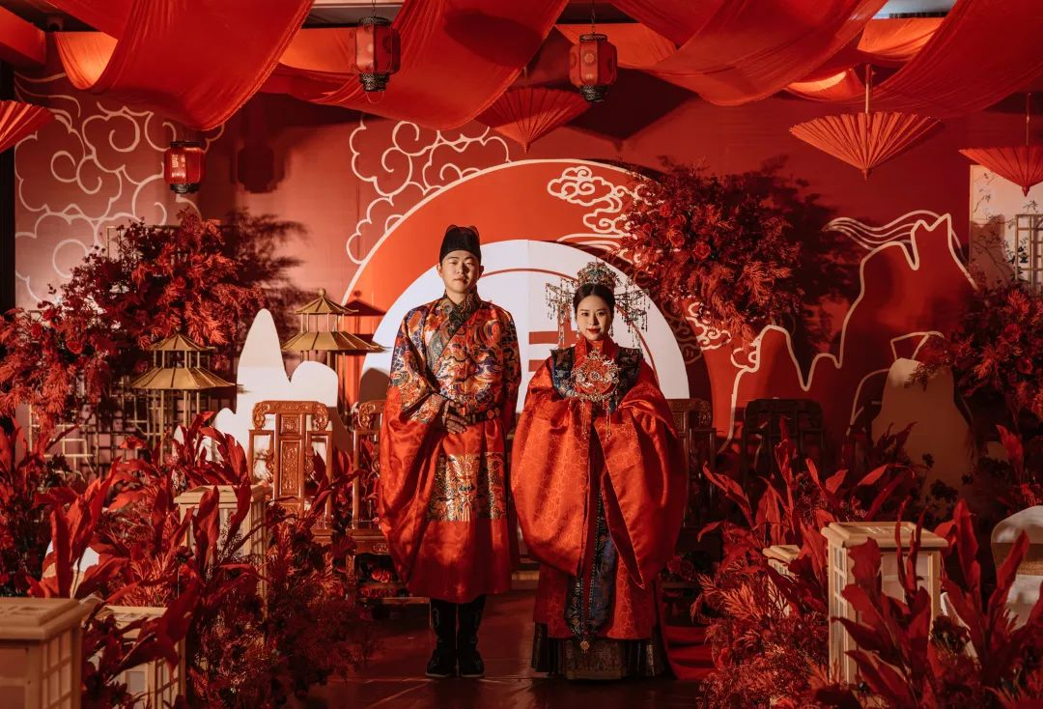
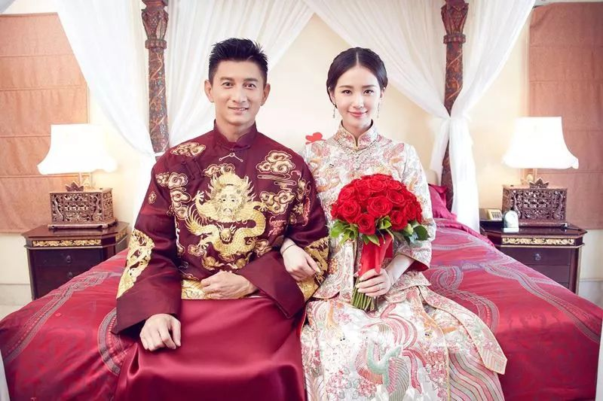
Changes in terms of Wedding Dresses
1.Ancient Times
2. The Republic of China （民国时期）
3. Contemporary Times
（图片来源于网络,侵权必删）

Slide 12
Discussion Time
Q1
Do you agree with the action that some parents ask or urge their children to get married?
Q2
What do you think a good marriage should be like?
equal
economically dependent or not?
housewife or not?

Slide 13
References
[1]https://baike.quark.cn/c/lemma/42941840970753#/index
[2]http://baike.baidu.com/l/FurMnDH9?bk_
[3]http://baike.baidu.com/l/dMw6WPwc?bk_
[4]董梦缘.唐代“和离”制度的成因分析[J].山西省政法管理干部学院学报,2021,34(03):25-27.
[5]孙 晓 . 中 国 传 统 婚 姻 制 度 与 观 念 的 演 变 [J]. 人 民 论坛,2021(16):110-112.
[6]刘国良.中国古代文化常识探骊——浅析中国古代婚姻制度与婚姻传统[J].课程教育研究,2017(26):42-43.

Slide 14


再
会

