Slide 1

The World
in
a Cup of Tea
日语笔译 杨 帆

Slide 2

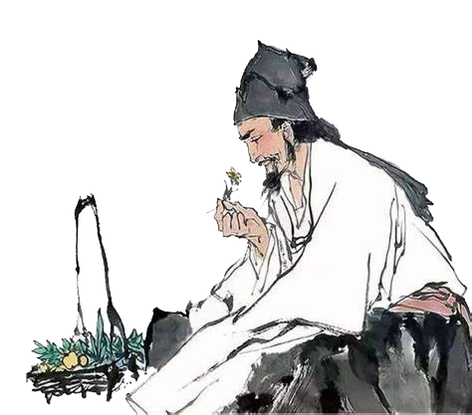
Tea
A long time ago in ancient China, there was an emperor named Shen Nong, known for discovering herbs and plants. One day, while boiling water under a tree, a few leaves drifted into his pot due to the breeze. As the leaves infused into the water, they released a pleasant aroma. Shen Nong took a sip and felt instantly refreshed and energized.

Slide 3
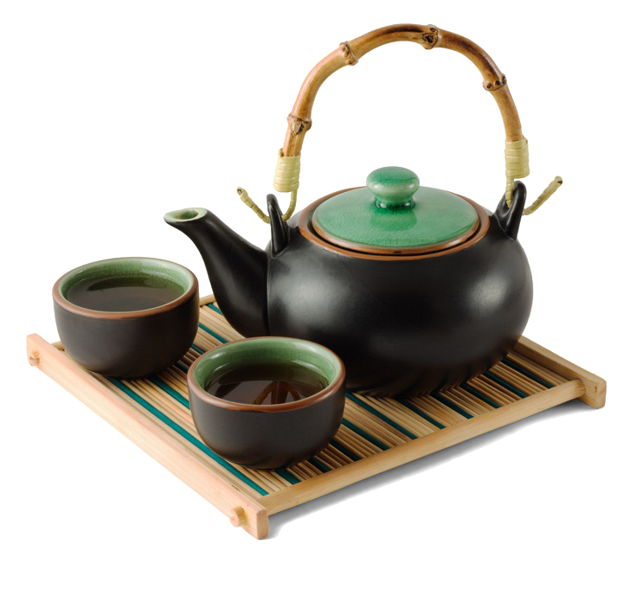

Tea
These leaves were tea leaves, and from that moment on, tea became a popular drink in China, known for both its taste and health benefits. Over time, tea evolved into a central part of Chinese culture, with tea house becoming place for socializing and relaxation.

Slide 4
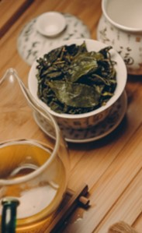
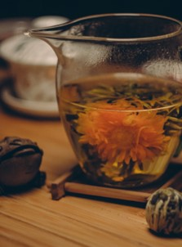

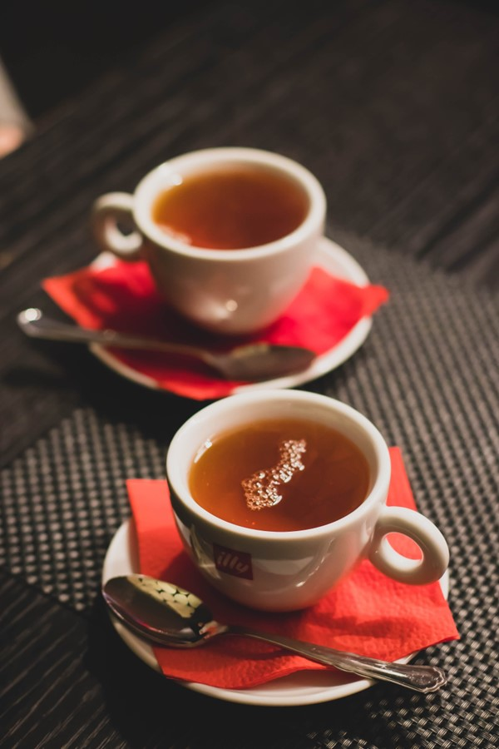
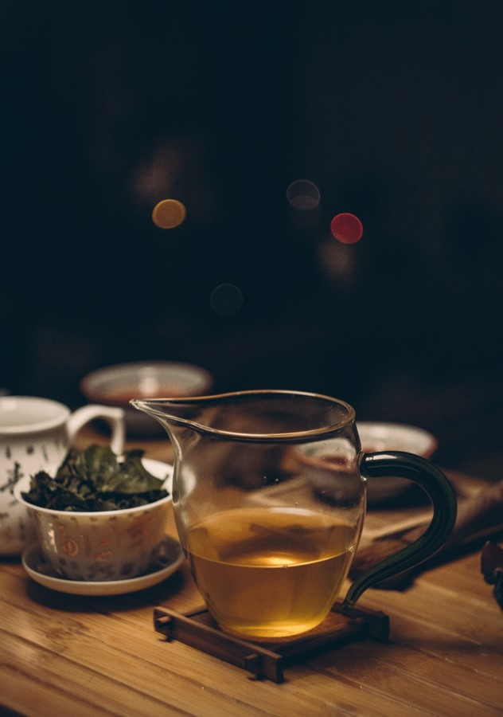
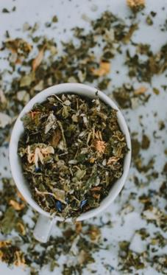
Types
Green Tea
Oolong Tea
Yellow Tea
Black Tea
White Tea
Dark Tea

Slide 5
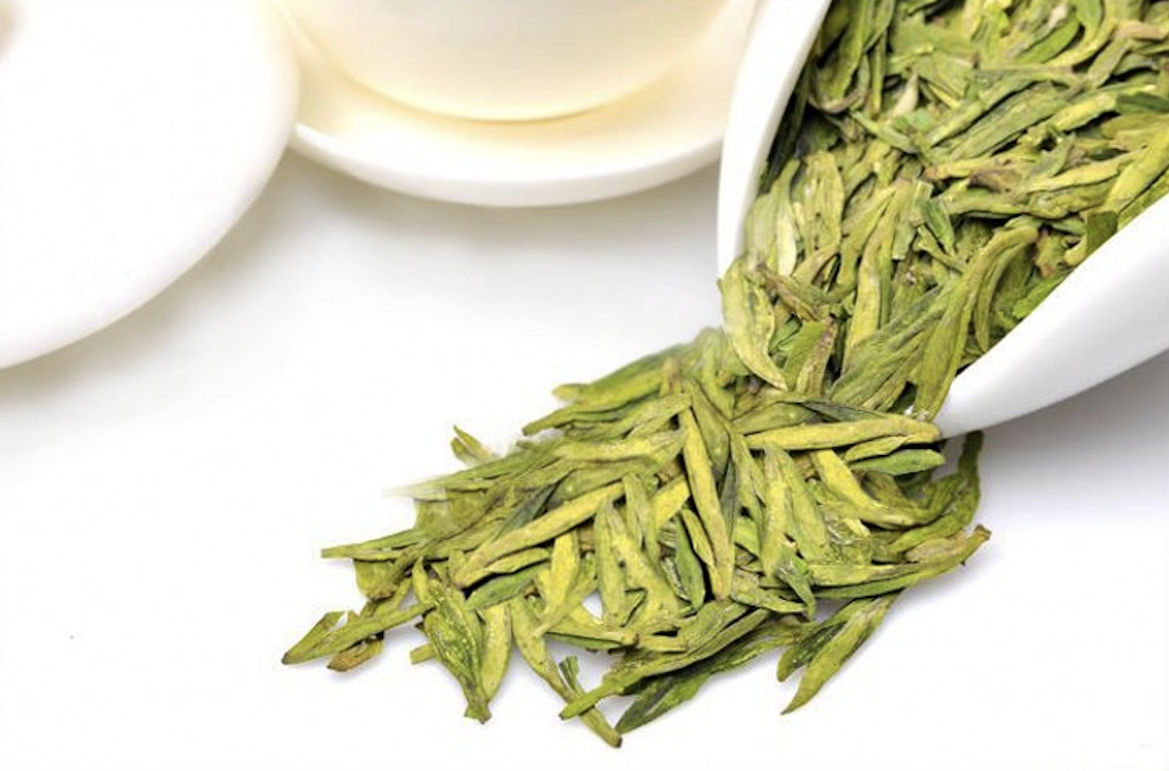
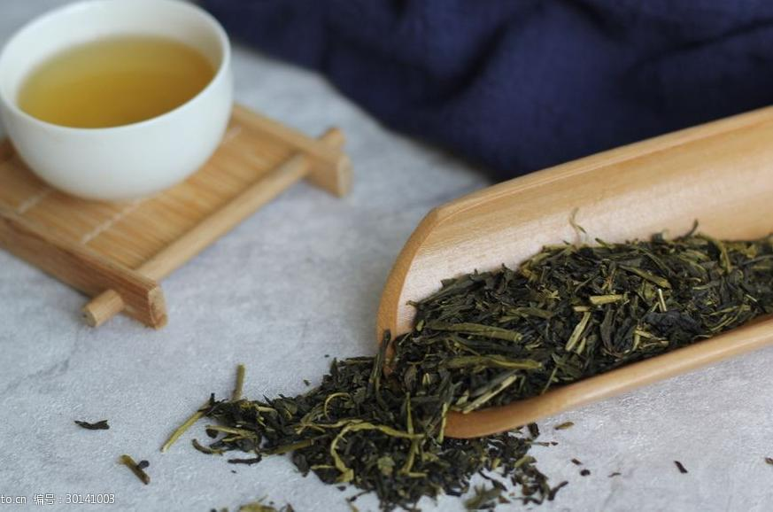
Green Tea
A
B

Slide 6
Green Tea
West Lake Longjing Tea
Sencha
（煎茶）

Slide 7
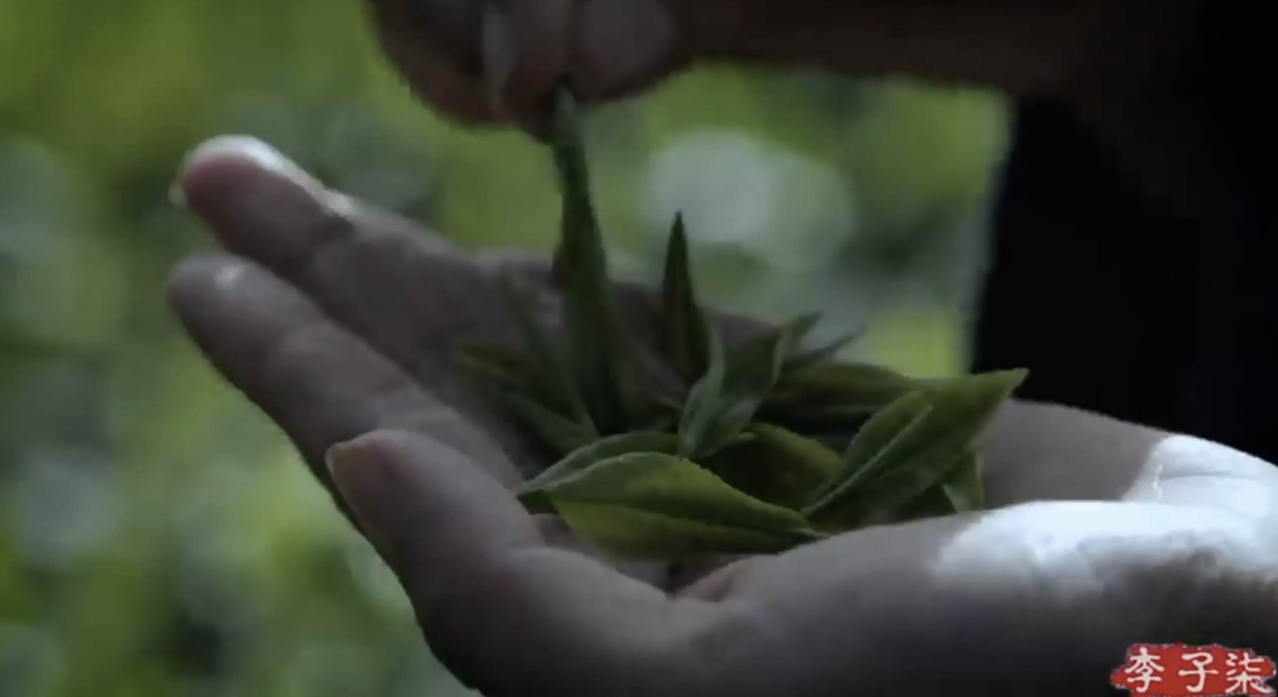

Green Tea

Slide 8


博大精深
源远流长
中华茶文化
Thank you！

