Slide 1
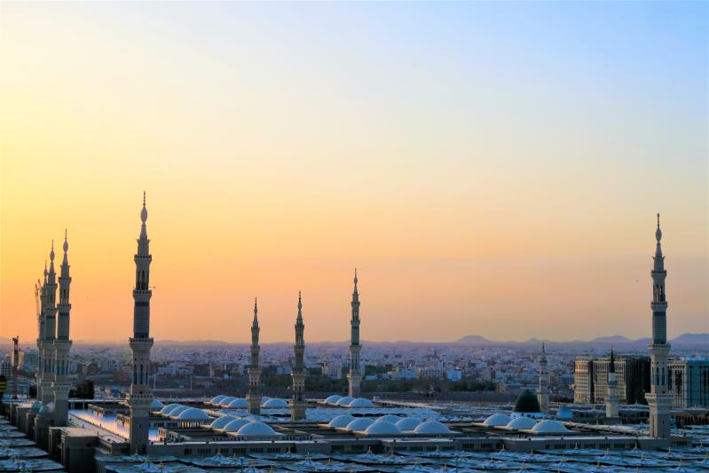
Islam
Presenter： 刘柳
Group member： 刘怡瑜

Slide 2
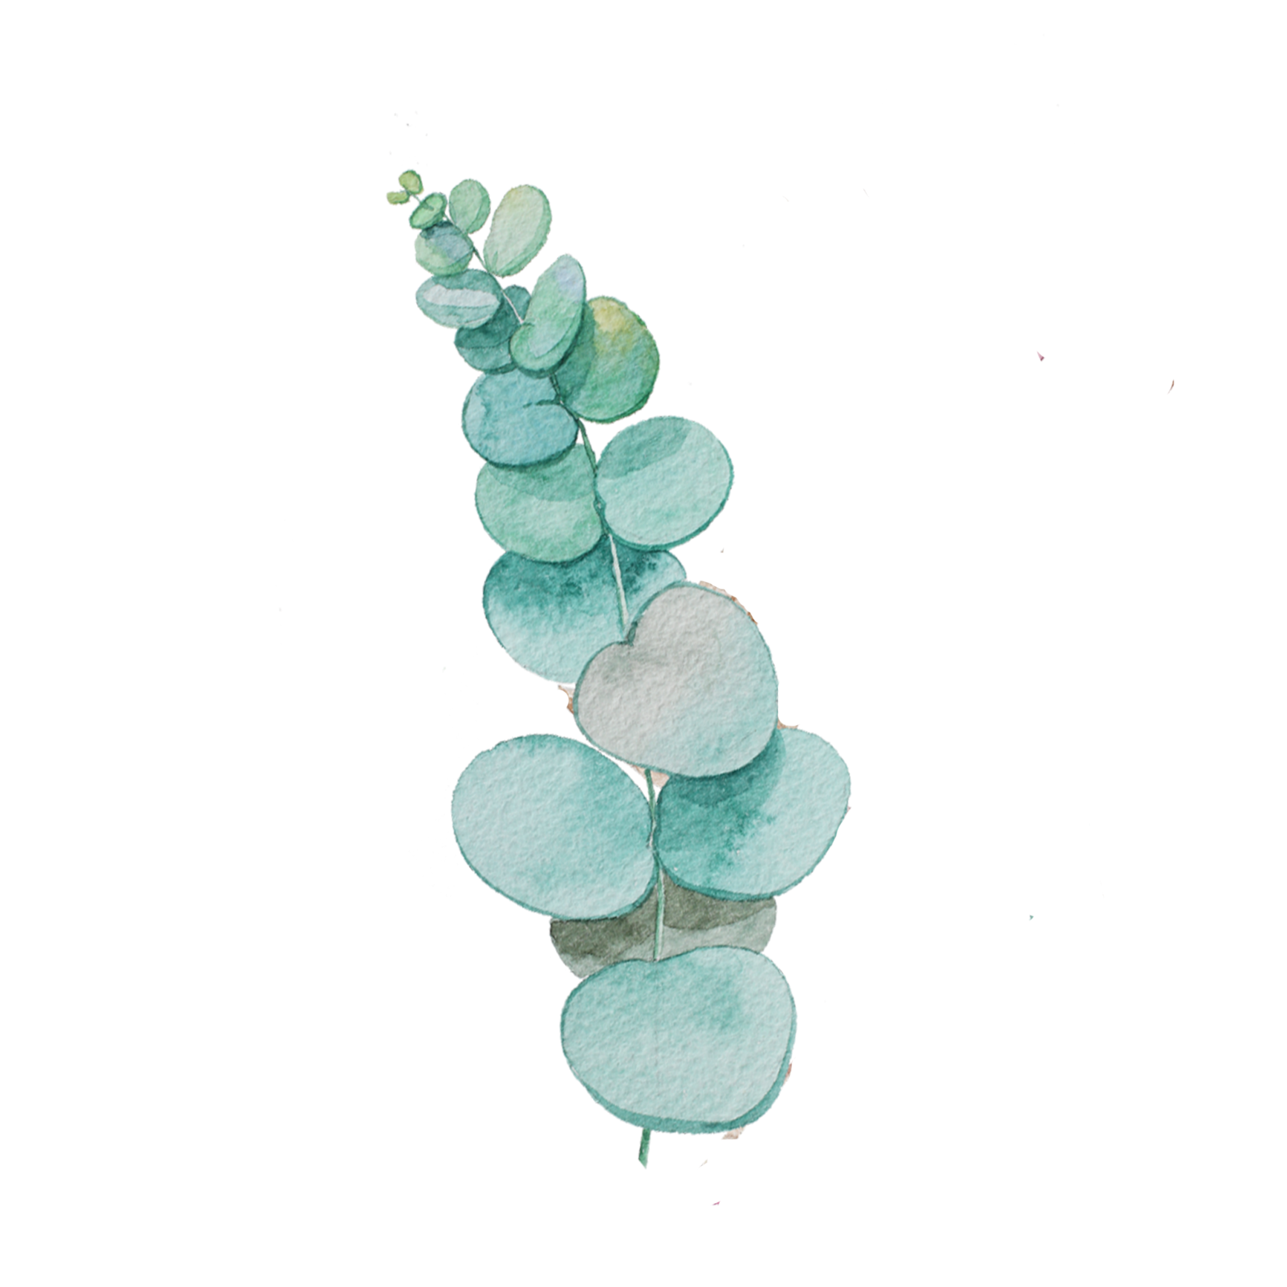
01
Brief Introduction
02
Taboo Customs
Contents
03
Hypotaxis and Parataxis

Slide 3


PART ONE
Brief Introduction

Slide 4


I
One of the three major world religions
b
Muslim
f
About 1.6 billion Muslims worldwide (2018)

Slide 5
PART TWO
Taboo Customs

Slide 6
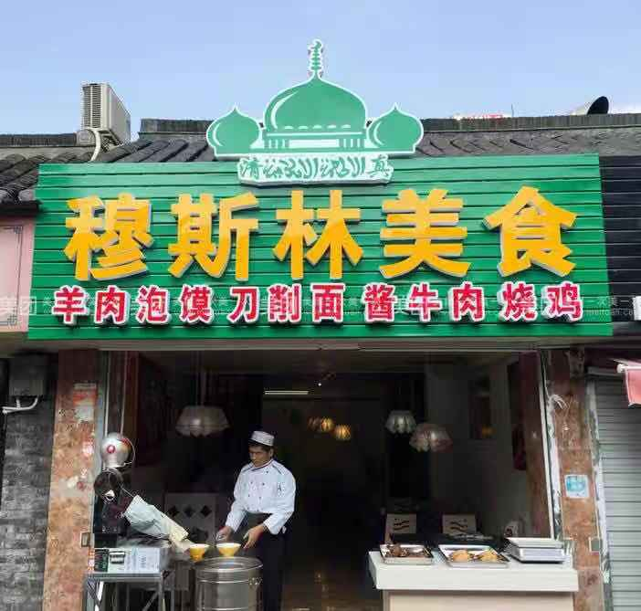
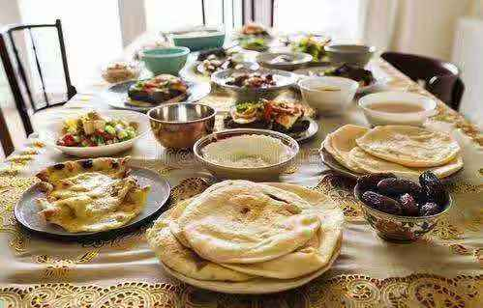
Food
f
Market
Prohibition of drinking alcohol.
Y
Recruitment
Prohibition of eating pork, animal blood, self-dead animals and all animals that are not slaughtered in the name of Allah.
h
Analyze
Prohibition of mixing with non-halal food.

Slide 7
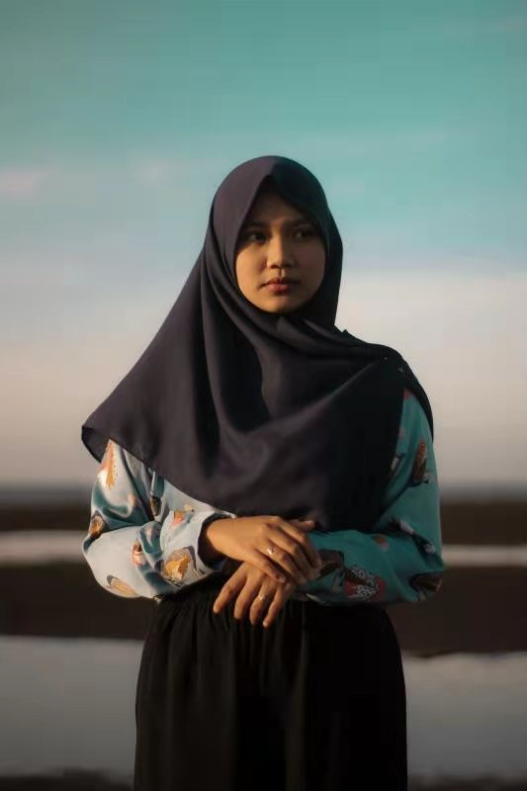

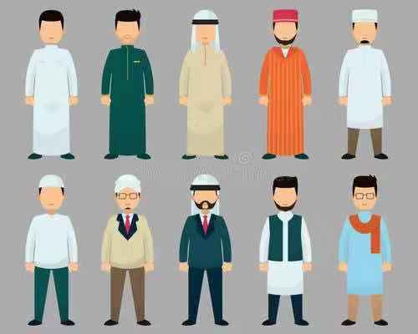
Men are forbidden to wear noble clothing and luxury items such as gold and silver.
Costume
s
Conference
Women are forbidden to show their beauty and clothes.
w
12
11
1
Planing
They are forbidden to change the original human creation.
10
2
E
9
3
8
4
Muslims are forbidden to wear clothes of other religions.
v
7
5
6
Work
Men are forbidden to imitate women's behaviors and attires and vice versa.
l

Slide 8
PART THREE
Hypotaxis and Parataxis

Slide 9
The dependent or subordinate construction or relationship of clauses with connectives.
Parataxis
Hypotaxis
The arranging of clauses one after the other without connective showing the relation between them.

Slide 10
Form-focused with emphasis on
explicit cohesion（显性联接）
以形驭意
English
Meaning-focused with emphasis on
implicit coherence（隐性连贯）
以意统形
Chinese

Slide 11
他不去我去。
I’d like to go if he wouldn’t.
他不去我也去。
I’d go there even if he wouldn’t go with me.
他不去我才去。
I’d go there only if he wouldn’t.

Slide 12
早知今日，何必当初？
If I had known it would come to this, I would have acted differently.
跑得了和尚，跑不了庙。
The monks may run away, but the temple can't run away with him.

Slide 13

《回乡偶书（一）》
贺知章
少小离家老大回，
乡音未改鬓毛衰。
儿童相见不相识，
笑问客从何处来。
译文一:
Homecoming
He Zhizhang
When I was young, I left home, when old, I come back.
My accent is unchanged, my hair no longer black.
I'm unknown to my children I meet on the way.
“Where do you come from, dear sir?” with a smile they say.
(许渊冲)
译文二:
Casual Compositions on Homecoming
He Zhizhang
I left home young and small, but came back old and grown.
My native accent never changed, but sideburns are fading gray.
Kids met me, but no recognition shown.
And asked me smiling where's my home.
(任治稷，余正)

Slide 14

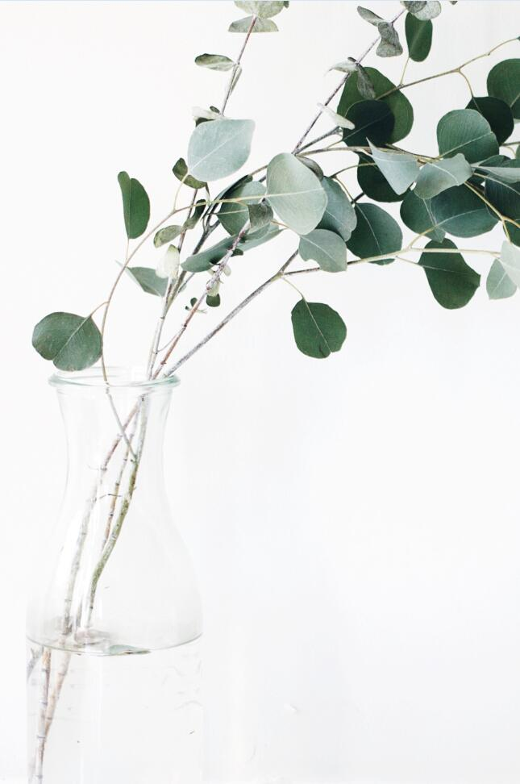
Thank You!

