Slide 1

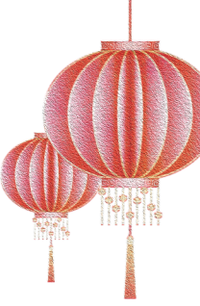



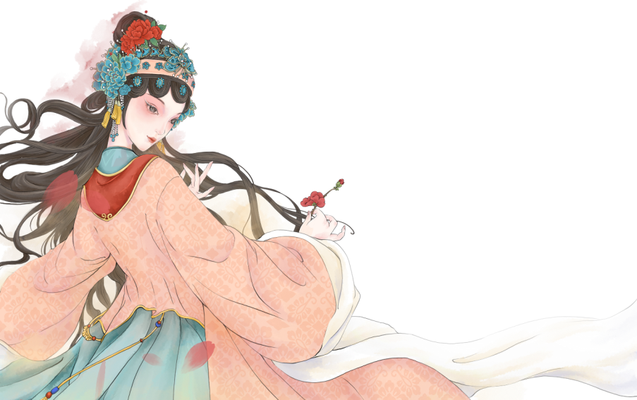
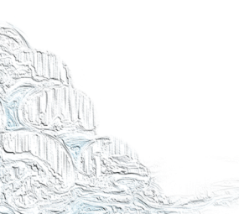

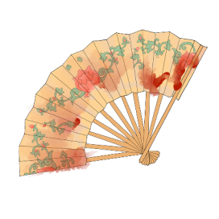
Huangmei Opera
Presenter: Liu Ziling

Slide 2
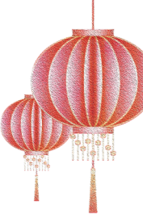
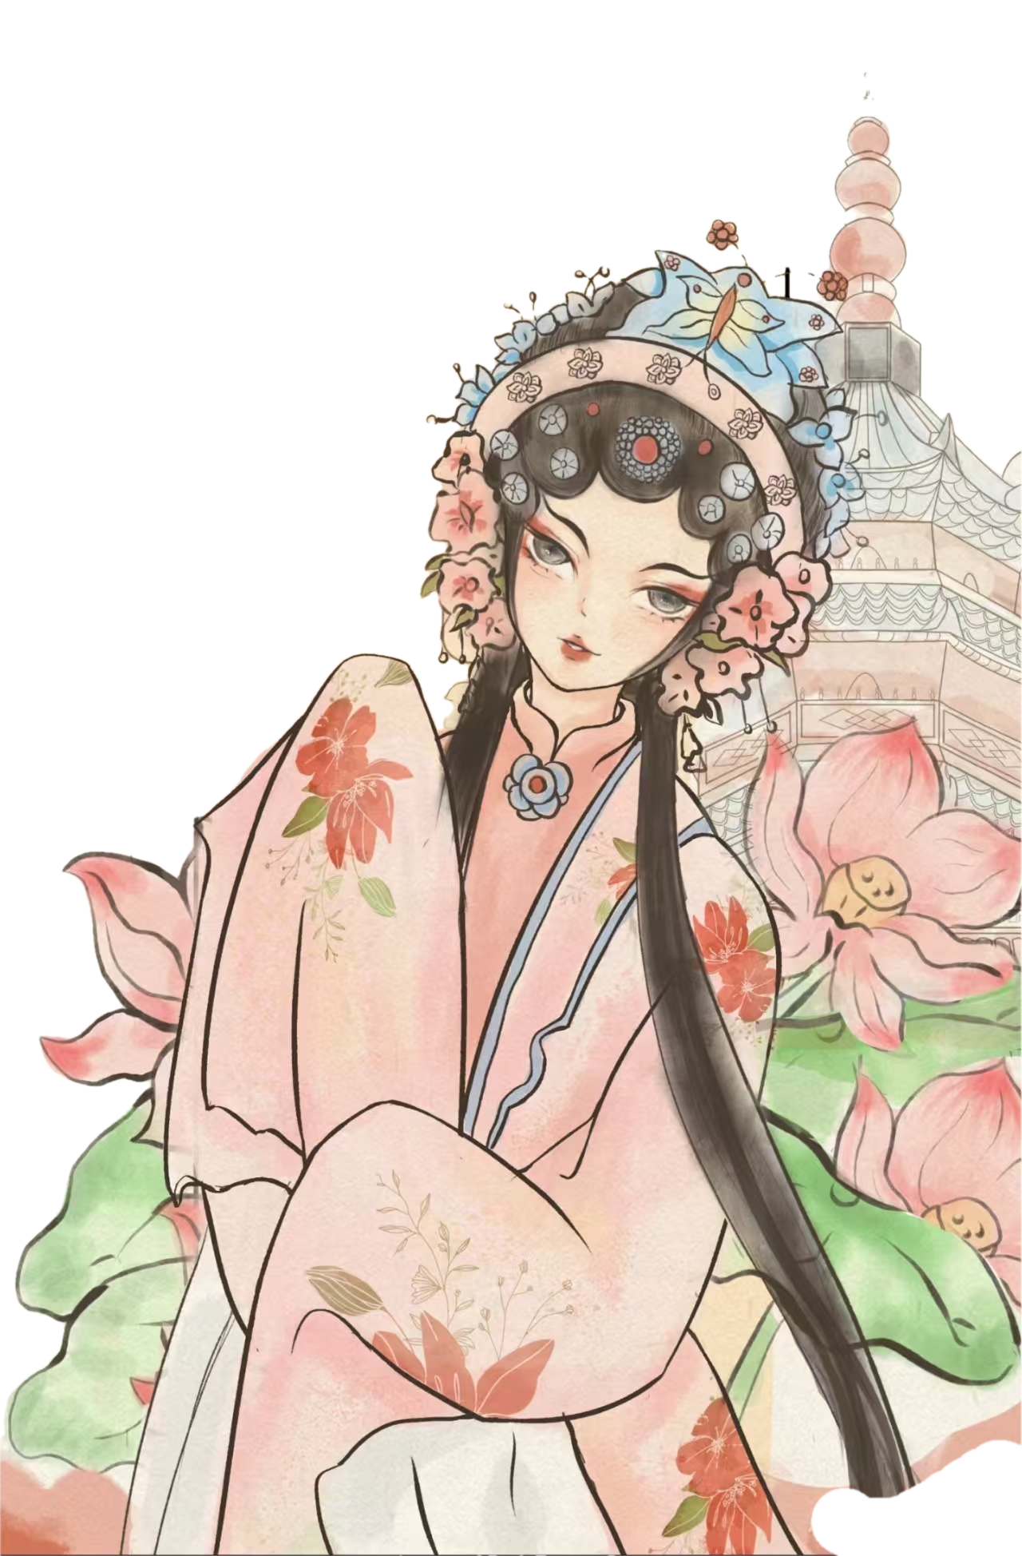

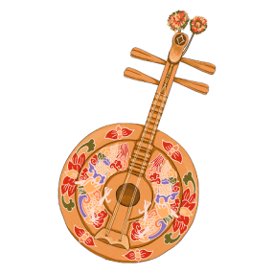

DIALOGUE
1
Brief Introduction
2
Artistic Characteristics
3
‌The Female Son-in-Law‌

Slide 3
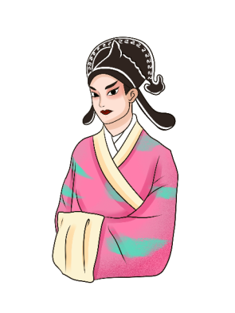

1
Introduction
Huangmei opera, also known as Huangmei tune and Caicha opera
one of the major local operas in Anhui Province
one of the "five major opera genres in China"
黄梅戏

Slide 4
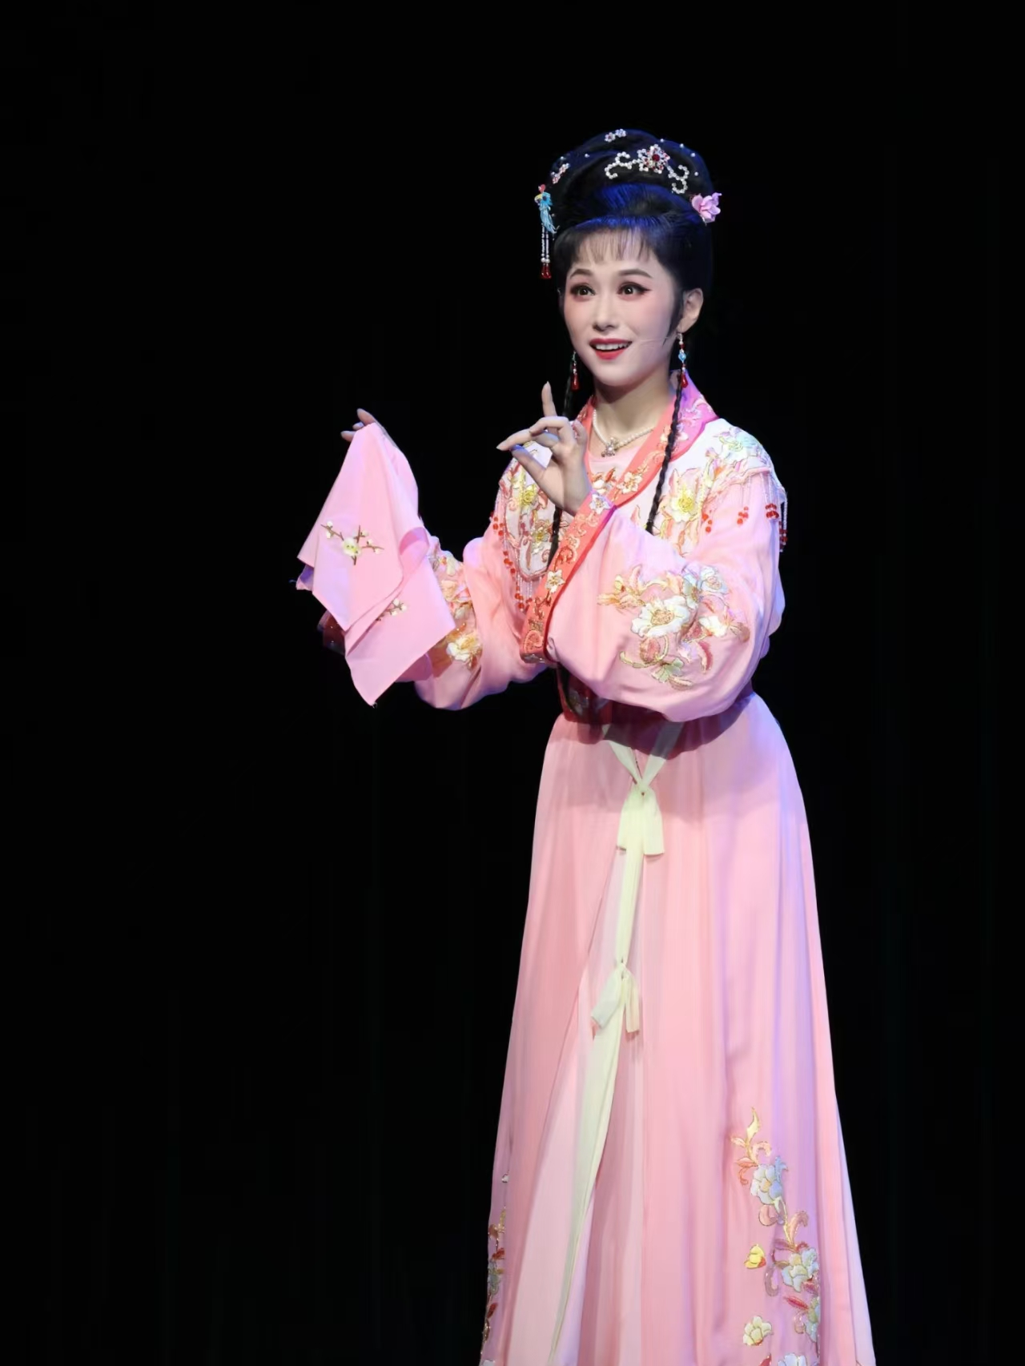
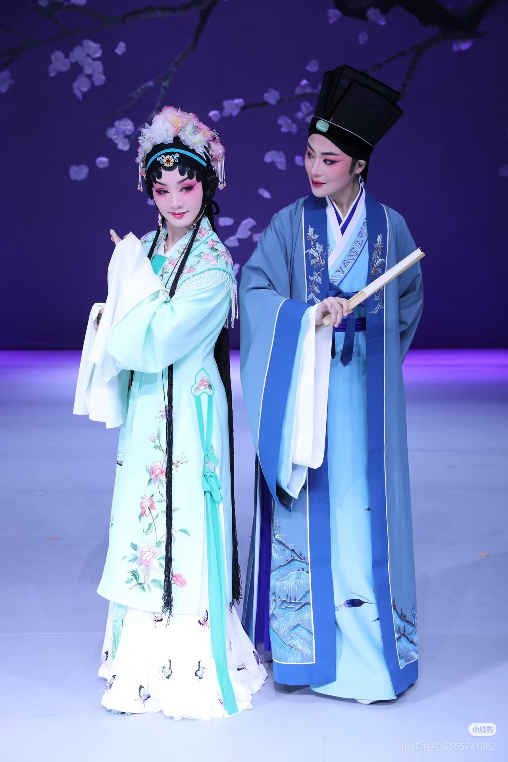
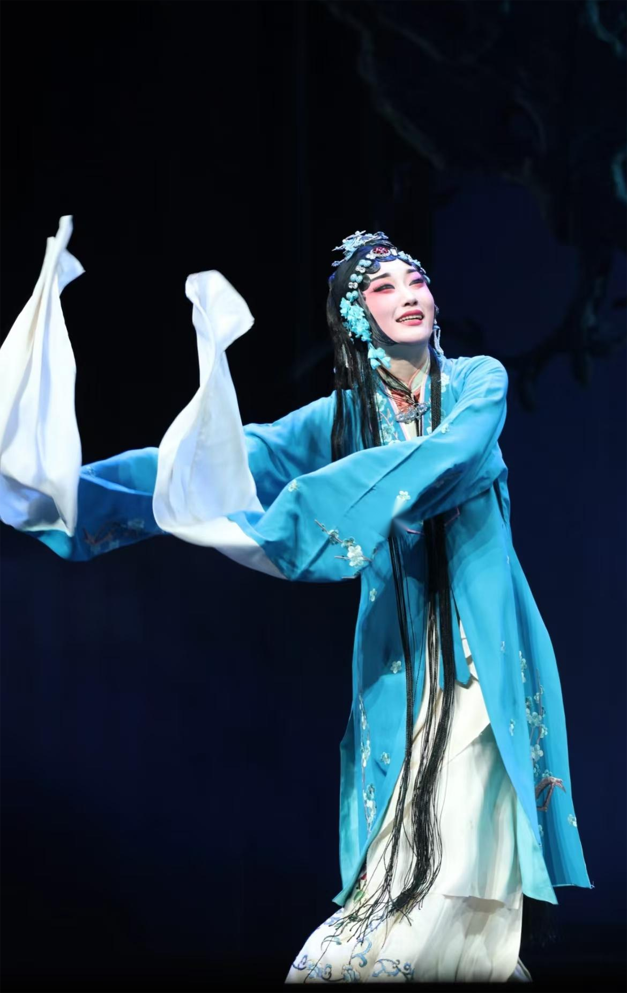
2
Artistic Characteristics——costume

Slide 5
2
Artistic Characteristics——costume
Costume Characteristics：
simple and natural，is close to the flavor of folk life.
traditional Han clothing style, mainly featuring the styles from the Tang, Song and Ming dynasties.

Slide 6
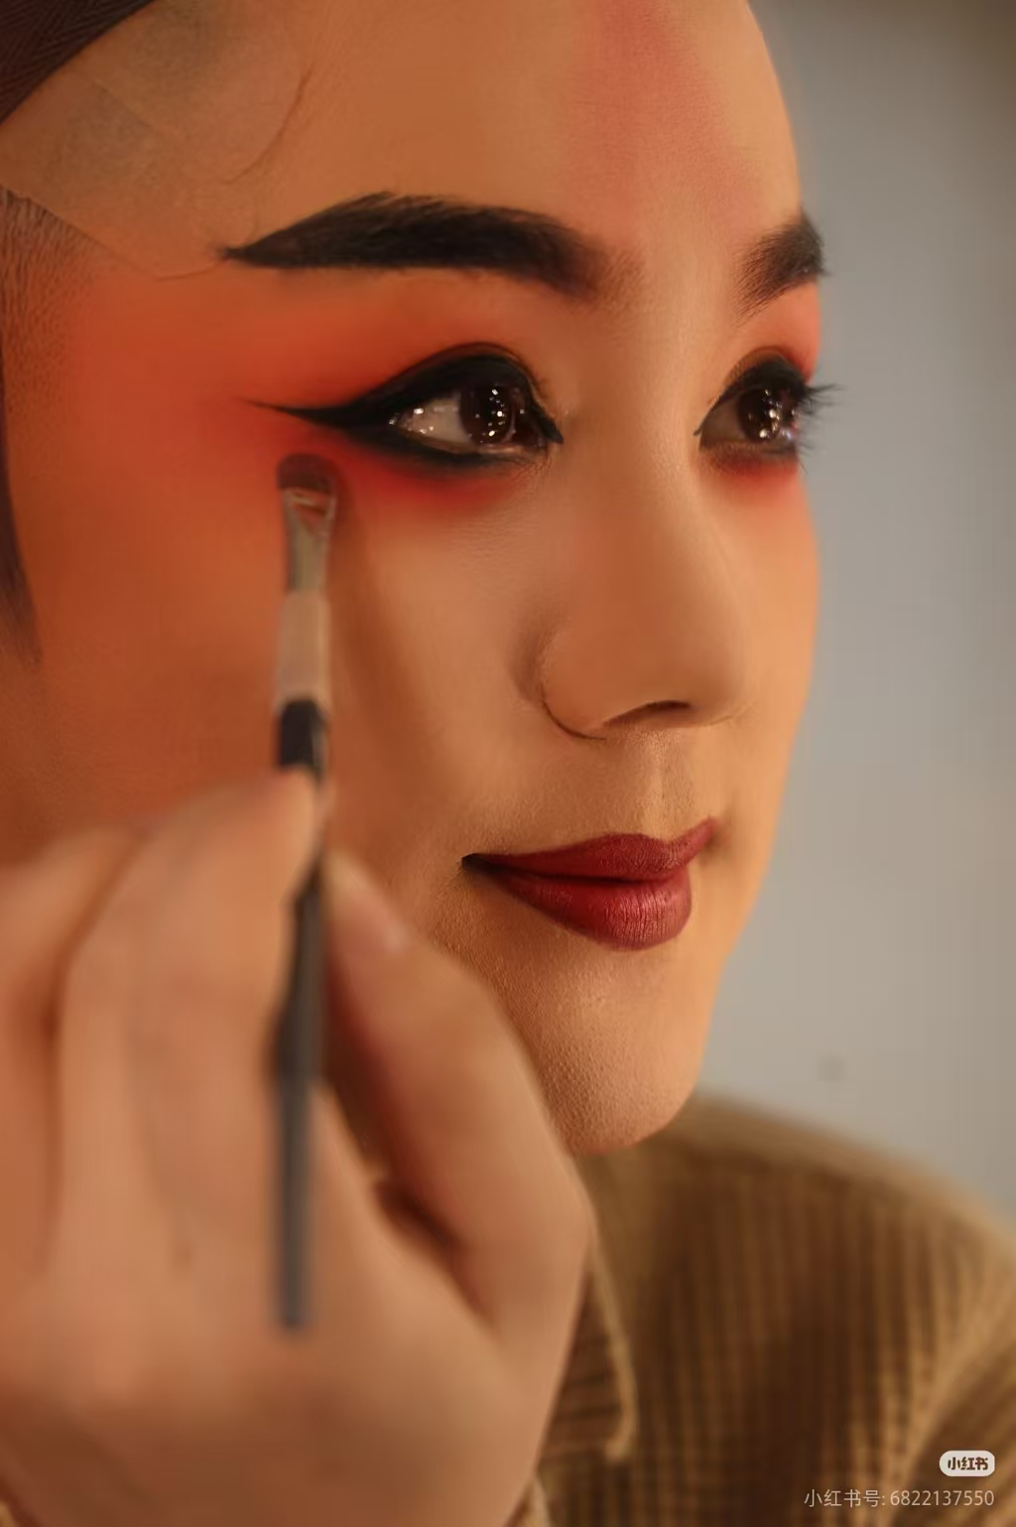
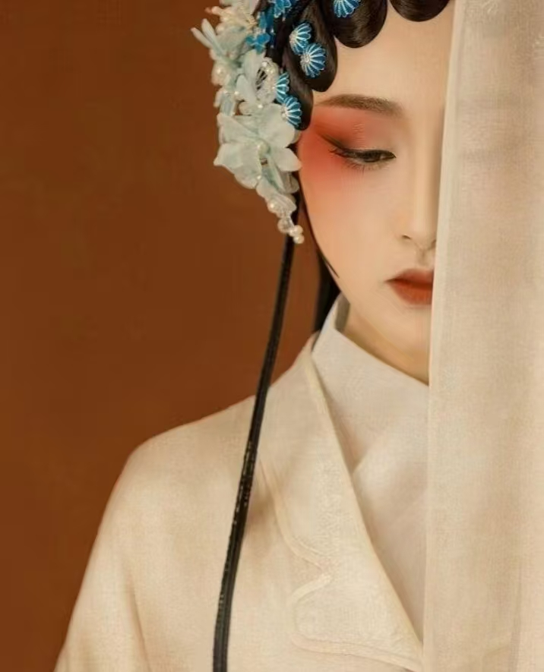
2
Artistic Characteristics——costume
Makeup Characteristics：
Highlight the areas of the eyes and eyebrows.

Slide 7
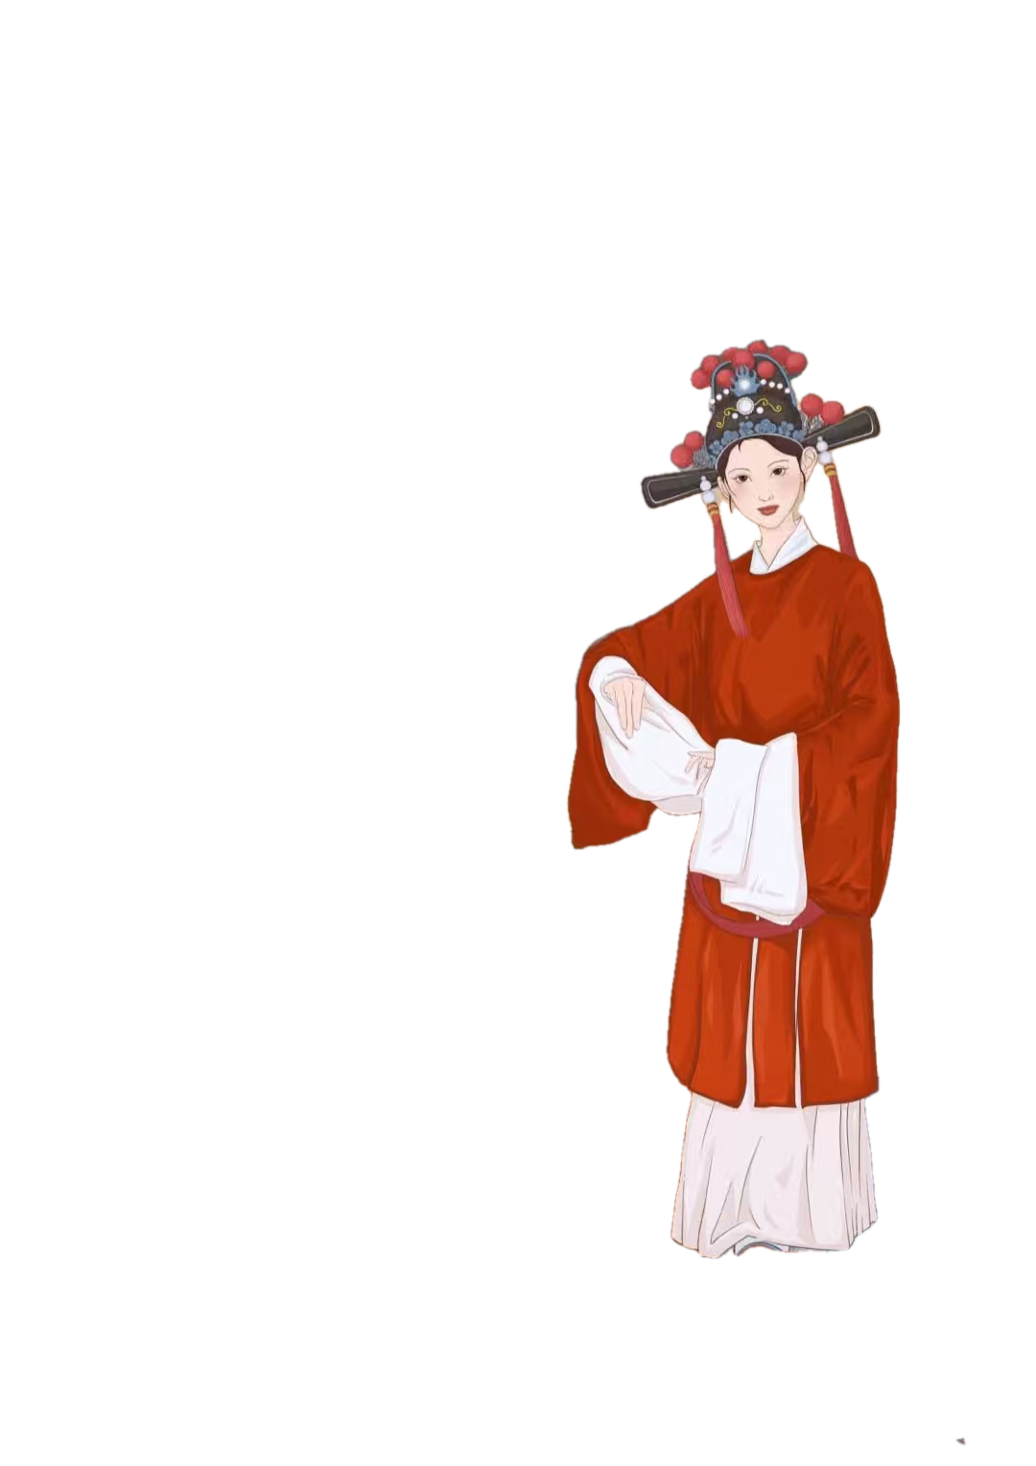

2
Artistic Characteristics——singing voice
Three forms: flower cavity, the main cavity,three cavities("colorful cavity", "fairy cavity", "Yin Si cavity" three cavities collectively).
黄梅戏

Slide 8
2
Artistic Characteristics——singing voice
the flower cavity
The flower cavity is mainly composed of small plays;the tone and plot are simple; the number of character is small , with a strong sense of life and the color of the folk songs.
Representative Opera: The Heavenly Match

Slide 9

2
Artistic Characteristics——singing voice
the main cavity and three cavities
The main cavity is the most dramatic expression of a cavity in the traditional singing cavity of Huangmei opera.
The three cavity is very popular, and it has been widely used in the small dramas.

Slide 10
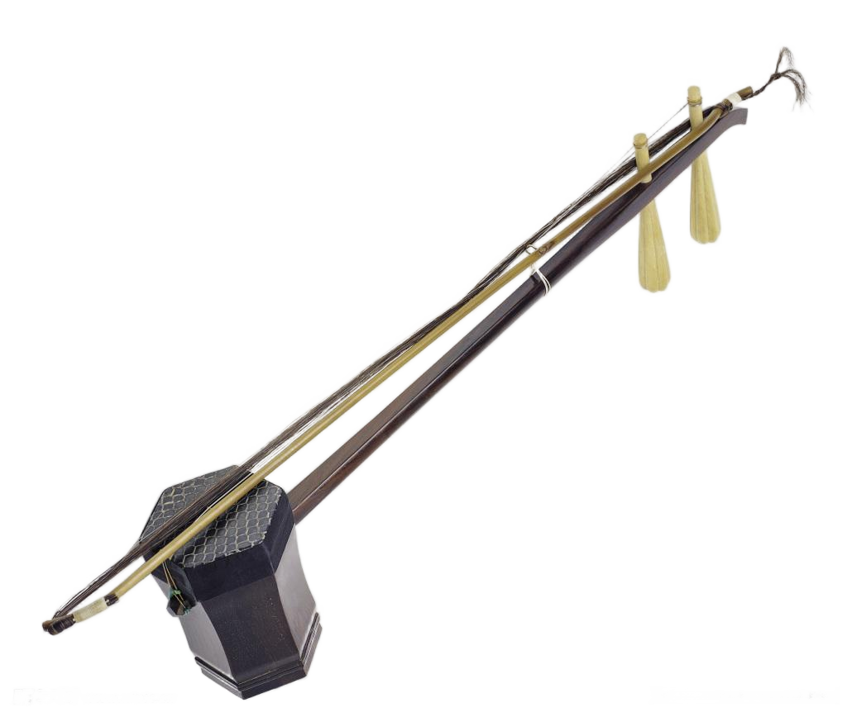
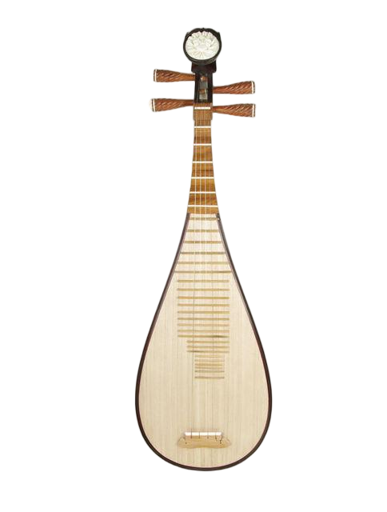
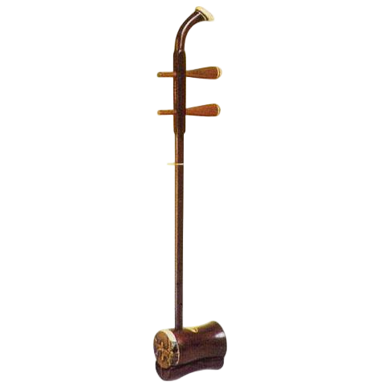
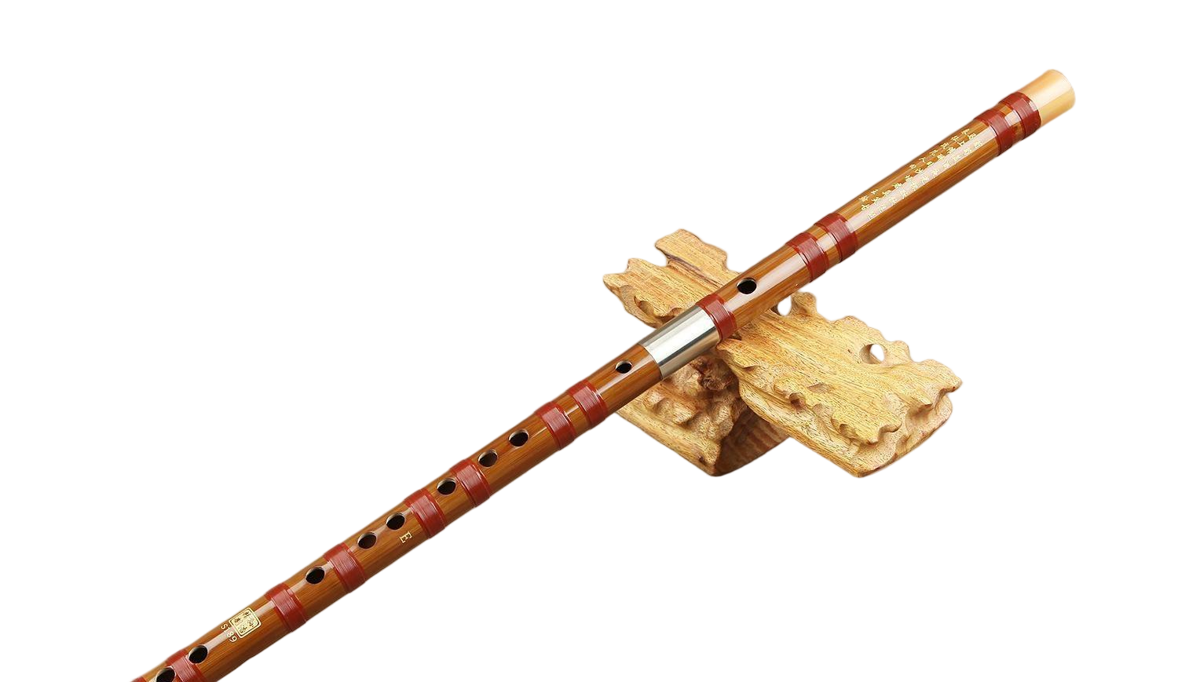
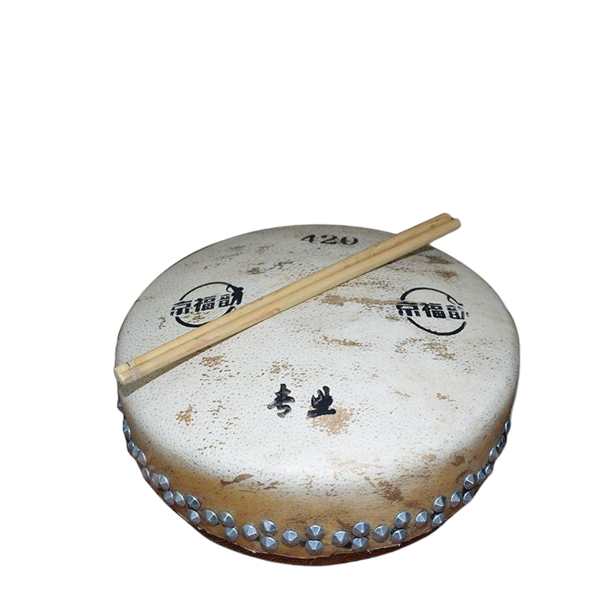
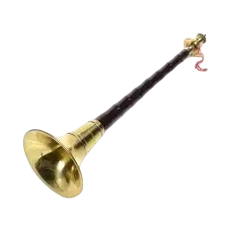
Artistic Characteristics——Musical Instruments
3
Chinese Musical Instruments
gaohu‌
pipa
erhu
wooden flute
suona horn
drum

Slide 11
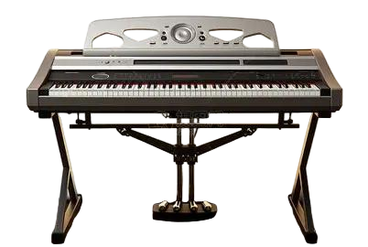
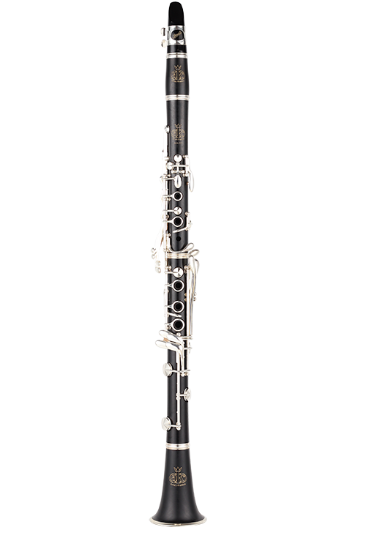

Artistic Characteristics——Musical Instruments
2
western musical instrument
electronic organ
clarionet
harmonica

Slide 12
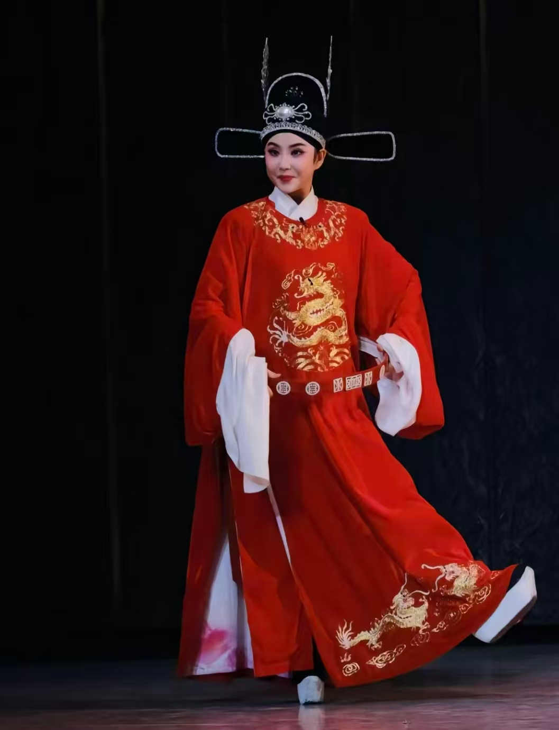
3
The Female Son-in-Law‌
The story of "The Female Son-in-Law‌" is about Feng Suzhen, the daughter of a provincial magistrate, who disguised herself as a man to rescue her fiancé. By chance, she saw the imperial examination announcement and used her fiancé Li Zhaoting's name to take the exam. Unexpectedly, she passed and became the top scorer. Out of his love for talent, the emperor wanted him (Feng Suzhen)to marry the princess. This led to a series of farces, but in the end, the lovers were finally able to be together.
评剧

Slide 13
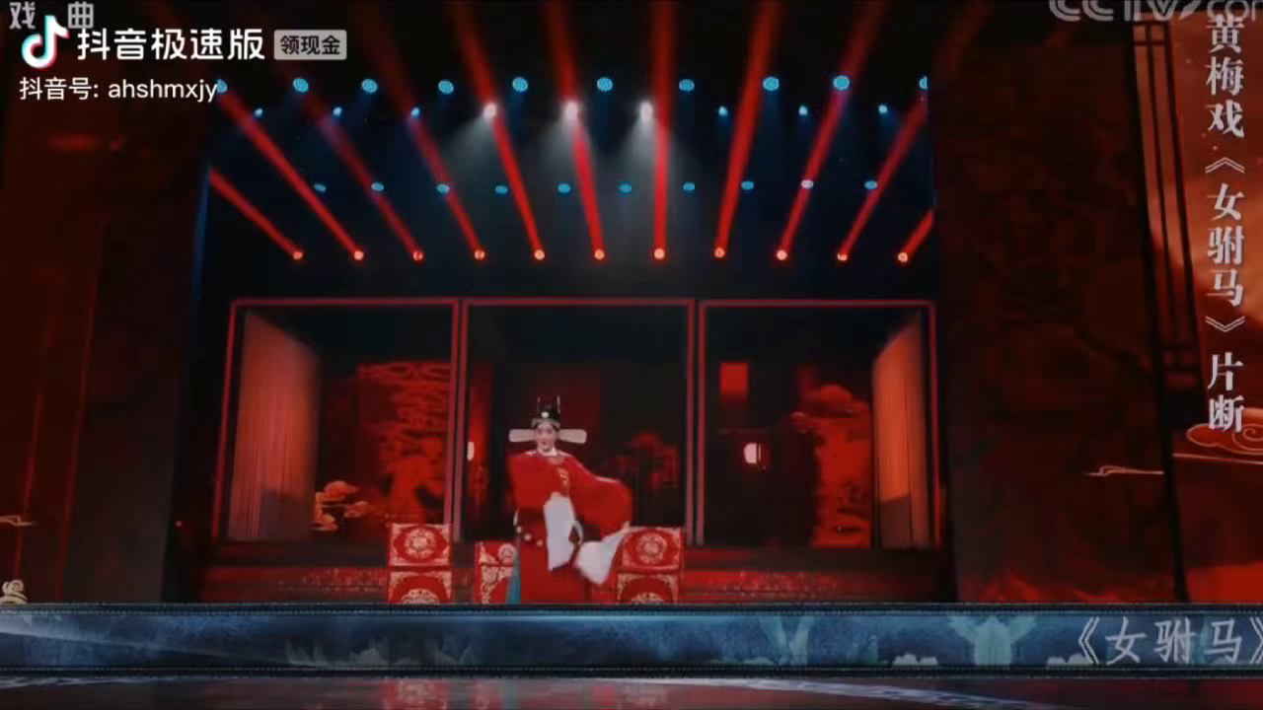

Slide 14
take up your time
Thanks!

