Slide 1

Chinese cuisine
Tofu meatball with pig blood in Shaoyang
邵阳特色美食——猪血圆子
中国的饮食文化渊源流长，一个菜系的形成和它的悠久历史与独到的烹饪特色分不开的。同时也受到这个地区的自然地理、气候条件、资源特产、饮食习惯等影响。
Reporter:Yang Haodan

Slide 2
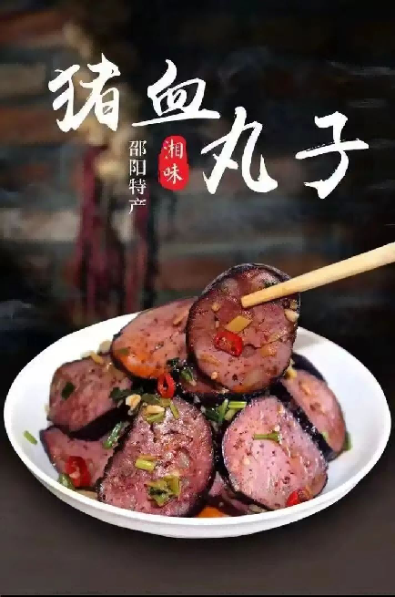
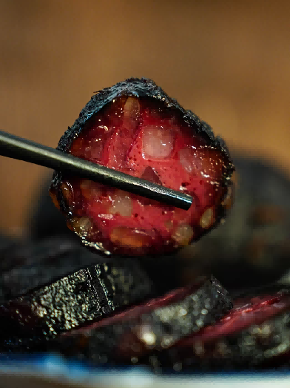
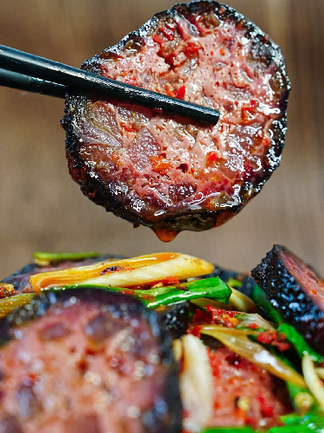
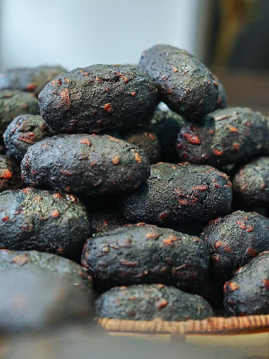
A Brief Introduction
Tofu meatball with pig blood, also known as “Xueba Tofu” or “Pig Xueba”, is an authentic traditional delicacy from Shaoyang. Due to their bun-like shape and dark, glossy appearance, locals refer to them as "Black Pearls". And it is a local custom to prepare this tofu meatball with pig blood every December of the lunar calendar.
In 2010, the making technique of tofu maetball with pig blood was included in the list of municipal intangible cultural heritage projects.

Slide 3
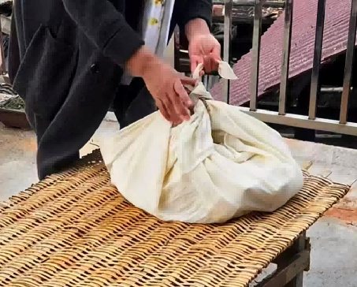
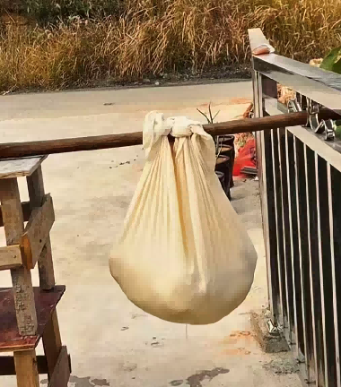
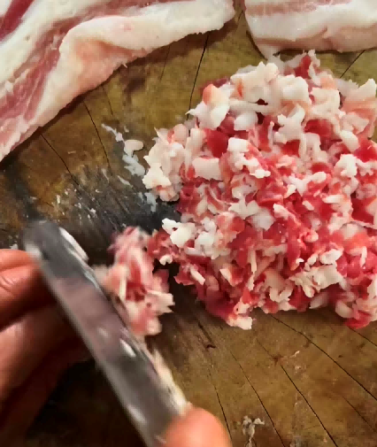
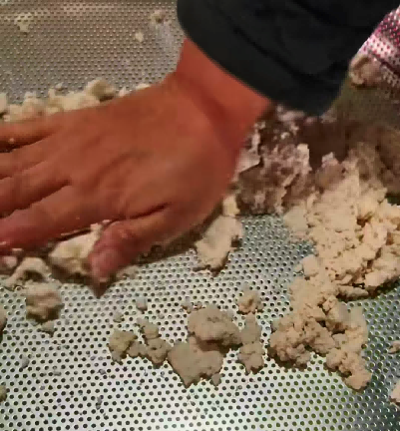
Making Steps
Step 1
Wrap the tofu in clean gauze and then hang it up to drain the water inside.
Step 2
Cut the meat into long strips and crumble the dried tofu. Marinate the meat and tofu with salt separately for three hours.

Slide 4
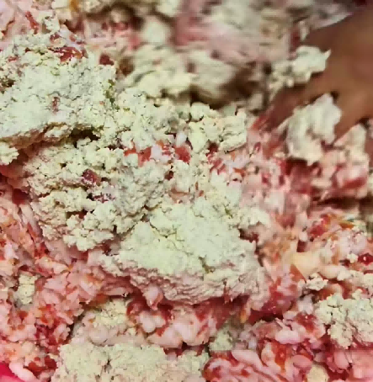
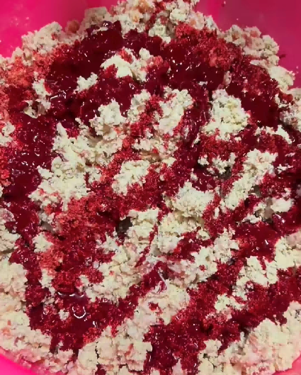
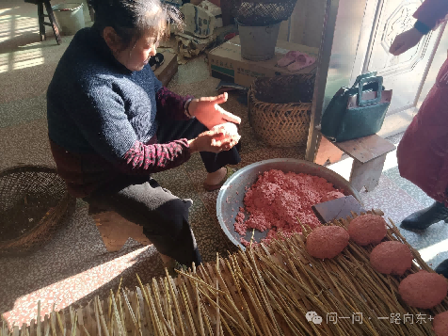
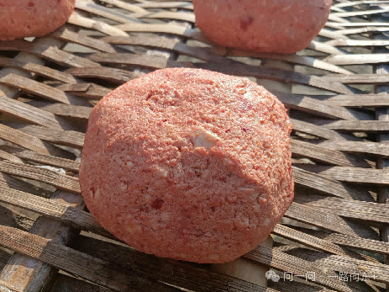
Making Steps
Step 3
Mix the tofu and meat together, and add the soulful pig blood.
Step 4
Constantly patting and squeezing it, expelling the air inside, and shaping the round shape of the ball.

Slide 5
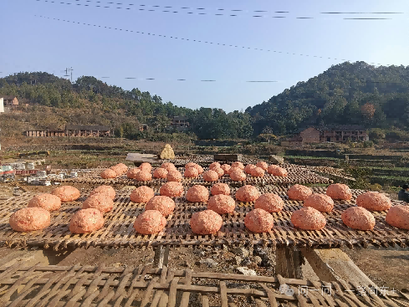
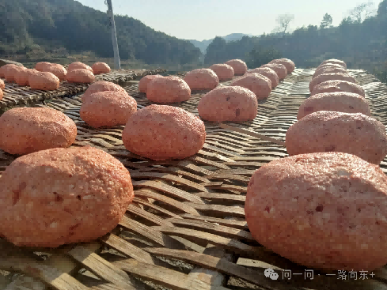
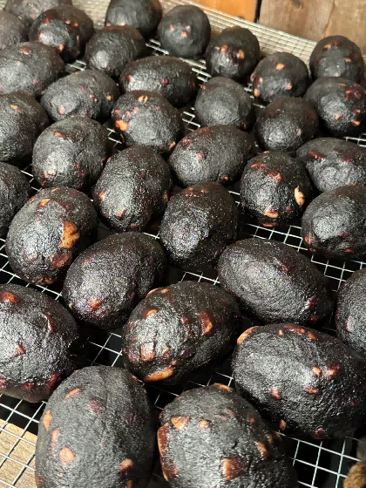
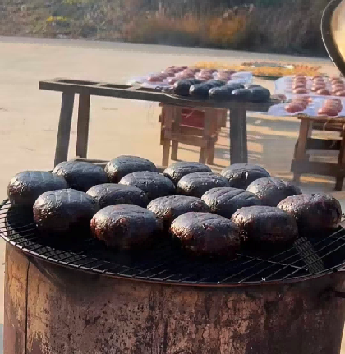
Making Steps
Step 5
Place the kneaded balls in the sun and let them dry for three days, thereby removing most of the moisture inside.
Step 6
After drying, these meatballs were hung up and placed over the wood-fired stove for 15 days of smoking.

Slide 6
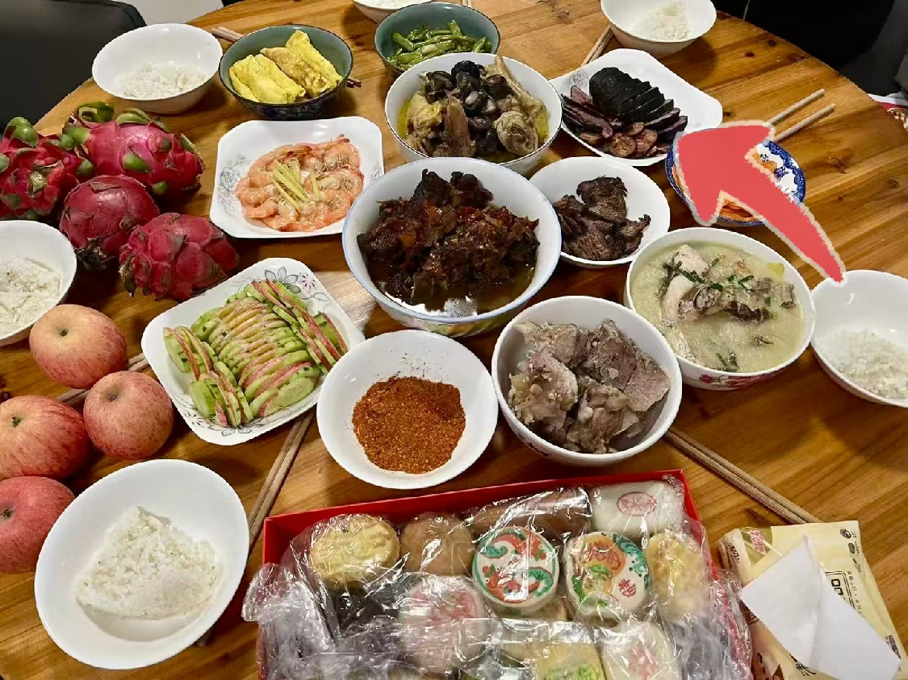



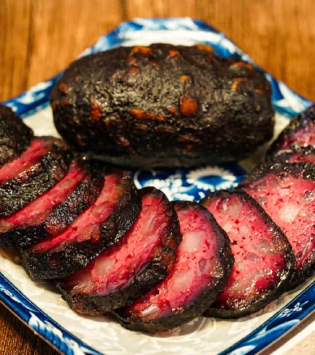
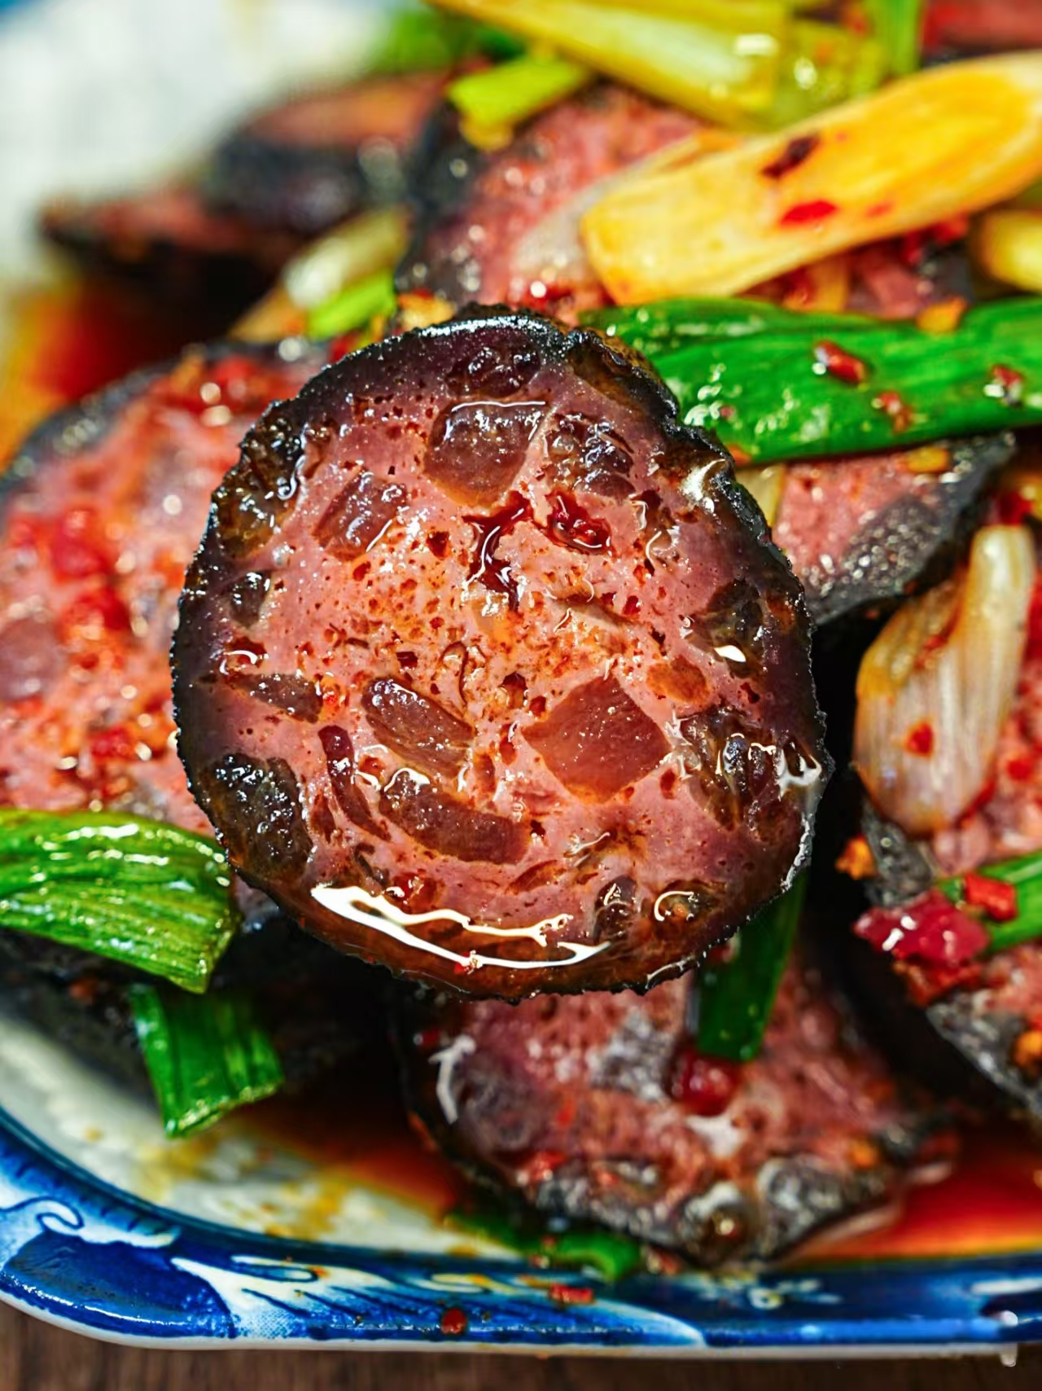
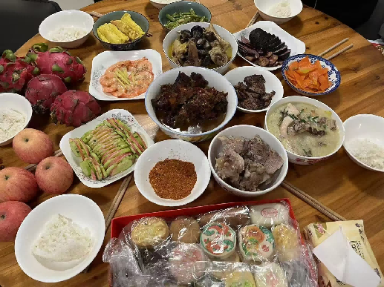
Cooking Methods
Steam
Stir-fry
Steam with other smoked meats
Sliced it and steam for 15 minutes, then we can enjoy it directly.
Stir-fry it with garlic paste, chili peppers and other seasonings.
Steam it with orther smoked meats. we usually enjoy this dish during Spring Festival.

Slide 7
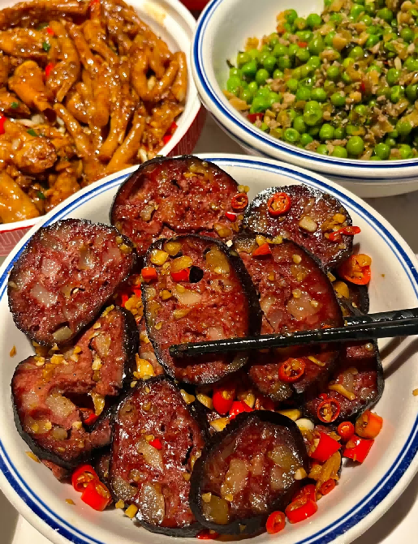

Cultural Meaning
In the rural areas of Shaoyang, the two words, “Wanzi” and “Yuanzi,” are pronounced the same way, representing reunion with family and friends. They also represent our wish for a better life and imply a warm New Year with the whole family.
Shaoyang people, who study or work outside their hometown, always leave home with packages filled with special local products prepared by the elders. Pig Blood Balls are one of the necessities among these products, and the balls also remind them of their warm family and make them miss their hometown.

Slide 8

Thank you!

Slide 9

资料来源:
中国语言与文化课本
小红书
微信公众号
辅助工具：有道词典

