Slide 1




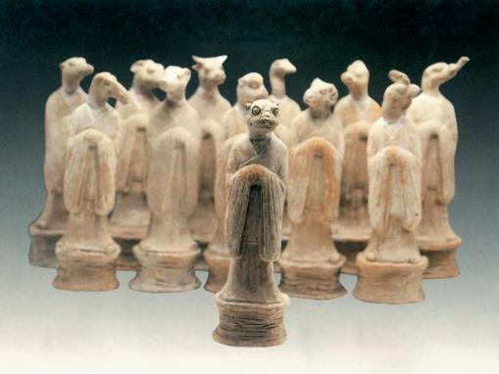
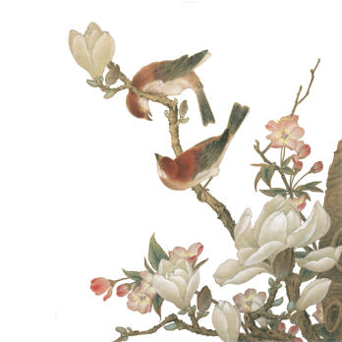

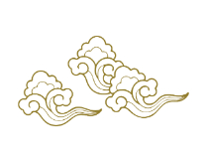

Twelve Animals of the Chinese Zodiac
The Chinese Zodiac: More Than Cute Animals
—A Cultural Code
Presenter：Qin Mingwen
淡雅
三只喵

Slide 2


Contents
part5
part3
part1
conclusion
The Deep Logic of Animal Selection
Exploring from the Perspective of “Others” to “Essence”
part4
part2
Interaction and speculation
Cosmology and the Yin Yang Five Elements System

Slide 3

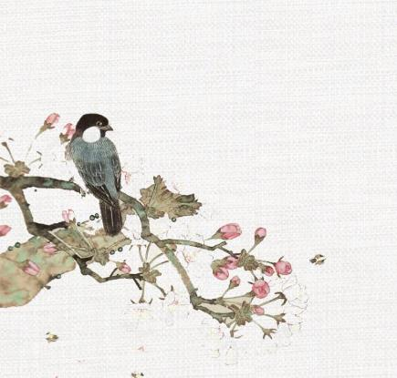
Exploring from the Perspective of “Others” to “Essence”
Chapter1

Slide 4


We often see the Zodiac as a quirky folklore. Today, let’s examine it as a complex cultural system that reflects Chinese cosmology, social psychology and temporal philosophy.
Why these 12 animals? What is the underlying logic beyond the folktale?

Slide 5
Cosmology and the Yin Yang Five Elements System
Chapter2

Slide 6
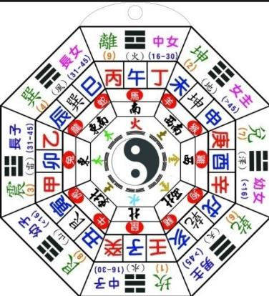
The folk tale is a popular veneer. The deeper structure is the integration with Yin-Yang and the Five Elements (Wu Xing).
Each animal has a Yin or Yang attribute (e.g., Dragon Yang, Rabbit Yin).
Paired with the Five Elements (Wood, Fire, Earth, Metal, Water), the 12-animal cycle becomes a 60-year cycle (Jiazi). This creates a complex matrix for interpreting destiny and personality.

Slide 7
The Deep Logic of Animal Selection
Chapter3

Slide 8
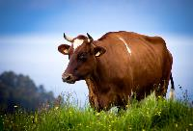
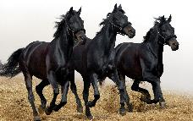
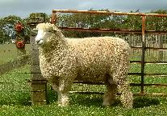
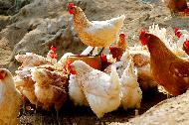
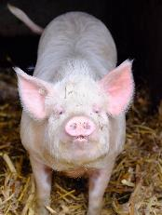
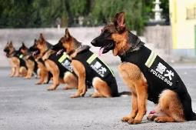
Social Ecology and Symbolism
The selection isn’t random. It reflects the “Six Domestic Animals” and “Six Wild Animals” theory in ancient Chinese social ecology.
Ox, Horse, Goat, Rooster, Dog, Pig -> “Six Domestic Animals” (Fundamentals of agricultural society).

Slide 9
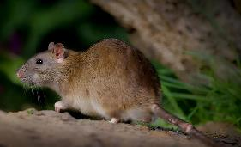
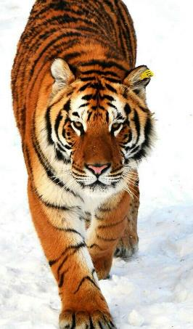
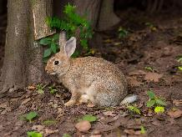

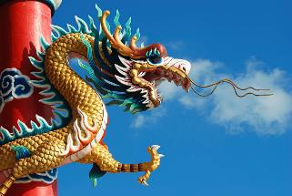
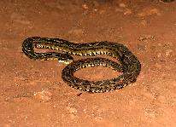
Social Ecology and Symbolism
Rat, Tiger, Rabbit, Dragon, Snake, Monkey -> “Six Wild Animals”
(Representing the unknown natural world and spiritual totems).

Slide 10
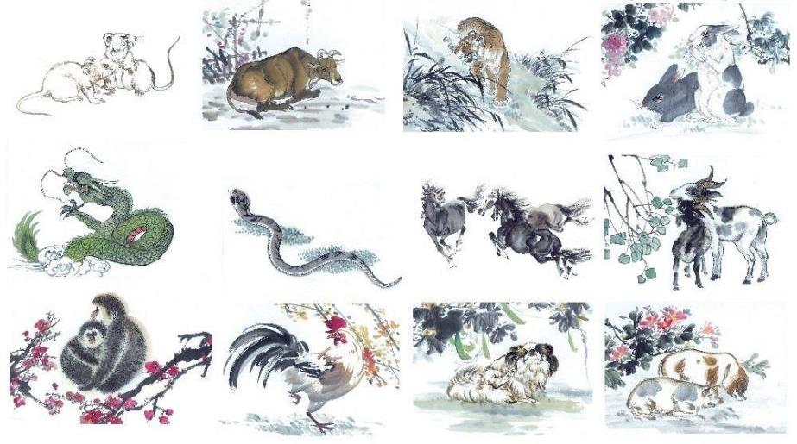
The Zodiac is a symbolic map of the ancient Chinese world order.

Slide 11
Interaction and speculation
chapter4

Slide 12
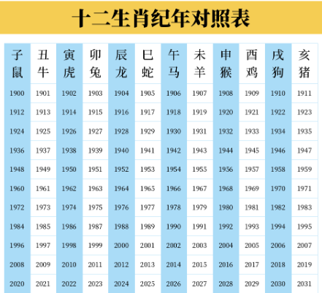
Comparison Table
The social and psychological functions of zodiac animals
“Now that you have your sign, let’s ponder: In a modern, individualistic society, what is the social function of such a collective identity label?”

Slide 13
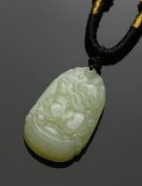
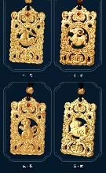
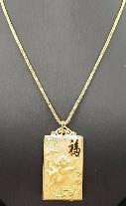
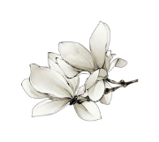
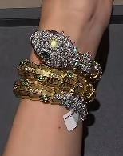
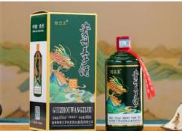
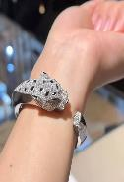
Icebreaker & Social Bonding: A low-stakes way to initiate conversation and find common ground.
The elements related to zodiac signs are widely used in industries such as luxury goods, jewelry and alcohol. Zodiac limited edition products are not only commodities, but also “symbolic consumption” objects endowed with cultural narrative and emotional value, effectively stimulating consumption behavior at specific time points.
As members of a certain zodiac sign, especially in the “zodiac year”, people tend to reinforce a sense of group identity and psychological resonance through common behaviors such as wearing red socks.

Slide 14
conclusion
chapter5

Slide 15
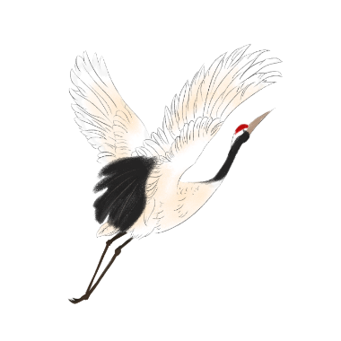
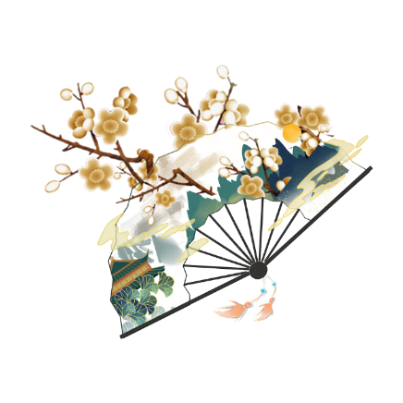
行业PPT模板http://www.1ppt.com/hangye/
The Chinese Zodiac is not superstition, but a “Living Fossil” of ancient Chinese thought.
It encodes a holistic worldview that connects Time (cyclical calendars), Nature (animals) and Human Destiny into one coherent system.
By understanding its layers, we gain a key to decoding the deep structure of Chinese culture.
Notes:
模板来自于： 第一PPT https://www.1ppt.com/

Slide 16
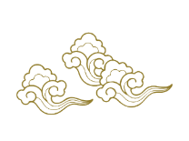

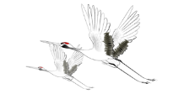
Thanks for your listening

