Slide 1


the celadon song
celadon
and
SiestaZzz

Slide 2





Contents
01
02
03
04
Introduction
History
Five famous kilns
Song

Slide 3








01
Introduction

Slide 4
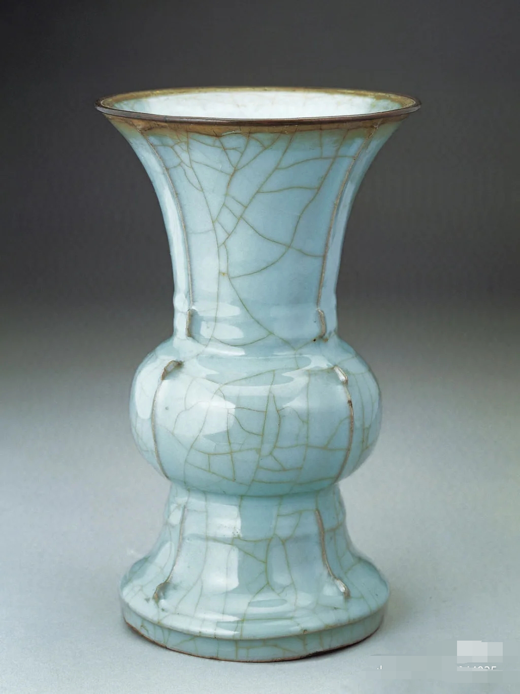
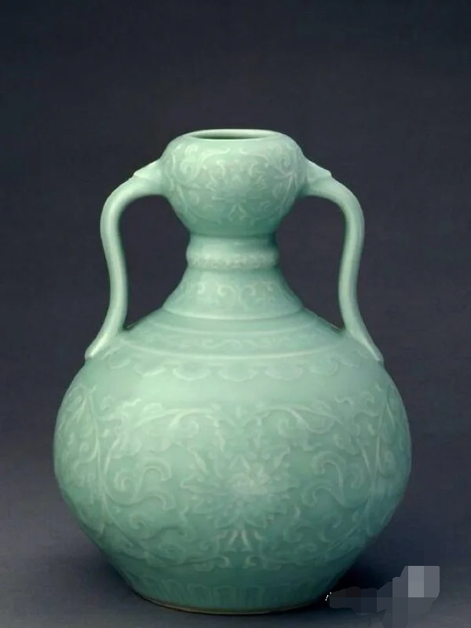
Introduction
Celadon is the most widespread type of ancient Chinese porcelain.
It is a mixture of iron oxide（铁氧化物） with a glaze that results during the firing process. The glaze is the characteristic green tone of the porcelain, which occurs due to the presence of iron in the clay

Slide 5

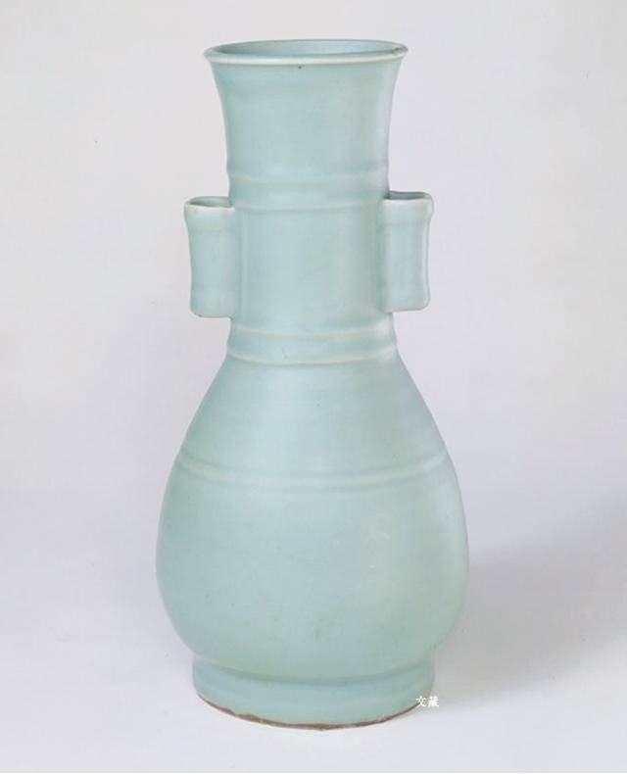
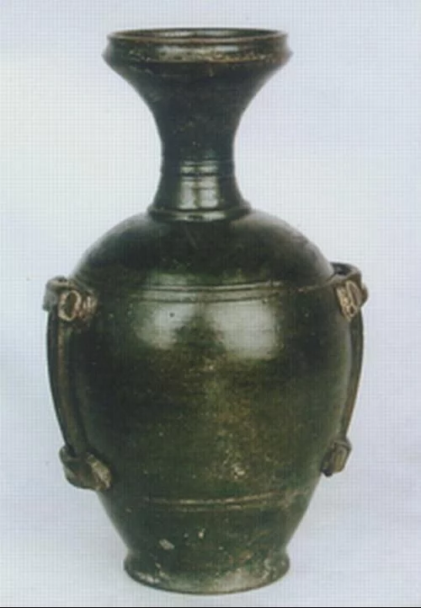
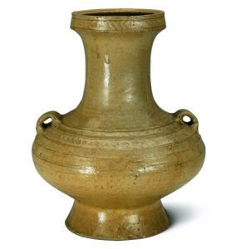

History
Celadon first appeared in East China known as green porcelain
Manufacturing of the green porcelain reached new heights.Five most famous kilns
Art of making celadon
matured
Han Dynasty
(206 BC-25 AD)
Tang Dynasty (619-960)
e Song Dynasty (960-1279)

Slide 6
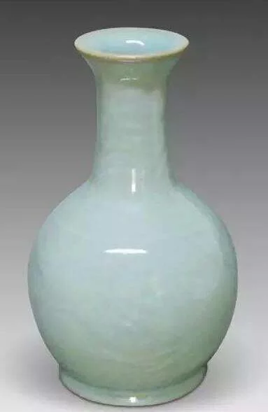
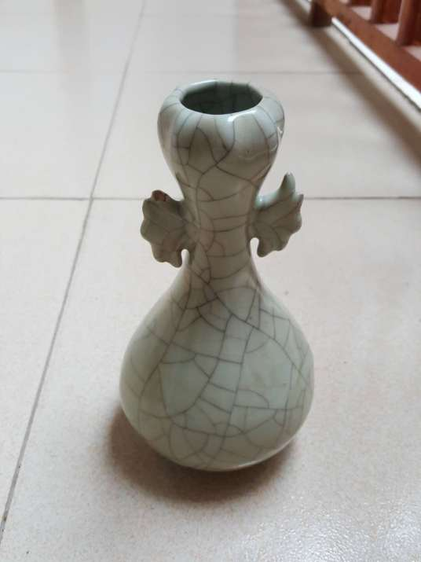
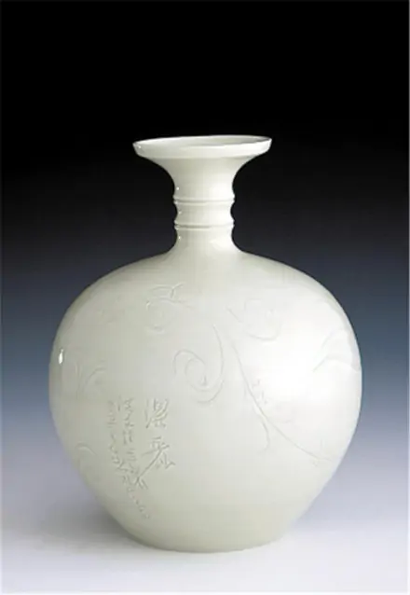
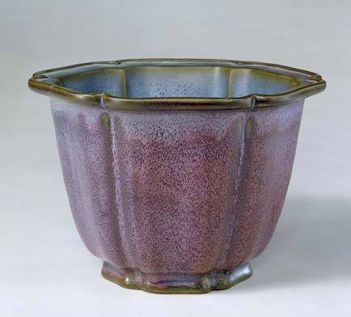
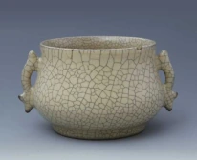
Ru Ware | Jun Ware | Guan Ware | Ding Ware | Ge Ware
Ru City, HeNan Province | Jun City, HeNan Province | HanZhou City KaiFeng City | DingZhou City HeBei Province | LongQuan City ZheJiang Province

Slide 7
The Celadon Song《青花瓷》
素胚勾勒出青花, 笔锋浓转淡
瓶身描绘的牡丹一如你初妆
冉冉檀香透过窗, 心事我了然
宣纸上走笔, 至此搁一半
釉色渲染仕女图, 韵味被私藏
而你嫣然的一笑如含苞待放
你的美一缕飘散, 去到我去不了的地方
天青色等烟雨, 而我在等你
炊烟袅袅升起, 隔江千万里
在瓶底书汉隶, 仿前朝的飘逸
就当我为遇见你伏笔
天青色等烟雨, 而我在等你
月色被打捞起, 晕开了结局
如传世的青花瓷自顾自美丽, 你眼带笑意
色白花青的锦鲤跃然于碗底
临摹宋体落款时却惦记著你
你隐藏在窑烧里千年的秘密
极细腻, 犹如绣花针落地
帘外芭蕉惹骤雨, 门环惹铜绿
而我路过那江南小镇惹了你
在泼墨山水画里, 你从墨色深处被隐去
天青色等烟雨, 而我在等你
炊烟袅袅升起, 隔江千万里
在瓶底书汉隶, 仿前朝的飘逸
就当我为遇见你伏笔
天青色等烟雨, 而我在等你
月色被打捞起, 晕开了结局
如传世的青花瓷自顾自美丽, 你眼带笑意
https://www.bilibili.com/video/BV1Lf4y1n7eh/?spm_id_from=333.788.recommend_more_video.1

Slide 8
What on earth is it about, a love story or
the making of blue-and-white porcelain?
天青色等烟雨，而我在等你，月色被打捞起，晕开了结局

Slide 9


In ancient times, craftsmen could wait endlessly for a misty rain that did not know when to burn out the most beautiful sky blue. Today, we might as well be more patient and persistent, wait for a gust of wind, wait for one thing, wait for a person

Slide 10
感谢您的聆听

