Slide 1
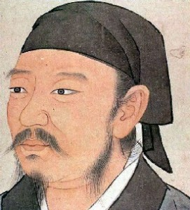
XUNZI
Confucianism

Slide 2
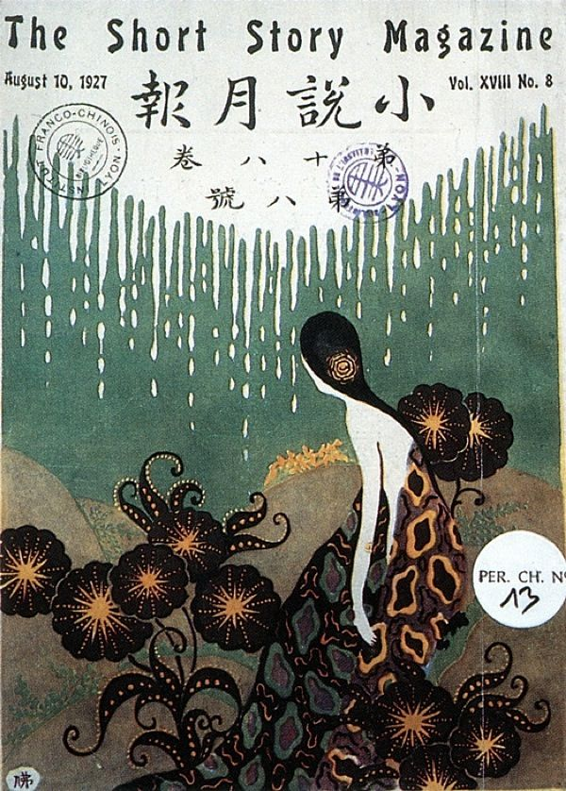
Biography
I lived toward the end of the Warring States period born in Zhou and studied in Qi (453-221 BCE).
My last post ended when my patron was assassinated in 238 BCE, ending my chances to put his theories of government into practice.
My students Han Feizi and Li Si counseled my nation’s rivals and contributed to my philosophical magrinalization.

Slide 3

On Ritual
ritual is crucial for reforming humanity’s original nature. Human nature lacks an innate moral compass, and left to itself falls into contention and disorder.
If you do not take ritual as your way, it will be like trying to measure the depth of a river with your finger, you simply will not succeed at it.

Slide 4

Government
In lives without ritual people cannot survive; In affairs without ritual success does not thrive; To states without ritual peace does not arrive.
The true ruler is one who is good at forming a community.
And so, the enlightened ruler hastens to obtain the right person.

Slide 5
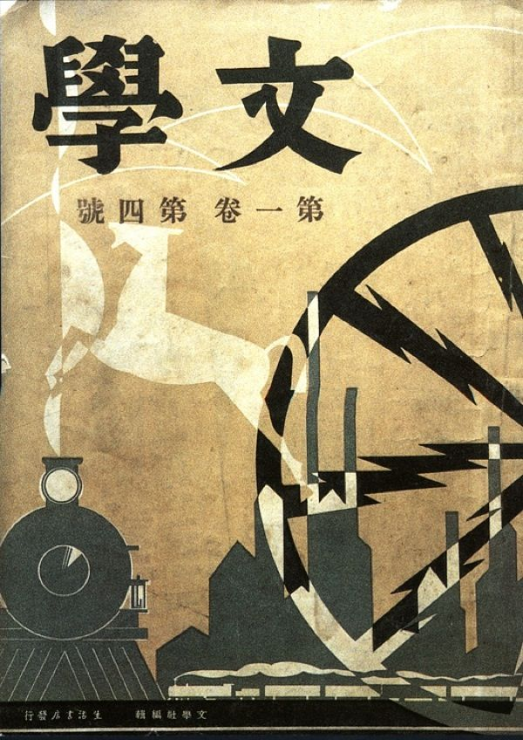
On Learning
I once spent the whole day pondering, but it wasn’t as good as a moment’s worth of learning.
The learning of the gentleman enters through his ears, fastens to his heart, spreads through his four limbs, and manifests itself in his actions.

Slide 6

On Mentoring
Of the paths to learning, none is quicker than to like the right person, and exalting ritual comes second.
The scholar has the gentleman and the gentleman the sage, and the sage has heaven.
If you imitate the right person in his practice of the precepts of the gentleman, then you will come to honor the rituals for their comprehensiveness, and see them as encompassing the whole world.

Slide 7
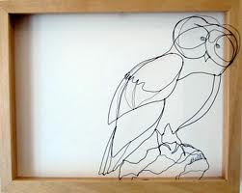
Self Cultivation
When you observe goodness in others, then inspect yourself, desirous of studying it. When you observe badness in others, then examine yourself, fearful of discovering it.
If an action tires your body but puts your heart at ease, do it.
Ritual is that by which to correct your Person.

Slide 8
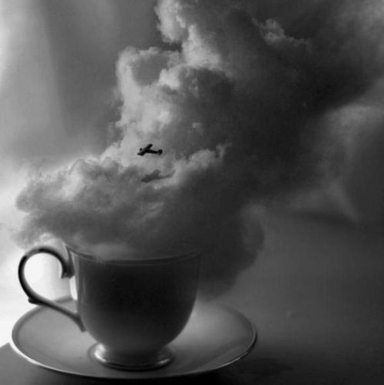
On Mozi
If your bearing is arrogant and obtuse and your heart is stubborn and deceitful, if your method is to follow Mozi, then your truest essence is polluted and corrupt.
Mozi distanced himself from ritual, and without ritual, Mozi himself was corrupt.
Mozi despises music, but you see, it was created by the sage kings for order, and expression.’

Slide 9

My Philosophy
Man is born with desires, and the sage kings created rituals and the standards of righteousness to satisfy their heart from chaos.
Nothing is more direct than following ritual, nothing is more important than having a good teacher, and nothing works with greater spiritlike efficacy than to like it with single-minded devotion.

