Slide 1

中国文化基础
Foundation of Chinese Cultures for Bachelor Students of Translation Studies
湖南师范大学 2022年2月21日-2021年6月6日
中国文化基础 周一第七和第八节课14:30-16:10，
上课地点：外国语学院大楼605机房
第二周2022年2月28日。助教：Deng Lulu 邓鲁露
吴漠汀特聘教授 Distinguished Professor Dr. Martin Woesler
湖南师范大学外国学院 Foreign Studies College, Hunan Normal University

Slide 2
Session 3 第三周
Preparation for this session[edit]
Do the translation homework. Here is the link: Please create link here. Here is the link to the Joint Translation Terms.
Do the correction of the translation of your fellow student. Here is the link: Please create link here.
Read textbook text Fengshui in Chinese Architecture
Take the quiz on Fengshui in Chinese Architecture: https://www.wjx.cn/vj/rCGKxuU.aspx
Read textbook text Architecture: The Forbidden City
Take the quiz on Architecture: The Forbidden City: Please create quiz and link it here.
Architecture: Fengshui in Chinese Architecture[edit]
student presentation This is the ppt by Chen Cheng 陈诚 on Architecture: Fengshui in Chinese Architecture .
Architecture: The Forbidden City[edit]
student presentation This is the ppt by Yu Ziqi 禹紫琪 on Architecture: The Forbidden City. Here is the link to the quiz on this topic:quiz
Homework of Session 3 for Session 4[edit]
Please list the homework here.

Slide 3
Schedule 学期题目
1 2.21 Organizational things, intro to intercultural communication
2 2.28
3 3.7
4 3.14
5 3.21
6 3.28
7 4.4
8 4.11
9 4.18
10 4.25
11 5.2
12 5.9
13 5.16
14 5.23
15 5.30
16 6.6
2 1 Aesthetic ideals and social customs: The Four Most Handsome Men in Ancient China 78%陈锟
2 8 Education: Historical Figures, The Four Talented Women of Ancient China 64%
3 10 Architecture: Fengshui in Chinese Architecture 61%陈诚
3 19 Architecture: The Forbidden City 55%禹紫琪
4 27 Mythology: Gods and Immortals 51%袁灵
4 30 Literature: Ancient literature: Chinese Mythology 50%李婉莹
5 2 Silk and porcelain: Celadon and Celadon Song 《青花瓷》歌词 72%喻锦博
5 11 Science and Technology: Douyin (Tik Tok) 61%欧欣榆
6 23 Beverages: Tea 53% 李思文
6 12 Beverages: Milk Tea 60%由馨凝
7 6 Traditional Cuisine: Hotpot 66%陈心怡
7 24 Traditional Cuisine: Breakfast Culture of Wuhan 53%魏静婷
8 4 Literature: Ancient literature: Chinese Classical Fairy Tales 68% 邓鲁露
8 20 Chinese Movies 55% 马菲菲
8 21 Stage entertainment: Crosstalk 相声 54% 周思睿
9 7 Clothing: Chinese Clothing 64% 刘倩仪
9 14 Facial Make-up 58% 邹享睿
10 9 Games: Mahjong: An Ancient Chinese card play 62% 李琳玉
10 29 Games: Kite Flying 51% 韩静茹
11 28 Social: Round Table Culture 51% 陈天钰
11 5 Beverages: The Liquor Culture of Ancient China 66% 燕妮
12 22 National Symbols: National Flag 54% 邓蕊欣
12 25 Chinese cultural influence on other cultures / Culture Export / Softpower 53%徐致远
13 16 Aesthetic ideals and social customs: Chinese Marriage Customs 57% 刘可仪
13 18 Money culture: The tradition of Red Envelope and Lucky Money 56%杨磊
14 3 Animals: Panda 70% 刘亦欣
14 17 Astrology: Twelve Animals of the Chinese Zodiac 56% 汪柔
14 26 Astrology: Calendar, The 24 Solar Terms 52%何明慧
15 13 Fine Arts: Painting 60%郭子瑞
15 15 Gender: Wu Zetian: The Only Female Emperor of Imperial China 58%雷珩

Slide 4
Architecture and Gardens

Slide 5
Questions Concerning Section A
Architecture
1. How long is the history of wooden structures in China?
2. What are the 3 categories of traditional Chinese wood buildings?
3. Which category is the most popular? How is it formed?
4. What is dou-gong? What’s its function?
5. What is the most widespread residential structure in North China? How is it related to Confucianism?
6. What is the general layout of Chinese architectural complex like?

Slide 6
7. Is the palace complex in Beijing the only one remaining in the whole country?
8. Is the construction of Buddhist temples important in Chinese architecture? What is the general layout of a Buddhist temple like?
9. What are Buddhist pavilion and pagodas? Could you name some important Buddhist pagodas in China?
10. What styles do traditional Chinese buildings' roofs have?
11. How are traditional Chinese buildings decorated?
12. How are colors used in the decoration of old buildings?
13. Have you ever been amazed at an old Chinese buildings?

Slide 7
14. Why are traditional Chinese roof tips pointing upwards?
15. Whom belonged yellow roof tiles to?

Slide 8
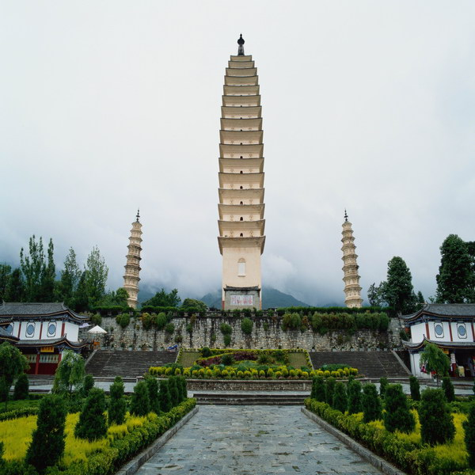
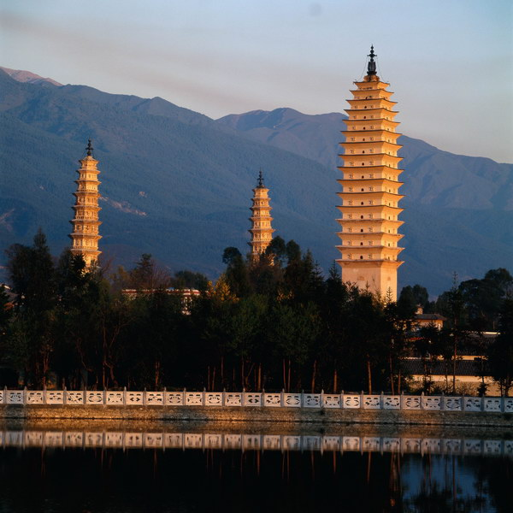
Buddhist towers

Slide 9
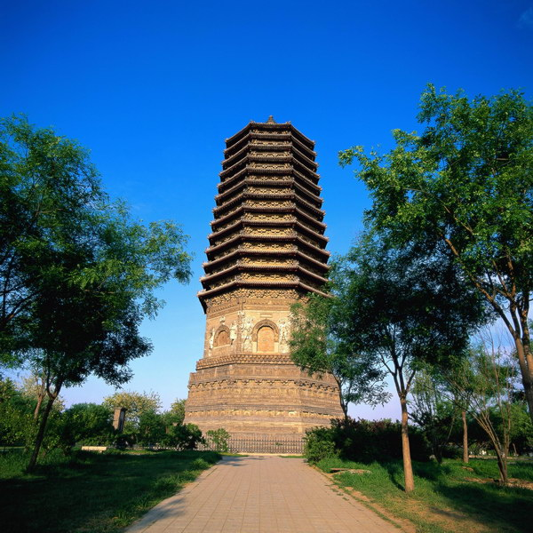
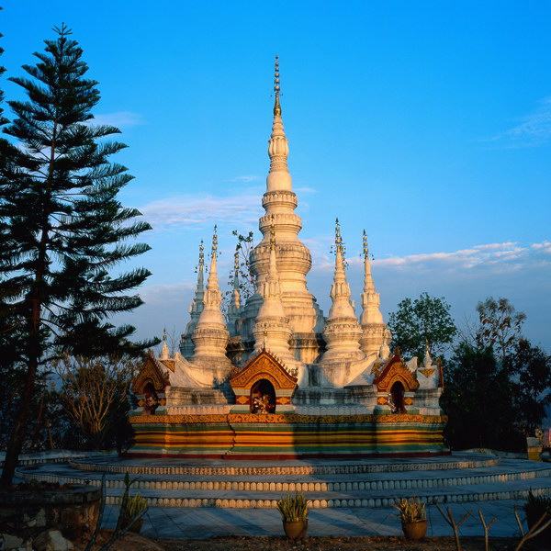
Buddhist tower & pagoda

Slide 10
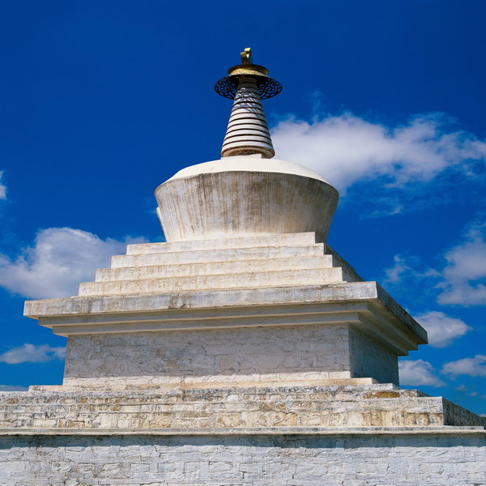
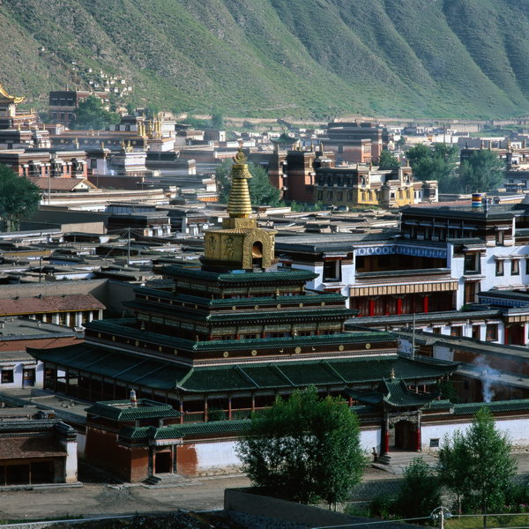
Buddhist pagodas

Slide 11
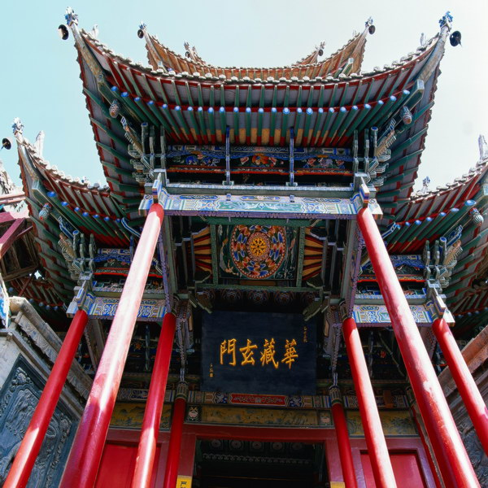
Decorations of Chinese pavilions

Slide 12
Questions Concerning Section B
Gardens
1. How did the Chinese garden grow into its present form?
2. What’s the greatest difference between European gardens and Chinese ones?
3. What are the major categories of Chinese gardens?
4. What do you know about China’s imperial gardens? In which part of China are they located? How many of them can you name?
5. What functions do they have?
6. How are China’s imperial gardens laid out? How are they decorated?

Slide 13
More Questions Concerning B
Gardens
1. In which part of China are most private gardens located? How are they laid out?
2. How are the scenes connected?
3. What do you know about the private gardens of Suzhou? What gardens there demonstrate the styles of Song, Yuan, Ming and Qing dynasties?
4. What styles do gardens in Yangzhou and Guangdong demonstrate?
5. What landscape gardens do you know? How are poets and painters related to landscape gardens?

Slide 14
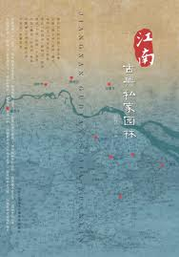
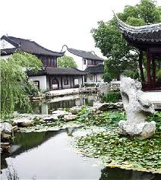
Private gardens south of the Yangtze River

Slide 15
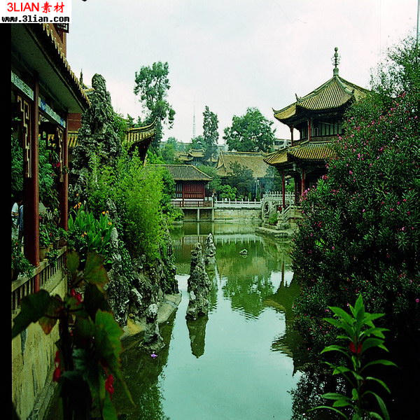
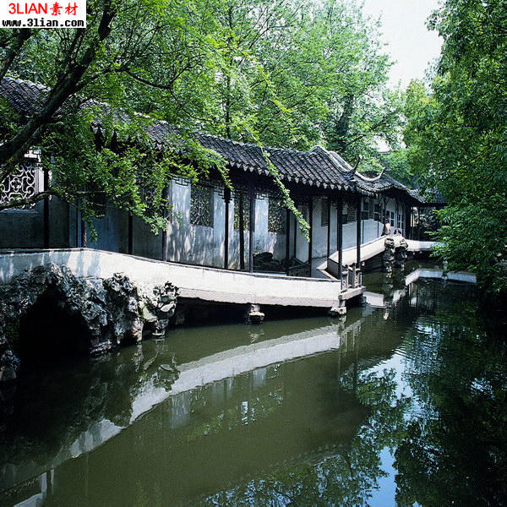
Riverside pavilions and a sightseeing veranda

Slide 16
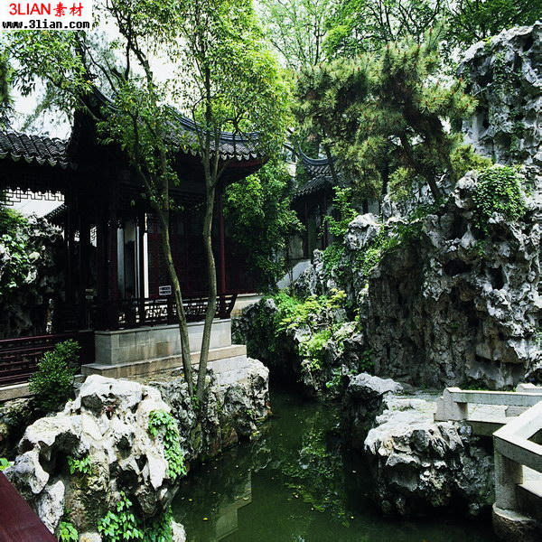
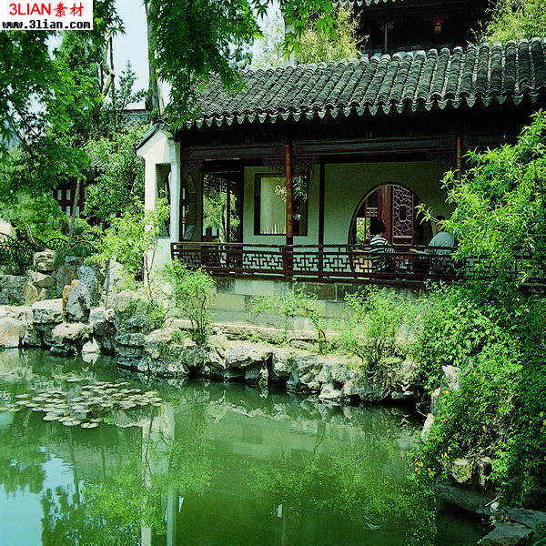
Rockery in a Chinese garden

Slide 17
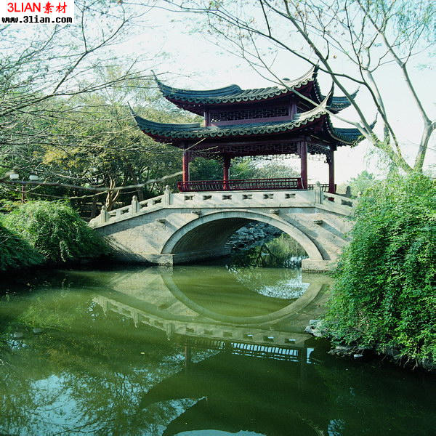
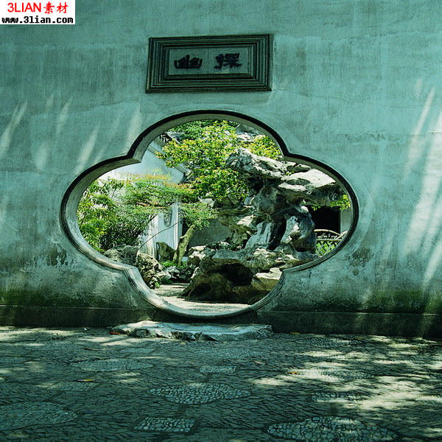
A flower-patterned door & a one-arch roofed bridge

Slide 18
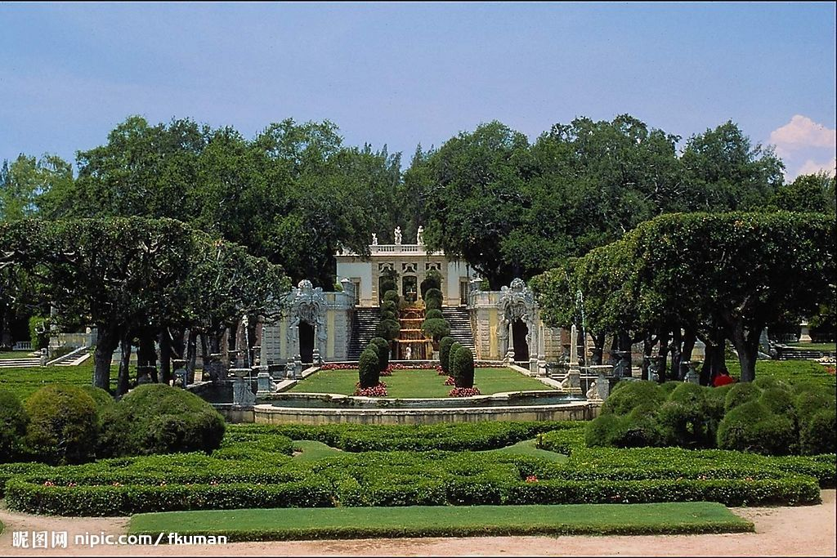
A western garden with geometrical patterns

Slide 19
Yuanmingyuan
Showcase for Western architecture and illusions
Combination of Chinese and Western arts
How do you feel about the destruction?
Should it be rebuilt?

Slide 20
Questions Concerning Section C
Summer Palace
1. What else was the Summer Palace called?
2. What did the Anglo-French invading troops do to it in 1860?
3. How did Empress Cixi have it rebuilt?
4. How important is the park in traditional Chinese gardening?
5. What’s the general layout like?

Slide 21
6. What do know about the halls in the park?
7. What is the park dominated by?
8. What do you know about the Cloud-Dispelling Hall?
9. What do you know about Cixi’s 70th birthday portrait?
10. What do you know about the Long Corridor?
11. What do you know about the Garden of Harmonious Delight?
12. What do you know about the Suzhou Street?

Slide 22
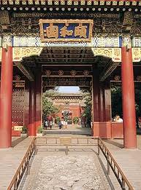
The Summer Palace

Slide 23
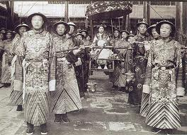
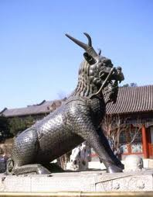
Empress Cixi & her eunuchs in the Summer Palace

Slide 24
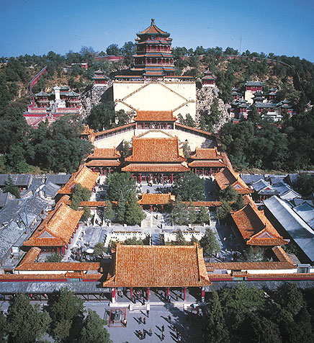
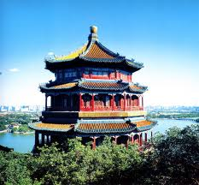
The palace on the Longevity Hill

Slide 25
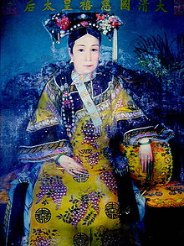
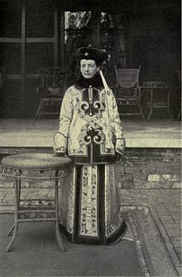
Empress Cixi and Katherine Carl in 1903

Slide 26
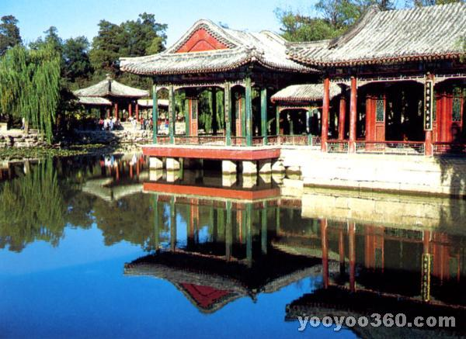
The Garden of Harmonious Delight

Slide 27
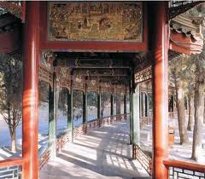
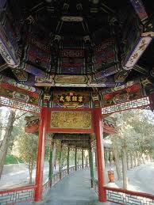
The Long Corridor, 728 m. in length, is the longest sightseeing corridor in the world.

Slide 28
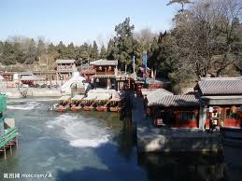
The Suzhou River in winter

Slide 29
Translation exercises
中国是世界四大文明古国之一，有着悠久的历史，劳动人民用自己的血汗和智慧创造了辉煌的中国建筑文明。中国的古建筑是世界上历史最悠久、体系最完整的建筑体系，从单体建筑到院落组合、城市规划、园林布置等在世界建筑史中都处于领先地位，中国建筑独一无二地体现了的“天人合一”的建筑思想。
古代世界的建筑因文化背景的不同，曾经有大约七个独立体系，其中有的早已中断，或流传不广，成就和影响也相对有限，如古埃及、古代西亚、古代印度和古代美洲的建筑等，只有中国建筑、欧洲建筑、伊斯兰建筑被认为是世界三大建筑体系，又以中国建筑和欧洲建筑延续时代最长，流域最广，成就也更为辉煌。

Slide 30
Translation exercises
园林艺术是人们为了游览、娱乐的方便，用自己的双手创造风景的一种艺术。由于各民族、各地区人们对风景的不同理解，也就出现了不同风格的园林。归结起来，世界上的园林可分为三个系统——欧洲园林、西亚园林和中国园林。中国园林有着悠久的历史，那“虽有人作，宛自天开”的艺术原则，那熔传统建筑、文学、书画、雕刻和工艺等艺术于一炉的综合特性，在世界园林史上独树一帜，享有很高的地位。
我国地域广大，各地的地理条件各不相同，因而园林也常表现出明显的地方特性。归总起来，江南地区、广东沿海和四川一带的园林较富特色，于是便有所谓江南园林、岭南园林和蜀中园林的称谓。而北京四周及山东、山西、陕西等地的园林风格较为相像，统称为北方园林。

Slide 31
Translation exercises
世界遗产委员会评价：北京颐和园始建于公元1750年，1860年在战火中严重损毁，1886年在原址上重新进行了修缮。其亭台、长廊、殿堂、庙宇和小桥等人工景观与自然山峦和开阔的湖面相互和谐、艺术地融为一体，堪称中国风景园林设计中的杰作。
概况：颐和园是世界著名的皇家园林，它地处北京西北郊外，距京城约15公里，旧称“清漪园”。1888年重建，改名“颐和园”，耗银3000万两，历时十年。颐和园规模宏大，占地面积达293公顷，主要由万寿山和昆明湖两部分组成。各种形式的宫殿园林建筑3000余间，大致可分为行政、生活、游览三个部分。

Slide 32
Topics for discussion
1. Have you ever been to a magnificent palace, a big temple or an unusual residential house? What there impressed you most deeply?
2. Have you ever been to an imperial garden or a well-known private one? What there impressed you most deeply?
3. What buildings or gardens have been inscribed by UNESCO in the List of World Cultural Heritage?

Slide 33
See you next time!

Slide 34
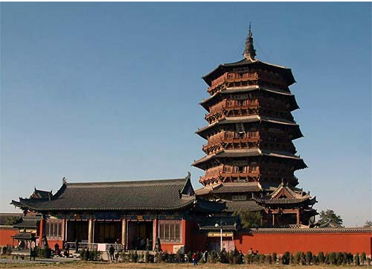
How long is the history of wooden structures in China?
世界上最高的木建筑：应县木塔

Slide 35
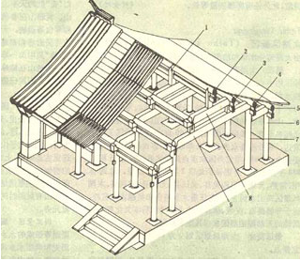
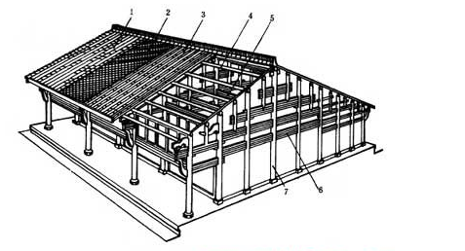
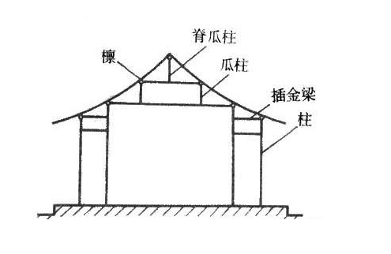
What are the 3 categories of traditional Chinese wood buildings?
穿斗式
抬梁式
井干式

Slide 36
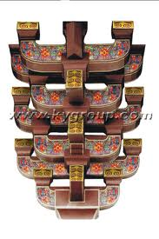
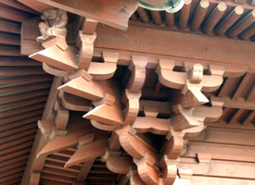
What is dou-gong? What’s its function?
A set of corbel brackets

Slide 37
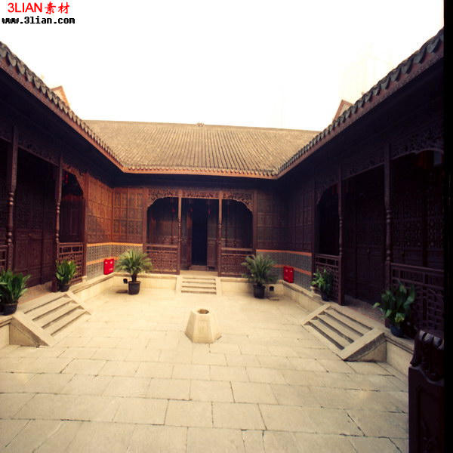
What is the most widespread residential structure in North China? How is it related to Confucianism?

Slide 38
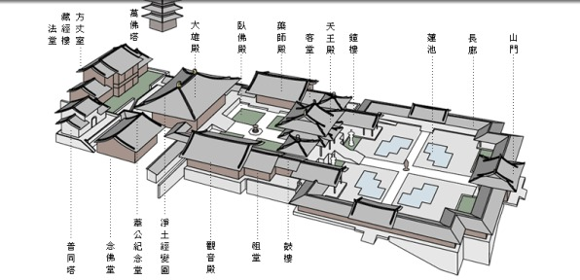
Is the construction of Buddhist temples important in Chinese architecture? What is the general layout of a Buddhist temple like?

Slide 39
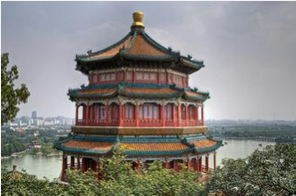
What are Buddhist pavilion and pagodas? Could you name some important Buddhist pagodas in China?

Slide 40
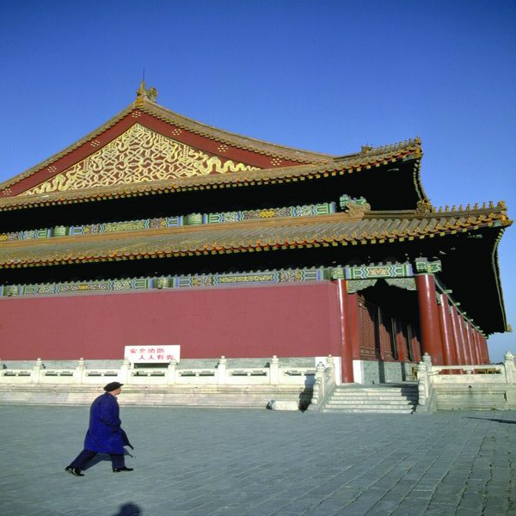
What styles do traditional Chinese buildings' roofs have?
Hipped and gabled roof of double eaves

Slide 41
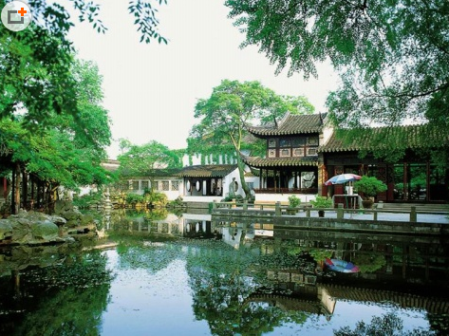
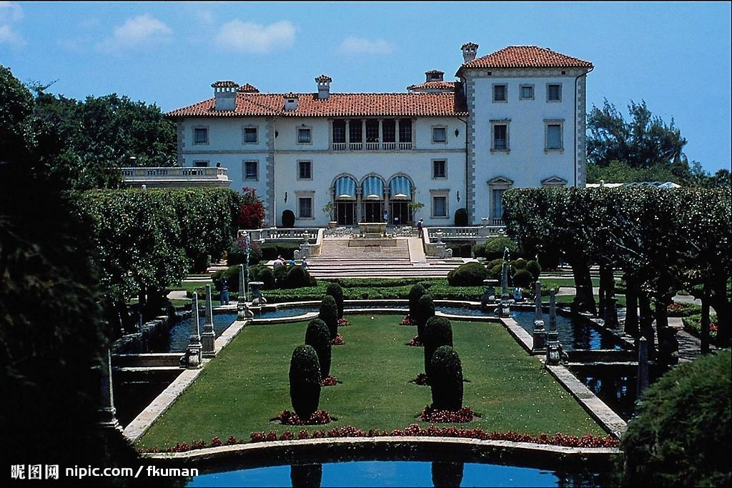
What’s the greatest difference between European gardens and Chinese ones?

Slide 42
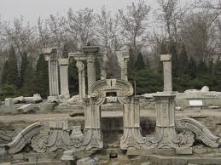
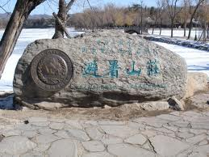
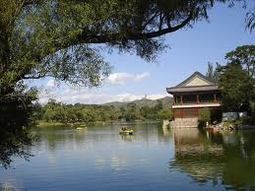
What do you know about China’s imperial gardens? In which part of China are they located? How many of them can you name?

Slide 43
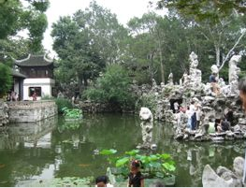
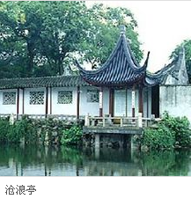
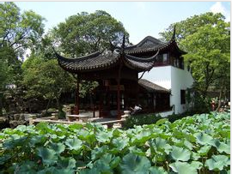
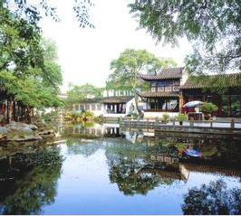
What do you know about the private gardens of Suzhou? What gardens there demonstrate the styles of Song, Yuan, Ming and Qing dynasties?
狮子林
拙政园
留园

Slide 44
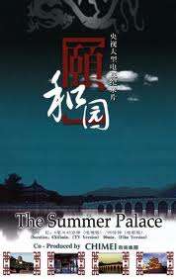
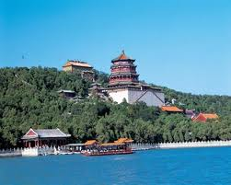
What else was the Summer Palace called?

Slide 45
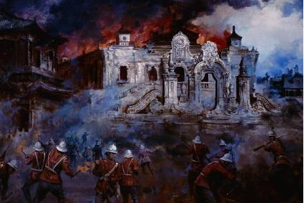
What did the Anglo-French invading troops do to it in 1860?

Slide 46
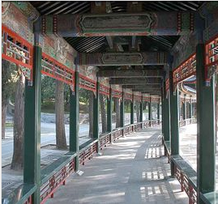
What do you know about the Long Corridor?

Slide 47



Architecture and Gardens
The Forbidden City

Slide 48

CONTENTS
  01
  The Name of the Forbidden City
  02
  The Collections in the Forbidden City
  03
  The History of the Forbidden City
  04
  The Structure of the Forbidden City

Slide 49

  The Name of the Forbidden City
01
PART

Slide 50

  Some Basic Informations
The Forbidden City (Zǐjìnchéng) is a palace complex
in Dongcheng District, Beijing, China,
and It lies in the center of Beijing's central axis with
a total area of 720,000 square meters.
基本情况简介
Today, the Forbidden City houses the Palace Museum, and was the former Chinese imperial palace and residence of the Emperor of China from the Ming dynasty (since the Yong Le Emperor) to the end of the Qing dynasty, between 1420 and 1924.
The residence of emperors
A history museum

Slide 51


  The Name of the Forbidden City
"Purple Forbidden City"
Zijincheng
"Purple"
The North Star
Ziwei Star
"harmony between man and nature"
The Forbidden City
The Forbidden City
stars in the sky
capital planning
Supreme power
and
status of the royal family
"Forbidden"

Slide 52
  The Collections in the Forbidden City
02
PART

Slide 53

  The Collections of the Forbidden City
The Palace Museum was then established in the Forbidden City in 1925.
Paintings，ceramics（陶器），seals（印章）, steles（碑文）,
sculptures（雕塑）, inscribed wares（篆刻）,
bronze wares（青铜器）, enamel objects（珐琅）, etc.
Han Banquet Map
韩熙载夜宴图
The Night Revels of Han Xizai

Slide 54


  The Collections of the Forbidden City
Meat-shaped Stone
肉形石
Jadeite Cabbage
翠玉白菜

Slide 55
  The History of the Forbidden City
03
PART

Slide 56
  The History of the Forbidden City
The Palace Museum
Li Zicheng's
damage
Ming Dynasty
  April, 1644
  to
  October, 1644
  After 1933
  1406-1644
  1683-1912
Beijing
Rreconstruction
12 years
14 years
1 million workers
Qing Dynasty

Slide 57
  The Structure of the
  Forbidden City
04
PART

Slide 58
  The Structure of the Forbidden City----The Inner and Outer Courts
Palace of
Heavenly Purity
乾清宮
The Hall of
Supreme Harmony 太和殿
The Hall of
Central Harmony 中和殿
The Hall of Union
交泰宫
The Hall of Preserving Harmony
保和殿
Palace of
Earthly Tranquility 坤宁宫

Slide 59

  The Structure of the Forbidden City----The Inner and Outer Courts
The Hall of
Supreme Harmony 太和殿
Tai He Hall
The Hall of Tai He
太和：
The universe keeps harmonious
The Hall of
Universe Harmony
Important ceremony
like the birthday of the emperor
Supreme---The supreme power of the royalty
Very great or the greatest in degree---universe

Slide 60

  The Structure of the Forbidden City----The Inner and Outer Courts
Palace of
Heavenly Purity
Hall of Union
交泰宫
Palace of
Earthly Tranquility
天地交泰：
言天地之气融通，则万物各遂其生，
指天地之气和祥，万物通泰。
Harmony
The monarch and his subjects
work in unity
Union

Slide 61
Tnank you！

Slide 63


Slide 64


Slide 65


Slide 66


Slide 67


Slide 68
Preparation for next week
Please prepare all texts of Session 2:
Mythology: Gods and Immortals 51%袁灵
Literature: Ancient literature: Chinese Mythology 50%李婉莹
Take the quizzes
Translate your part of HLM
Correct a fellow student‘s translation

Slide 69
Always here for you!
随时为你们服务
Professor Dr. Martin Woesler
吴漠汀
湖南师范大学特聘教授，博士导师
Office / 办公室: 外国语学院415
国际汉学中心309
Phone / 电话: (150) 1138 8818
(德国+49 178 2073538)
Email / 电子邮件: wmt@hunnu.edu.cn

Slide 70
Thank You

