Slide 1
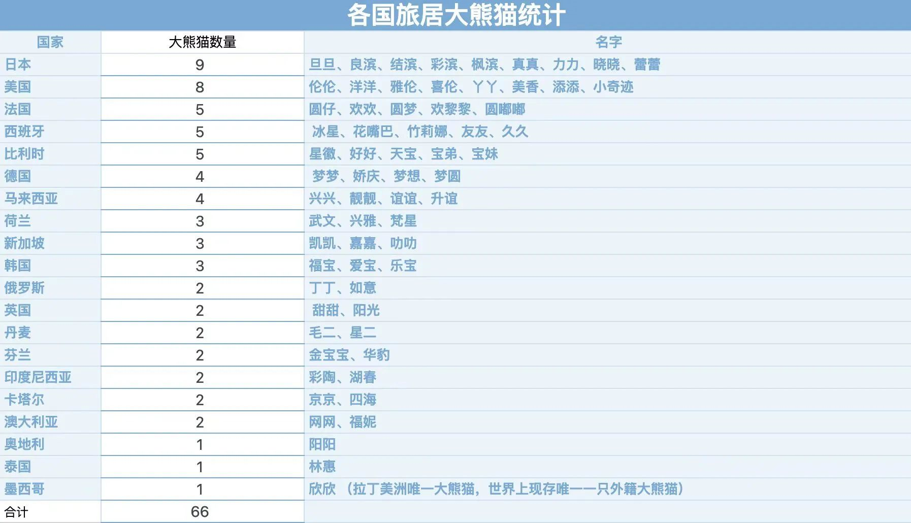

Slide 2


Slide 3
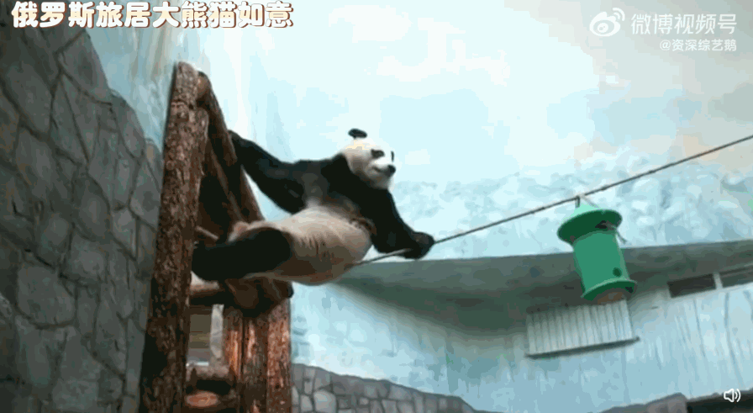

Slide 4


Slide 5


Slide 6


Thanks for Watching
Presentor:Wang Yihan

