Slide 1
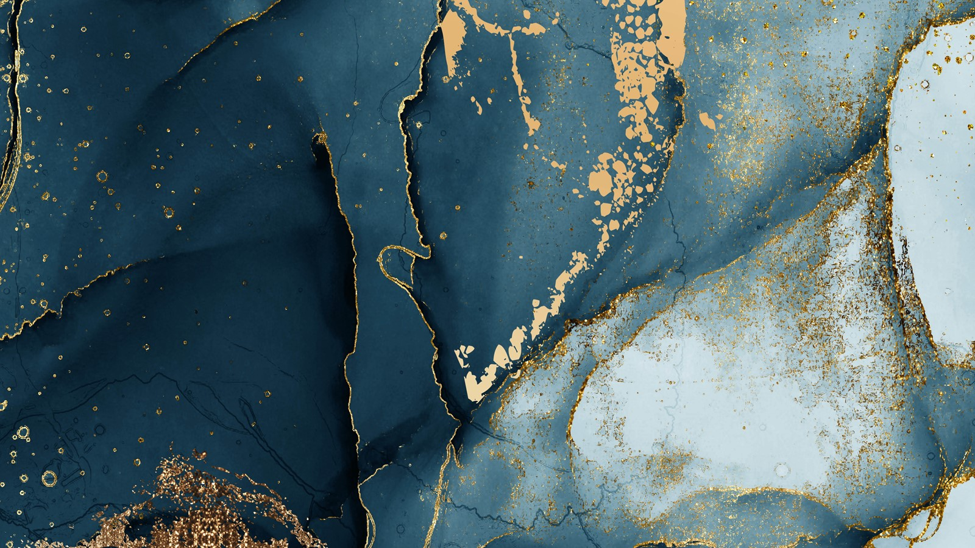
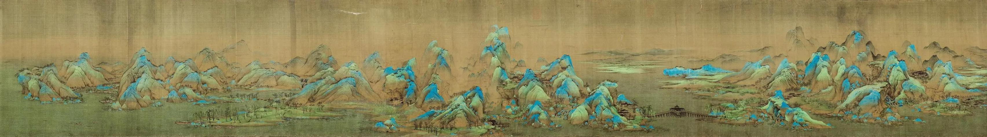
Chinese Painting:
A Thousand Miles of
Rivers and Mountains
Week14 Yao Yiyun
23英语笔译 姚懿芸

Slide 2
A Brief Introduction to the Painting
I
II
Analysis of the Painting
CONTENTS
Symbolism and Cultural Connotations
III
IV
Modern Interpretations and Conclusion

Slide 3
I
A Brief Introduction to the Painting

Slide 4
Title: A Panorama of Rivers and Mountains
Artist: Wang Ximeng (王希孟)
Year of Completion: AD 1113
Medium: Handscroll, ink, and colors on silk (绢本）
Dimensions: Approximately 12 meters in length
Current Location: Palace Museum, Beijing

Slide 5
Overview
The painting stretches nearly 12 meters long and depicts a panoramic landscape featuring mountains, rivers, and villages.
It includes vivid scenes of nature, wildlife, and human activities, presenting an idealized view of China's natural beauty.

Slide 6
Techniques Used
Blue-green landscape technique（青绿山水技法）：Wang employs a detailed, delicate style with meticulous brushwork and vibrant color palette.
The composition blends traditional Chinese landscape painting elements like "shan shui" (mountain-water) and incorporates distant perspectives.

Slide 7
Question 1
What’s the main technique adopted in this painting?
《千里江山图》的创作中主要运用了哪种技法？

Slide 8
II
Analysis of the Painting

Slide 9
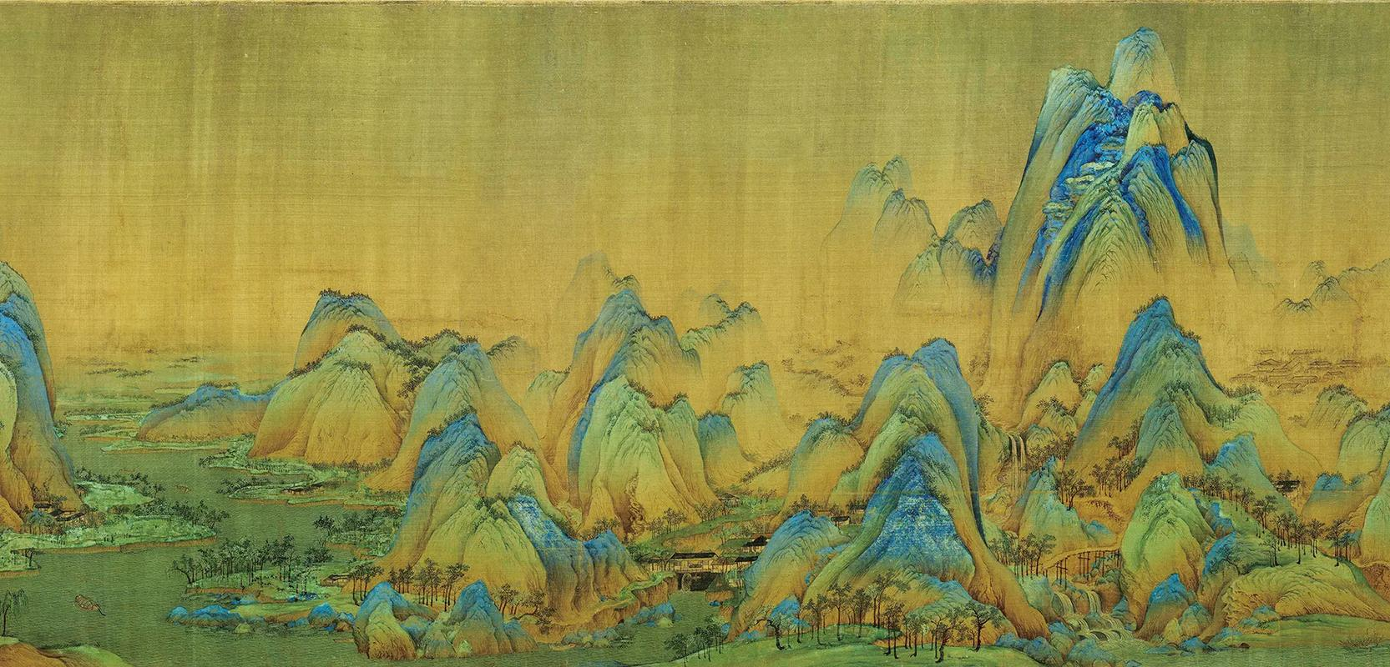
Key Elements
Rivers and mountains: Flowing rivers and towering peaks occupy the foreground, middle ground, and background, establishing depth and perspective.
Human architectures: Boats, bridges, and villages, suggesting the harmony between human activities and nature.

Slide 10
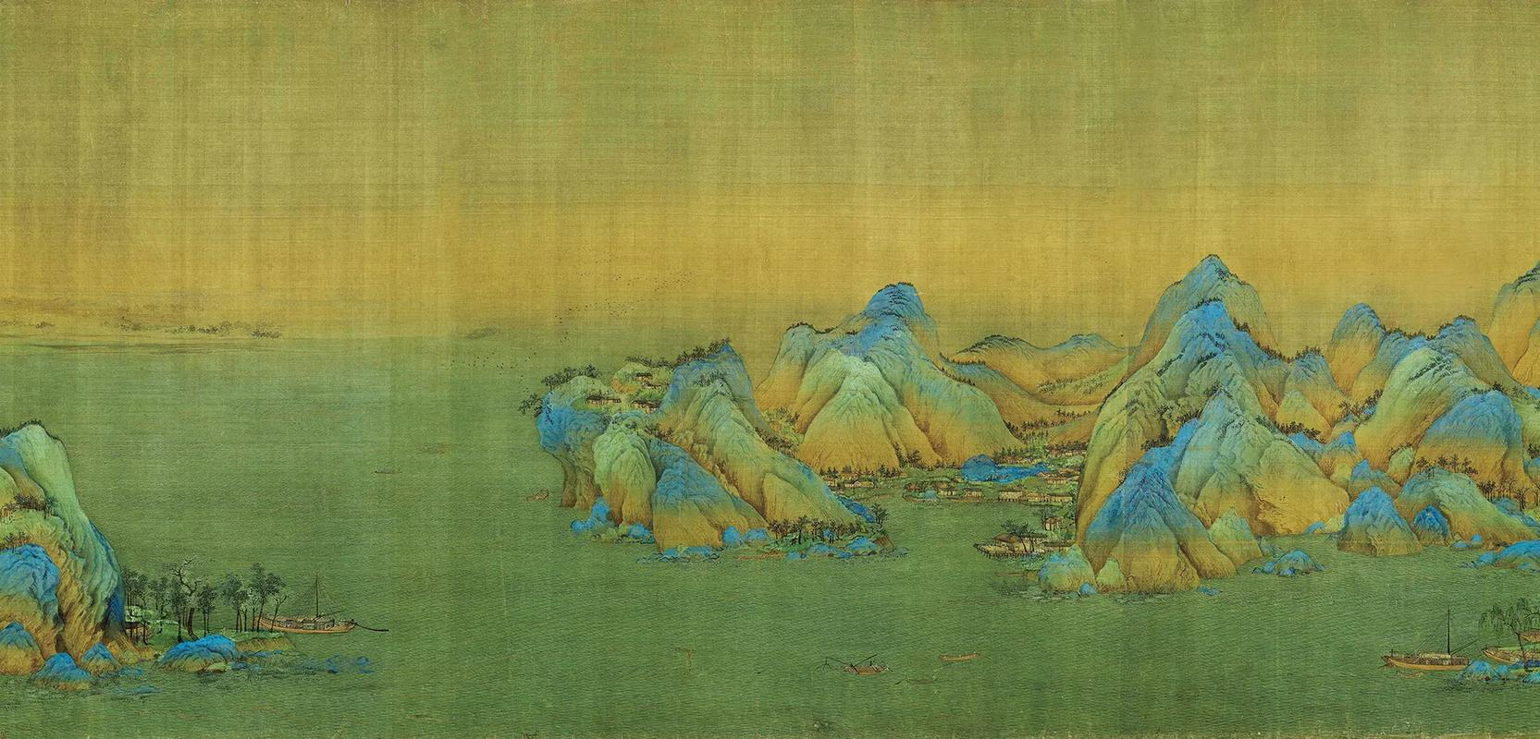
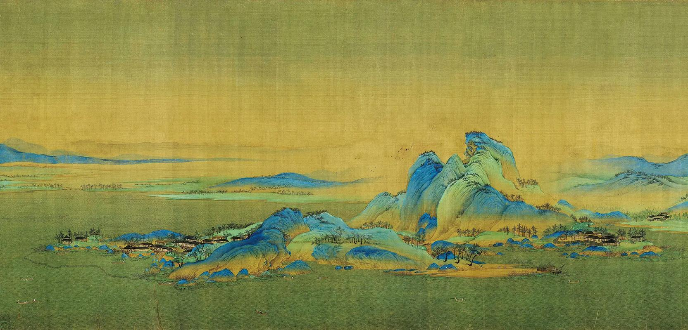
Natural Harmony
The painting symbolizes the ideal harmony between man and nature（天人合一）, a core principle in Chinese culture. The river represents life and the flow of time, while the mountains symbolize stability and endurance.

Slide 11
Question 2
What’s the main cultural and philosophical idea depicted in this painting?

Slide 12
III
Symbolism and Cultural Connotations

Slide 13
Philosophical Underpinnings
The painting embodies core elements of Confucianism and Taoism, which emphasize harmony with nature, the importance of balance, and the idea of natural order.
The landscape itself is a metaphor for the Chinese philosophical view that the natural world is an expression of cosmic order, where each element—mountains, rivers, sky, and human life—works together in a delicate equilibrium.

Slide 14
Cultural and Historical Context
During the Northern Song Dynasty, landscape painting flourished in China, reflecting the cultural and intellectual trends of the era, including an increased appreciation for nature and the role of art in expressing philosophical ideas.

Slide 15
Wang Ximeng's Legacy
Wang Ximeng, though a relatively young artist, created a work that has become a benchmark in Chinese art. It is not just an artistic achievement but a visual representation of the ideals of the Song Dynasty.

Slide 16
Enduring Legacy
This painting has influenced countless generations of Chinese artists and remains a cornerstone of landscape art.
It is admired for its intricate detail, philosophical depth, and technical mastery, influencing not only Chinese painters but also scholars and cultural thinkers

Slide 17
Question 3
Do you know the main setting of this painting?
《千里江山图》的取景地是？

Slide 18
IV
Modern Interpretations and Conclusion

Slide 19
Modern Interpretations
The painting continues to inspire contemporary Chinese artists, who explore the themes of nature, life, and balance in their work.
Its influence extends beyond art, becoming a symbol of China’s historical and cultural identity.

Slide 20
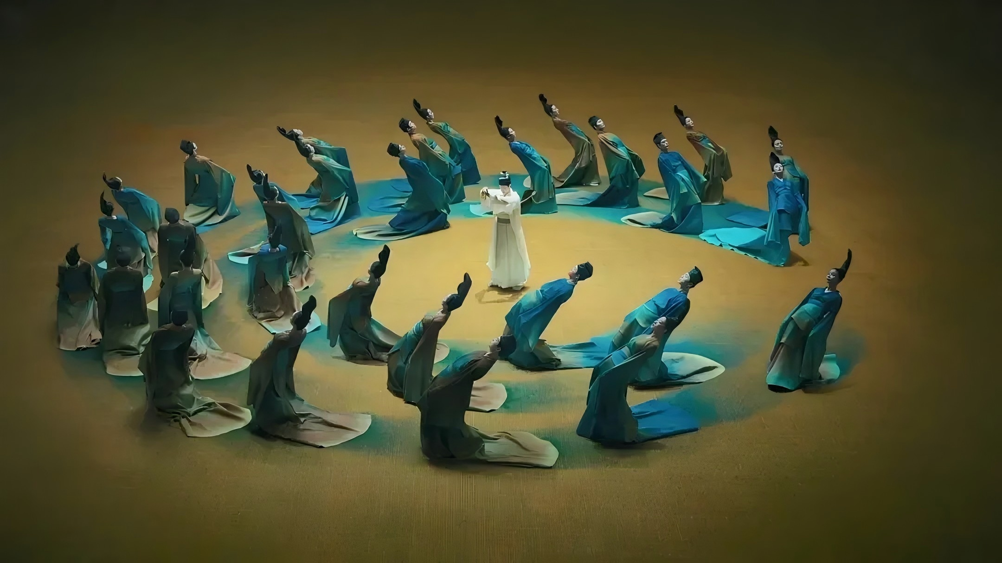
Poetic Dance: The Journey of a Legendary Landscape Painting
舞蹈诗剧《只此青绿》

Slide 21
So far, the dance drama has been staged more than 640 times worldwide and won top national performing arts awards. In October, the dance drama was turned into a movie and the music of the production was staged in concerts. This dance drama by the China Oriental Song and Dance Troupe, will perform in cities in the United States, including San Diego, Los Angeles and New York, at the end of this December.

Slide 22
Conclusion
The painting is a timeless expression of the unity between nature and humanity, and it highlights the cultural, intellectual, and artistic ideals of the Song Dynasty.
Wang Ximeng's work stands as a monumental achievement, reflecting not only technical mastery but also profound philosophical insight.

Slide 23
Question 4
Please mention at least one city where this dance drama will be performed at the end of this December.

Slide 24
THANKS FOR LISTENING!
23英语笔译 姚懿芸

