Slide 1
Marriage Accompanying Songs in Hunan
Speaker: Peng Huixuan

Slide 2
Contents
An introduction to marriage accompanying songs
Jiahe marriage accompanying songs
Importance of marriage accompanying songs

Slide 3
An introduction to marriage accompanying songs

Slide 4
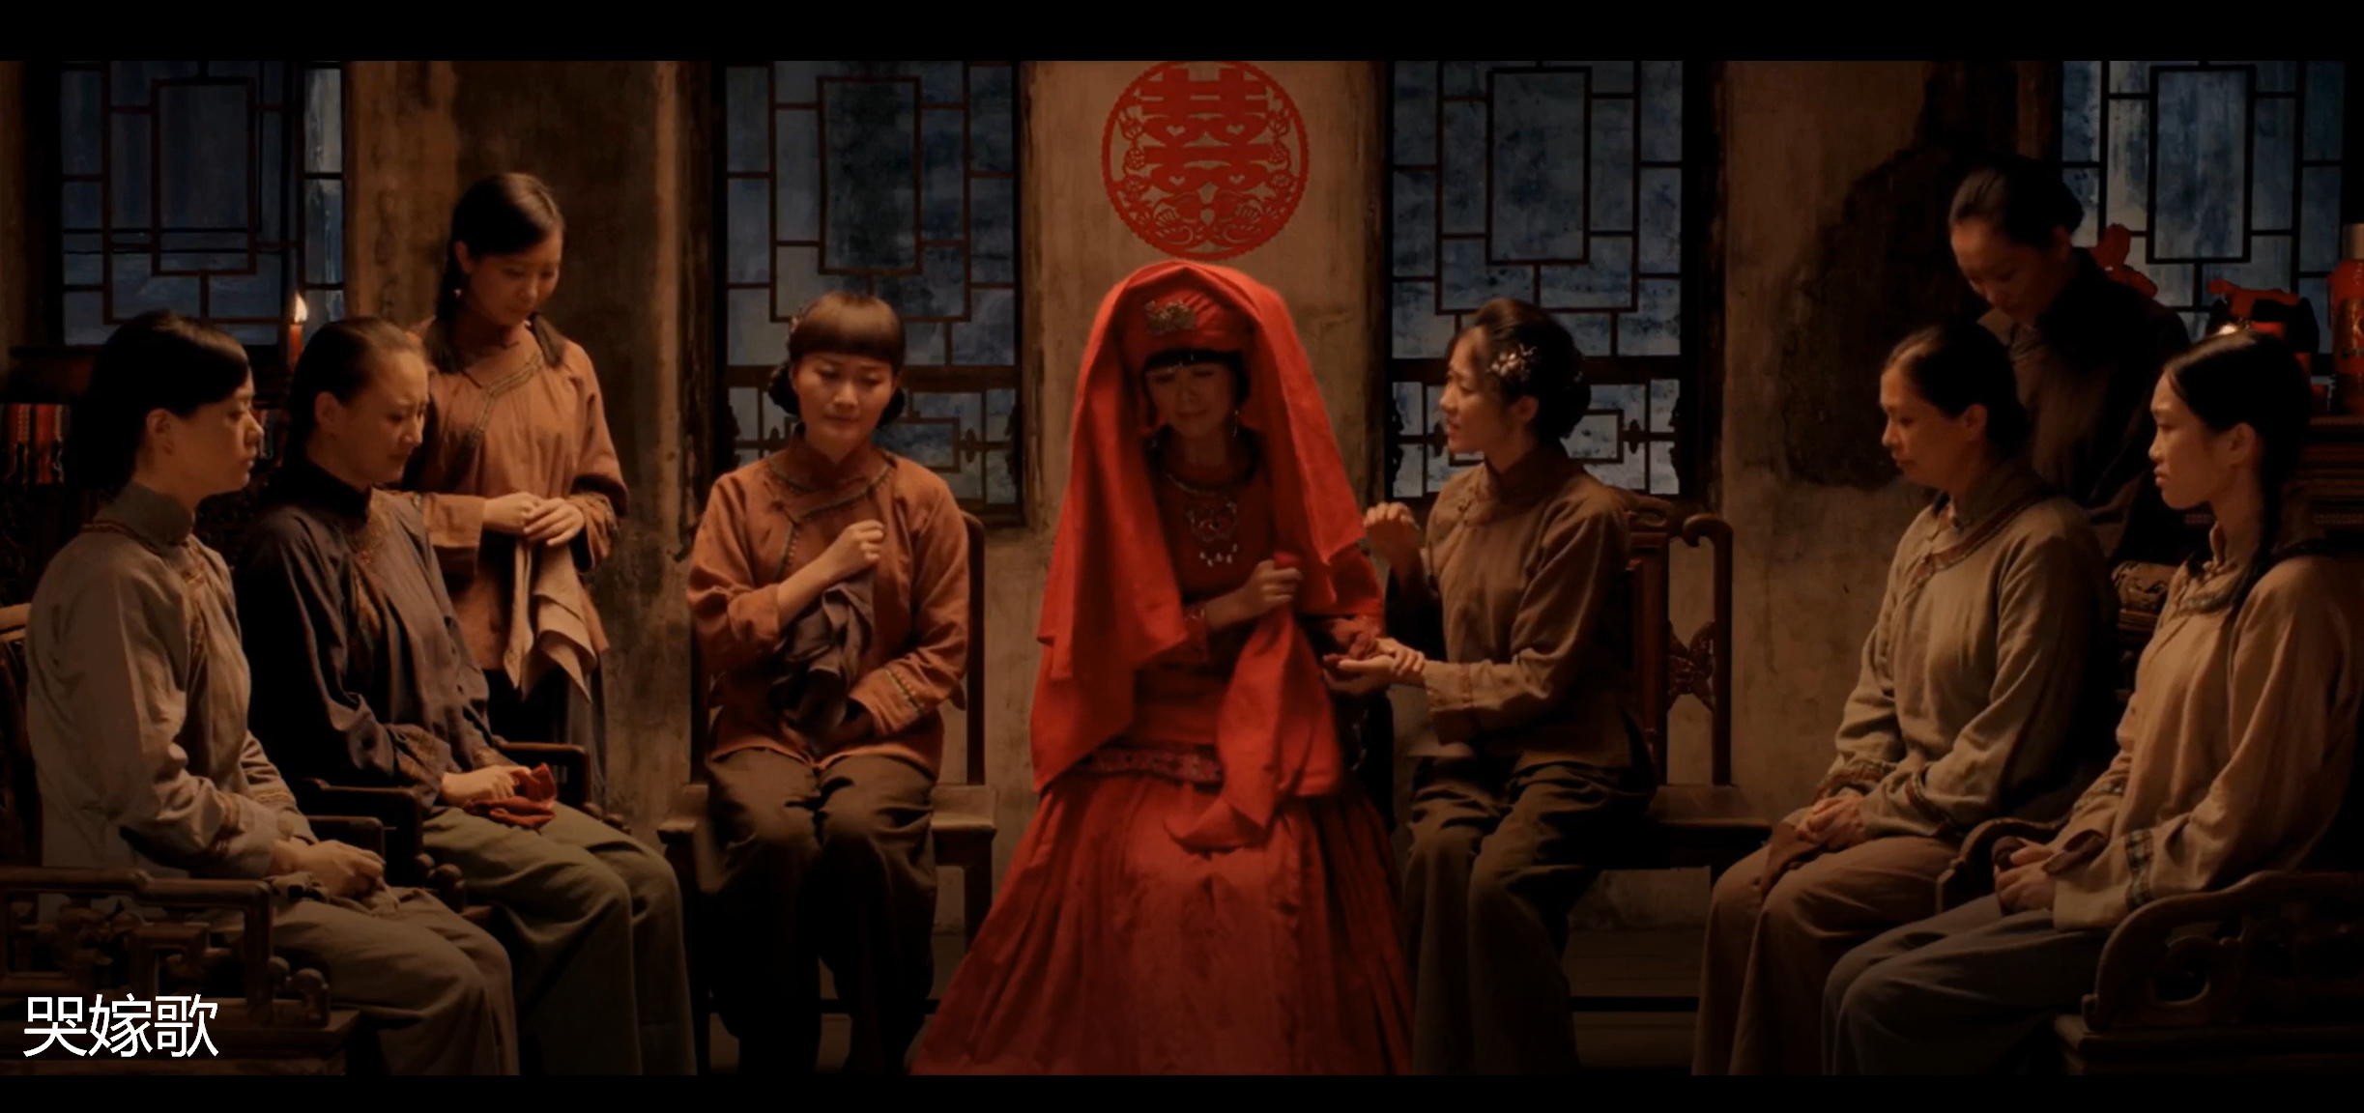
A short video of marriage accompanying songs

Slide 5
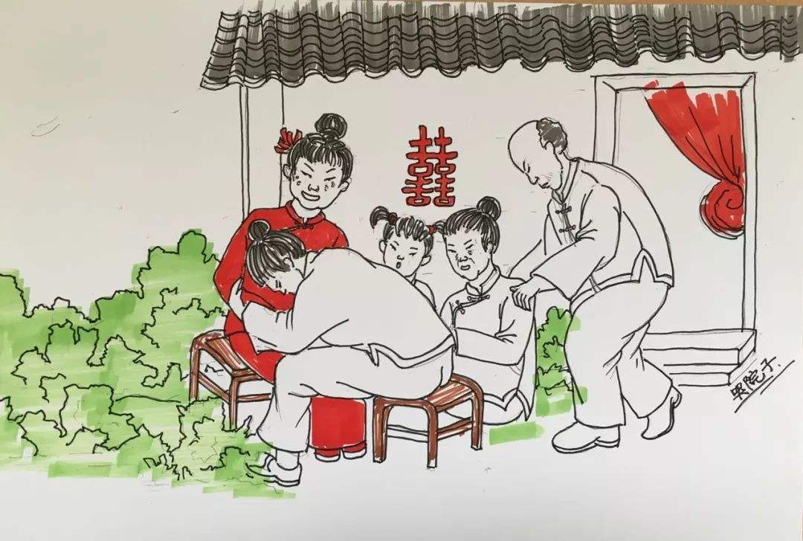
Introduction
Marriage Accompanying Songs is a kind of folk music that integrates poetry, song and dance.
Themed with the bride’s marriage, the songs mainly aim to express the feelings of departure, and resentment, anger and resistance to the feudal marriage system and the old ethics and morals.
However, with the development of society, the purpose of those songs have changed drastically, and now they are used to adjust the atmosphere of the wedding, and have become a cultural heritage.

Slide 6
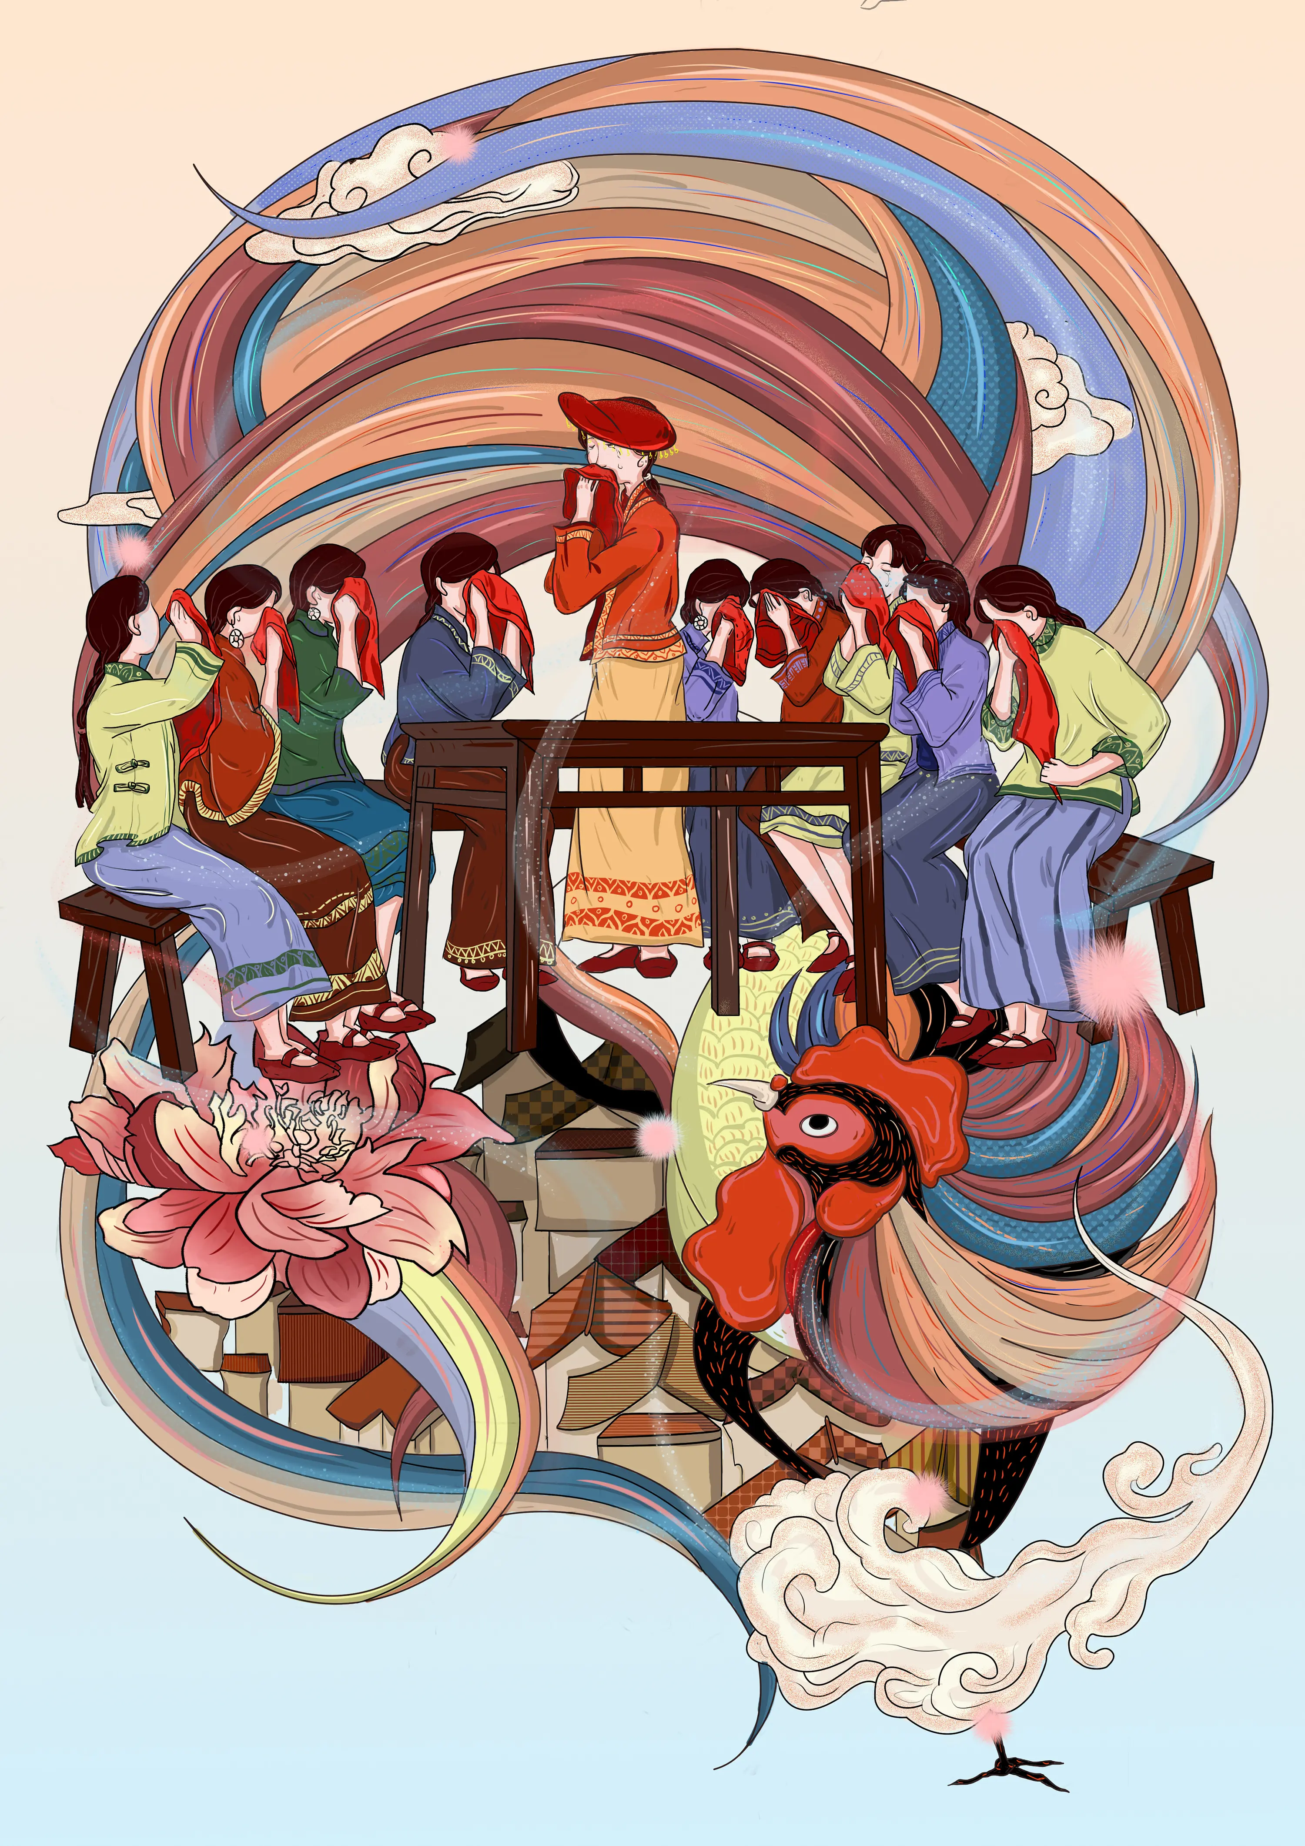
Introduction
The interesting legend about its origin:
According to the legend, Chu Yu, the daughter of the King of Chu Kingdom, met Chen Xianyun, a woman from Jiahe county (Chenzhou, Hunan), who planned to run out on her wedding. After learning about Chen's unfortunate story, Princess Chu led a group of fairies to the Chen family the night before her wedding, in order to cheer her up.
That night, Chen and Princess Chu sang hundreds of local “crying songs”, including seven long songs, each with more than 140 lines, expressing gratitude to the parents for their rearing and persuading them not to interfere with their children's freedom of marriage.

Slide 7
Jiahe marriage accompanying songs

Slide 8
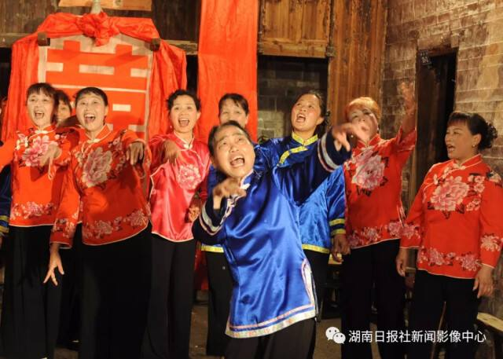
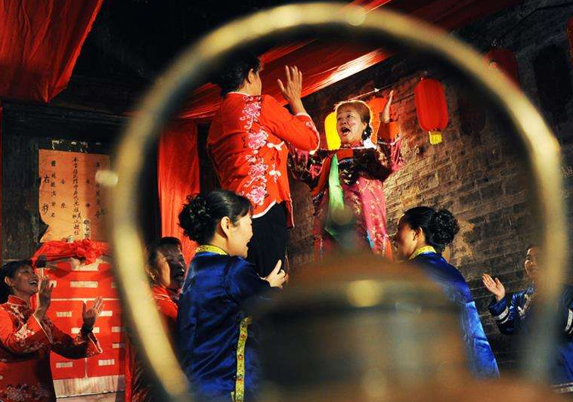
Jiahe marriage accompanying songs
“In the north there is Lan Huahua (a popular folk song of Northern Shaanxi), and in the south there is Jiahe marriage accompanying songs”.
It is a folk wedding custom of Jiahe county. The family members whose daughter will get marry will sing songs with each other for two nights during the wedding days.
In the first night, some short songs will be sung by the family members till mid night. In the second night, long songs and joking songs will be sung till the dawn time.
All the songs are sung by the female members of the family with Jiahe local language.
Notes:
Jiahe County, Chenzhou City, Hunan Province
There is a famous saying in the folk song sector, which is, which shows how famous and important

Slide 9
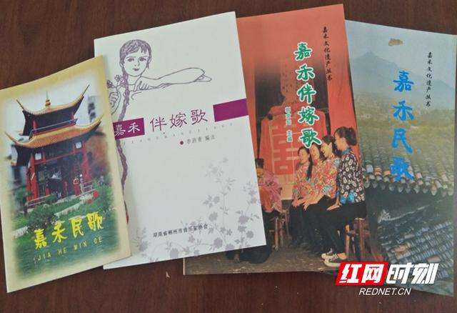
Types of Jiahe marriage accompanying songs
Long songs: Focusing on marital tragedies, they mainly tell sad stories, express the unwillingness to marriage.
Joking songs: When singing those songs, the girls who accompany the bride seems like are having fun together, but in fact those songs are used to complain and vent the feelings.
The purpose of the songs is to comfort the bride and set the wedding atmosphere, and most of them are sung in a casual and lively manner.

Slide 10
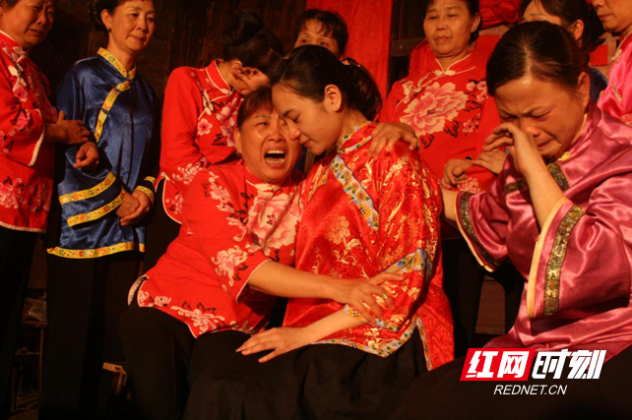
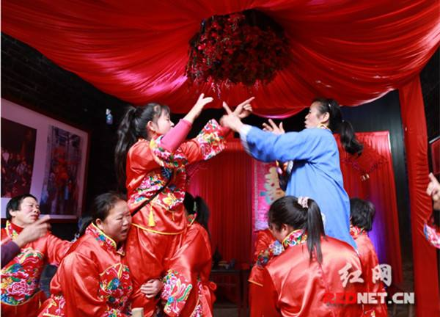
Types of Jiahe marriage accompanying songs
Crying songs: It is sung in a weeping way, so it is not very melodic, but it has a strong rhythm and a taste of lamentation. The content of the song is mainly about the sad feelings of departure.
Scolding matchmaker songs: They are song that accuses the feudal marriage rituals in form of accusing the matchmaker. As soon as a matchmaker appears, everyone will start to sing "scolding matchmaker songs", or sometimes pull the matchmaker over to tease and scold.

Slide 11
Importance of marriage accompanying songs

Slide 12
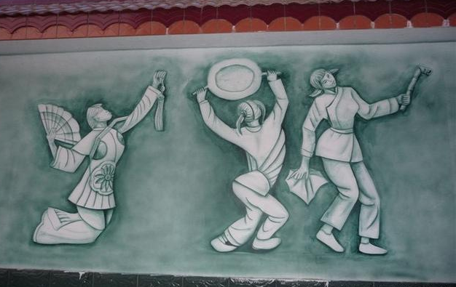
Importance of marriage accompanying songs
The marriage accompanying songs also represent a female culture. In the past, women did not have much opportunity to learn culture and etiquette, and they regarded those songs as a good teacher and friend, they can learn a lot from the accompanying marriage song.
The accompanying marriage song also played the role of promoting family harmony and neighborhood harmony.
In the wedding, through the singing of the marriage accompanying songs, the villagers and friends gathered in the home of the unmarried girl to bless her, send her off, give her encouragement, and let her get married without worry. It can also be used to made the husband to learn his responsibility for the marriage and regulate his marital virtues.
Notes:
Jiahe County, Chenzhou City, Hunan Province
There is a famous saying in the folk song sector, which is, which shows how famous and important

Slide 13
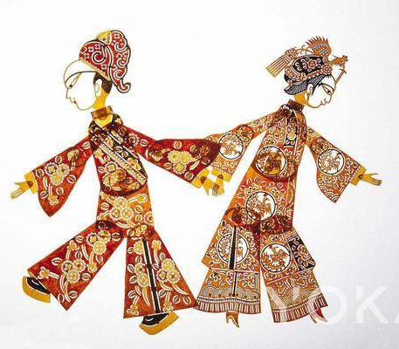
Importance of marriage accompanying songs
The marriage accompanying song is a unique folk culture, folk art and a treasure that reflecting marriage customs, which has important historical, cultural, and artistic values. It has been integrated into the life of local people in Jiahe, and has a strong cultural function. In 2006, it was enrolled into the first batch of Hunan provincial intangible cultural heritages.
At present, it is worthwhile to think about how to better protect, carry forward and develop this art form, so that it can shine in the new era.
Notes:
Jiahe County, Chenzhou City, Hunan Province
There is a famous saying in the folk song sector, which is, which shows how famous and important

Slide 14
Thanks for your listening!

