Slide 1
Huo Yuanjia: The Symbol of Chinese Martial Art Culture
Presenter: Luo Shuzhen

Slide 2
What do you know about martial arts?
What do you know about Huo Yuanjia?

Slide 3
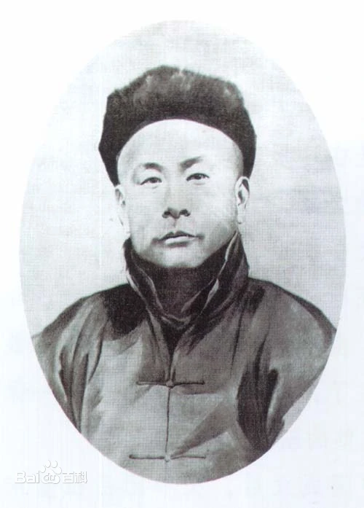
Huo Yuanjia (January 18, 1868 - September 14, 1910)
A famous patriotic martial artist in the late Qing Dynasty, styled Junqing, born in Jinghai County, Tianjin
Huo Yuanjia came from a family of martial artsstructors, inheriting the family's secret "Mi Zong Quan" (Secret Style Fist) martial arts skills.
Huo Yuanjia founded the Chin Woo Athletic Association.

Slide 4
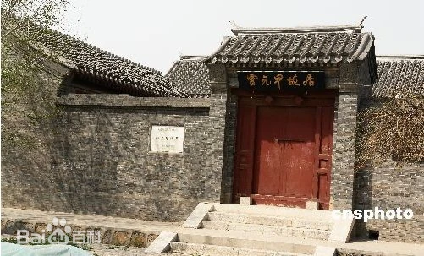
Early Life
Huo Yuanjia was born into a wushu master’s family in Dongguang County south of Tianjin. His father made a living as a bodyguard for wealthy people.
As little Huo was very weak and often ill, his father decided not to teach him martial arts as his career.

Slide 5
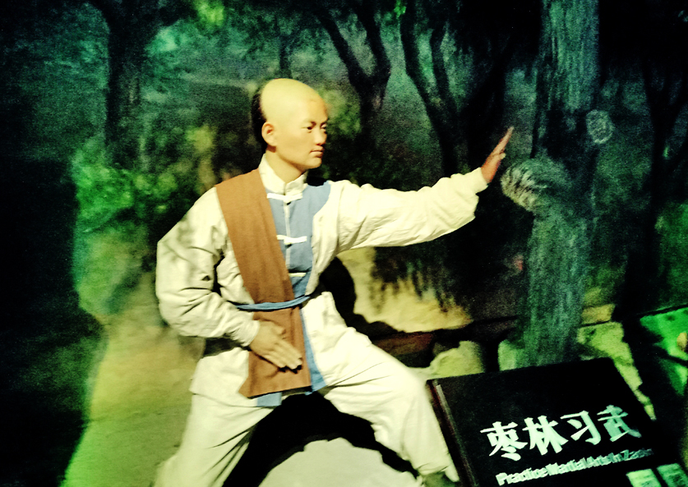
Martial Arts Training
Huo Yuanjia watched his father and brothers practiced wushu and imitated them secretly in the depths of the forest of date trees.
Moved by his determination and hard-working spirit, his father started to teach him. In 10 years, Huo learned the family’s exclusive boxing and the essentials of other schools of boxing as well.

Slide 6
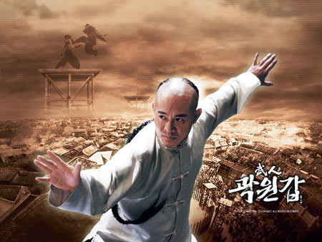
Battles of Fame
In 1890, a wushu master by the name of Du came from Henan to visit Huo’s father. His manner provoked a trial of strength with the boxers of the family. Huo’s brothers competed with him but were defeated. Then Huo fought with him. With one swift kick, Huo knocked his opponent to the ground. Thus Huo became famous in his village and the neighboring areas.

Slide 7

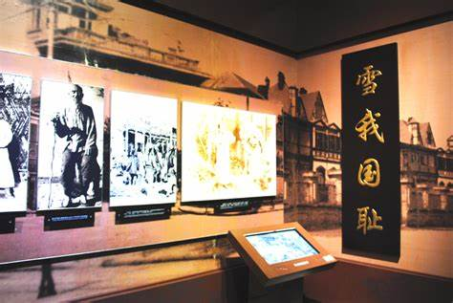
Upholding National Dignity
During a performance in 1901, a Russian boxer said something that insulted the Chinese people. When Huo heard this, he mounted the platform and reprimanded him severely. Scared by Huo’s bravery, the Russian boxer admitted his mistake and apologized.

Slide 8
Upholding National Dignity
In the spring of 1909, an arrogant British boxer named O’Brien came to Shanghai and announced that he was willing to have a match with any Chinese. On learning this, Huo and one of his disciples went to Shanghai to meet the challenge. He also advertised that he was ready to fight any foreign boxers. Startled by Huo’s fearlessness, O’Brien left Shanghai quietly before the date of the match.

Slide 9
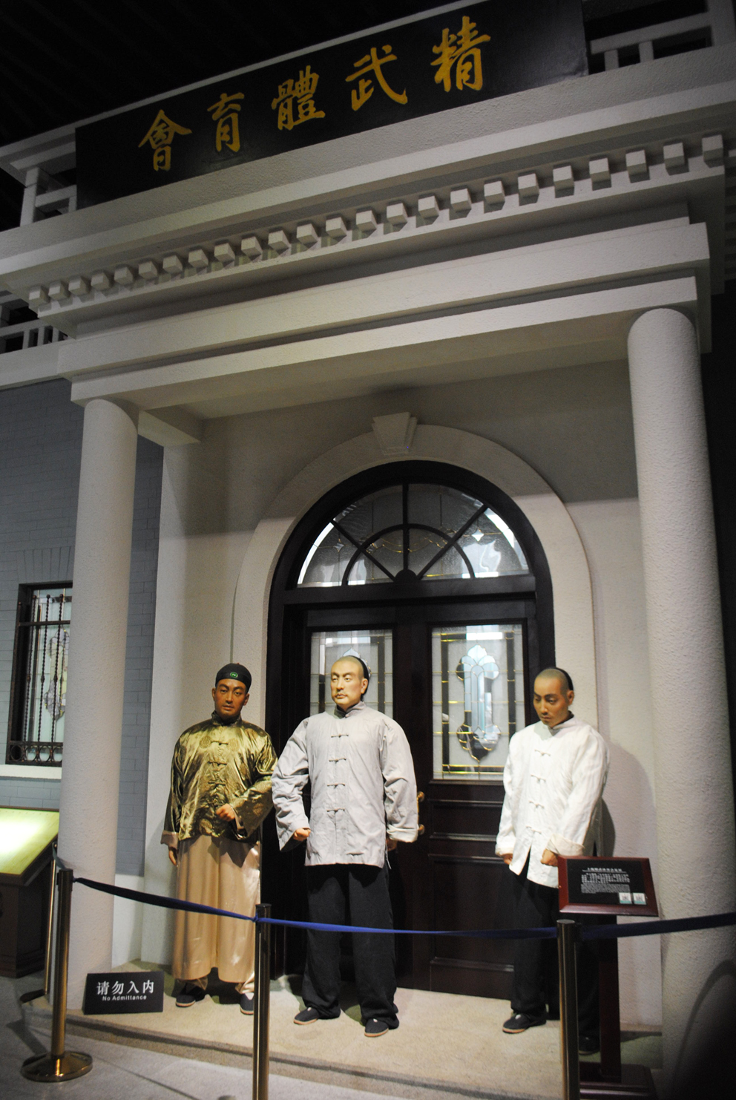
Inheriting Martial Arts Education
Huo thought that if the Chinese people wanted to make their nation strong, they had to build up their bodies. For this purpose he set up a martial arts school where he served as the main coach. In 1910, with the school as the basis, the Chin Woo Athletic Association was established.

Slide 10
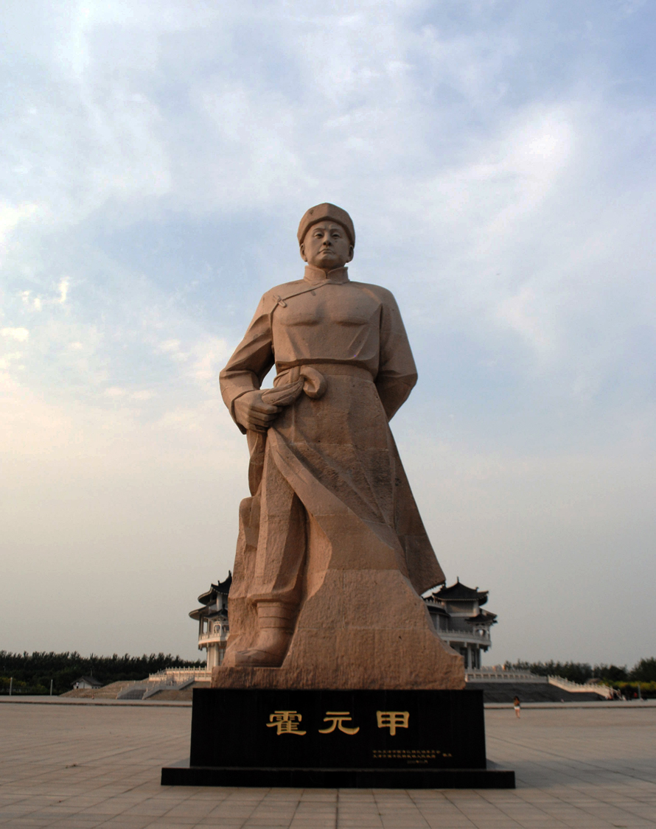
The Passing of Huo Yuanjia
Many Japanese judo wrestlers in Shanghai grudged Huo Yuanjia his name and success. They arranged competitions between Huo and some of the best judo athletes from Japan. However, all of them were defeated by this Chinese wushu master.
After attending a peace-making dinner given by the Japanese judo wrestlers, Huo died on Sept. 14, 1910. He is believed to have been poisoned at the banquet.

Slide 11
Why is Huo Yuanjia a symbol of Chinese martial arts culture?

Slide 12
The Influences of Huo Yuanjia
Martial Arts Achievement
Embodiment of National Spirit
Huo Yuanjia was renowned for his exceptional martial arts skills and numerous victories in competitions.
Huo Yuanjia's courage and perseverance in facing foreign challengers became a symbol of the Chinese people's resistance against foreign aggression and defense of national dignity.

Slide 13
The Influences of Huo Yuanjia
Promotion of Martial Arts Education
Cultural Heritage and Influence
He founded martial arts schools and was dedicated to the inheritance and education of martial arts, embodying the Chinese martial arts culture's tradition of valuing education and transmission.
His deeds have been adapted into numerous films, television series, and literary works, becoming an important part of Chinese martial arts culture.

Slide 14
Thank you
Presenter: Luo Shuzhen

