Slide 1

The Eight Characters of Destiny (八字)
汇报人：李嘉怡

Slide 2
CONTENTS
01
Origin
02
Development
03
Modern Application

Slide 3

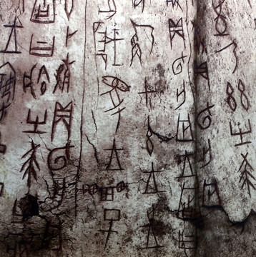
The Birth of the Heavenly Stems and Earthly Branches
The Heavenly Stems and Earthly Branches, first appeared in the oracle bone inscriptions of the Shang Dynasty in China, was used to record time, mainly the Stem-Branch method for dating.
The oracle bones of the Shang Dynasty contain the complete sixty Jiazi system that use the Heavenly Stems and Earthly Branches to record days. Later, they were added to record years, months, and days, providing a time basis for the emergence of the Eight Characters.

Slide 4
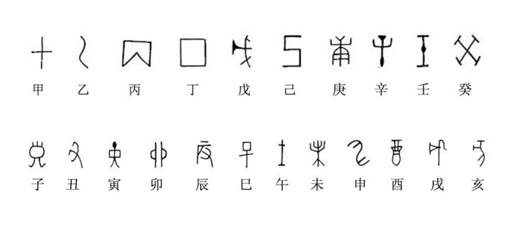
Theory formation
During the Warring States Period, people predicted good or bad fortune based on the changes of the Heavenly Stems and Earthly Branches. Li Xuzhong of the Tang Dynasty proposed that a person's “fate” is determined by three factors at the time of birth: year, month and day, thus forming the "Li Xuzhong Technique", which is the prototype of the Eight Characters of destiny.

Slide 5
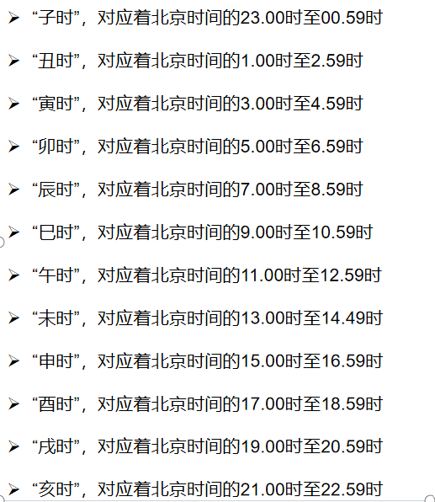
System Establishment
In the Song Dynasty, Xu Ziping added "hour" to the basis of "year, month and day", representing each factor with two characters, thus forming a system that "focuses on the five elements but not on the sound", making the Eight characters a complete system of divination. The divination of the eight characters is also known as "Ziping Divination".
During the Northern Song Dynasty, the "Yuanhai Ziping" passed down by Xu Ziping was widely circulated, and the study of the Eight Characters became an official subject in the imperial examinations.

Slide 6
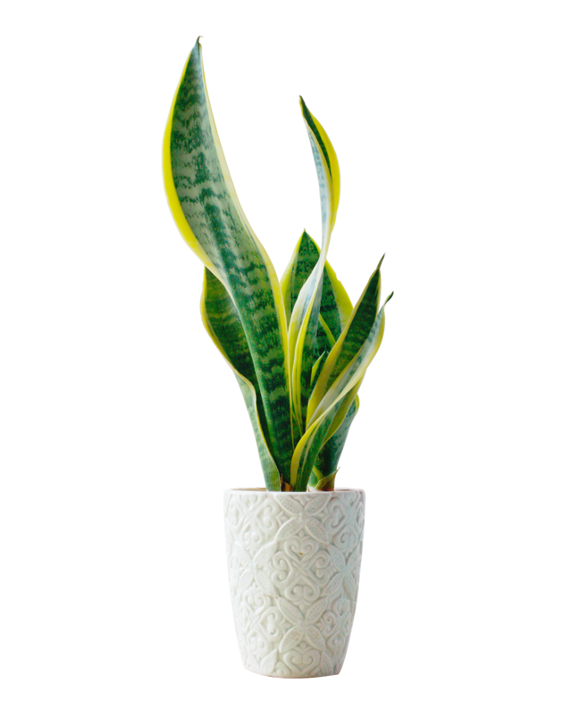
The Development
During the Ming and Qing dynasties, the theory of the Eight Characters of destiny was widely spread and was used for fortune-telling, marriage matching, career selection, etc.
Many renowned numerologists and works have emerged, such as Zhang Nan's "Shenfeng Tongkao Mingli Zhenzong"《神峰通考命理真踪》 and Wan Minying's "Sanming Tonghui"《三命通会》, which further developed and summarized the theory of the Eight Characters, making it more rich and complete.

Slide 7
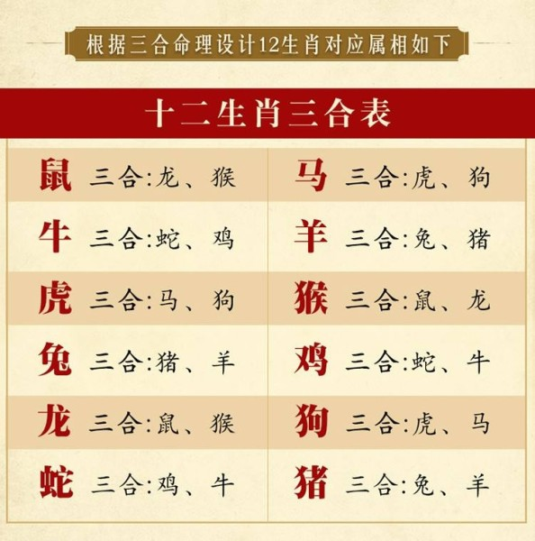
The Development
The year pillar in the eight characters represents the connection with ancestors, childhood and elders, etc.
The moon pillar reflects one's youth, personality traits, and career fortune, etc.
The day pillar represents the natal person themselves, the spouse or the inner world.
The time pillar reflects one's later years, the situation of children, and the connection with younger generations, etc.

Slide 8
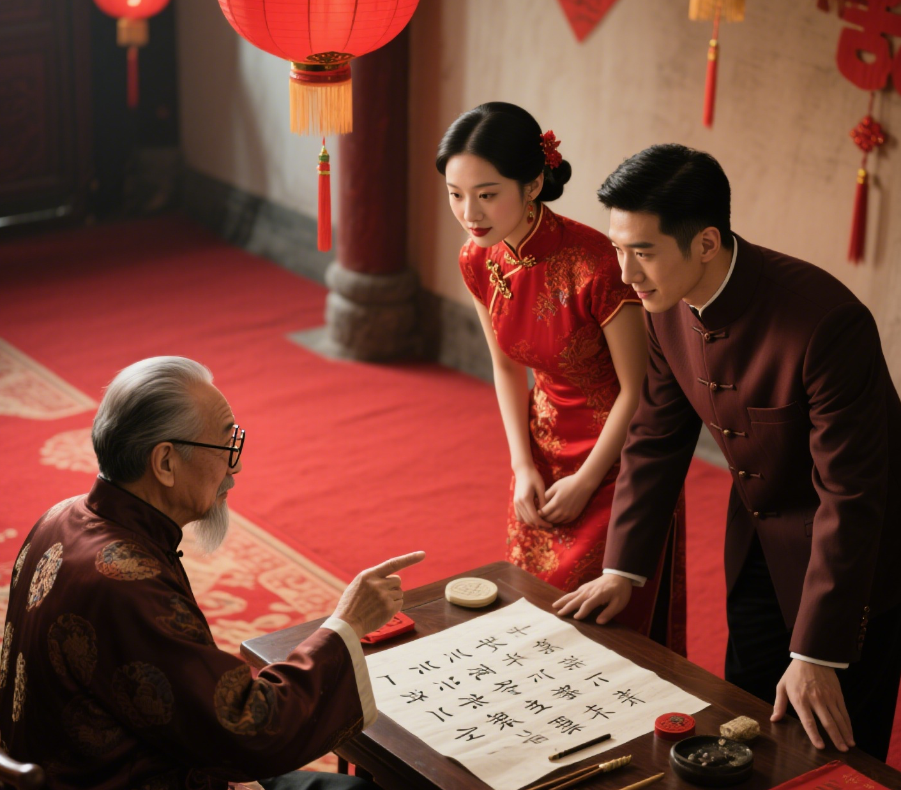
The Morden Application
In modern society, the Eight Characters are mentioned and used in some cultural activities and folk traditions. For instance, in traditional wedding, funeral and other ceremonies, some people still refer to the Eight Characters.
Furthermore, when some people are confronted with confusion and uncertainty in life, they seek psychological comfort through Eight Characters of Destiny counseling, and gain an explanation and expectation for themselves and the future from the analysis of destiny.

Slide 9
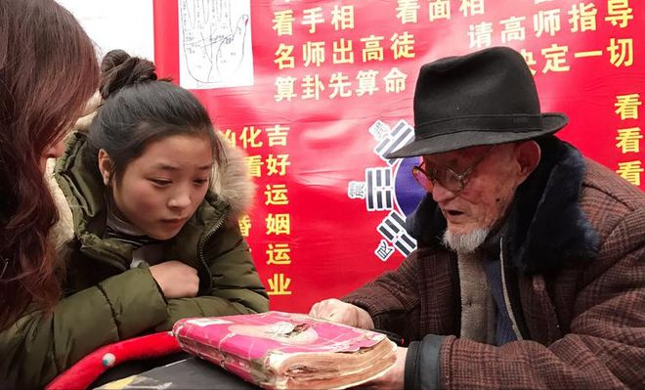
The Conclusion
The Eight Characters have evolved from an ancient time record to a complex system of numerology, running through Chinese history. In modern times, it is not only a carrier of traditional culture, but to a certain extent also meets people's spiritual needs.
However, it should be made clear that the theory of the Eight Characters of destiny has not yet been scientifically verified. We should view it with a rational and objective attitude, inherit its cultural value, and abandon the unscientific parts.

Slide 10
Fate is never calculated; it is forged step by step."

Slide 11
Thank You!

