Slide 1
Chinese Marriage Customs
Hu Yiqiang

Slide 2
01. Traditional Marriage
CONTENTS
02.Modern Marriage
03.My Witnesses

Slide 3
01. Traditional Marriage

Slide 4
Six Procedures
Na Cai
Wen Ming
Na Ji
inviting a matchmaker
asking the girl’s name and birthday
deciding to marry if there is an auspicious omen
Na Zheng
Qing Qi
Qin Ying
giving gifts
sending back gifts
choosing an auspicious wedding day
taking the bride to the groom’s home

Slide 5
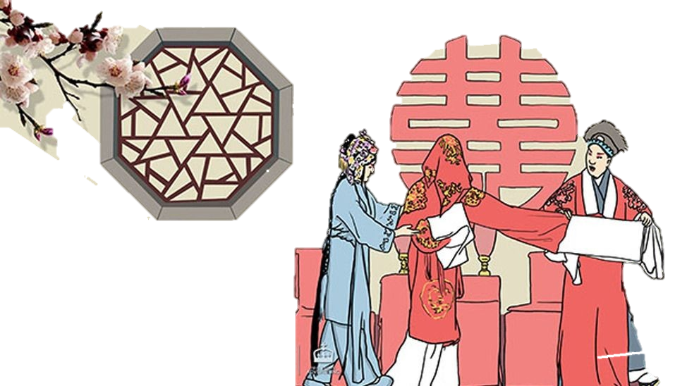
At the Wedding
worshiping ancestors
kowtowing
going to the bridal chamber
drinking until night

Slide 6
02. Modern Marriage

Slide 7
dating
skipping rites
free
traveling
choosing places and guests

Slide 8
Six Procedures
Na Cai
Wen Ming
Na Ji
inviting a matchmaker
asking the girl’s name and birthday
deciding to marry if there is an auspicious omen
Na Zheng
Qing Qi
Qin Ying
giving gifts
sending back gifts
choosing an auspicious wedding day
taking the bride to the groom’s home

Slide 9
03. My Witnesses

Slide 10
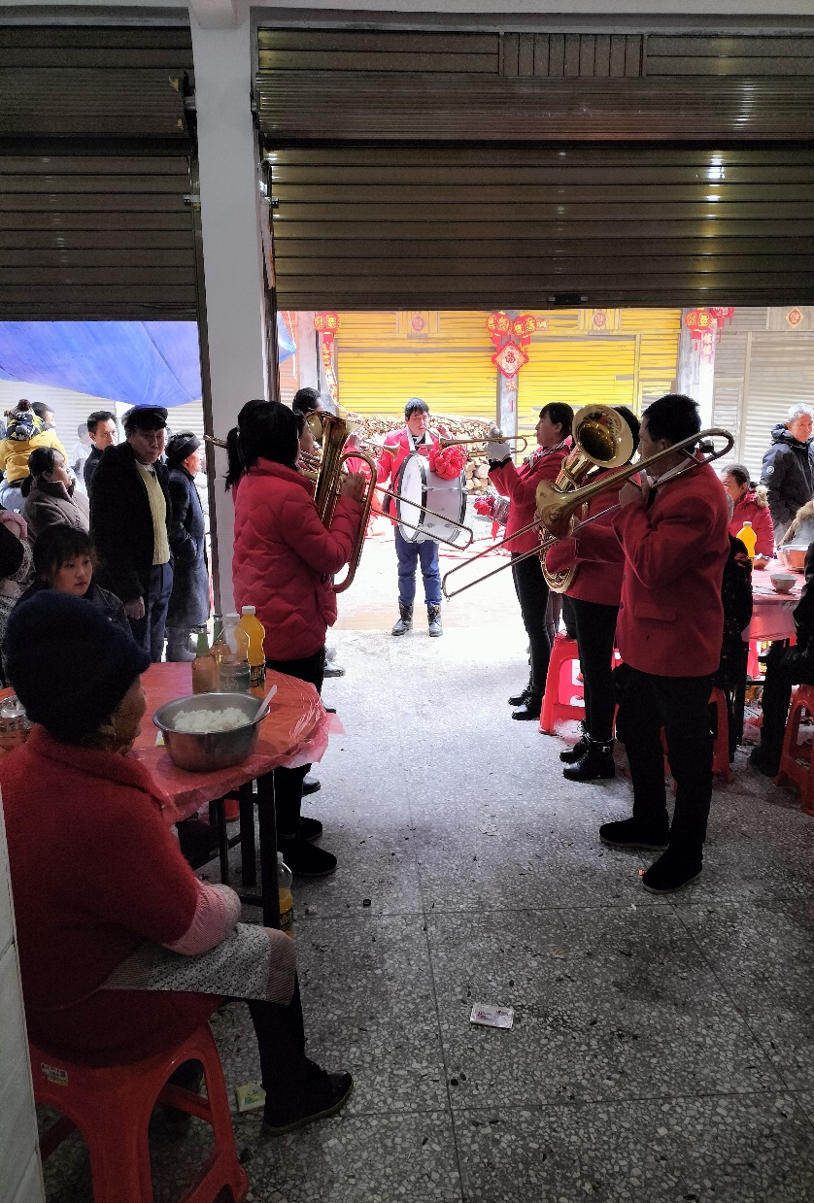
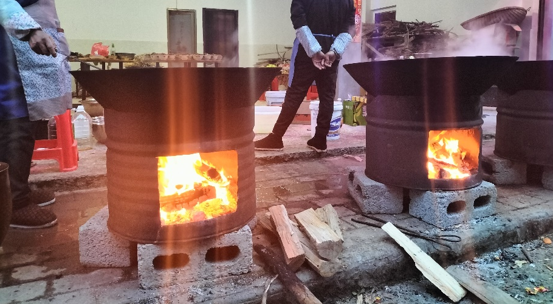
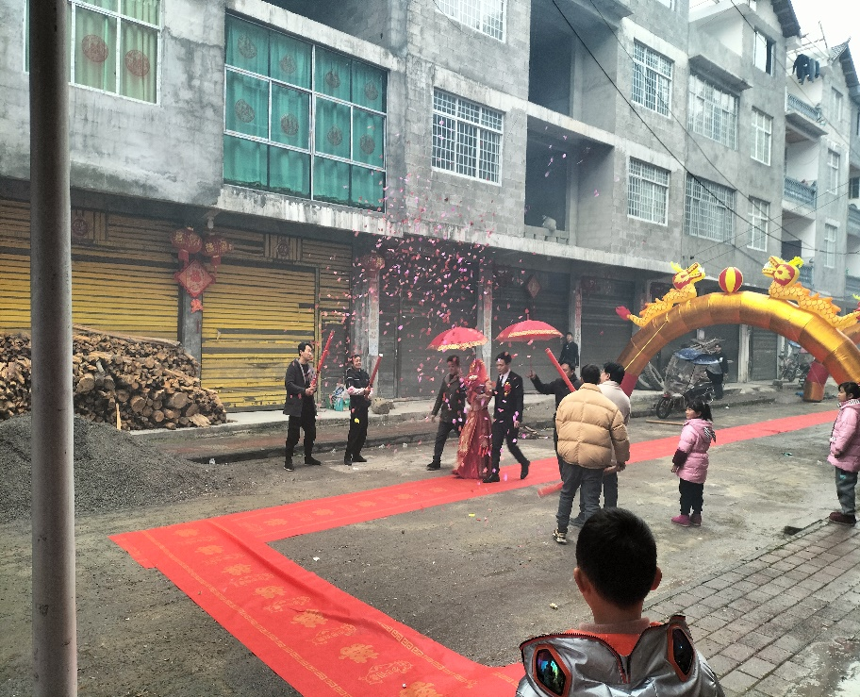
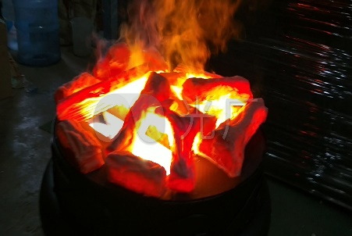
traditional wedding
添加标题文字

Slide 11
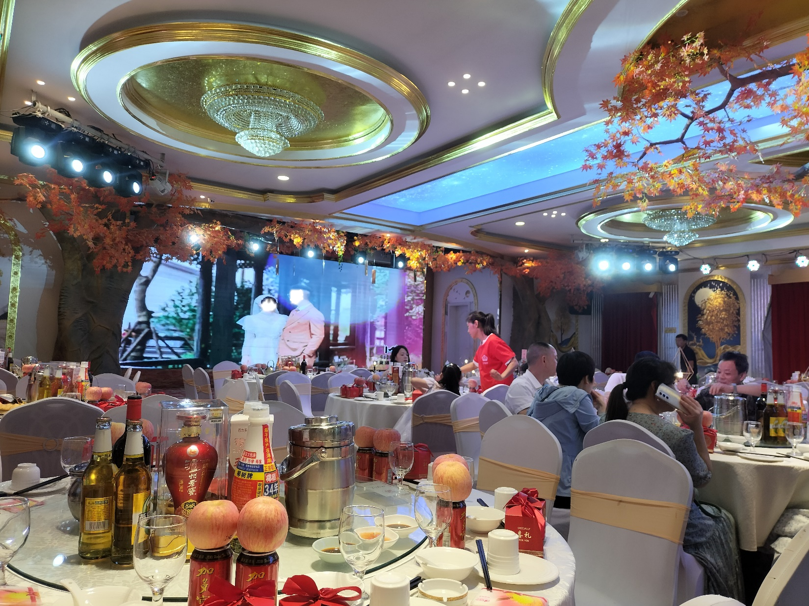
modern wedding
添加标题文字
Cum sociis natoque penatibus et magnis dis parturient montes, nascetur ridiculus mus.
Cum sociis natoque penatibus et magnis dis parturient montes, nascetur ridiculus mus.
Cum sociis natoque penatibus et magnis dis parturient montes, nascetur ridiculus mus.

Slide 12
Thank you!
Hu Yiqiang

