Slide 1
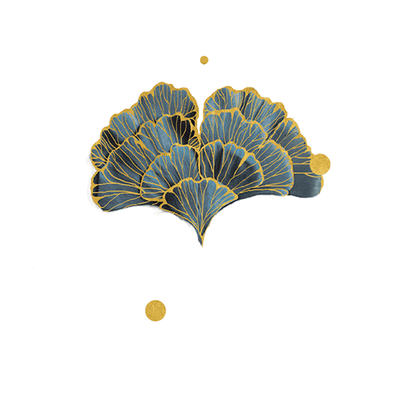
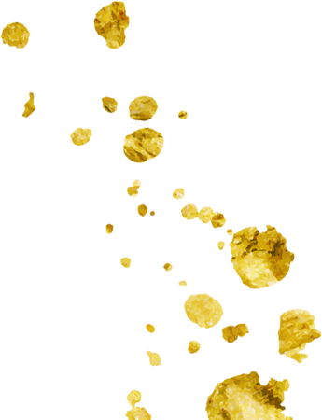
Opera: Hunan Flower-drum Opera (Huagu Opera)
汇报人：熊嘉玲 Xiong Jialing.

Slide 2


01
Introduction
02
Origin and Development
CONTENTS
03
Aria Melody
04
Main Schools and Famous Repertoires

Slide 3
01
Introduction

Slide 4
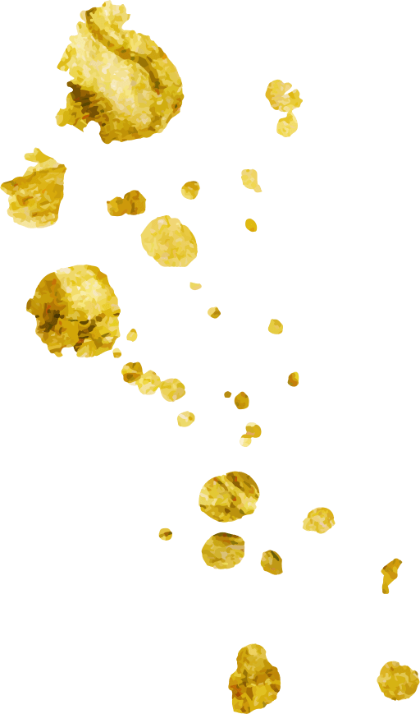
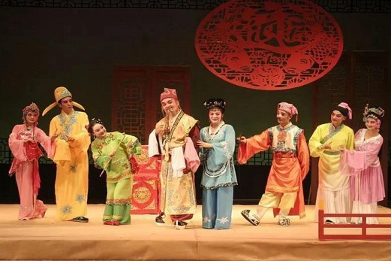
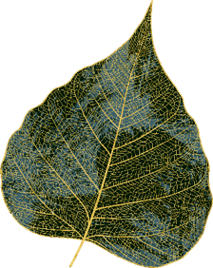
Flower-drum opera (Huagu Opera) is the general term for "flower-drum" in various local small plays in China, which is mainly spread in Hunan, Hubei, Anhui, Zhejiang, and other places. It is one of the opera dramas developed on the basis of folk songs, minors, labor chants, and various local flower-drums (including flower-drum beaten(打花鼓), field flower-drum(地花鼓)— flower-drum lantern(花鼓灯)). At the end of the Ming Dynasty, Fan Wenruo's legendary works described the drama scene of singing the flower-drum, showing the original appearance of this art form. In the course of practice, it drew on the performance mode of local dramas, absorbed various artistic factors, and eventually developed into an independent local opera genre. Hunan flower-drum opera is sung in Hunan dialect, with a total of 123 traditional repertoires. It is popular in central Hunan, eastern Hunan, and Dongting Lake areas.

Slide 5
02
Origin and Development

Slide 6

The origin of Hunan flower-drum Opera can be traced back to the recreational folk entertainment song and dance performances that appeared in Qing Dynasty. The County Annals of Liuyang(《浏阳县志》), published during the Jiaqing period of the Qing Dynasty, recorded the early Hunan flower-drum opera. People sang and danced in their spare time to relieve fatigue. The main sings are folk minor tunes and brand tunes.
Over time, the early flower-drum gradually developed into a professional or semi-professional song and dance show with audiences and actors. During the reign of Guangxu, this kind of small singing and dancing troupe often held some seasonal performances in the countryside, and then the field flower-drum was called the "flower-drum opera" by convention. (Zeng Dingling, 2020, 14)

Slide 7
From different perspectives, the development of Hunan flower-drum opera has different stages.
the organizational form of the classes
development of vocal tunes
its role of business（角色行当）
It has gone through the stages of folk song, lantern tune(灯调), fixed-melody(曲牌）, opera-like Daluo (playing gong打锣腔), and Sichuan tune（川调） to the confluence of various tunes. (Yin Bokang, 1997, 61)
It has experienced three stages of development from “two young”（二小）(young Chou and young Dan小丑和小旦), “three young”（三小） (two young plus young Sheng小生) to “multi-role”（多行当）. The multi-role system is formed on the basis of the “three young” by adding the role of Sheng, Jing（净）, etc. Between Tongzhi and Guangxu in the Qing Dynasty, with Sheng, Dan, Jing, and Chou, the multi-role system was complete then, and repertoires expanded to large whole plays（大本戏）. (Yin Bokang, 1997, 61)
There have been three kinds of classes: seasonal classes, professional classes, and half-stage classes. The seasonal class is a semi-professional opera troupe. Actors performed during the slack season since they were busy farming in harvest time. It was popular before the Xianfeng period in the Qing dynasty. The professional class is a kind of professional opera troupe, also known as four seasons class, which performs all year round. It has a fixed leader, outfits, and relatively stable cast members. It was formed in the late Xianfeng period. Half-stage class is a special form during the period from the end of the Qing Dynasty to the beginning of the Republic of China.

Slide 8
03
Aria Melody

Slide 9
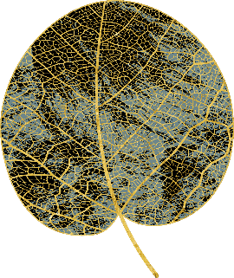
The tunes of Hunan flower-drum opera are divided into three kinds including Sichuan tune, Daluo(playing gong), and minor.
Sichuan tune is an aria form accompanied by Daidong（大筒） and suona（唢呐）, with its various tunes, different colors. The echoing two sentences are composed of upper and lower sentence aria and upper and lower sentences interlude. (Zhu Yongbei, 2014, 45)
Daluo is a tune formed to the period of transition, one sings and others chorus, and responding with gongs, no supporting of the orchestra, all of these are the remarkable features. The basic structure of Daluo is a combination of cavity and flow, it is usually composed of the source cavity（发腔）, counted beats speech（数板）, and the closed cavity（收腔）. (Zhu Yongbei, 2014, 44)
Folk minor is one of the main melodies of field flower-drums, which are divided into three kinds including field flower-drums, local folk songs, and silk string minors（丝弦小调）. Field flower-drum has a strong melody, and the quality of song and dance is strong. Local folk songs are "The Song of Women and Children", which has local flavor extremely, lively and vivid, bright and relaxed. Silk string minors come from a generation of Jiangnan folk songs and folk tunes, which have a wonderful melody, and the quality of the singing is powerful. (Zhu Yongbei, 2014, 46)
.

Slide 10
04
Main Schools and Famous Repertoires

Slide 11
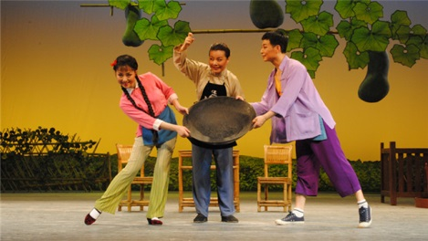

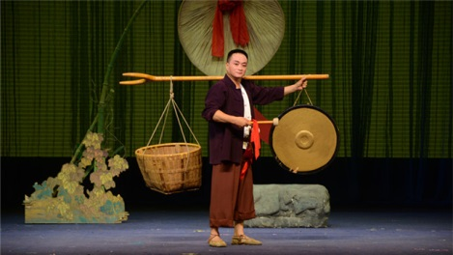
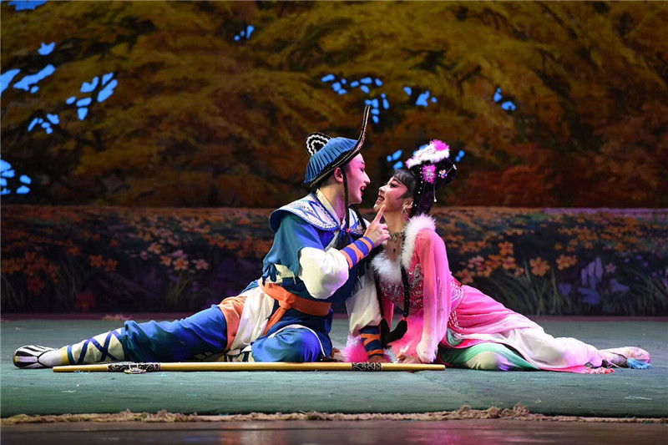
Hunan flower-drum opera is divided into 6 art schools including Changsha, Yueyang, Shaoyang, Hengyang, Changde, and Yongzhou. These six schools have their own characteristics in terms of stage language, melody types, performance forms, and repertoire content, and they are also interconnected. (Zeng Dingling, 2020, 14)
01
Hunan flower-drum opera has many famous repertoires, such as, Woodcutter Liuhai（《刘海砍樵》）Play Tam-tam（《打铜锣》）, Tinker a Pan（《补锅》）, and so on.
02

Slide 12
Thank You For Your Listening

