Slide 1
中國語言文化
Session 3, Thursday Sep 19, 2024, Zhishan Bldg. 至善楼105, room 105
Martin Woesler

Slide 2
TOPICS
=Session 3 Thursday Sep 19, 2024 19:00-21:35=
All students: Please prepare these three texts in the textbook for today.
During the three hours today, the students are presenting the following 6 topics:
44. Facial Make-up: Cosmetics, Traditional Chinese Make-Up, p. 393 (Li Xiaosu/Jacinda) [[Media:Cosmetics_2024.pptx]]
50. Games: Go 围棋, p. 439 (Peng Yixin/ Eason) [[Media:Go_2024.pptx]]

Slide 3
TOPICS
51. Games: Kite Flying p. 445 （Liu Huixuan/ Polly）[[Media:Kite_2024.pptx]]
52. Games: Mahjong: An Ancient Chinese card play, p. 452(Zeng Wenjing/Zoey)[[Media:Mahjong_2024.pptx]]
55. Garden culture: the Summer Palace, p. 493(Liu Zhehui/Mary) [[Media:Summer_Palace_2024.pptx]]
56. Garden Culture: Qingming Riverside Landscspe Garden 500 (Cai Yingchu/ Rachel) [[Media:Qingming_2024.pptx]]

Slide 4
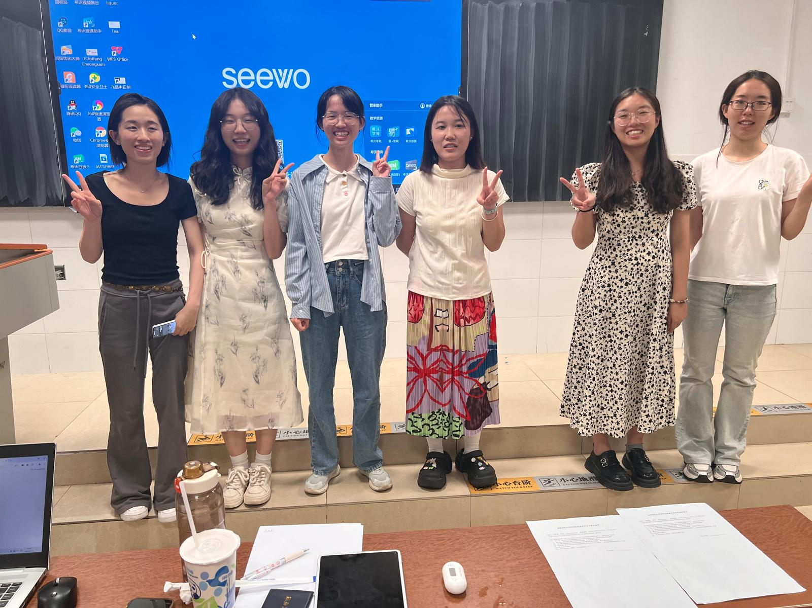
Li Xiaosu | Peng Yixin | Liu Huixuan | Zeng Wenjing | Liu Zhehui | Cai Yingchu
Make-up | Go | Kite | Mahjong | Summer Palace | Qingming

Slide 5
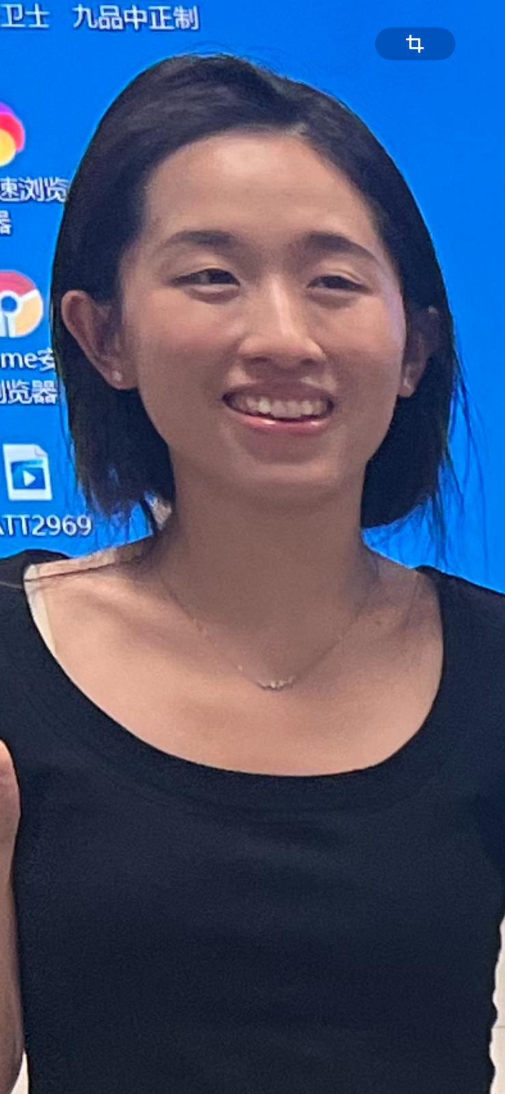
Li Xiaosu Facial Make-up

Slide 6
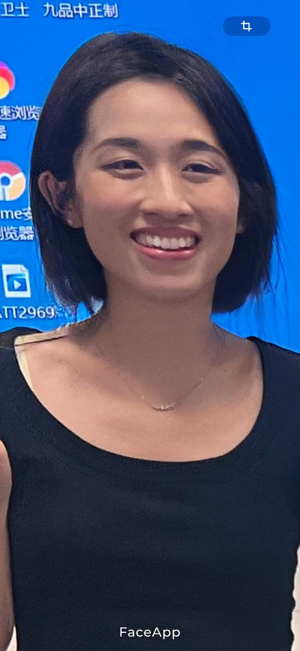
Li Xiaosu

Slide 7
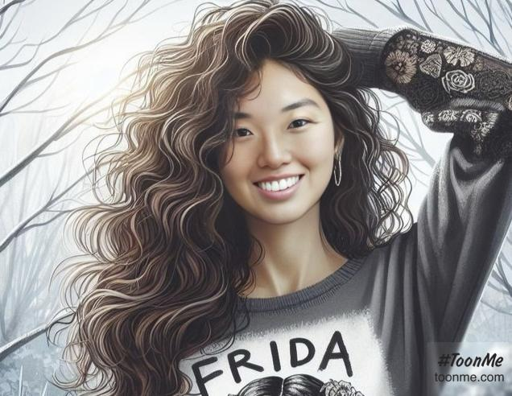
Li Xiaosu Facial Make-up

Slide 8
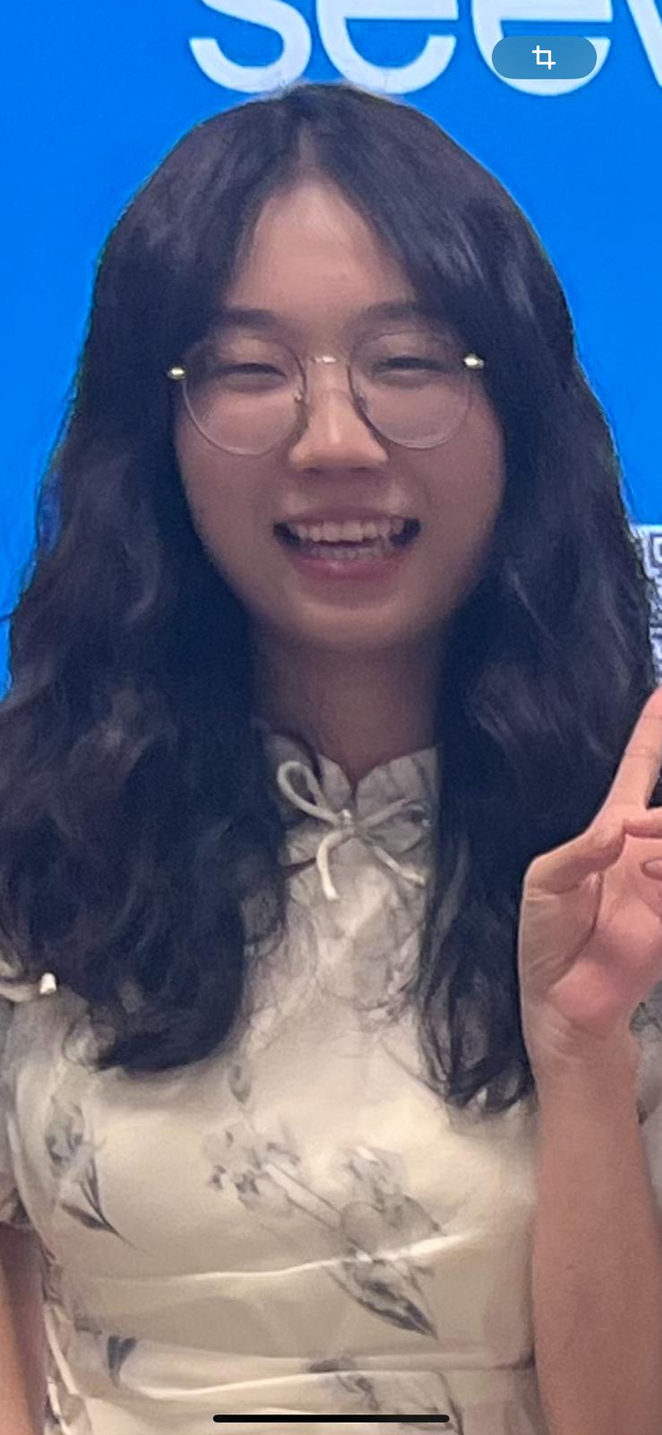
Peng Yixin GO

Slide 9
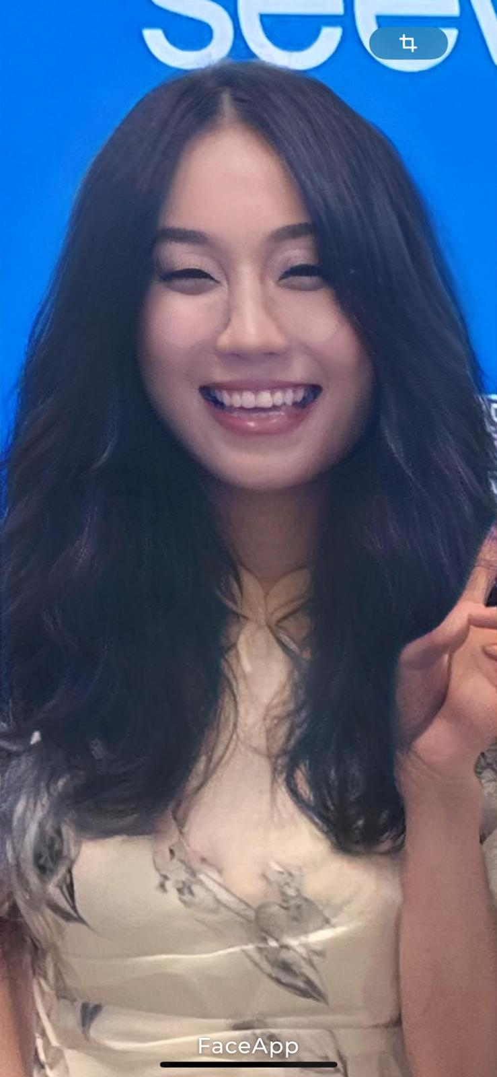
Peng Yixin Go

Slide 10
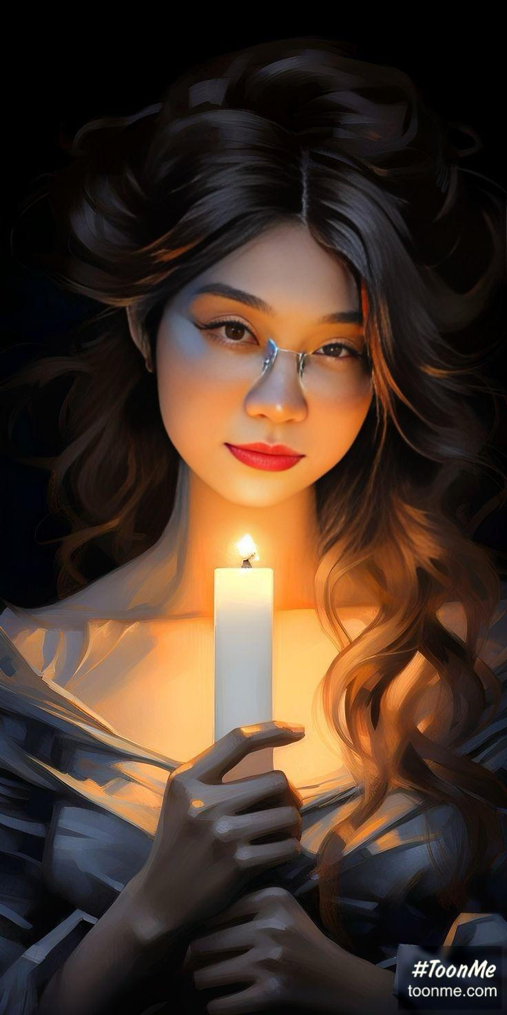
Peng Yixin GO

Slide 11
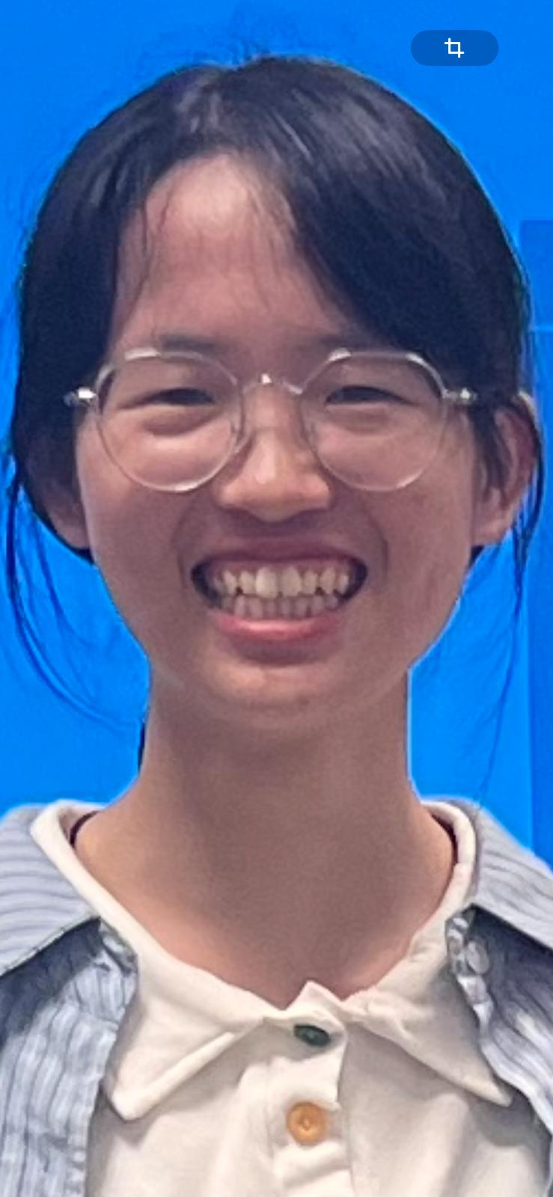
Liu Huixuan Kite

Slide 12
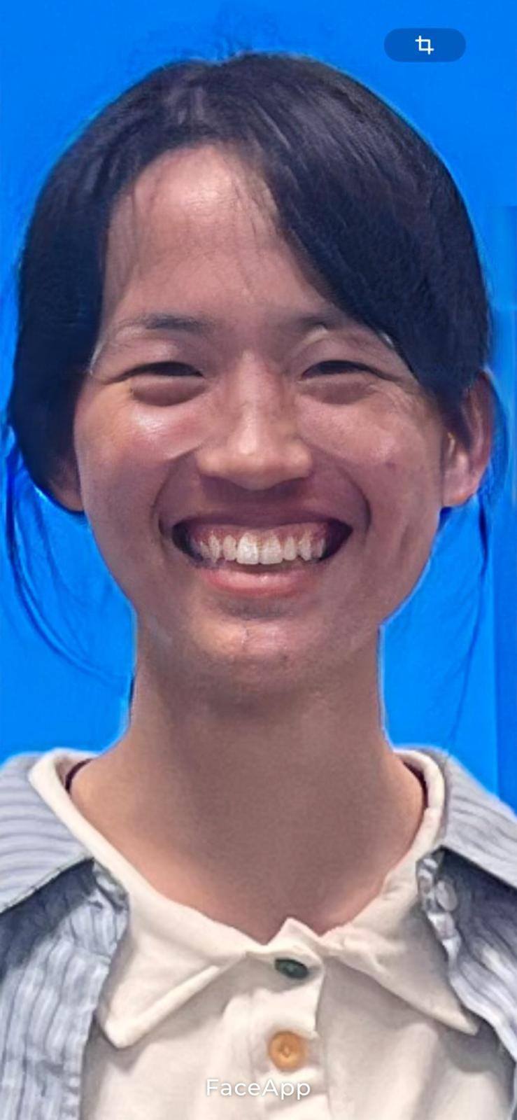
Liu Huixuan

Slide 13
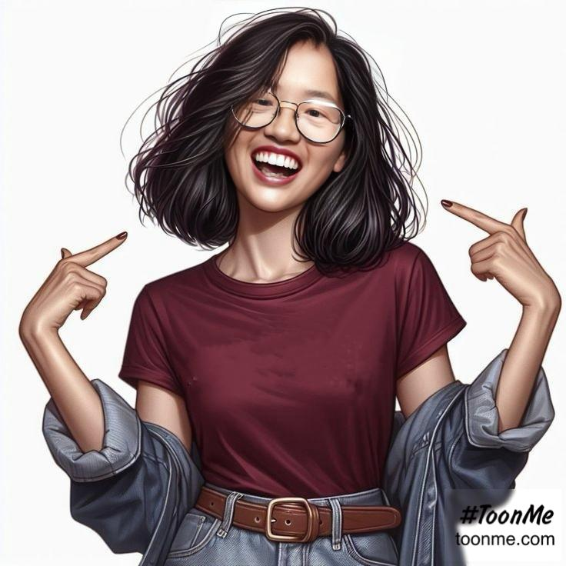
Liu Huixuan

Slide 14
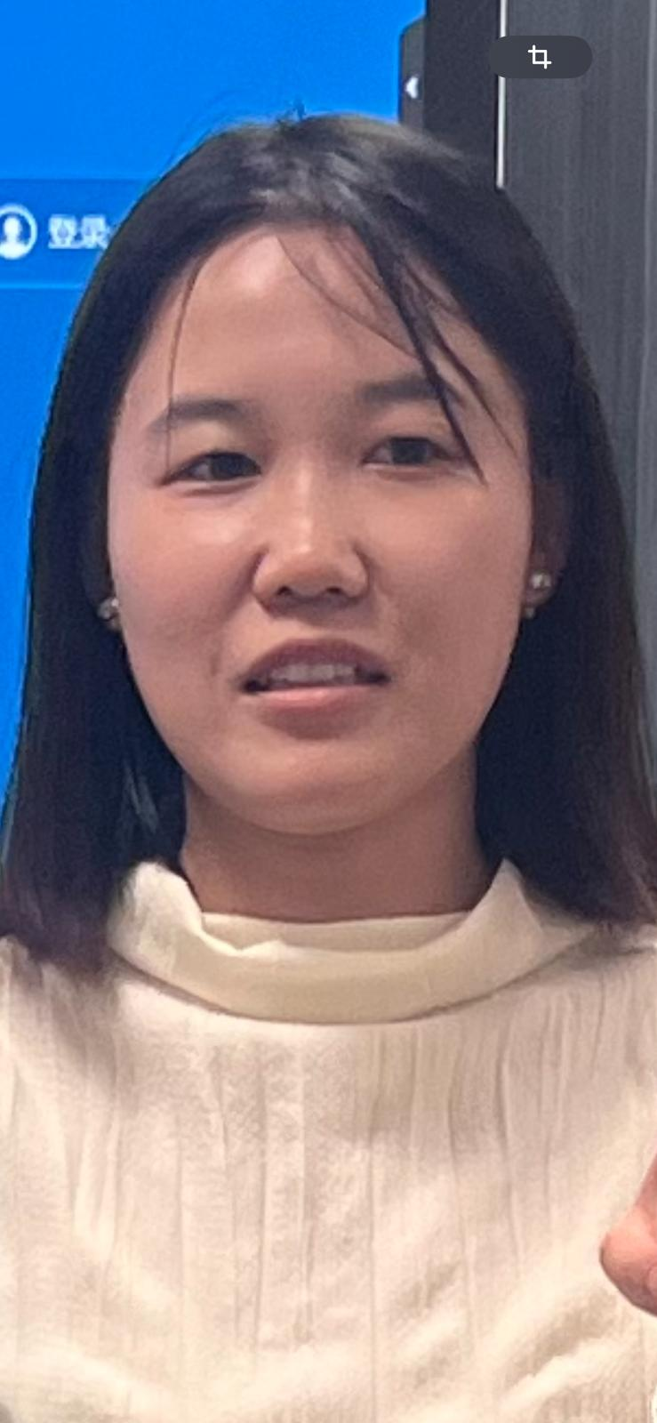
Zeng Wenjing Mahjong

Slide 15
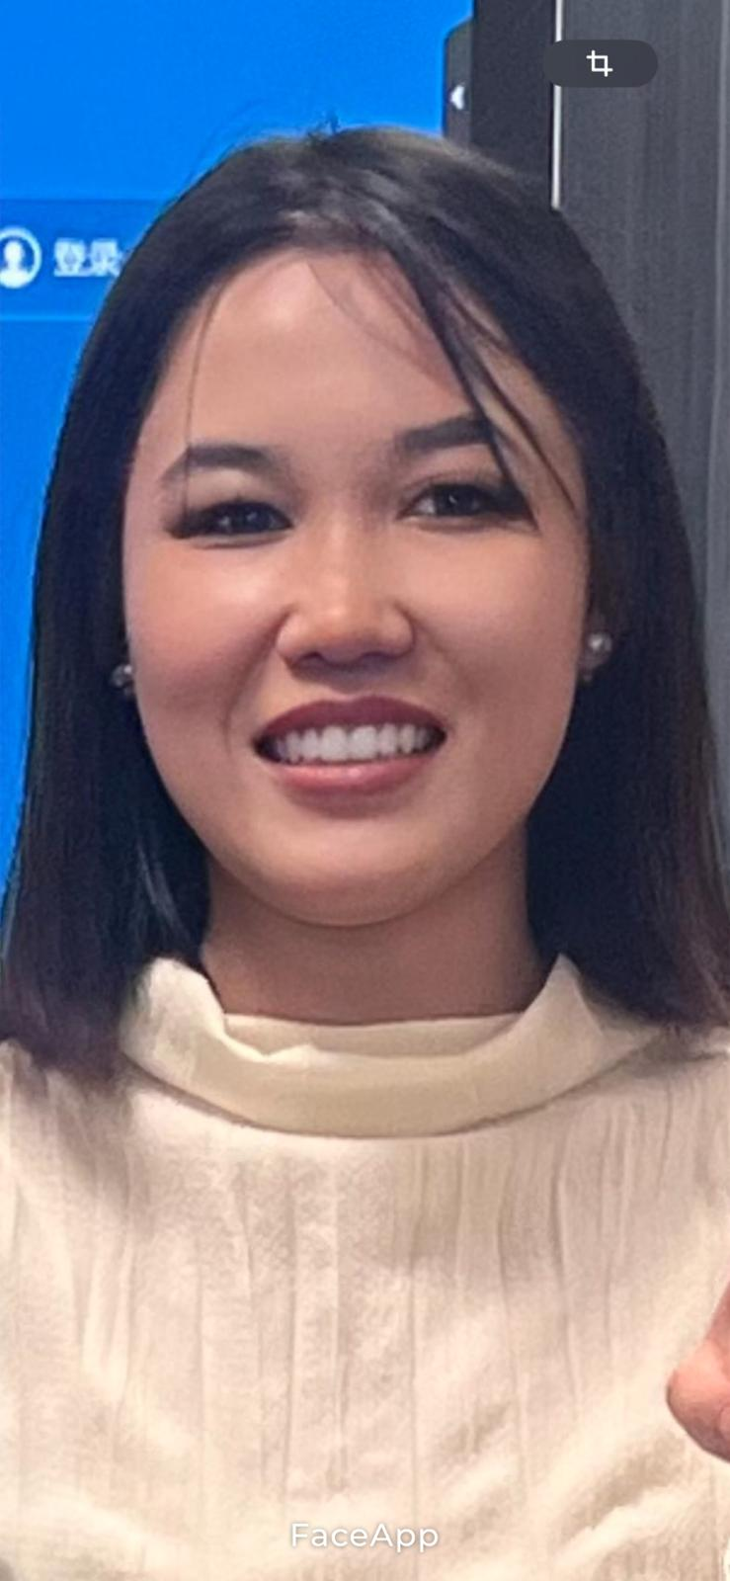
Zeng Wenjing

Slide 16
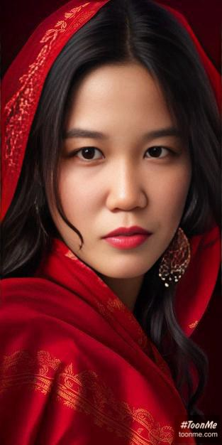
Zeng Wenjing

Slide 17
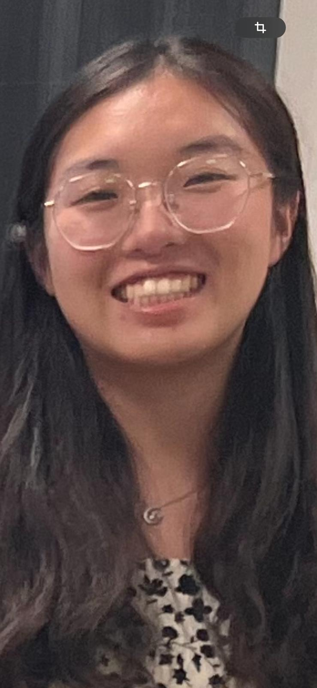
Liu Zhehui Summer palace

Slide 18
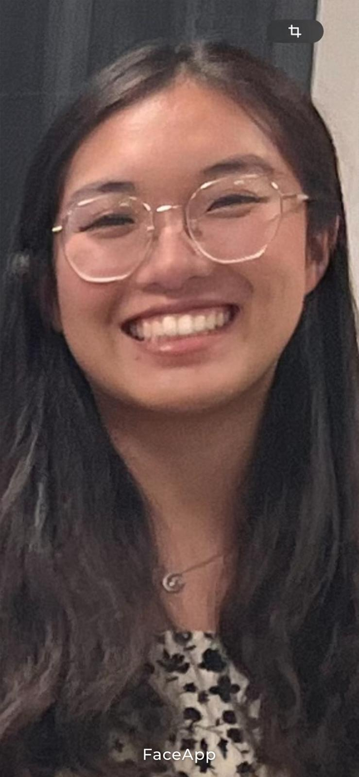
Liu Zhehui

Slide 19
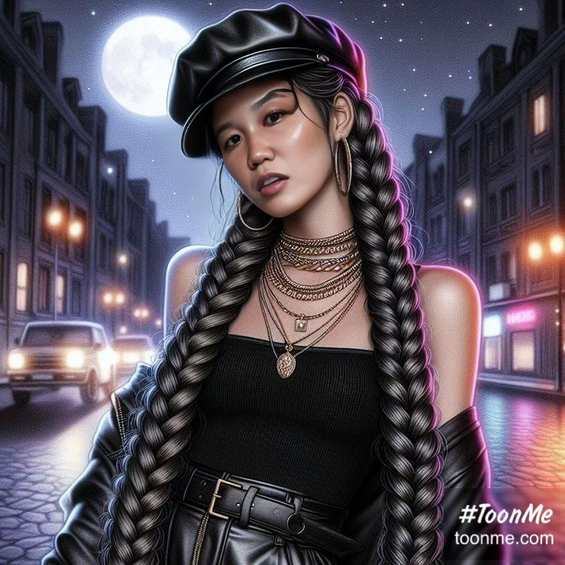
Liu Zhehui

Slide 20
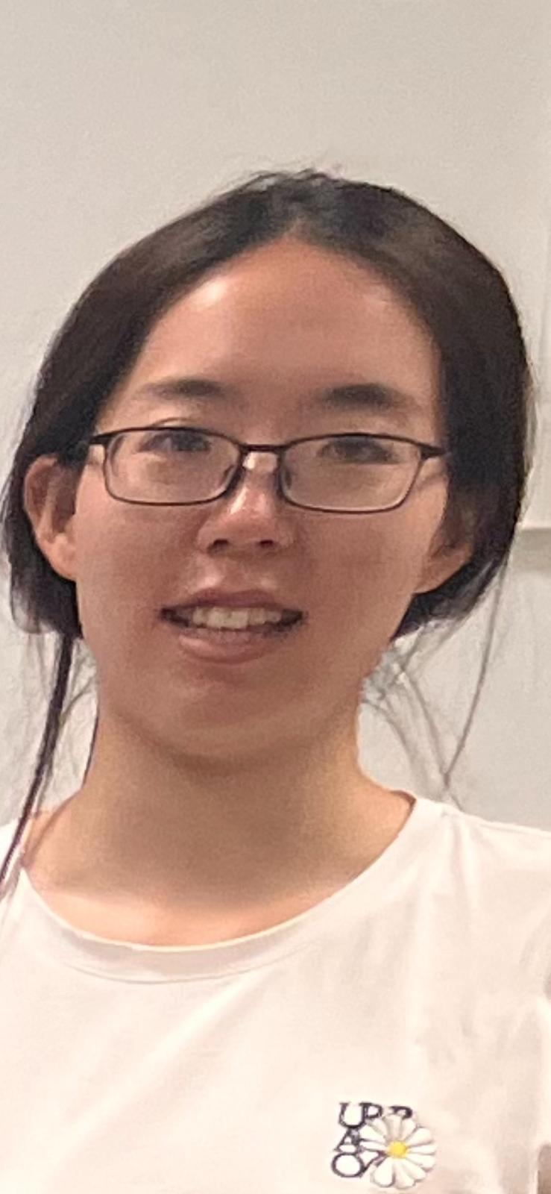
Cai Yingchu Qingming

Slide 21

Cai Yingchu

Slide 22
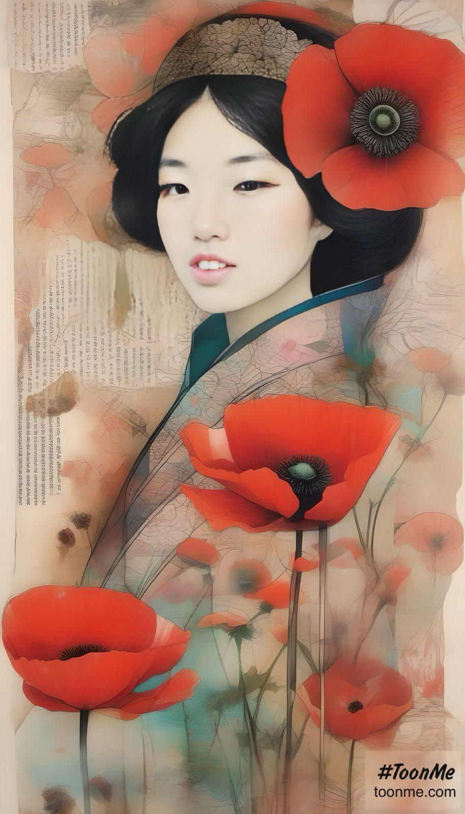
Cai Yingchu

Slide 23
Prepare for next time
Homework:
1. Please read the six texts for next time in the textbook.
2. Please add your final exam paper topic and your name in the respective section above.
3. Take the surveys (EU: https://wn8ae3qwafbc11zv.mikecrm.com/9gdWrQT
, 2024: https://wn8ae3qwafbc11zv.mikecrm.com/CTrdOjm).

Slide 24
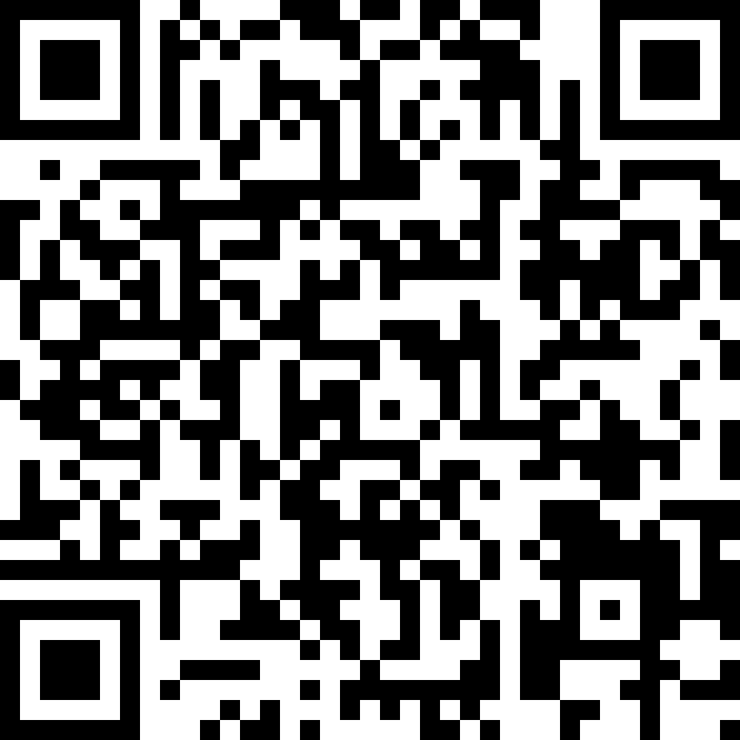
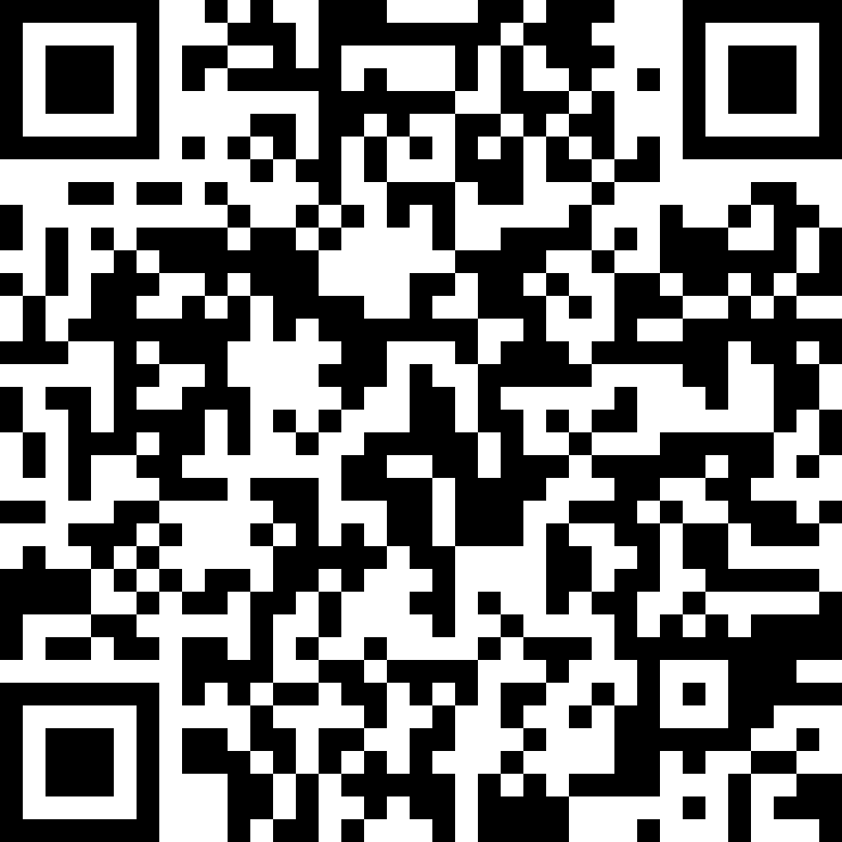
Questionnaires
EU
https://wn8ae3qwafbc11zv.mikecrm.com/9gdWrQT
2024 https://wn8ae3qwafbc11zv.mikecrm.com/CTrdOjm

