Slide 1
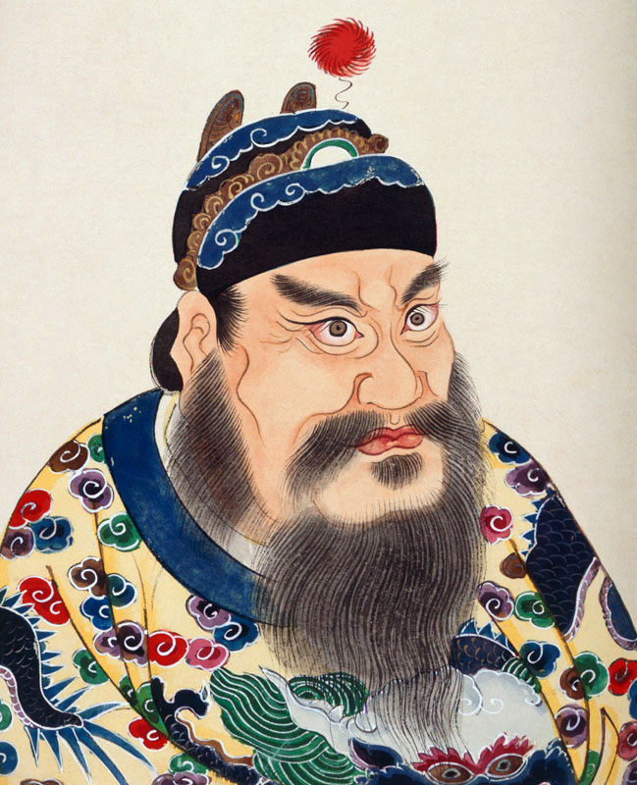
Qin Shihuangdi
The “First” Emperor

Slide 2
Who was I?
I was born in 259 BCE.
My Father was King Zhuangxiang of the state of Qin.
My given name was Zhao Zheng or Ying Zheng.
At the age of 13 my father died and I ascended to the throne.
Lu Buwei was my Prime Minister and Li Si was one of his retainers, they helped me rule while I was still young.

Slide 3
My rule of Qin
My reign of Qin was marked by constant warfare.
In the year 238 BCE at the age of 21 I received the cap of manhood and put on the girdle and the sword.
During that same year I had to deal with a revolt started by Lao Ai.
I dealt with this rebellion swiftly. Lao Ai and his followers were executed. His followers were beheaded and Lao Ai was torn in two by carriages.
Lu Buwei was implicated in this treacherous plot so I removed him from his post. He later committed suicide.

Slide 4
My campaign to unify China
Li Si urged me to take over Han to terrify the other states.
I took over Han first in 230 BCE with the help of an earthquake and famine.
Zhao fell in 228 BCE. I travelled to Handan and had all the enemies of my mother’s family killed.
I attacked the Yan capital of Ji in 226 and defeated the army of the Crown Prince of Dan and beheaded him. The king escaped my wrath.
I conquered Wei in 225 BCE, I flooded the capital and the king surrendered.
I conquered Chu (Jing) in 223 BCE
In 222 BCE I finished off the Yan at Liaodong.
In 221 BCE I moved from Yan south to attach Qi. I seized the King of Qi and with this act I conquered all the states.

Slide 5
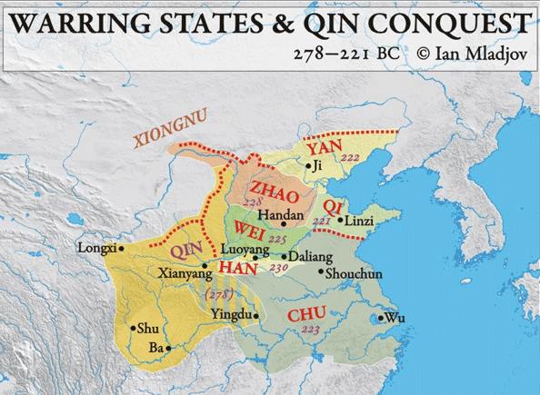

Slide 6
How did I do it?
I had a grand army that varied from 500,000 to 1 million strong.
My army was capable of having 1 million armored infantry, 1000 chariots, and 10,000 horses.
My armies used the most advanced weapons available. Iron swords, crossbows, chariots.
My army was disciplined and well trained as a result of the bureaucratic institutions in Qin.

Slide 7
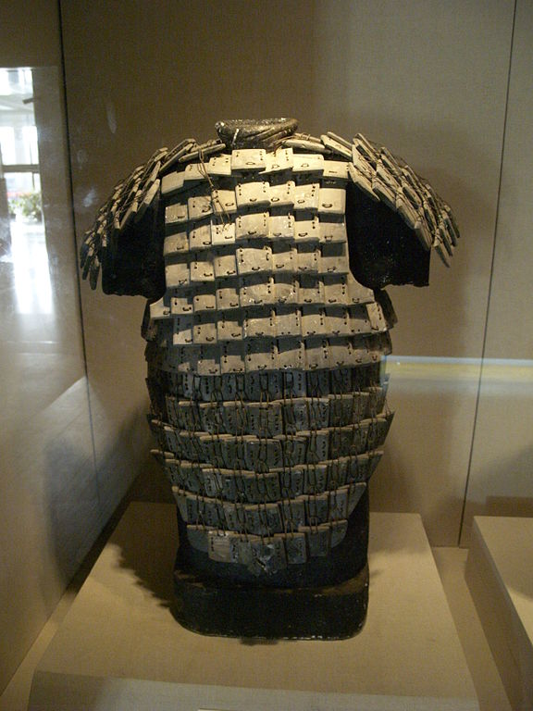
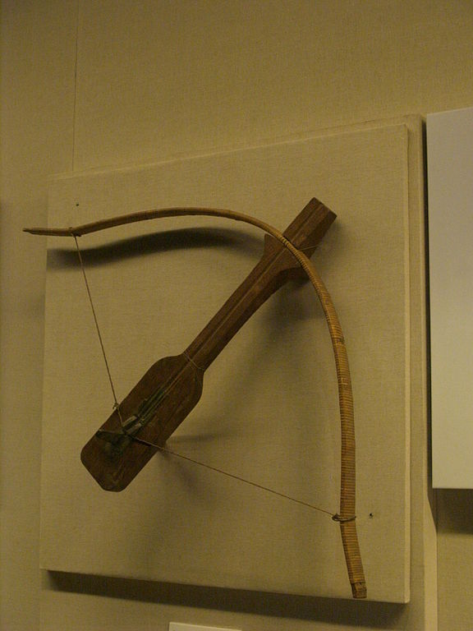

Slide 8
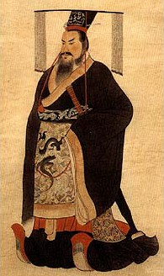

Slide 9
Qin Shihuangdi
After the unification of China, I proclaimed my self the First Emperor of the Qin Dynasty.
I was also known as the August Emperor.
I wanted my empire to last for 1000 or 10000 generations. A succession without end.
I succeeded in pacifying the world and I ruled all under heaven.
My Empire was divided into 36 provinces.

Slide 10
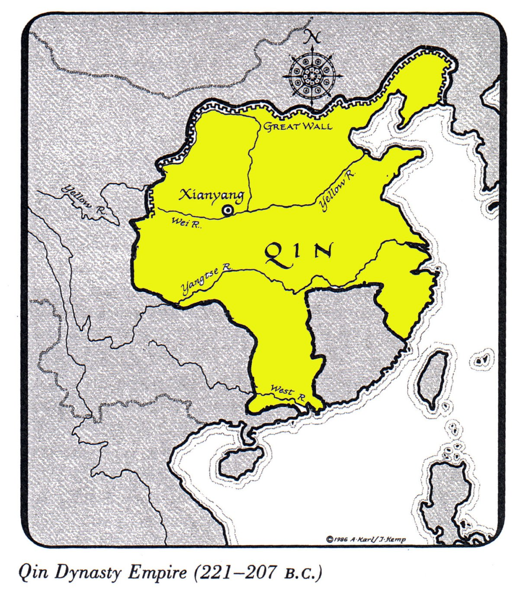

Slide 11
My Accomplishments
I abolished all feudal ranks and privileges.
I appointed Li Si as my Chancellor.
I made sure no private citizen had weapons. I melted them all down.
I moved the rich and powerful families to the capital where I could keep a closer eye on them.
I standardized weights and measures, and writing scripts.

Slide 12
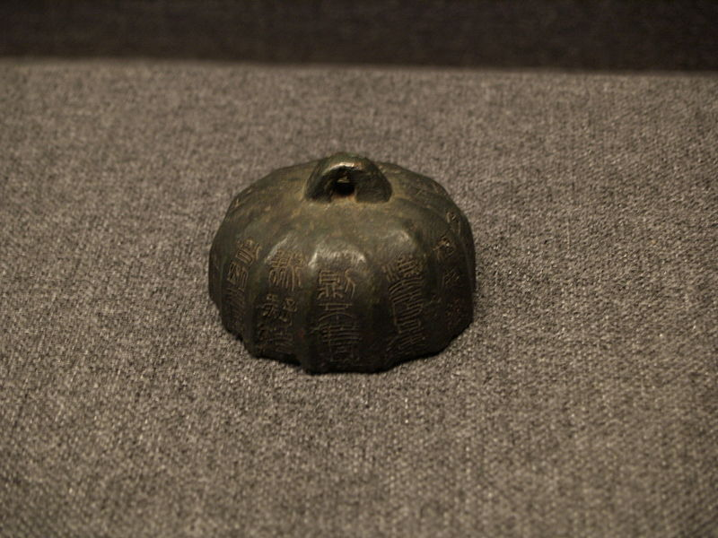
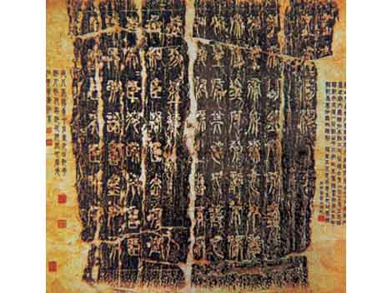

Slide 13
Justice
People must follow my laws or else they would be put to death or punished by hard labor.
No one was allowed to criticize me. The punishment was death.
The records of the past could be used to criticize me so I burned them. Anyone who discussed the Odes and the Documents I had them killed.
I used hard labor to improve the roads and to build my magnificent palace.
I connected the Great Wall and protected my people.

Slide 14
My Death
I became obsessed with immortality.
I spent large sums of money sending magicians to locate herbs which would make me immortal.
I dreamed an ocean God in the shape of a giant fish that was blocking my efforts at sea to locate the herbs at Peng Lai.
I died from illness in 210 BCE.

Slide 15
My legacy
I left a legacy of evil and oppression.
Yet my reforms such as a centralized government, and standards of weights and measures, and unification lasted well after my death.
I was buried with a life size terracotta army which would protect me in the after life.

Slide 16
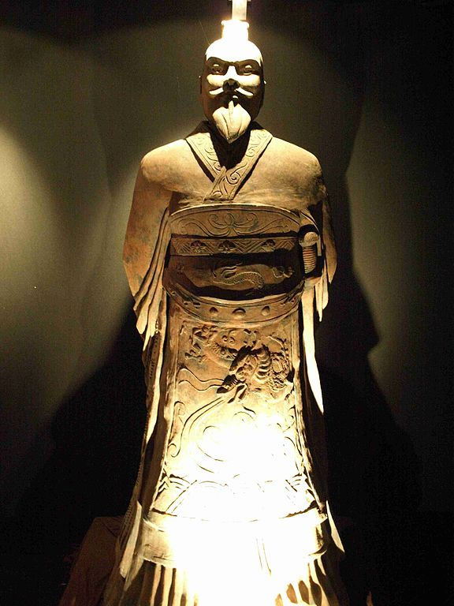

Slide 17
Sources
De Bary, WM. Theodore, and Irene Bloom, eds. Sources of Chinese Tradition, vol 1, From Earliest Times to 1600. New York: Columbia University Press, 1999.
Ebrey, Patricia. Cambridge Illustrated History of China, Second Edition. Cambridge: Cambridge University Press, 2010.
Kiser, Edward, and Yong Kai. “War and Bureaucratization in Qin China: Exploring an Anomalous Case.” American Socialogical Review, Vol. 68, No. 4, (August 2003), p. 511 – 539.
Qian, Sima. Records of the Grand Historian. Translated by Burton Watson. Hong Kong: Columbia University Press, 1993.

