Slide 1
Round Table Culture
Yu Yi

Slide 2
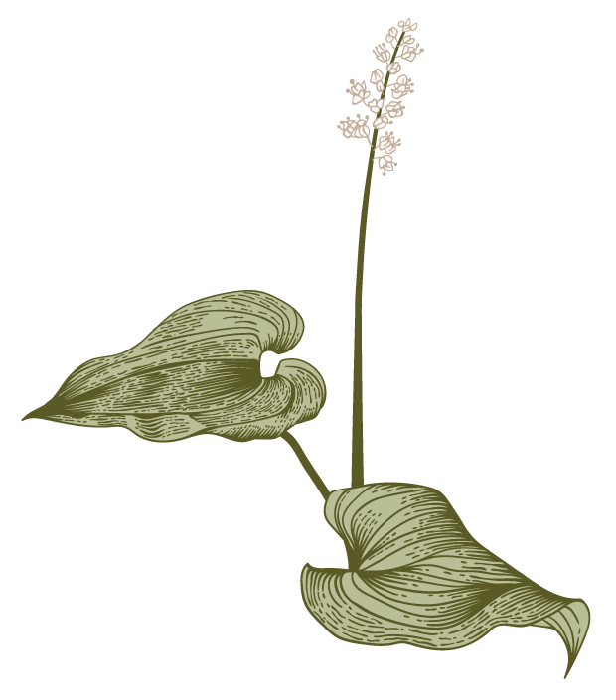
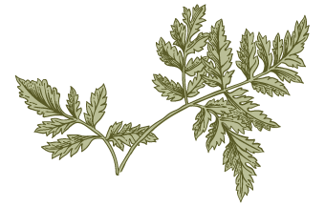
Contents
A
Brief Introduction of the round table
Cultural significance of the round table
Contrast to western countries

Slide 3
Brief Introduction of the round table

Slide 4
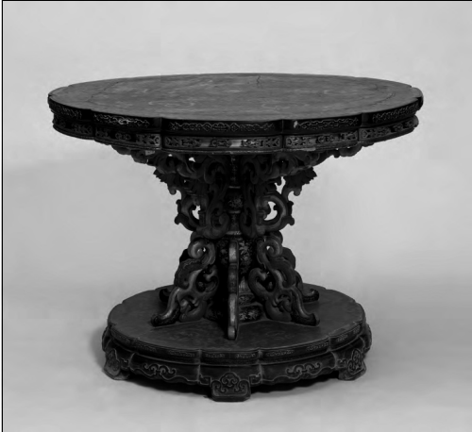
Is there a round table in your home?

Slide 5
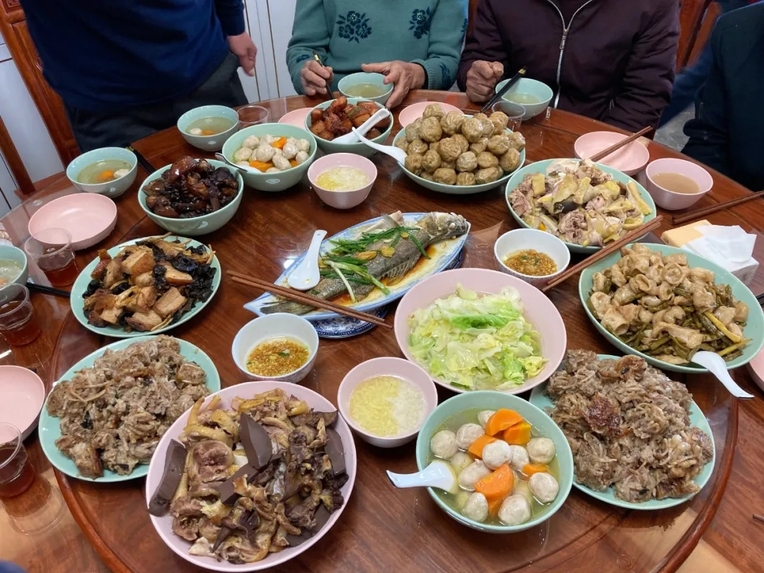
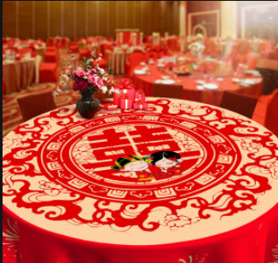
Family reunion
Weddings

Slide 6
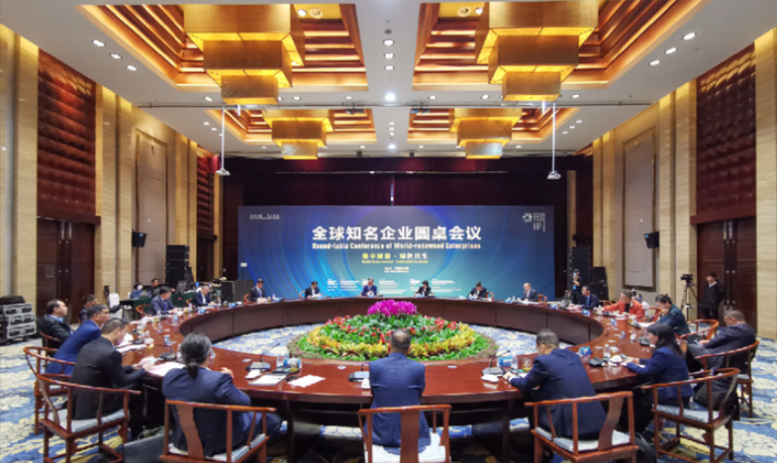

Meetings
Negotiations

Slide 7
Cultural significance of the round table

Slide 8
"Round", a typical totem of Chinese traditional culture, mainly represents perfection and wholeness and has always been advocated by Chinese people. And without sides or corners, it is widely used in Chinese gardens for harmony and balance.

Slide 9
Round table is a symbol of reunion, representing our attachment to our families. On almost every Chinese traditional festival, families will reunite to have dinner at round tables. And the seat order can show our respect for the elder.

Slide 10
Round table demonstrates equality. When we are sitting at a round table, the distance between each of us or between us and dishes will be equal.

Slide 11
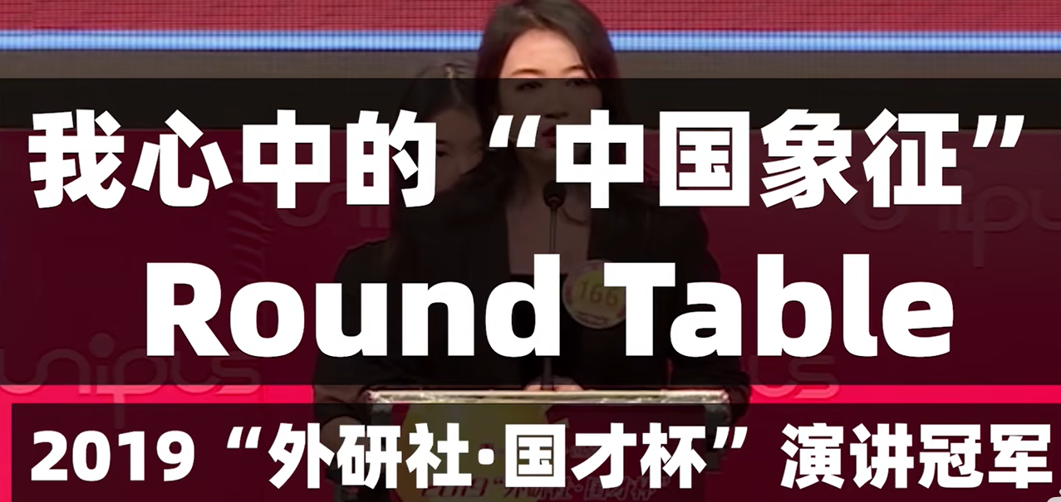
Video

Slide 12
Contrast to western countries

Slide 13
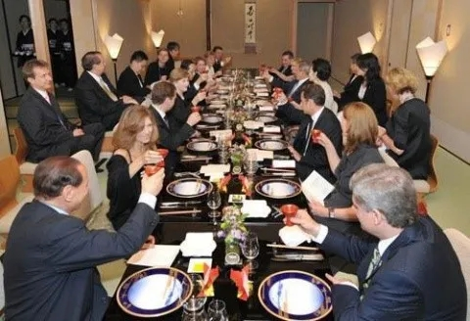
Square table

Slide 14
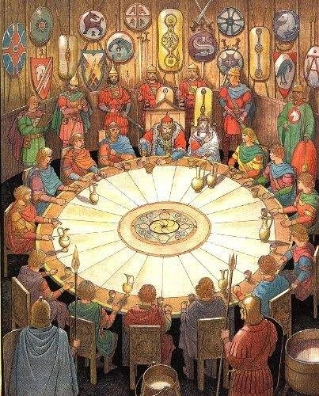
King Arthur of England with the knights under his command

Slide 15
Thank you!

