Slide 1


Wu
Zetian
The Only Female Emperor of Imperial China
汇报人：储守娟

Slide 2
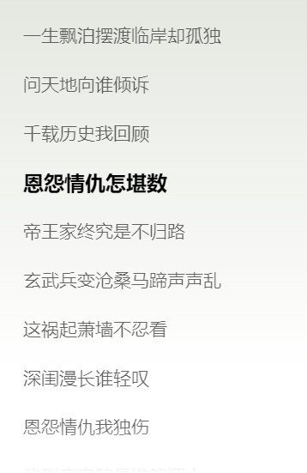
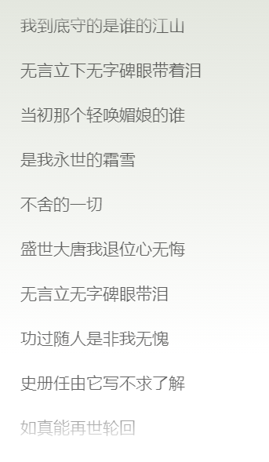
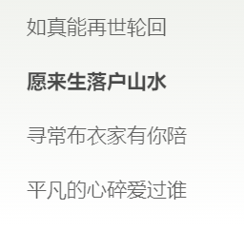

Slide 3
行业PPT模板http://www.1ppt.com/hangye/
Contents
1
Biography
2
Administrative measures
3
Anecdotal allusion
4
Comments

Slide 4
Biography
---- A legendary woman
Part one

Slide 5
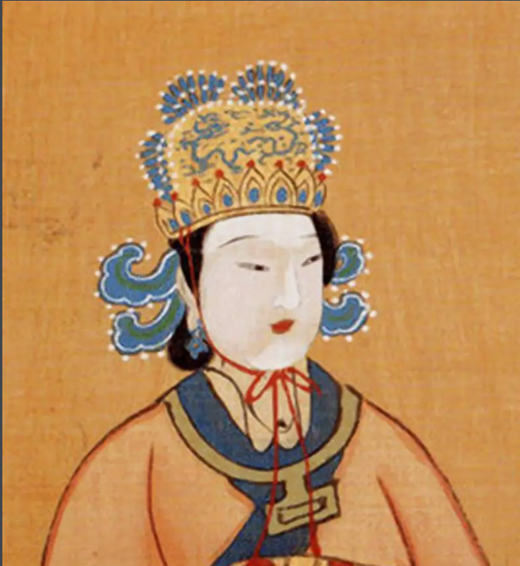
Statesman from Tang Dynasty to Wuzhou Dynasty, founding monarch of Wuzhou Dynasty (690 - 705CE)
She was the only female emperor of Imperial China and was one of the most effective and controversial monarchs in China's history.
Wuzhao (624-705CE)
Nicknames: Wu Zetian, Wu Meiniang, and Wu Hou.

Slide 6
Come to the court
In the eleventh year of Zhenguan, Emperor Taizong came to Luoyang Palace and heard that the fourteen-year-old Wu Zetian was "beautiful", so he took her to the court.
1
2
Reenter the court
In the second year of Yonghui, Wu Zetian entered the court again. After Wu Zetian returned to the palace, she quickly defeated Xiao Shufei and won Li Zhi's favor. The following year, Wu Zetian was given the title of Zhaoyi.

Slide 7
Fei Wang Li Wu
In 655, Li Zhi deposed the Empress Wang and made Wu Zetian Empress. He also deposed a large number of senior ministers. The "Fei Wang Li Wu" incident dealt a heavy blow to Guanlong Group, and the situation of the imperial power was changed, which had a very great impact on Chinese history.
3

Slide 8
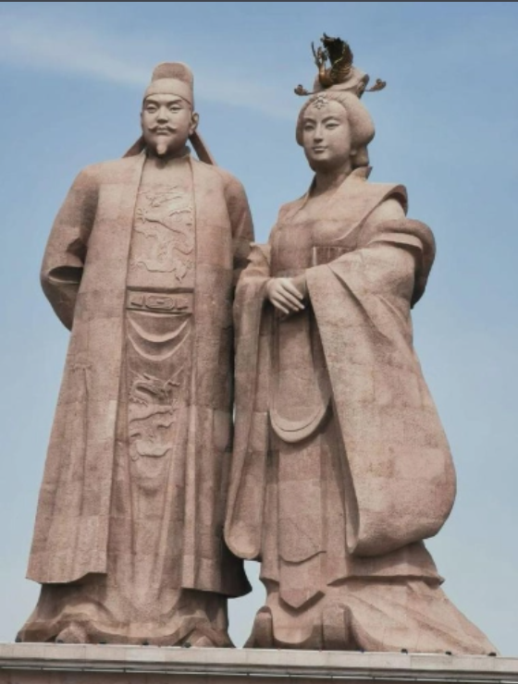
Two Saints in court
In 660, Li Zhi became ill and let Wu Zetian handle the administration. After Wu Zetian gained her ambition and acted recklessly, Li Zhi and Shang Guanyi discussed the removal of the empress. Wu Zetian got the news and immediately went to Li Zhi to complain, Li Zhi regretted it again, and put the responsibility on Shangguan Yi. From then on, whenever Li Zhi ruled, Wu Zetian would stay behind.
In 674, Li Zhi was proclaimed Emperor and Wu Zetian Empress.
4

Slide 9
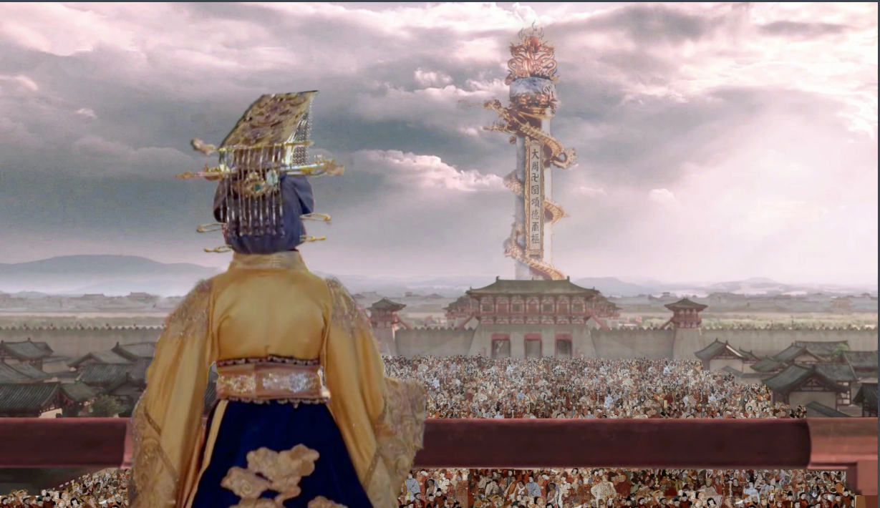
Tai Hou Cheng Zhi
After the death of Li Zhi, Wu Zetian was honored as Empress Dowager. She ruled the dynasty and held great power.
Years of the Queen
In 690, Wu Zetian changed the name of Tang to Zhou. This marked the establishment of the Wu Zhou Dynasty. In history, that event was called the "Wuzhou Revolution". From then on, Wu Zetian began her empress years.
5
6

Slide 10
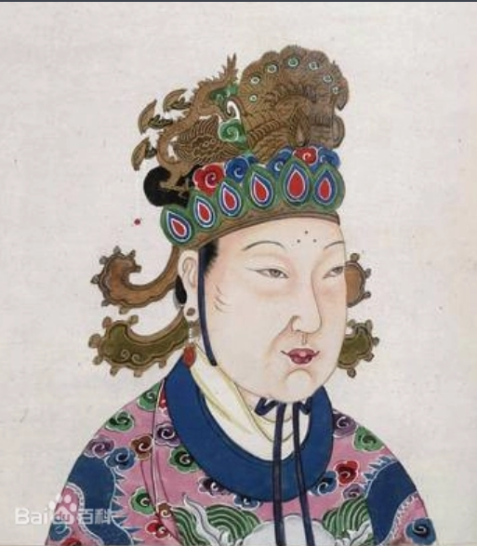
7
Abdicate and die
In her later years, Wu Zetian indulged in pleasure and trusted Zhang brothers. Therefore, in the first year of Shenlong, the court ministers launched a coup d 'etat, asking Wu Zetian to abdicate and Li Xian to restore. After her abdication, Wu Zetian fell ill and died.

Slide 11
Administrative measures
Politics
Economy
Culture
Part two

Slide 12
Politics
1
2
3
4
Attack gate valve, cultivate common people, develop imperial examination
Rectify official administration, punish corrupt officials severely, promote the virtuous
Open the way, pay attention to advice
Appoint cruel officials

Slide 13
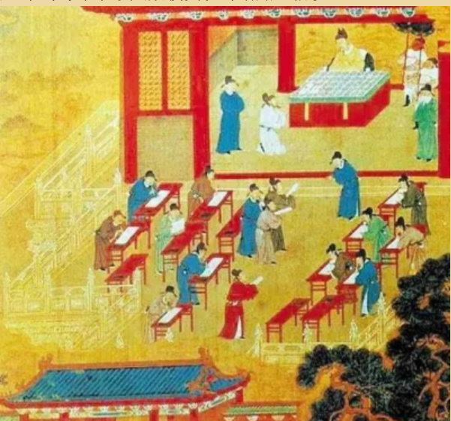
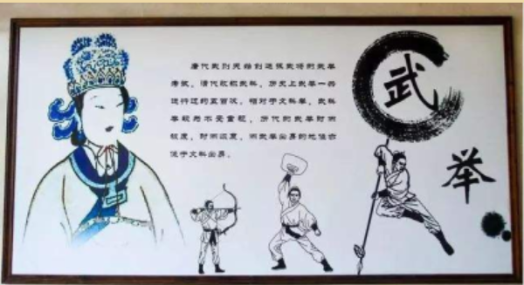
Politics
One is to adjust the subjects.
The second is to create a temple.
Three is the first martial arts.

Slide 14
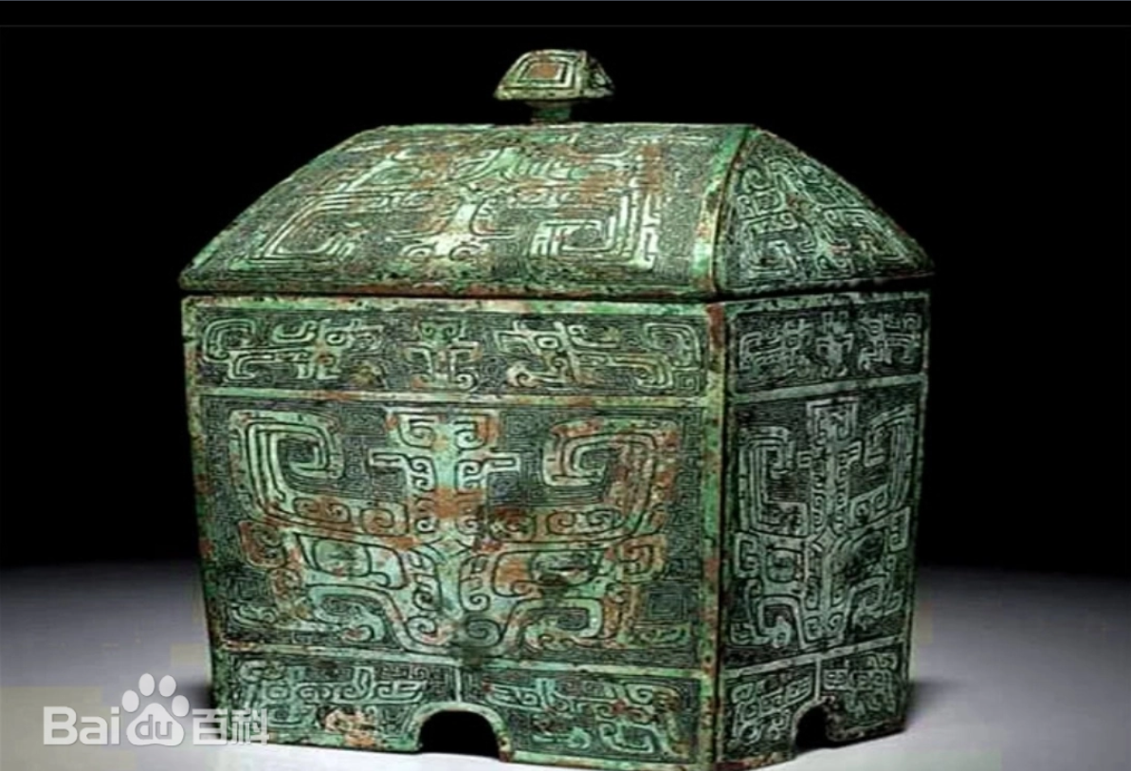
Politics
Copper box

Slide 15
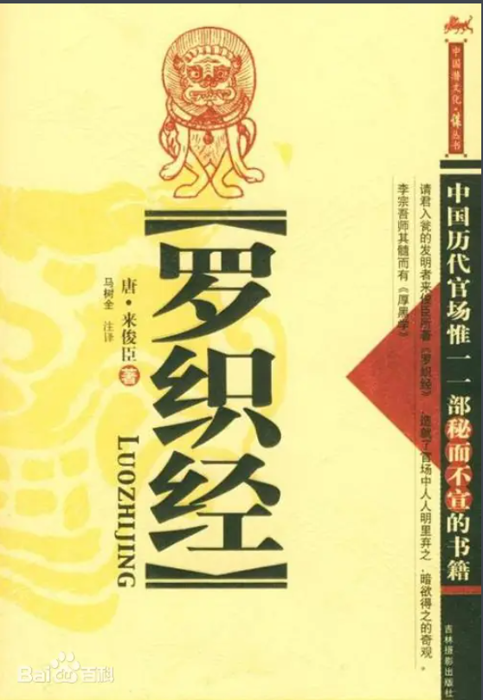
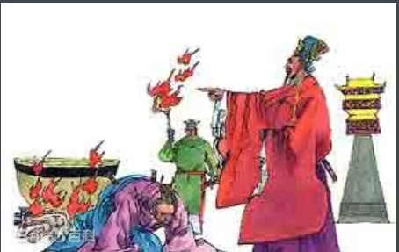
Politics
Lai Junchen
Please enter the urn

Slide 16
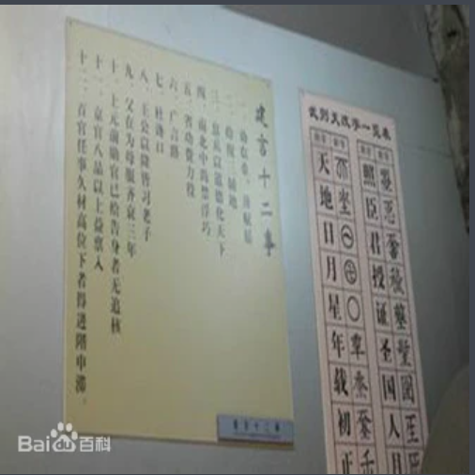
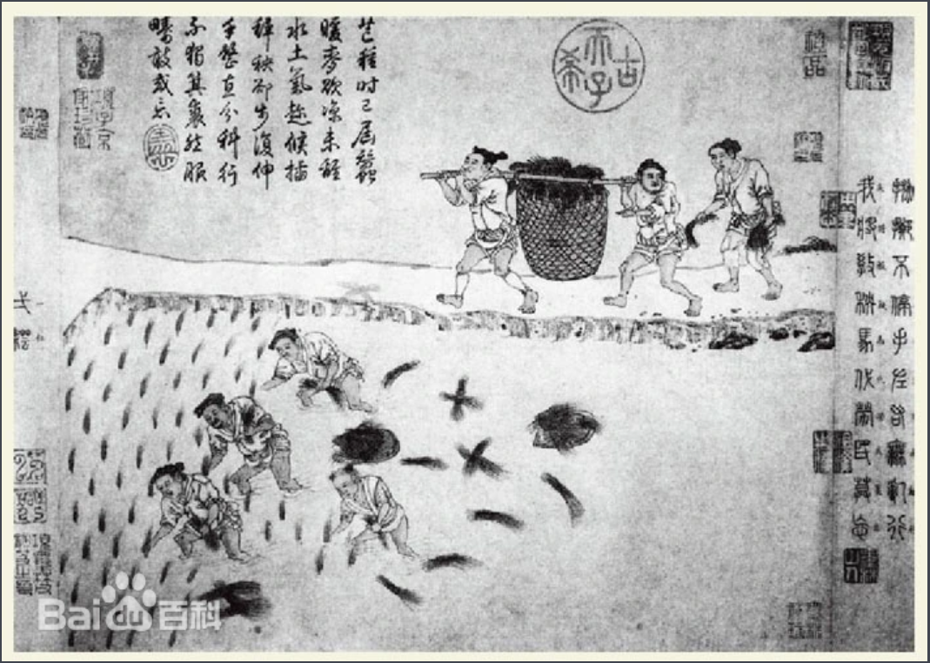
Economy
Attach importance to the development of agriculture, light corvee, and rest with the people
Advice on twelve things
The equalization system

Slide 17
Culture
Words
Zetian script
Literature
Wu Zetian herself produced many literary works, although many were for political purposes.
With her support, the court also published many works, such as the Collection of Precious Glories.
Metrical poetry was finally formed.

Slide 18
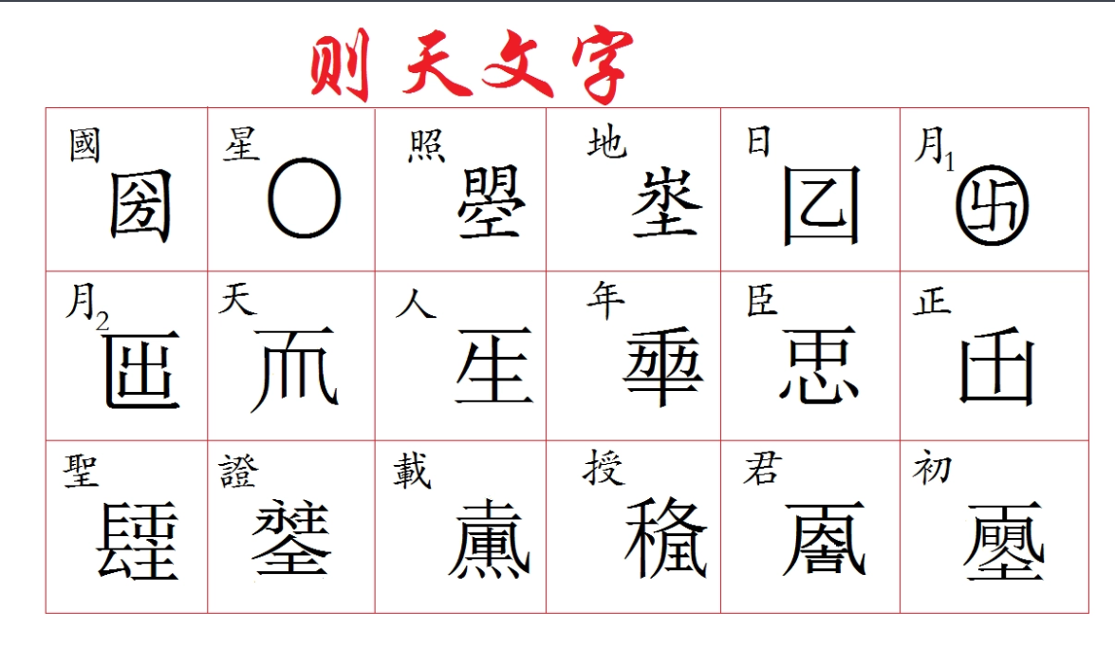
Culture

Slide 19
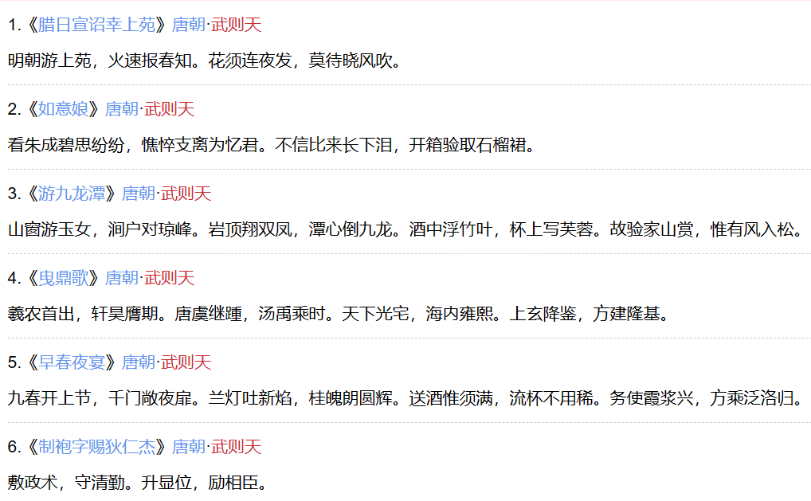
Culture

Slide 20
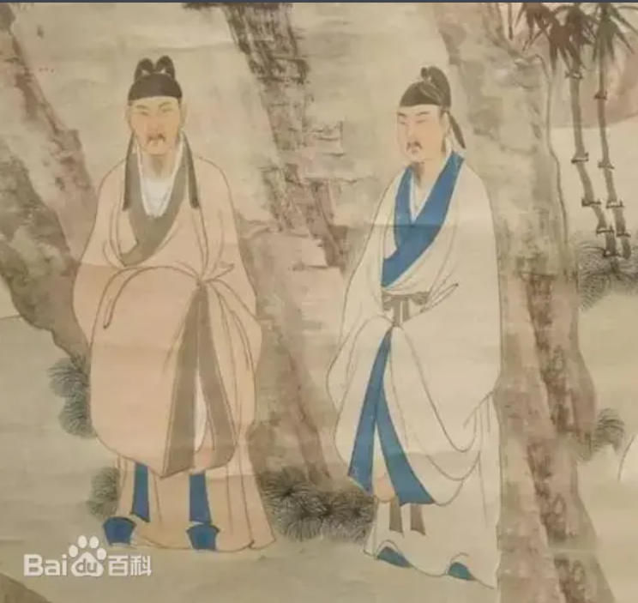
Culture

Slide 21
Anecdotal allusion
Nv Zhu Wu Wang
Zui Gu Wang Xiao
Pamper male concubines
Part three

Slide 22
When Wu Zetian was a child, Yuan Tiangang asserted that her future was limitless.
Nv Zhu Wu Wang
In order to put an end to Wang and Xiao's thoughts, Wu Zetian severed their hands and feet and threw them into the big wine Weng.
Zui Gu Wang Xiao
In her later years, Wu Zetian was addicted to pleasure and had many male concubines, and even set off a trend in the court hoping to enter the harem as a concubine.
Pamper male concubines

Slide 23
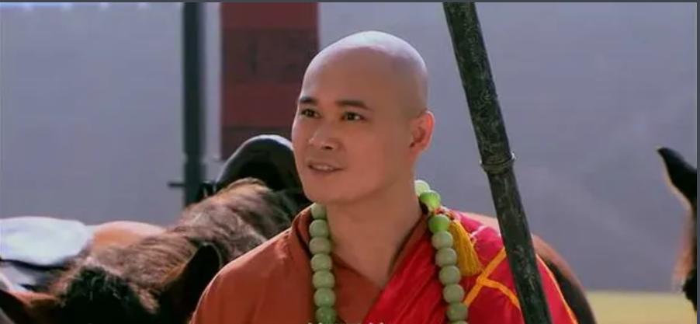
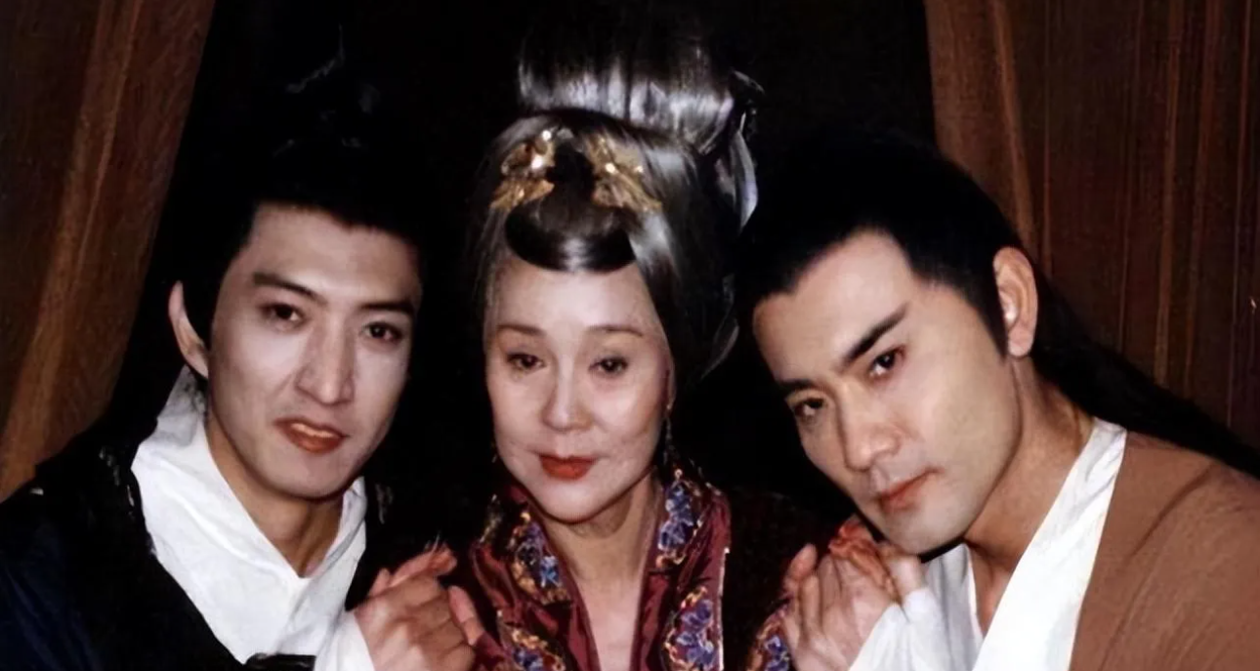
Pamper male concubines

Slide 24
Comments
Positive comment
Negative evaluation
Part four

Slide 25
Positive comment
To attack the conservative family
Promote economic development
Promote cultural development

Slide 26
Negative evaluation
Treat cruel officials with high regard
1
There were male concubines
2
Lost territory
3
Cronyism
4

Slide 27
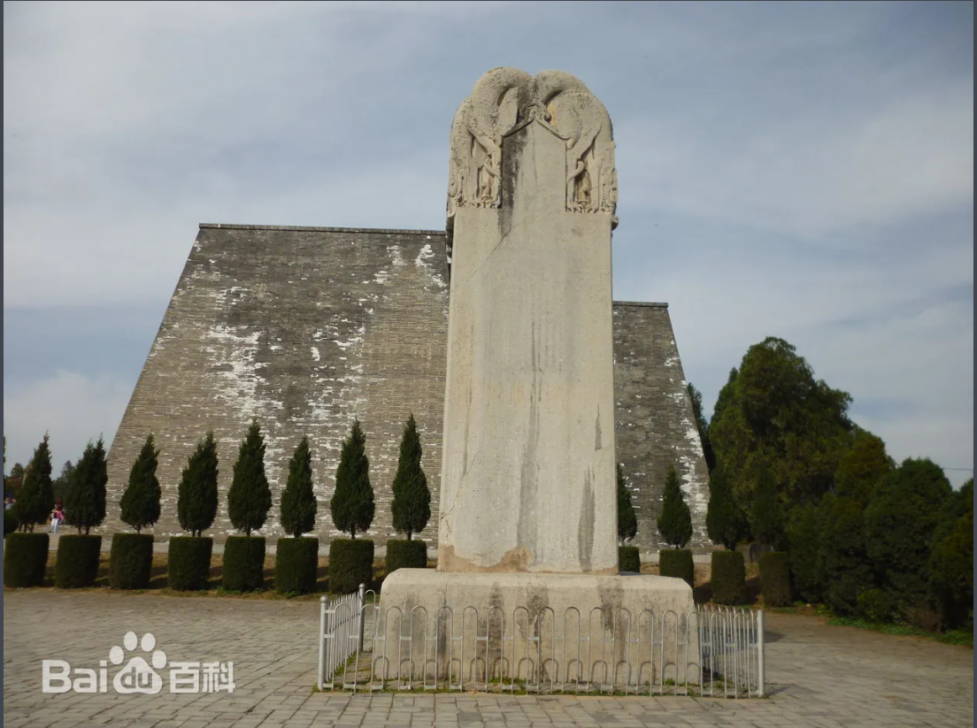
The first view is that Wu Zetian erected the "no character tablet" to brag about herself, indicating that her accomplishments are more than words can express.
The second view is that Wu Zetian set up the "letter-free tablet" because she knew that her SINS were great and felt that it was better not to write the tablet.
The third view is that Wu Zetian was a self-aware person, and it was a smart move to set up a "monument without words", and let future generations comment on the merits and wrongs, which is the best way.
Stele without inscription

Slide 28
Thanks for watching
汇报人：储守娟

