Slide 1
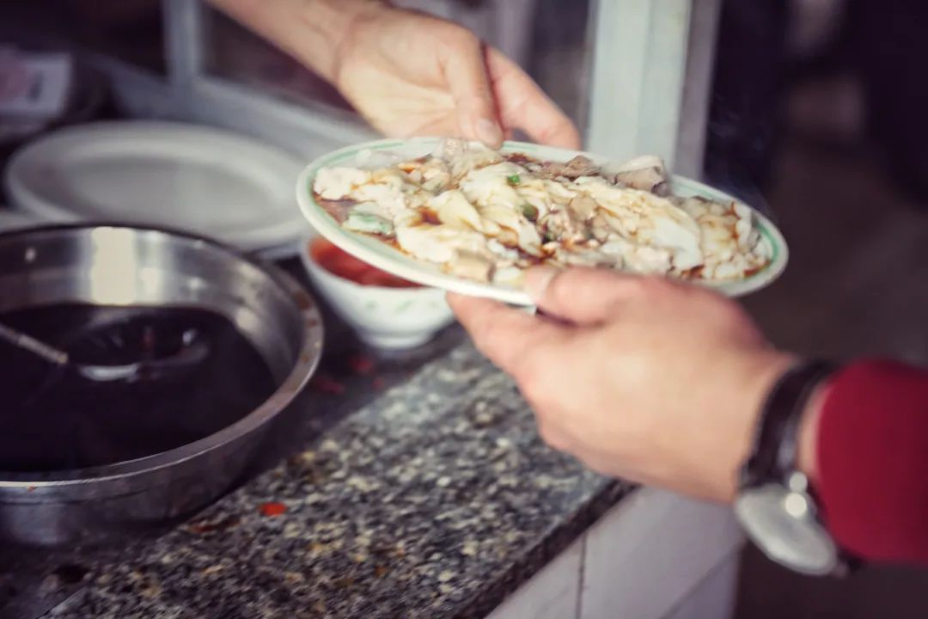
Introduction to Guangdong Daily Breakfast

Slide 2
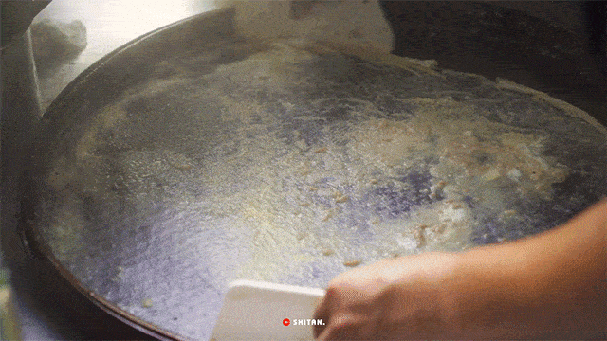
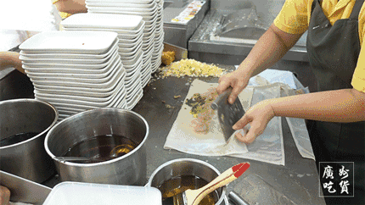
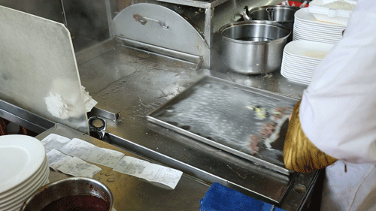
The King: Cantonese Steamed Rice Roll - 肠粉（coeng4 fan2）
Basic Ingredients
Rice milk, vegetable (lectures or bean sprouts), fillings, sauce, peanut oil
Flavors or Fillings
egg, minced pork or beef, deep-fried dough stick, pork liver, chittering, shrimp, oyster and almost anything you can imagine
Tools for Steaming
Bamboo Basket, Cloth, iron drawer
2024. 哪道美食堪称广东“早餐之王”，40年老师傅说酱油是关键 [OL]. https://static.nfapp.southcn.com/content/202402/10/c8595382.html

Slide 3
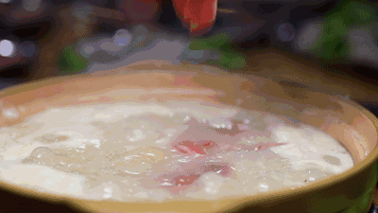
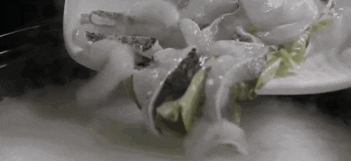
The Queen: Cantonese Congee
- 粥（zuk1）
General flavor
Umami and salty – unlike most Western sweet porridge, sweet congee in Central China or plain gruel with coarse grain in Northern China
Ingredients
Rice and anything edible (“give me a rice congee, I can cook the whole world” – from https://www.gznf.net/neighbor/30138.html)
Famous types of Cantonese congee
century egg and pork congee, sampan congee, dried fish and peanut congee, water snake congee

Slide 4
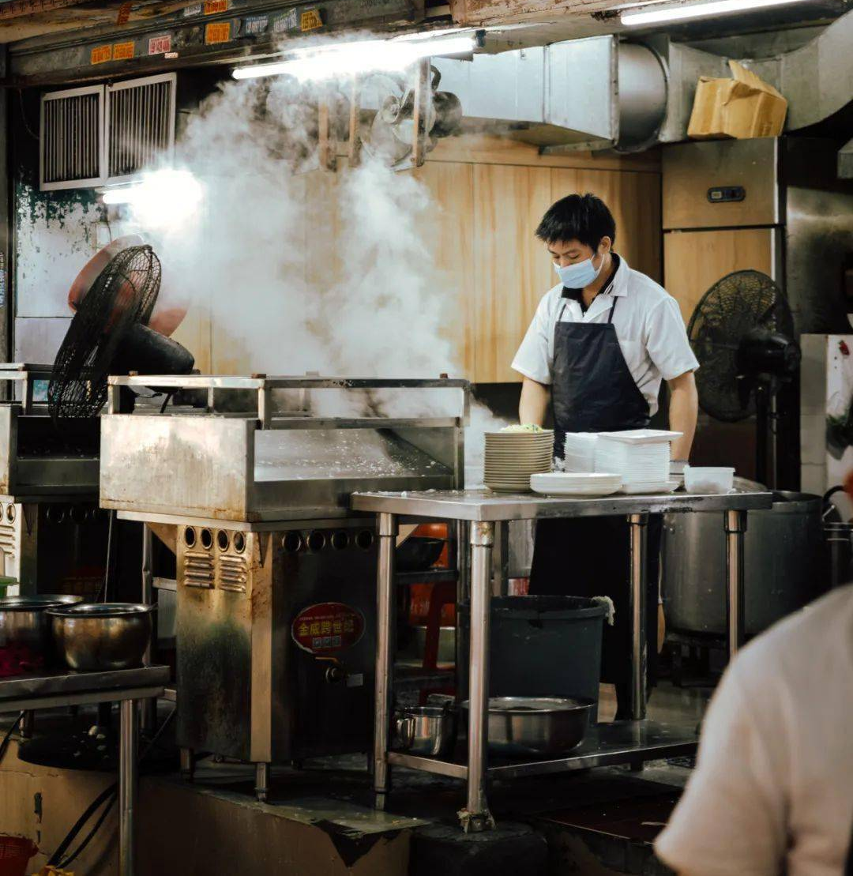
Functions of Guangdong Breakfast

Slide 5
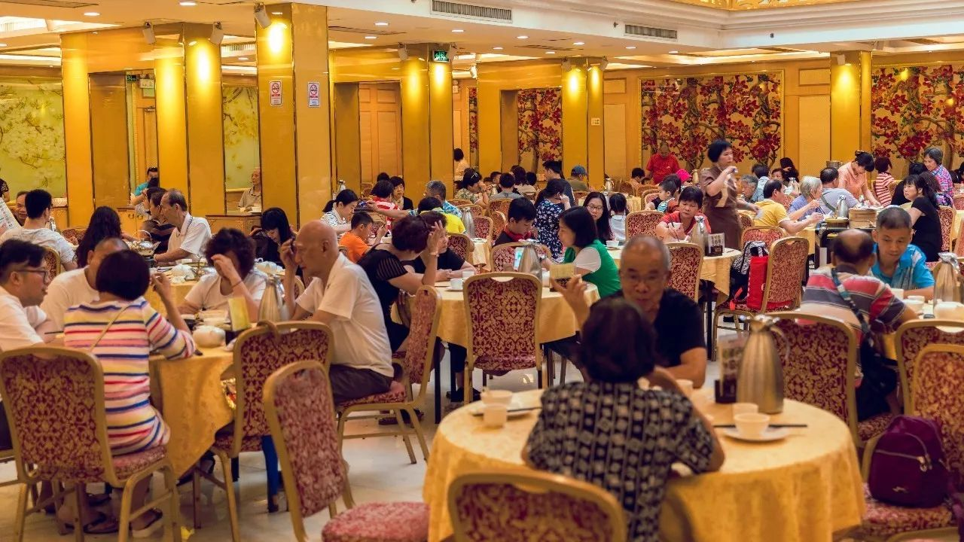
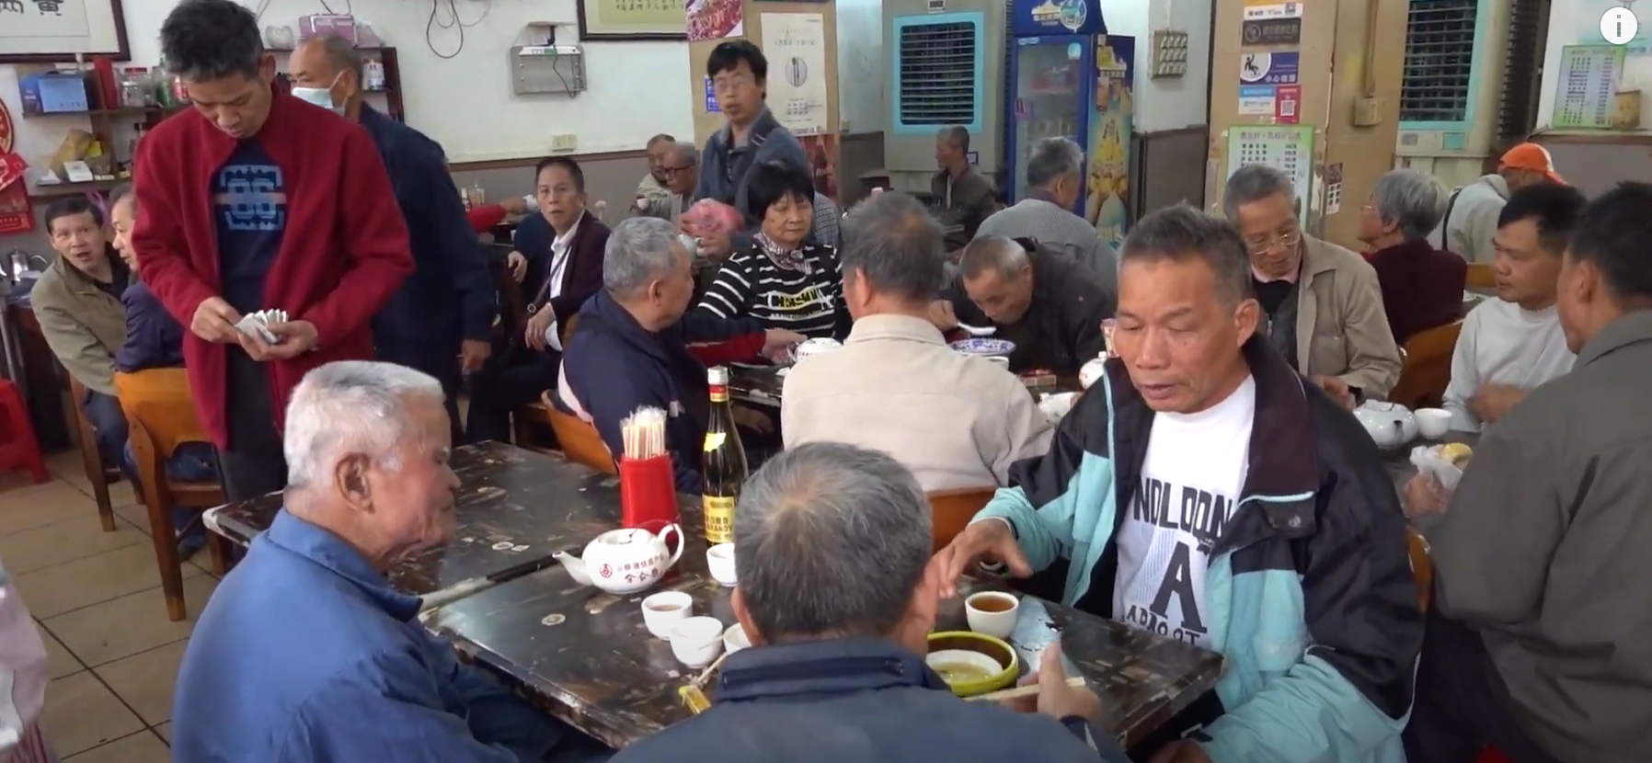
A Social Platform
Eating (Maybe)
Chatting -- 倾keng1偈gai2
（YES）
More importantly: A place for the senior

Slide 6
A Showcase of Diligent Cantonese
Ps. There used to be a video. But it makes the ppt too large to upload. If you want to watch, please click the link at the bottom.
By 陈-思华.片刻「烟火人间」·第05话 | 这家凌晨一点营业的早餐店，是街坊们的深夜食堂. 片刻「烟火人间」·第05话 | 这家凌晨一点营业的早餐店，是街坊们的深夜食堂_哔哩哔哩_bilibili

