Slide 1

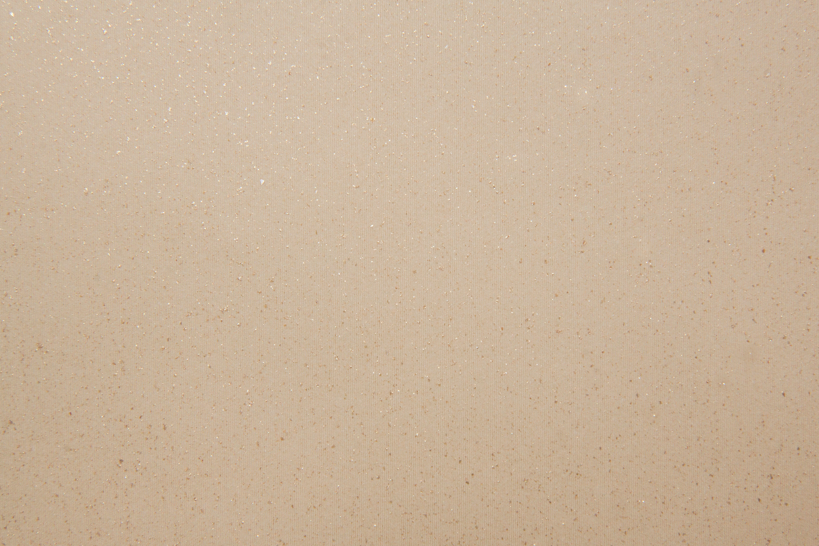
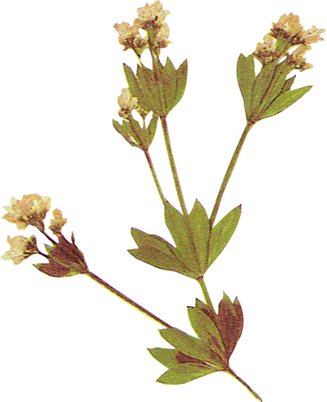
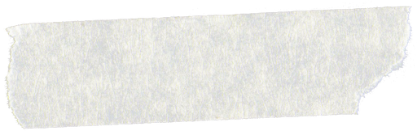
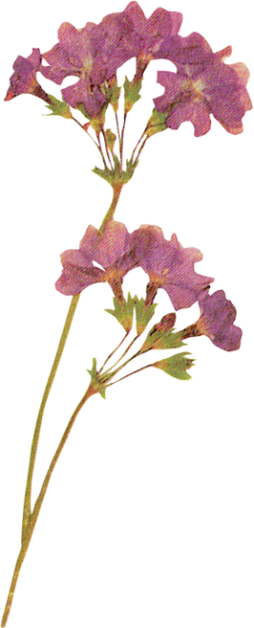
Strange Tales from the Liaozhai Studio
罗杨

Slide 2
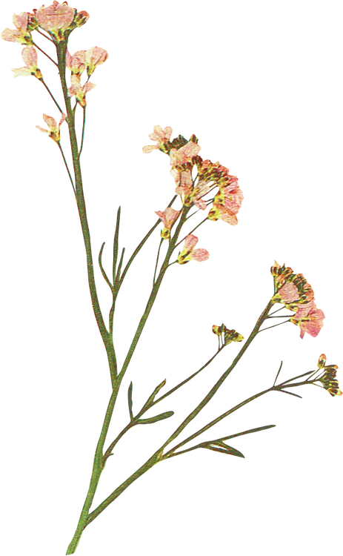

Contents
1
background information
2
characterization techniques
3
the influence
4
conclusion

Slide 3
01
background information

Slide 4
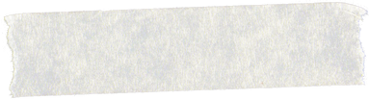

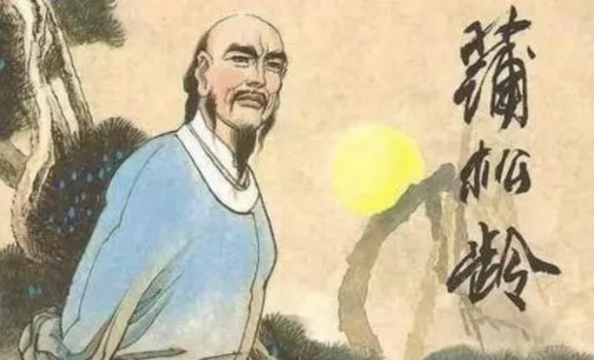
about the author
Pu Songling was born into a scholarly family in Shandong Province.Under his father's teaching, Pu Songling was proficient in all subsets of classics and histories, which laid a solid foundation for his later literary creations.
However, contrary to Pu Songling's extremely high literary talent, his life has experienced ups and downs. Pu failed repeatedly in the imperial examination. What's worse, his career didn’t go well. In conclusion, his rough life experience has enabled him to directly and extensively observe all aspects of social life, and he can better get closer to the voices of the middle and lower classes.

Slide 5
MDM Company
June 1, 2021
the social background
Pu Songling lived in an era of social turmoil during the late Ming and early Qing dynasties. At that time, society and politics were dark and brutal.
Through creating “Liaozhai”, Pu Songling boldly exposed and sharply criticized social issues. This creative motive has endowed “Liaozhai” with profound social significance, making it fundamentally different from previous strange stories that only recorded strangeness.
官虎而吏狼者，比比皆是也。
—— 蒲松龄

Slide 6
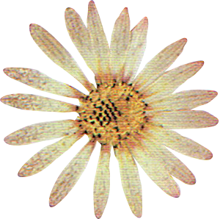
02
characterization techniques

Slide 7
characterization techniques of spirits
1
appearance
Pu Songling not only absorbed the essence of the previous strange novels, but also made bold innovations in writing. In particular, it is outstanding in the characterization of strange characters.
2
superpower
3
humanity

Slide 8
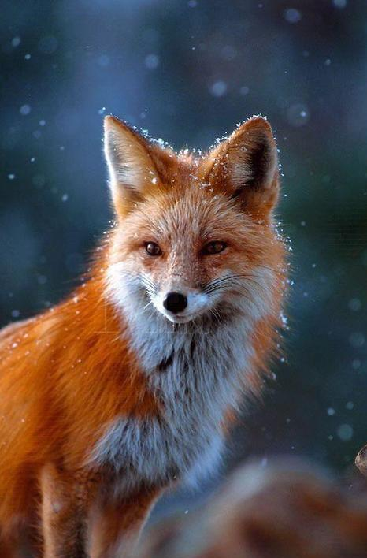
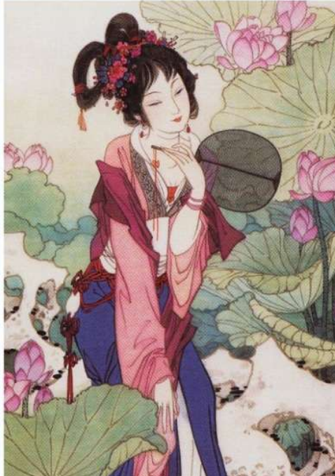
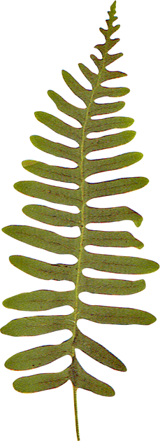
appearance
In terms of appearance, all the physical characteristics of animals or plants are removed, so that hobgoblins can transform into a complete human form.
Pu Songling skillfully internalized the features of the hobgoblin prototype into the transformed human body.For example, the green bee is very thin, and after turning into a human, her waist is so slim that it can be held with a hand.

Slide 9
The superpower is set according to the hobgoblins’ archetype.
In "Huang Ying", the Huang Ying sisters and brothers, who are transformed from chrysanthemums, have the magic skill of planting and caring chrysanthemums.
superpower
1.
The superpowers of the hobgoblins are all used for the needs of human life.
In "Jiao Na", Jiao Na is a fox spirit who masters medical treatment and she cured Kong Sheng, her lover.
2.
Hobgoblins’ superpowers are limited.
The rat spirits in Liao Zhai live in ordinary mountain villages and are only good at keeping a house. Their strength is very weak.
3.

Slide 10
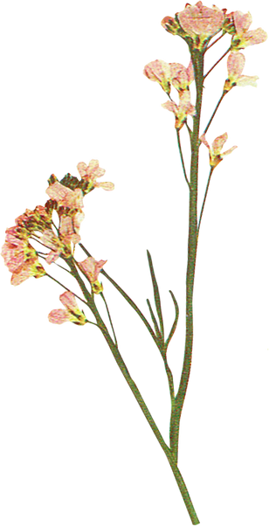
humanity
Despite having animalistic and supernatural traits, the spirits' essence lies in human nature. They exemplify human emotions, mentality, and behavioral characteristics. Pu Songling's writing about spirits stands out due to the profound humanity he brings to these creatures.

Slide 11
Pu depicts human nature mainly through two aspects:
One is that he set up the family background for the spirits, making them socialized. Most of the hobgoblins in LiaoZhai have relatives of the same kind and families. Their families follow the ethics and morals of human society. In "Qing Feng", the fox spirit Qing Feng lives with her uncle's family, which has strict regulations.
The second is that the humanity of spirits is deepened in emotional entanglement with human. Qing Feng shows her depth of humanity in both her treatment of love and family affection. Although her uncle severely prevented her from falling love with human,she was willing to risk her life to save him when he is in danger.

Slide 12
03
the influence

Slide 13
influence
Strange Tales from the Liaozhai Studio is not only a brilliant pearl of ancient Chinese traditional culture, but also the common wealth of people all over the world. The translation and research of the book promote Chinese classical culture to the world. So far, Liaozhai has been translated into more than 20 languages, making it the most translated Chinese classical novel.
Strange Tales from the Liaozhai Studio has influenced Japanese literature as early as the Edo period (1603-1868).
— The Japanese Encyclopedia
The literary language of Strange Tales from the Liaozhai Studio is outstanding and powerful, reaching a level of the peak of Chinese classical prose.
— The French Encyclopedia

Slide 14
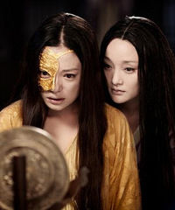
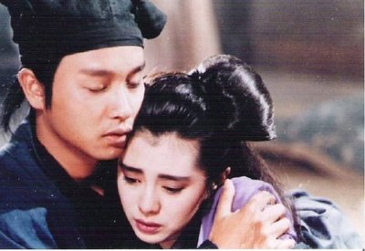
There have been countless operas, films and TV plays adapted from Strange Tales from the Liaozhai Studio. Especially, some famous movies such as “ A Chinese Ghost Story”(倩女幽魂) and “The Painted Skin”(画皮) have swept overseas.
《画皮》
《倩女幽魂》

Slide 15
04
conclusion

Slide 16
  写鬼写妖高人一等，刺贪刺虐入骨三分。
  —— 郭沫若
conclusion
  Pu Songling used his extraordinary imagination to create for us a bizarre world where humans and monsters coexist. Apart from the vivid record of strange things, Pu Songling sharply mocked social injustice. It is the deep combination of literary interest and profound thought that has made Strange Stories from the Liaozhai Studio popular to this day and continues to flourish.

Slide 17
references
[1] [清]蒲松龄《聊斋志异》[M]
[2]郑春元. 《聊斋志异》中精怪形象的塑造方法新探[J]. 蒲松龄研究, 2008, (01): 16-27.
[3]孟斌斌. 《西游记》与《聊斋志异》的比较——以精怪形象为中心[J]. 文艺评论, 2013, (12): 81-83.
[4林雪媛. 《聊斋志异》精怪题材小说研究[D].青岛大学,2022.

Slide 18
Thanks for listening!

