Slide 1
Traditional Cuisines: Four Distinct Regional Cuisines
HeYing 何颖

Slide 2
Four Distinct Regional Cuisines:
Sichuan Cuisines
Shandong Cuisines
Guangdong (Cantonese) Cuisines
Jiangsu-Zhejiang Cuisines

Slide 3
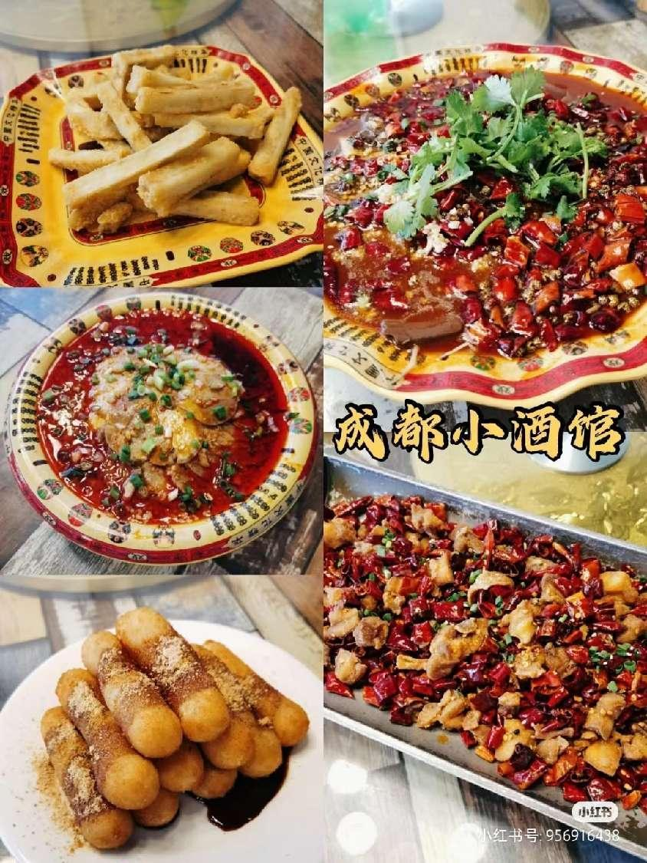
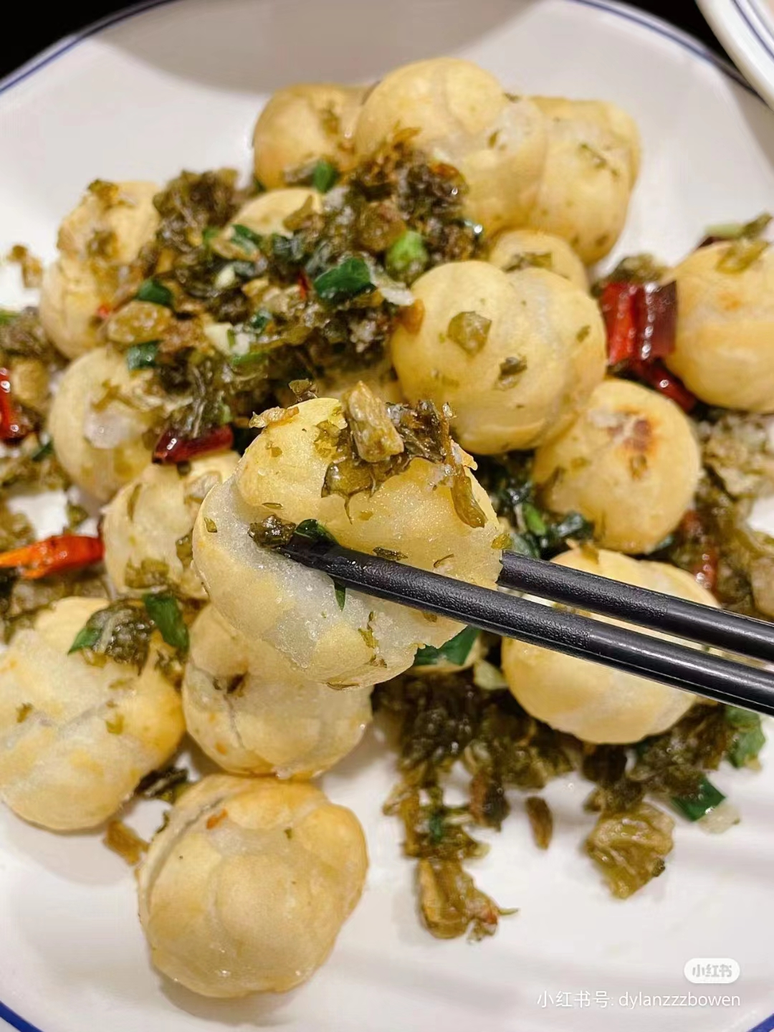
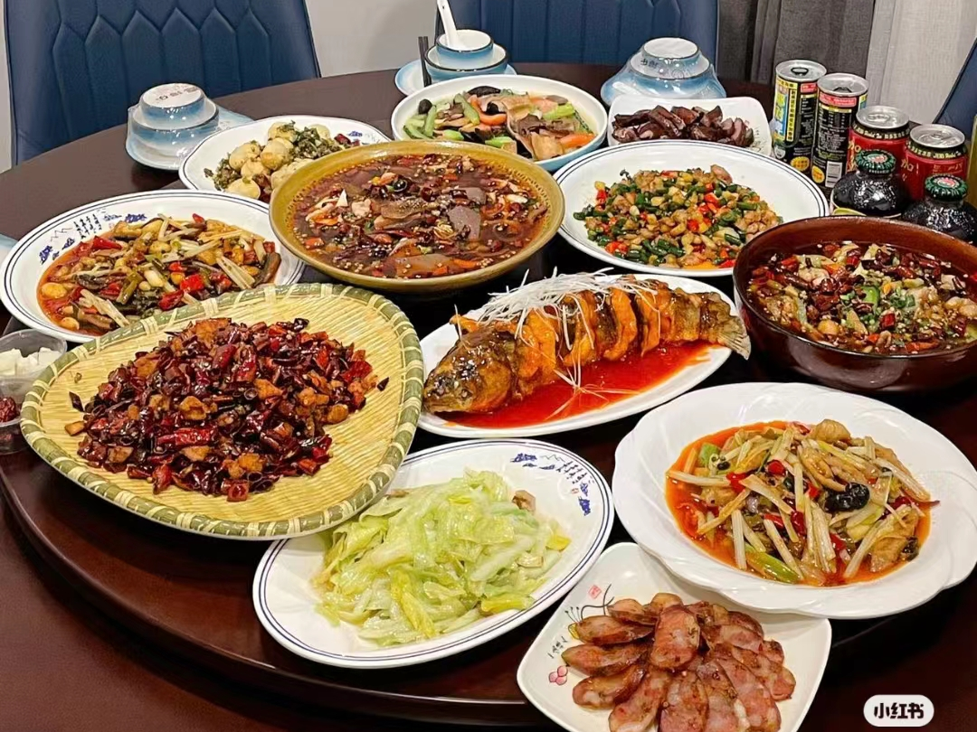
1.Sichun cuisine--川菜
Sichun cuisine is perhaps the most
popular one. It is well-known for its hot and
pungent flavoring. Sichuan cuisine boasts
a variety of flavors and different methods of
cooking. A Sichuan dish may be hot, sweet,
sour, salty or tongue-numbing.

Slide 4
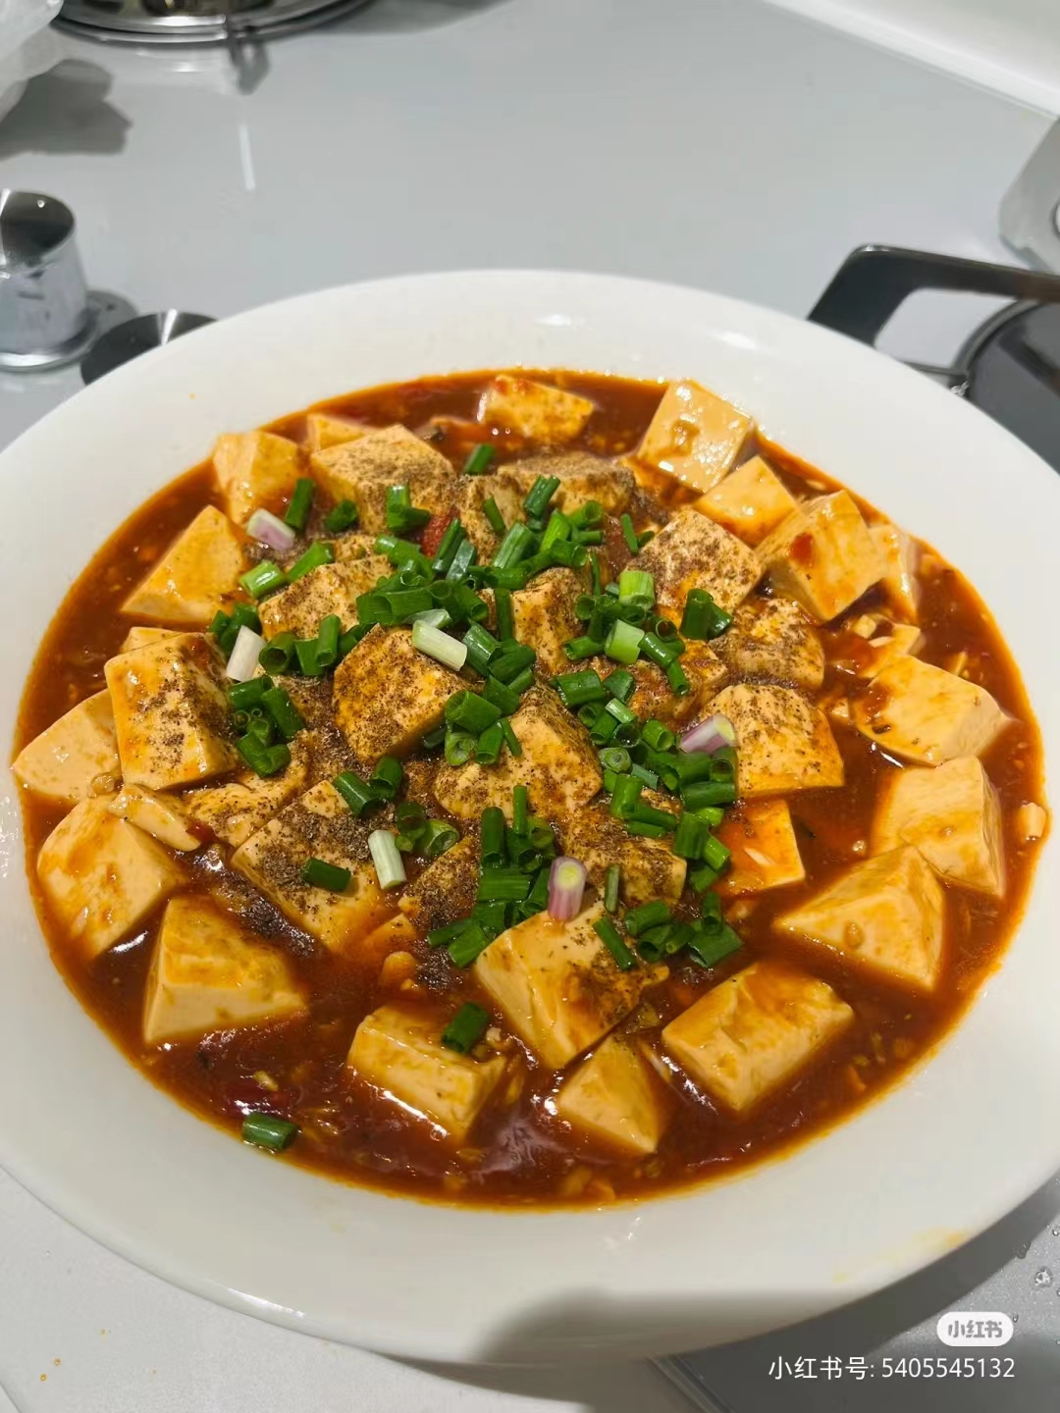
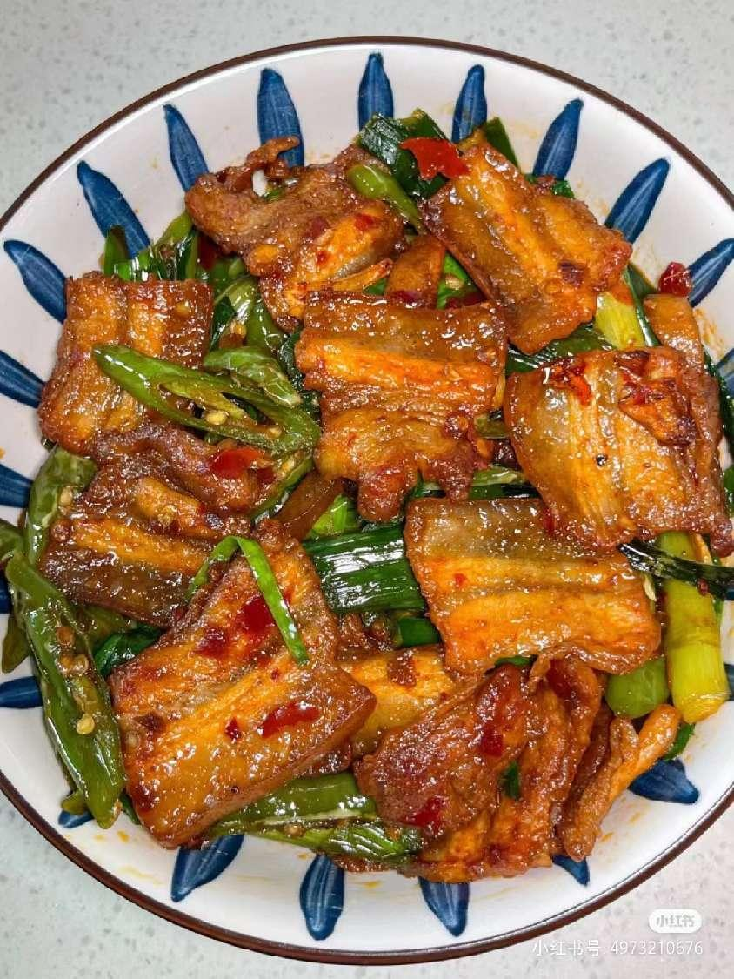
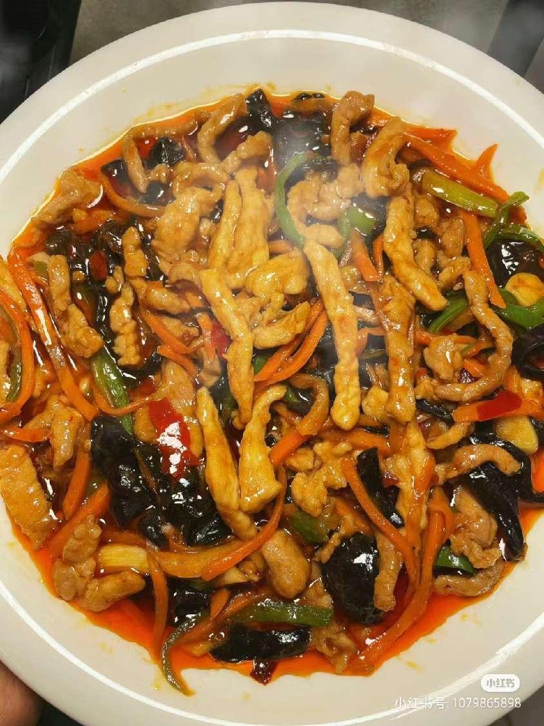
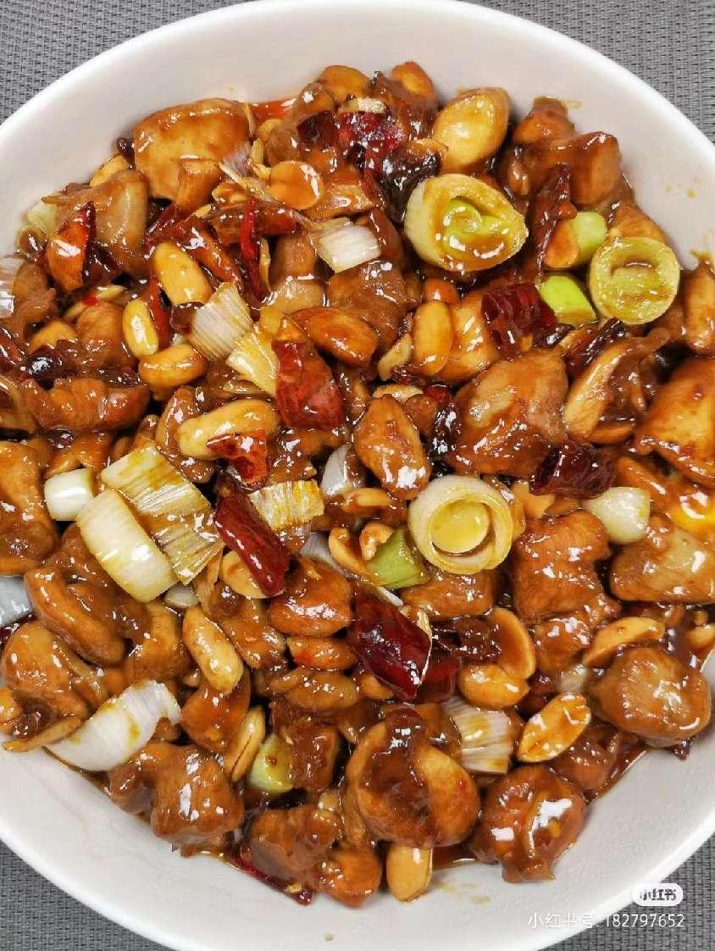
1.Sichun cuisine--川菜
Pockmarked Woman’s Bean Curd
麻婆豆腐
Spicy Diced Chicken with Peanuts
宫保鸡丁
Twice Cooked Pork Slice
回锅肉
Fish-flavored Pork Shred
鱼香肉丝

Slide 5
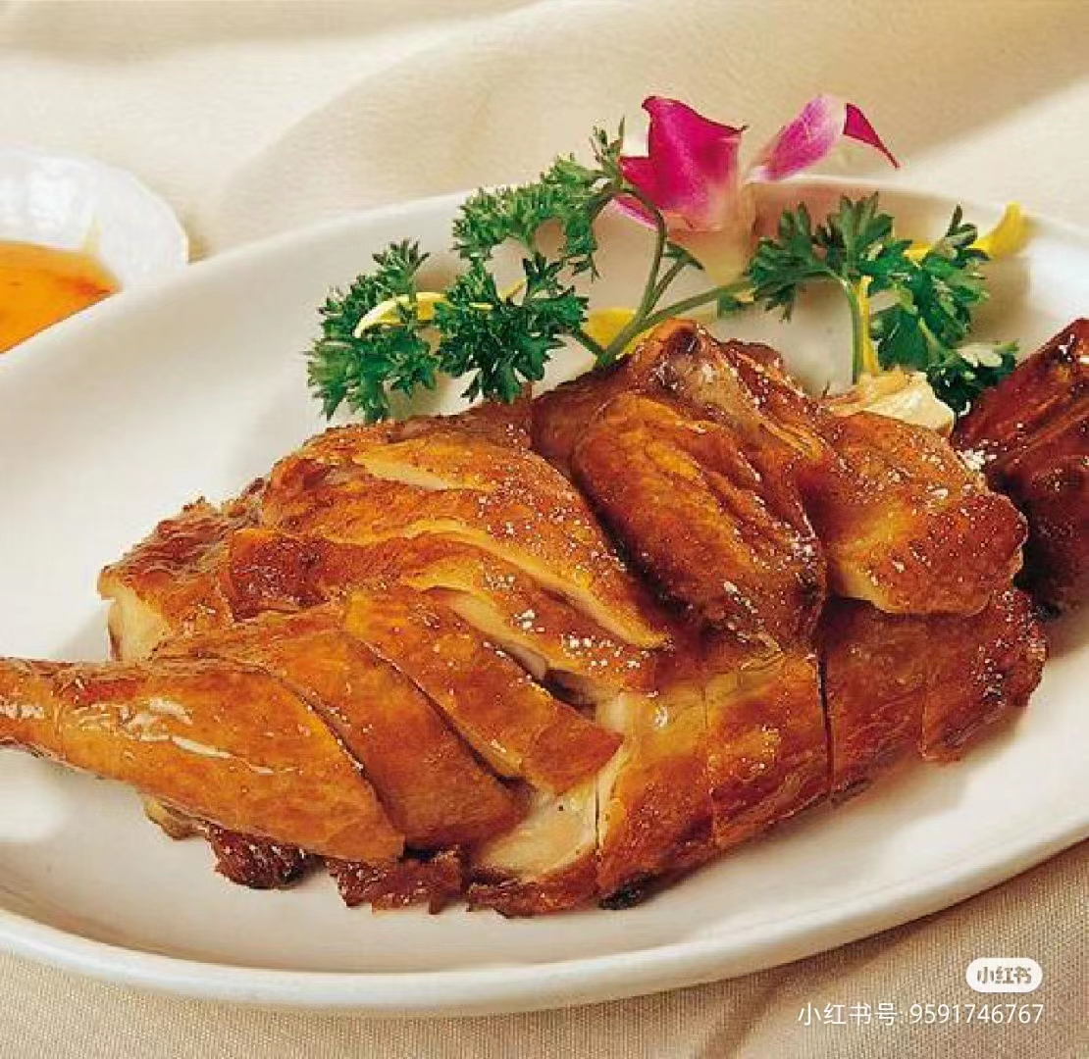
2.Shandong cuisine--鲁菜
The most representative of Shandong cuisine is, perhaps, Peking Roast Duck.
Shandong dishes are usually fresh, tasty but not greasy.
Dezhou Braised Chicken（德州扒鸡） is known throughout the country. The chicken is so well cooked that the meat easily separates from the bone although the shape of the chicken is preserved.

Slide 6
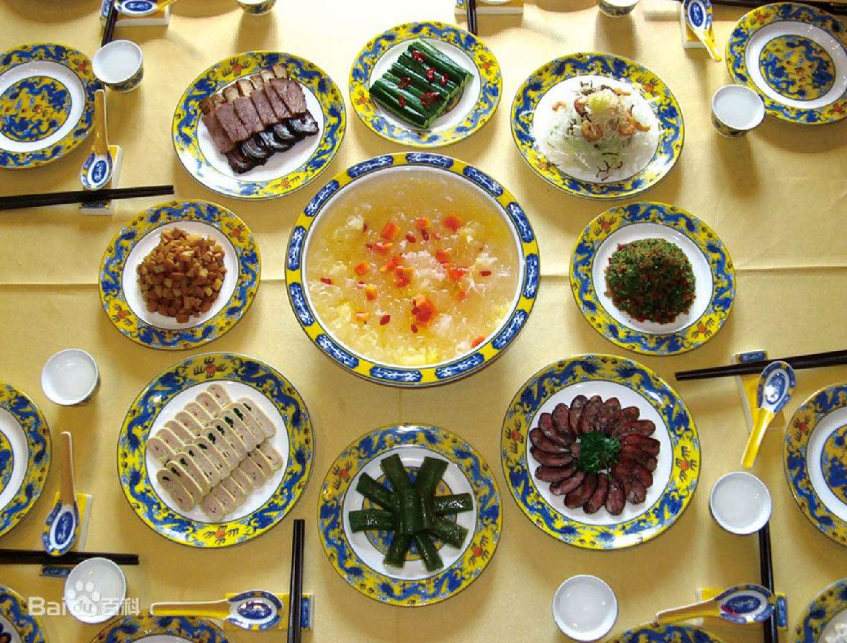
2.Shandong cuisine--鲁菜
As an important part of Chinese food culture, the Confucius Family Dishes is a special high-level banquet for the reception of distinguished guests, the appointment of a Lord, the anniversary, the birthday, the wedding and funeral. It is a set of unique family feasts gradually formed after hundreds of years of continuous development and enrichment.
the Confucius Family Dishes
孔府家宴

Slide 7
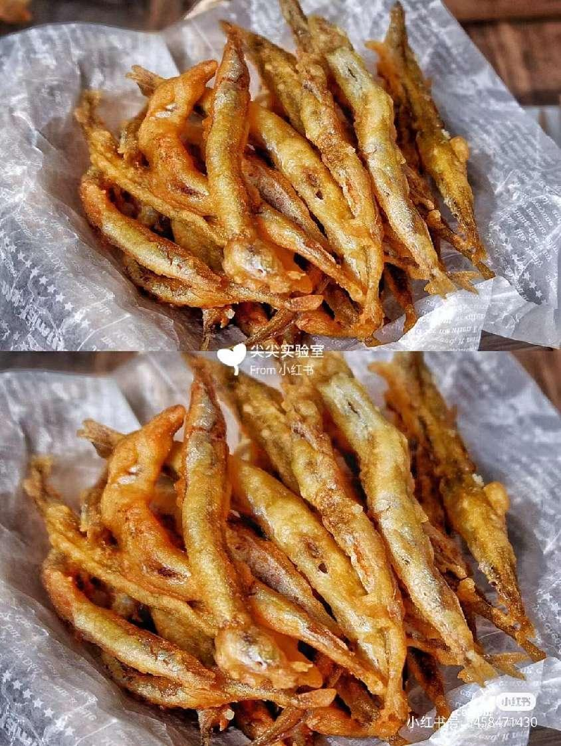
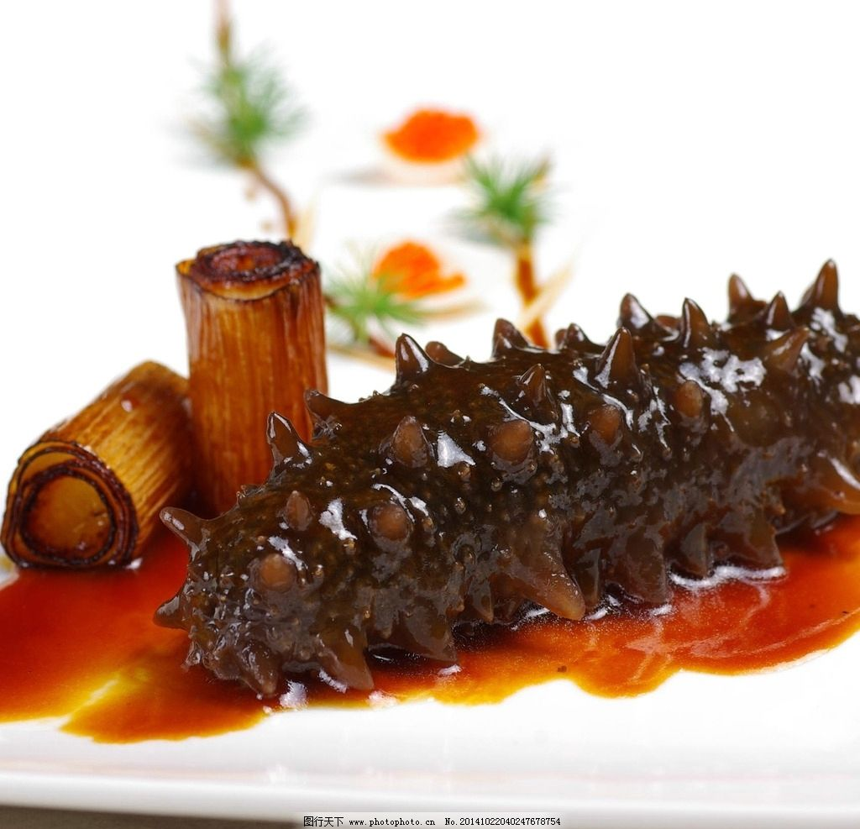
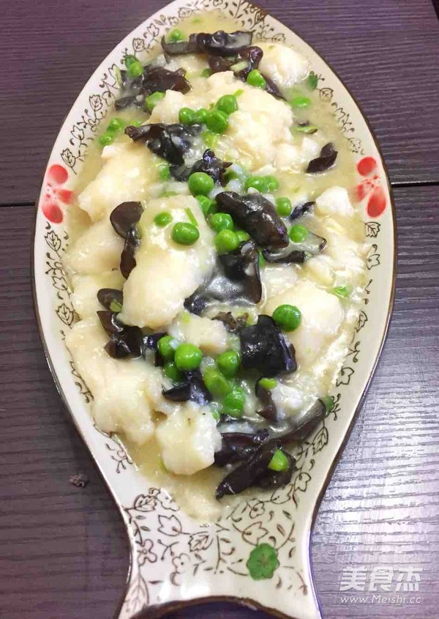
2.Shandong cuisine--鲁菜
Stewed Sea Cucumber
红烧海参
Sautéed Pickled Fish Slice
糟溜鱼片
Deep-Fried Red-Scale Fish
干炸赤鳞鱼

Slide 8
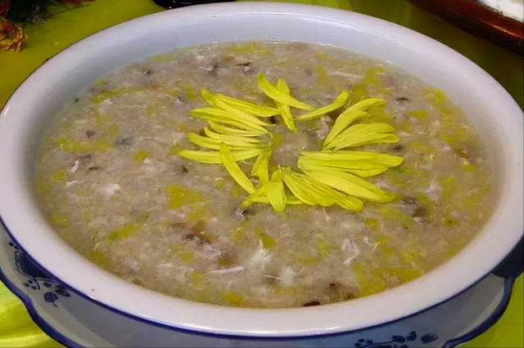
3.Guangdong cuisine--粤菜
It known as Cantonese cuisine in the west.
It was developed in Guangzhou, Huizhou, Chaozhou and Hainan Island. As the climate of Guangdong is hot, these dishes must be fresh, tender, and lightly seasoned. The raw material for Guangdong cuisine is very rich, including snake, cat and pangolin穿山甲.
Traditional chrysanthemum three-snake soup
传统菊花三蛇羹

