Slide 1
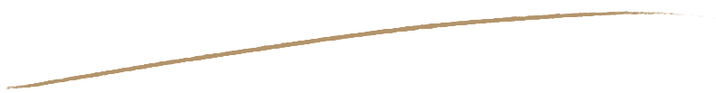
Language and Calligraphy
----The Evolution of Calligraphy
Xiao Shuangling 肖双玲
Wang Xuan 王轩

Slide 2

Content
1
Brief Introduction of Chinese Calligraphy
1.1 What is calligraphy?
1.2 Tools for calligraphy
2
The Evolution of Calligraphy

Slide 3
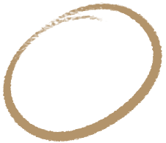
Chapter 1
Brief Introduction of Chinese Calligraphy

Slide 4
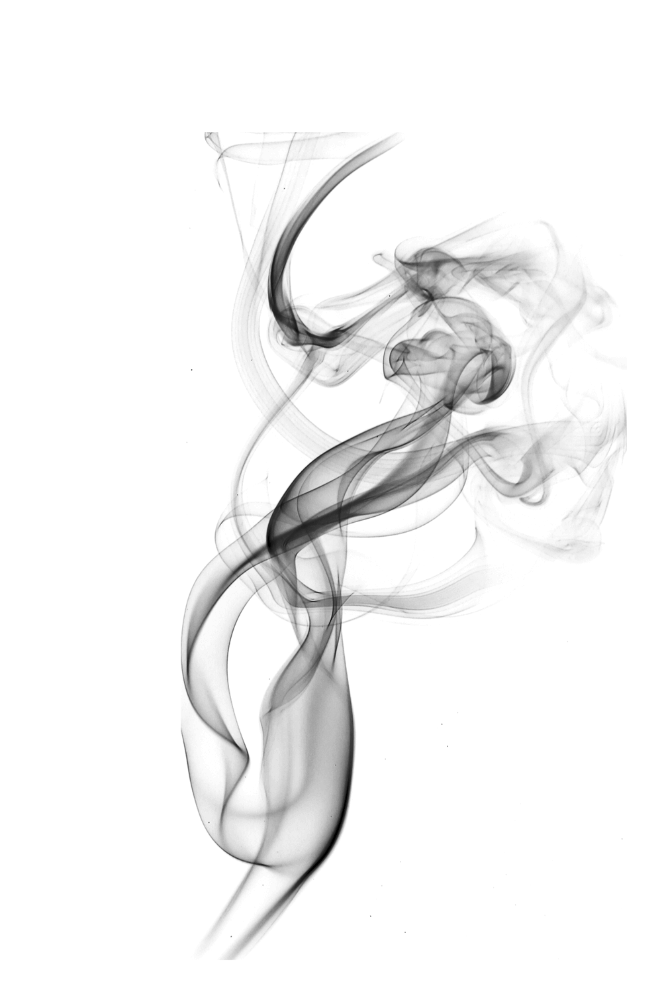
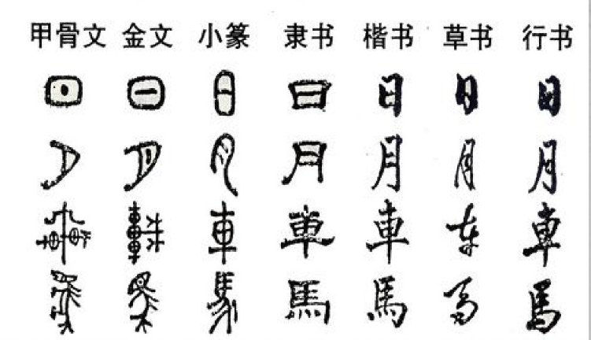
1.1 What is Calligraphy?
Chinese calligraphy is a traditional art of Chinese characters writing with a long history and particular national features. It is a unique form of art that came into existence with the birth of Chinese characters, and has been widely practiced throughout China to this day. “Shufa” is the Chinese version of calligraphy.

Slide 5
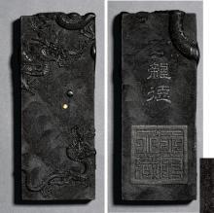

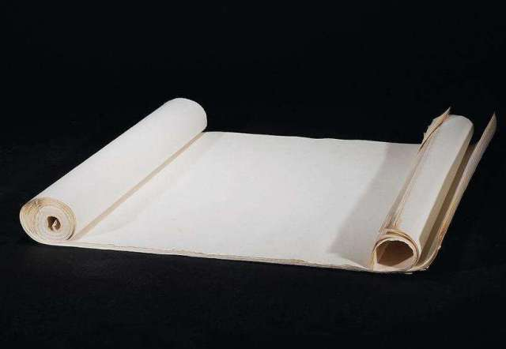
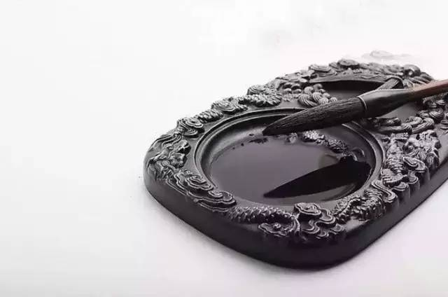
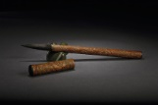
1.2 Tools for calligraphy
Ink
Paper
Ink Slab
Brush

Slide 6
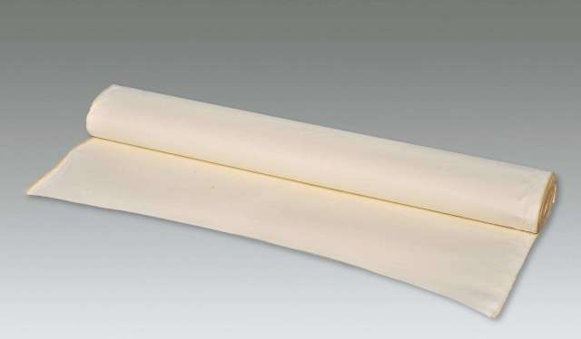
Paper
Paper is one of the four major Chinese inventions. Paper produced in Xuan county of Anhui province is the most famous, known as “xuan paper.” Xuan paper can express the elegance of ink.

Slide 7
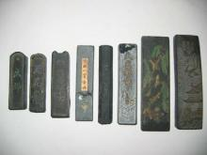
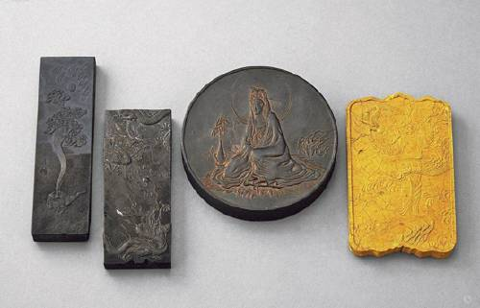
Ink
Traditional ingredients for the making of ink originate from burned palm twigs or the smoke from tar. But the process of ink grinding requires time and patience, thus, this process is able to make people stay calm and enter a state of mind suitable for calligraphy.

Slide 8
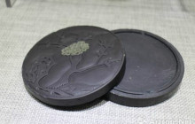
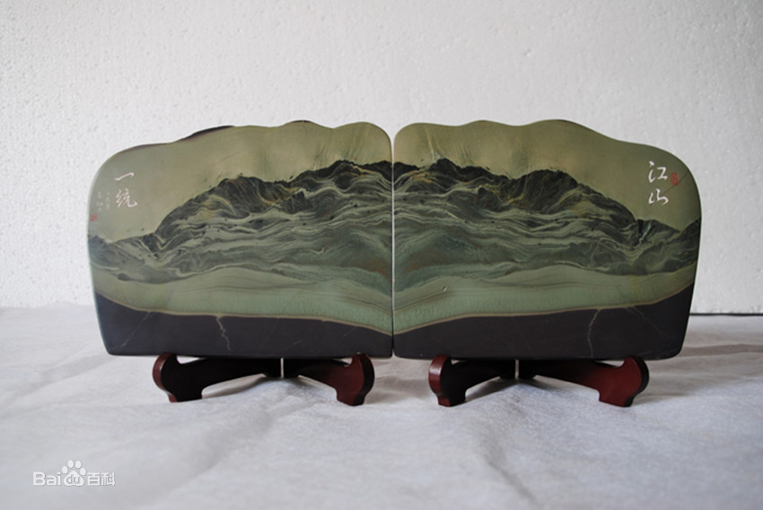
Ink Slab
An Ink slab is an essential for ink grinding and writing. Ink slabs appear in many varieties but ordinary slabs are made from stone-hitting.

Slide 9
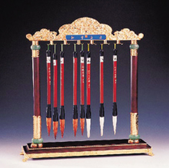
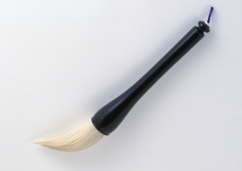
Brush
Chinese brushes are made of animal hair being soft and flexible. By controlling the pressing or raising of the brush, the calligrapher delivers a feeling of brush thickness or fineness, of feather-weight or of heavy-strength.

Slide 10
Chapter 2
The Evolution of Calligraphy

Slide 11

The Evolution of Calligraphy
Oracle Bone Inscriptions （甲骨文）
Bronze Inscription （钟鼎文）
Seal script （篆书）
Clerical script（隶书）
Cursive script （草书）
Running script （行书）
Regular script （楷书）
Five main categories of Chinese calligraphy

Slide 12
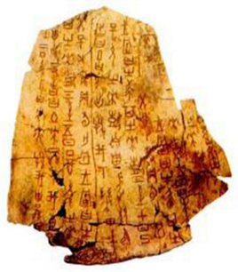
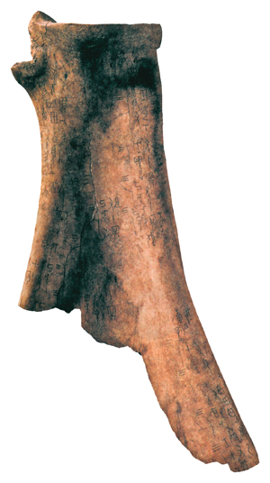
1.Oracle Bone Inscriptions（甲骨文）
Oracle bone inscriptions are divinatory（占卜的） scripts carved on turtle shells, and animal bones after the shells and bones were used for the practice of divination. They are characters of the Shang dynasty of Yin before1300 B.C. The characters are essentially pictographic（象形文字的） but are formed by reorganizing their strokes（笔画）. They are the earliest seal script（篆书） of China.
Inscriptions on bone

Slide 13
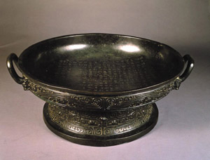
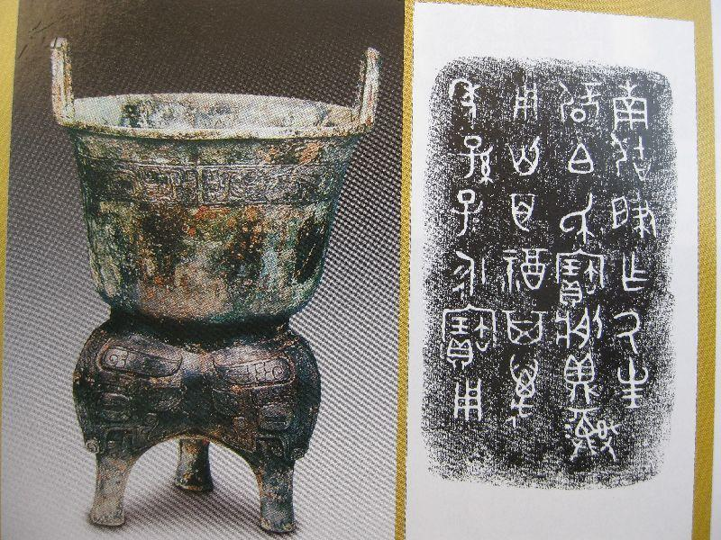
2.Bronze Inscription （钟鼎文）
In the eight hundred years between the end of Shang dynasty and the period of Spring and Autumn and the Warring States, there appeared words carved or inscribed on bronze wares（青铜器） of bells and dings, known as bronze inscriptions, bell and ding inscriptions.

Slide 14
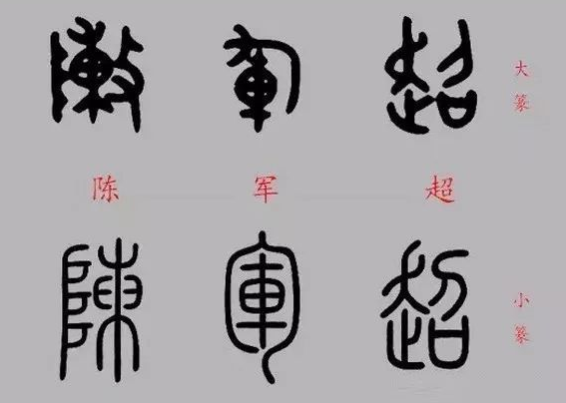
3.Seal Script （篆书）
The Seal script includes the large seal script（大篆） and the small seal script（小篆）. The Writing of a seal script is complicated. Such an inconvenience led to the seal script gradually being replaced by other types of scripts. Meanwhile, the seal script lost its practical function although its aesthetic function has been preserved. It has become the script of pure aesthetics up until the present day.

Slide 15
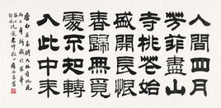
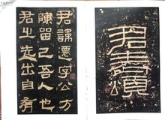
4.Clerical script（隶书）
The emergence of the clerical script ended the era of ancient writing that had spanned nearly two thousand years, while opening a new generation for calligraphic art which looked for beautification. The most apparent feature of the clerical script is that the beginning of horizontal lines is akin to the head of a silkworm while the finish is akin to the tail of a wild goose and that its form appears flat and square, as if the characters were gliding in the sky.

Slide 16
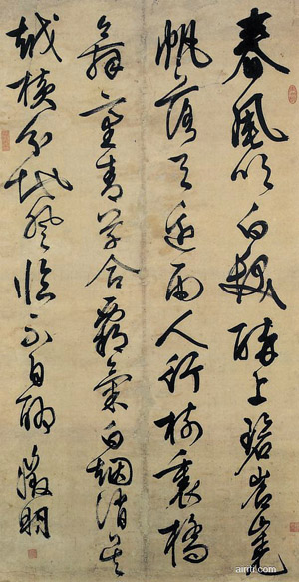
5.Cursive script （草书）
The “cursive script” according to Xu Shen refers to semi cursive script. Semi cursive script, spurred by the need for speed writing in clerical script, is a form of calligraphy facilitating writing with ease and speed. It preserves the feature of the wild goose’s tails of clerical script while changing the angular turning point into a round one. In terms of layout, each word is independent with no coherence between each other.

Slide 17
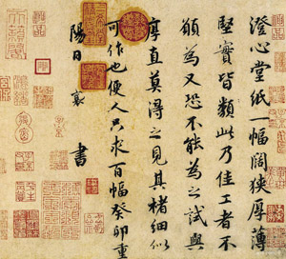
6.Running script （行书）
Running script had already been formed in the late Eastern Han dynasty, reaching its prime in the Eastern Jin dynasty. Its style moderates between regular script（楷书） and cursive script（草书）: it is more free-flowing than the orderly regular script while more easily recognized than the spontaneous cursive script. It was thus widely used.

Slide 18
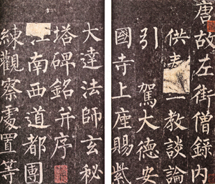
7.Regular script （楷书）
Regular script is a regular typeface（字体）directly evolved from clerical script. The word turns from being flat to square and regular. Regular script began to bud in the late Han dynasty, gaining momentum in Wei-Jin North and South dynasties and reaching its prime in the Tang dynasty. This script has remained in use until now and is the fundamental skill people must learn well in their study of calligraphy.

Slide 19
Thank You!

