Slide 1
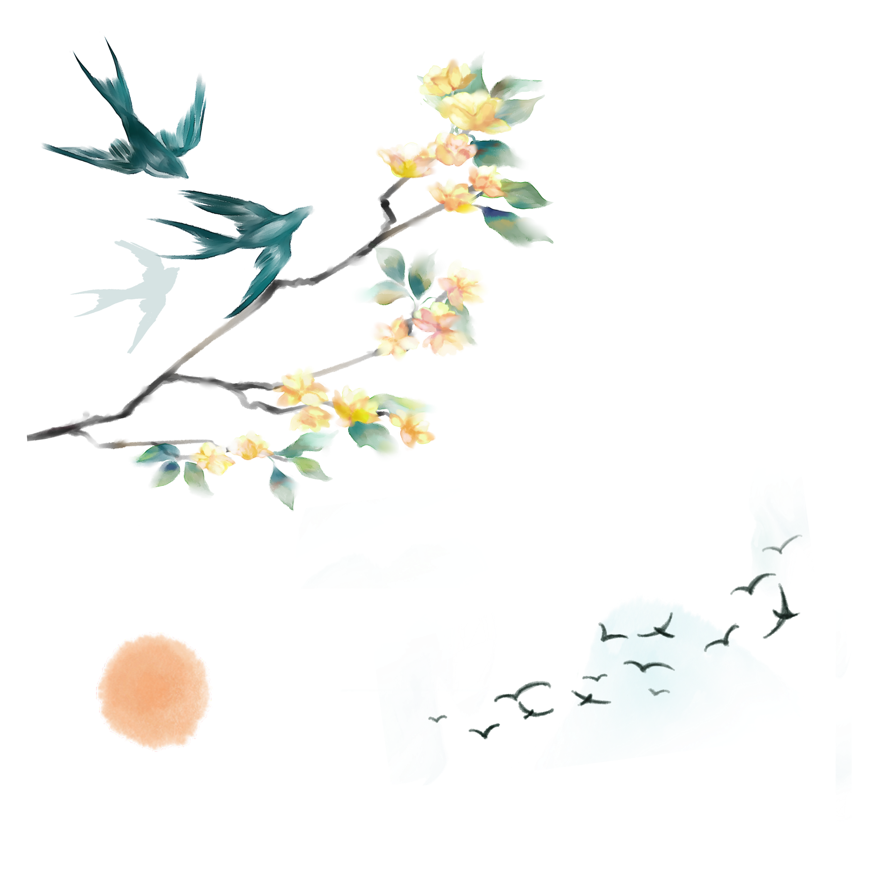


The Art of Chinese Cooking
——By Qin Annie 秦安妮

Slide 2
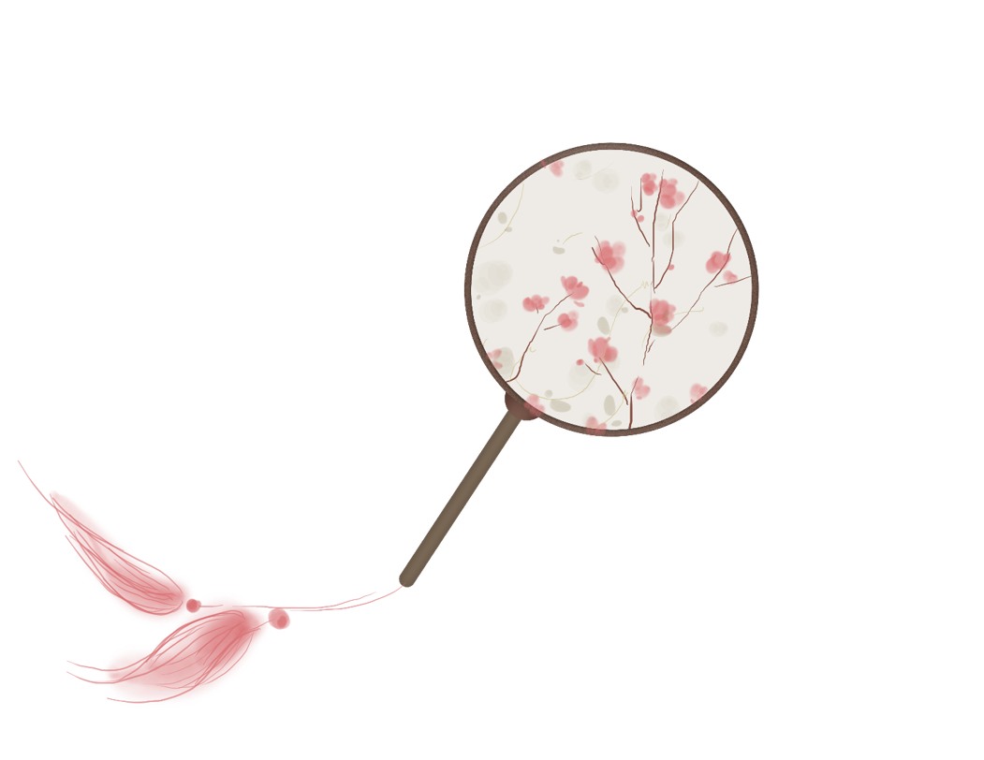

the Principal Aspects of Chinese Culinary Art
Contents
Differences between Chinese Cuisine & Western Cuisine
The emotion involved in Chinese Cuisine

Slide 3

PartⅠ
the Principal Aspects of Chinese Culinary Art

Slide 4
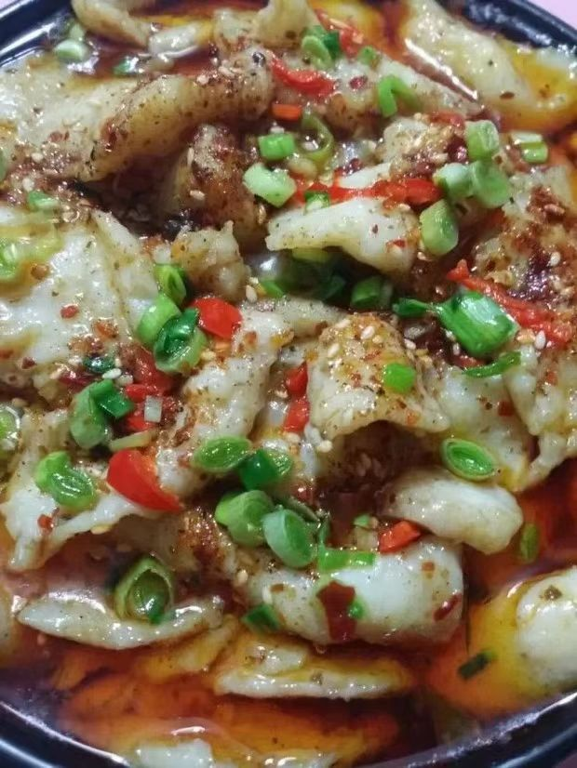
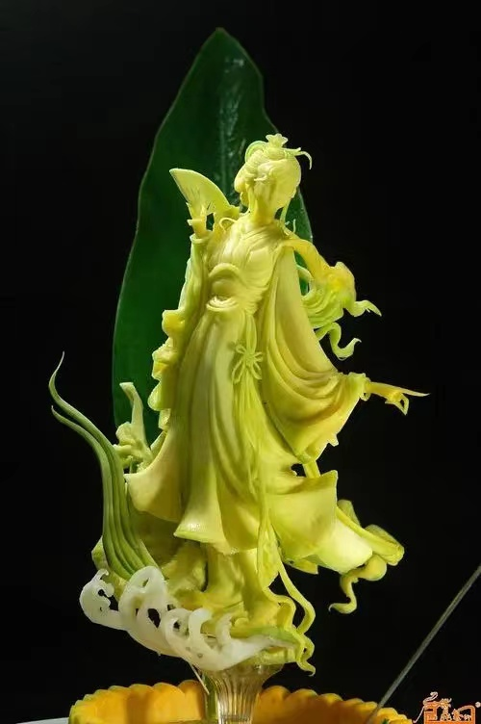
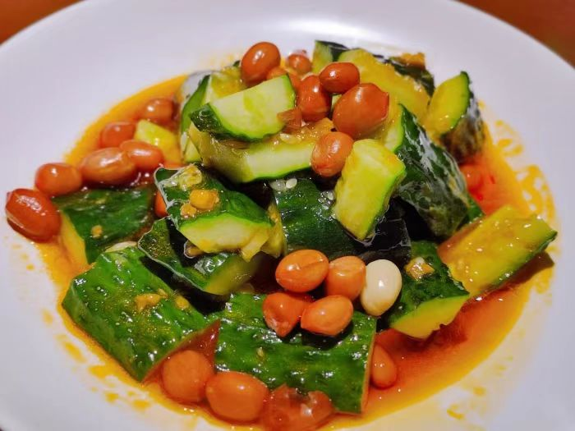
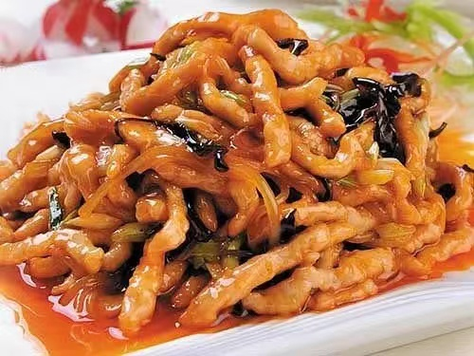
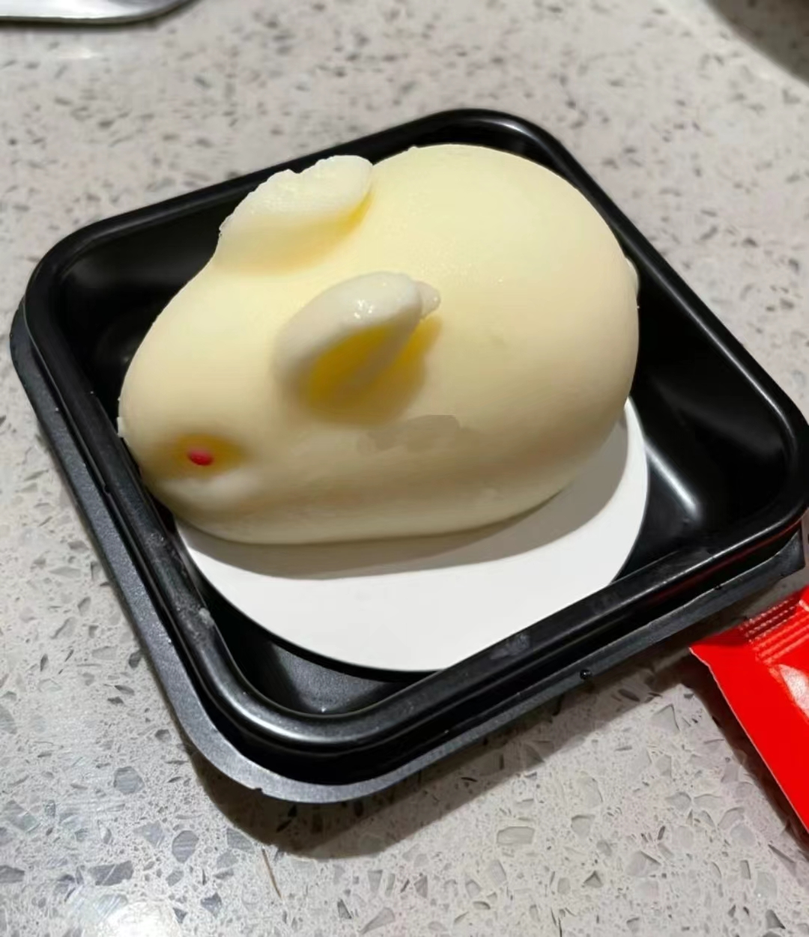
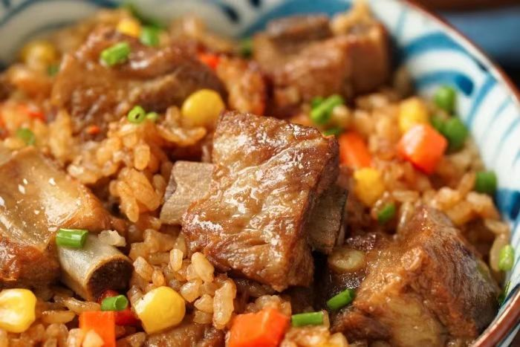
Raw Materials
Cutting
use abundant ingredients
be particular about the selection and preparation of the ingredients used
slices, strips, shreds, cubes
The shapes of flowers and animals
Chinese characters

Slide 5
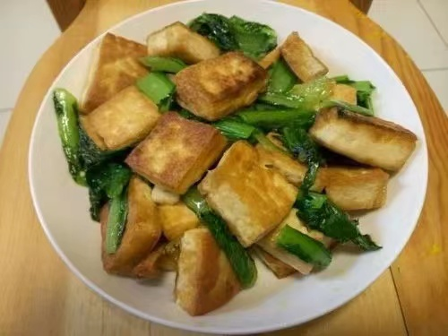
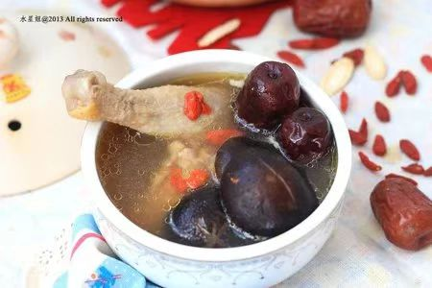
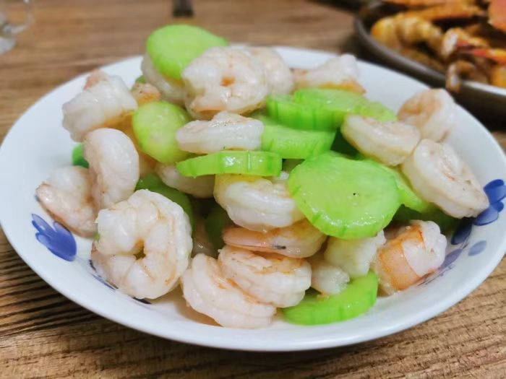
The combination of main ingredients
shrimps（虾仁） greens
bean curd mushroom
chicken cucumber

Slide 6
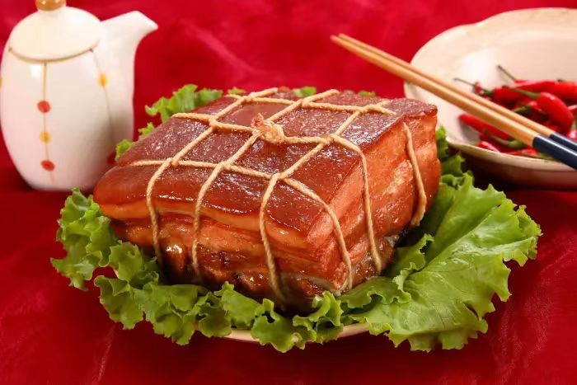

Seasoning
Time and Temperature
The spices and herbs used in various geographical regions have helped to shape the different styles of Chinese cooking, and all kinds of salty, sweet, sour, and pungent flavors can be found in those cuisines.
Different ingredients require different cooking times and temperatures so that they may be hard, soft, crisp or tender.

Slide 7
Techniques in Chinese cuisine
boil（煮）：boiled egg 煮蛋
fry（煎）：fried eggs 煎荷包蛋
saute （炒）：sauteed shrimp rolls 清炒虾仁
roast 烤（烤鸭/烤鹅）

Slide 8
PartⅡ
Differences between Chinese Cuisine & Western Cuisine

Slide 9

It always allows for a creative and stylistic touch to it.
Chinese
Cuisine
The well seasoned chef is the guarantee.
Recipes are followed strictly like laboratory instructions.
Western
Cuisine
The recipe is the key to success in any culinary attempt.

Slide 10
PartⅢ
The emotion involved in Chinese Cuisine

Slide 11
The emotion involved in Chinese Cuisine
1. The Chinese believe eggs symbolize fertility. After a baby is born, parents may hold a "red egg and ginger party," where they pass out hard boiled eggs to announce the birth.
2.Noodles are a symbol of longevity in Chinese culture. They are as much a part of a Chinese birthday celebration as a birthday cake with lit candles is in many countries.

Slide 12
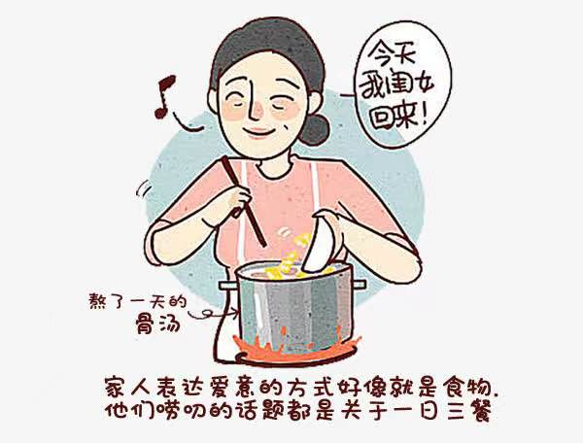
The emotion involved in Chinese Cuisine
A side water and soil, raises a party person.（一方水土养一方人）Food is the best way to make people feel homesick，and the taste of family affection conveyed by the food is so affectionate and moving.

Slide 13
Thanks

