Slide 1
Quiet
Translation of Modern Classics
---Mo Yan, Yu Hua and Liu Cixin
PPT:孙丽君
文献综述：马艳焕
教材编写：刘瑶&刘双英

Slide 2
1
An Overview
Con
2
Translation of Mo Yan’s Works
Contents
3
Translation of Yu Hua’s Works
4
Translation of Liu Cixin’s Works

Slide 3
01
Chapter
An Overview of the Translation of Modern Classics

Slide 4
The Translation and Dissemination of Modern Chinese Classics
➢ In English-Speaking Countries
The history of modern Chinese literature translated to English-speaking countries can be roughly divided into four stages.
The “Seventeen Years” (1949-1965) : Chinese modern literature translated to English-speaking countries focused more on social and political aspects than on literary aspects.
The “Cultural Revolution”(1966-1976): Due to the influence of the Cultural Revolution, the translation activities of Chinese literature dominated by China decreased.
The new period (1977-1999): “Scar literature”, received domestic and international attention and became the focus of translation in the late 1970s and early 1980s, but gradually went into decline in the late 1980s.
The new century (2000-present): The translation of modern Chinese literature has gradually become prosperous, and the mode of translation in China has also undergone significant changes.

Slide 5
02
Chapter
Translation of Chinese Modern Classics
----Mo Yan, Yu Hua and Liu Cixin
PPT模板 http://www.1ppt.com/moban/

Slide 6
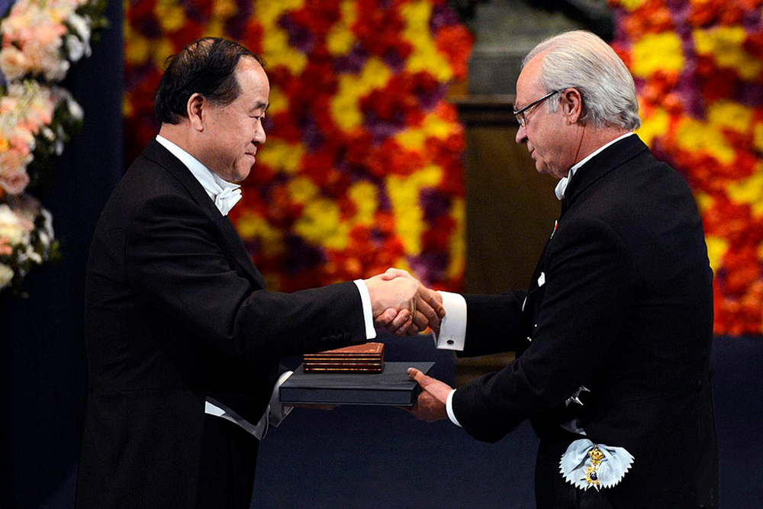
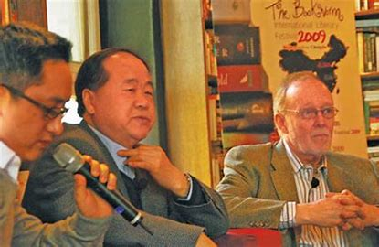
Translation of Mo Yan’s Works
Influenced by magical realism since 1985, Mo Yan has produced a number of unique avant-garde works and is known for his bold and novel writing style. On October 11, 2012, Mo Yan was awarded the Nobel Prize in Literature, becoming the first Chinese writer to win the Nobel Prize in Literature.
Mo Yan has published more than 80 short stories, 30 novellas, 11 full-length novels, five collections of essays, and a complete collection of essays. Since 1988, Mo Yan’s works have been translated into 45 languages including English, French, Spanish, German, Swedish, Russian, Japanese and other languages. As of October 2019, there are 388 kinds of Mo Yan’s works published in 41 countries and Mo Yan has become a representative of contemporary Chinese writers to the world.
Howard Goldblatt（葛浩文） , an important translator of Mo Yan’s works, and is known as the “midwife” of Mo Yan’s works in the West.
From 1988 to the present, the English translations of Mo Yan’s works have been translated almost by the American translator and sinologist Howard Goldblatt alone. He has translated Red Sorghum, Frog, The Republic of Wine, and so on.

Slide 7
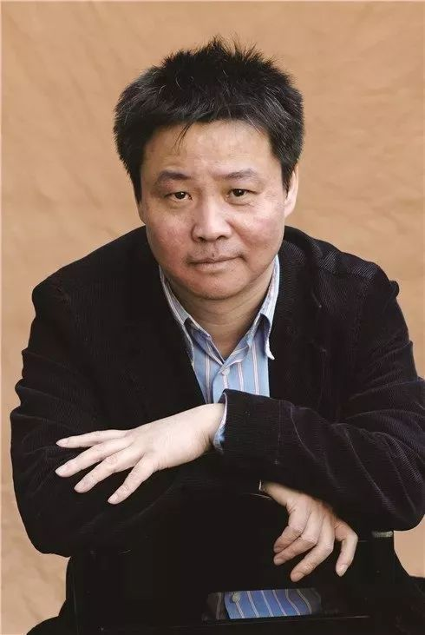
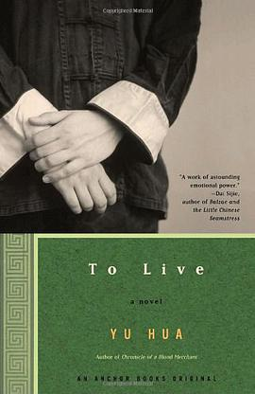
Translation of Yu Hua’s Works
Yu Hua is a contemporary Chinese writer and a member of the committee of the Chinese Writers' Association. In 1998, he won the Grinzana Carver Literary Award, the highest prize for Italian literature, for his novel To Live.
His major full-length novels include, Cries in the Drizzle, To Live, Chronicle of a Blood Merchant, The Seventh Day and so on. Among the foreign translations of Yu Hua's works, To Live and Chronicle of a Blood Merchant are more famous for foreign readers.
To Live has been translated into more than 20 languages and sold abroad. Its acceptance has been more successful in Germany, Japan, Vietnam, the United States, Italy, and Korea.
When translating To Live, Michael Berry, focused on conveying cultural imagery such as thinking habits, historical customs and religious culture in the cultural context of the original work. When faced with the translation of cultural imagery unique in China, Michael Berry chose the method of foreignization, translating the words directly and adding notes to make the translation as objective and realistic as possible.

Slide 8
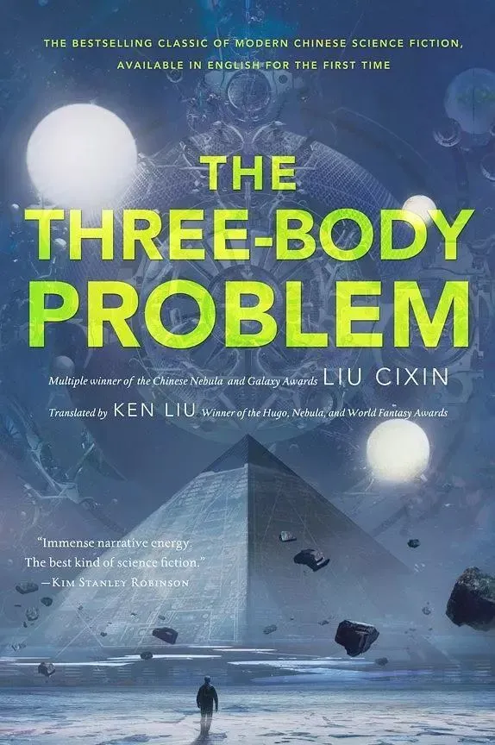
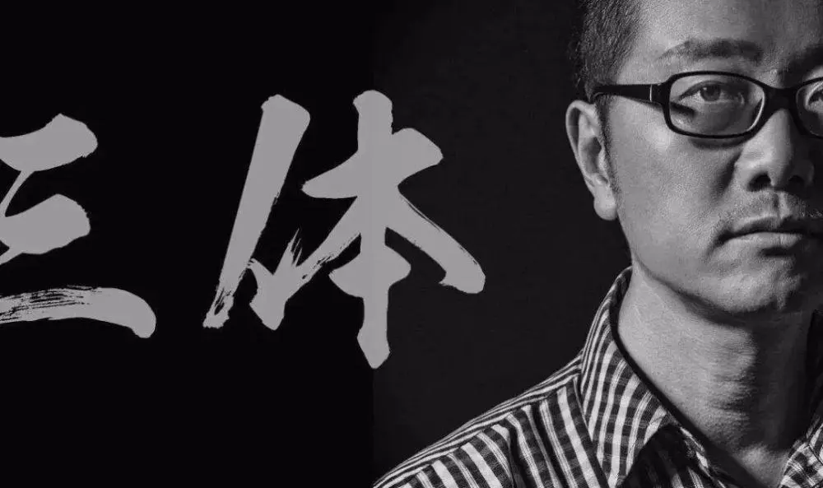
Translation of Liu Cixin’s Works
Liu Cixin is a senior engineer, member of the Chinese Writers Association, and also one of the representative writers of Chinese science fiction.
His representative works include the full-length novels like The Supernova Era, Ball Lightning, and The Three Body Problem, etc., and the short story The Wandering Earth. Among them, The Three Body Problem is widely regarded as a landmark work of Chinese science fiction literature. On August 23, 2015, he was awarded the Hugo Award for Best Full-length Novel at the 73rd World Science Fiction Convention, for The Three Body Problem.
The Three Body Problem has been translated into 25 languages and sold more than 21 million copies worldwide. Three Body Problem 1 and 3 were translated by Liu Yukun( 刘 宇 昆 ), and the second one was translated by Joel Martinsen(乔尔·马丁森) . To save time and speed up the process, the two started translating almost simultaneously to facilitate subsequent publication and distribution.
Notes:
内容页
图表
面积图

Slide 9
As an important channel of external communication, the translation of Chinese modern classics has its own characteristics and laws. In order to promote Chinese culture to go global, we can do a good job in the translation of classics from the following four aspects.
cultivate high-level translation talents, arouse the enthusiasm of overseas Sinologists in translating Chinese classics.
choose appropriate translation methods.
expand the external communication channels.
establish a perfect translation and dissemination quality evaluation mechanism.

Slide 10
Thanks
Thanks for Listening!

