Slide 1

Chinese Writing：Calligraphy
Presenter：Cui Xiaofan 崔晓凡

Slide 2
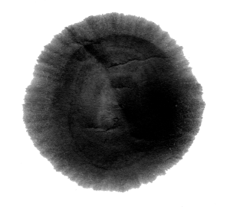

CONTENTS
1 Introduction and Evolution of the Calligraphy
2 Representative Figures & Masterpieces

Slide 3


【一】Introduction and Evolution of the Chinese Calligraphy

Slide 4
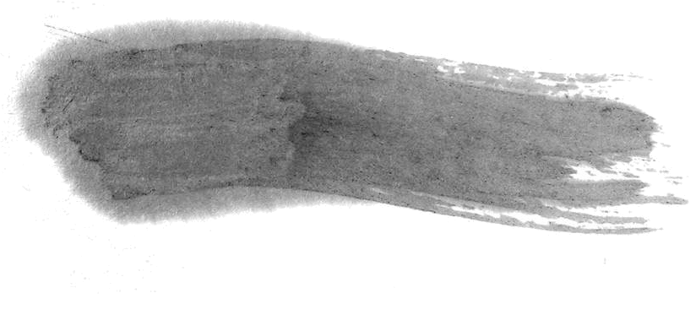
Introduction
1 What's the Chinese Calligraphy?
2 The Evolution of Chinese Calligraphy

Slide 5
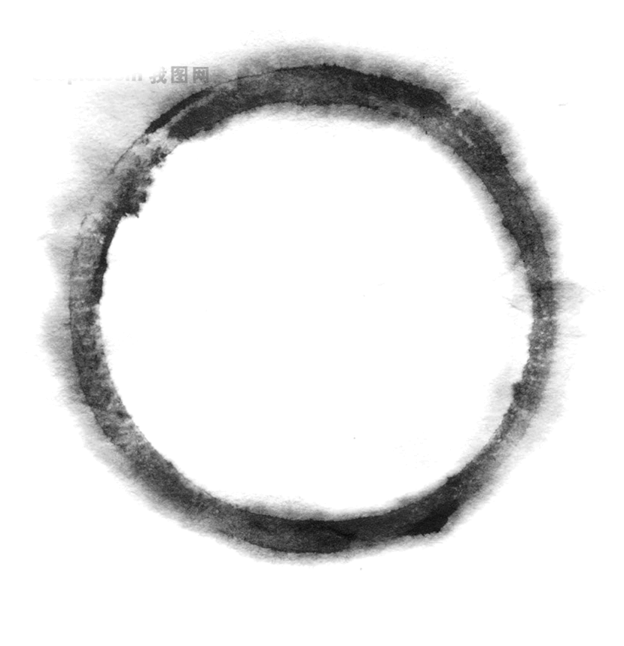
Introduction
Calligraphy is regarded in China as either the art of writing or beautiful hand-writing with the brush or the study of the rules and techniques of this art. As a school of traditional art, calligraphy occupies the same position as painting in the history of Chinese art and constitutes an indispensable part of the heritage of national culture.

Slide 6
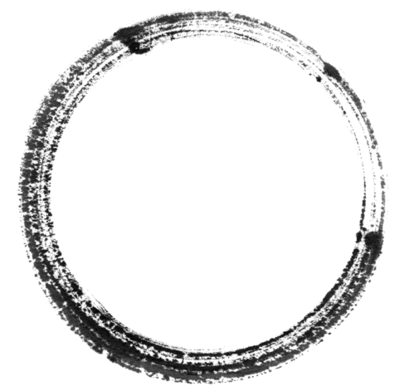

2 the Evolution of Chinese Calligraphy
the seal script
the official script
the regular script
the cursive script
the running script

Slide 7
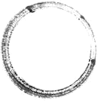
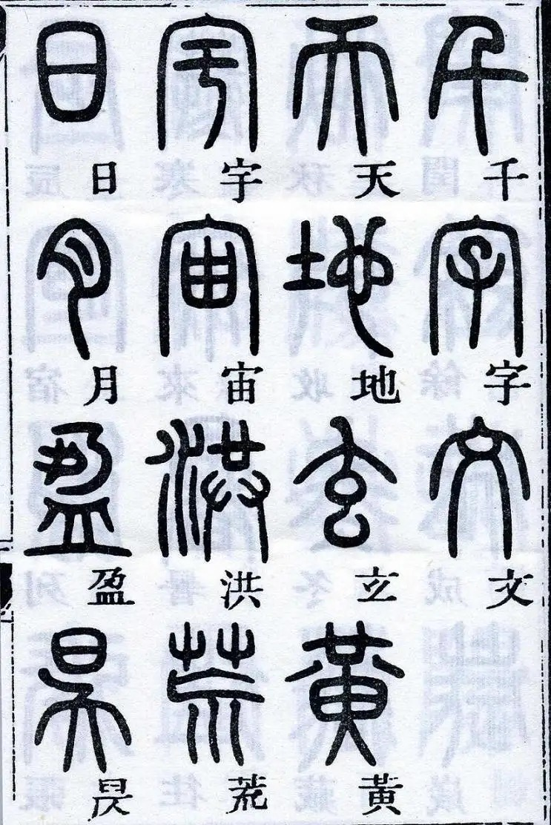
篆书
the seal script(zhuan)
After unifying the country, the first emperor of Qin ordered Prime Minister Li Si to promote the seal script used in the Qin State during the Warring States era as the standard national script. Li then invented a new type of script: Xiao Zhuan (small seal script).

Slide 8
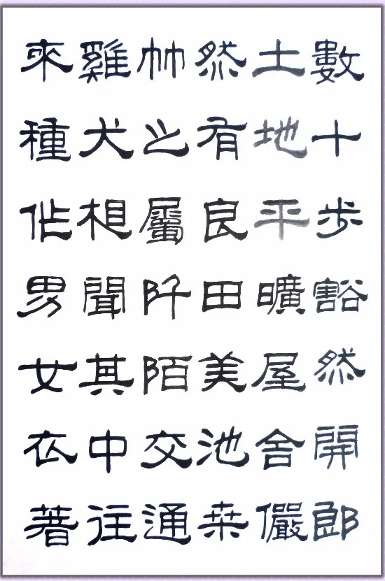
隶书
the official or clerical script(li)
The Western Han and Eastern Han Dynasties are the climax of calligraphy. Lishu, or the clerical script, widely used then, followed some rules of the seal script, set the style of calligraphy for the later Wei, Jin, Southern, Northern, Sui and Tang Dynasties, and led to other scripts. Since the Sui and Tang Dynasties, this official script has never been abolished although the regular script and the cursive script have prevailed, justifying its charm as art.

Slide 9
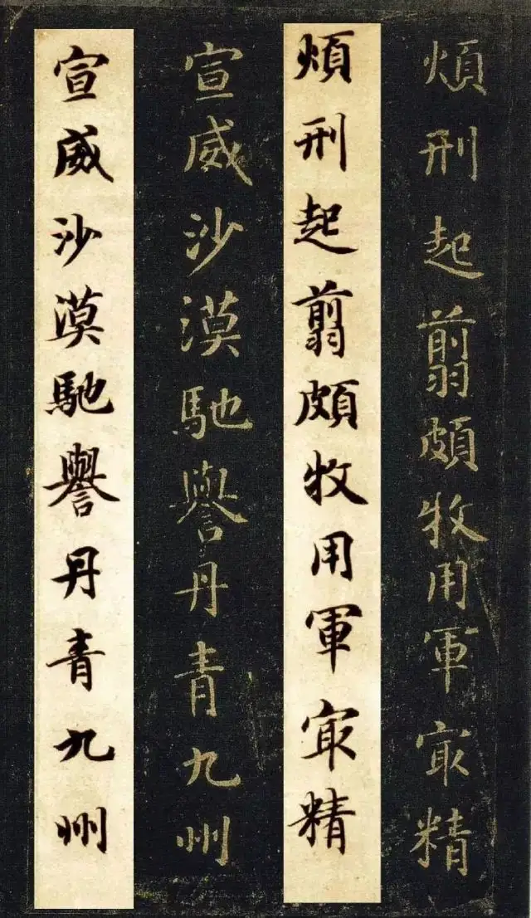
楷书
the regular script(kai)
Lishu was very close to and led to the appearance of kaishu - regular script. The oldest existing example of this dates back to the Wei Dynasty (220-265). The standard writing today is square in form, non-cursive and architectural in style. The characters consist of a number of strokes based on a total of eight kinds - the dot, the horizontal, the vertical, the hook, the rising, the left-falling, the right-falling and the bending strokes. Any aspirant for the status of calligrapher must start by learning to write a good hand in kaishu.

Slide 10
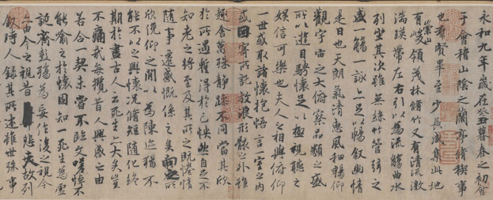
行书
the running hand(xing)
The xingshu script or the running hand is something between the regular and the cursive scripts. When carefully written with distinguishable strokes, the xingshu characters will be very close to those done in the regular style; when swiftly executed, they will approximate to caoshu characters. Chinese masters have always compared with vivid aptness the three styles of writing - kaishu, xingshu and caoshu - to people standing, walking and running respectively.

Slide 11
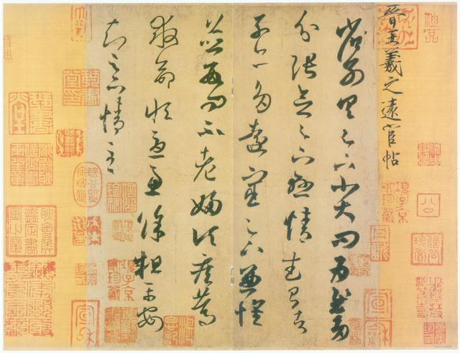
草书
the cursive hand(cao)
On the basis of lishu evolved caoshu (grass writing or cursive hand), which is rapid and used for making quick but rough copies. This style is subdivided into two schools: zhangcao and jincao. The characters are often joined up, with the last stroke of the first merging into the initial stroke of the next. They also vary in size in the same piece of writing, all seemingly dictated by the whims of the writer.

Slide 12
【二】Representative figures & Masterpieces

Slide 13
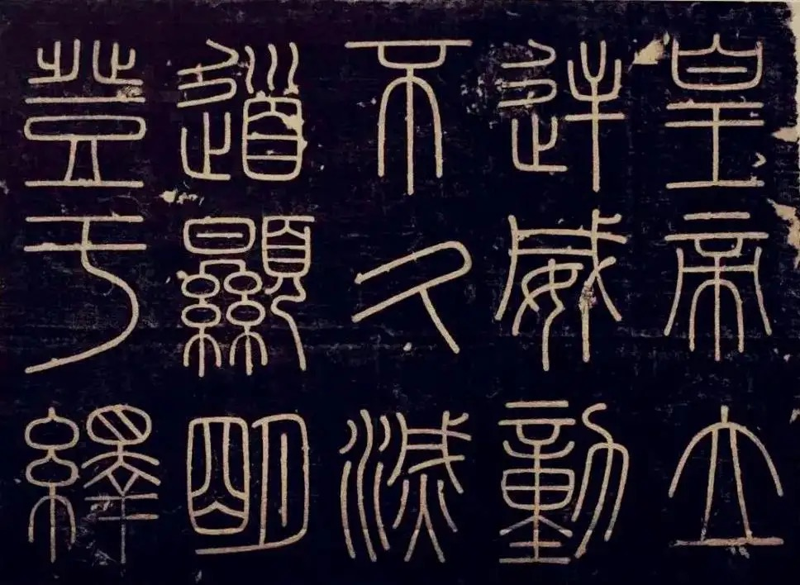

Representative figures & masterpieces
the small seal script
单击此处
添加文字
点击添加文字
Stone Inscriptions at Mt. Tai(峄山刻石-李斯）

Slide 14
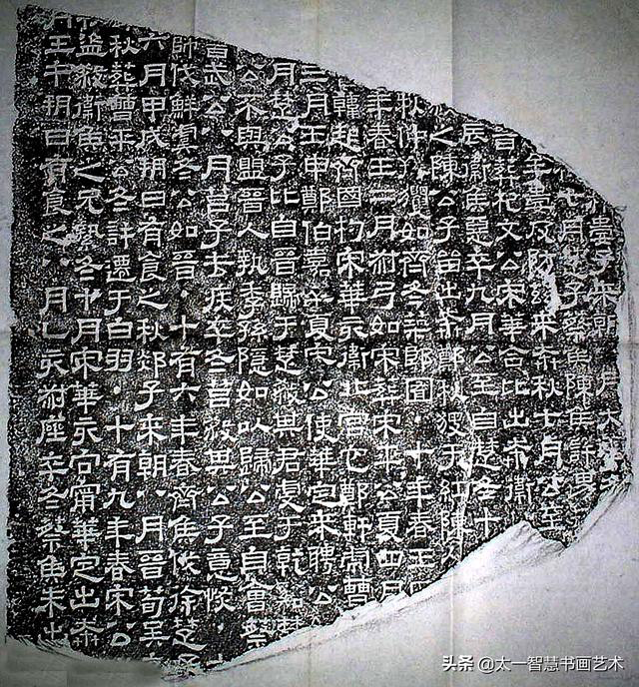
Representative figures & masterpieces
the clerical script
Xiping Stone Classics《熹平石经》-蔡邕

Slide 15
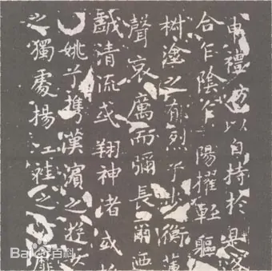
Representative figures & masterpieces
the regular script
Nymph of the Luo River《洛神赋》-王献之

Slide 16
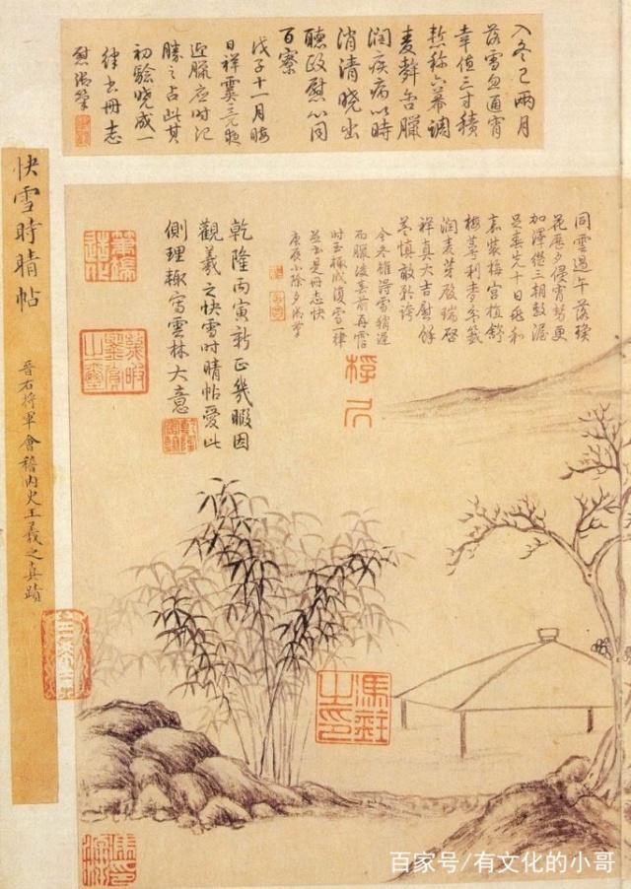
Representative figures & masterpieces
the running hand
《快雪时晴帖》-王羲之

Slide 17
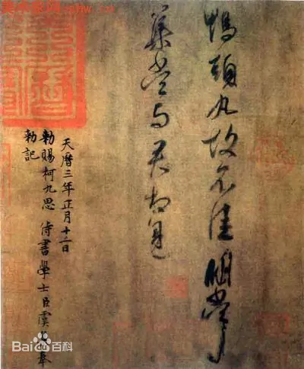
Representative figures & masterpieces
the cursive hand
《鸭头丸帖》-王献之

Slide 18
中国风
Thank You!

