Slide 1
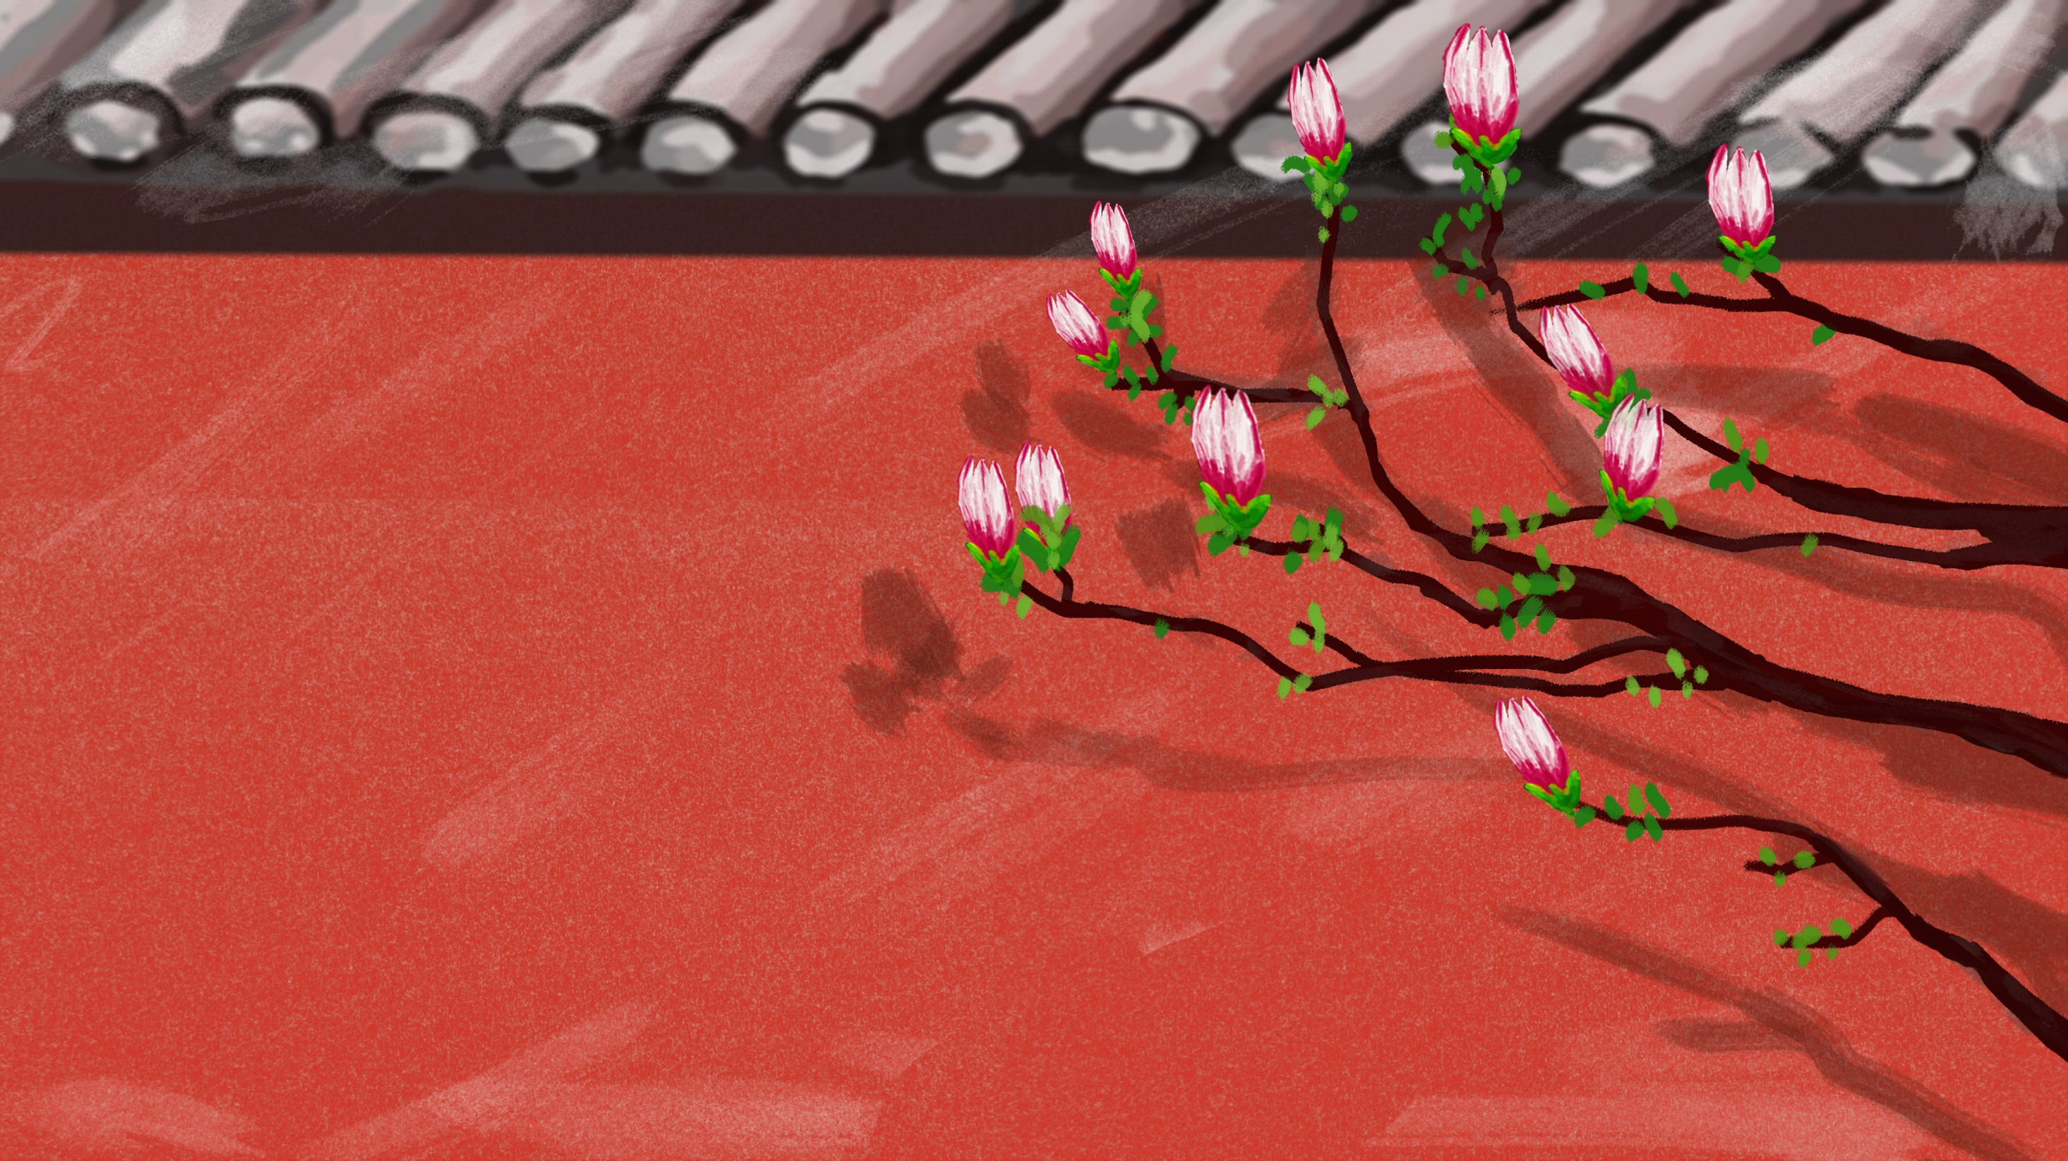

H
O
T
P
O
T
火锅
202130092042 Liu Xinwen 刘欣雯

Slide 2
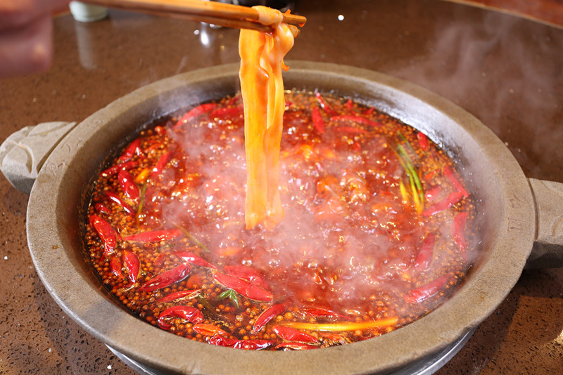
MENU
ONE
TWO
THREE
FOUR
一锅历史渊源
THE HISTORY
一锅多姿多彩
一锅文化底蕴
THE CULTURE
一锅创新潮流
THE CREATION
THE KIND

Slide 3


Overview of hot pot

Slide 4
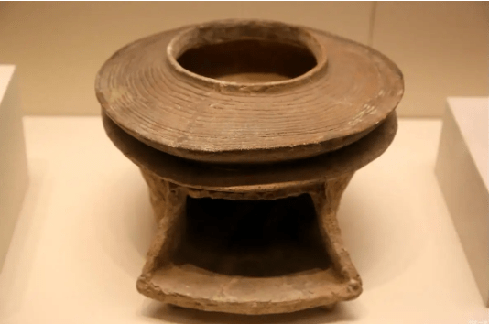
What is Hot Pot?
Hot pot is an ancient name for “Goudong soup”(古董羹）, named after the “goudong”（咕咚） sound made when food is put into boiling water, and is one of China's original cuisines and a kind of food for both young and old.
Hot pot generally refers to a cooking method in which a pot is used as an container to boil water or soup with a heat source to cook various types of food, and also refers to the pot used for this cooking method. The characteristics of hot pot are that it is eaten while cooking, or the pot itself has a heat preservation effect, so that the food is still steaming hot when eaten, and the soup is united.

Slide 5

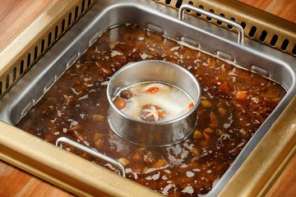
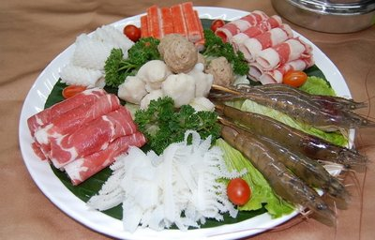
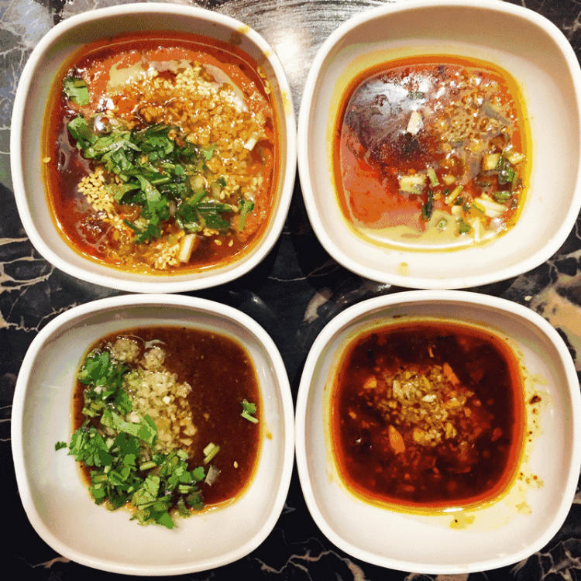
The consist of Hot Pot
01
02
03
添加标题
添加标题
添加标题
点击添加文本信息点击添加文本信息点击添加文本信息
点击添加文本信息点击添加文本信息点击添加文本信息
点击添加文本信息点击添加文本信息点击添加文本信息

Slide 6
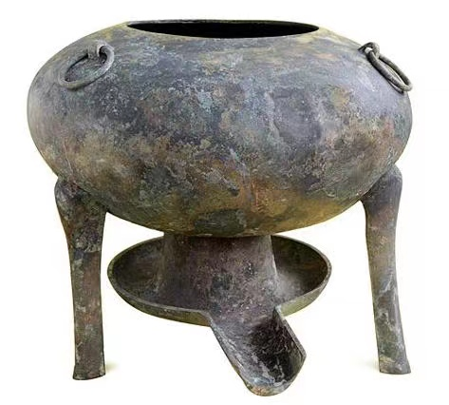
HISTORY
About the origin of hot pot, there are two statements: one says that in China during the Three Kingdoms period or Wei Dynasty, when the “copper tripod“(铜鼎）, the predecessor of hot pot; the other says that hot pot began in the Eastern Han Dynasty, excavated artifacts in the ”bucket”（斗） refers to the hot pot. It can be seen that hot pot in China has a history of more than 1900 years.

Slide 7
HISTORY
The most famous hot pot is the Chongqing and Sichuan hot pot. In ancient times in Sichuan and Chongqing, after killing cattle, pigs and other livestock animal offal, such as tripe, intestines are often discarded, the slender men feel wasteful, they will pick them back, cooked in a large pot with boiling water, and a lot of pepper, chili pepper to adjust the taste, not only can cover the offal of the fishy taste to increase the flavor, but also to remove moisture and drive away the cold, this is the origin of hot pot in Chongqing, Sichuan.

Slide 8
Types of Hot Pot

Slide 9
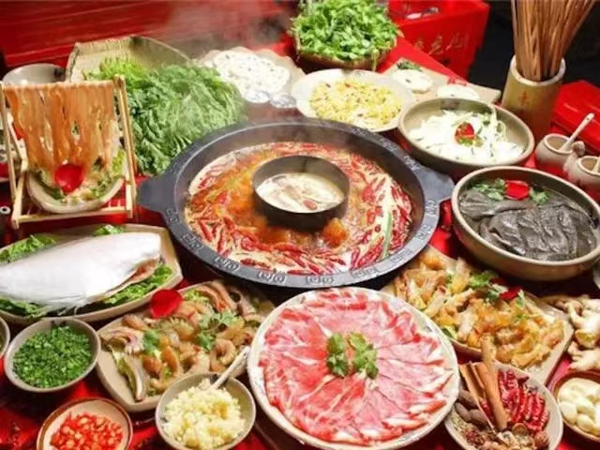
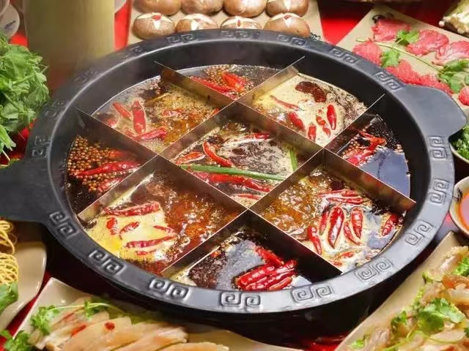
Diversity

Slide 10
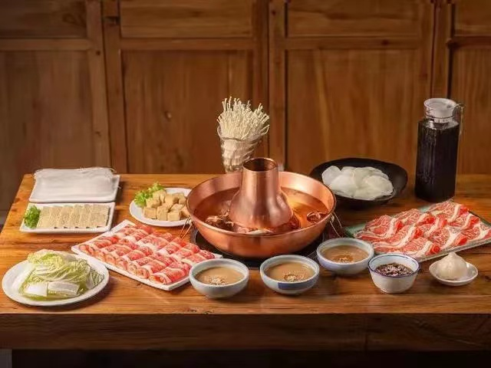
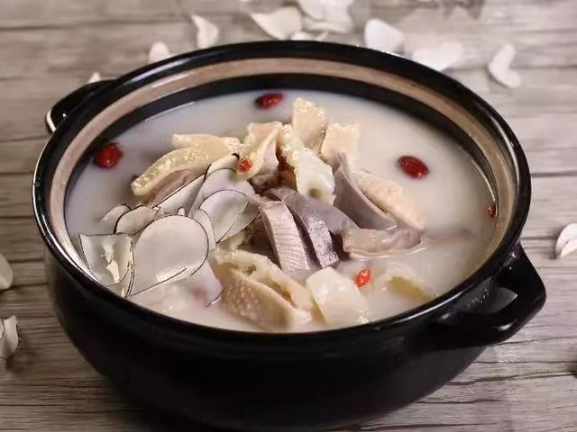
Diversity
Old Beijing copper pot with instant-boiled meat
Hainan Coconut Chicken Hot Pot

Slide 11
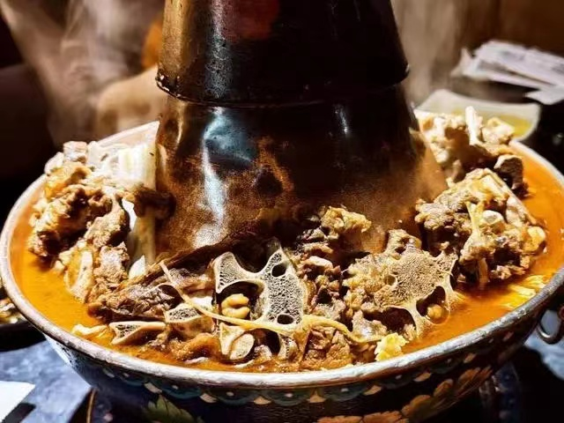
Diversity
Lamb Spine Hot Pot 羊蝎子火锅
（Scorpion is a dish made from a complete sheep vertebra with loin and spinal cord（带里脊肉和脊髓的完整羊脊椎骨）, which is commonly known as scorpion because of its resemblance to a scorpion.

Slide 12
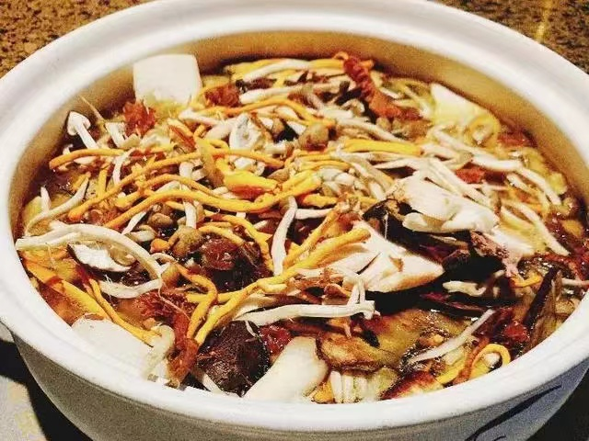
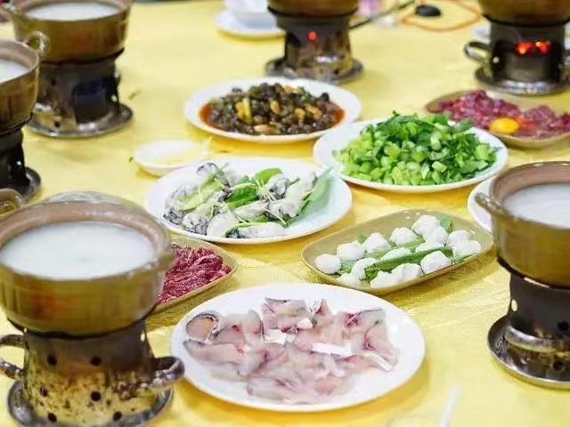
Diversity
Yunnan Wild Mushroom Hot Pot
Cantonese Congee Hot Pot

Slide 13
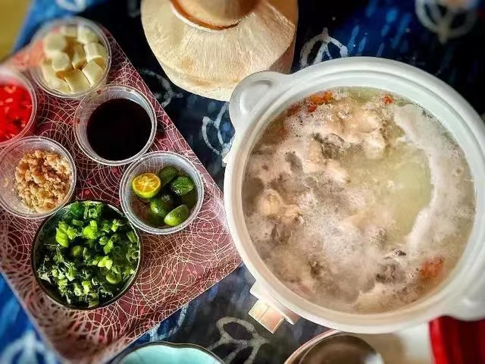
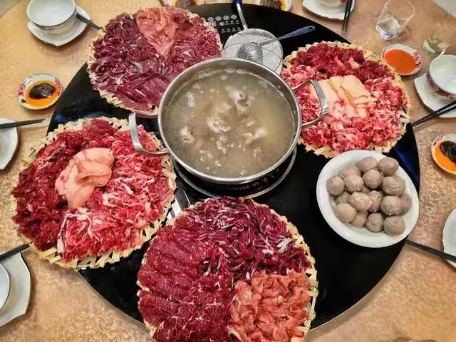
Diversity
Pork Belly Hot Pot
Beef Hot Pot in Chaoshan

Slide 14
Culture of Hot Pot

Slide 15

The Culture in Hot Pot
——inclusive
Hot pot inside vegetables, noodles, beans, meat, seafood, all can be put into the pot, the meat and vegetarian mix, seasoning inclusive of things, the material does not distinguish between north and south, the symbol of the sea to accept all rivers, and the world.（海纳百川，有容乃大）

Slide 16
The Culture in Hot Pot
——reunion
Hot pot's hot whirring, expressing intimacy, there is a hot and intimate emotions, hot pot's round, indicating reunion, eating hot pot, friends and relatives, countryside, men, women and children around the hot pot, raise a glass of wine, overflowing with a cordial and warm atmosphere, reflecting the traditional Chinese culture of reunion.

Slide 17
The Culture in Hot Pot
Hot pot is not only a delicious food, but also contains a lot of food culture , for people to taste when adding elegant. For example, Taiwan Hakka People(台湾客家人） mostly eat hot pot on the seventh day of the New Year, hot pot with seven dishes is indispensable, namely celery, garlic, green onions, coriander, leeks, fish, meat. This means: "diligent, calculating, smart, good people, long-lasting happiness, surplus, and abundance.

Slide 18
The creation of Hot Pot

Slide 19
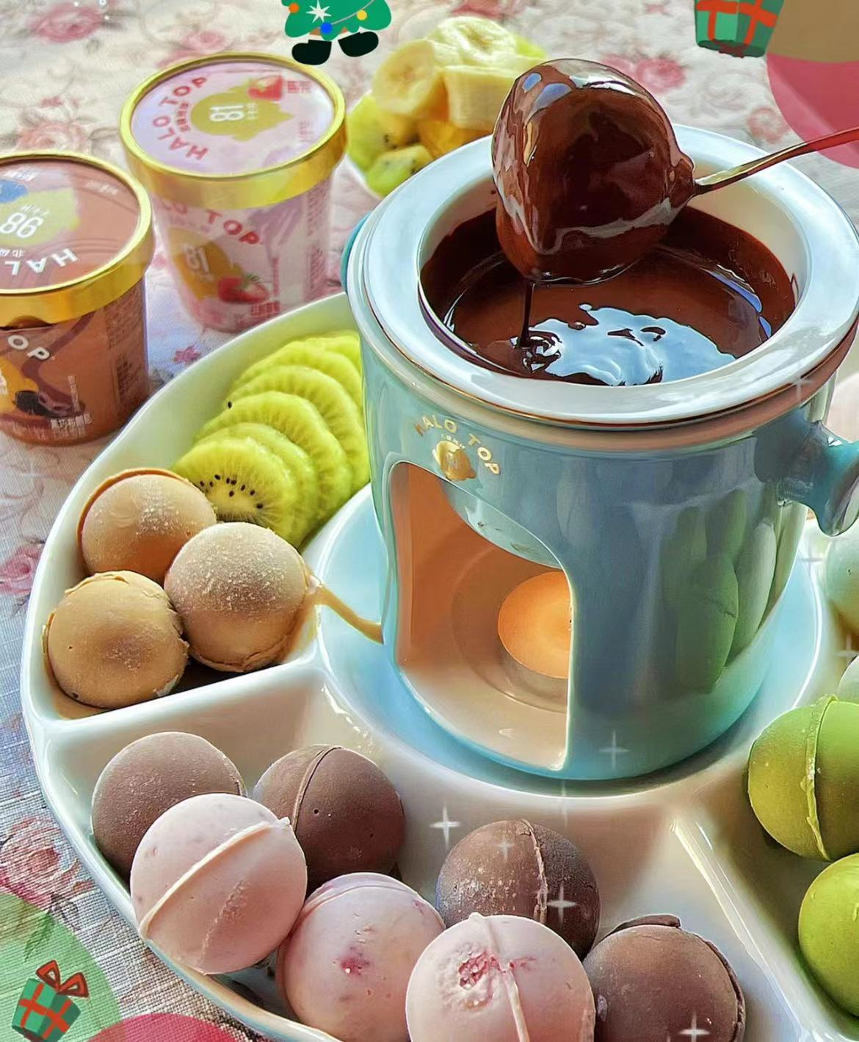
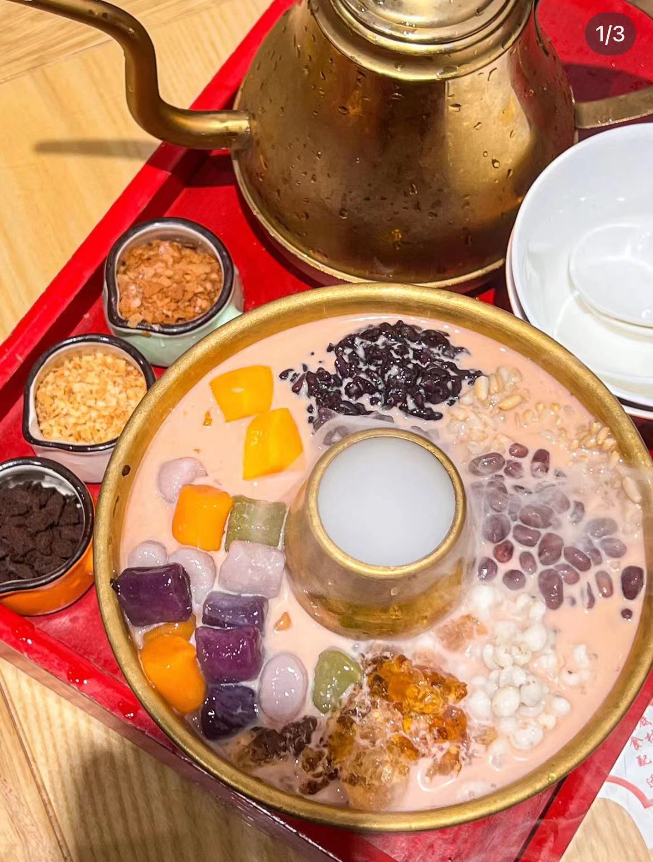

Creation

Slide 20
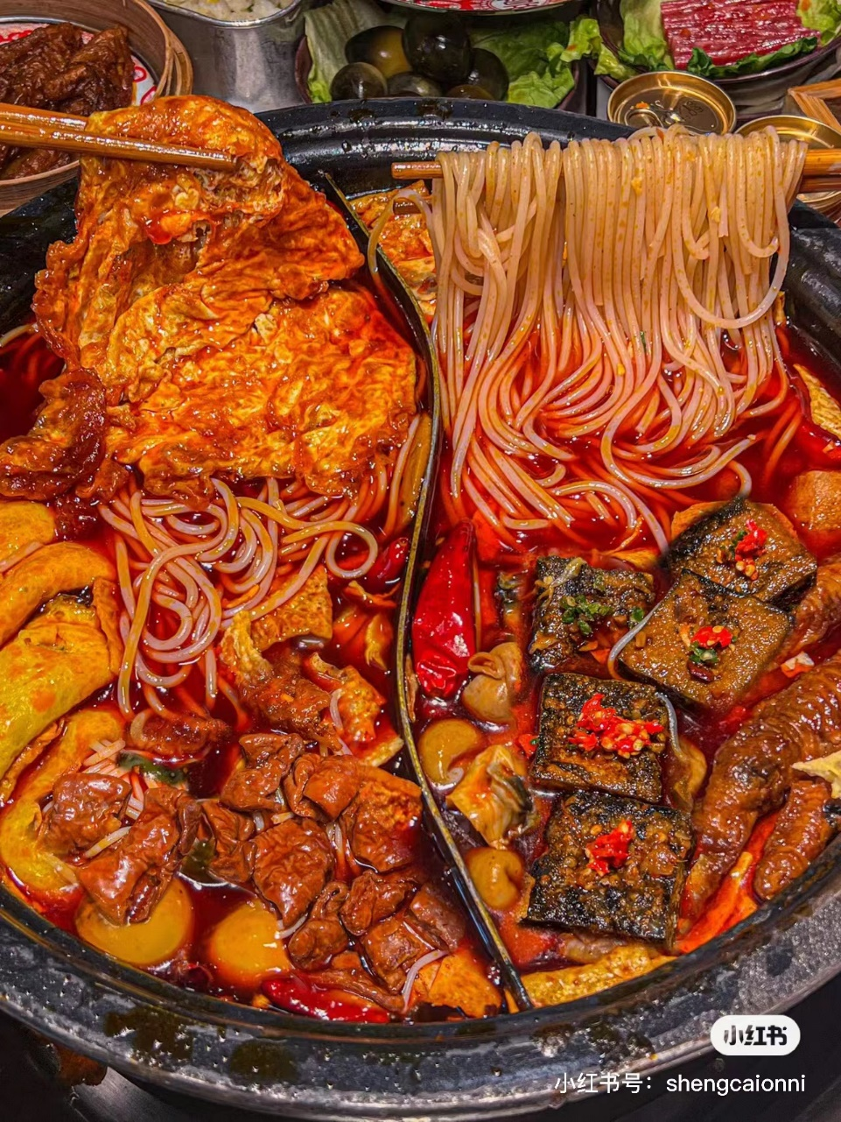

Creation

Slide 21
Thanks for watching

