Slide 1





The History of Chinese Buddhist Translation Theories
ppt：邱婷婷
handout：卫怡雯

Slide 2
4. From Northern Song Dynasty
2. From Eastern Jin Dynasty to Sui Dynasty
3. The Tang Dynasty
1. From eastern Han dynasty to Western Jin Dynasty

Slide 3
1. From eastern Han dynasty to Western Jin Dynasty
Some characteristics of translation in this period :
The translators were mainly foreign monks
Translation tended to be literal
The translation was not supported by the government

Slide 4
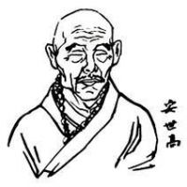
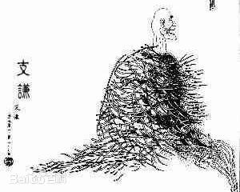
1. From eastern Han dynasty to Western Jin Dynasty
An Shigao（安世高）
The founder of Chinese Buddhist translation
Literal translation
An Ban Shou Yi Jing （《安般守意经》）
Zhi Qian（支谦）
tried to translate more concisely and reduce transliteration
the dispute of Wen and Zhi
(Wen refers to free translation and Zhi refers to literal translation)

Slide 5
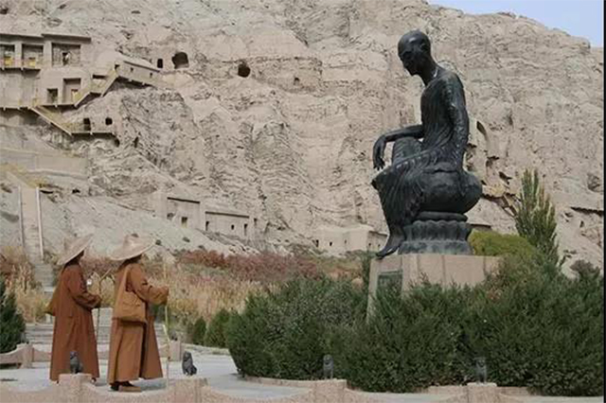
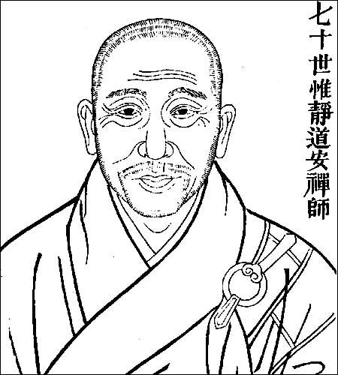
2. From Eastern Jin Dynasty to Sui Dynasty
Kumarajiva（鸠摩罗什）（343-413）
Foreign monk
Free translation
On the premise of not violating the general idea of the original text, there is no need to stick to the form
Dao An（道安）（312-385）
The pioneer of systematic arrangement and compilation of Buddhist sutras in The history of Chinese Buddhism
Five Losses of Source Text and Three Difficulties in Translation

Slide 6
Five Losses of Source Text and Three Difficulties in Translation
five losses：（summarized in three points）
1.the word order
2.the balance of “Wen” and “Zhi”（be applied in different translation situations ）
3.the simpleness and complex
Three difficults：
1.context:the scriptures translated long time ago may not be appliable to it’s
later society
2.reader:To impart buddhist texts to the general public
3.translator:first need to have the corresponding knowledge reserves, fully understand
the content of the original text

Slide 7
3. The Tang Dynasty
Some characteristics of translation in this period :
dominated by Chinese monks
The translation was supported by the government and the ruling class

Slide 8
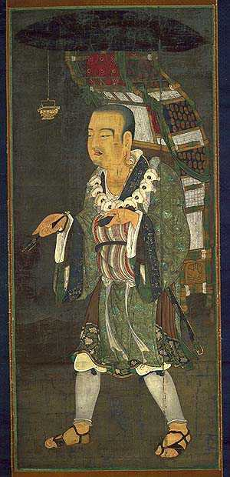
3. The Tang Dynasty
Xuan Zang （玄奘）（602-664）
translation standard of being true and easy to understand
Five situations not be translated （五不翻）
transliteration（音译）
Words that are hard to understand
Words have many meanings, and it is hard for translators to choose which specific meaning in the context
Words do not make sense in target languages
Some transliterations of proper nouns had been widely
accepted by former people and we can adopt it directly
Words in the original text show respect, if we translated it,
may change the meaning and show contempt.

Slide 9
4. The Reflection on Buddhist Scripture Translation
Throughout the history of Chinese translation, half is the history of Buddhist scripture translation. Those thories of ancient Chinese Buddhist translators in their translation practice seem to be unsystematic, but in fact they have their own internal development process. They are the source and foundation of Chinese translation studies and the soil for the birth, development and innovation of modern Chinese translation theories.

Slide 10
References
[1]包布赫.浅析玄奘的翻译观及其佛经翻译[J].文学教育(下),2017(12):185.
[2]库瑜珂,库在强.道安“五失本”与“三不易”的佛经翻译理论论析[J].黄冈师范学院学报,2020,40(04):18-23.
[3]李颖.从翻译史上的几个重要时期看中国翻译理论与实践的发展[J].湖北经济学院学报(人文社会科学版),2016,13(10):132-133.
[4]孟悦. 中国佛经翻译发展史综述[C].外语教育与翻译发展创新研究(第六卷）.四川西部文献编译研究中心,2017:312-315.
[5]于飞. 历史上的佛经翻译与佛教中国化[N]. 中国民族报,2020-10-20(008).

Slide 11
Thanks for your whatching!

