Slide 1
Cinema Movie Adaptations of Chinese Calssics
REC
汇报人：张姣玲 Zhang Jiaoling

Slide 2
REC
Contents
Overview of Adaptations of Chinese Classics
Types of Adaptations of Ancient Chinese Classics
Types of Adaptations of Modern Chinese Classics
The Epochal Significance of Chinese Classics Adaptation

Slide 3
REC
Overview of Adaptations of Chinese Classics

Slide 4
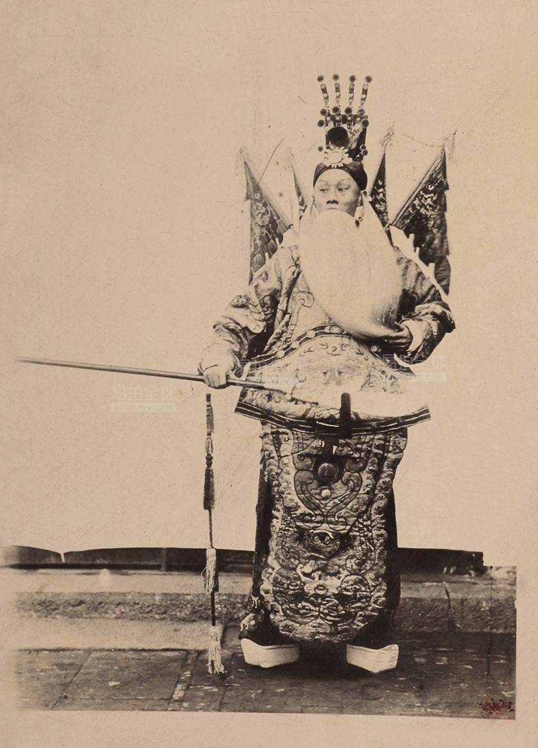
The Start
In 1905, China's first silent opera film Dingjun Mountain《定军山》 appeared and symbolized the birth of Chinese film.
The film is based on the 70th and 71st chapters of the classic novel Romance of The Three Kingdoms.

Slide 5
The Development
rising stage
initial stage
slump stage
golden stage
turning stage
1905-1949: Almost all films were related to literary classics, and many literary classics were made into films.
1950-1979: With the influence of the "Cultural Revolution", the film and television production of literary classics temporarily entered a period of low tide with a slight decline in the number.
1980-1989: After the reform and opening up, the literary classics in film developed rapidly and entered the golden age.
1990-1999: There was a certain turning point, and the scale and influence of film adaptations were slightly reduced.
2000-present: The annual production of literary classic film and television works began to increase compared with before, and the number gradually picked up.

Slide 6
REC
Types of Adaptations of Ancient Chinese Classics

Slide 7
Although classical literature is a product of history, it is still loved by contemporary people because of its profound ideological content and its unique artistic charm. Its popularity has also largely contributed to its adaptation into film and television works, and every time adaptation of a classical literature comes out, it attracts great public attention.

Slide 8
Three Types of Adaptations of Ancient Chinese Classics
01
02
03
Restoration
Adaptation
Recreation
For example, Director Gao Chang's 2012 film Liu Rushi《柳如是》 is faithful to Chen Yinke's Supplement Biography of Liu Rushi.
Those adapted works make some changes and go beyond the original works.
The film only to take the original work as the material and finally show it to the audience in the form of parody.
It refers to the faithful reflection of the content of classical literature based on the content of classical texts.
For instance, the movie Painted Skin《画皮》, it aimed to satirizing others for their duplicity, but now it is more about telling people how to love.
This type of works, represented by Hong Kong director Liu Zhenwei, are popular among many young people, such as A Chinese Odyssey《大话西游》.

Slide 9
REC
Types of Adaptations of Modern Chinese Classics

Slide 10
Since 1980s, the need for cultural and historical inheritance based on the needs of national cultural development is increasingly urgent. Therefore, literary classics have been purposefully retold and recreated in the context of specific film industry and society, and their meanings may be generated from different dimensions such as nation, society, commerce and the public. For example, according to the purpose and intension of the adaptation, the following main types of film adaptation of modern literary classics have appeared, among which fine film art works may appear.

Slide 11
Four Types of Adaptations of Modern Chinese Classics
National education adaptation
Popularization adaptation
Commercialized adaptation
Artistic adaptation
Different from the emphasis on artistry in popular adaptation, these adaptations are richer in cultural reflection and formal exploration.
In this type of adaptation, the modern intellectual sentiment of the original work often gives the work an intellectual depth. The adapted version is also committed to highlighting the cognitive value of the work to the history and society of the past era, and tends to illustrate the original work.
The adaptation strategy of the film shows the intention of paying tribute to the original work and its author, taking up and maintaining the classicality of the literati and their works in the form of a film, and focusing on the realization of aesthetic value as the artistic appeal of the film.
In this type of cases, Yan Yu Chang He 《烟雨长河》has some defects in plot and narration, but it has made an attempt in the mixed type of commercial films. In the context of trans-regional film cooperation, the movie adaptations of The Husband《丈夫》 has tried to achieve commercialized operation and commercialized goals.
In a "perfect adaptation", the film A Girl From Hunan《湘女萧萧》 creates an overall symbolic meaning that the original does not possess, transcending the appeal of popularization.
The True Story of AH Q《阿Q正传》 is an eclectic and moderate adaptation of this kind, which also contains annotations and interpretations.
Film adaptations of Midnight《子夜》, The Rickshaw Boy《骆驼祥子》, Thunderstorm《雷雨》, Border Town《边城》 and other works all belong to this category.

Slide 12
REC
The Epochal Significance of Chinese Classics Adaptation
PPT模板 http://www.1ppt.com/moban/

Slide 13



For the classics itself, the heritage of classics needs to keep pace with the times, otherwise it will have difficulty in gainning the affirmation of new times and in having a wider impact. In order to have a broader scope of dissemination, classical literature needs to find and use various new means, such as film and television adaptations.
For film and television audience, film and television works have a stronger communication function. Many film and television plays adapted from classic literature now pay special attention to incorporating current social problems in the process of adaptation, so those popular film and television series are faithful reflection of the current public mentality and sincere expression of social problems concerned by the public, and play a guiding role to a certain extent.
From the perspective of the adapters and the cultural construction of society, every writer who adapts classic literary works is the inheritor of classic literary works, and a link in the inheritance chain of those works. At the present stage, the development of the film and television industry cannot be ignored if cultural construction is to be achieved. As the most important link of film and television industry, the adaptation of classic literature should also make its due contribution.

Slide 14
References：
周莹.二十一世纪经典文学改编的价值趋向研究[D].曲阜师范大学,2012.
廖涛.经典视域中的影视书写——论2010年以后的中国古装电影[J]. 成都大学,2018,01.
戴佳言.当下文学名著影视化传播研究[D].东北师范大学,2015.
童晨.文学作品影视化改编的传播分析[J].哈尔滨师范大学,2022,11(154-156）.
刘诗杨，唐杨.文学经典影视化：融合、困境与出路[J].湖南师范大学,2021,26(137-138).
张一玮.《从名著到电影——中国现代文学经典作品的当代电影改编版研究》[J].全国新书目,2021(06):68.

Slide 15
Thank you for your attention

