Slide 1

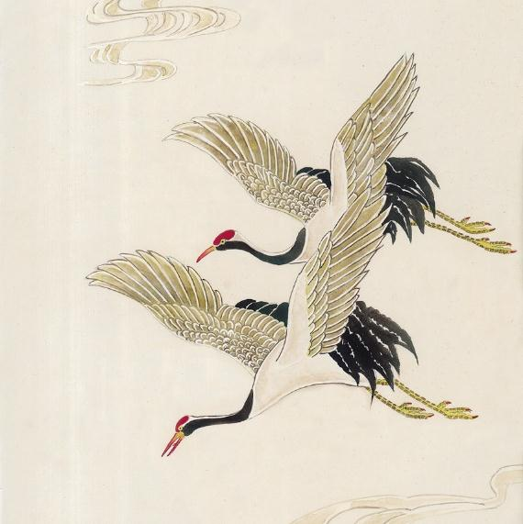

Archaeological Ruins of Liangzhu City
Presenter: Bai Ting

Slide 2



Contents
Significance
Geographical Position
Heritage Elements

Slide 3

壹
Significance
the significance of the archaeological ruins of Liangzhu City

Slide 4

Question
中 国 风 文 化
How many years of history does China have?

Slide 5
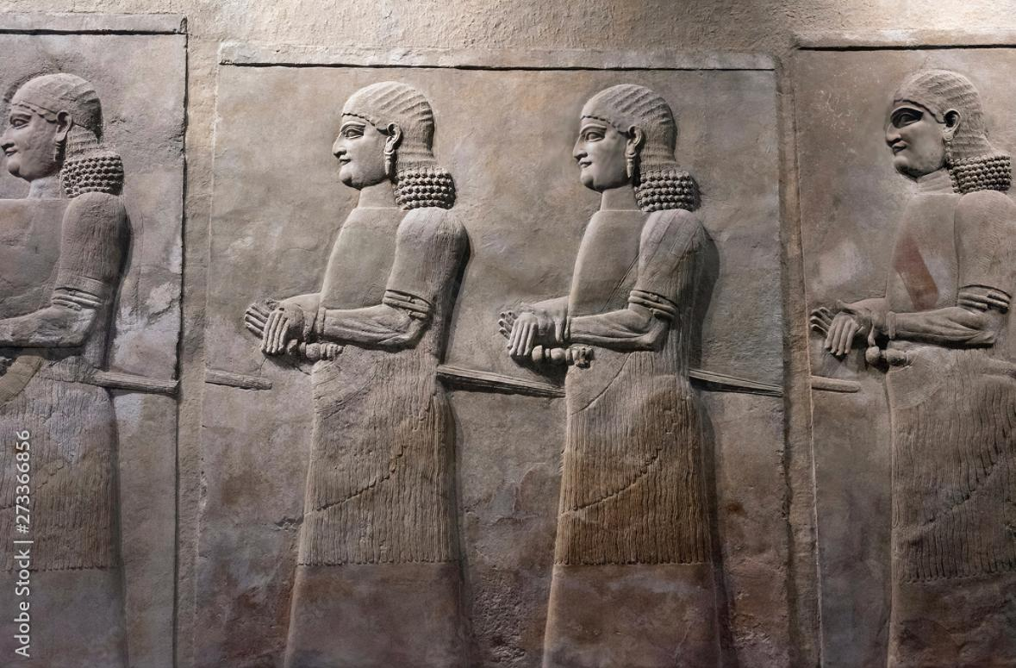
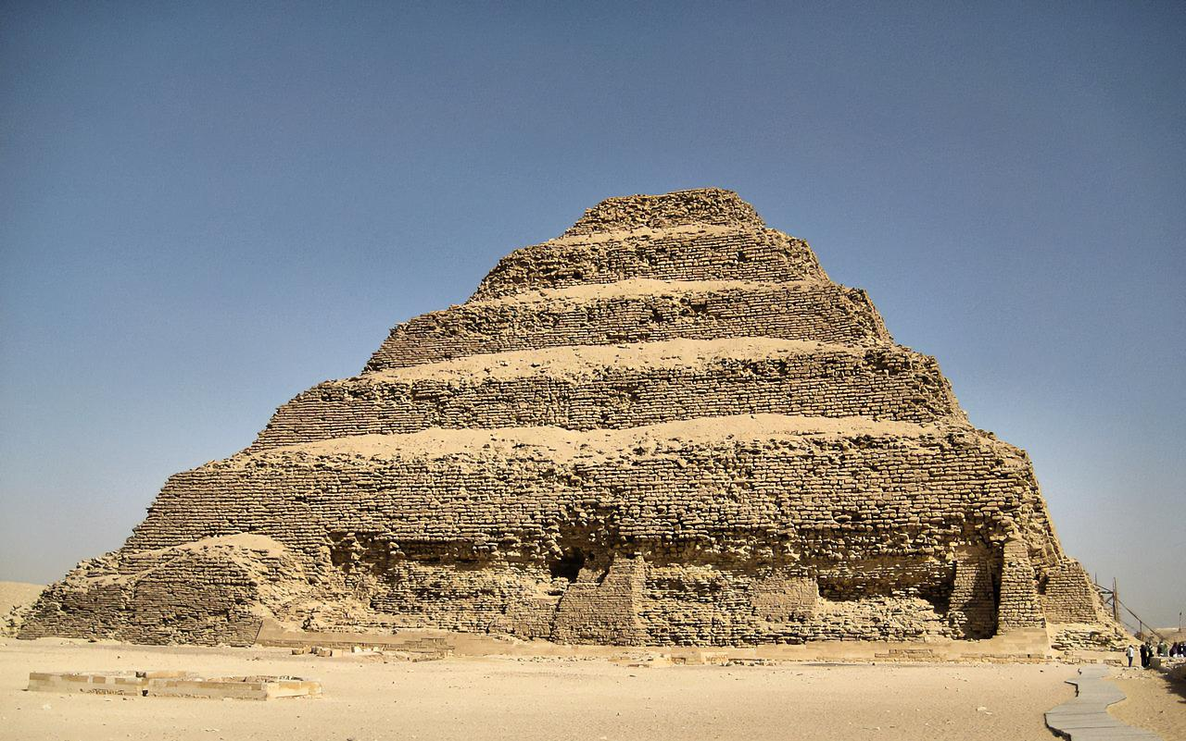
Ancient Sumerian Stone Carving on Wall
5,000 years ago
Pyramid of Djoser
4,700 years ago

Slide 6

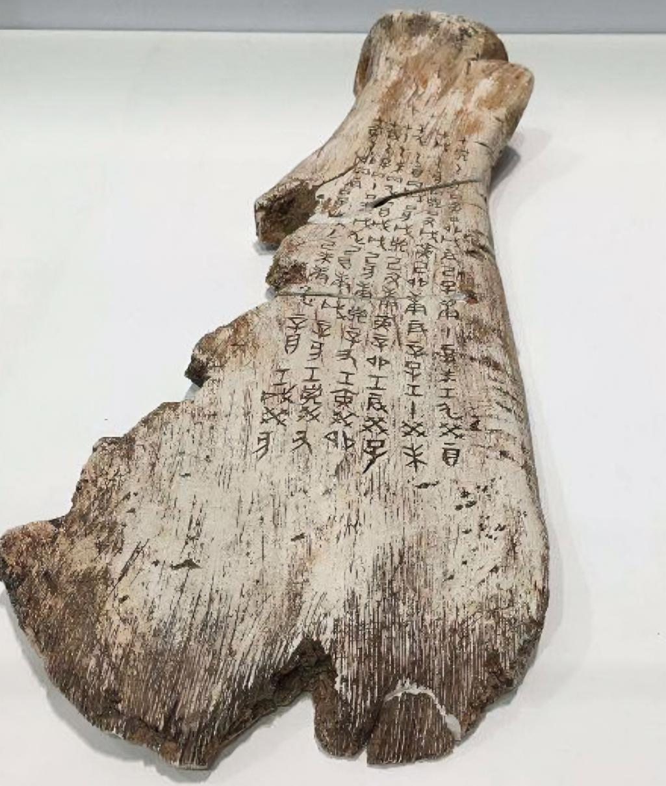
Oracle bone script
The Oracle bone script of the Shang Dynasty(1711-1066 BC) is the earliest systematic form of Chinese characters inscribed on animal bones and tortoise shells.
The earliest written records in China date back only to 3,500 years ago.

Slide 7
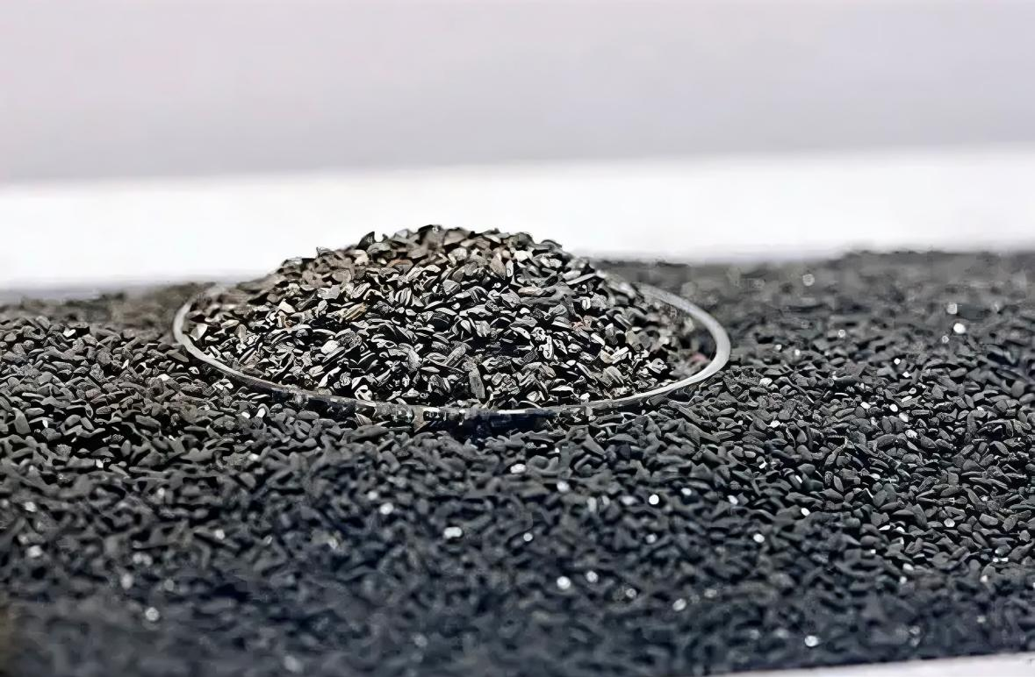
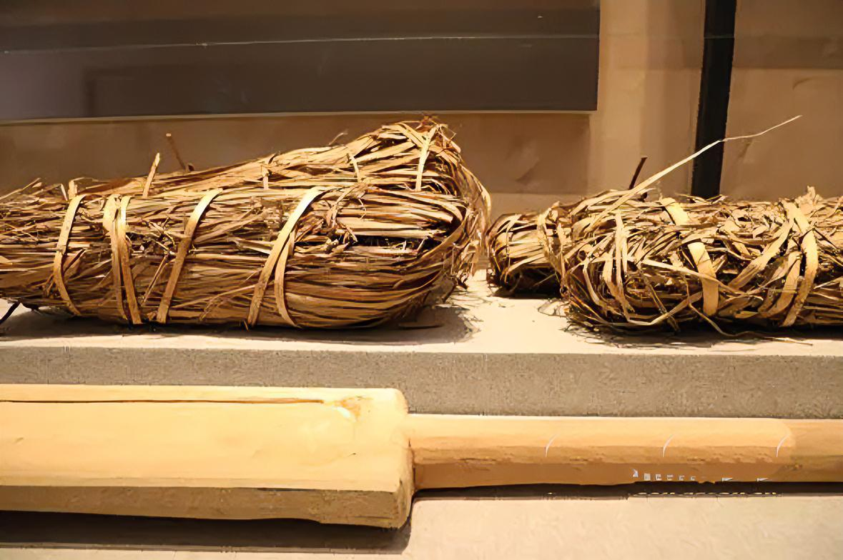
Yet through a series of archaeological findings, including those at the ruins of Liangzhu City, we can verify that the ancient city of Liangzhu dates back to 3,300-2,300 BC.
In 2019, Liangzhu was inscribed on the World Heritage List, marking the international recognition of China’s 5000-year civilization.

Slide 8
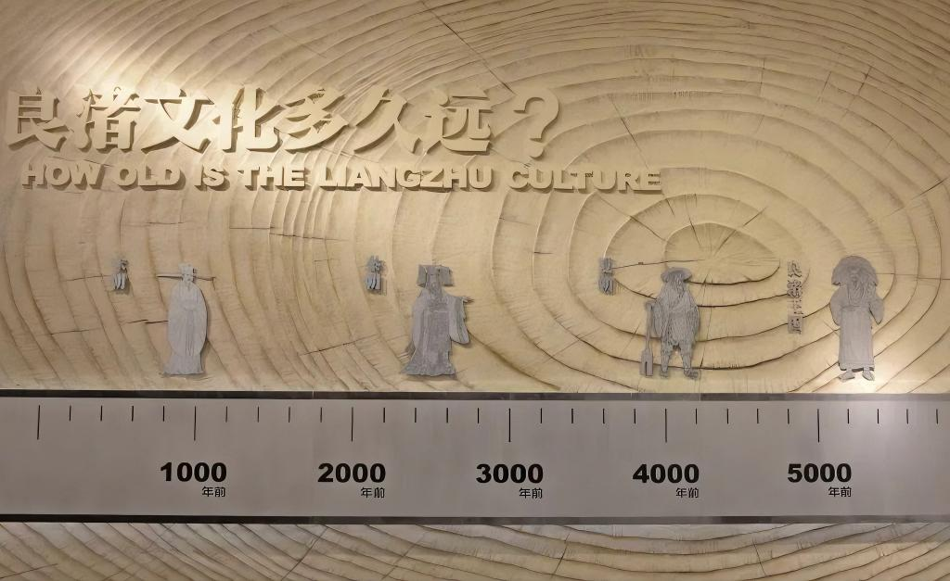

Slide 9
贰
Geographical Position
the location of the archaeological ruins of Liangzhu City

Slide 10
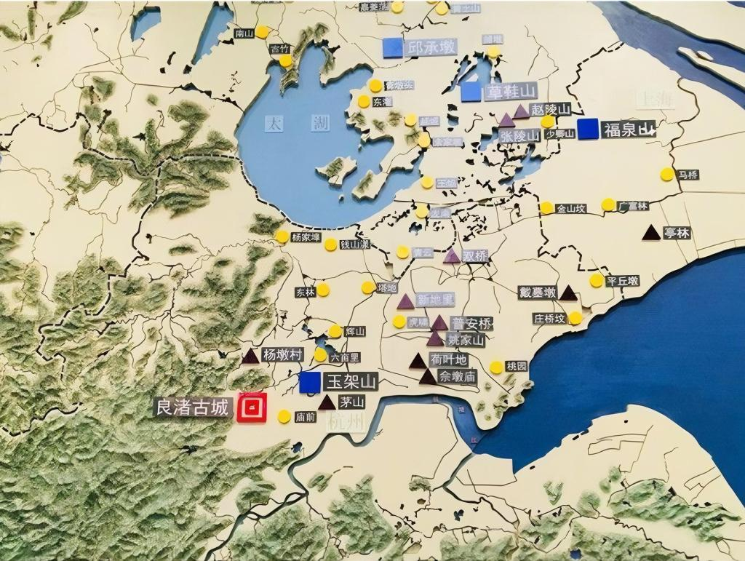
Liangzhu Culture is located in the middle and lower reaches of the Yangtze River around Taihu Lake, which are in the southeast of China.
Its distribution area is very broad. It is named after the civilization that was first discovered in 1936.

Slide 11
叁
Heritage Elements
the heritage elements of the archealogical ruins of Liangzhu City

Slide 12

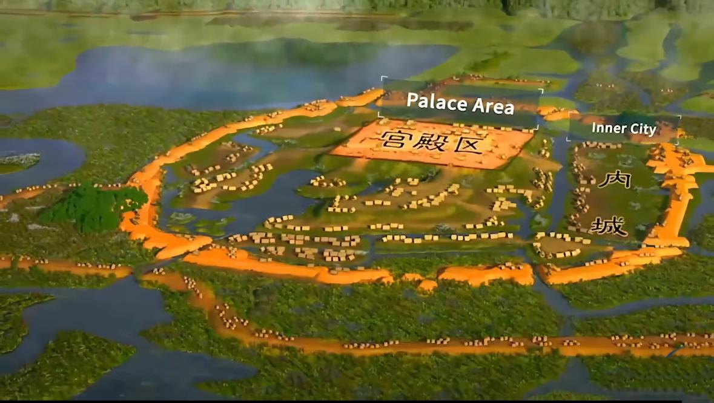
The Ancient City Site
The site is composed of the palace area, the inner city and the outer city.
The inner city is surrounded by a perimeter wall, covering a total area of about three square kilometers.

Slide 13
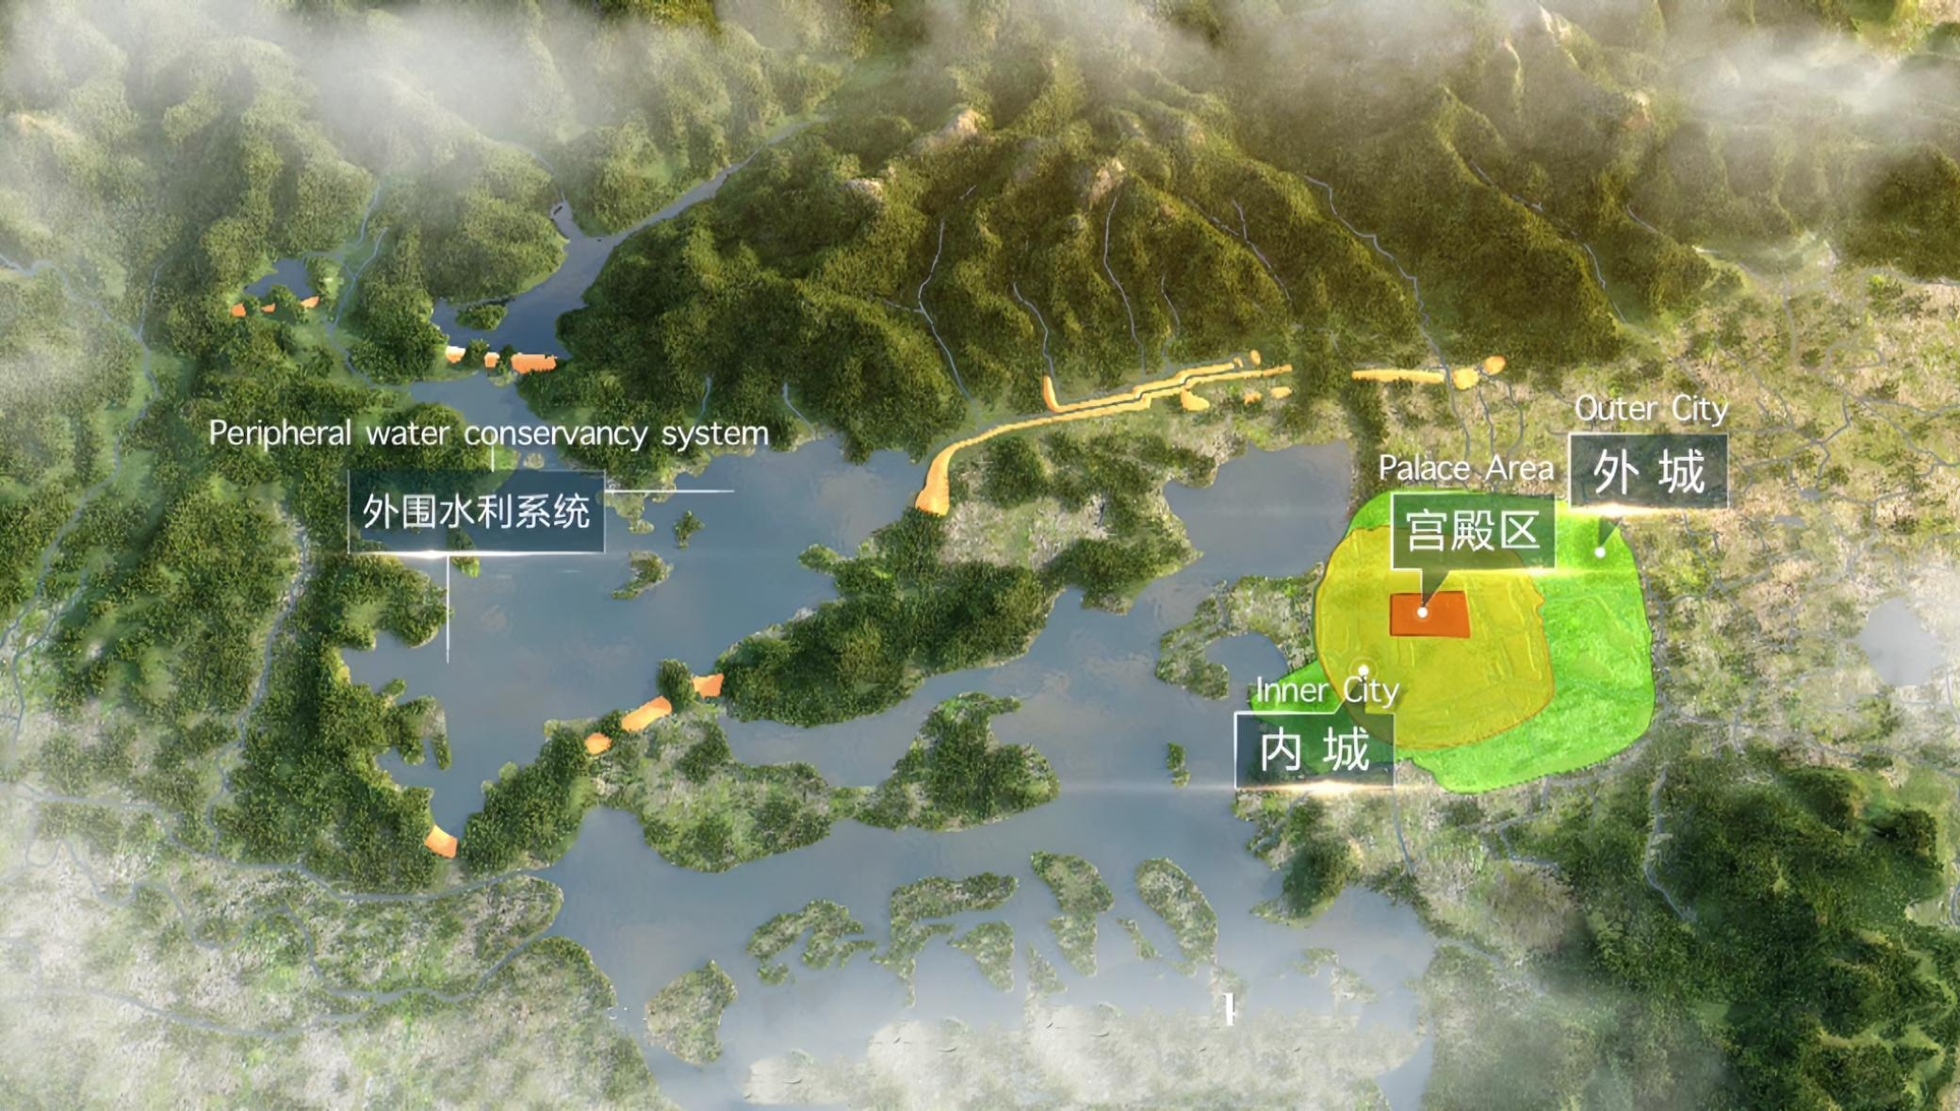
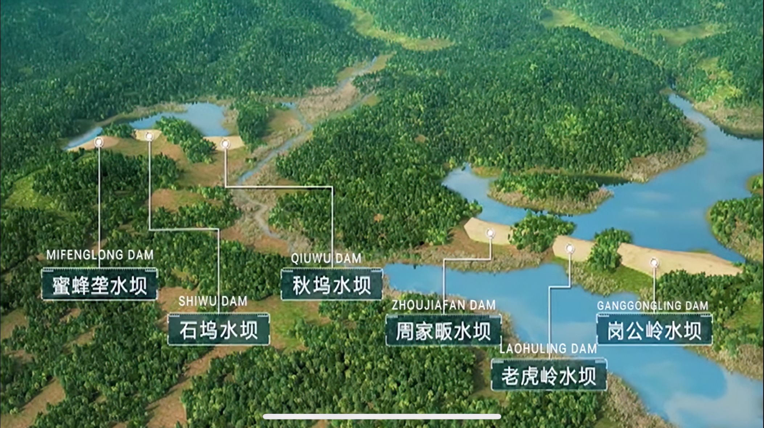
Water Conservancy System on the Outskirts

Slide 14
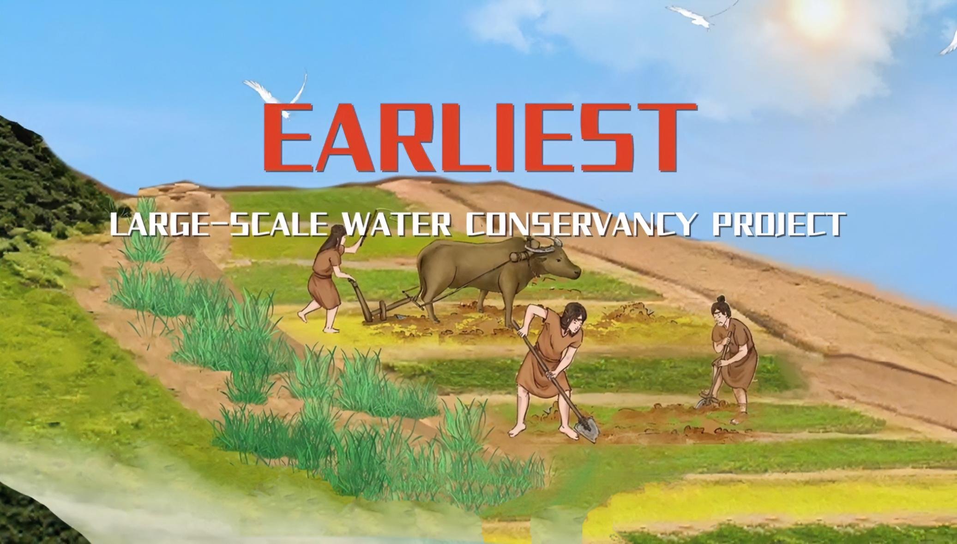
Water Conservancy System on the Outskirts
➡️the earliest large-scale water conservancy project in China
➡️the earliest flood dam project in the world so far

Slide 15
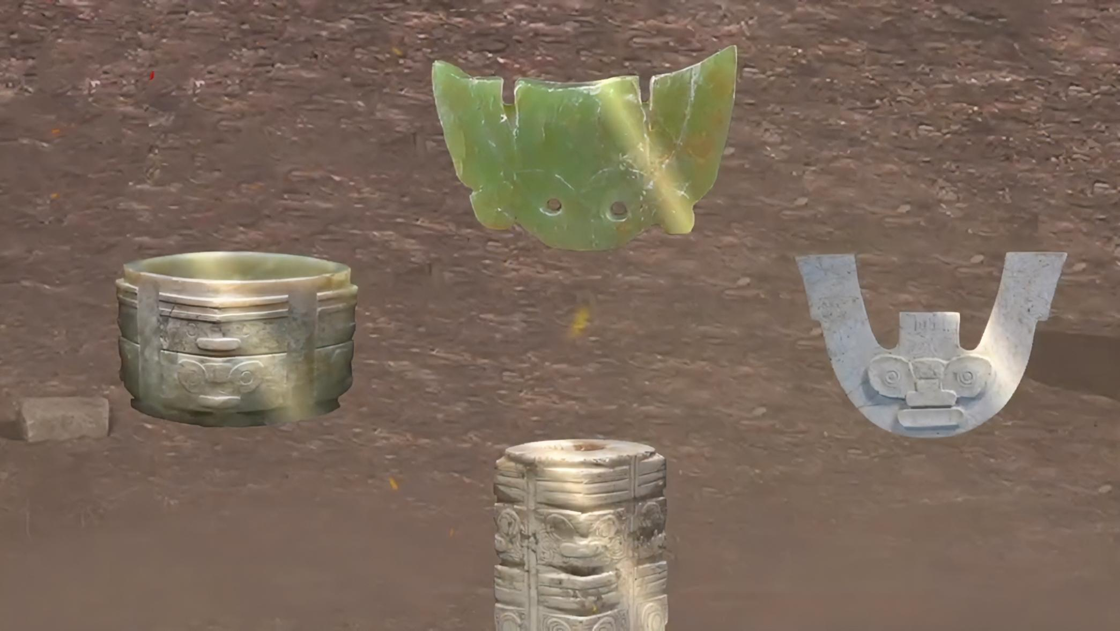
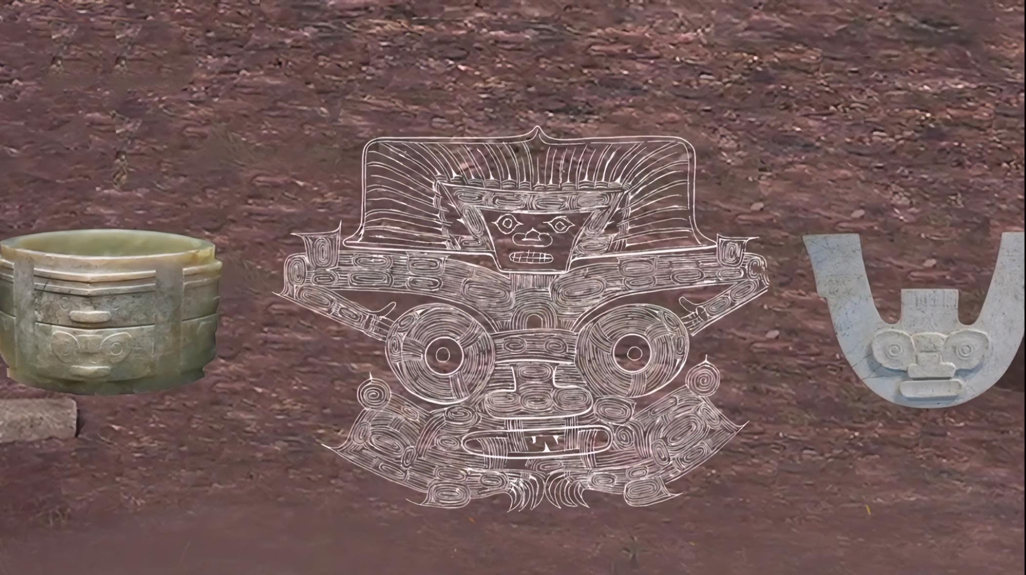
Handicraft Industry
“face mark on top of a mythical beast”
a symbol of Liangzhu culture

Slide 16
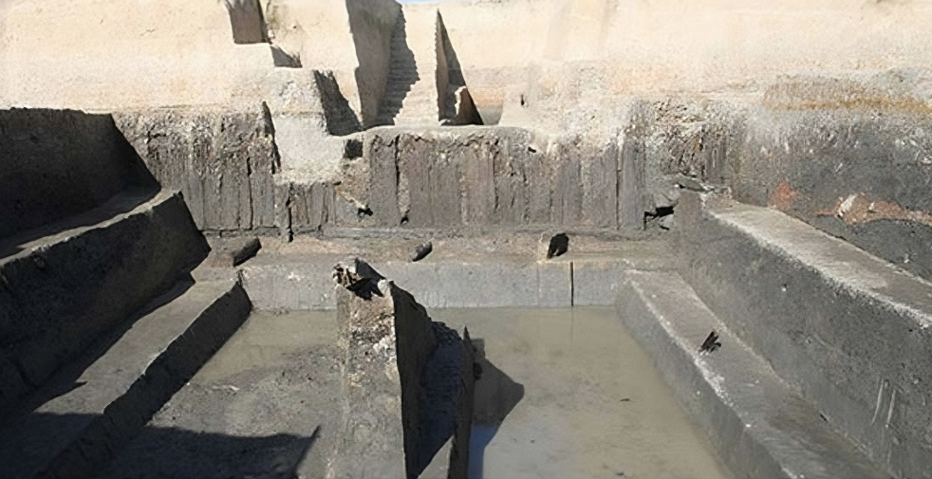
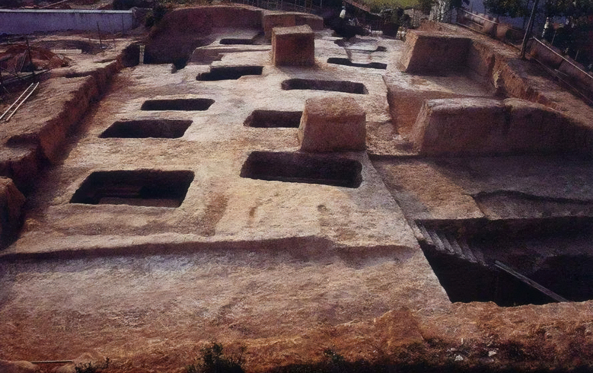
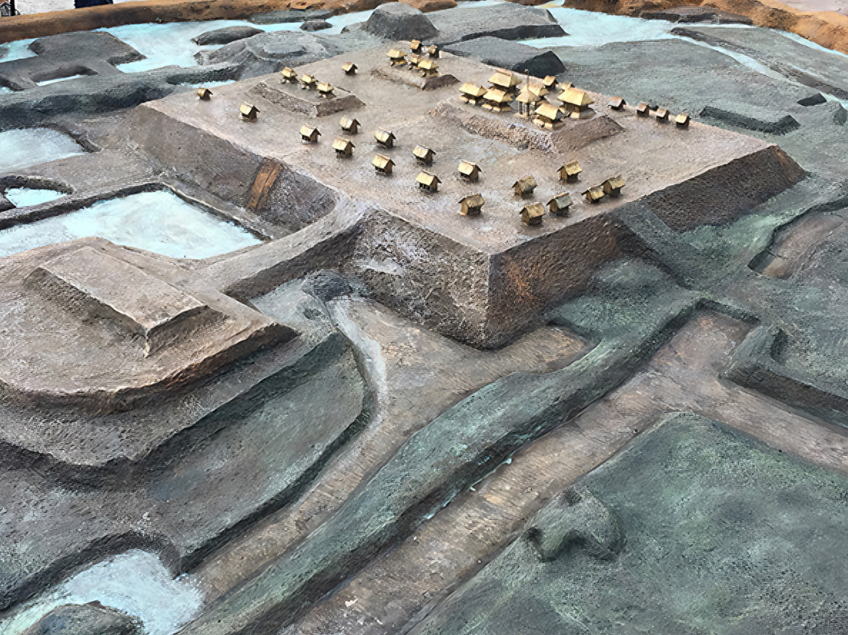
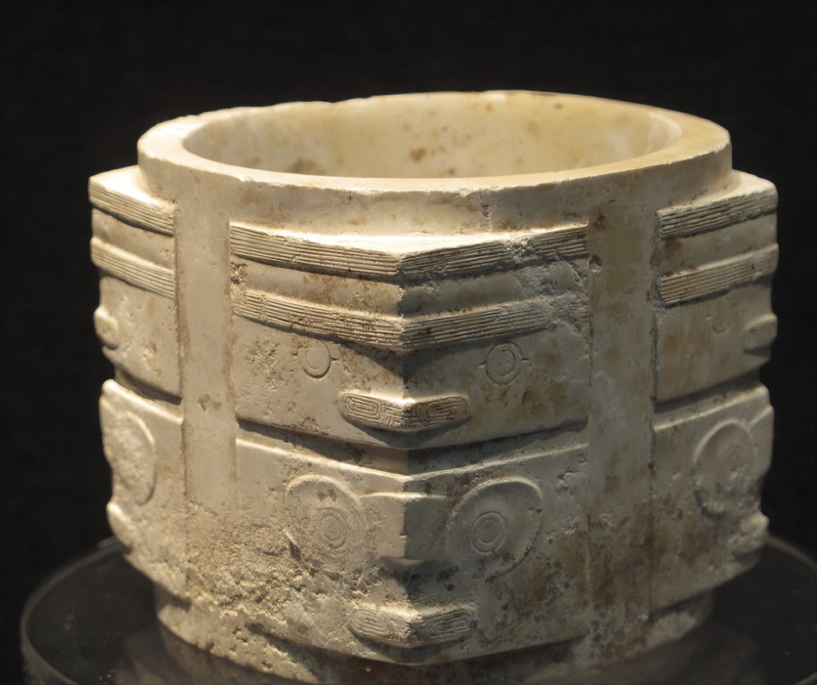
Conclusion

Slide 17

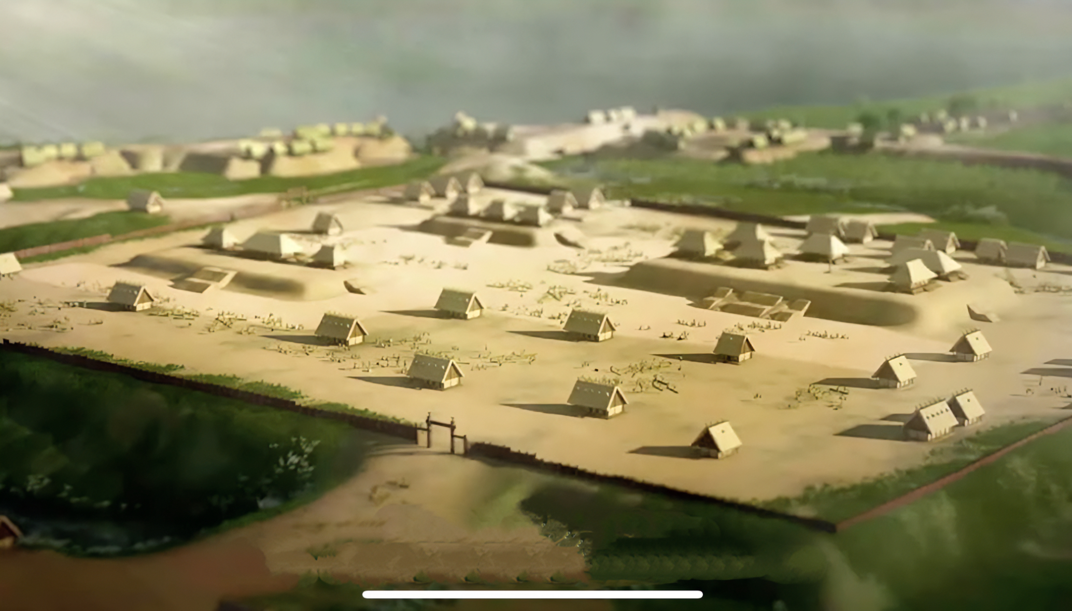
Conclusion
The four prominent manmade relics of the city together show that about 4,300-5,300 years ago, there was an early regional state. It was supported economically by rice farming and had a sophisticated social division of labor, social hierarchy, urban civilization, and unified religion.

Slide 18
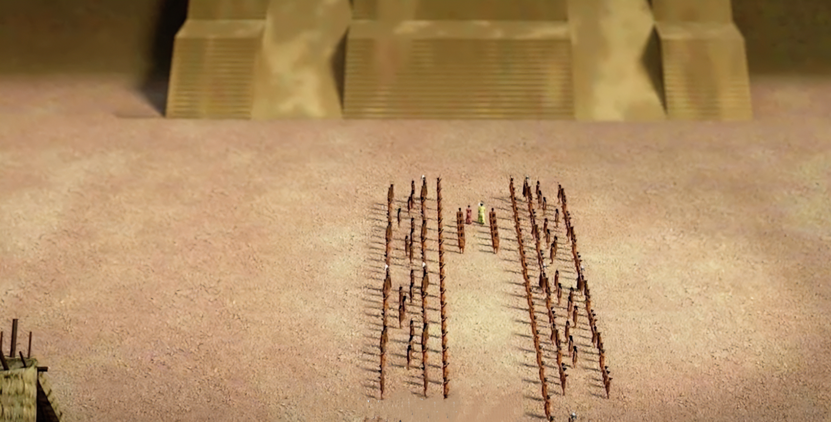
Conclusion
The four prominent manmade relics of the city together show that about 4,300-5,300 years ago, there was an early regional state. It was supported economically by rice farming and had a sophisticated social division of labor, social hierarchy, urban civilization, and unified religion.

Slide 19
Thanks

