Slide 1

Literal Translation and Free Translation
Si Yu & Wu Yilu
2020/11/9

Slide 2

Contents
①
The Origin of Literal Translation and Free Translation
②
The Definition of Literal Translation And Free Translation
③
Literal Translation and Dead Translation; Free Translation
and Random Translation
④
The Debate Between Literal Translation And Free Translation
⑤
Application of Free translation and literal translation

Slide 3

1
The Origin of Literal Translation and Free Translation

Slide 4
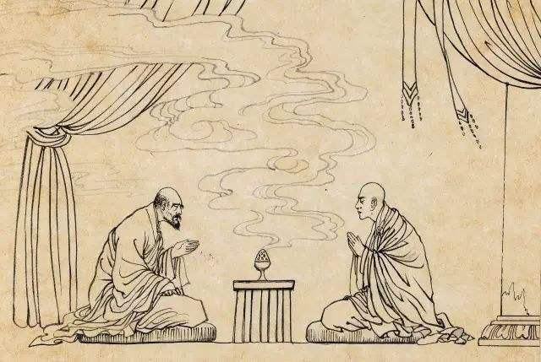
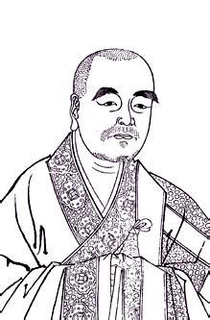
Western
Countries
The Central
Plain
Daoan（道安）
literal transaltion
Qian Qin State during the East Jin Dynasty
the Sanskrit Buddhist scriptures

Slide 5
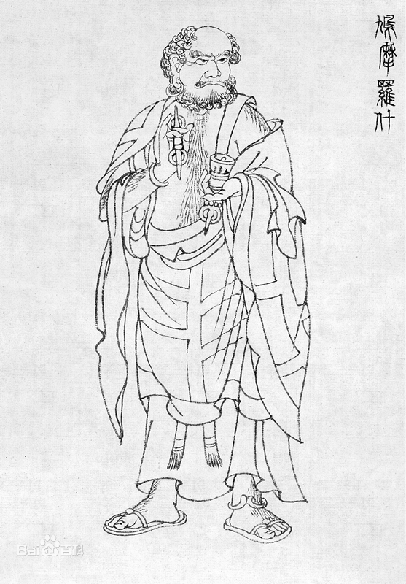
a great influence
Kumara Jiva(鸠摩罗什)
free translation
addition or omission
the sense of the Buddhist sutra
a great influence

Slide 6

Tang Dynasty
Xuanzang(玄奘)
new devices for translation
literal translation
free translation
addition
omission
other means
✅
✅
meaning and spirit

Slide 7
2
The Definition of Literal Translation And Free Translation

Slide 8

Literal translation
1.Literal translation takes sentences as its basic units and the whole text into consideration at the same time in the course of translating.
2.Literal translation strives to reproduce both the ideological content and style of the entire work and and reatin as much as possible the figures of speech and main sentence structures or patterns such as SV, SVO and so on.
2.Literal translation strives to reproduce both the ideological content and style of the entire work and reatin as much as possible the figures of speech and main sentence structures or patterns such as SV, SVO and so on.

Slide 9

Literal translation
a supplementary means
the meaning and spirit of the original without trying to reproduce its sentence patterns or figures of speech.

Slide 10
3
Literal Translation and Dead Translation;
Free Translation and Random Translation

Slide 11
Literal Translation and Dead Translation
Literal Translation
“not to alter the original words and sentences”
“keep the the sentiments and style of the original”
a corresponding and appropriate expression
Dead Translation
mechanically
regardless of whether it is well-collocated or not in the target language
intelligible

Slide 12
Free Translation And Random Translation
Free Translation
the meaning and spirit of the original sentence structure and/or its figure of speech
Random Translation
addition to or omission of the original meaning at will

Slide 13
4
The Debate Between Literal Translation And Free Translation

Slide 14
a great influence
the Eastern Han period
Shi Dao 'an
Kumarajiva
different idea

Slide 15
“正译”须不增不减，不颠不倒，不恃取意”
17th Century to the mid-19th century
Wei Xiangqian
“正译”须不增不减，不颠不倒，不恃取意”
Literal Translation

Slide 16
a great influence
the 30s of this century
Zhao Jingshen
Rather to be smooth (in language) than faithful (in thought)
LuXun
Rather to be faithful (in thought) than smooth (in language)

Slide 17

Zhu Guangqian
literal translation ： translating according to the surface meaning of source text word by word, sentence by sentence, and the order of words and sentences should be remained as the original text.
free translation ：retelling the source text in translator’s own language, which means there is no need to be oriented to the order of the source text.

Slide 18
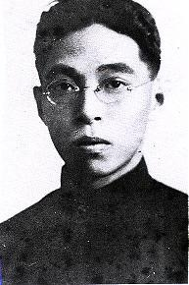
the fourth period of the development of translation
01
02
a distinction between these two translation methods
no necessary to make a choice between literal translation and free translation.

Slide 19
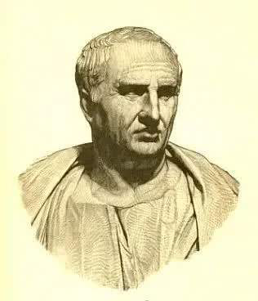
foreign translators
Cicero
He didn’t think it necessary to translate word for word, he preserved the general style and force of the language.

Slide 20
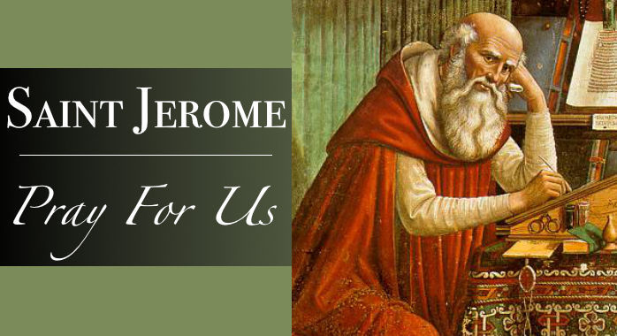
foreign translators
Saint Jerome
Terence has translated Menander; Plautus and Caecilius have translated the old comic poets. But do they stick at the literal words?
Don’t they rather try to preserve the beauty and style of their originals?
What men like you call accuracy in translation, learned men call pedantry.

Slide 21
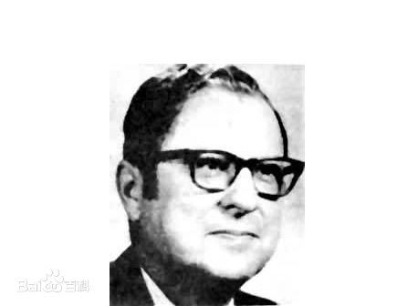
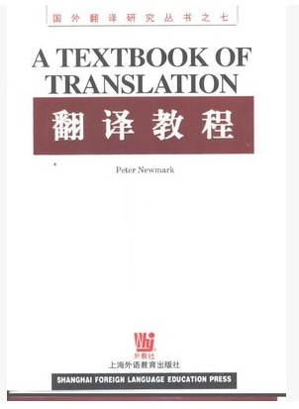
Newmark
“
criticized both of these two translation methods.

Slide 22
the formal elements of the target language and even the intelligibility of the target language tex
the form of the source language
technical texts
how-to-do-it manuals
urgent notices
popular news
classic literature
religious documents
political documents
the integrity of the source text.
elegance and intelligibility in the target language

Slide 23
supplement
Literal Translation
Free Translation
faithfulness, expressiveness and elegance

Slide 24
5
Application of Free translation and literal translation

Slide 25
A. being necessary to adopt literal translation;
B. being necessary to adopt free translation and
C. being necessary to adopt a combination of the two.

Slide 26
It means killing two birds with one stone.
A. 这意味着一石二鸟。（literal translation）
B. 这意味着一举两得。（free translation）
C. 这意味着一箭双雕。（combination）

Slide 27
你不要班门弄斧了。
A. Don’t display your ax at Lu Ban’s door. (literal translation)
B. Don’t teach your grandmother to suck eggs. (free translation)
C. Never offer to teach a fish to swim. (free translation)

Slide 28

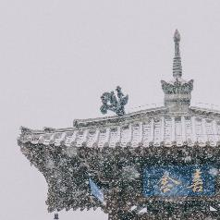
conclusion
depends on the actual sentence-structure and/or the figure of speech and on the demand of the principle of faithfulness, expressiveness and closeness
indispensable and supplementary

Slide 29
Reference
[1]刘重德.《文学翻译十讲》[M]. 北京：中国对外翻译出版公司.1991.
[2]彭长江.《英汉-汉英翻译教程》[M].湖南：湖南师范大学出版社.2017
[3]杨颖.浅谈直译与意译的动态统一[J]. 海外英语.2019(17)：160-161
[4]吴爽.翻译的最高境界--直译与意译的完美统一[J].现代交际.2018(08):107-108
[5]Jin Di et Nida, Eugene A. On Translation[M].北京：中国对外翻译出版公司，1984：77-78

Slide 30
Thank You！
Si Yu & Wu Yilu
2020/11/9

