Slide 1
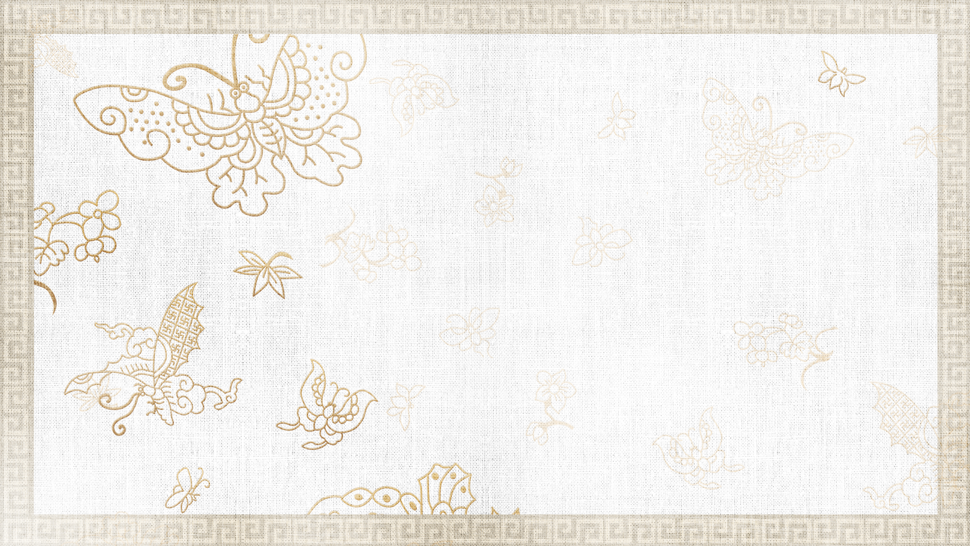

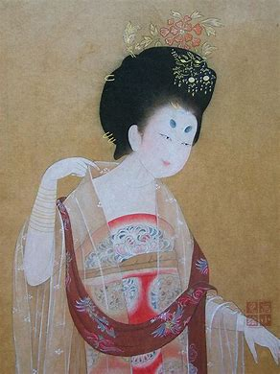
Facial Make-up:
Cosmestics, Traditional Chinese Make-up

Slide 2
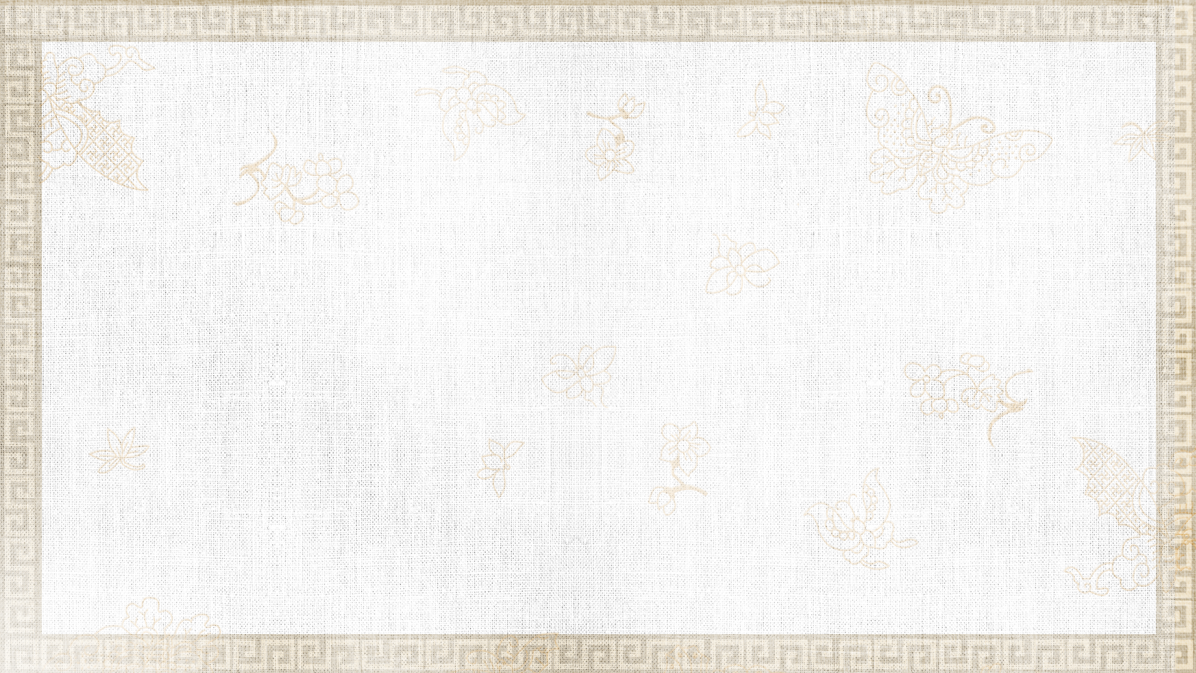


Contents
①
Introduction
②
Cosmestics
Various types of Makeup in Tang dynasty
③
④
Conclusion

Slide 3


Introduction

Slide 4
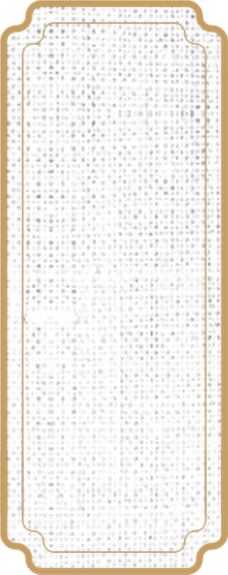
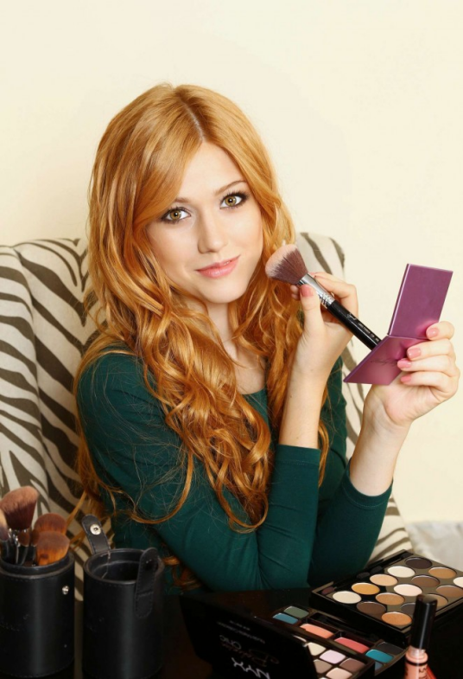
Makeup
the human face, features and other parts of the rendering（渲染）, painting（描绘）, finishing（整理)
Comestics + Tools
enhance the three-dimensional impression
adjust the shape and color
cover up defects
express great spirit
achieve the purpose of beautifying the visual perception

Slide 5
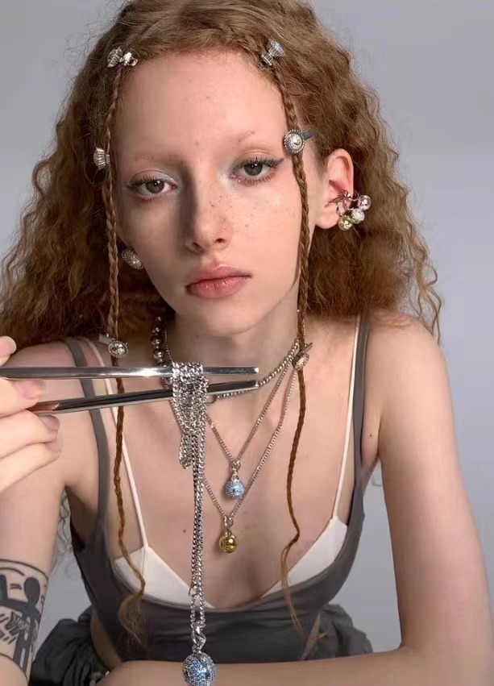
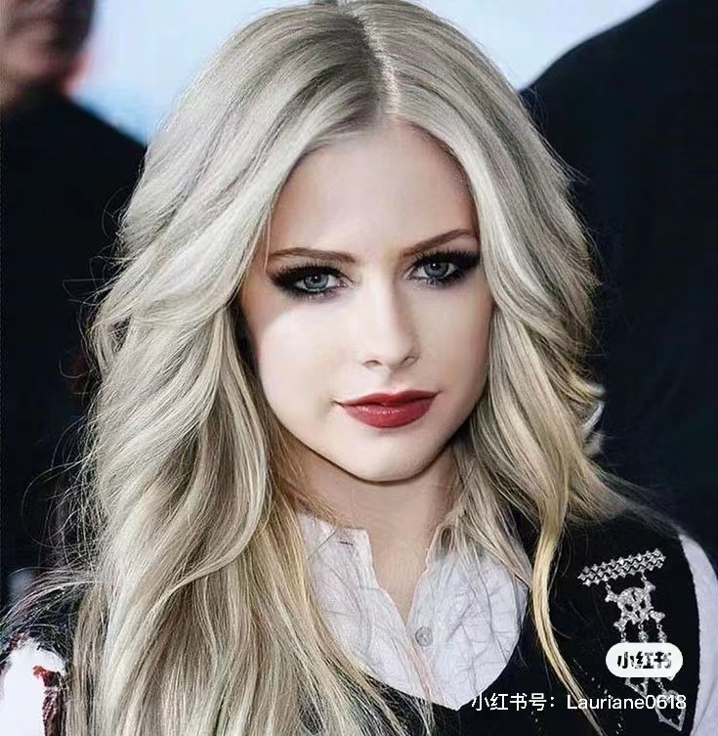
Makeup
Retro rock makeup(复古摇滚装）
show the unique natural beauty
。
improve the original "shape" "color" "quality"
presenting a visual feast and expressing the feelings
An art form
smoky eyes makeup（烟熏妆）

Slide 6
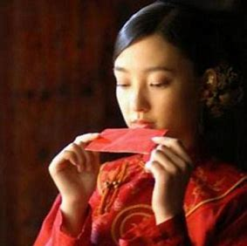
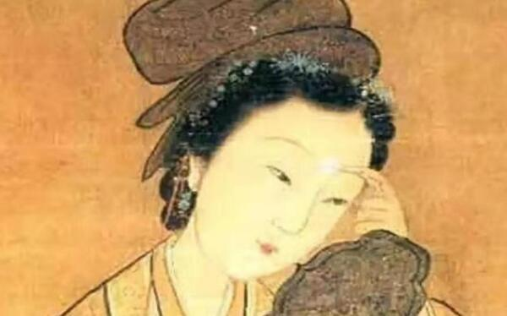
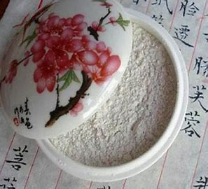
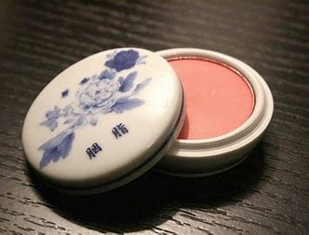
Makeup
Most Chinese women owns yellowish skin color
The women of ancient China used a powder made from rice starch
painted lips red
painted eyebrows shaded black
For contrast
blushed cheeks with rouge

