Slide 1

Stand-up Comedy
HAVE FUN
Stand-up Comedy:
More Than Just Laughter
HAVE FUN
---- From Western Origins to
Chinese Innovation
2025.10.25
Let’s go!
Presenter：Liu Hui

Slide 2
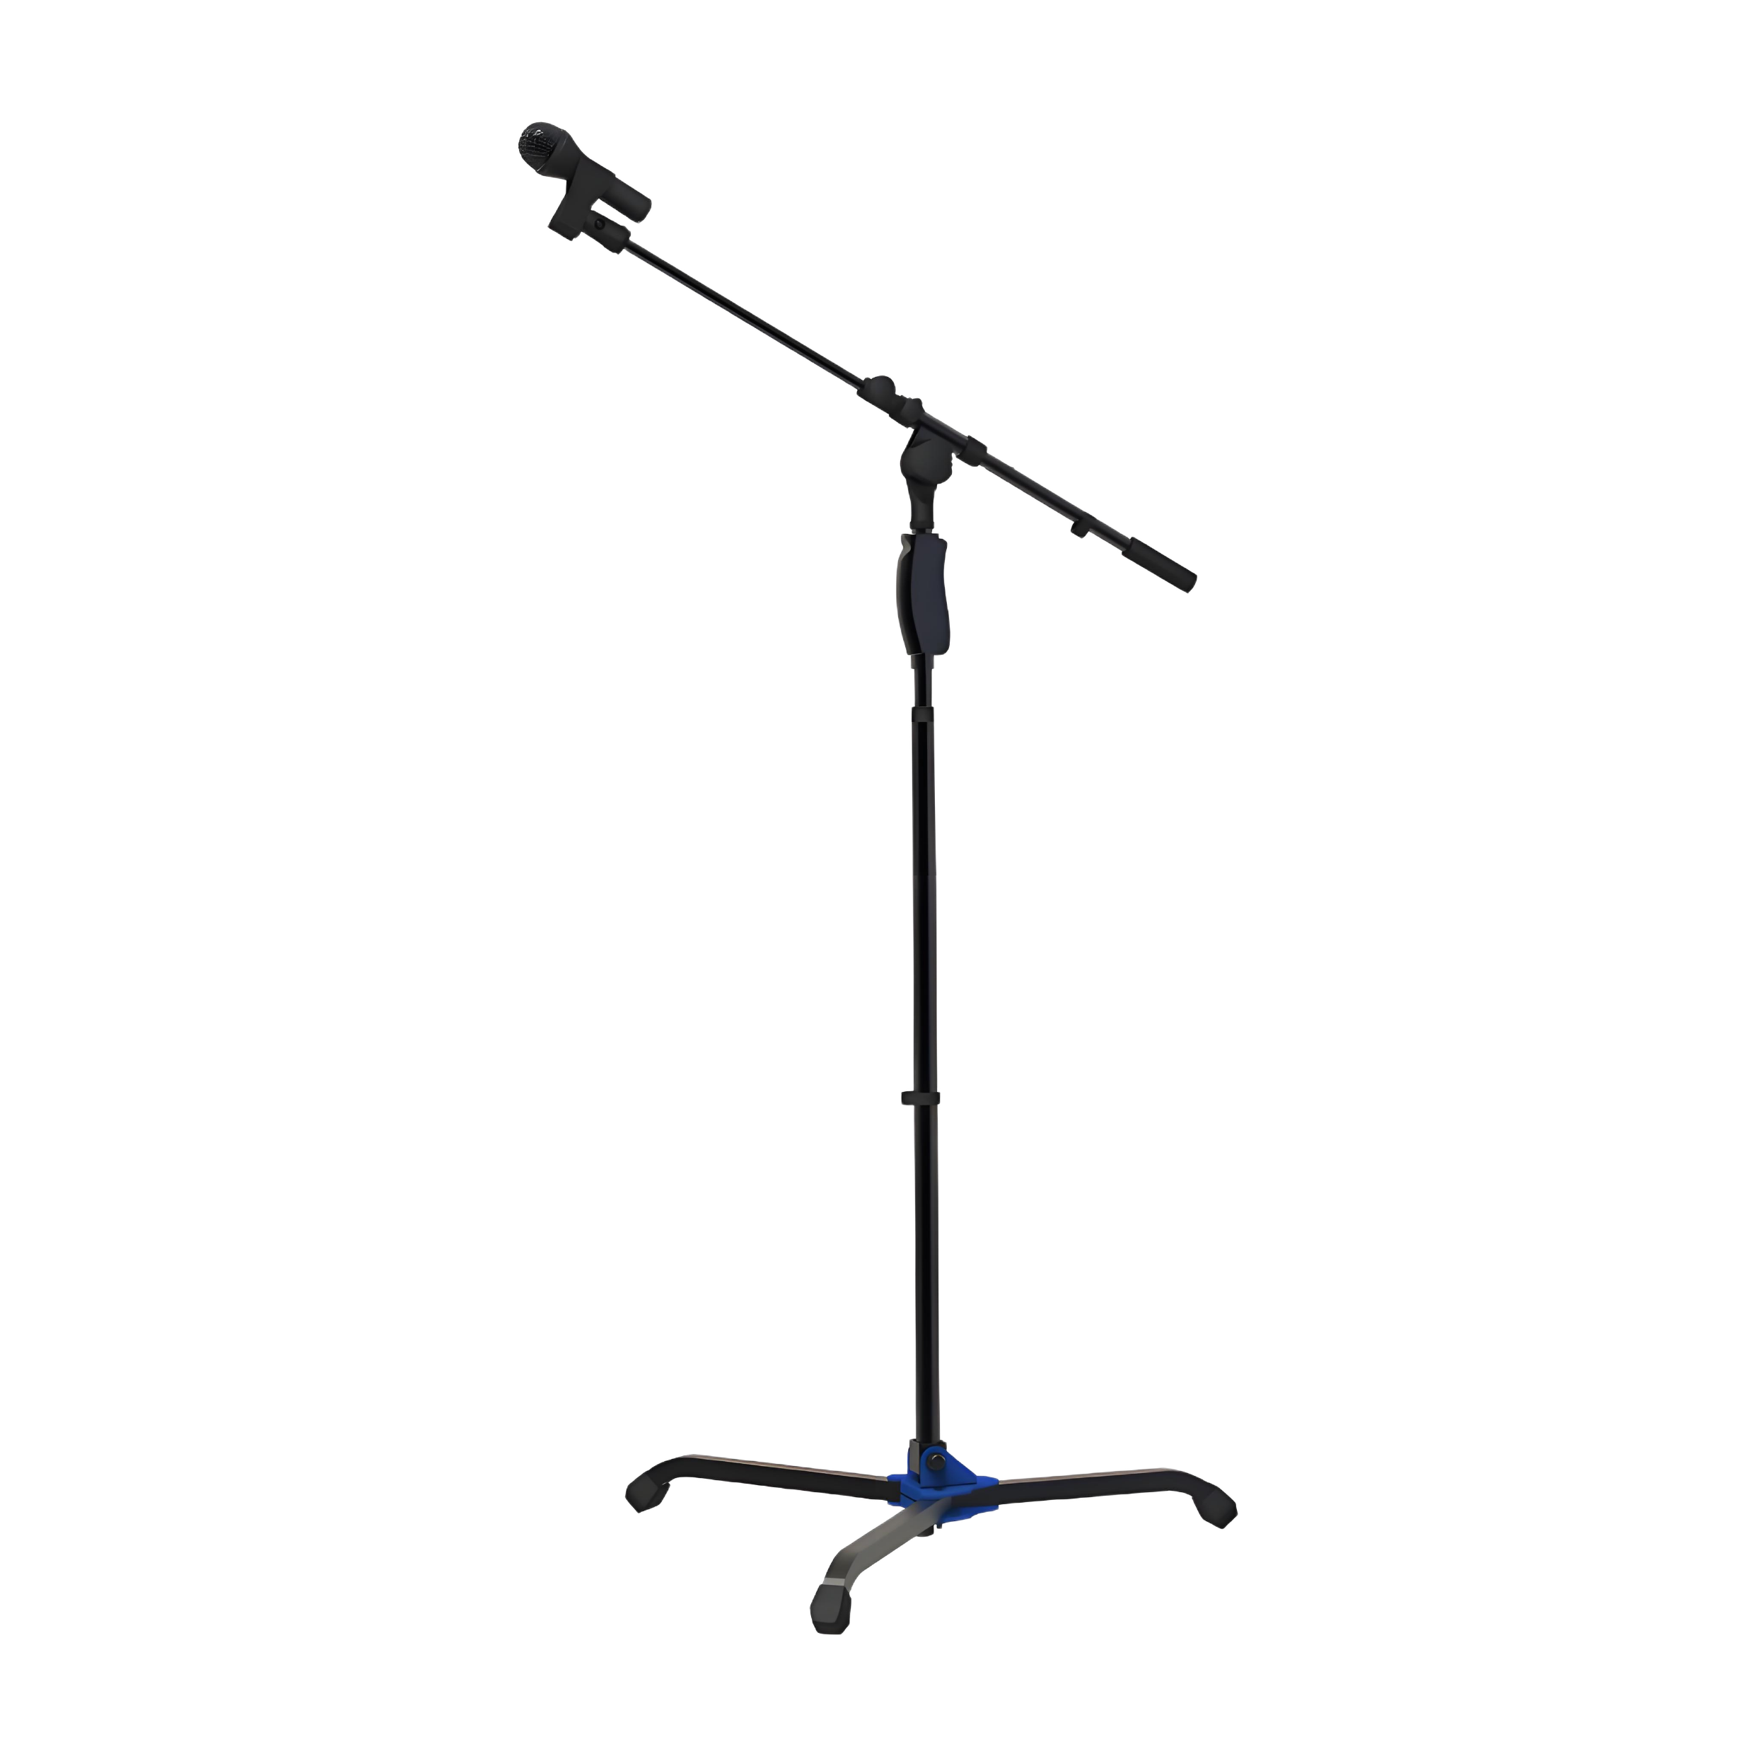
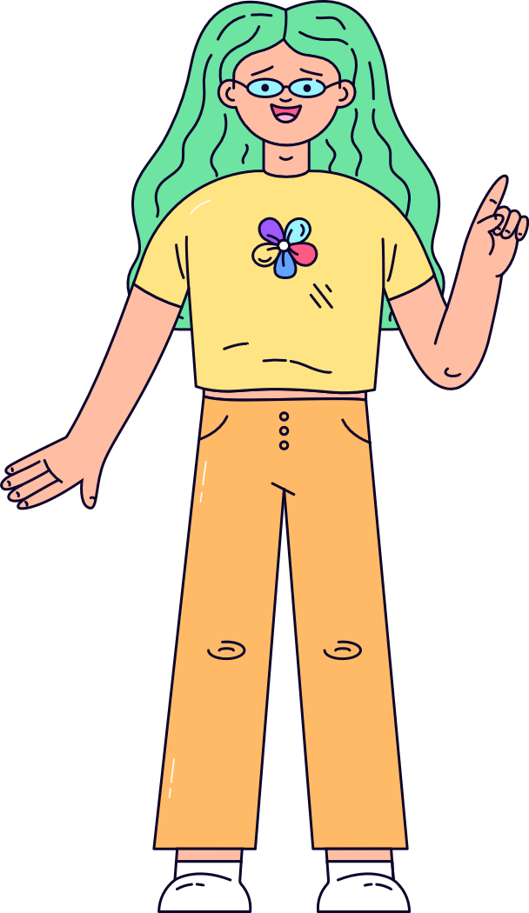
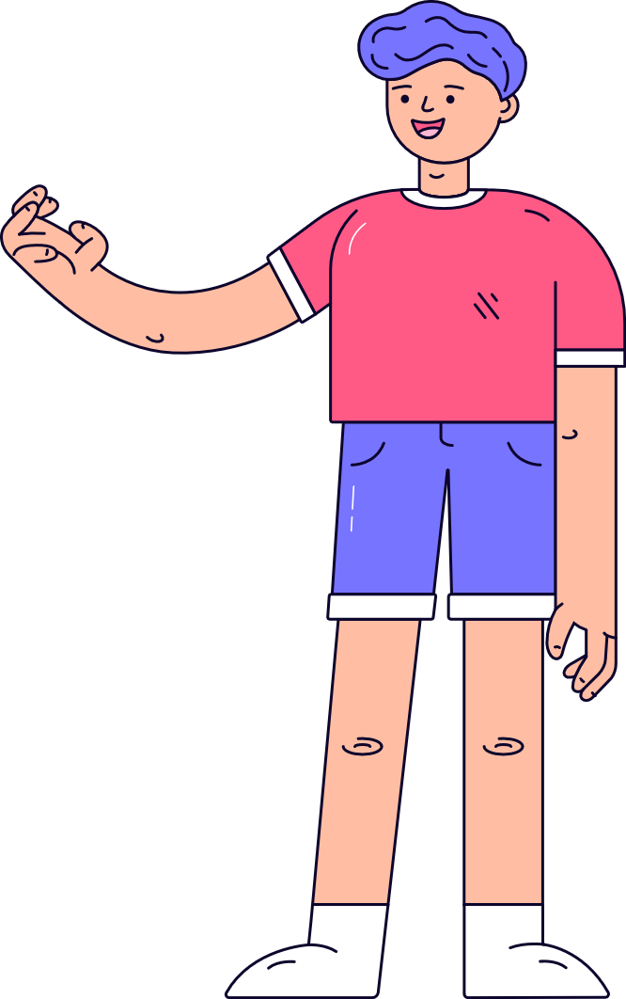
HAVE FUN
Q & A
What Is
Stand-up Comedy?
HAVE FUN
“One Person, one mic”

Slide 3
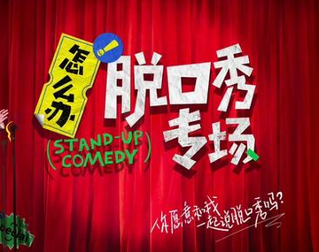
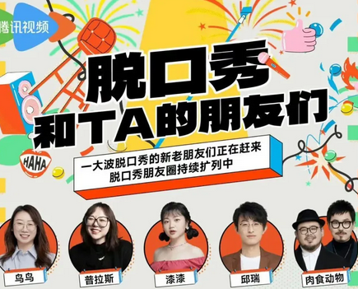
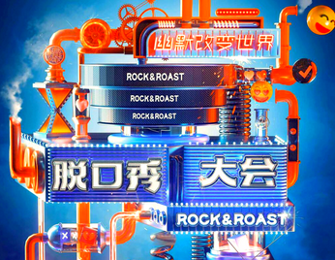
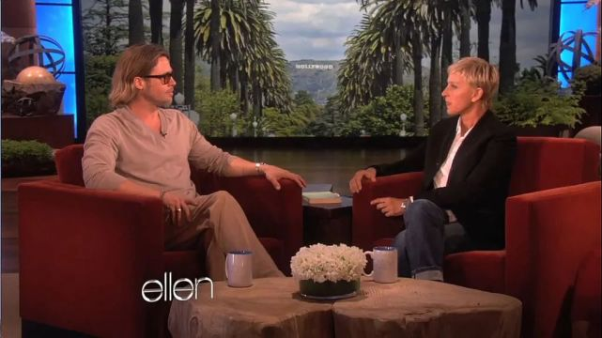
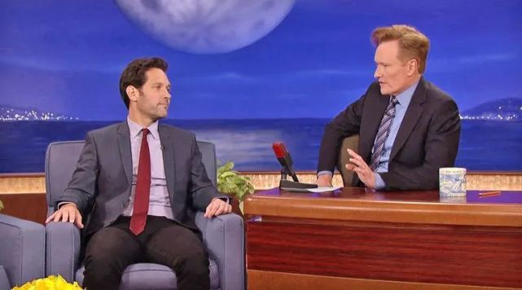
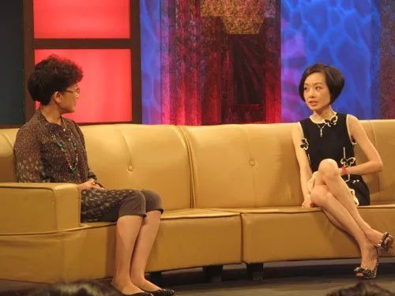
In Chinese
HAVE FUN
“脱口秀”？
HAVE FUN
“单口喜剧”？
TV talk shows: A guest + A host + A script
Stand-up Comedy

Slide 4
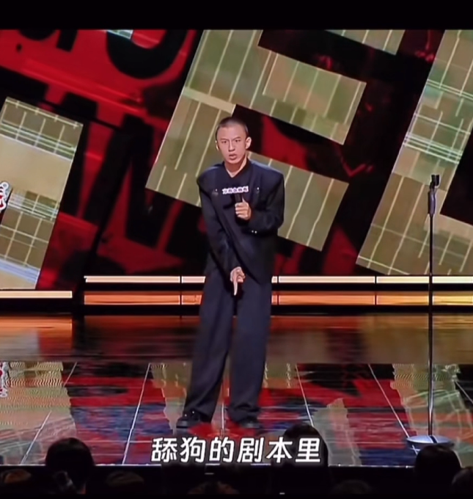
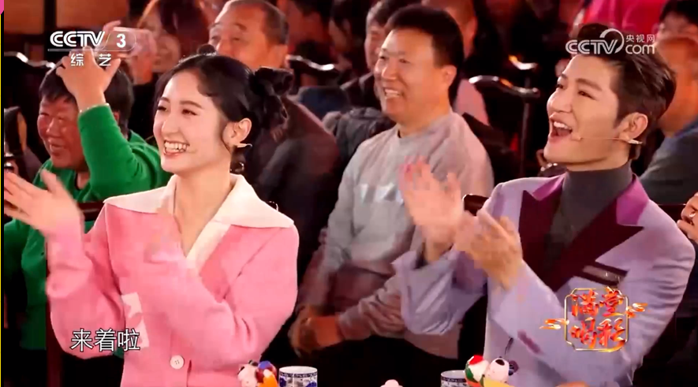
In Chinese
单口喜剧 (Stand-up Comedy)
HAVE FUN
单口相声(monologue comic talk)
Aspect | 单口相声 | Stand-up Comedy
Style | Structured stories with props | Casual, personal stories
Content | Historical tales, wordplay | Social issues, self-mockery
Performance | Fixed position (traditional tools) | Walking freely, interacting
Origin | Traditional Chinese folk art | Western industrialization
HAVE FUN

Slide 5
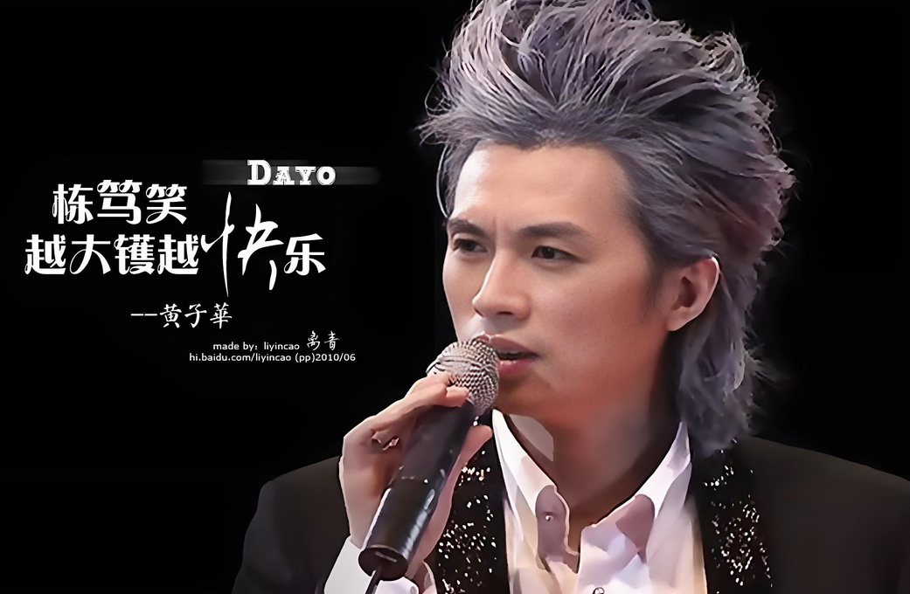
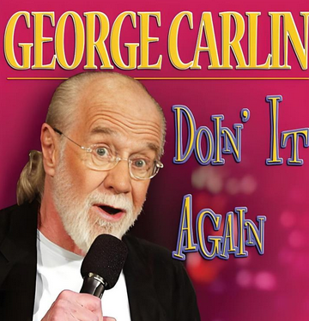

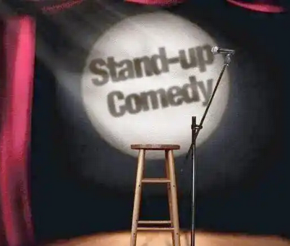

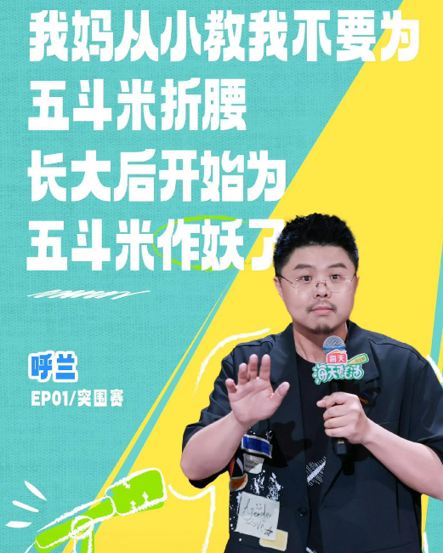
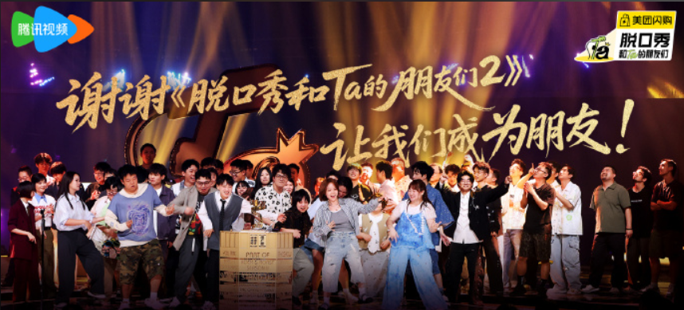
Historical Roots and Global Spread
HAVE FUN
Stand-up Comedy
Hong Kong: Huang Zihua’s “栋笃笑”
Origin: British music hall
18th-19th Century
1990s
HAVE FUN
Nowadays
Mainland China Hit
US popularization
Topics: Politics&Race
为四大奖项获奖人员及团队颁奖
20th Century

Slide 6
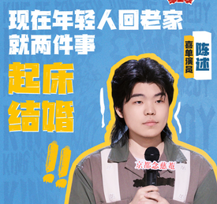
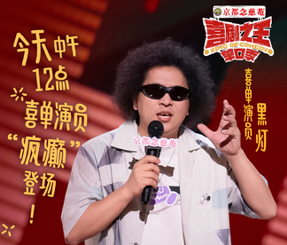

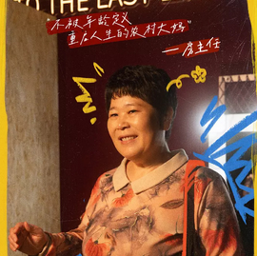
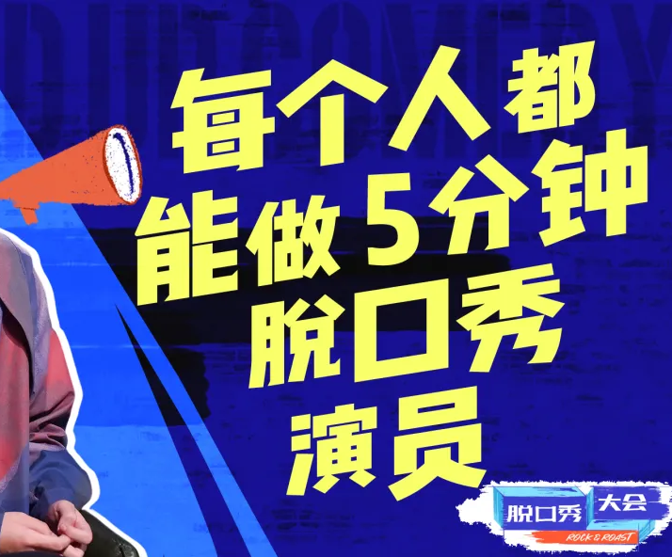
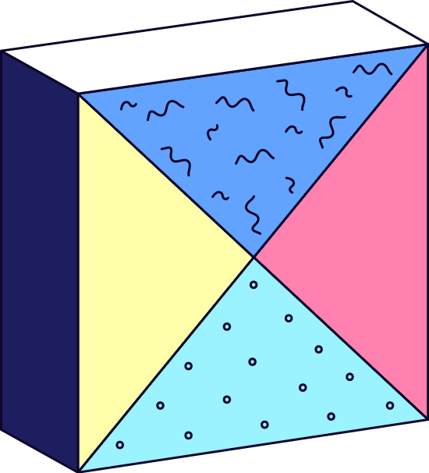
In my opinion, …
Why Stand-up Comedy Matters in China
HAVE FUN
helps people reconcile with life's hardships
Encourages expression
HAVE FUN
Uses humor to address social "pain points"
Views through “common people”

Slide 7
Surprise Guest
HAVE FUN
He /She
The city’s honker
城市的鸣笛者
Stand-up comedian
HAVE FUN
Whether it's satire or self-mockery, the essence is always telling the truth in a humorous way.
无论是讽刺还是自嘲，核心永远是笑着说真话。
21th century
Prominent figures

Slide 8

cooperative partner
HAVE FUN
Organizer
Thanks for cooperation
me
HAVE FUN
Collaborator
文本参考
文本润色者
视频
图片提供者
环球网报道；凤凰网读书；中国青年报
DeepL; Deepseek
央视网；小红书；Bilibili
百度

Slide 9
Everyone can deliver a 5-minute stand-up comedy,
HAVE FUN
Be kind and sincere
HAVE FUN
THANKS
by：Liu Hui
Stand-up Comedy
and everyone can enjoy themselves for 5 mins.

