Slide 1


An Overview of Translation of Modern Classics
—Taking Mo Yan, Yu Hua, Liu Cixin as Examples
By Ma Yanhuan

Slide 2
One
Introduction
目
Two
Research Methods and Steps
CONTENTS
Three
Research Results and Analysis
录
Four
Conclusion

Slide 3
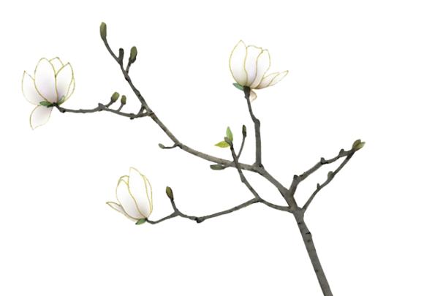
Introduction
春路雨添花
花动一山春色
壹

Slide 4





Introduction
This paper will study the translation of modern classics by reviewing the academic papers of CNKI, mainly taking the translation works of representative writers Mo Yan, Yu Hua and Liu Cixin as the research object. this paper explores the contents of translation studies to further promote its in-depth development, so as to better serve the strategy of Chinese culture going abroad.

Slide 5
Research Methods & Steps
春路雨添花
花动一山春色
贰

Slide 6
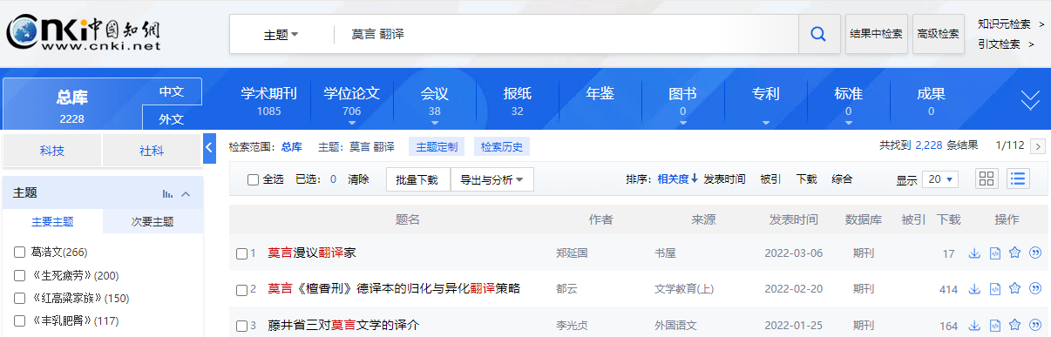
Research Methods & Steps
The research materials of translation of modern Chinese classics discussed in this paper include academic journals, papers and proceedings. In order to obtain these materials, the author takes the journal paper database of CNKI as the retrieval source, with "Mo Yan / Yu Hua / Liu Cixin Translation" as the theme and "Core Journals" as the source category. Then the search results are checked one by one.

Slide 7
Research
Results & Analysis
春路雨添花
花动一山春色
叁

Slide 8
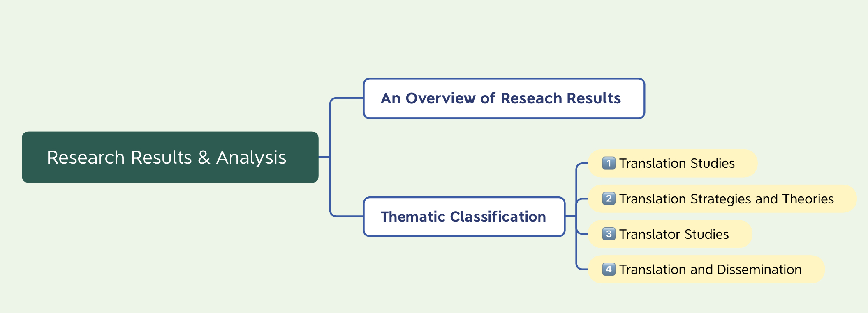
Research Results & Analysis

Slide 9
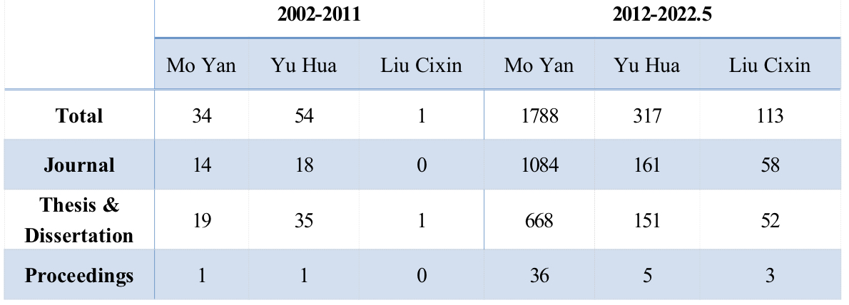
Research Results & Analysis—An Overview
表1 国内莫言、余华、刘慈欣作品外译研究成果分布情况（截至2022年5月）

Slide 10
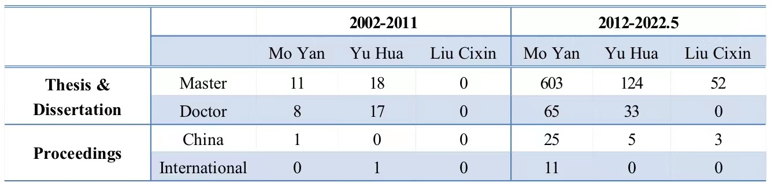
Research Results & Analysis—An Overview
表2 学位论文和会议论文中研究成果分布情况（截至2022年5月）
It is worth mentioning that the distribution of academic papers from 2002 to 2022.5 is uneven.
Of the 926 dissertations, there are only 123 doctoral dissertations, accounting for 13.28% of the total, and in terms of proceedings, there are only 12 international conference papers accounting for 26.09% of the total number of proceedings, indicating that the level of domestic modern and contemporary foreign translation of ancient books and international influence still need to be improved. (see Table 2)

Slide 11
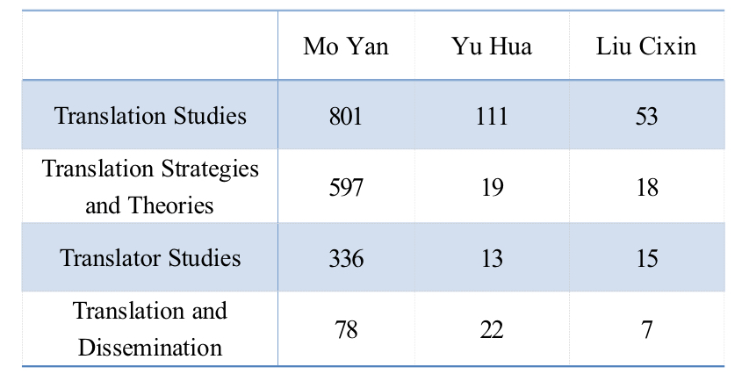
Research Results & Analysis—Thematic Classification
According to the research theme, the author divides the foreign translation research achievements of the three writers from 2012 to May of 2022 into four categories: translation studies, translation strategies and theoretical construction studies, translator studies and translation and communication (see Table 3).
This paper selects the representative research results in each category to analyze in order to realize the outline of the study of foreign translation of modern classical books.
表3 三位作家外译作品研究成果主题分类（截至2022年5月）

Slide 12
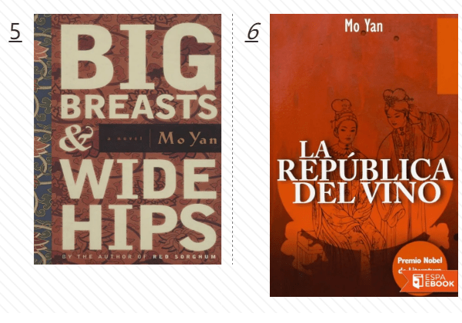

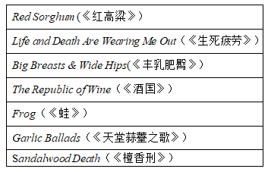
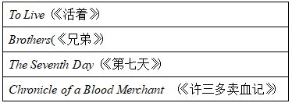
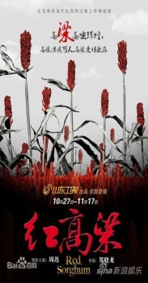
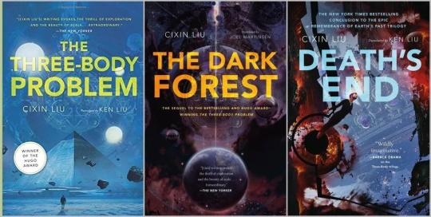

Research Results & Analysis—Thematic Classification : Translation Studies
Translation study has always been one of the key areas in the study of foreign translation of classical books in China. The research results of the foreign translation of the works of the three writers since 2012 are mainly aimed at the translation of the famous and popular novels. They include：
Mo Yan :
Yu Hua :
Liu Cixin :

Slide 13

Research Results & Analysis—Thematic Classification : Translation Studies
Huang Xiaohua(2019)
Song Xueting(2021)
Red Sorghum: the general situation of the translation，the research content and the mistranslation research，and puts forward four considerations
The Three-Body Problem II:The Dark Forest
translation strategies of the culture-loaded words based on Newmark's translation theory
Wang Min(2021)
Deng Yuanyuan(2022)
To Live:
Ecological environment of the translation. translator's adaptive choice in the process of translation based on language, culture and communication
Life and Death Are Wearing Me Out:
dialect translation from the dimensions of phonetics，semantics， syntax and pragmatics with literal translation and free translation

Slide 14
Research Results & Analysis—Thematic Classification : Translation Studies
Niu Yating(2016)
Zhang Yuanyuan(2017)
study translation strategies and translator style based on the Chinese-English-French trilingual corpus of Mo Yan's novels
studies the translation, introduction and acceptance of Mo Yan's literary works in South Korea
Duan Yun (2018)
Feng Mengnan(2020)
analyze the translation strategies selected in the German translation of Sandalwood Death
probes into the translation strategies of the Japanese translation of Life and Death Are Wearing Me Out

Slide 15
Research Results & Analysis—Thematic Classification : Translation Strategies and Theoretical Studies
The study of translation strategies has always been an important part of the study of English translation of classical books. In recent years, such studies tend to be more refined.
Yin Jian (2021), from the theoretical perspective of intercultural communication, takes the translation of Howard Goldblatt in Mo Yan's Red Sorghum as an example, deeply analyzes the translator's translation strategies of all kinds of taboos in the source text, and puts forward the strategies of complete equivalence, partial equivalence and cultural substitution.
Wu Shiyao (2021) according to Howard Goldblatt's English translation Shifu, You'll Do Anything for a Laugh （《师傅越来越幽默》）， the metaphors contained in the works are divided into animal metaphors, appellation metaphors and idiom metaphors, and analyzes the differences and translation strategies of different types of English and Chinese metaphors.
Tian Cheng(2021) chooses cognitive translation as the theoretical guidance to translate and revise Mo Yan's novel A Late Bloomer（《晚熟的人》）. Some translation strategies are adopted, such as adjusting word order, deleting redundant information, conversion and amplification, division/spliting and retaining culture-loaded words. The aim is to make the translation conform to the cognitive habits of western readers on the basis of preserving Mo Yan's writing style and language style.

Slide 16
Research Results & Analysis—Thematic Classification : Translation Strategies and Theoretical Studies
Luo Ying (2020) studies and discusses four types of translation compensation: semantic compensation, cultural compensation, aesthetic compensation and pragmatic compensation. Based on the characteristics of literary translation and the principle of translation compensation put forward by predecessors, this paper summarizes and expounds five important translation compensation strategies in literary translation: gain method, substitution method, interpretation method, annotation method and ellipsis method.
According to the study of Luo Xi (2022), from the perspective of cultural translation, the translation strategies of culture-loaded words in “To Live" include literal translation, transliteration, transliteration + footnotes and additional translation.
Ye Yuchun (2021), from the perspective of constructing cultural soft power, through the analysis and study of the translation examples of the English translation of The Three-Body Problem , it is found that when dealing with words with Chinese characteristics, the translator promotes foreignization by domestication, first domestication and then foreignization, and the flexible combination of the two. It ensures the attractiveness and affinity of the works to readers, and points out the direction for the construction of cultural soft power and the realization of real alienation.

Slide 17

Research Results & Analysis—Thematic Classification : Translation Strategies and Theoretical Studies
Generally speaking, although there are various studies of translation strategies and theories, this kind of research is still in its infancy, and the main approach is to directly graft the concepts of pure theories of relevant disciplines into the construction of the theoretical system of English translation of Chinese classics. Therefore, it still needs a long-term process of deepening, infiltration and integration, and there are still many things worth digging in the future.

Slide 18

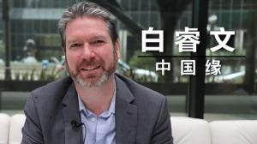
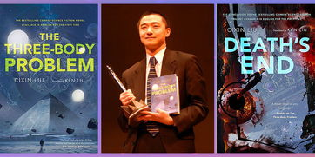
Research Results & Analysis—Thematic Classification : Translator Studies
葛浩文
Howard Goldblatt
Michael Berry
刘
宇
昆

Slide 19



Howard Goldblatt
With the improvement of the subjective status of the translator and the frequent award-winning of Howard Goldblatt's translation, scholars have attached great importance to the manifestation of the translator's subjectivity in Howard Goldblatt's translation in recent years.
Yang Tianting (2021) focuses on the figurative rhetoric in Mo Yan's Life and Death Are Wearing Me Out, and finds that Howard Goldblatt creatively adopts literal translation, free translation, deletion and addition in translation to place himself in the grand background of China. And he focus on foreign cultural exchanges and cultural construction, leading readers to feel the extraordinary artistic charm.

Slide 20
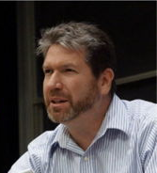

Michael Berry & Liu Yukun
Jiang Ying (2022) analyzes the translator behavior of Berry in his version To Live from the intra-translation and extra-translation aspects based on Zhou Lingshun's theory of Translator Behavior Criticism. On that basis, the author put forward that the translator should find a balance between being truth-seeking and utility-attaining.
From the sociology of Pierre Bourdieu，combined the Three－Body Problem，Ren Jinglei (2020) summarizes Liu Yukun’s life track，digs out his translator habitus in society，and then analyzes the role of his habitus in translation, thus mining a number of reasons that make the work popular in western world. Therefore，it can provide some inspirations for translators．

Slide 21
Research Results & Analysis—Thematic Classification : Translation and Dissemination Studies
One of the important purposes of the foreign translation of Chinese works is to tell Chinese stories and spread Chinese culture. Translation is no longer an independent branch, but must intersect with various disciplines and borrow from each other before the translated works can successfully go out.
Jia Ya (2021) studies the spread of Mo Yan's novels in Mongolia. She pointed out that the frequent literary exchanges and cooperation between China and Mongolia, the translator's full combination of Mongolian culture and the writer's own international vision promoted the successful translation and dissemination of Mo Yan's novels in Mongolia. And she sorts out the spread path of Mo Yan's novels in Mongolia.

Slide 22
Research Results & Analysis—Thematic Classification : Translation and Dissemination Studies
Li Hanji (2014) combed the basic information of Yu Hua's works and their English translations, and combined with his sales data on Amazon's North American website, expounded in detail the reasons for the popularity of his works from the aspects of translator, translation language, theme and so on. it is intended to provide reference for the foreign translation of Chinese literature in the future.
Zhang Wenhui (2021) analyzed the Japanese translation of Three-body Problem and concluded:
In terms of translation, it is necessary to adapt to the reading habits of the target country, use wording close to the culture of the target country, and adapt the original text to free translation appropriately so that the target country readers can receive cultural input without barrier.
Second, the selection of overseas publishers and the publicity of traditional and emerging media, such as social networks, can effectively enhance the promotion effect of Chinese culture going out, and the works can also be accepted by more overseas audiences.

Slide 23
Conclusion
春路雨添花
花动一山春色
肆

Slide 24
Conclusion
First, the research perspective is becoming more and more diversified. The study of English translation of classical books involves multi-disciplinary fields and is interdisciplinary in nature. the current relevant research has been extended to the fields of literature, culture, sociology, communication and so on.
Second, the richness and refinement of the research content. At present, the study of English translation of classical books in China involves many topics, such as translator's subjectivity, translation comparison, translation strategies, theoretical system construction, talent training and so on. At the same time, the relevant research has gradually gone deep from the macro level to the micro level, paying attention not only to the translation strategies and cultural images of the translation, but also to the more micro issues such
as metaphor, cohesive devices and English translation of address terms.

Slide 25

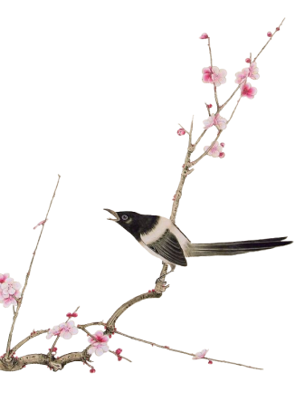
Conclusion
At the same time, we should also be soberly aware that there are still many shortcomings in the existing research, and the academic circles and relevant departments should pay more attention to the study of English translation of classical books so that it can better serve the construction of translation discipline and the cultural exchange between China and the West.

Slide 26
References
[1]黄晓华.《红高粱》系列英译研究探析[J].湖北第二师范学院学报,2019,36(05):99-103.
[2]邓园园.关联理论翻译观视域下《生死疲劳》中的山东方言英译研究[J].扬州教育学院学报,2022,40(01):62-67.DOI:10.15977/j.cnki.cn32-1555/g4.2022.01.011.
[3]王敏.生态翻译学三维转换视角下《活着》的英译研究[J].长春工程学院学报(社会科学版),2021,22(03):60-63.
[4]宋雪婷. 科幻小说《三体Ⅱ：黑暗森林》中文化负载词英译研究[D].中北大学,2021.DOI:10.27470/d.cnki.ghbgc.2021.000561.
[5]段云.浅析莫言《檀香刑》德译本的俗谚语翻译策略[J].散文百家,2018(09):41.
[6]牛雅婷,牟凡,韩明月,刘金鹏,朱彩霞.语料库驱动下的莫言小说翻译策略研究——基于葛浩文英译本杜特莱夫妇法译本[J].北方文学,2016(19):118-119.
[7]张园园. 莫言作品在韩国的译介研究[D].山东大学,2016.
[8]冯孟楠. 异化与归化翻译理论下《生死疲劳》的日译研究[D].吉林大学,2020.DOI:10.27162/d.cnki.gjlin.2020.003846.
[9]殷健,贺丽璇.跨文化交际视角下汉语禁忌语翻译策略研究——以《红高粱》葛浩文译本为例[J].英语广场,2021(34):45-47.DOI:10.16723/j.cnki.yygc.2021.34.013.
[10]武诗瑶.浅谈英汉隐喻文化差异及翻译策略——以葛浩文《师傅越来越幽默》英译本为例[J].新纪实,2021(22):87-89.

Slide 27
References
[11]田铖. 认知翻译理论下莫言短篇小说翻译研究[D].济南大学,2021.
[12]罗茜.文化翻译观视域下《活着》中文化负载词的翻译策略研究[J].兰州职业技术学院学报,2022,38(01):56-58.
[13]叶育春.论文化软实力视域下翻译的归化与异化策略——以《三体》的英译本为例[J].辽宁经济职业技术学院.辽宁经济管理干部学院学报,2021(03):55-57.
[14]杨添婷,陈敬勇,刘君玲.译者主体性视角下《生死疲劳》中的比喻英译研究[J].英语广场,2021(34):25-27. DOI:10.16723
/j.cnki.yygc.2021.34.007.
[15]蒋颖. 译者行为批评视域下《活着》之白睿文英译本研究[D].四川外国语大学,2021.DOI:10.27348/d.cnki.gscwc.2021.000147.
[16]任晶蕾.刘宇昆的译者惯习研究——以《三体Ⅰ》英译为例[J].现代英语,2020(20):82-84.
[17]佳雅（Tsolmonzaya Khash-Erdene）. 莫言小说在蒙古国的译介与传播研究[D].贵州师范大学,2021.DOI:10.27048/d.cnki.ggzsu. 2021. 000372.
[18]李晗佶.余华作品在英语国家的译介与传播[J].辽宁工业大学学报(社会科学版),2014,16(05):61-63.
[19]张文慧. 译介学视阈下《三体》日文版对我国文化“走出去”的启示[D].北京外国语大学, 2021.DOI:10.26962/d. cnki.gbjwu.2021.00 0933.

Slide 28

感谢倾听
Thank you ！

