Slide 1
Terra Cotta Warriors
Guarding the Emperor’s Tomb

Slide 2
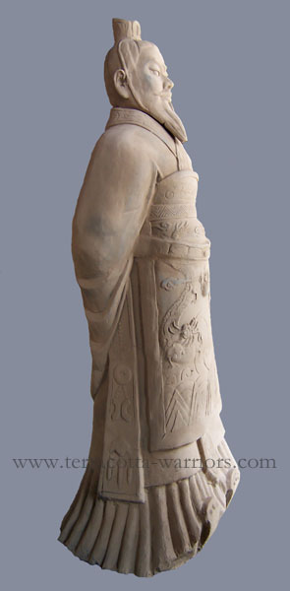
Emperor Qin Shi Huang

Slide 3
The Terra Cotta Warriors guard the tomb of China’s first Emperor, Qin Shihuangdi (221bce). Farmers digging a well found the first warrior in 1979 and since then several thousand have been uncovered. Many thousand more are still covered.

Slide 4
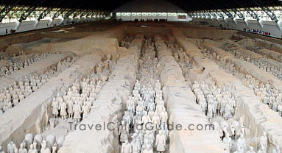
Pit #1

Slide 5
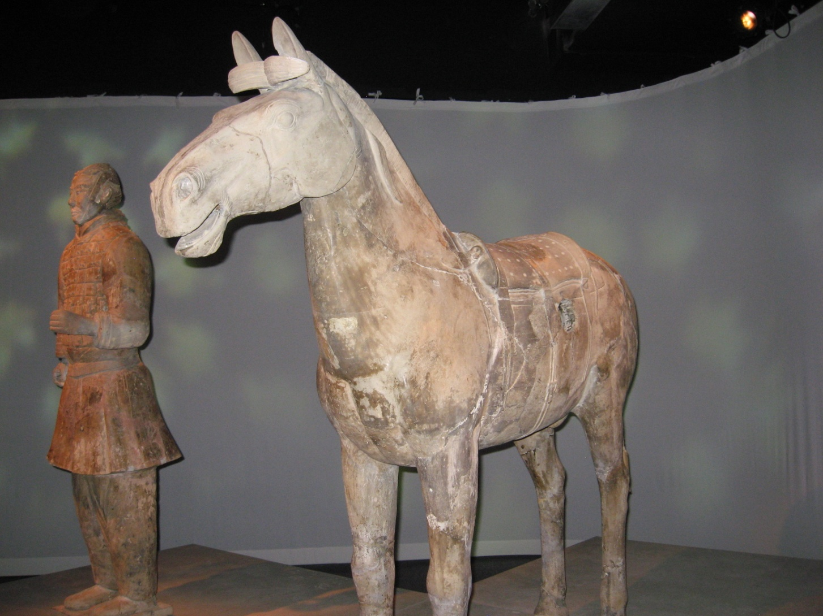
Warrior and Horse

Slide 6
The emperor's tomb lies beneath a forested hill, surrounded by cultivated fields about a half-mile from the museum. Out of reverence for an imperial resting place and concerns about preserving what might be unearthed there, the site has not been excavated. According to a description written a century after the emperor's death, the tomb contains a wealth of wonders, including man-made streambeds contoured to resemble the Yellow and Yangtze rivers, flowing with shimmering, quicksilver mercury that mimics coursing water.

Slide 7
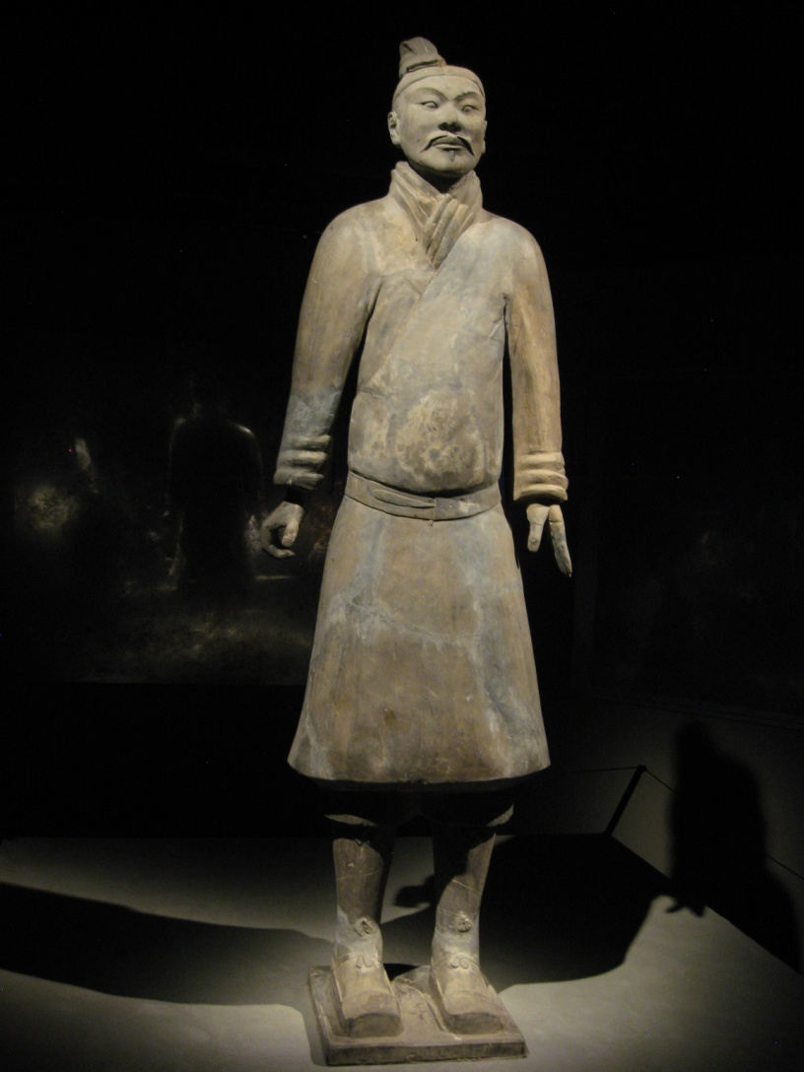
Every figure has its own face and dress which are different from all the others.

Slide 8
Qin Shi Huangdi decreed a mass-production approach; artisans turned out figures almost like cars on an assembly line. Clay, unlike bronze, lends itself to quick and cheap fabrication.
Workers built bodies, then customized them with heads, hats, shoes, mustaches, ears and so on, made in small molds. Some of the figures appear so strikingly individual they seem modeled on real people, though that is unlikely.

Slide 9
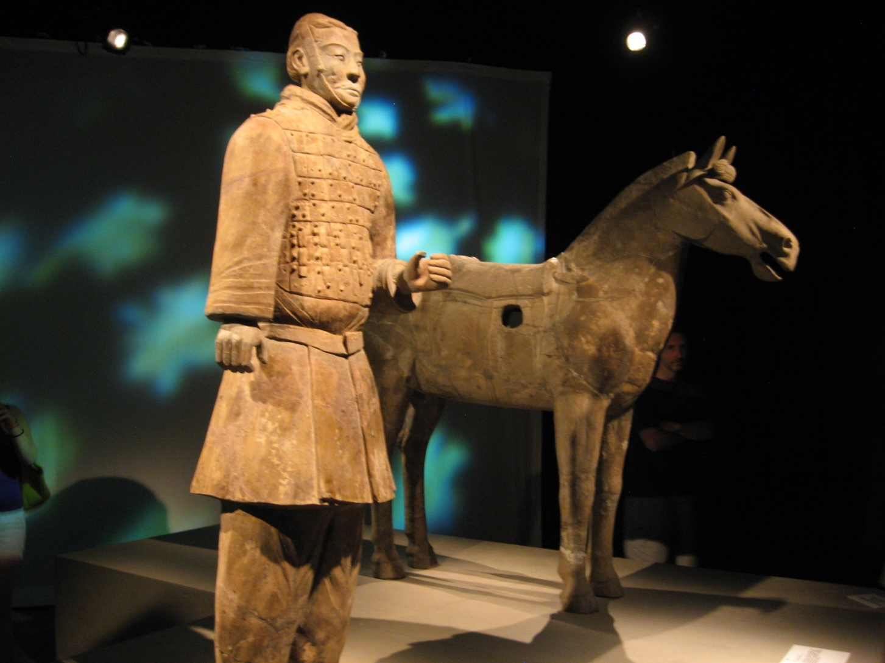
Hole in horse is where chariot harness was attached.

Slide 10
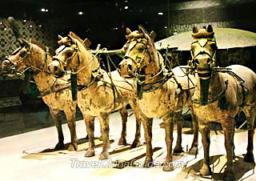
Chariot horses with reins and rigging attaching them to chariots

