Slide 1
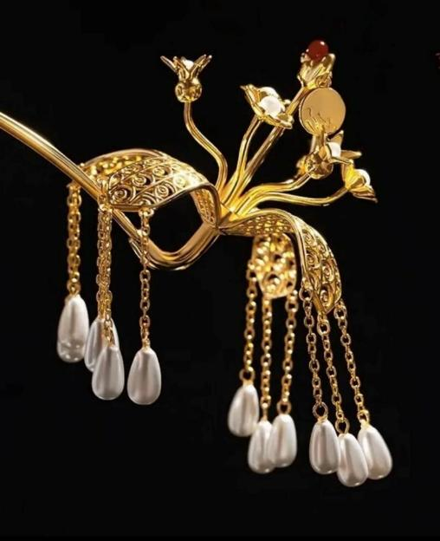
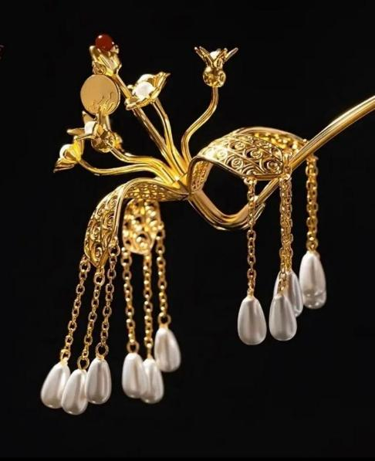

步摇
Bu Yao
步摇金翠玉搔头，倾国倾城胜莫愁。

Slide 2
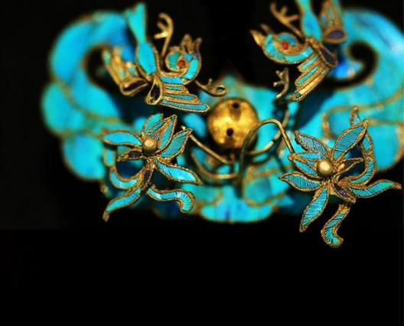

目
壹
贰
叁
肆
录
Significance of the
Bu Yao
What is BuYao
Why called Bu Yao
Several classical Bu Yao
CONTENTS

Slide 3
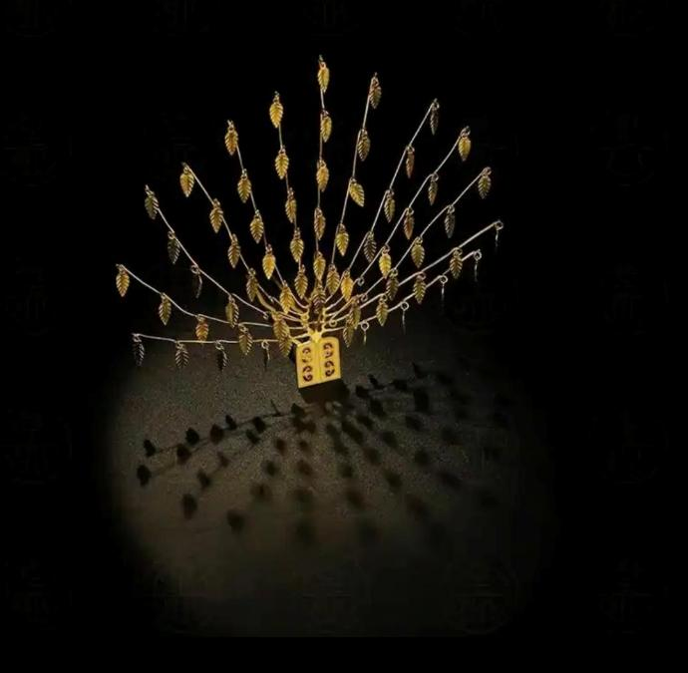

壹
What is Bu Yao
“Her golden kingfisher hairpin sways, her jade comb glows bright; She outshines all beauties, even the famed Mochou fair and bright.“

Slide 4
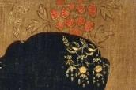
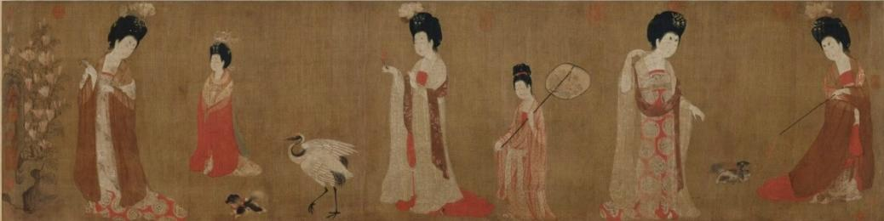
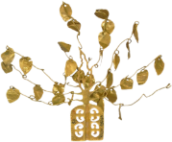
What is Bu Yao——not just a Hairpin
Painting of Court Ladies Adorning Their Hair with Flowers
（簪花仕女图）
Court Lady with Lotus in Hair
Court Lady with Crabapple Blossoms in Hair
Court Lady with Peony in Hair
Jade and Pearl Bu Yao
Double Phoenix Pattern Gold Bu Yao
Leaf Pattern Gold Bu Yao

Slide 5
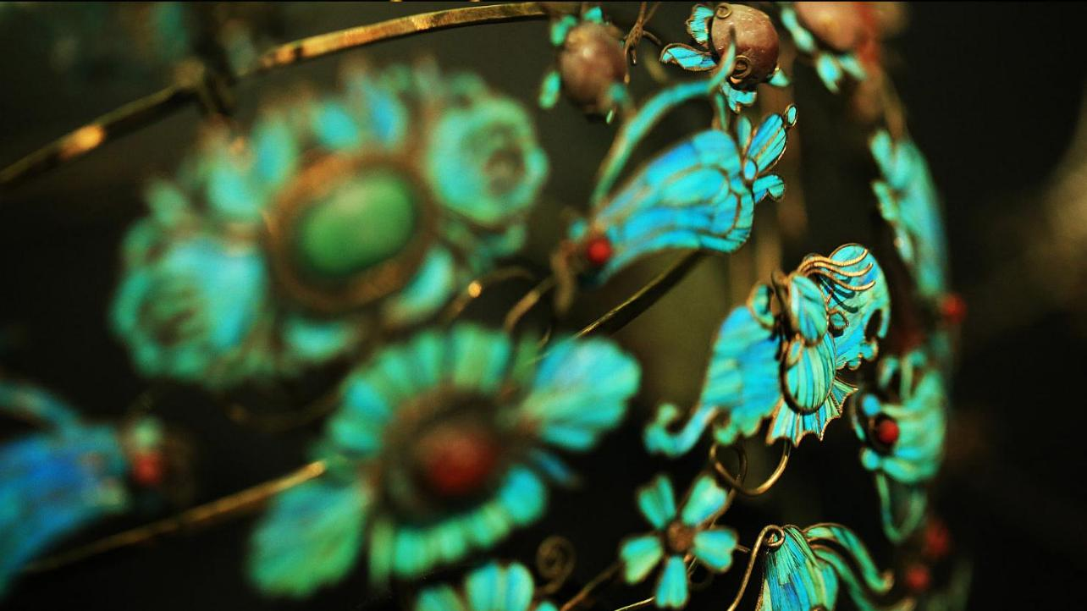
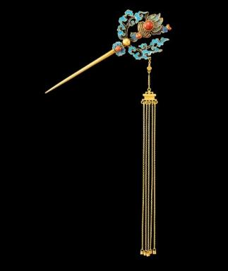
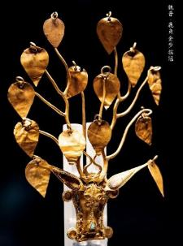
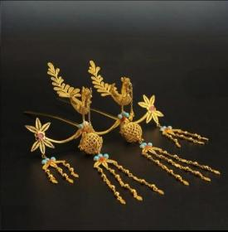
Single-hairpin-style Bu Yao
Hairpin-style Bu Yao
Crown-style Bu Yao
It takes a single hairpin body as the base, with swaying components decorated on the hairpin head, such as bead strings, golden leaves, flower shapes, etc.
It takes a double-pronged hairpin as the base, with swaying components decorated on the hairpin head, such as bead strings, golden leaves, flower and bird shapes, etc.
It takes a "crown" as the carrier, with Bu Yao components decorated on the crown, such as golden leaves, bead strings, flower trees, etc.

Slide 6
Why called Bu Yao
贰
“Her golden kingfisher hairpin sways, her jade comb glows bright; She outshines all beauties, even the famed Mochou fair and bright.“

Slide 7
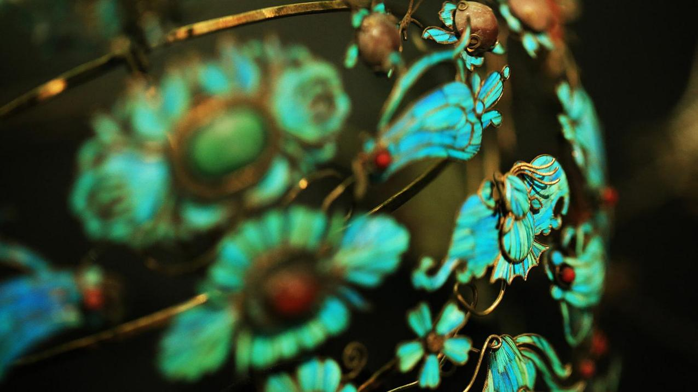
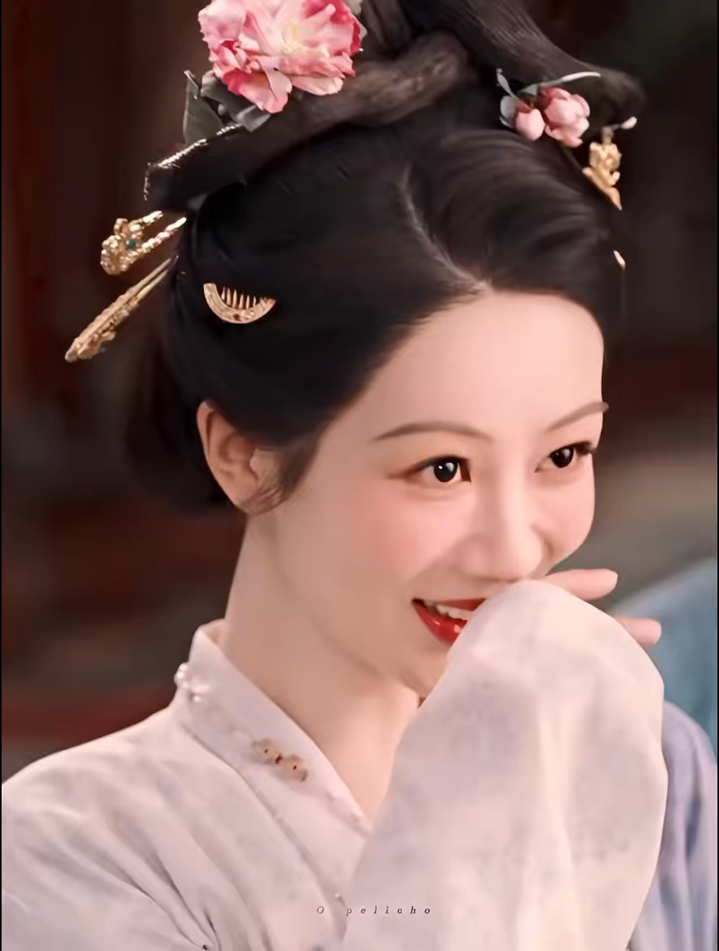
Why called Bu Yao
sways with the wearer's steps
Explanations of Terms:
"Bu Yao, with hanging beads above, sways when walking."

Slide 8
Several classical Bu Yao
叁
“Her golden kingfisher hairpin sways, her jade comb glows bright; She outshines all beauties, even the famed Mochou fair and bright.“

Slide 9
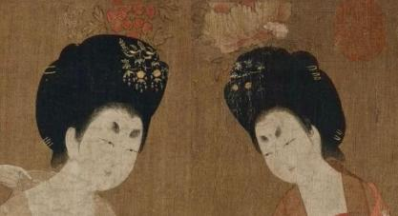
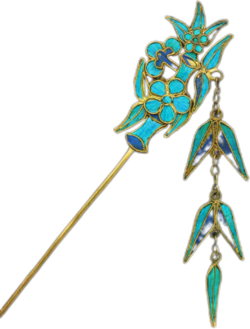
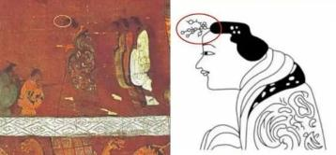
The origin and development of the Buyao
Origin
Pre-Qin to Han Dynasty: part of the queen's sacrificial ritual attire.
Popularization
Transform
Tang Dynasty: In terms of form, it combined with hairpins to form "Bu Yao Hairpin".
Song, Yuan to Ming and Qing Dynasties: more decorative and integrated with folk cultures such as opera and novels.

Slide 10
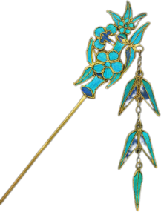
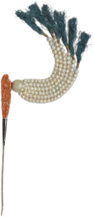
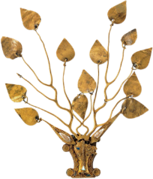
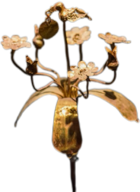
Several classical Bu Yao
Qing Dynasty•Silver Gilt Kingfisher-feather Inlaid Bamboo Bu Yao
Eastern Han Dynasty•Gold Bu Yao
“One Pedestal with Four Blossoms”
Bamboo pattern; three-layer tassels.
Northern Dynasties•Gold BuYao in the Shape of Ox Head and Deer Horn
Qing Dynasty•Coral and Jade Bead Bu Yao
The base features an ox head and horns, with each branch hanging a peach-shaped golden leaf.
Mainly made of coral and jade, symbolizing preciousness and beauty.

Slide 11
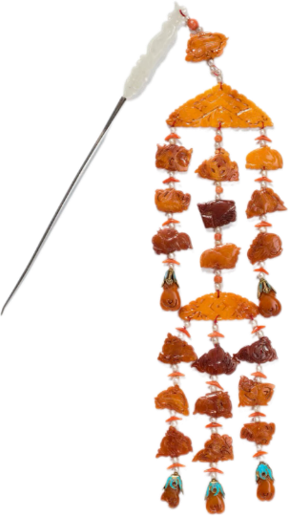
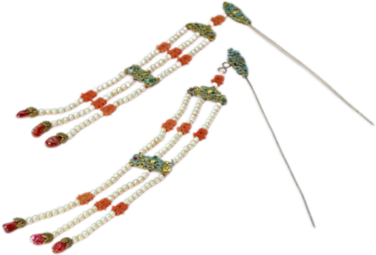
Qing Dynasty•Silver Gilt Kingfisher-feather Inlaid Beaded Tassel
Qing Dynasty•Silver-inlaid Amber and Hetian Jade Bu Yao with Hidden Eight Immortals Motif
Cloud and bat patterns; coral-made "囍" (tassel component).
Materials: silver, amber, jade, pearls, etc.

Slide 12
Significance of the Bu Yao
肆
“Her golden kingfisher hairpin sways, her jade comb glows bright; She outshines all beauties, even the famed Mochou fair and bright.“

Slide 13
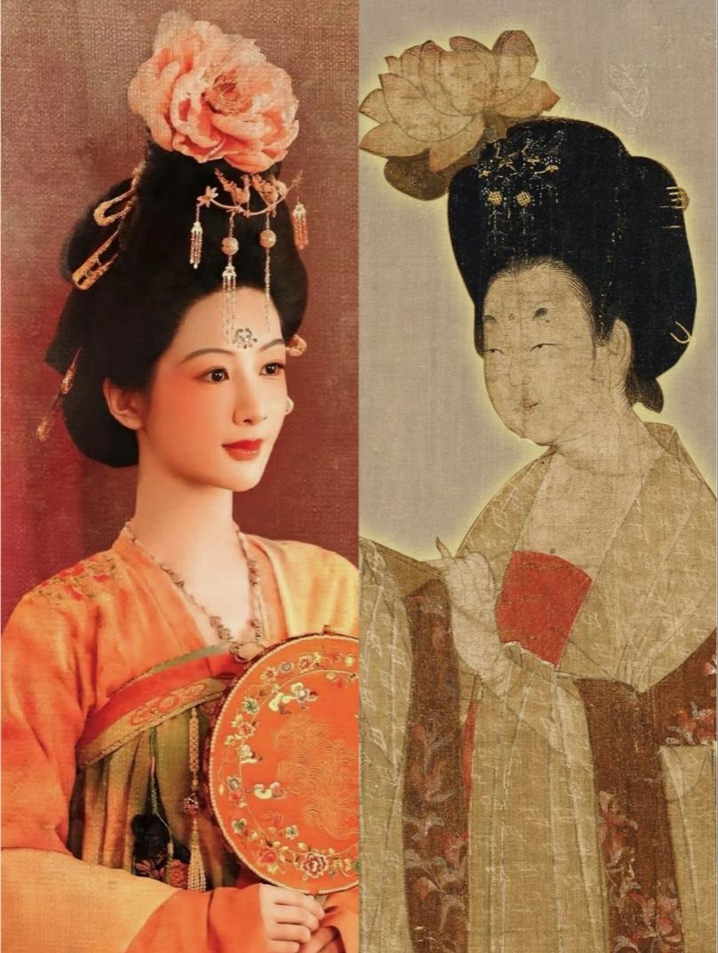
Cultural significance
a symbol of status and good fortune
symbolize wealth and joy
express elegance and grace
点翠施红竞春日
罗裙玉佩当轩出
A living tradition

Slide 14


THANK YOU
“Her golden kingfisher hairpin sways, her jade comb glows bright; She outshines all beauties, even the famed Mochou fair and bright.“

