Slide 1

Big No No

Slide 2

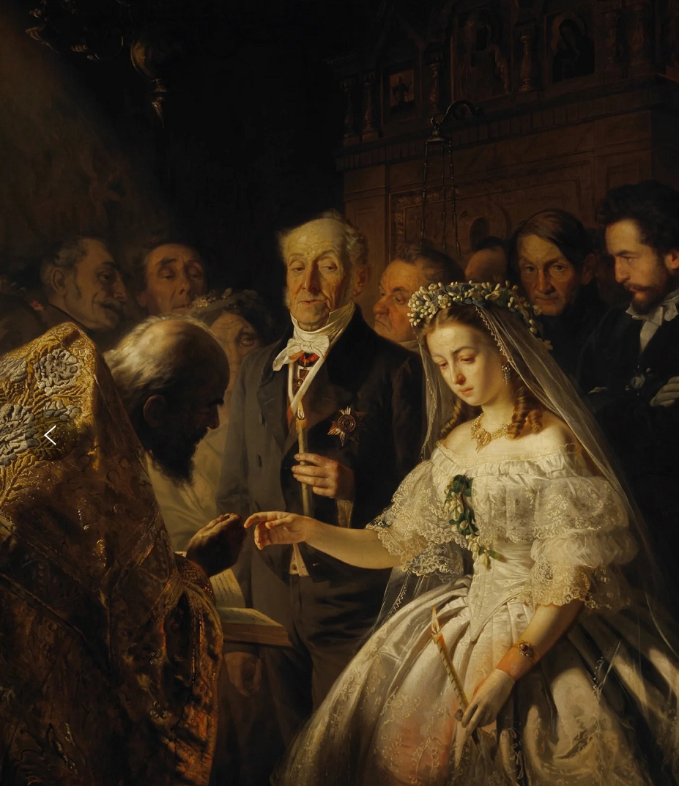
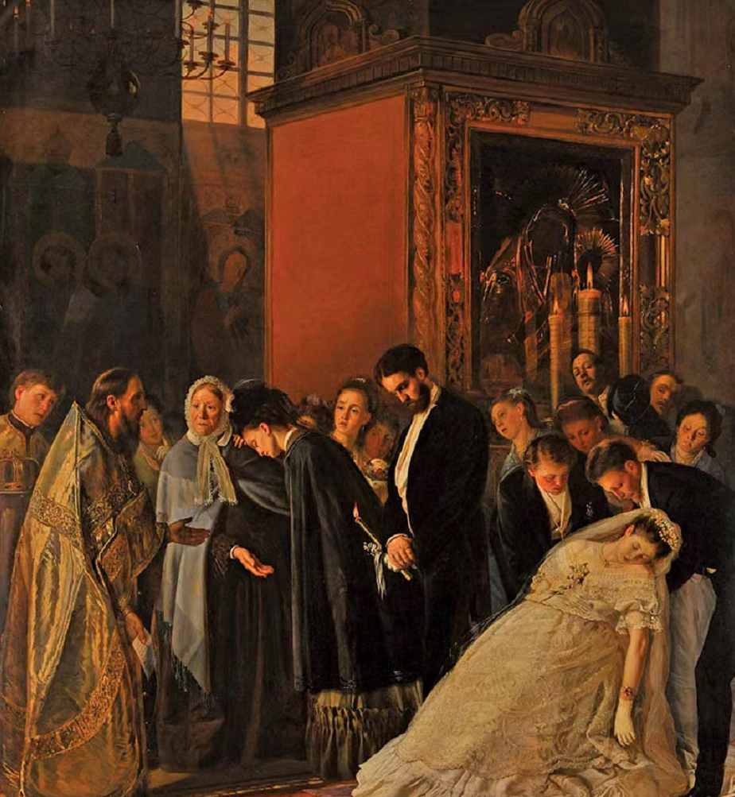
Marriage=Grave

Slide 3
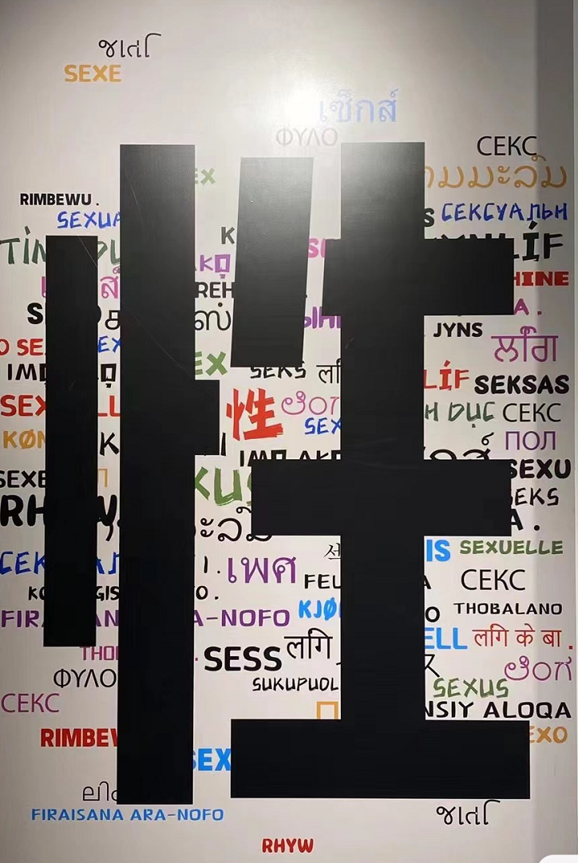

Sex=Taboo

Slide 4
“女子无才便是德”
“男尊女卑，故以男为贵。”
“男以强为贵，女以弱为美…
幼从父兄，嫁从夫，夫死从子”
“良人丈夫者，所仰望而终身也”

Slide 5
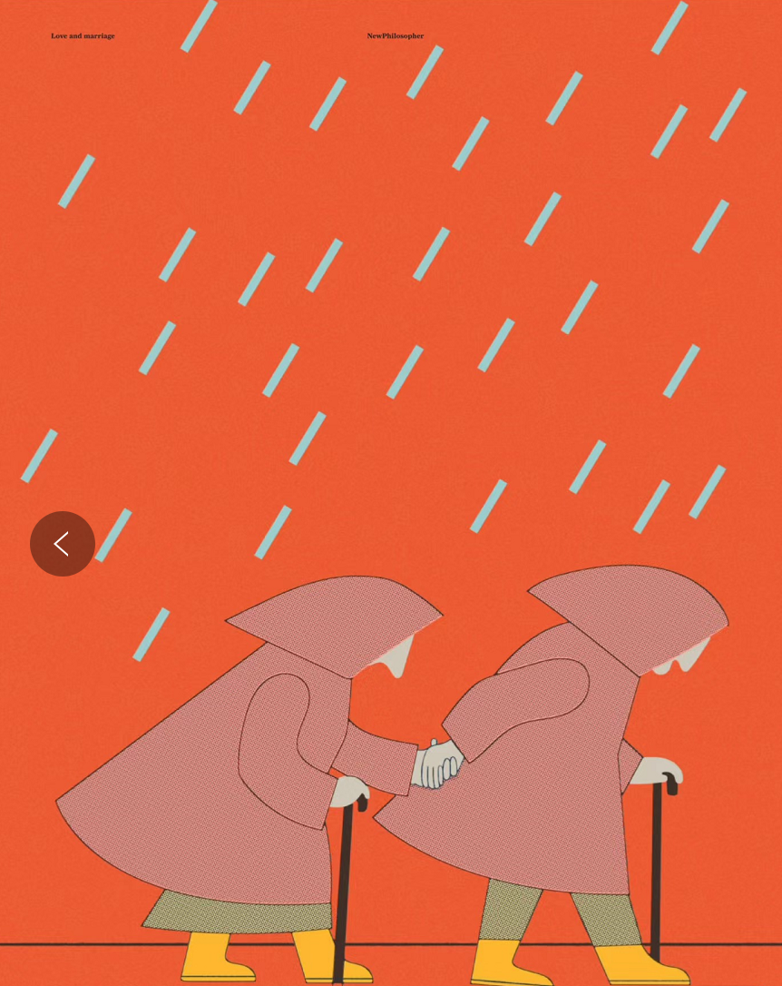
Shift in the Purpose of Marriage
psychological needs
companionship
emotional support
friendship
intimate romantic relationships
Mutual Growth

Slide 6
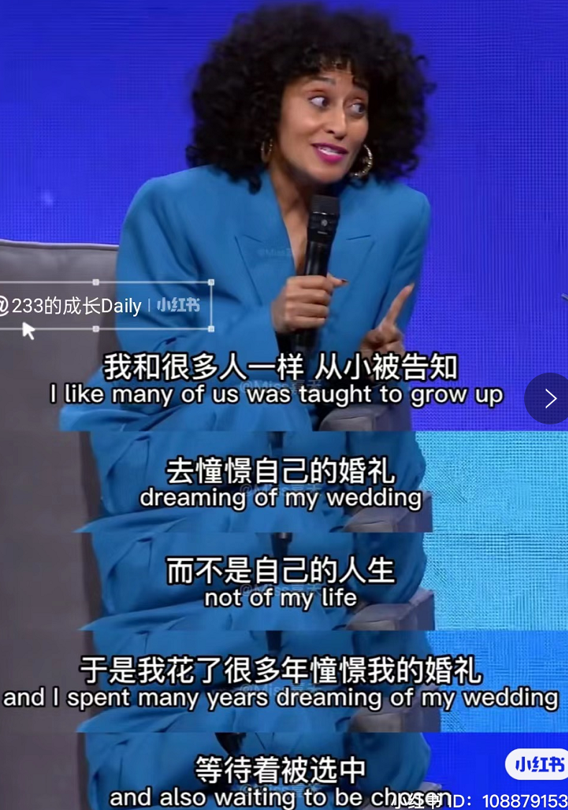
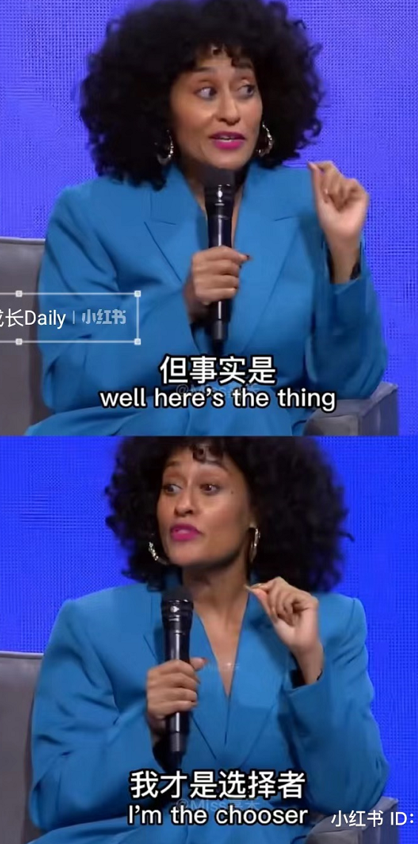
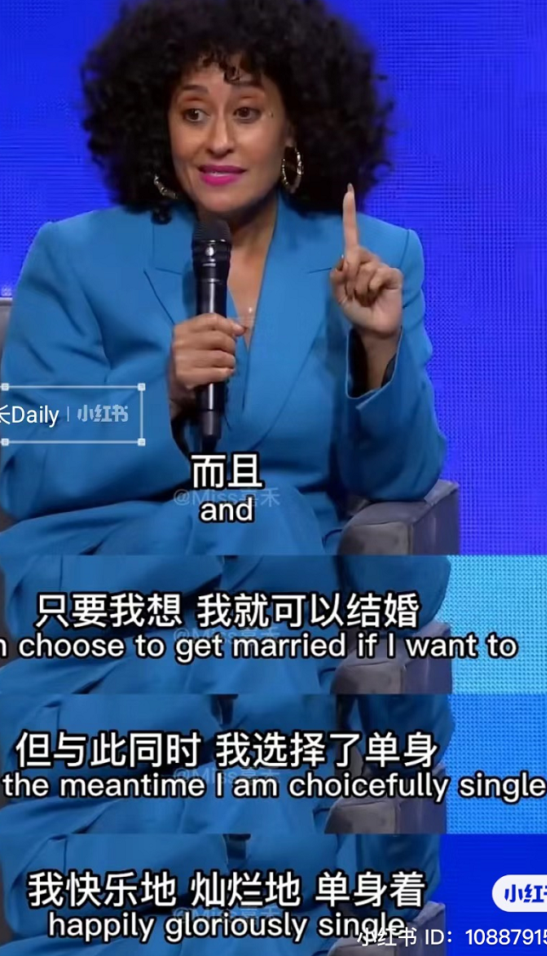
Increased Autonomy in Partner Selection

Slide 7
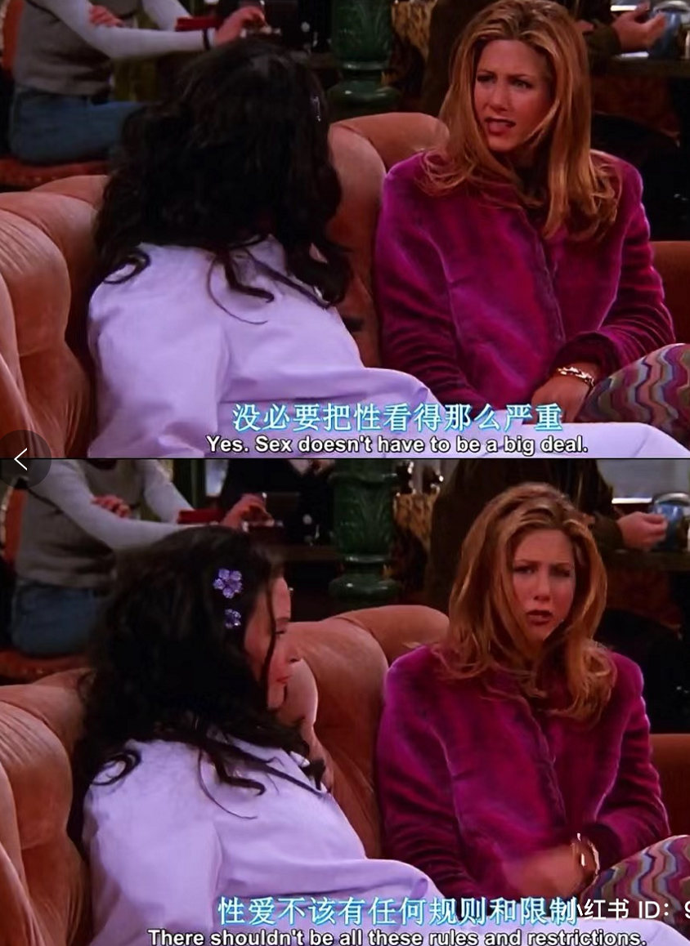
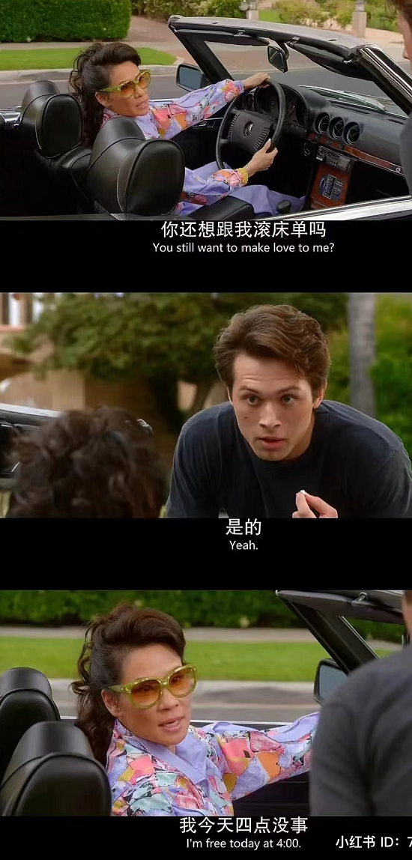
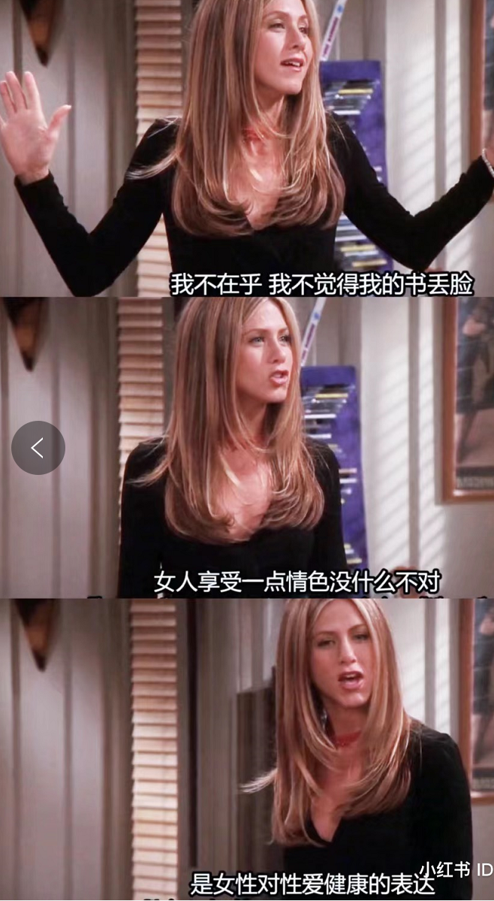
Sexual value

Slide 8
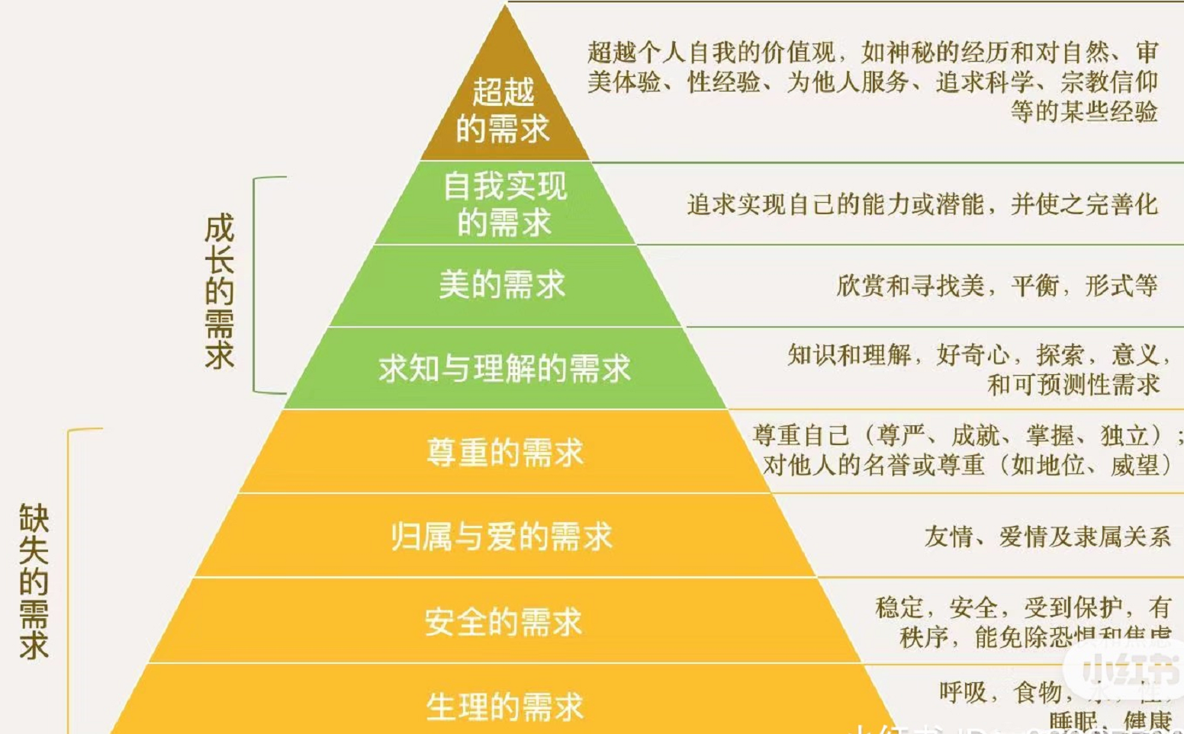
why change？

Slide 9
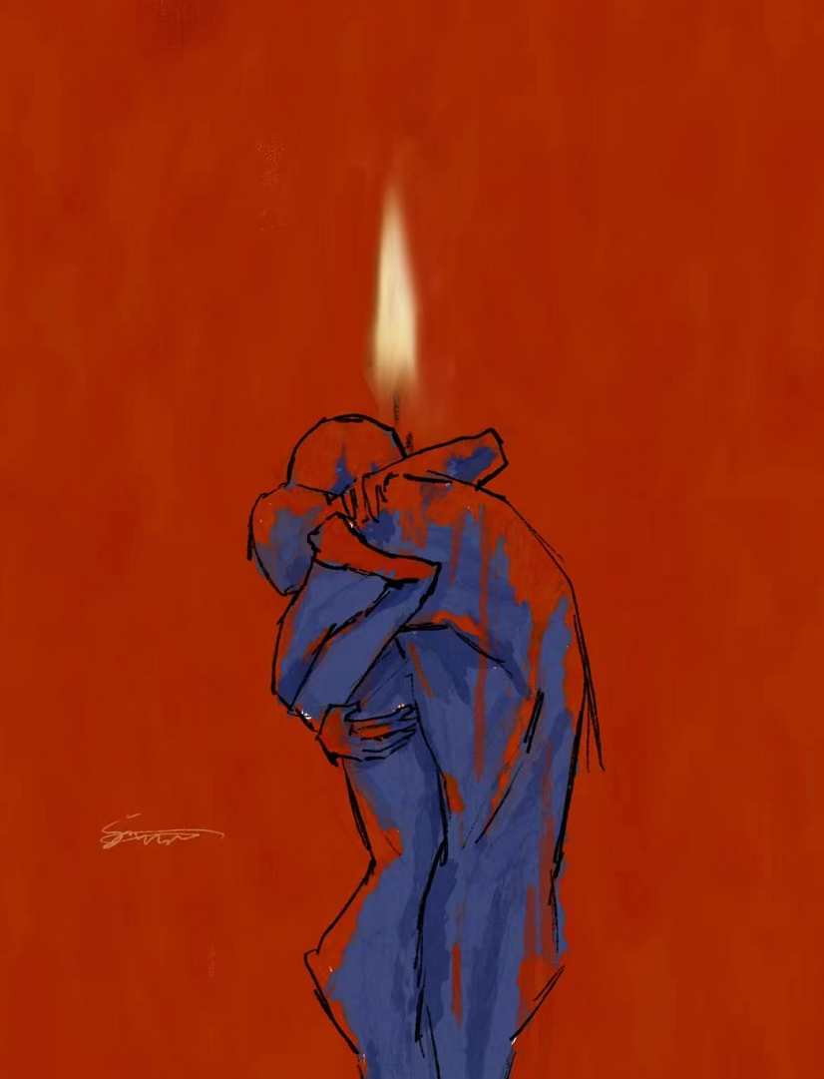

“You should get married because you have so much to give, not because you're starving for something.
If you're seeking attention, approval, or someone to make you feel important, you become a burden.
Marrying for those reasons makes you a burden to your partner.”

