Slide 1
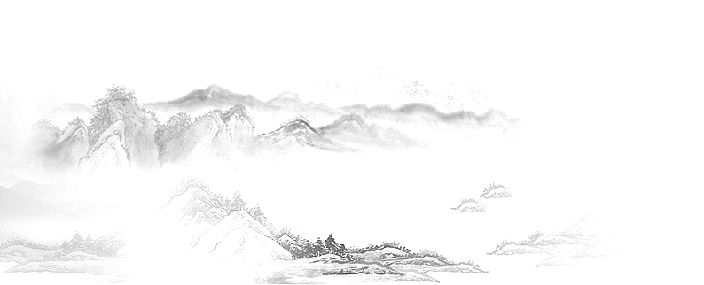
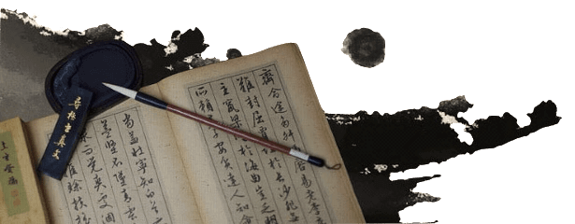

28. Chinese Writing: Calligraphy

Slide 2
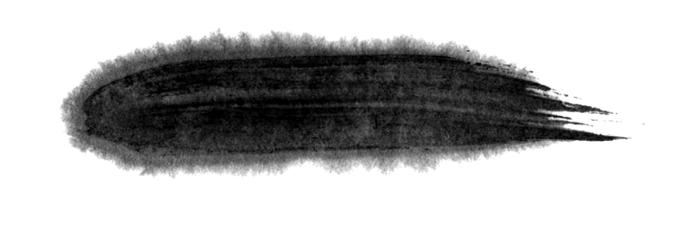

Content
1. The Evolution of Chinese Characters
2. Notable Calligraphers
3. The Future of Calligraphy

Slide 3

1. The Evolution of Chinese Characters

Slide 4
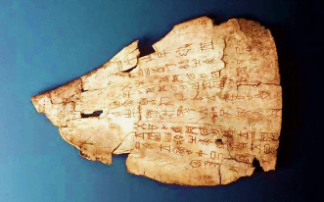
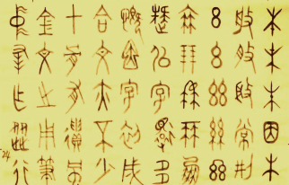
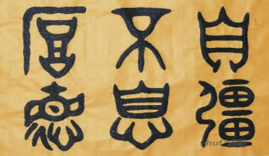

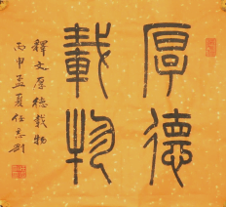
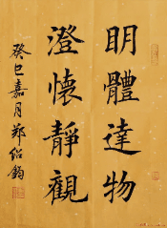
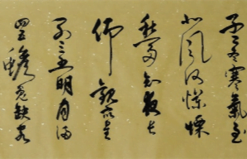
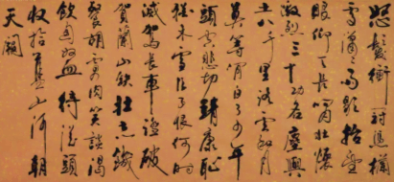
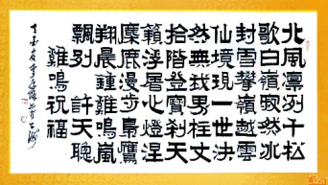
Chinese Characters
​Oracle Bone Script
Bronze Script
​​Great Seal Script
Cursive Script
Running Script
Official Script
Regular Script
​​Small
Seal Script

Slide 5
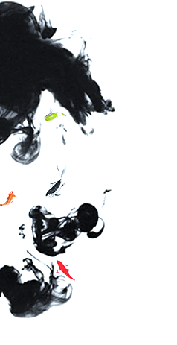
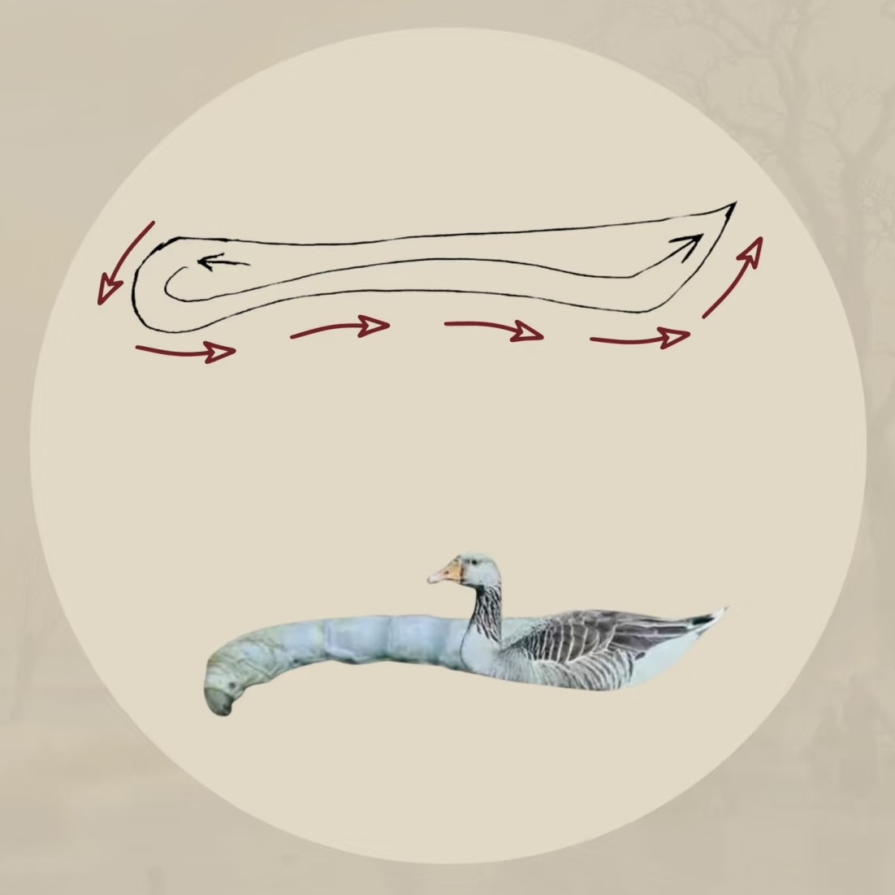

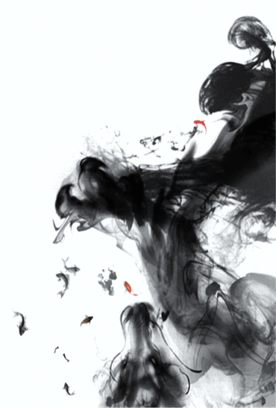

Slide 6
2. Notable Calligraphers

Slide 7
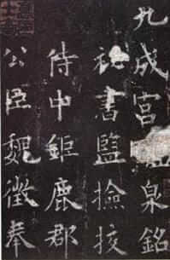
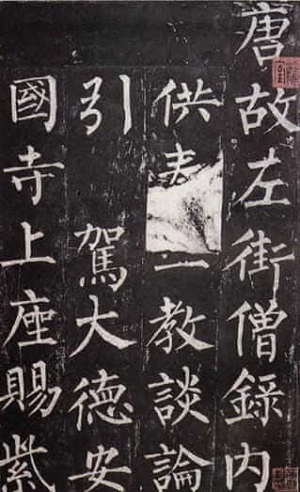
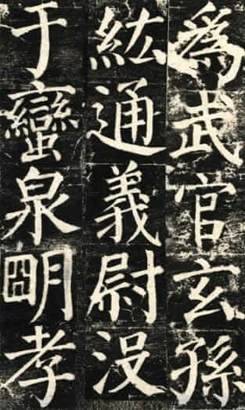
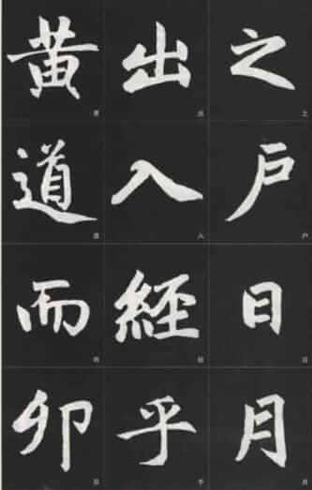
Regular Script
Ouyang Xun
Liu Gongquan
Yan Zhenqing
Zhao Mengfu

Slide 8
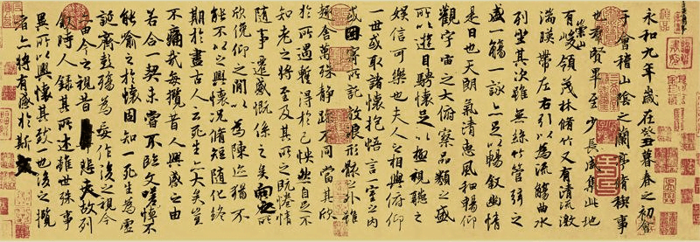
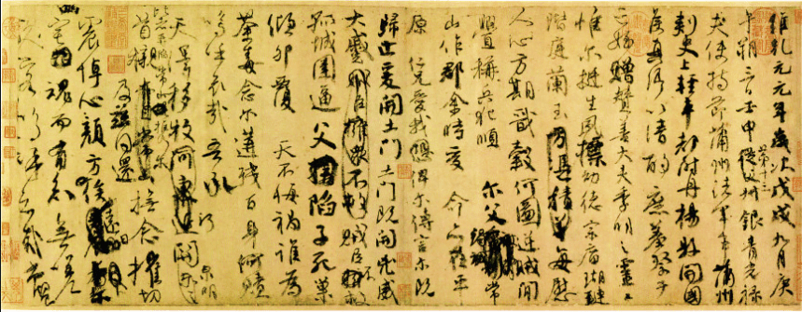

Running Script
Wang Xizhi
Yan Zhenqing
Su Shi

Slide 9
3. The Future of Calligraphy

Slide 10
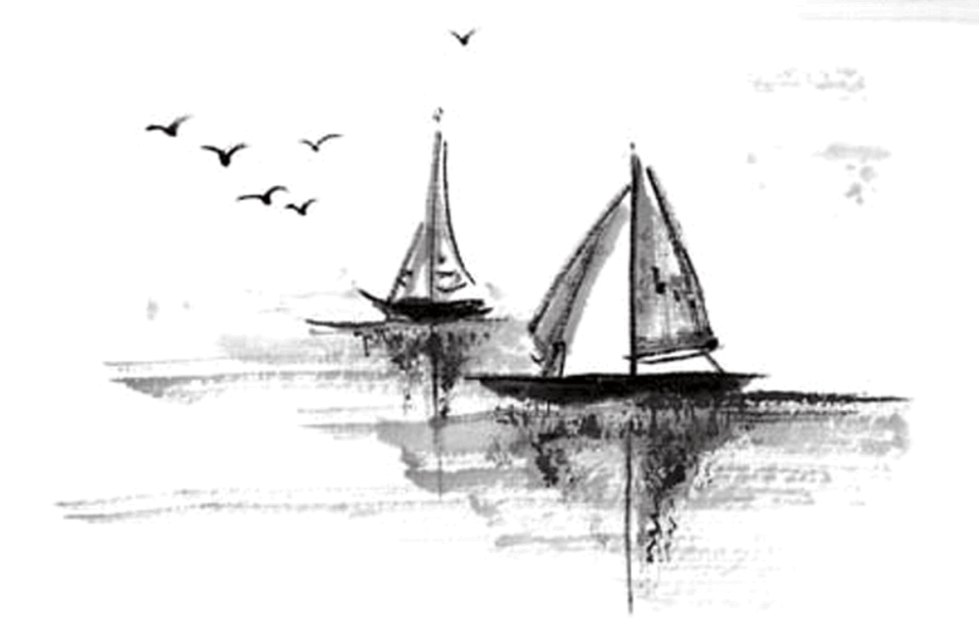
Question:
With the advancement of the IT industry and typing, will Chinese calligraphy become obsolete?

Slide 11
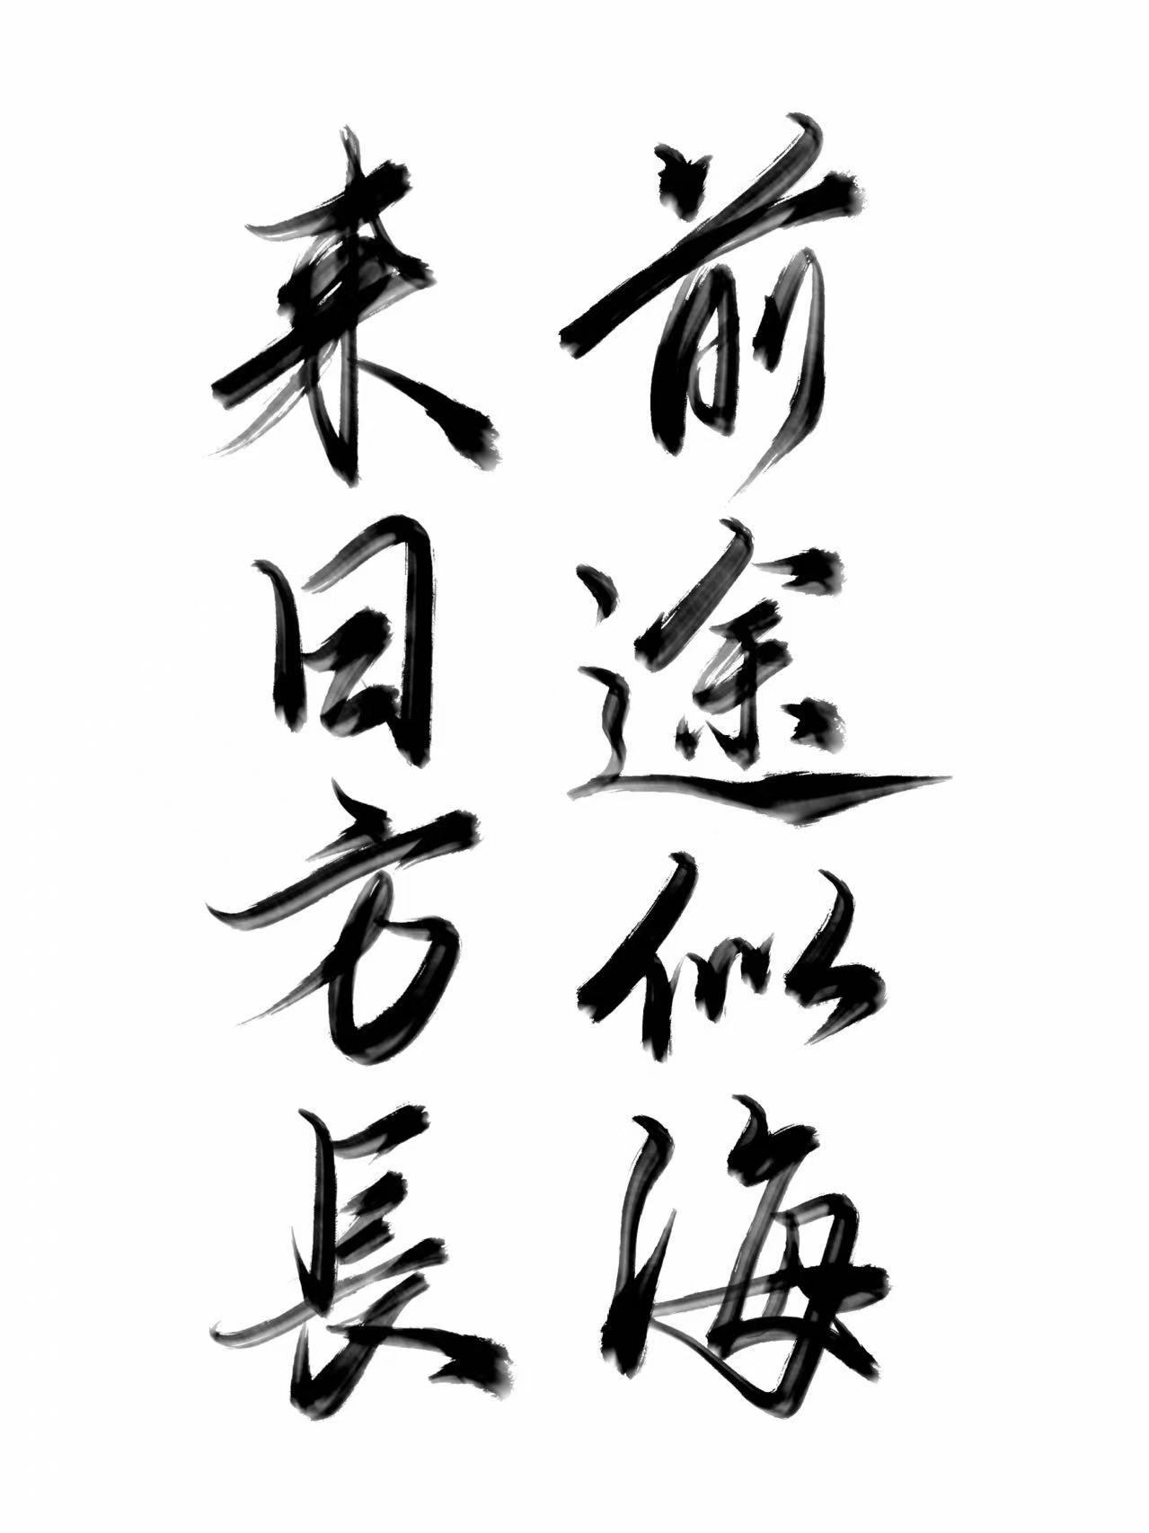

Slide 12

感谢观看
Thanks for listening!

