Slide 1
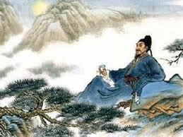
李白

Slide 2
Early Life and Childhood
Li Bai was born in 701 A.D.
As for the Birthplace, this is widely argued and disputed. Many Scholars believe he was born in an area of modern day Kyrgyzstan, some believe it may have been as far west as Turkey. Others think it was in Gansu in western China. One thing most scholars do agree on is that he was born far west as his family had been sent in exile before his birth.
As a little boy, Li Bai grew up and was raised in Sichuan, Chengdu. They moved there secretly by his father to have a better life.
Here is where Li Bai started studying the old books of history and writings. He studied extensively Confusious and his teachings

Slide 3
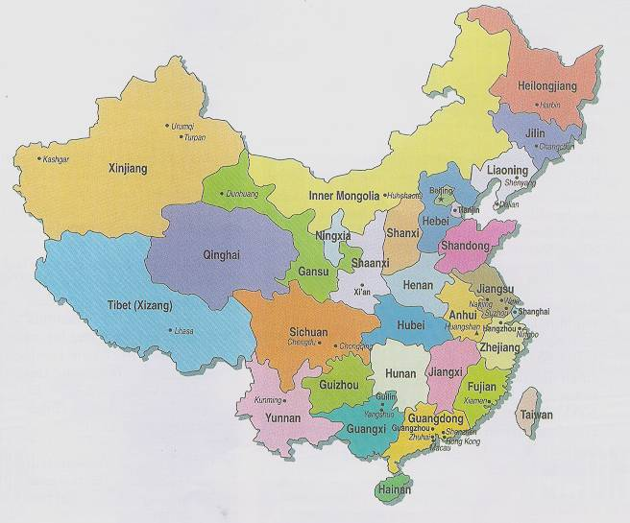

Slide 4
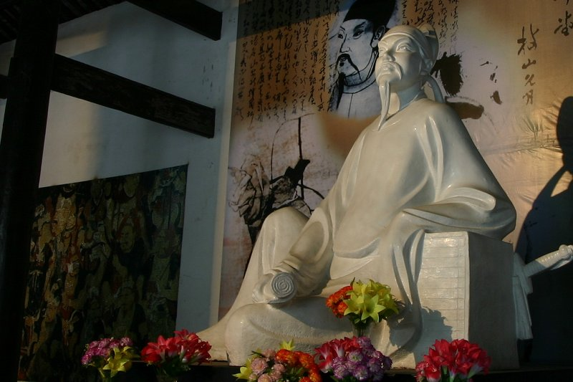
Statue Of Li Bai in Sichuan
Li Bai is regarded as one of the most influential Chinese Poets of the Tang Dynasty.

Slide 5
Coming of Age / Period of Wandering
Sometime in his Twenties, Li Bai left Sichuan and started a period of wandering. Though he settled and stayed in some areas for quite some time, the rest of his life he spent traveling and writing poetry
During his period of wandering, he was married for a brief time, worked for the emperor and met with other scholars and poets.

Slide 6
Death Sentence / Exile / Final Years
Later in his life, the empire saw much unrest. He worked for one of the emperors sons who attempted to seize control of the empire. Once the Emperor put an end to the plan, he killed his son and had Li Bai sentenced to Death.
Death Sentence was changed to exile in what many people believe to be in Yunan.
Before he made it to his exile, he learned that he had been exonerated and was free to return to the kingdom
In 762, Li Bai died. His death is widely debated and still to this day no one knows of the true reason

Slide 7
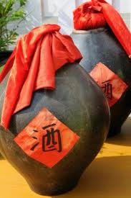
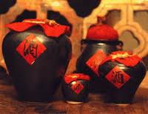
Lifestyle

Slide 8
Poetic Writing Styles
He wrote quite a lot about Wine. This seemed to be a great passion in his life
In the famous book of 300 poems, it contains over 30 of his writings
He is considered one of the best and most influential poets not only in during the Tang Dynasty, but also in Chinese History
He is compared with another great Poet Du Fu
He also wrote poems in different personas. Usually in the form of a woman.

Slide 9
Waking From Drunkenness on a Spring Day (春日醉起言志)
處世若大夢, Life in the world is but a big dream;
胡爲勞其生. I will not spoil it by any labour or care.
所以終日醉, so saying, I was drunk all the day,
頹然臥前楹. lying helpless at the porch in front of my door.
覺來盼庭前, when I awoke, I blinked at the garden-lawn;
一鳥花間鳴. a lonely bird was singing amid the flowers.
借問此何時, I asked myself, had the day been wet or fine?
春風語流鶯. the Spring wind was telling the mango-bird.
感之欲嘆息, moved by its song I soon began to sigh,
對酒還自傾. and, as wine was there, I filled my own cup.
浩歌待明月, wildly singing I waited for the moon to rise;
曲盡已忘情. when my song was over, all my senses had gone.

Slide 10
Drinking Alone by Moonlight
花間一壺酒。 A cup of wine, under the flowering trees;
獨酌無相親。 I drink alone, for no friend is near.
舉杯邀明月。 Raising my cup I beckon the bright moon,
對影成三人。 For he, with my shadow, will make three men.
月既不解飲。 The moon, alas, is no drinker of wine;
影徒隨我身。 Listless, my shadow creeps about at my side.
暫伴月將影。 Yet with the moon as friend and the shadow as slave
行樂須及春。 I must make merry before the Spring is spent.
我歌月徘徊。 To the songs I sing the moon flickers her beams;
我舞影零亂。 In the dance I weave my shadow tangles and breaks.
醒時同交歡。 While we were sober, three shared the fun;
醉後各分散。 Now we are drunk, each goes his way.
永結無情遊。 May we long share our odd, inanimate feast,
相期邈雲漢。 And meet at last on the Cloudy River of the sky.

Slide 11
A Song of Chang’An
My hair had hardly covered my forehead.
I was picking flowers, paying by my door,
When you, my lover, on a bamboo horse,
Came trotting in circles and throwing green plums.
We lived near together on a lane in Ch'ang-an,
Both of us young and happy-hearted.
...At fourteen I became your wife,
So bashful that I dared not smile,
And I lowered my head toward a dark corner
And would not turn to your thousand calls;
But at fifteen I straightened my brows and laughed,
Learning that no dust could ever seal our love,
That even unto death I would await you by my post
And would never lose heart in the tower of silent watching.
...Then when I was sixteen, you left on a long journey
Through the Gorges of Ch'u-t'ang, of rock and whirling water.
And then came the Fifth-month, more than I could bear,
And I tried to hear the monkeys in your lofty far-off sky.
Your footprints by our door, where I had watched you go,
Were hidden, every one of them, under green moss,
Hidden under moss too deep to sweep away.
And the first autumn wind added fallen leaves.
And now, in the Eighth-month, yellowing butterflies
Hover, two by two, in our west-garden grasses
And, because of all this, my heart is breaking
And I fear for my bright cheeks, lest they fade.
...Oh, at last, when you return through the three Pa districts,
Send me a message home ahead!
And I will come and meet you and will never mind the distance,
All the way to Chang-feng Sha.

Slide 12
A Message to Meng Haoran
Master, I hail you from my heart,
And your fame arisen to the skies....
Renouncing in ruddy youth the importance of hat and chariot,
You chose pine-trees and clouds; and now, whitehaired,
Drunk with the moon, a sage of dreams,
Flower- bewitched, you are deaf to the Emperor....
High mountain, how I long to reach you,
Breathing your sweetness even here!

Slide 13
Influence throughout the World
静夜思 A Quiet Night Thought
床前明月光 In front of my bed is the bright moonlight.
疑是地上霜 I doubt if it was the frost on the ground.
举头望明月 I lift my head to look up at the August Moon,
低头思故乡 Lowering my head to think about my hometown.
This above Poem is recited and memorized by school kids in China
His works are said to have influence Mao Zedong
Biography was written about him in 1997 by Simon Elegant called “The Floating Life”

Slide 14
http://www.youtube.com/watch?v=_p6icTK4qy4
WATCH ME

