Slide 1
The Palette of
Ancient China
A Journey Through Traditional Colors
申奕珂

Slide 2
CONTNETS
1
What are Chinese Traditional Colors
2
The Core System and Cultural Connotation
3
Classification and Poetic Interpretation
4
The Contemporary Revival and Application

Slide 3
What are Chinese Traditional Colors
Definition and Features
part1

Slide 4
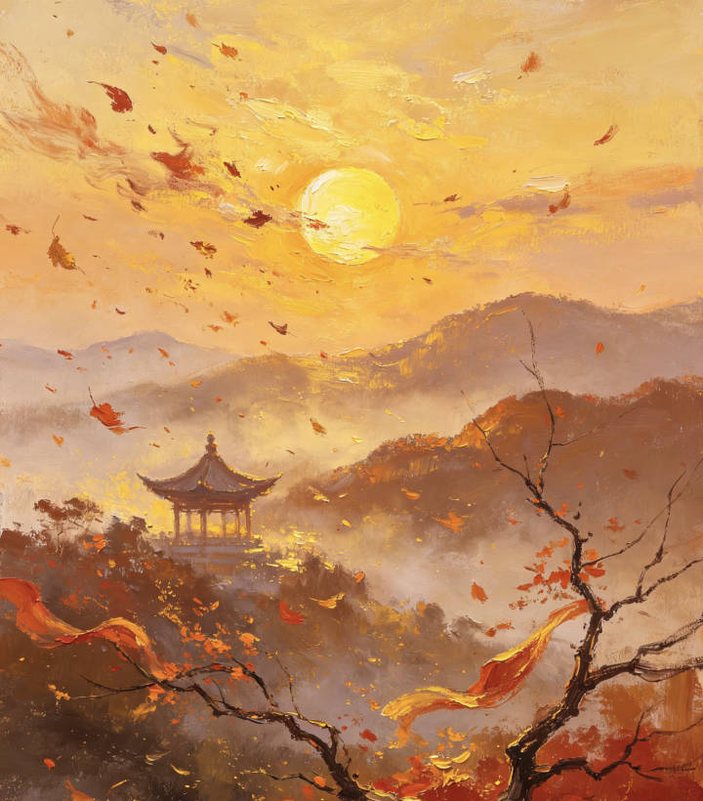
What are Chinese Traditional Colors
Definition
Chinese traditional colors are a unique Oriental color system crafted by ancient people, rooted in nature and woven into daily life through thousands of years of accumulation. Distinct from modern industrial color palettes, every shade boasts a special name, symbolic meaning and cultural story, standing as the core embodiment of Chinese aesthetics.
Features
Rooted in nature, infused with traditional rituals and culture, endowed with elegant poetic names, and rich in both beauty and meaning.

Slide 5
The Core System and Cultural Connotation
五正色
part2

Slide 6
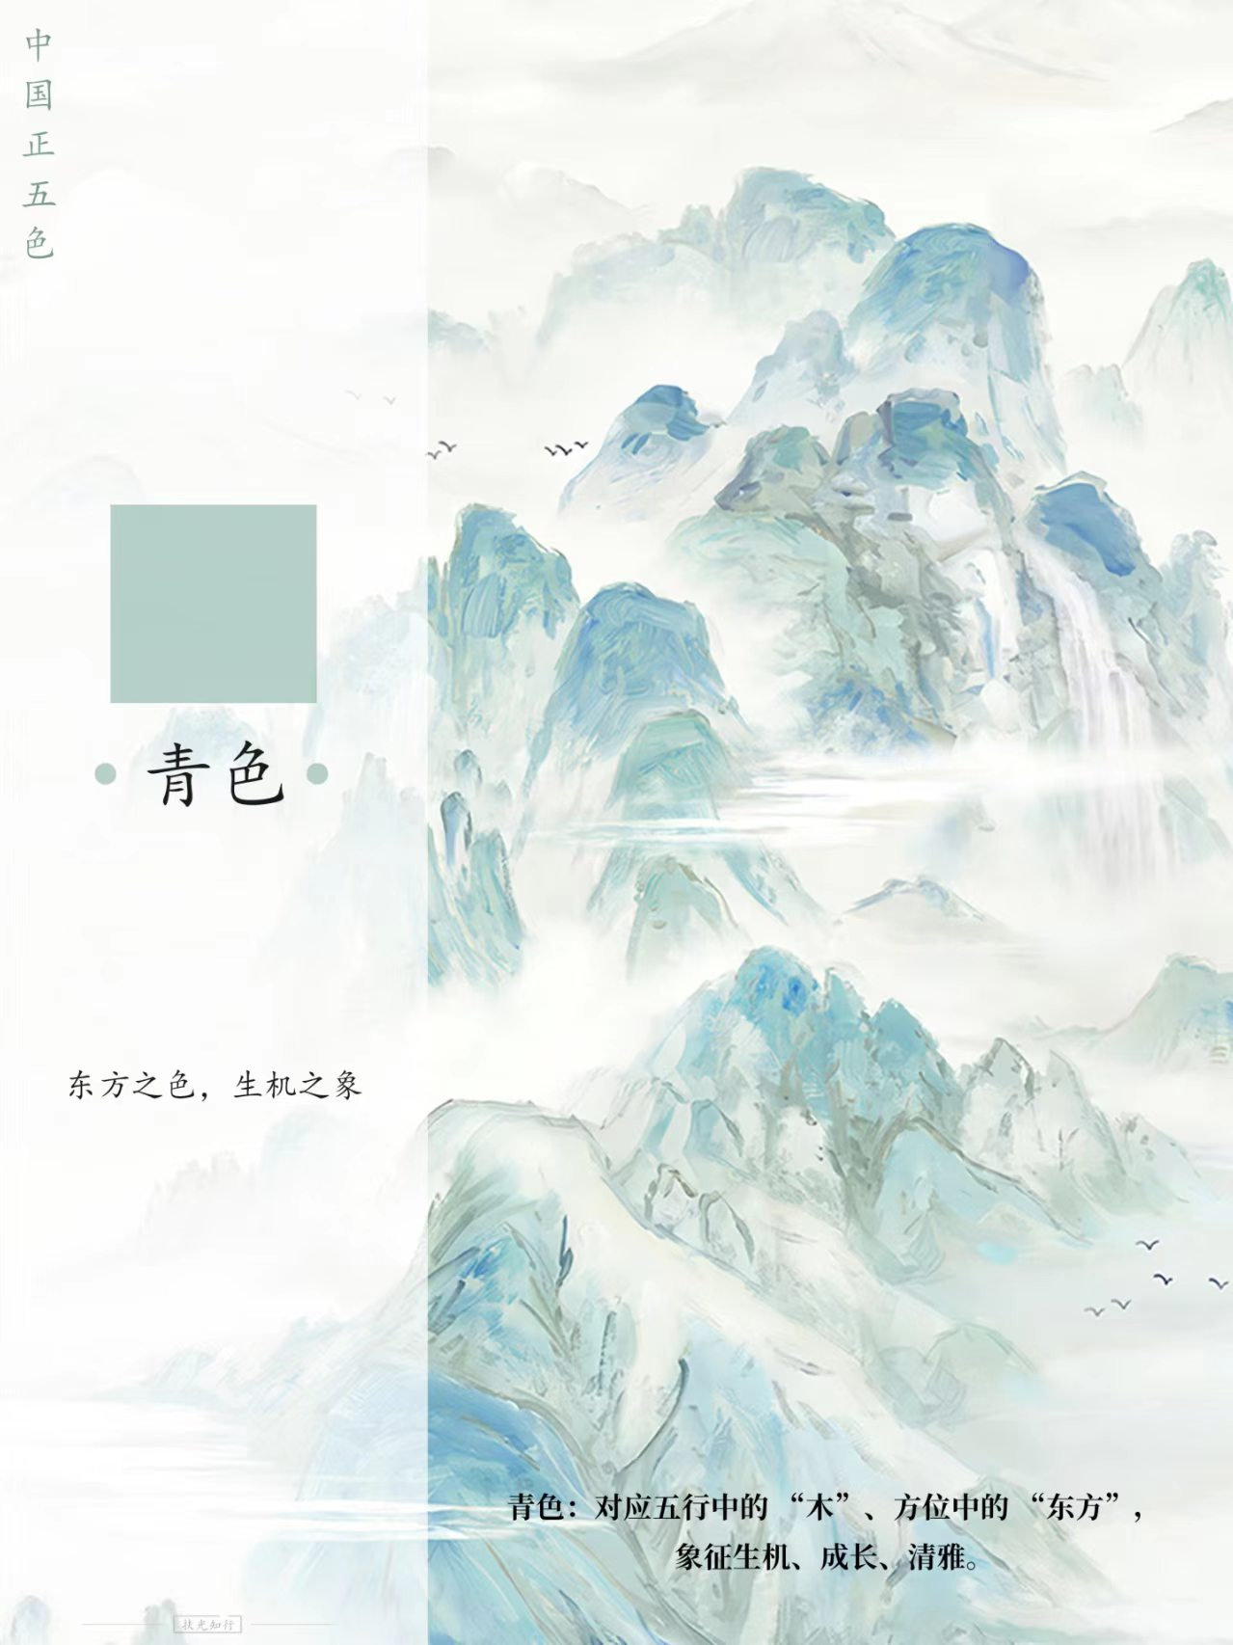
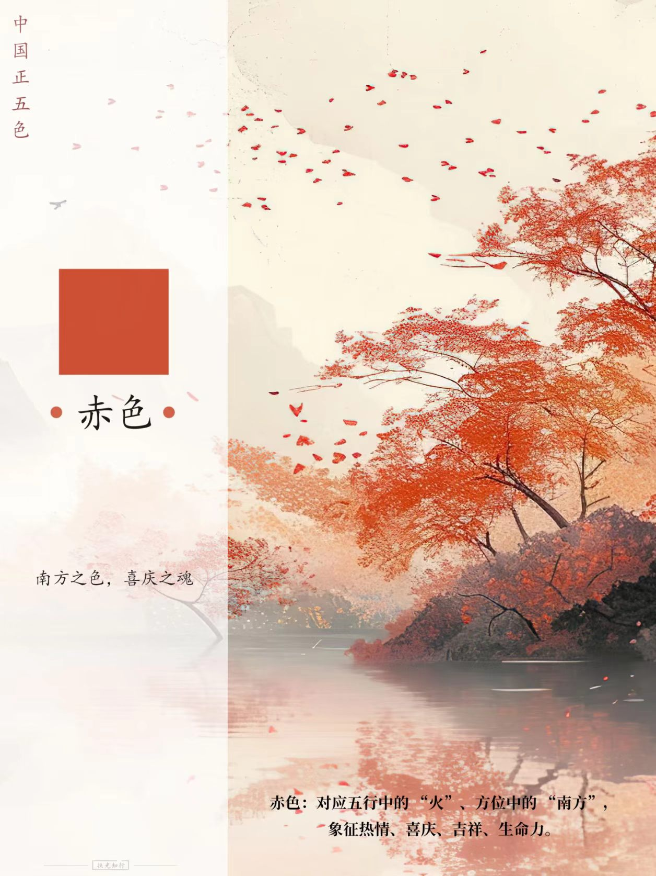
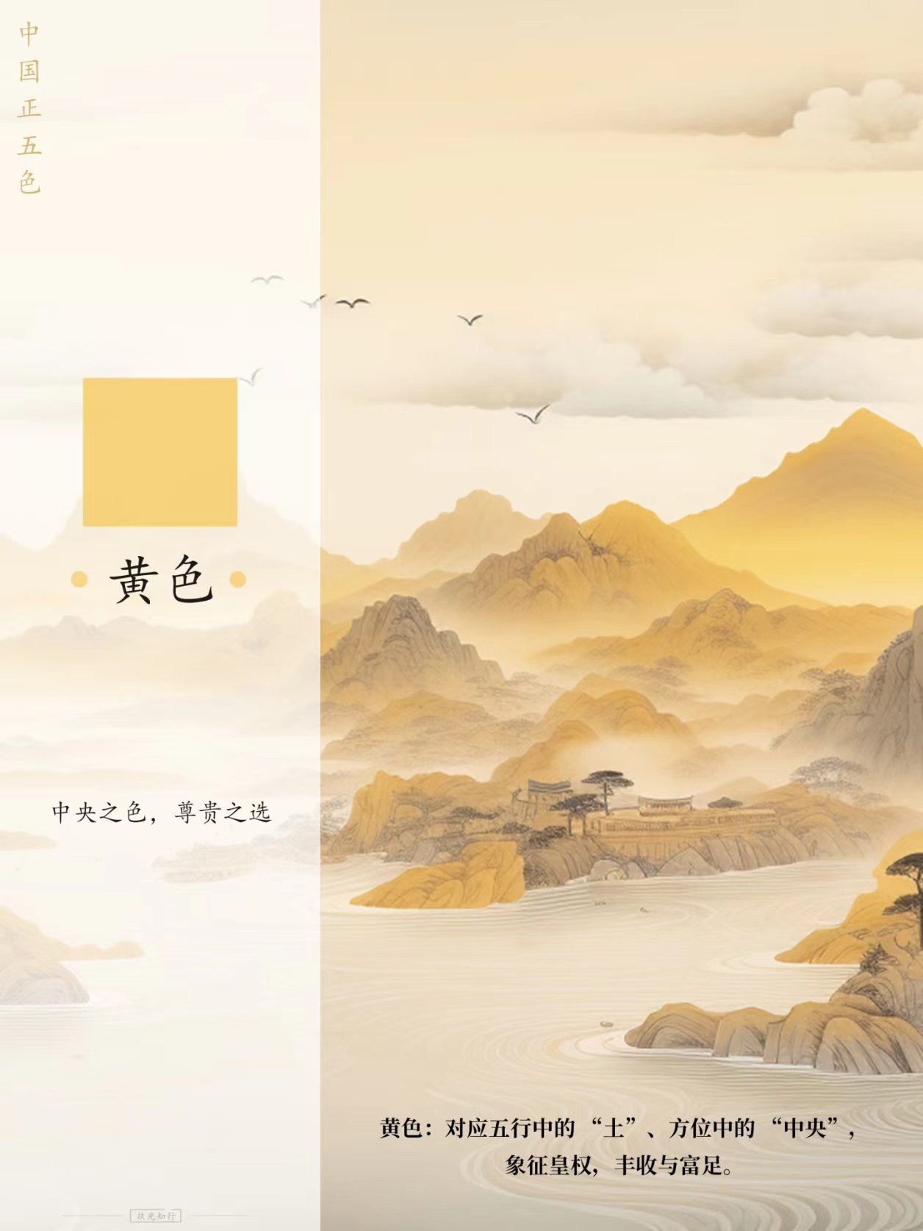
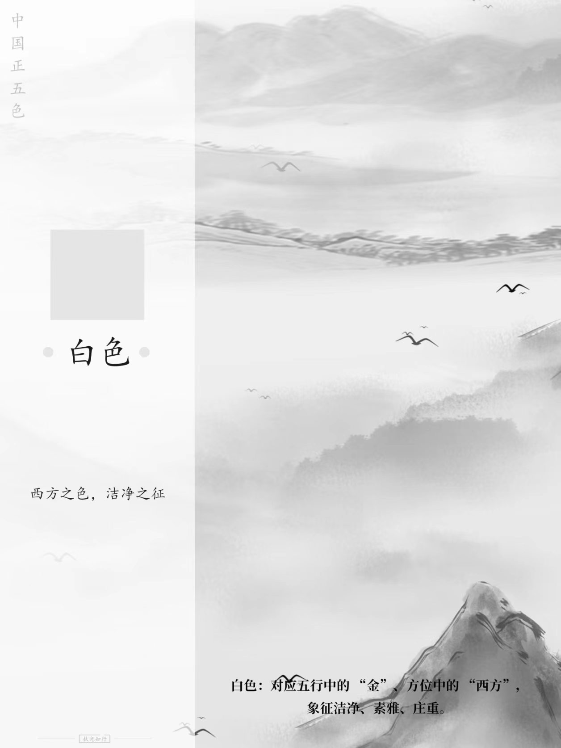
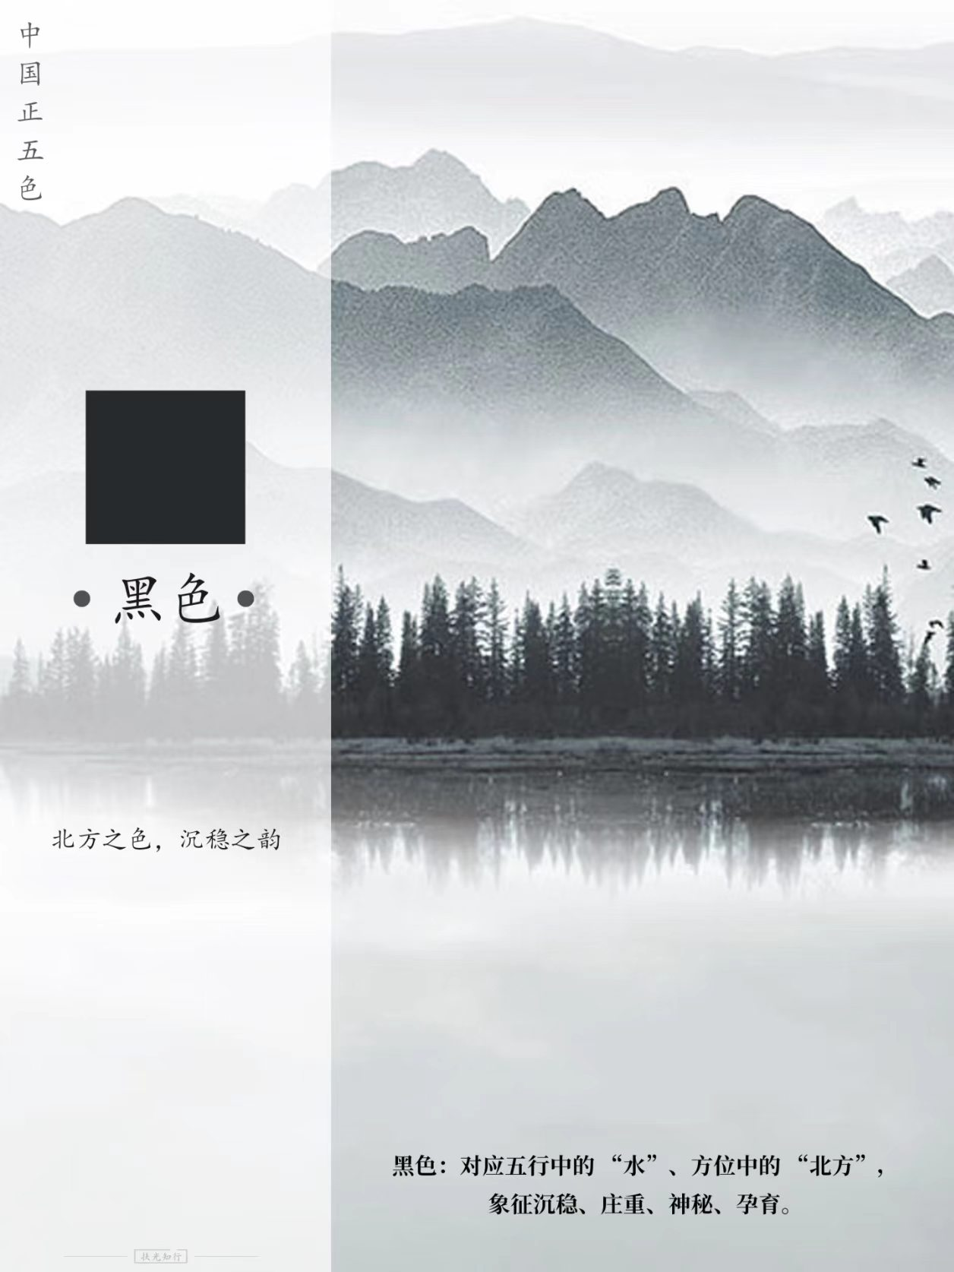
The Core System and Cultural Connotation of Traditional Colors
Far from random matching, traditional Chinese colors adhere to strict ritual and natural systems, falling into two main branches.
青
赤
黄
白
黑
Corresponding to the Five Elements, Five Directions and Four Seasons.

Slide 7
The Core System and Cultural Connotation of Traditional Colors
Far from random matching, traditional Chinese colors adhere to strict ritual and natural systems, falling into two main branches.
青
赤
黄
白
黑
Core Meaning: Traditional Chinese colors are not just colors. They are the tangible embodiment of the ancient people's views on the universe, rituals and aesthetics.

Slide 8
Classification and Poetic Interpretation
some colors
part3

Slide 9
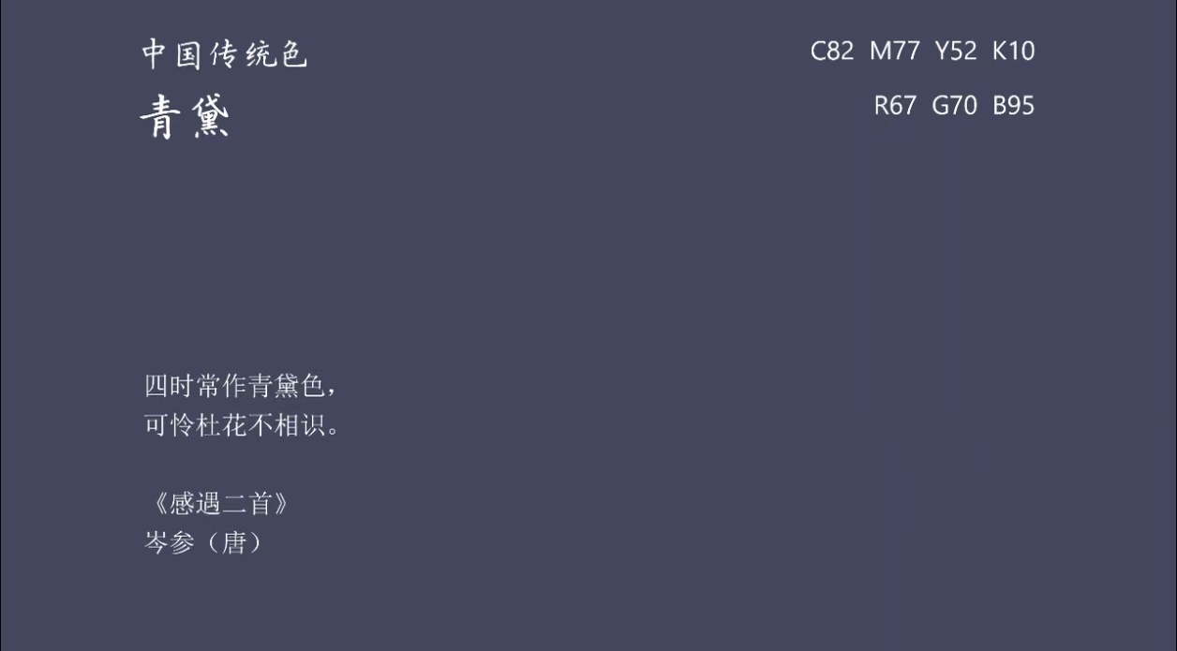
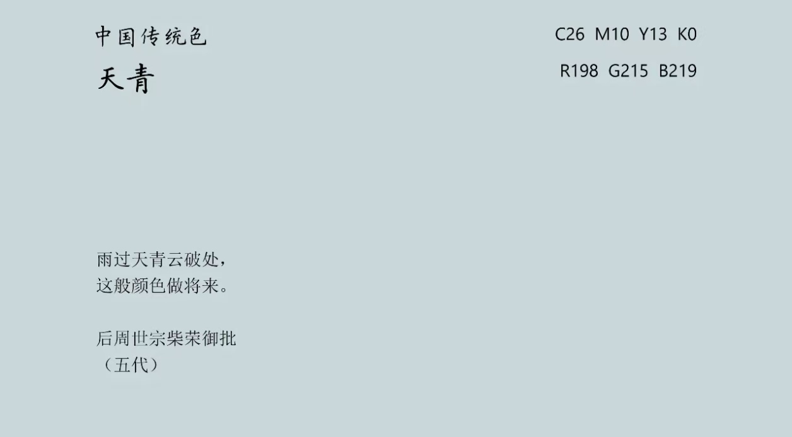
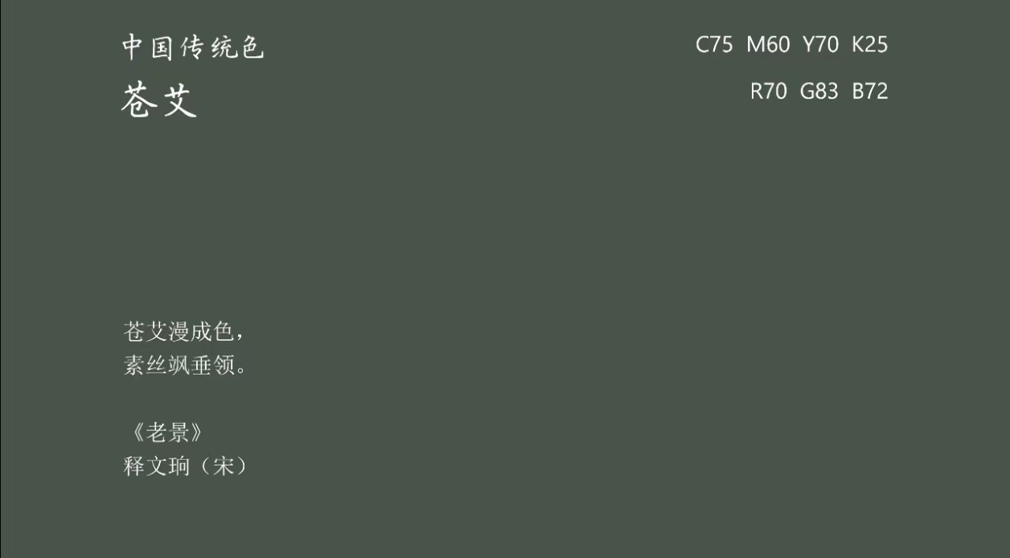
Classification and Poetic Interpretation of Traditional Colors
Colors of Plants, Trees, Mountains and Rivers
青黛
天青
苍艾
远山如黛，是青山浓绿的色泽
雨过天青云破处，极致清雅的淡蓝
天地苍茫之色，涵盖浅青灰调，自带辽阔大气的东方意境

Slide 10
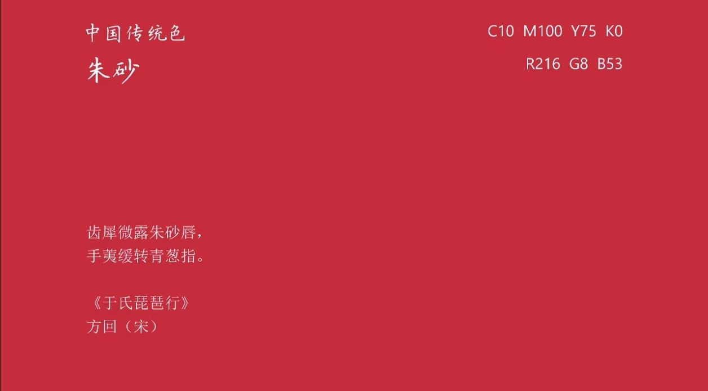
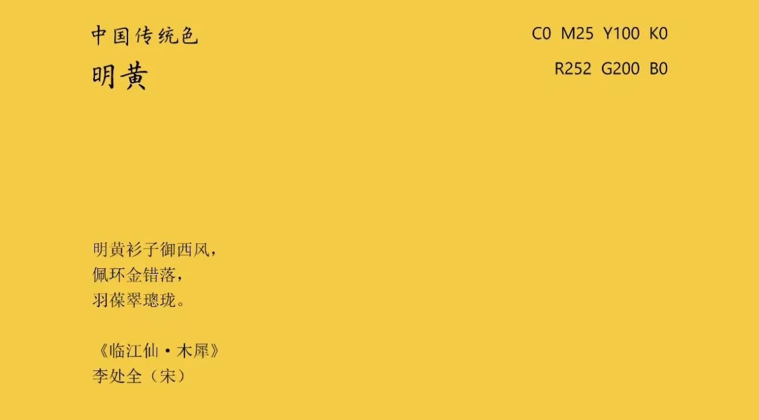
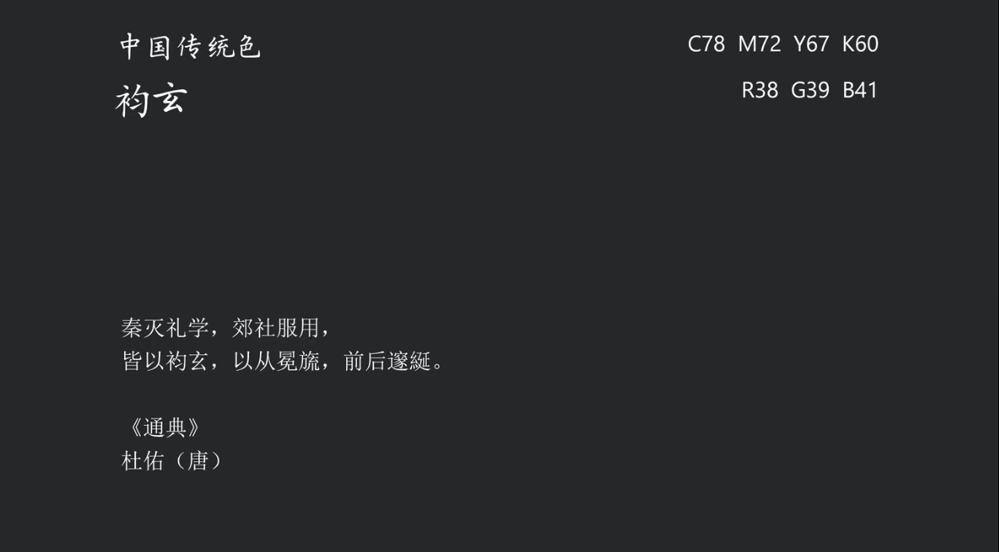
Classification and Poetic Interpretation of Traditional Colors
The canonical colors of ritual etiquette
朱砂红
明黄
玄黑
正统中国红，古朴厚重，用于宫墙、印章、春联
帝王正统之色，尊贵典雅
天地本源之色，沉稳肃穆

Slide 11
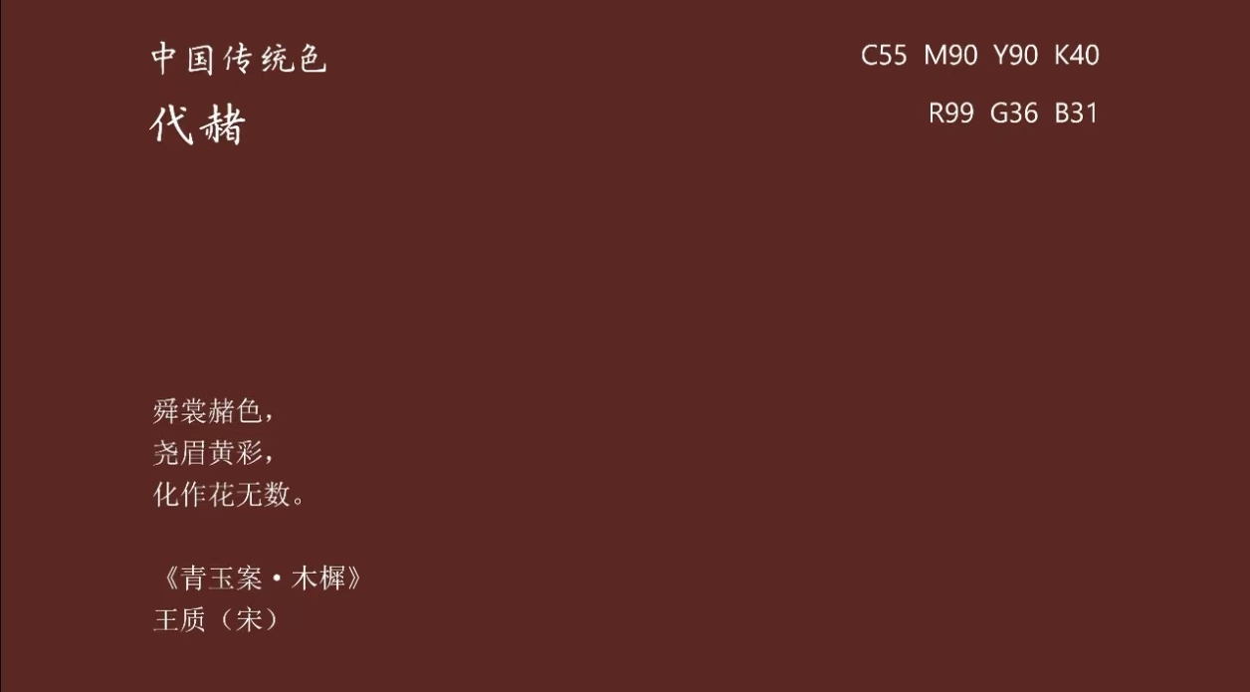
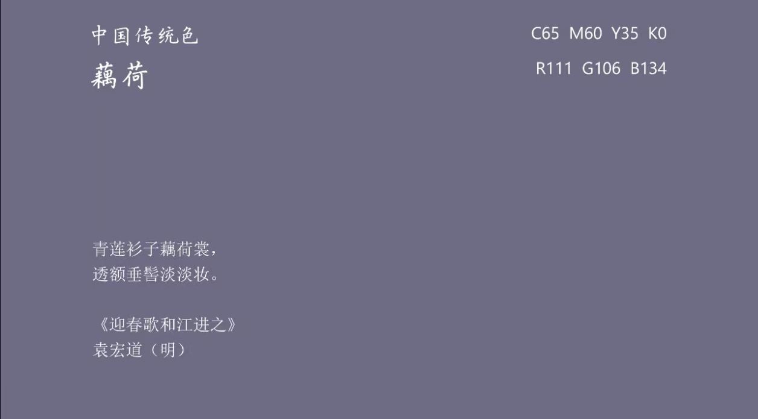
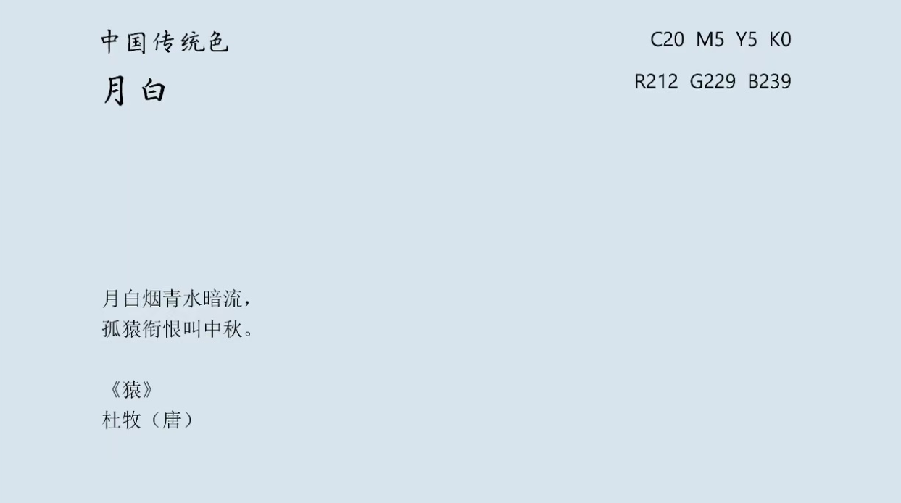
Classification and Poetic Interpretation of Traditional Colors
Colors of mortal grace
代赭
藕荷
月白
大地草木的暖棕色调，质朴温润
浅粉淡紫，柔和温婉
月光澄澈的淡青白，干净通透

Slide 12
The Contemporary Revival and Application
some examples
part4

Slide 13
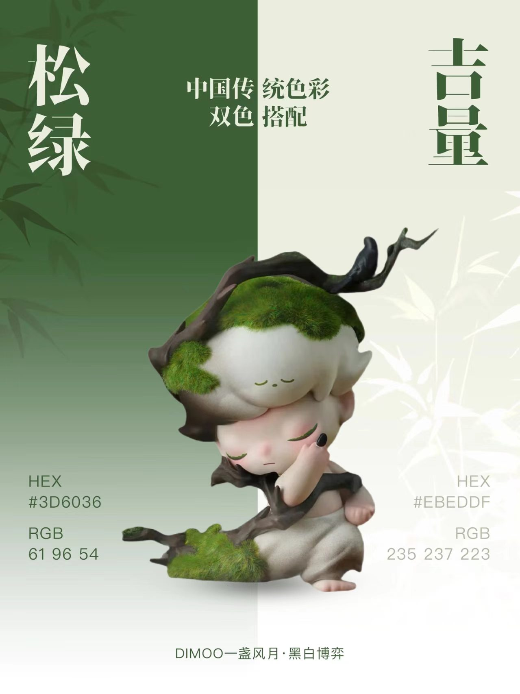
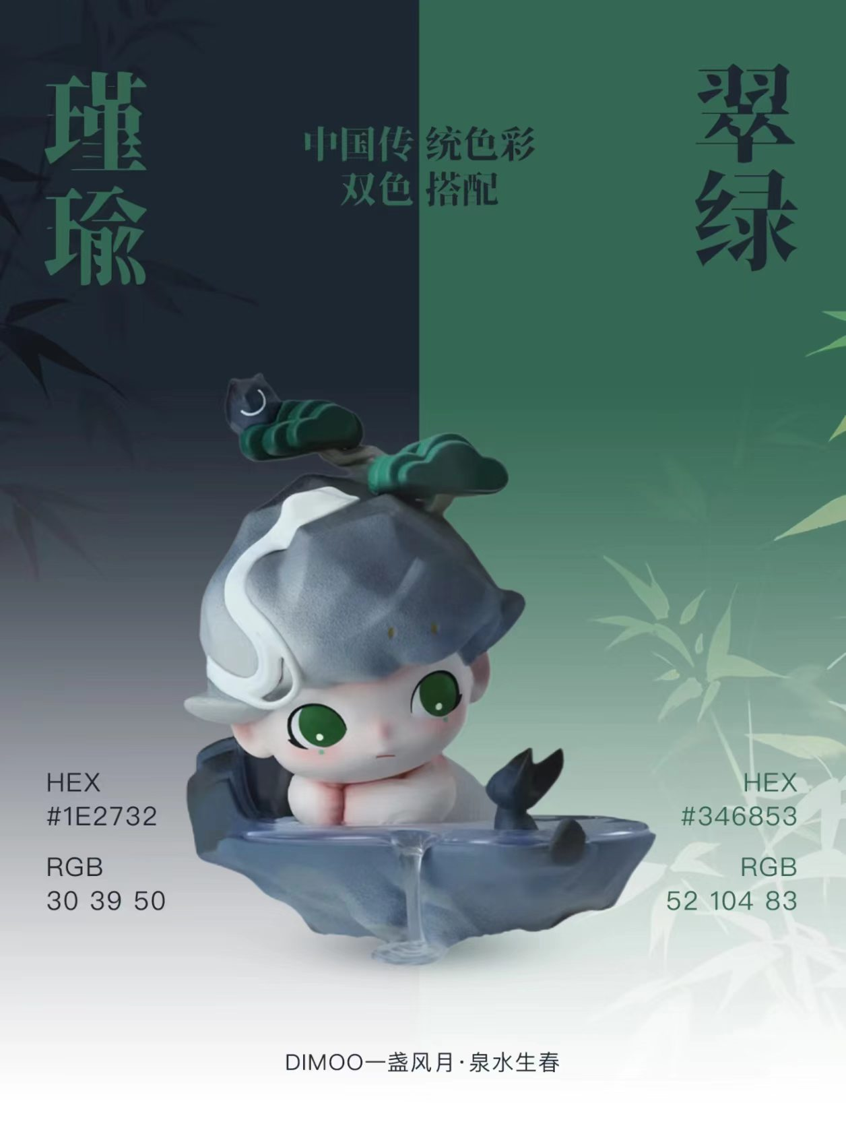
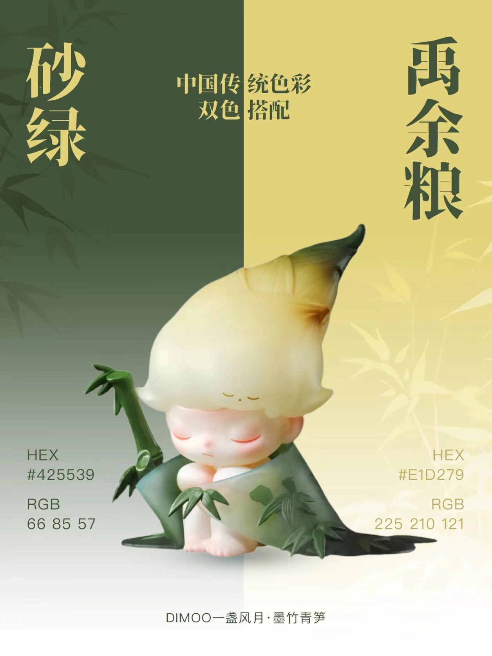
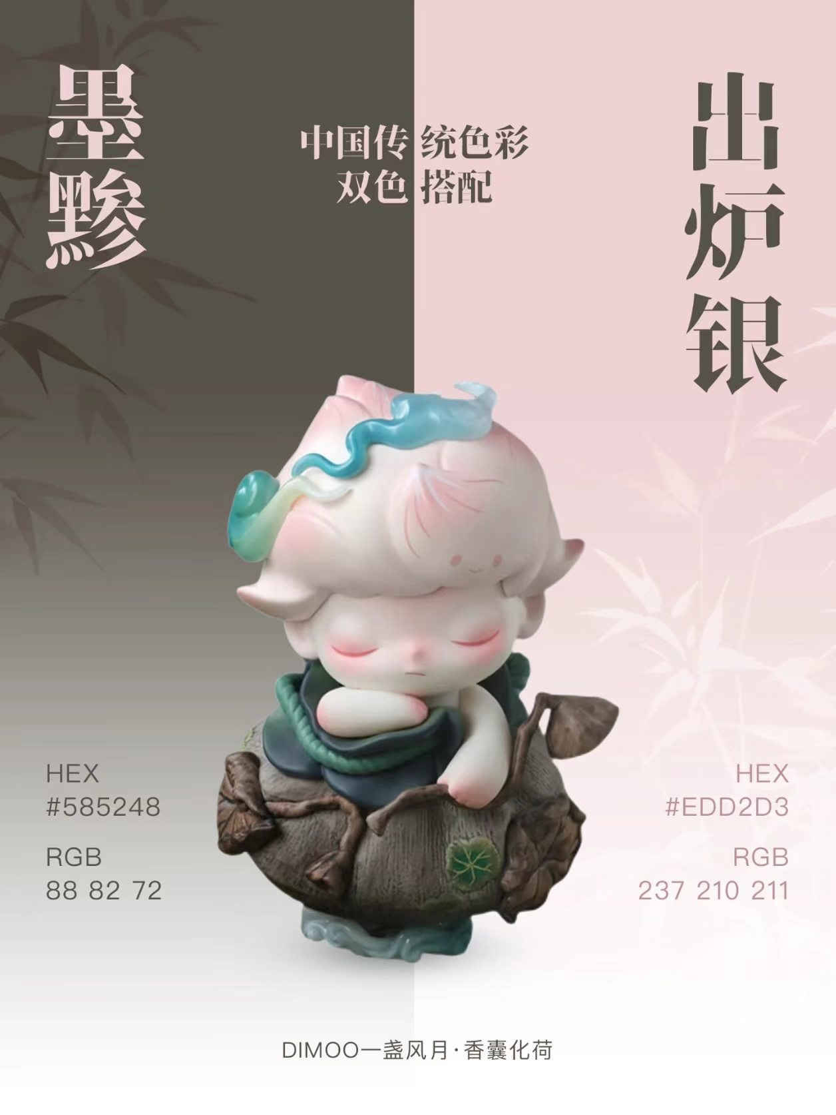
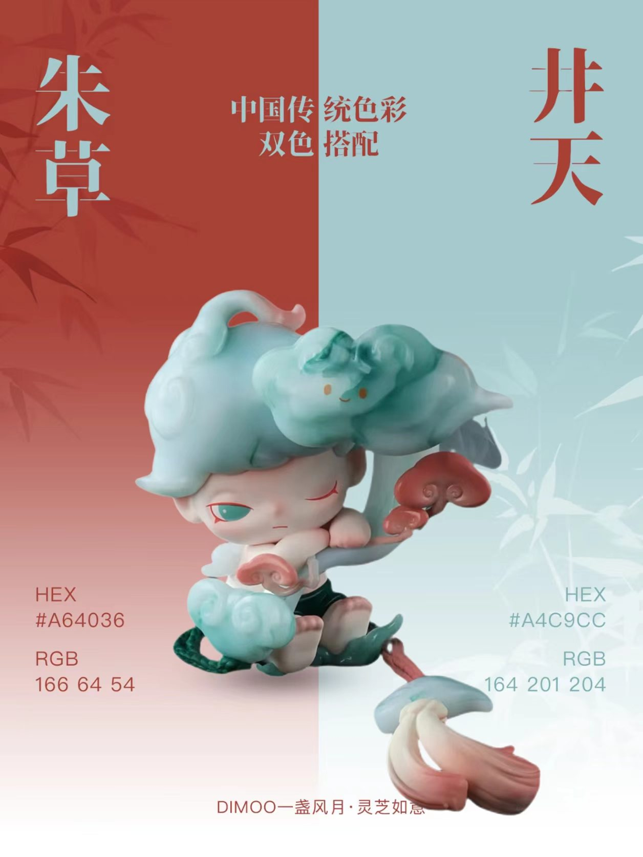
The Contemporary Revival and Application
of Traditional Colors
POP MART
DIMOO

Slide 14
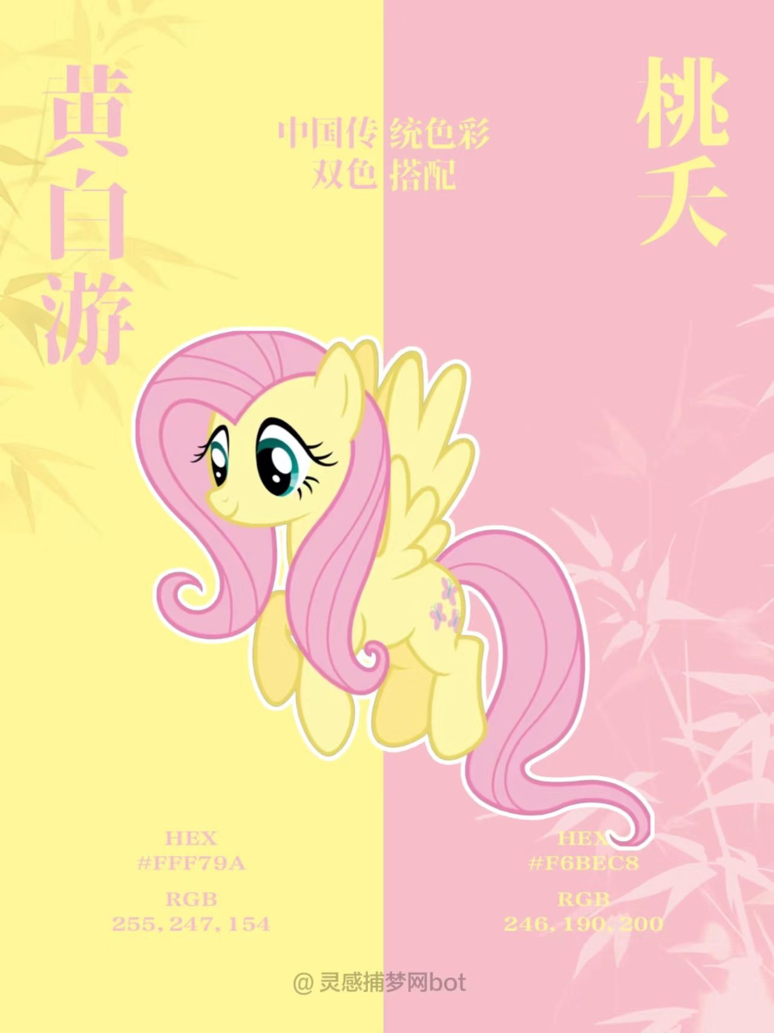
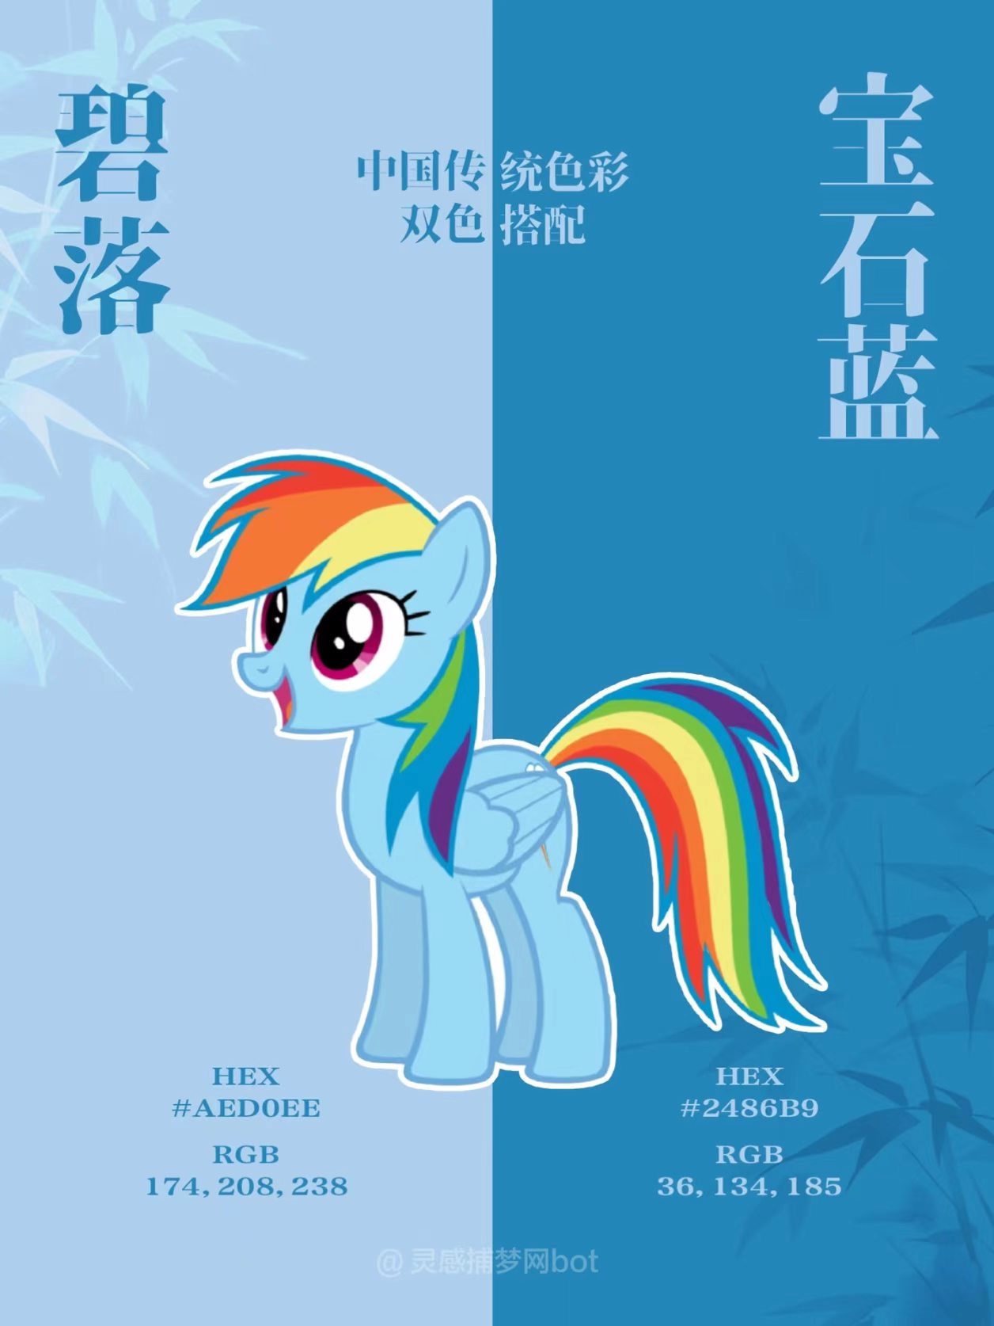
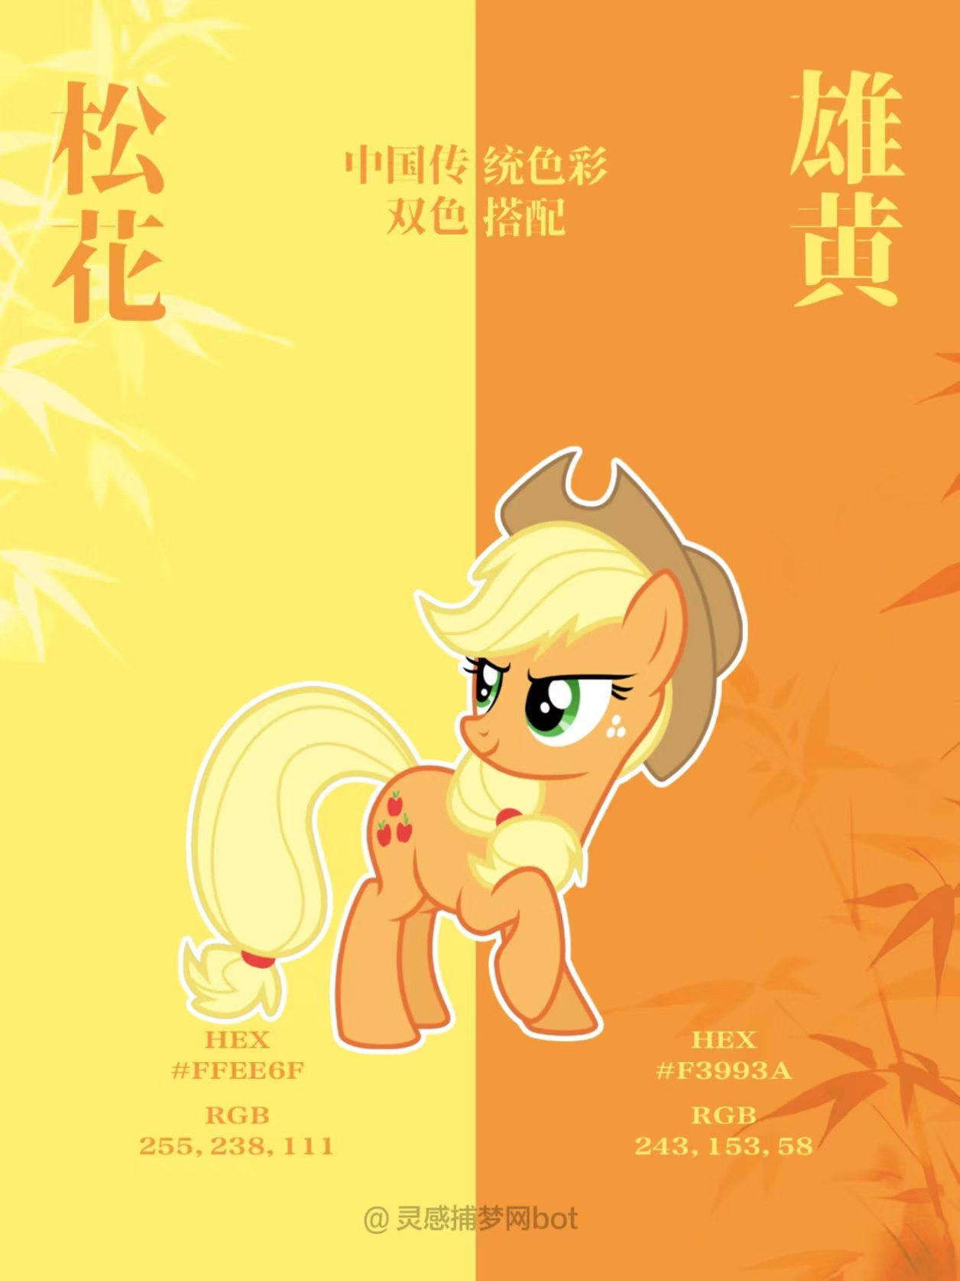
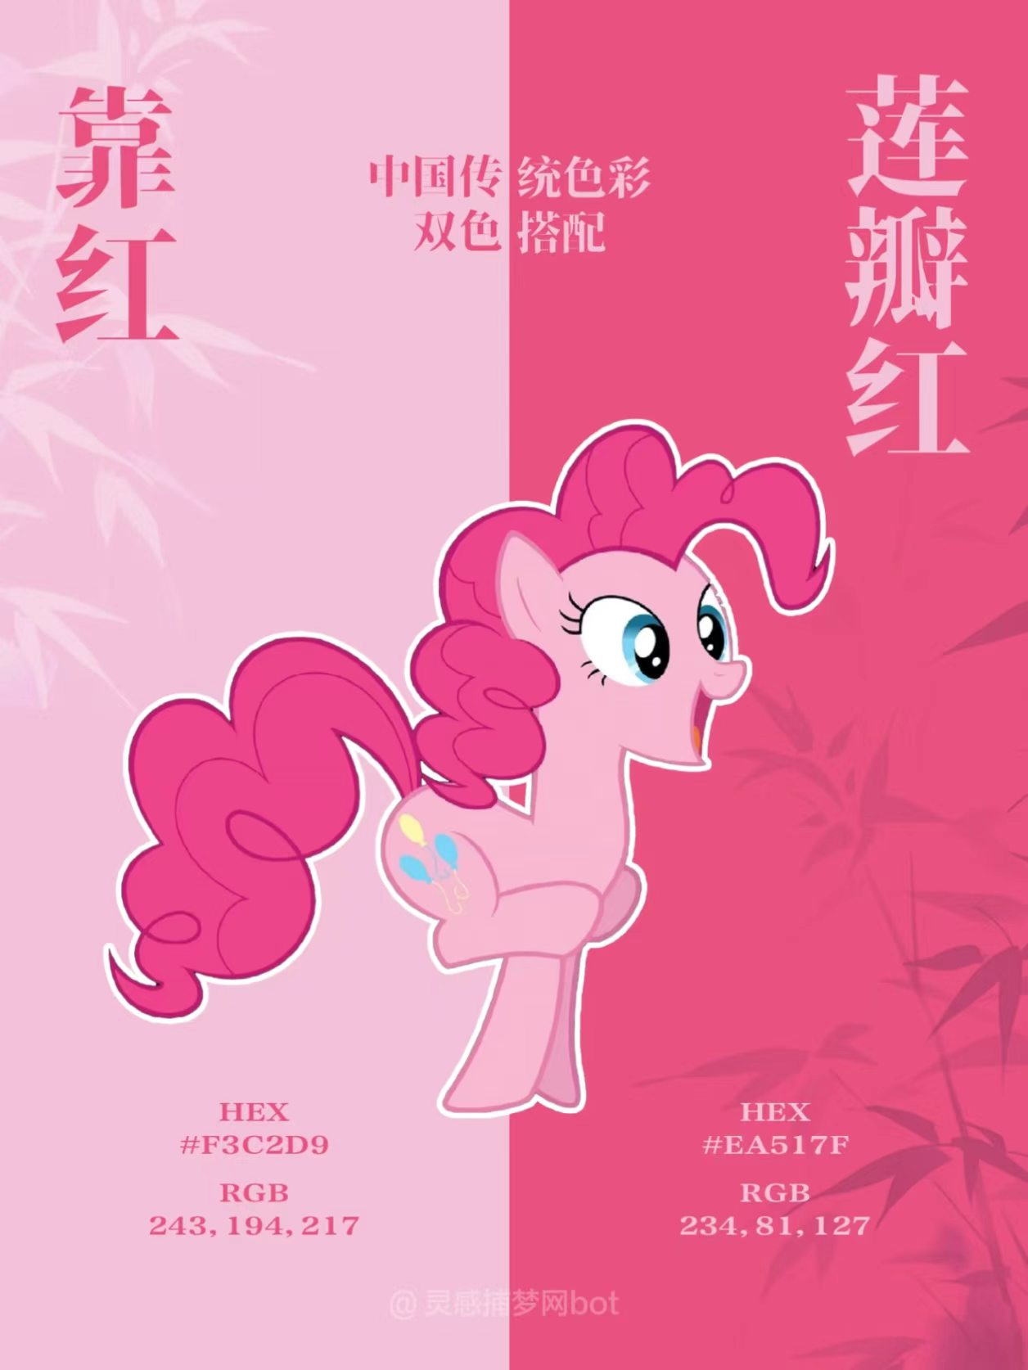
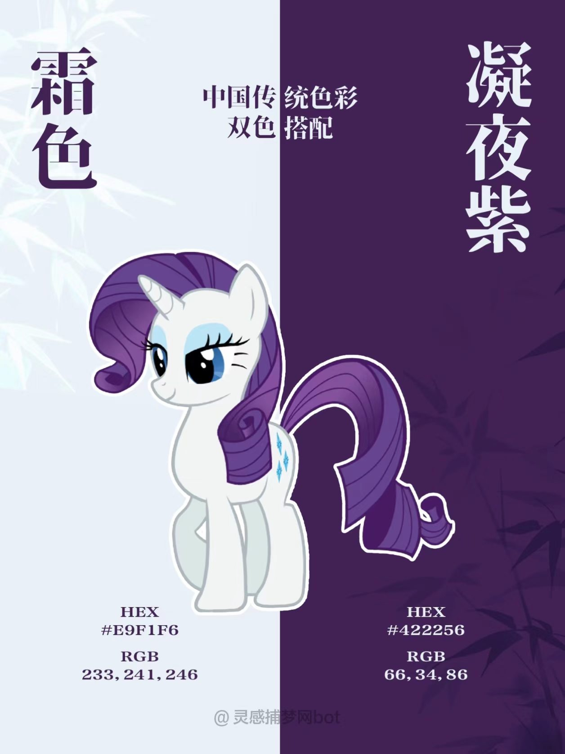
The Contemporary Revival and Application
of Traditional Colors
小马宝莉

Slide 15
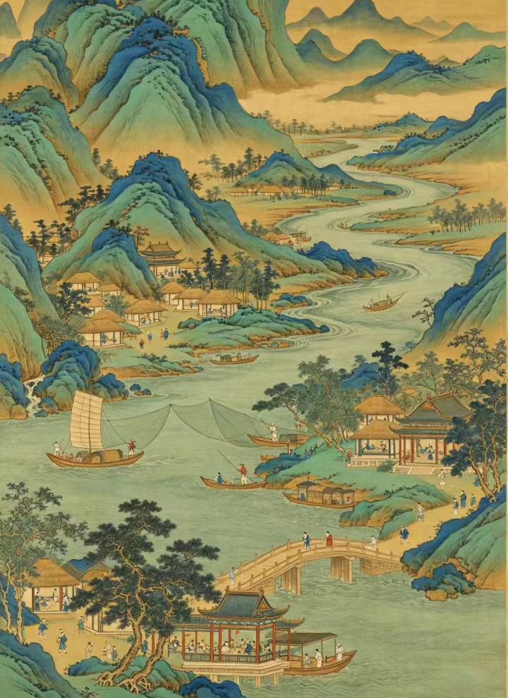
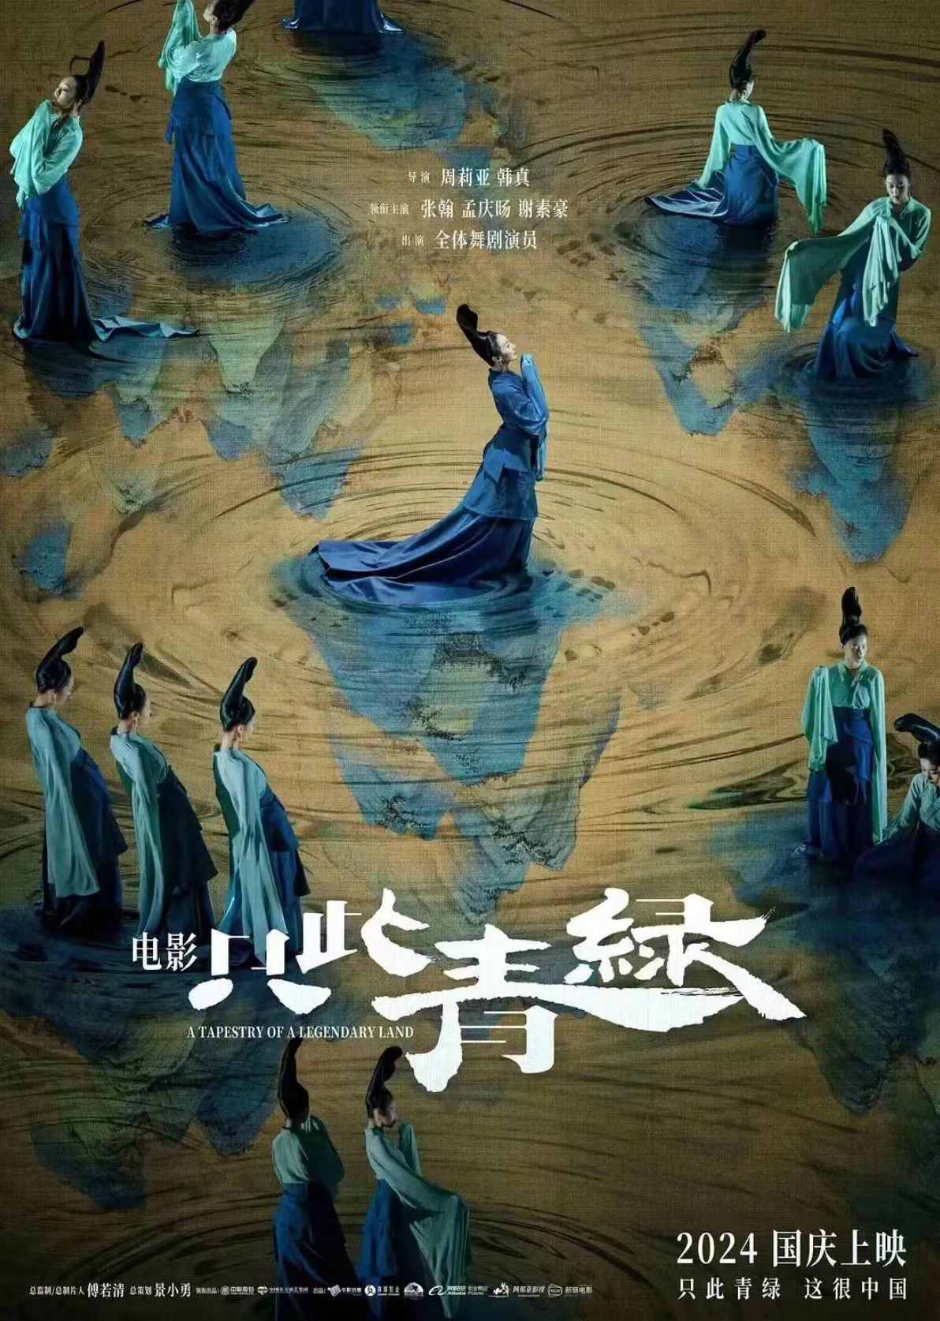
The Contemporary Revival and Application
of Traditional Colors
The dance Only Green has brought traditional Chinese colors to life, turning them into a shining cultural calling card for China. Through this stunning performance, the world gets to see the beauty of Eastern aesthetics, strengthening our cultural confidence along the way.

Slide 16
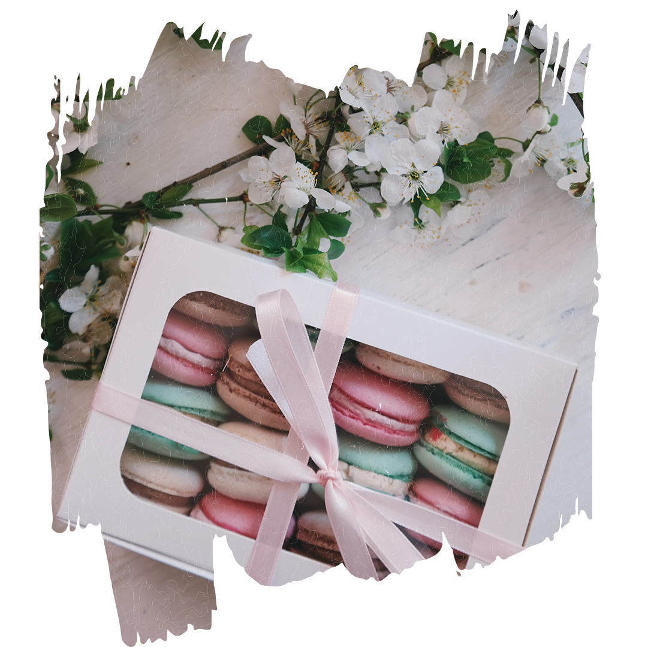
Conclusion
Traditional Chinese colors are the romance and grace carved into the very soul of the Chinese nation. A touch of green, a dash of red, a stroke of black, a hint of white—all born from the land and rivers, holding within them a thousand years of ritual and humanity. They have never faded into the pages of old books or relics; instead, they glow with new life in the modern age, weaving into every corner of our lives. To read these colors is to read the poetry of China, and to carry forward the pulse of Eastern culture.

Slide 17
感谢观看
THANKS FOR YOUR LISTENING
申奕珂

