Slide 1

Baijia: The Debates of the 100 Schools
Unemployed scholars engage in unreasonable discussions -Mencius

Slide 2
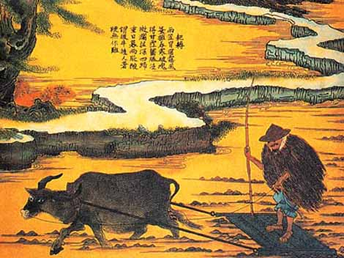
Outline
Confucianism (Most popular)
Mohism
Taoism
Legalism
Yangism
Yin-Yang School
Five Elements School
Not so Popular Schools
Agriculturalism
Military School
Logician
School of Minor Talks
Q: What do you know of any of these schools?
Q: Favorite School

Slide 3
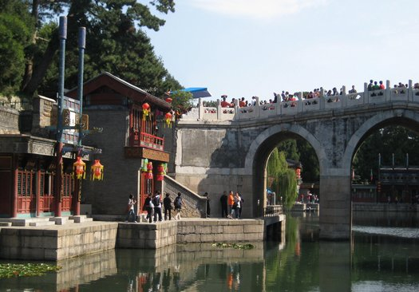
Confucianism – Confucius
Mencius is the most notable during this era.
Core concepts are humanism and society.
Ren - humanism
Yi – Upholding righteousness and morality
Li – Tradition or system of society
The Gentleman
Mandate of heaven
Q: What is the value of tradition?

Slide 4

Mohism – Mo Tzu
Core concept is universal love
Major rival to Confucianism
Very strict and Mo Tzu has most of the control
Luxury is of no use
Money must be put to good of people
Q: What is the value of culture, luxury, music, etc.?

Slide 5

Taoism – Laozi
The Universal Way and Harmony
Society
Lack of doctrine
Religion
Knowledge
Q: Why is this true? When you don’t work towards something only then does it unfold naturally (I.e. world)

Slide 6
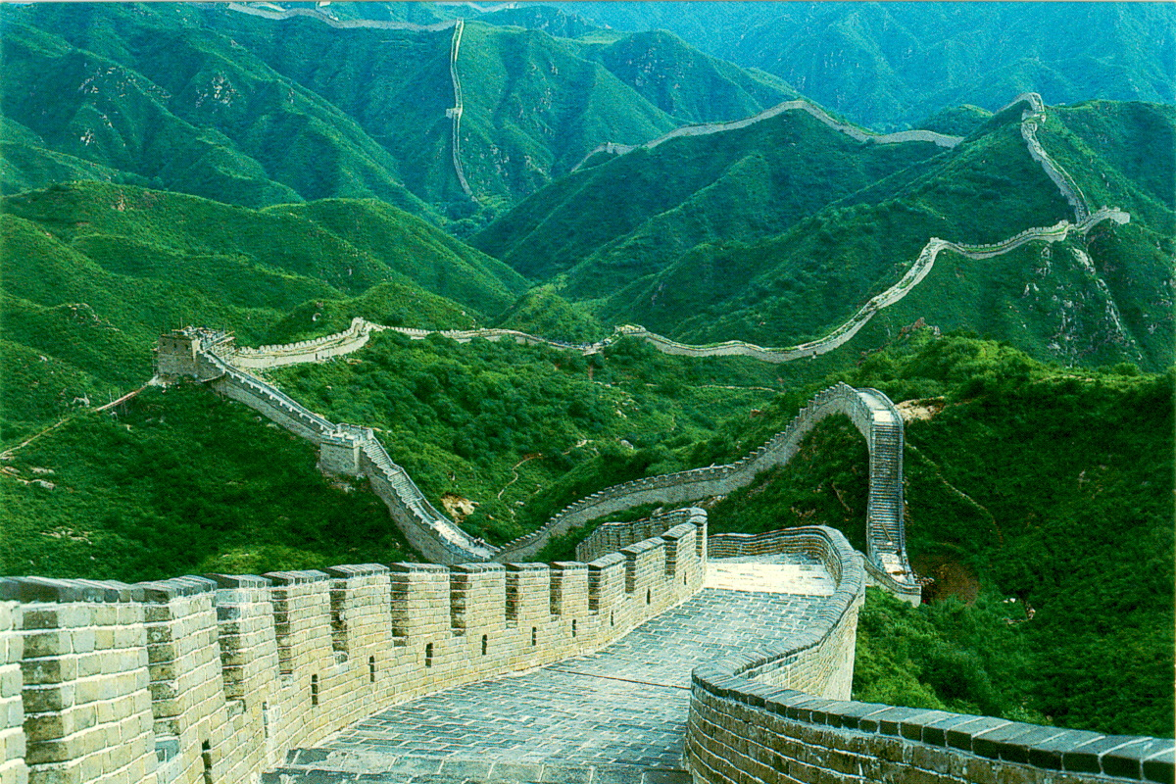
Legalism - Shang Yang
State power
Fa, Shi, and Shu
No individualism
Importance of Law
Ruler = non-activity
Q: What is the value and problems of laws?

Slide 7

Yangism – Yang Zhu
Individualism (Xing = human nature)
Opposite Monism
Didn’t survive the Qin Dynasty and was lost for awhile (Not originally included in 100 schools)
Q: What is the value of individualism?

Slide 8

The End
Destruction by the first emperor in the Qin Dynasty. Resulted in Legalism and Confucianism used by the ruler. Later Confucianism, Taoism, Legalism would become the most popular schools and in some cases became no longer separate. The naturalist schools as well as a few others are absorbed into the main Chinese beliefs.
Q : Should this have ended?
Specification or no specification? What is the value in each?
Favorite School?

