Slide 1

Pandas
Presentor:Wang Yihan

Slide 2

High in dense bamboo forests in the misty, rainy mountains of southwestern China lives one of the world's rarest mammals: the giant panda, also called the panda. Only about 1,500 of these black-and-white bears survive in the wild.

Slide 3
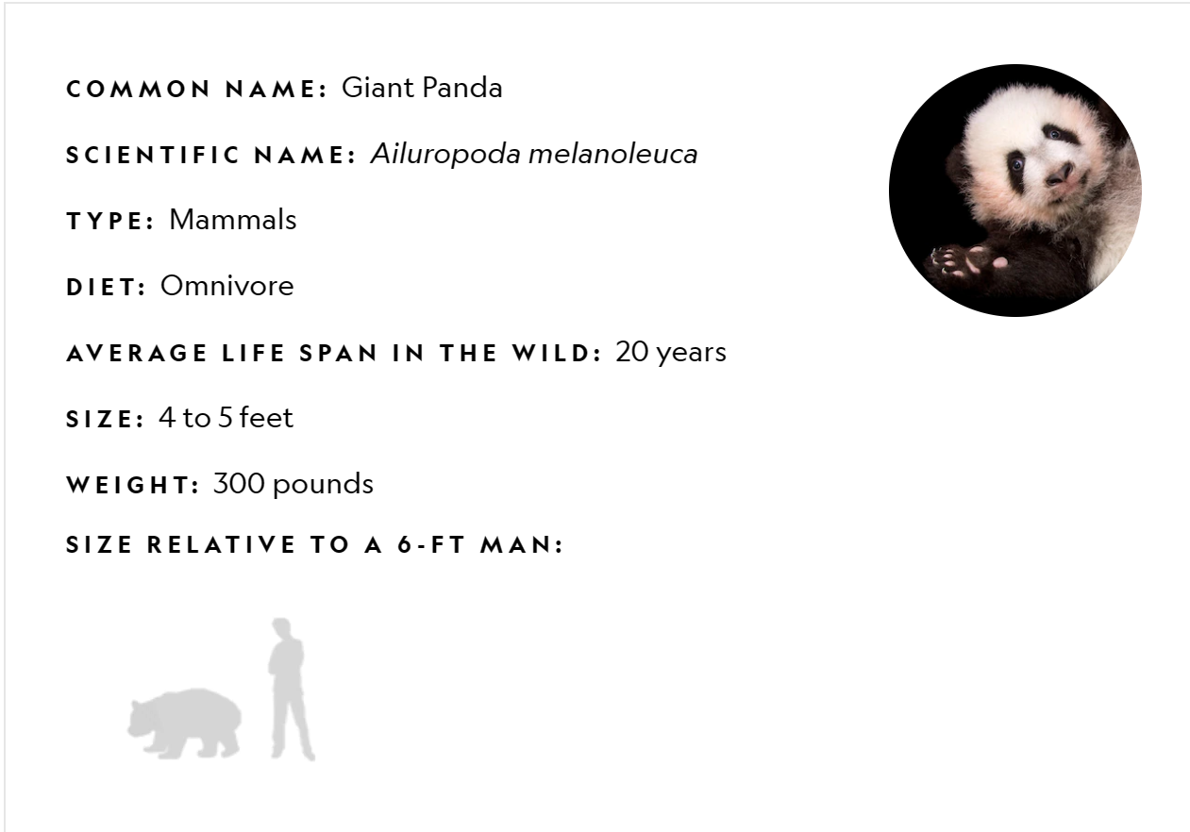

Slide 4
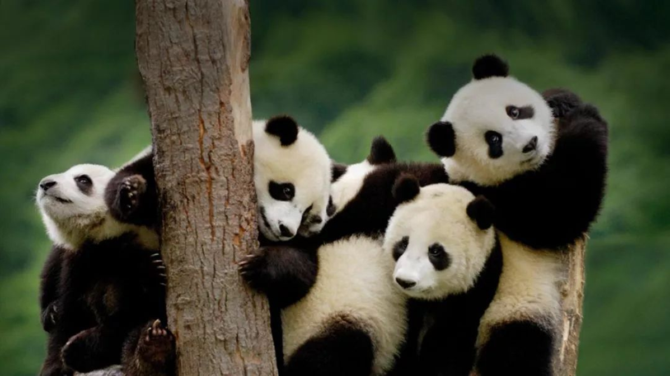
The 6 long and narrow areas where giant pandas live, including Minshan, Qionglai, Liangshan, Daxiangling, Xiaoxiangling and Qinling Mountains, spans 45 counties (cities) in the 3 provinces of Sichuan, Shaanxi and Gansu.
The land area of their habitats is more than 20, 000 square kilometers, and the population of there is about 1, 600, of which more than 80% are distributed in Sichuan.
Pandas are shy; they don't venture into areas where people live. This restricts pandas to very limited areas.

Slide 5
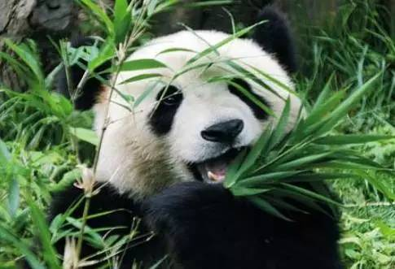
Pandas eat almost nothing but bamboo shoots and leaves. Occasionally they eat other vegetation, fish, or small mammals, but bamboo accounts for 99 percent of their diets.
Pandas' molars are very broad and flat. The shape of the teeth helps the animals crush the bamboo shoots, leaves, and stems that they eat. They can chomp on bamboo up to one-and-a-half inches thick.

Slide 6
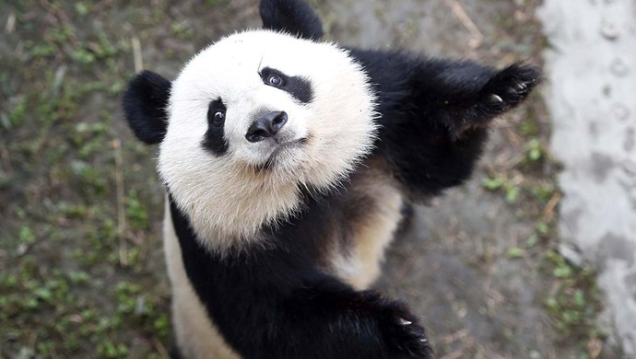
Pandas eat fast, they eat a lot, and they spend about 12 hours a day doing it. The reason: They digest only about a fifth of what they eat. Overall, bamboo is not very nutritious. To stay healthy, they have to eat a lot—up to 15 percent of their body weight in 12 hours—so they eat fast.

Slide 7
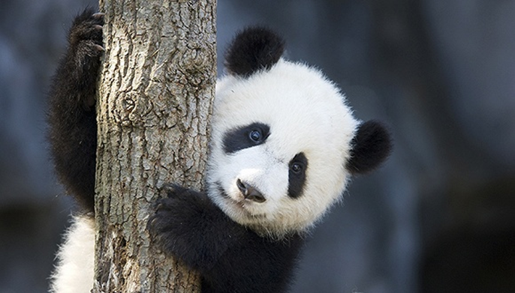
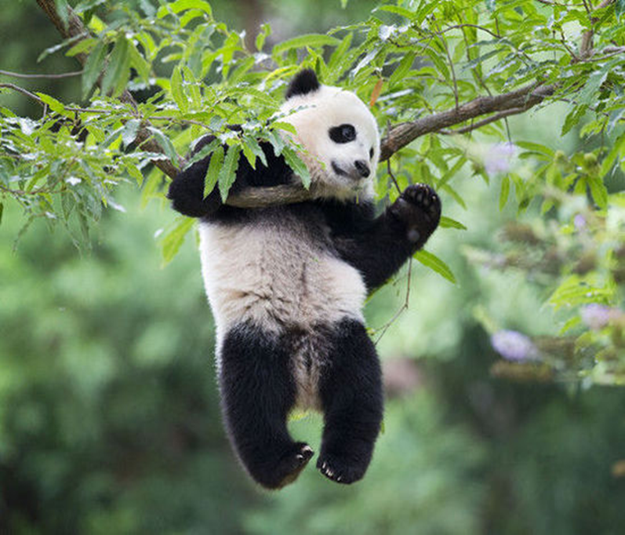
Wild pandas live only in remote, mountainous regions in central China. These high bamboo forests are cool and wet—just as pandas like it. They may climb as high as 13,000 feet to feed on higher slopes in the summer season.
Pandas are often seen eating in a relaxed sitting posture, with their hind legs stretched out before them. They may appear sedentary, but they are skilled tree-climbers and efficient swimmers.

