Slide 1
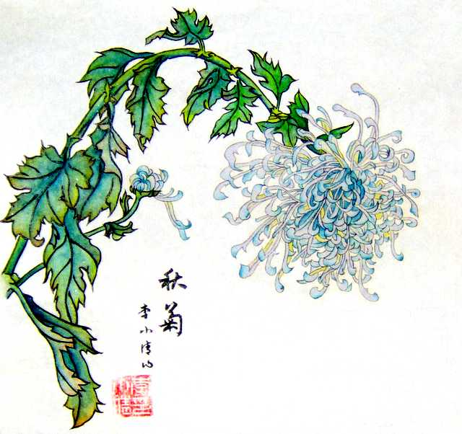
Tao Qian
Tao Yuanming
By: Arnold Qin
Notes:
Qian = “hiding”
Name changed after the end of the eastern Jin dynasty.
Also known as Master of the Five Willows

Slide 2
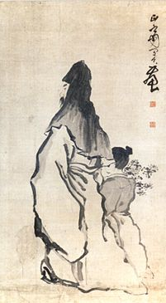
Life
Born in 365(CE) in Chaisang
Prominent southern noble family
Justification to leave office
405 – Sister died
“Neo-Taoist”
Death in 427.
Notes:
Served many posts, but none of high positions
-served many years
- Both civil and military
Last position was of county magistrate at Pengze (not far from hometown)
During this period of service in a series of minor posts, Tao Yuanming's poems begin to indicate that he was becoming torn between ambition and a desire to retreat into solitude.
One source states that Tao was the first Chinese poet to grapple with the justification of my decision to withdraw from office. [Nienhauser, 193]
405 –death: resignation
My disgust at the corruption and infighting of the Jin Court prompted me to resign.
I had become convinced that life was too short to compromise on my principles.
Last 22 years of life I lived in retirement.
I have a personal inclination towards a private life of leisure and spontaneity.
Great grandfather: Tao Kan
- native of south
some say not Han
Had 5 sons
Neo Taoism because at the time everyone was tired of Confusism (dull, success oriented). Throw in Buddist discourses and you get a weird mix.

Slide 3
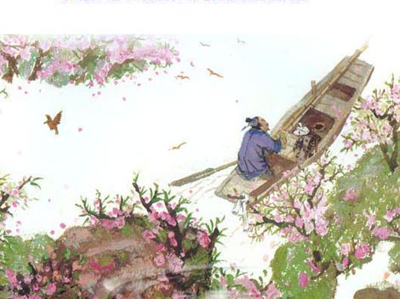
Poetry
Reclusion
“Autobiography”
– highly self-constructed image with integrated narrative element
Defense of private values against public values
The Record of Peach Blossom Spring
Notes:
What is reclusion?
Frederick Mote:
“in Chinese society... [terms designating recluses] signified withdrawal from the active
public life in the service of society that Confucian ethics prescribed as the most suitable
course for all whose abilities, cultivation, and learning qualified them for it. To bar one's gates
and earn one's own living without reliance on the emolument of office, to display
a lack of regard for the social status which could be attained only by entering
officialdom, and to devote one's life to self-cultivation, scholarship or artistic pursuits
made one a recluse.”
Not the first to write about reclusion.
Transformed stock images and normal vocabulary = into highly personalized poetry.
It was during the Six Dynasties period where reclusion was positively valued, and in some cases highly sociable practice that continued to
evolve. [Swartz 80] I am considered a very significant figure in the history of reclusive poetry.
Alluded to the “here and now” and my particular circumstance rather then generic gentleman reclusion.
This had an impact in future poems, as short prefaces soon began to appear before poems and f, relating the real-life occasions of the composition.
I used simple language to record the events of my life, thoughts, and feelings. There was a lot of sophistication and emotion that my poetry captures, something others since have not been able to do.
I also introduced many new topics in my poetry, such as:
Begging
Moving
Encountering a fire
Harvesting dry rice
I was also the first to introduce calendar dates in my extremely long poem titles, something which has become a common practice.
As usual I am a very well read person, and my works contain references to previous works, like the analects.
-all the above was basically from book
-To me, personal fulfillment of happiness is more important than public life.
Poem: shangra la

Slide 4
Biographies - Introduction
History of the Liu Song (Song shu)
History of the Southern Dynasties (Nan shi)
History of the Jin (Jin shu)
Biography of Tao Yuanming
Notes:
Many direct and indirect sources of my characterizations or anecdotes that illustrate them are from my earliest biographies.
They provide accounts for my life and character, and for many people served as the principal guide to reading my works.
These biographies were written in the late fifth to the early seventh centuries. These documents have generally been accepted as fact and treated as primary sources. However, scholars in the future have studied these works against my own works, and it has since been revealed that many of them do not stand up to critical analysis, and they often contradict one another.
From this it is clear that these texts are based on how the author chooses to present my life, and which characteristic they wish to idealize.
-Example would be Records of the Grand Historian
- He would narrate one or two key scenes from the subject, so its like a half body portrait “image is not complete but personality is very vivid.”
All four have very similar content but the process of adding and deleting materials show a very different picture.
For example, in the Book of Song (first one) Shen Yue primarily uses stories where I am seen drinking, but still showing genuineness and candor. These two qualities would be further adapted as part of my image.
I am portrayed as a lofty recluse, very loyal to the Jin dynasty, one who drinks a lot and enjoys simple poetry.

Slide 5
Variations- manuscript Culture
Annotated works already exist
Projection of author’s view of me
Conventional ideas
“I gaze (or see) at South Mountain in the distance”
Notes:
Annotated works from authoritative scholars already exist, and they served as the foundation for most criticism and interpretation.
People pay more attention to the allusions, names, and analysis of the syntax in the annotations, but forget about the textual and manuscript variants – we taken them as records.
However, it is the variants that matter. They compete with each other, one trying to beat the other. Is there a legitimate, single, definite version of the text?
My poems have very many different versions that have been edited to server a particular aesthetic and ideological purpose.
However, we do not have the original manuscript authored by me, so we have to take every version into account.
There are many historical, ideological, and cultural contexts in the text.
However I am more complicated and more engaging then previously thought.
STATEMENT:
There are many different readings to this sentence, and Su Shi was confident that he had gotten the True meaning when he stated that “see” was more spontaious then “gaze”.
This is due to the importance of “possessing” in Song culture. People were anxious about the authenticity of texts and getting the genuine edition.
I am not a “eternal presence”, canonized by these authoritative and definitive texts.

