Slide 1


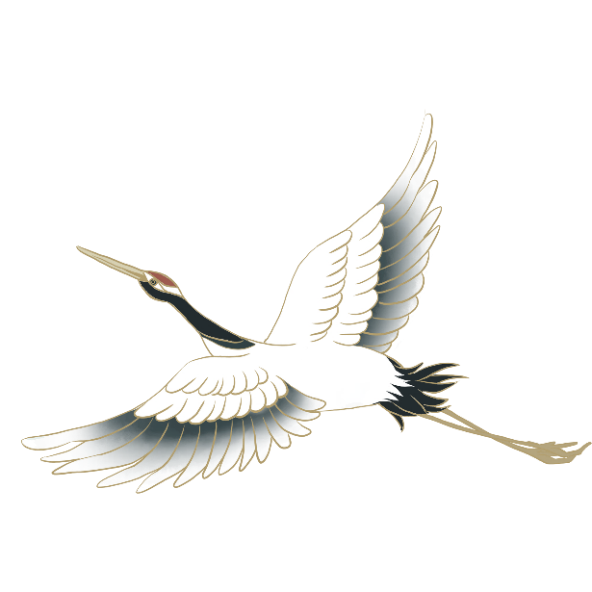

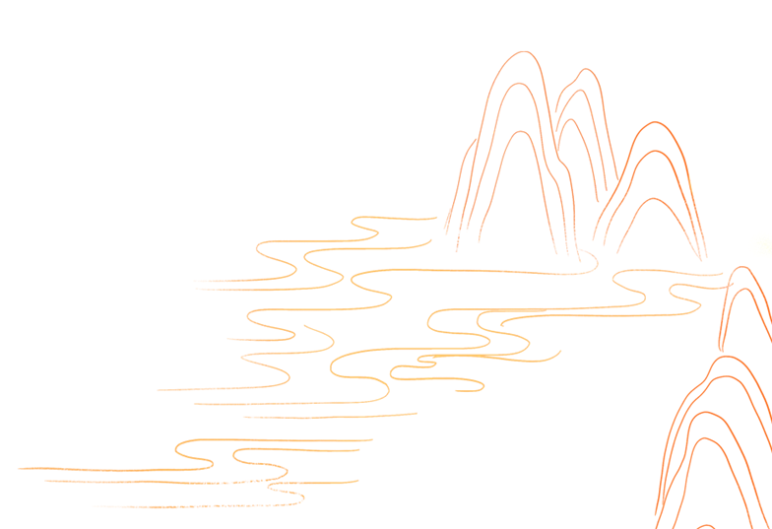

Minority Cultures
The Ethnic Minorities’Costumes
Speaker: Xiang Lu

Slide 2
Contents
Part 1
Features
Part 2
Traditional Celebration
Part 3
Connections
Part 4
Reflections

Slide 3
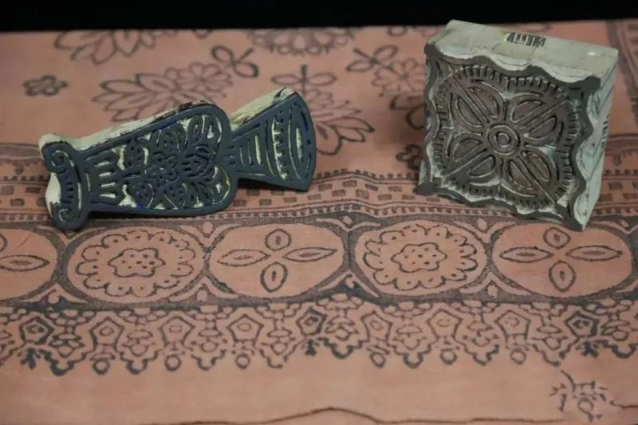
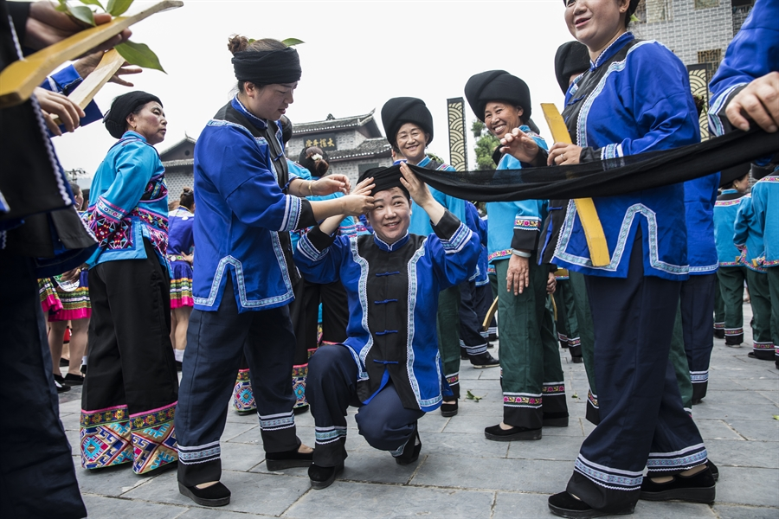
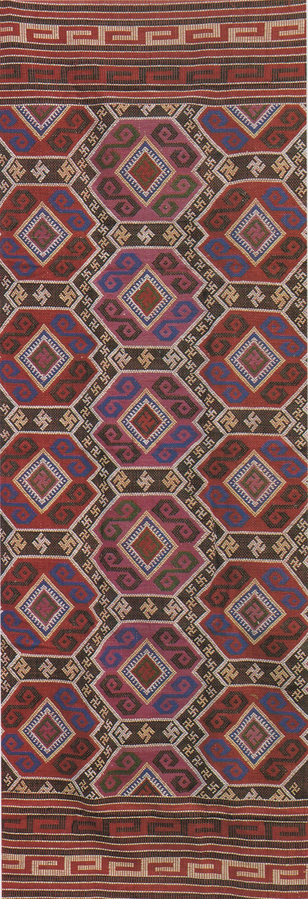
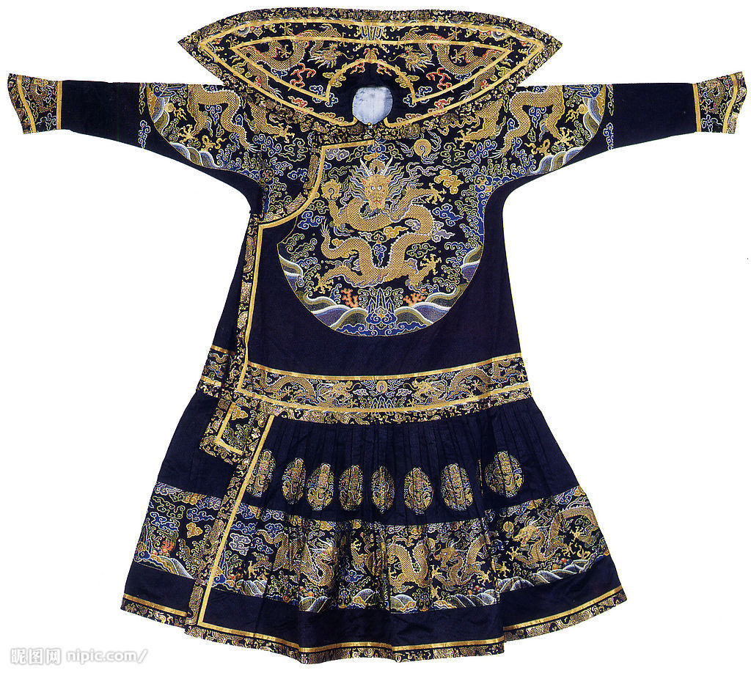
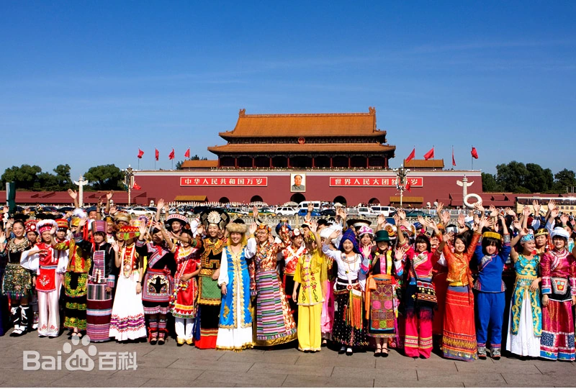
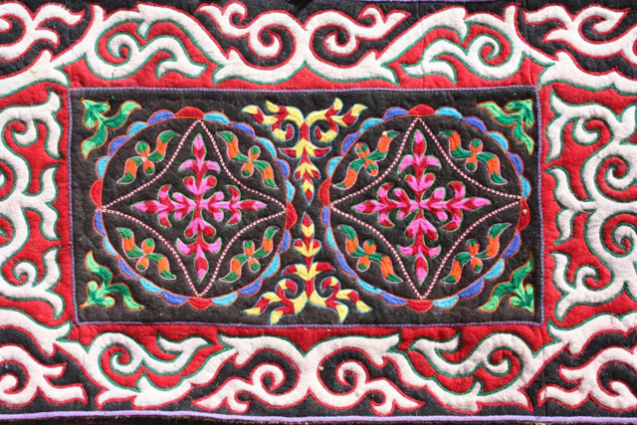
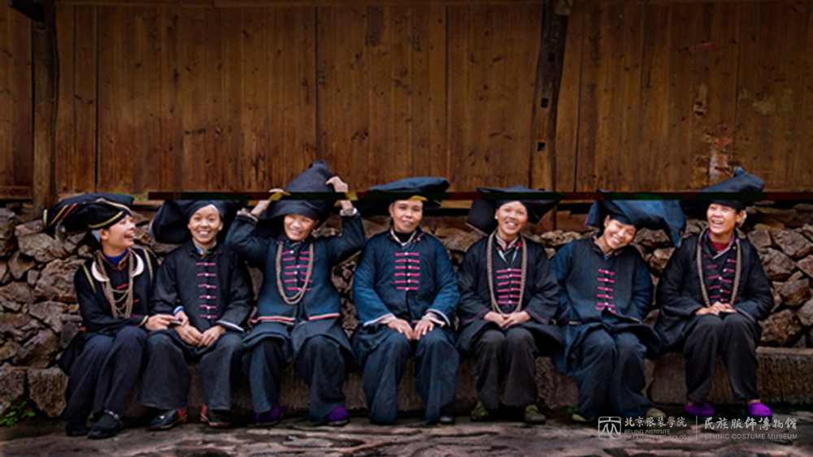
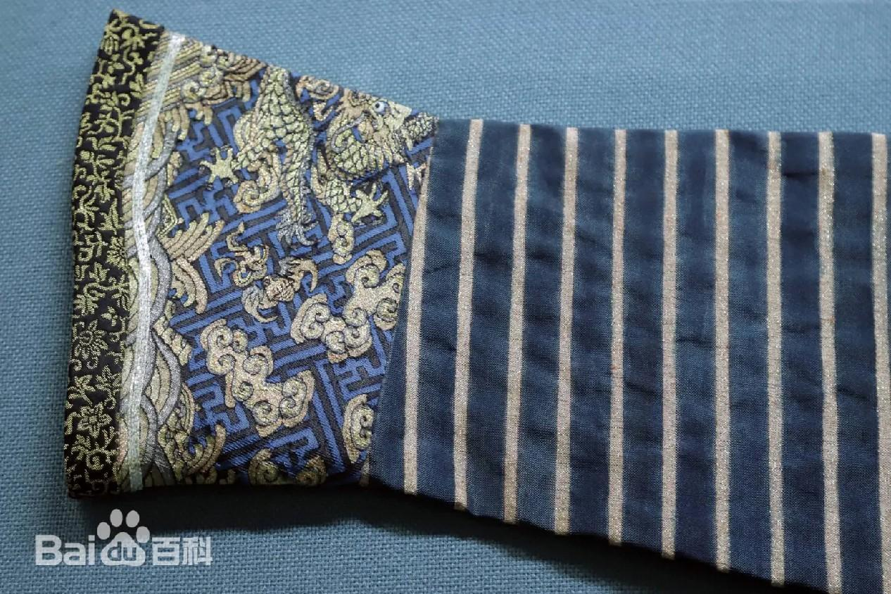
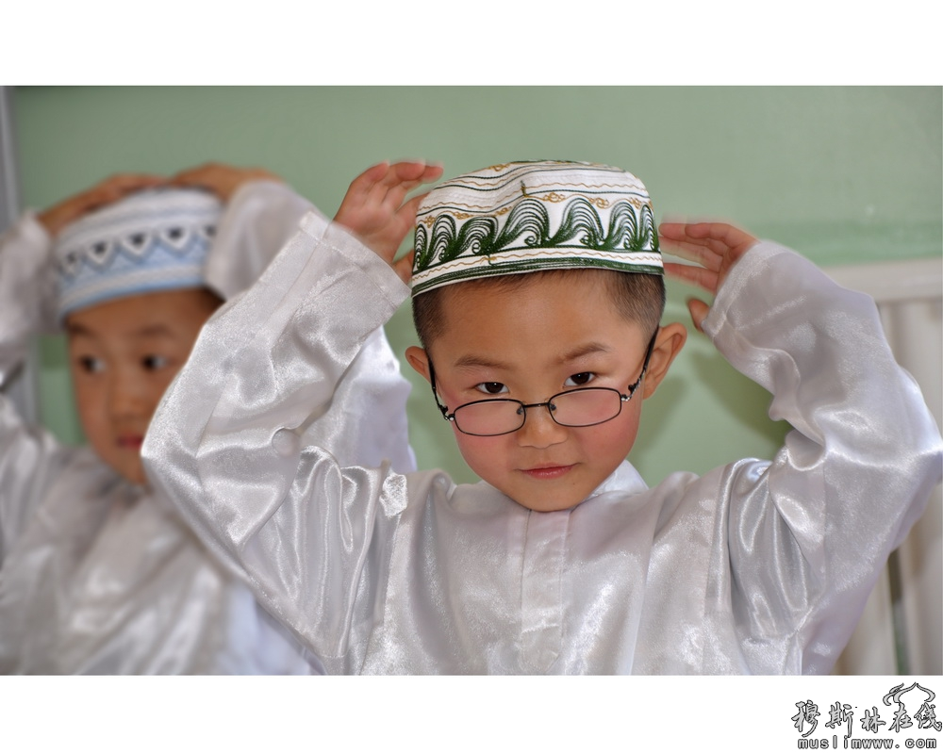
Part 1
Features
Utility:
Daily Wear Needs
Festive and Ceremonial Occasions
Regionality:
Northern Regions: Thicker and Warmer
Southern Regions: Lighter and Breathable
Diversity:
55 Ethnic Minorities
Ethnic Identity:
Aesthetic Values
Cultural Traditions

Slide 4
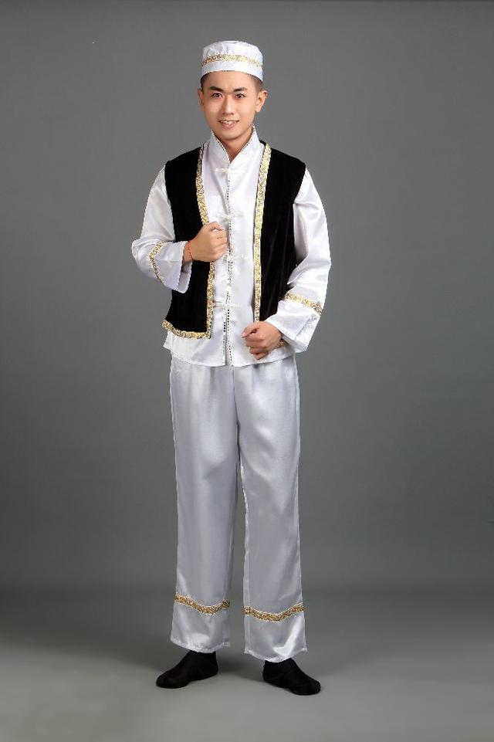
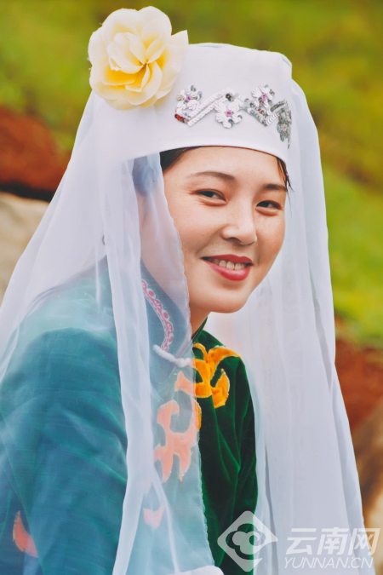
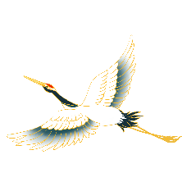
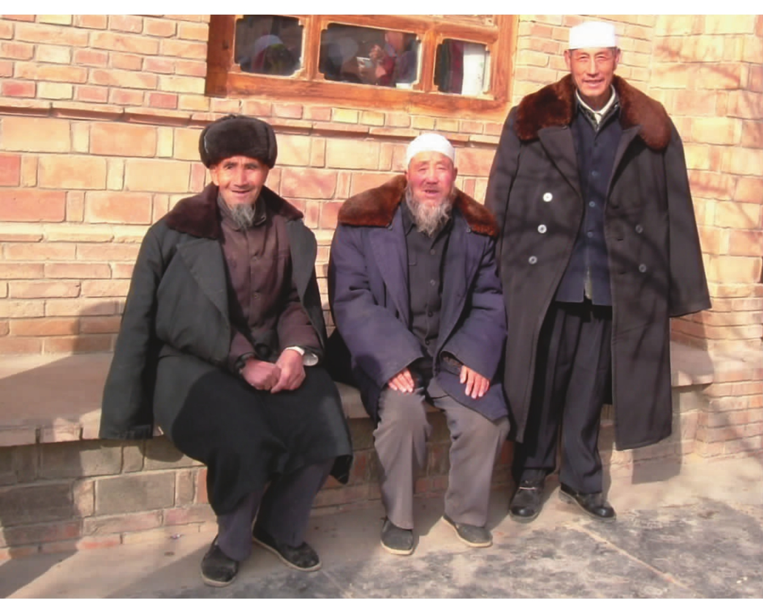
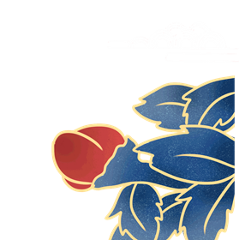
Part 1
Features
Simplicity and Comfort
White, Green, and Black
Summer: White Winter: Black and Purple
The Combination of A Top and Trousers

Slide 5
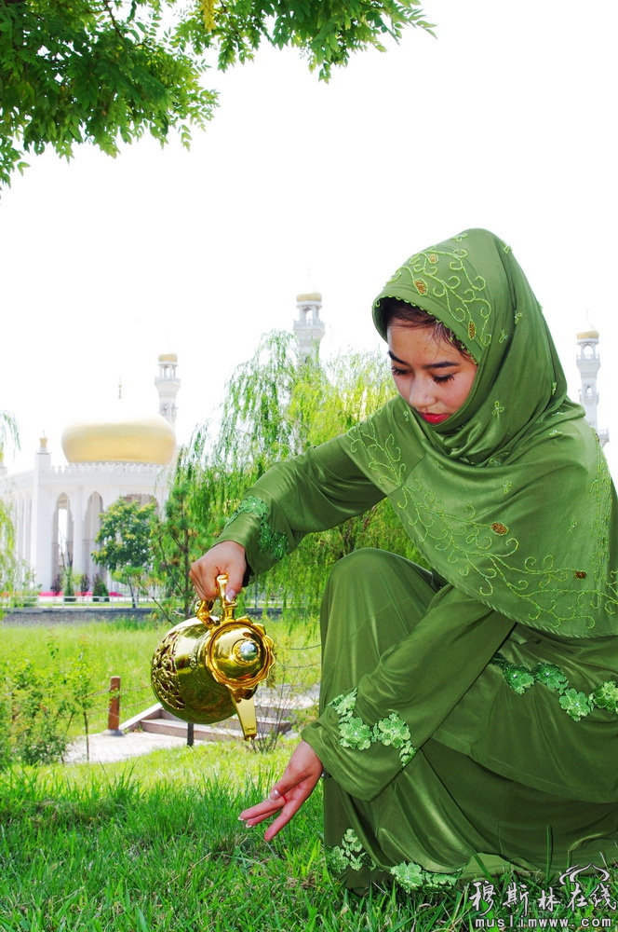
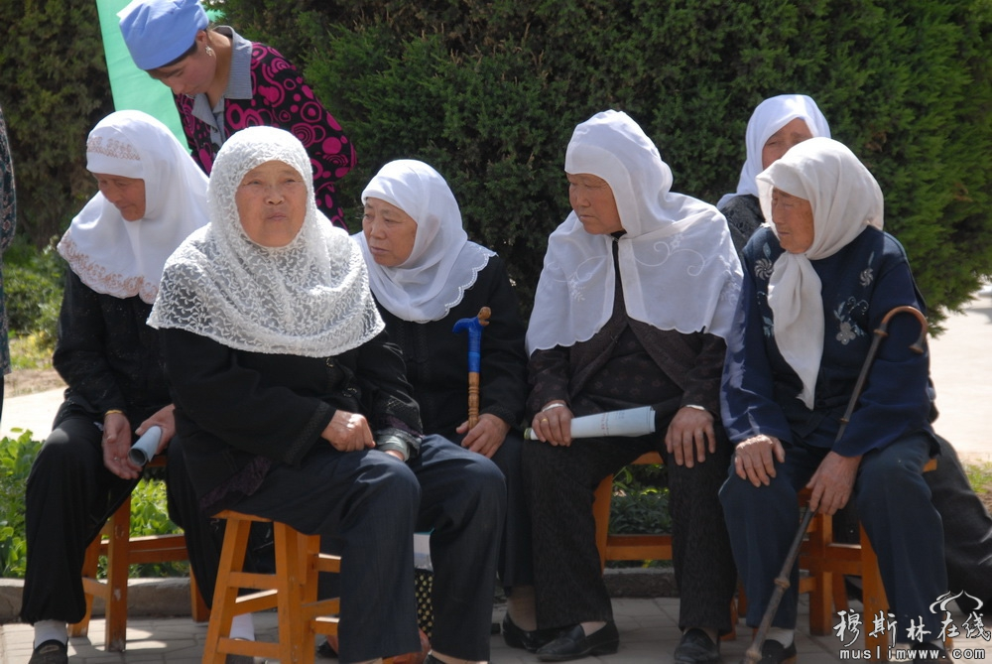
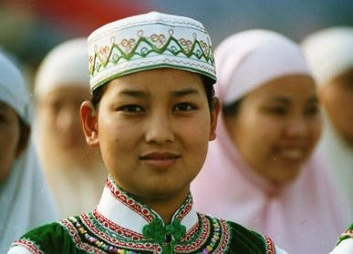
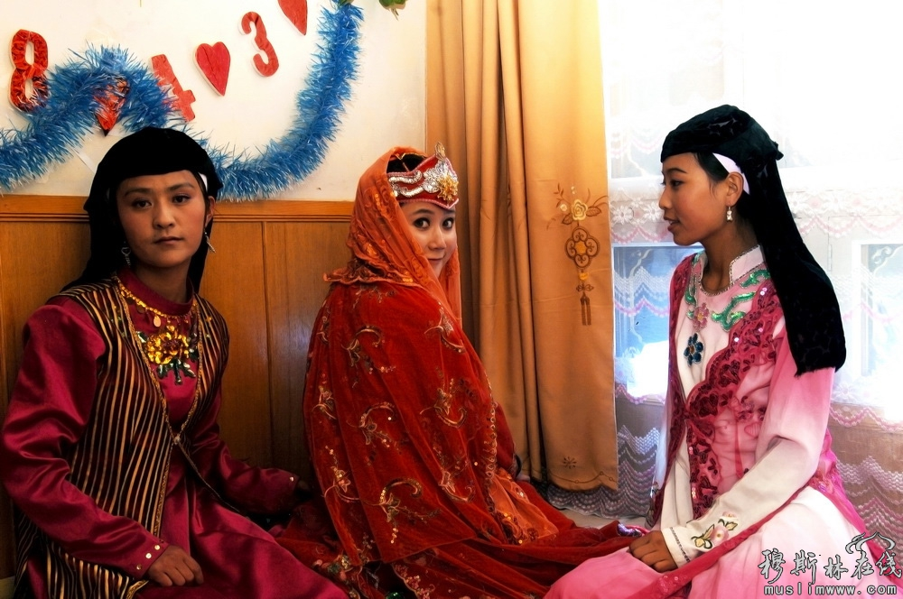
A comprehensive clothing system
Headwear:
Round Hat (Muslim cap/Hui hat)
Hijabs
Colour:
Green, Black and White

Slide 6
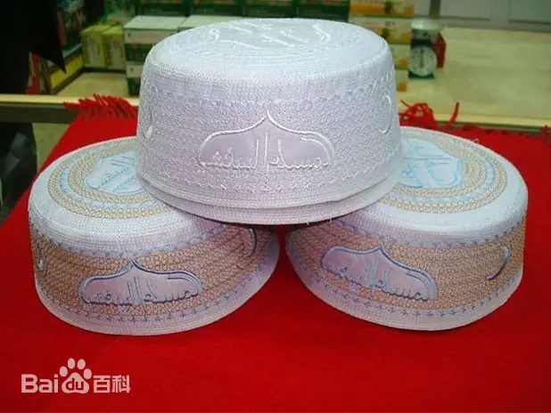
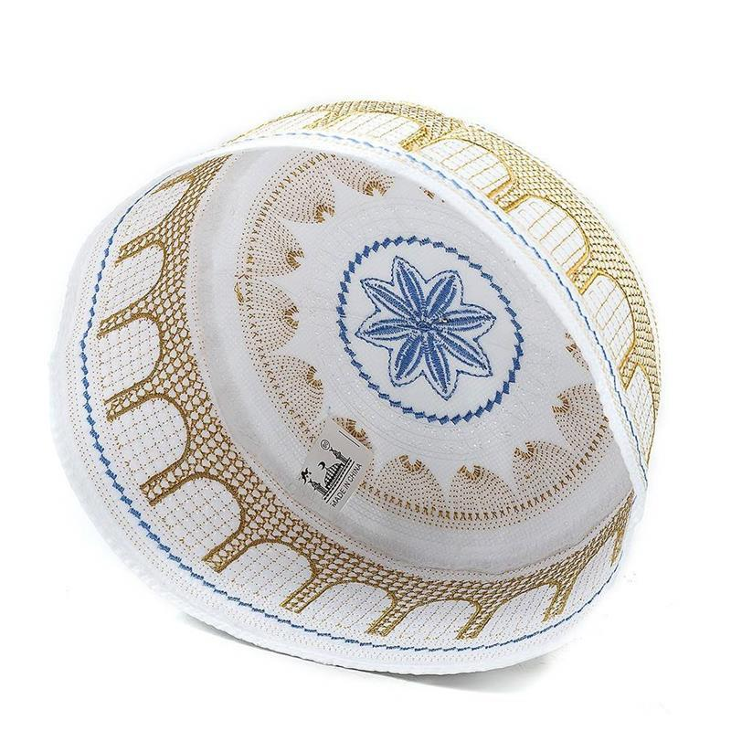
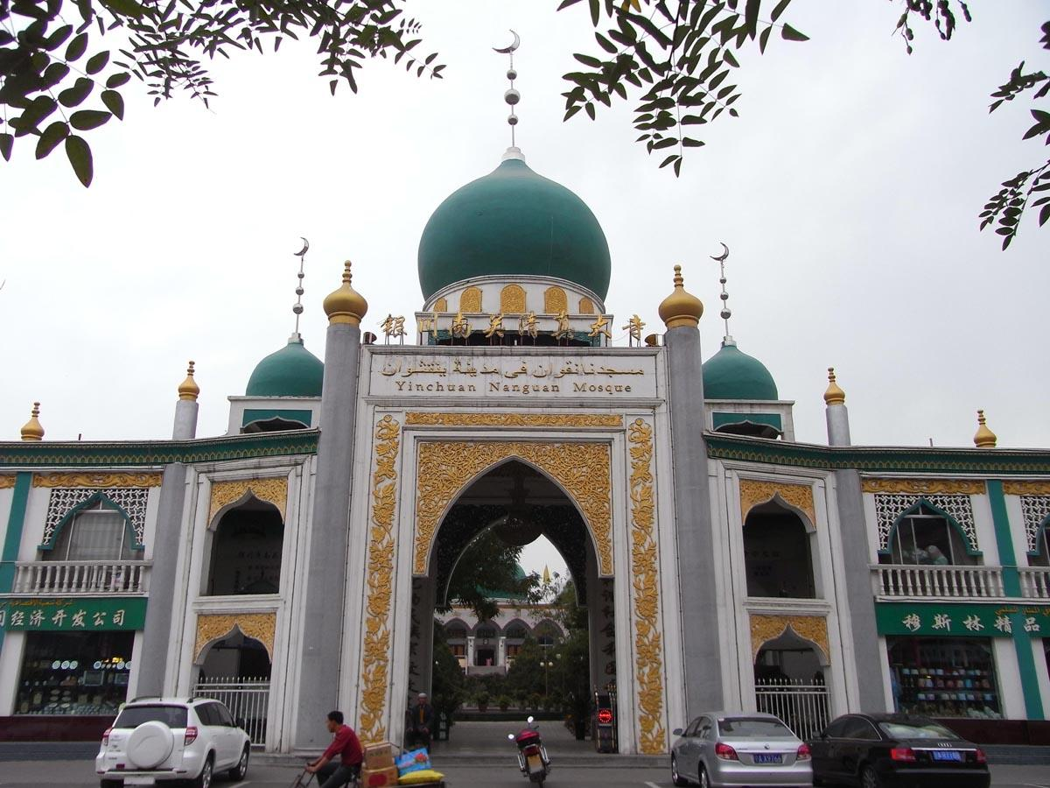
Islamic Cultural Influence
Design
Crescent Moon and Star Motif
Arabic script
Cultural Symbol
Cultural Identity and Religious Beliefs

Slide 7
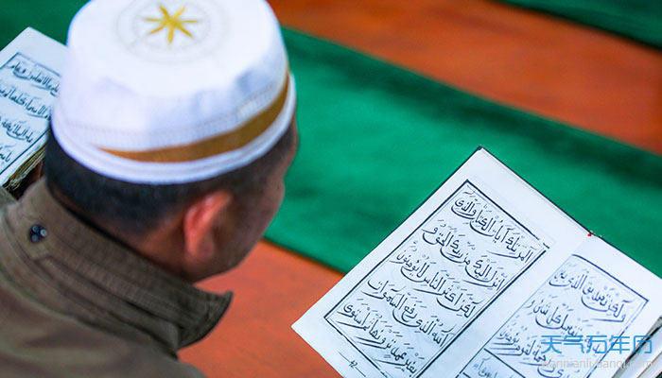
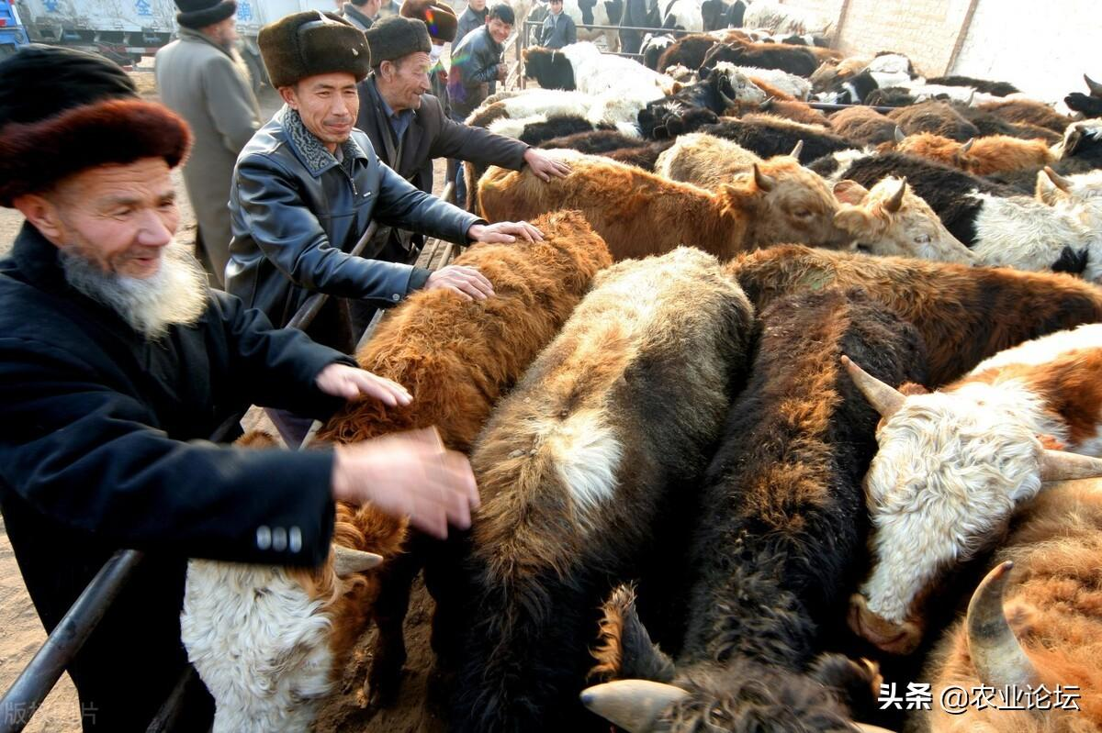
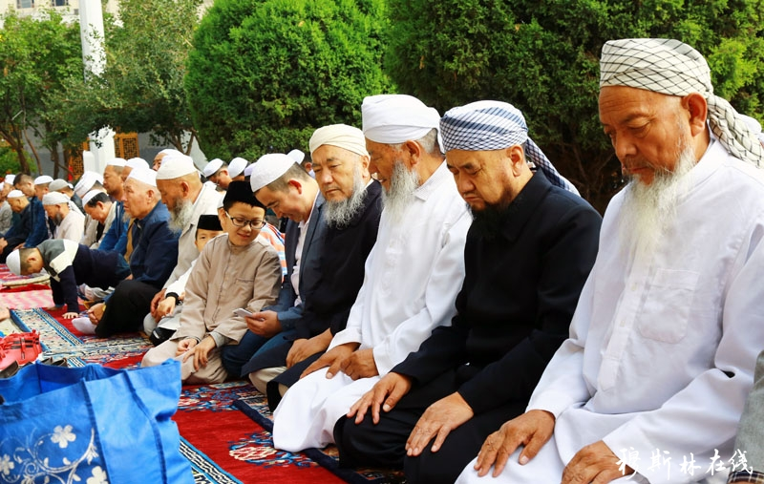
Part 2
Traditional Celebration
Eid al - Adha

Slide 8
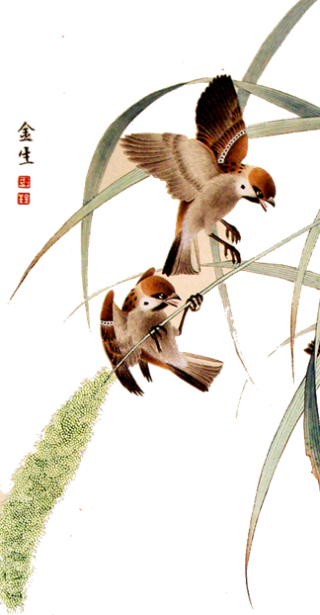

Part 3
Connections
An Essential Element of Festival Celebrations
The joint Embodiment of Ethnic Cculture

Slide 9
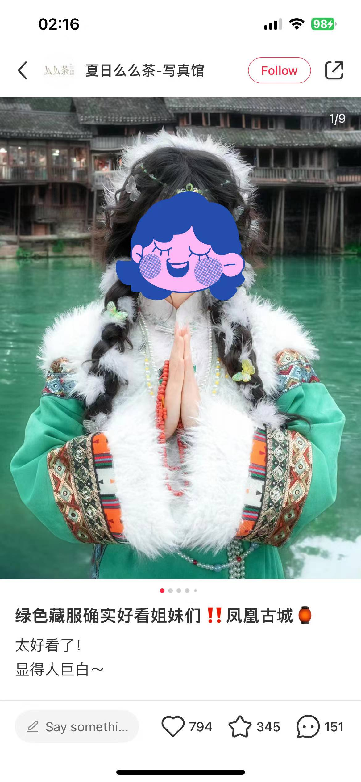

Part 4
Reflections
The Complete Loss of
Some Ethnic Minority Costumes
Negative Impact of Commercialization

Slide 10
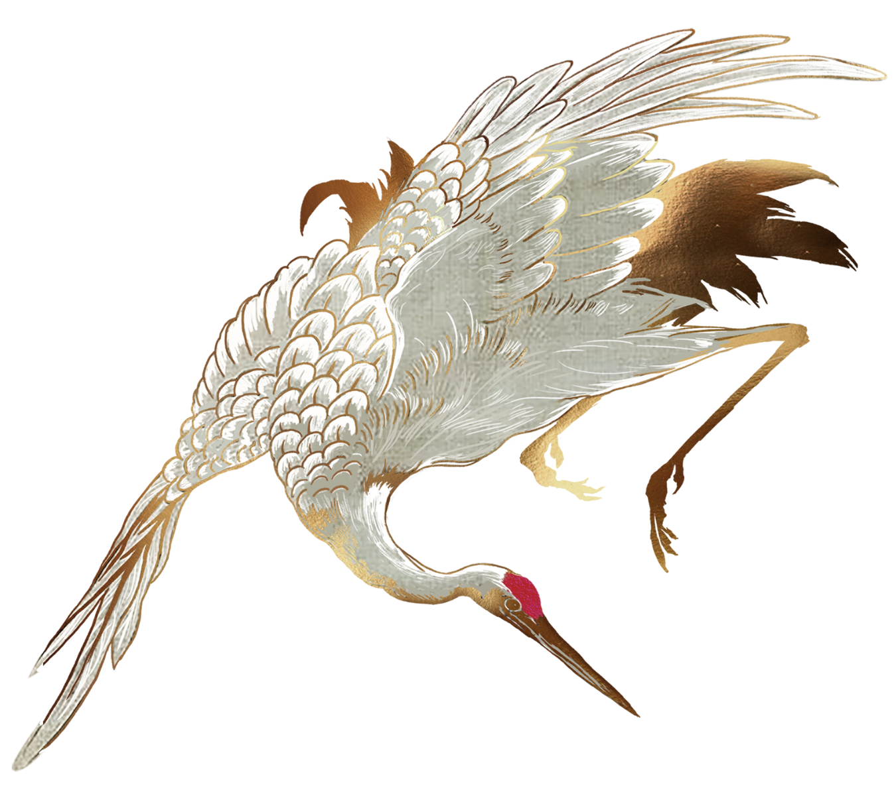


Questions
What are the characteristics of
Chinese ethnic costumes?
Which three colors are the main tones of Hui nationality's clothing?
What do people do during
Eid al-Adha?

Slide 11
Thank You!

